Slide 1
AuditLens
Statutory audit analytical review for Indian companies
A trial balance goes in. The face of the Schedule III financial statements, the eleven mandated ratios, SA 240 journal entry testing, an SA 530 sample and the CARO 2020 checklist come out.
Schedule III
SA 240
SA 320
SA 530
CARO 2020
CA. Rajendra Bagade · Senior Partner, SARC & Associates
AICA Level 2 · Module C Capstone Project · Batch 104
Notes:
[0:00 - 0:15] CAMERA FULL FRAME. No screen share yet. "Good morning. I am CA Rajendra Bagade, Senior Partner at SARC and Associates. For my AICA Level 2 capstone I have built AuditLens - a statutory audit analytical review tool for Indian companies." DELIVERY: Look at the lens, not the screen. Say the name of the project clearly; this is the only time the evaluator hears it cold.

Slide 2
Every statutory audit begins with the same week
A trial balance is mapped to Schedule III. Eleven ratios that the Ministry of Corporate Affairs made mandatory in 2021 are computed, and any that moved more than 25 per cent must be explained in the notes. Journal entries are tested for management override. Materiality is determined, a sample selected, and twenty-one CARO clauses worked through.
11
ratios mandated by
Schedule III since FY 2021-22
21
CARO 2020 clauses,
every one to be answered
It is identical across clients. It consumes the opening week of every engagement. And in most firms it is done by hand, in a spreadsheet that is rebuilt each year.
For the mid-sized manufacturer used in this demonstration, that means sixty-one ledgers to classify, nine hundred and eighteen journal entries to test, and twenty-one clauses to answer — before any audit evidence is looked at.
6
journal entry routines
required under SA 240
AuditLens · AICA Level 2, Module C · CA. Rajendra Bagade
2
Notes:
[0:15 - 1:00] CAMERA FULL FRAME, or this slide with your camera inset. "Every statutory audit of an Indian company begins with the same work. The trial balance is mapped to Schedule III. Eleven ratios that MCA made mandatory in 2021 are computed - and any that moved more than twenty-five per cent has to be explained in the notes. Journal entries are tested for management override under SA 240. Materiality is set, a sample is selected, and twenty-one CARO clauses are worked through. It is identical across clients. It takes the opening week of every engagement. And in most firms it is still done by hand." DELIVERY: This is the slide that earns the evaluator's attention, because they have done this work themselves. Slow down. Let "the opening week of every engagement" land.

Slide 3
What the application does
Eight modules. Seven of them answer to a provision.
1
Ingest
2
Map
Schedule III
Trial balance and general ledger in whatever shape the client exported them - aliased headers, Indian number formats, bracketed negatives.
Every ledger to a Division I presentation head, on the account code first and the ledger name second.
3
Present
Schedule III
4
Measure
G.S.R. 207(E)
The Balance Sheet and Statement of Profit and Loss, with an honest reconciliation when they do not tie.
The eleven mandated ratios, with every movement beyond 25 per cent flagged for the notes.
5
Test
SA 240
6
Sample
SA 320 / SA 530
Six journal entry routines plus the Benford first-digit test.
Materiality from the auditor’s benchmark, and a monetary unit sample with the seed recorded.
7
Report
CARO 2020
8
Draft
Applicability and all twenty-one clauses, pre-populated from what the books evidence.
The analytical memorandum, the ratio variance notes, and the enquiry letter to management.
AuditLens · AICA Level 2, Module C · CA. Rajendra Bagade
3
Notes:
[1:00 - 1:40] SLIDE ON SCREEN, camera inset. "The application does seven things, and each one answers to a provision. It reads the trial balance and the general ledger in whatever shape the client's system exported them. It maps every ledger to a Schedule III Division I head. It builds the face of the statements. It computes the eleven ratios. It runs six journal entry routines under SA 240. It sets materiality and selects a sample under SA 320 and SA 530. And it works through all twenty-one CARO clauses." DELIVERY: Do not read all seven descriptions - just the module names and their authority. The slide carries the detail; you carry the pace. Forty seconds.

Slide 4
The design decision that matters
The engine computes.
The model writes prose.
Nothing else.
Every figure that reaches a workpaper is produced by a pure Python function with a unit test. The language model is asked for two things only — an explanation in words, and correspondence.
It never computes a figure.
It never classifies a ledger that reaches the statements.
It never concludes on a CARO clause.
A Chartered Accountant signs the report. Every number in it has to be traceable to a calculation that can be re-performed.
Notes:
[1:40 - 2:10] CAMERA FULL FRAME for the rule, then back to the slide. "Before I show you the application, one design decision, because everything else follows from it. THE ENGINE COMPUTES. THE MODEL WRITES PROSE. NOTHING ELSE. Every figure that reaches a workpaper comes from a Python function with a unit test. The language model is asked for exactly two things - to explain a movement in words, and to draft correspondence. It never computes a figure. It never classifies a ledger that reaches the face of the statements. And it never concludes on a CARO clause. Why? Because a Chartered Accountant signs the report. Every number in it has to be traceable to a calculation that can be re-performed." DELIVERY: This is the most important thirty seconds in the video. Say the rule slowly, in three beats, and pause after it. An evaluator who is a practising CA will be testing you on exactly this point.

Slide 5
How it is put together
A thin interface, a deterministic core, and a model layer that only ever reads and writes.
PYTHON
PYTHON
PYTHON
MODEL LAYER
PYTHON
Ingest
Map
Compute
Draft
Deliver
›
›
›
›
Trial balance,
comparative,
general ledger
Account code first,
ledger name second,
UNMAPPED otherwise
Statements, ratios,
SA 240 routines,
materiality, sample
Memorandum,
ratio notes,
enquiry letter
PWA dashboard,
11-sheet workpaper,
n8n automation
Only the fourth stage touches the language model — and it receives figures the engine has already computed. Remove the model entirely and the analytical review is unchanged; only the prose falls back to a template.
AuditLens · AICA Level 2, Module C · CA. Rajendra Bagade
5
Notes:
[2:10 - 2:40] SLIDE ON SCREEN. "Here is the pipeline. Ingest, map, compute, draft, deliver. Notice that only the fourth stage - drafting - touches the language model, and by the time it does, every figure has already been computed by Python. You could remove the model entirely and the analytical review would be identical; only the prose would fall back to a template. That is not an accident, it is the whole design." DELIVERY: Point at the gold box as you say "only the fourth stage". Thirty seconds - do not linger, the demo is where the marks are.

Slide 6
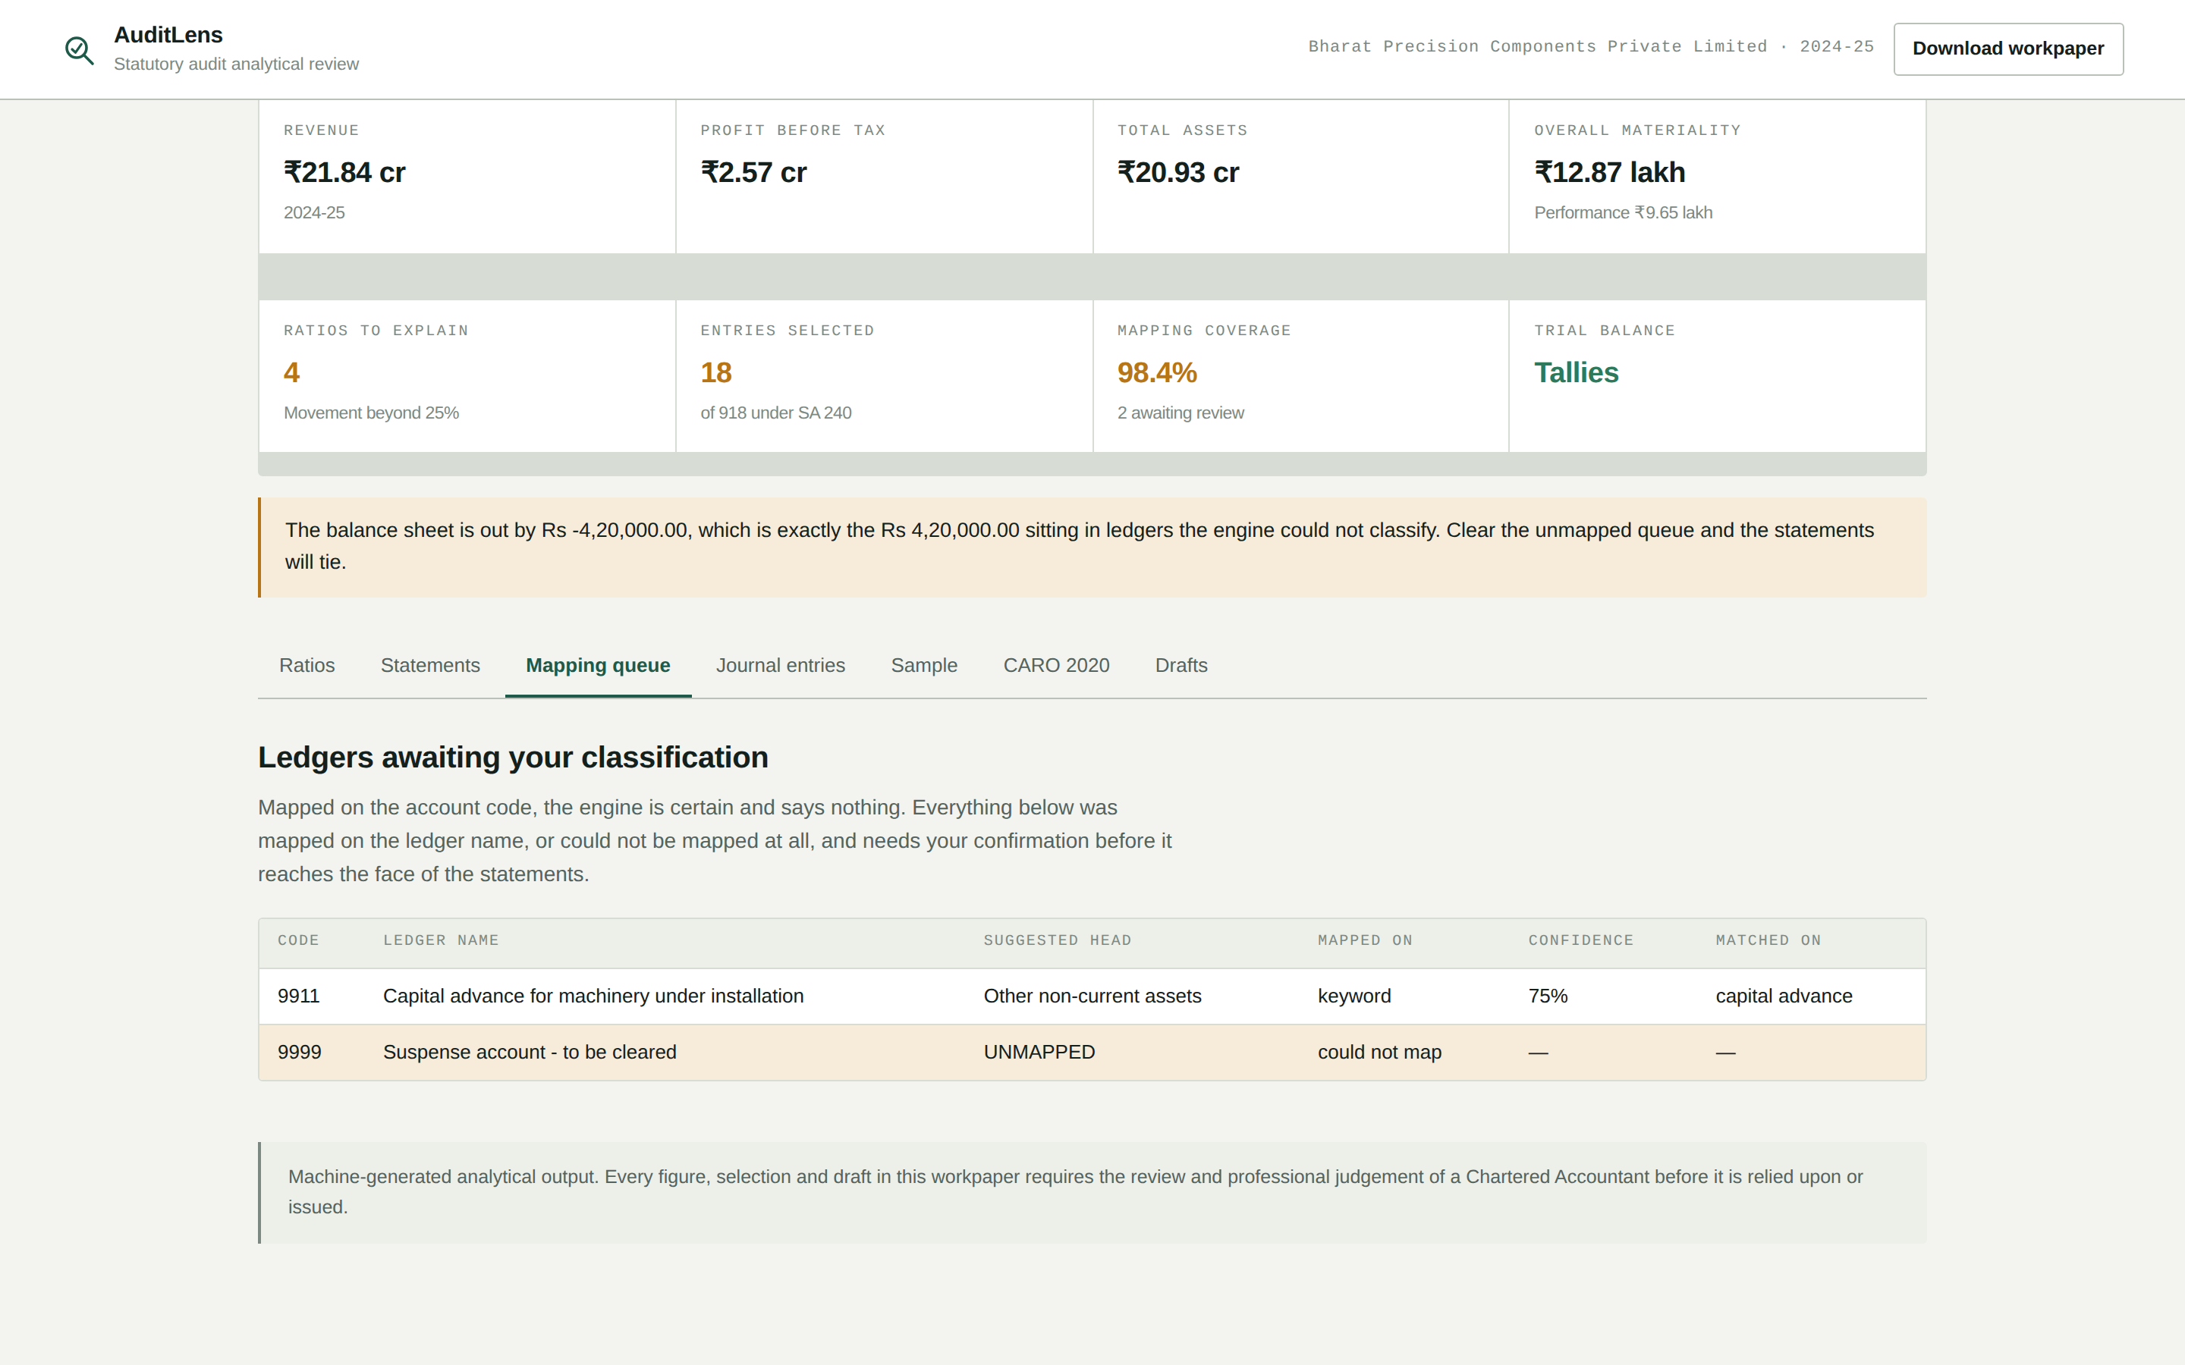
LIVE DEMO
Ingest, and the ledgers it refuses to guess
Schedule III, Division I
Fifty-nine of sixty-one ledgers were mapped on the account code, and the engine says nothing about them. Two are in this queue: one it mapped on the ledger name, and one it could not map at all.
It returned UNMAPPED rather than guessing, because a mis-mapped ledger appears on the face of the financial statements.
Click "Use the sample client" - say the client is fictitious and no client data is used anywhere
Let the summary tiles land, then open the Mapping queue tab
Point at the suspense account row and the word UNMAPPED
AuditLens · AICA Level 2, Module C · CA. Rajendra Bagade
6
Notes:
[2:40 - 3:20] SCREEN SHARE BEGINS. Camera stays in the corner. "Let me run it. I click Use the sample client - and I should say clearly that this is a fictitious company. No client data is used anywhere in this project. [wait for the review to run] Here is the mapping queue. Fifty-nine of the sixty-one ledgers were mapped on the account code, and the engine says nothing about those. Two are here. One was mapped on its ledger name, so it is flagged for me to confirm. And this one - a suspense account - it could not map at all, so it returned UNMAPPED. It did not guess. A mis-mapped ledger ends up on the face of the financial statements, so a guess there is worse than an admission." DELIVERY: Move the cursor deliberately. Do not scroll while talking.

Slide 7
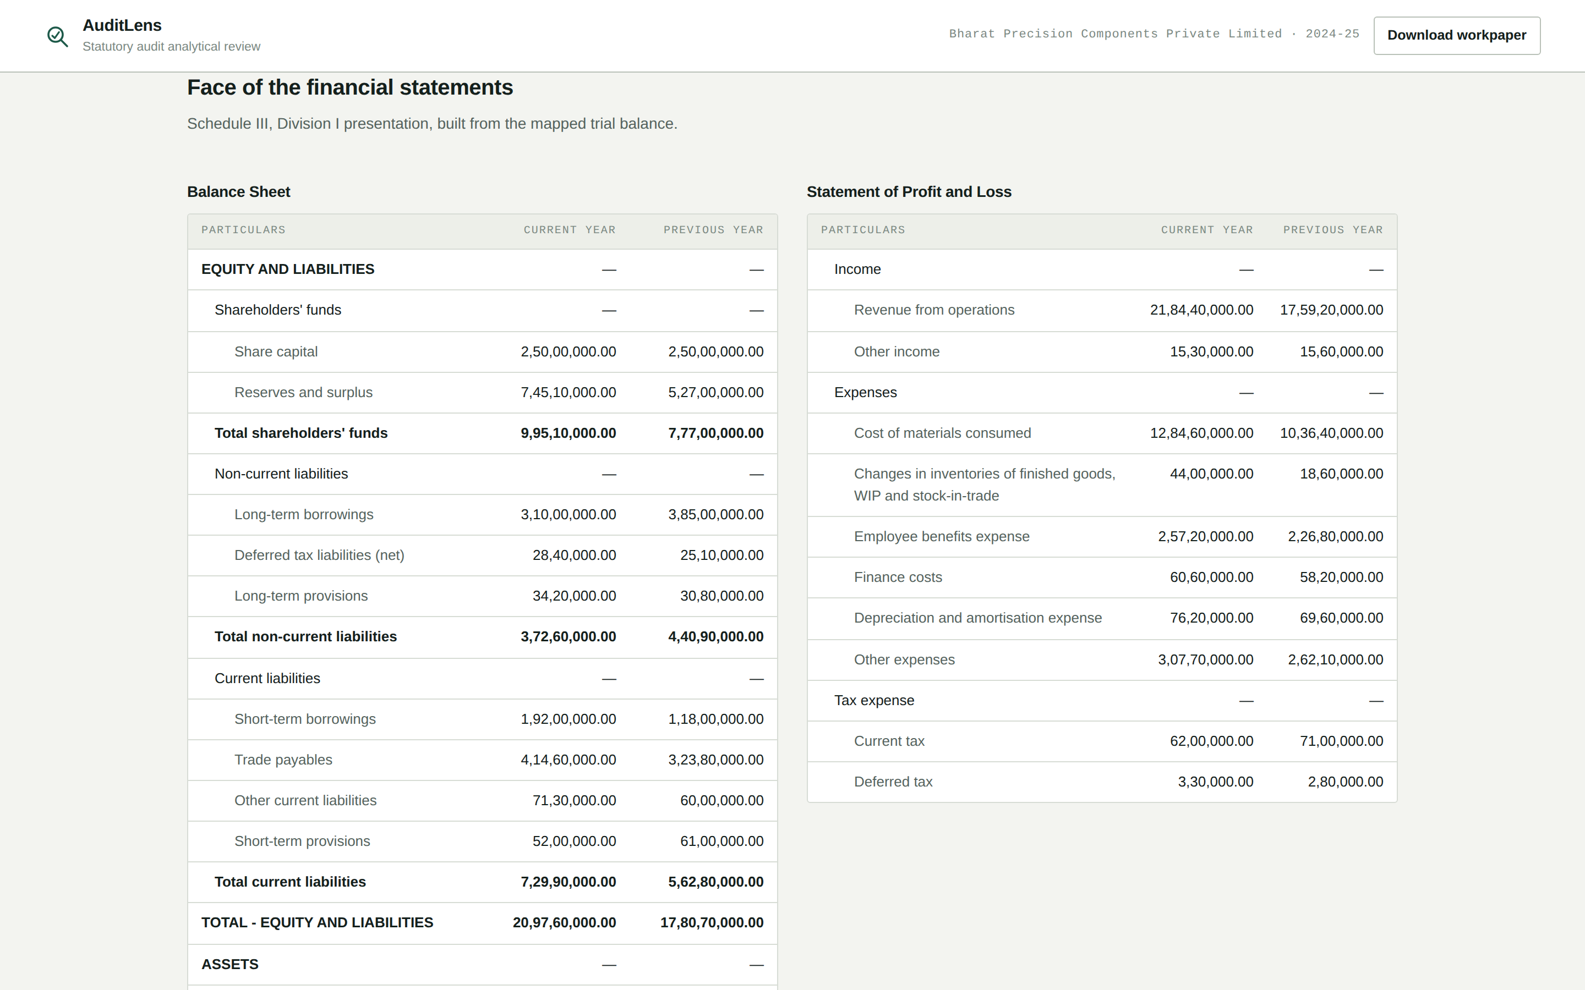
LIVE DEMO
A balance sheet that does not tie — and says so
The strongest 30 seconds in the demo
The balance sheet is out by four lakh twenty thousand rupees — exactly the amount sitting in the suspense account the engine refused to classify.
A lesser tool would force that difference to a rounding line and produce statements that tie and are wrong.
Open the Statements tab
Point at the reconciliation banner and read the figure out loud
Say what a tool that forced the difference would have produced
AuditLens · AICA Level 2, Module C · CA. Rajendra Bagade
7
Notes:
[3:20 - 3:55] SCREEN SHARE. "Now look at this banner. The balance sheet does not tie. It is out by four lakh twenty thousand rupees - and that is exactly the amount sitting in the suspense account the engine just refused to classify. I want to be clear about why this matters. A tool that wanted to look finished would push that difference into a rounding line, and hand me a balance sheet that ties and is wrong. This one tells me it does not tie, tells me precisely why, and tells me what to do about it - clear the unmapped queue and the statements will tie." DELIVERY: This is the single best moment in the demo. Slow right down. If the evaluator remembers one thing, make it this.

Slide 8
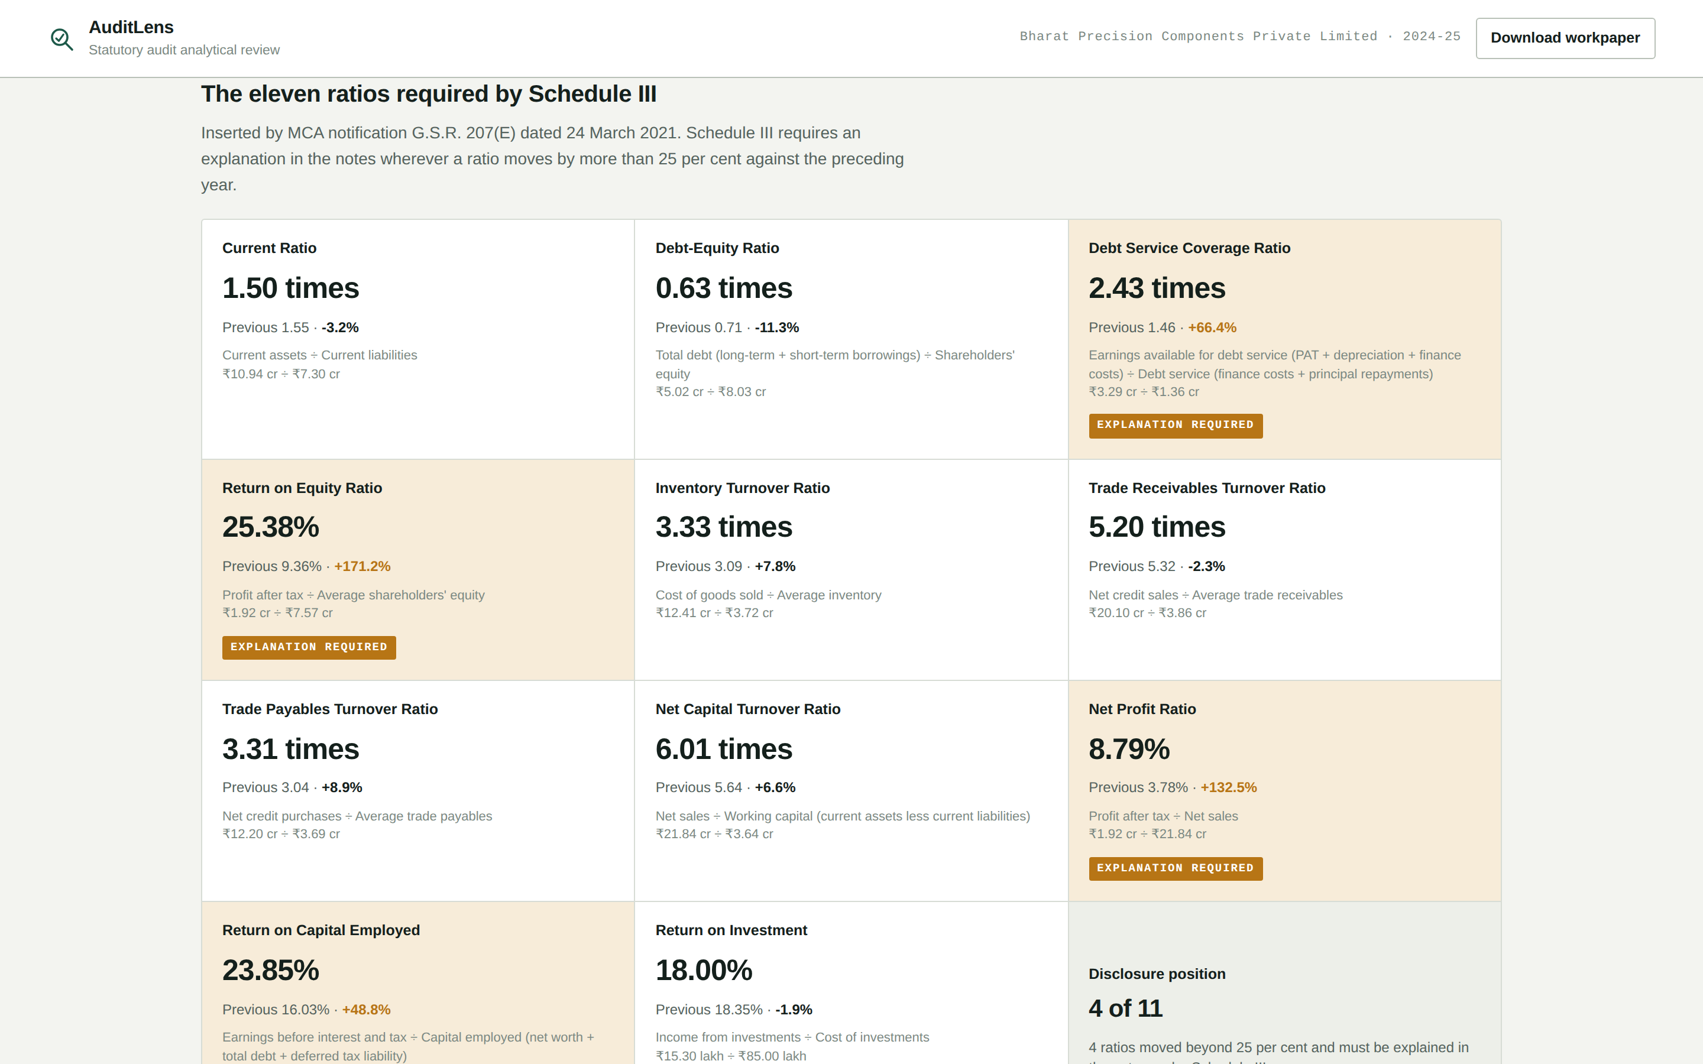
LIVE DEMO
The eleven ratios Schedule III requires
G.S.R. 207(E) dated 24 March 2021
Inserted by MCA notification G.S.R. 207(E) dated 24 March 2021, applicable from FY 2021-22. Four ratios moved beyond twenty-five per cent and must be explained in the notes.
The movements are shown in neutral colour. Whether a fall in the debt-equity ratio is favourable is the auditor’s judgement, not a colour the tool assigns.
Open the Ratios tab
Read the citation off the panel heading
Open one flagged card and read its numerator and denominator aloud
Point out that the movement is not coloured green or red
AuditLens · AICA Level 2, Module C · CA. Rajendra Bagade
8
Notes:
[3:55 - 4:40] SCREEN SHARE. "These are the eleven ratios, inserted into Schedule III by MCA notification G.S.R. 207(E) dated 24 March 2021, and applicable from financial year 2021-22. Four of them moved by more than twenty-five per cent, so under Schedule III each one has to be explained in the notes. The tool flags them and shows me the numerator and denominator it used - here, profit after tax over average shareholders' equity - so I can re-perform it. One deliberate choice: the movements are not coloured green or red. Whether a fall in the debt-equity ratio is a good thing is my judgement as the auditor, not a colour the tool assigns." DELIVERY: Say the notification number precisely - it is the kind of detail a CA evaluator checks.

Slide 9
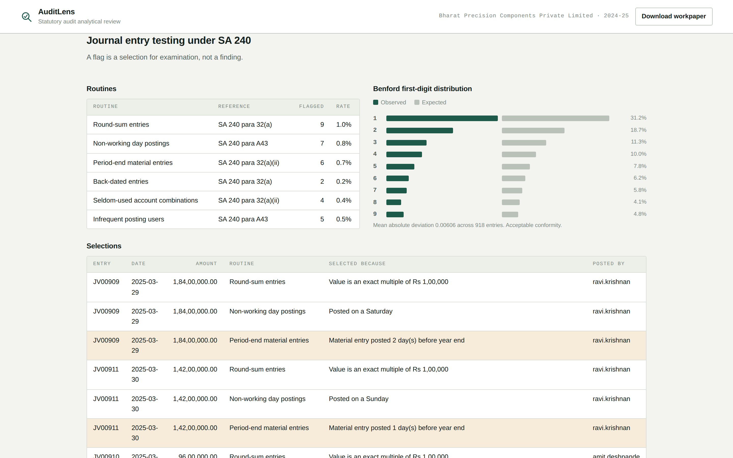
LIVE DEMO
Journal entry testing under SA 240
SA 240
SA 240 requires the auditor to test journal entries, because management override of controls is a risk in every entity. Six routines, and every flag rate is under one per cent — so the output is a work programme, not a haystack.
The population conforms to Benford, which is what makes the other routines’ findings worth looking at.
Open the Journal entries tab
Walk the six routines and their flag rates
Point at the Benford chart and read the conclusion
Say: a flag is a selection for examination, not a finding
AuditLens · AICA Level 2, Module C · CA. Rajendra Bagade
9
Notes:
[4:40 - 5:25] SCREEN SHARE. "SA 240 requires me to test the appropriateness of journal entries, because management override of controls is a risk in every entity. Six routines: round sums, non-working days, material entries at the period end, back-dated entries, seldom-used account combinations, and infrequent posting users. Look at the flag rates - every one is under one per cent. That matters. A routine that flags thirty per cent of the population has given me a haystack, not a work programme. And here is the Benford first-digit test. The population conforms - which is precisely what makes the departures the other six routines found worth looking at. One sentence I want on the record: a flag is a selection for examination, not a finding." DELIVERY: End on that last sentence and pause. It shows professional judgement, which is what separates this from a script that prints numbers.

Slide 10
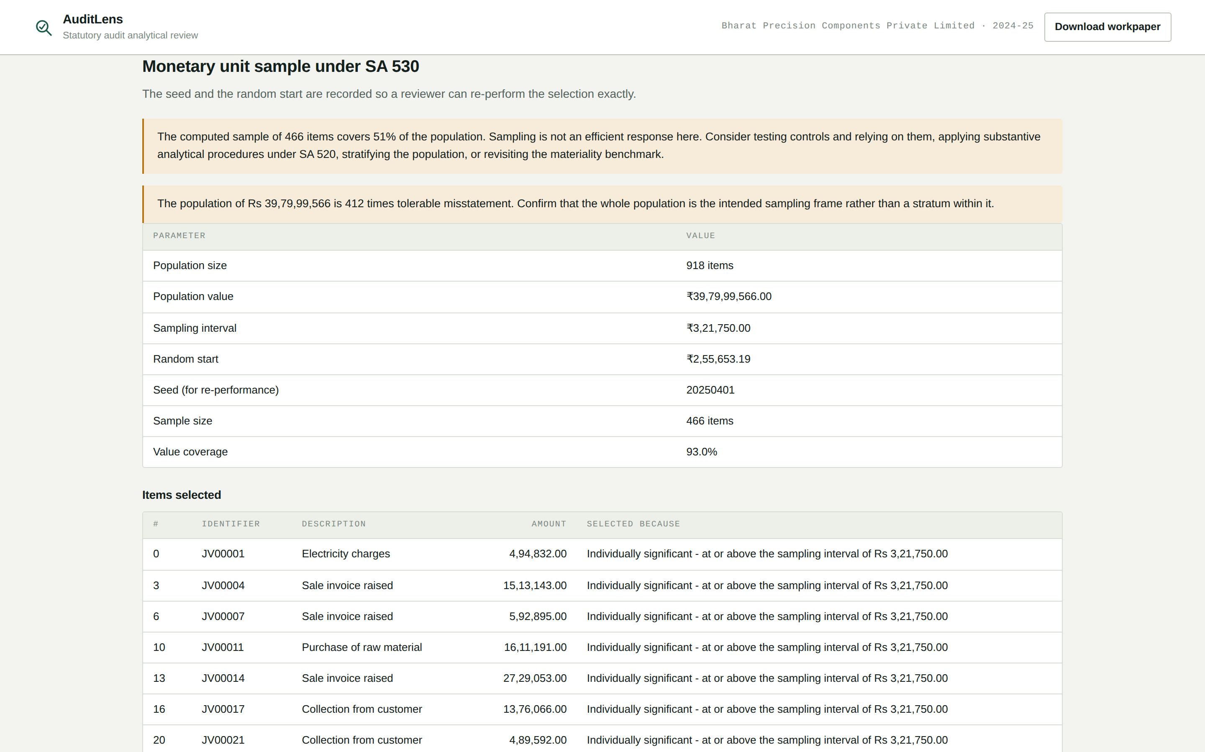
LIVE DEMO
When the tool says sampling is the wrong answer
SA 530 / SA 520
The sample is arithmetically correct and professionally useless: it covers fifty-one per cent of the population.
So the tool says so, and points to controls reliance, substantive analytical procedures under SA 520, or stratification instead. The seed and random start are recorded so a reviewer can re-perform the selection exactly.
Open the Sample tab
Read the warning banner aloud
Point at the seed and the random start
AuditLens · AICA Level 2, Module C · CA. Rajendra Bagade
10
Notes:
[5:25 - 5:50] SCREEN SHARE. "Monetary unit sampling under SA 530. The seed and the random start are recorded, so a reviewer can re-perform this exact selection. But look at the warning. The computed sample covers fifty-one per cent of the population. That is arithmetically correct and professionally useless - nobody is vouching four hundred and sixty-six items. So the tool says so, and points me to testing controls, or substantive analytical procedures under SA 520, or stratifying the population. A tool that handed me that programme without saying this would be worse than no tool at all." DELIVERY: Twenty-five seconds. This is a judgement moment, not a feature - land it and move on.

Slide 11
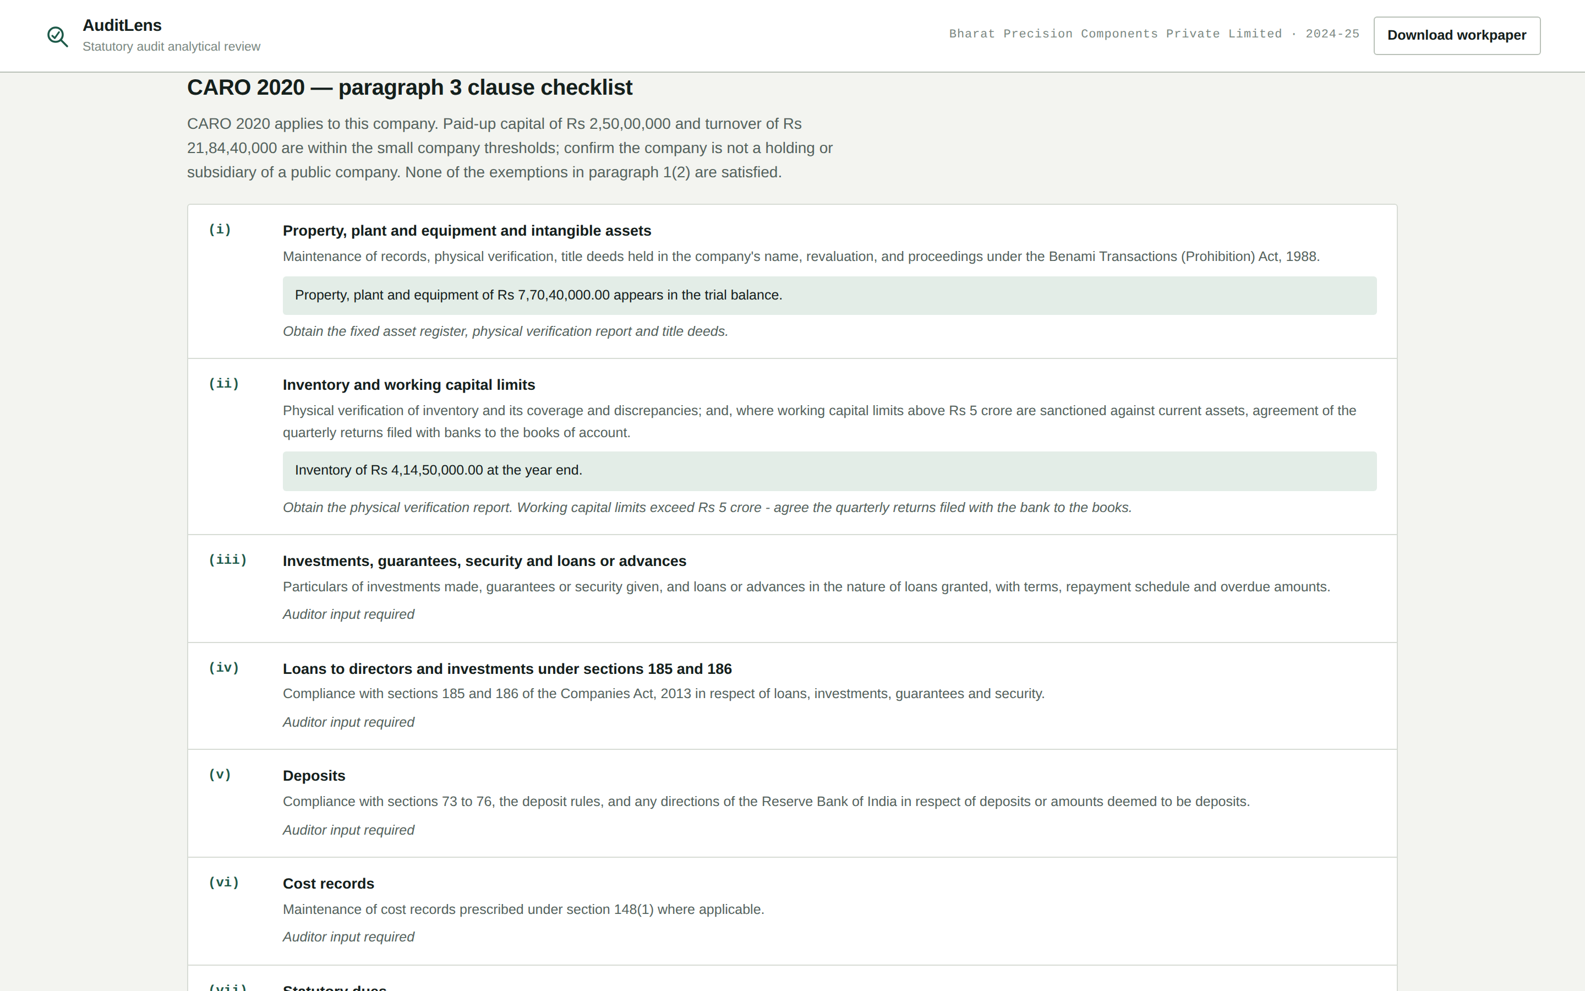
LIVE DEMO
CARO 2020 — twenty-one clauses, none of them answered
CARO 2020, paragraph 3
Applicability is tested under paragraph 1(2) first. Then all twenty-one clauses, eight of them pre-populated with what the books actually evidence.
Not one is concluded. Every clause comes back with an empty auditor response, because concluding on a CARO clause is not the tool’s to do.
Open the CARO 2020 tab
Read the applicability line at the top
Scroll to clause (xvii) or (xix) and show the evidence it pulled from the books
AuditLens · AICA Level 2, Module C · CA. Rajendra Bagade
11
Notes:
[5:50 - 6:10] SCREEN SHARE. "CARO 2020. It first tests whether the Order applies at all under paragraph 1(2) - here it does. Then all twenty-one clauses of paragraph 3, with eight of them pre-populated from what the books evidence. Clause seventeen knows whether there was a cash loss. Clause nineteen knows the current ratio. But look at what it does not do. Not one clause is answered. Every one comes back with an empty auditor response, because concluding on a CARO clause is my job, not the tool's." DELIVERY: Twenty seconds. Keep it brisk - the point is the restraint, not the list.

Slide 12
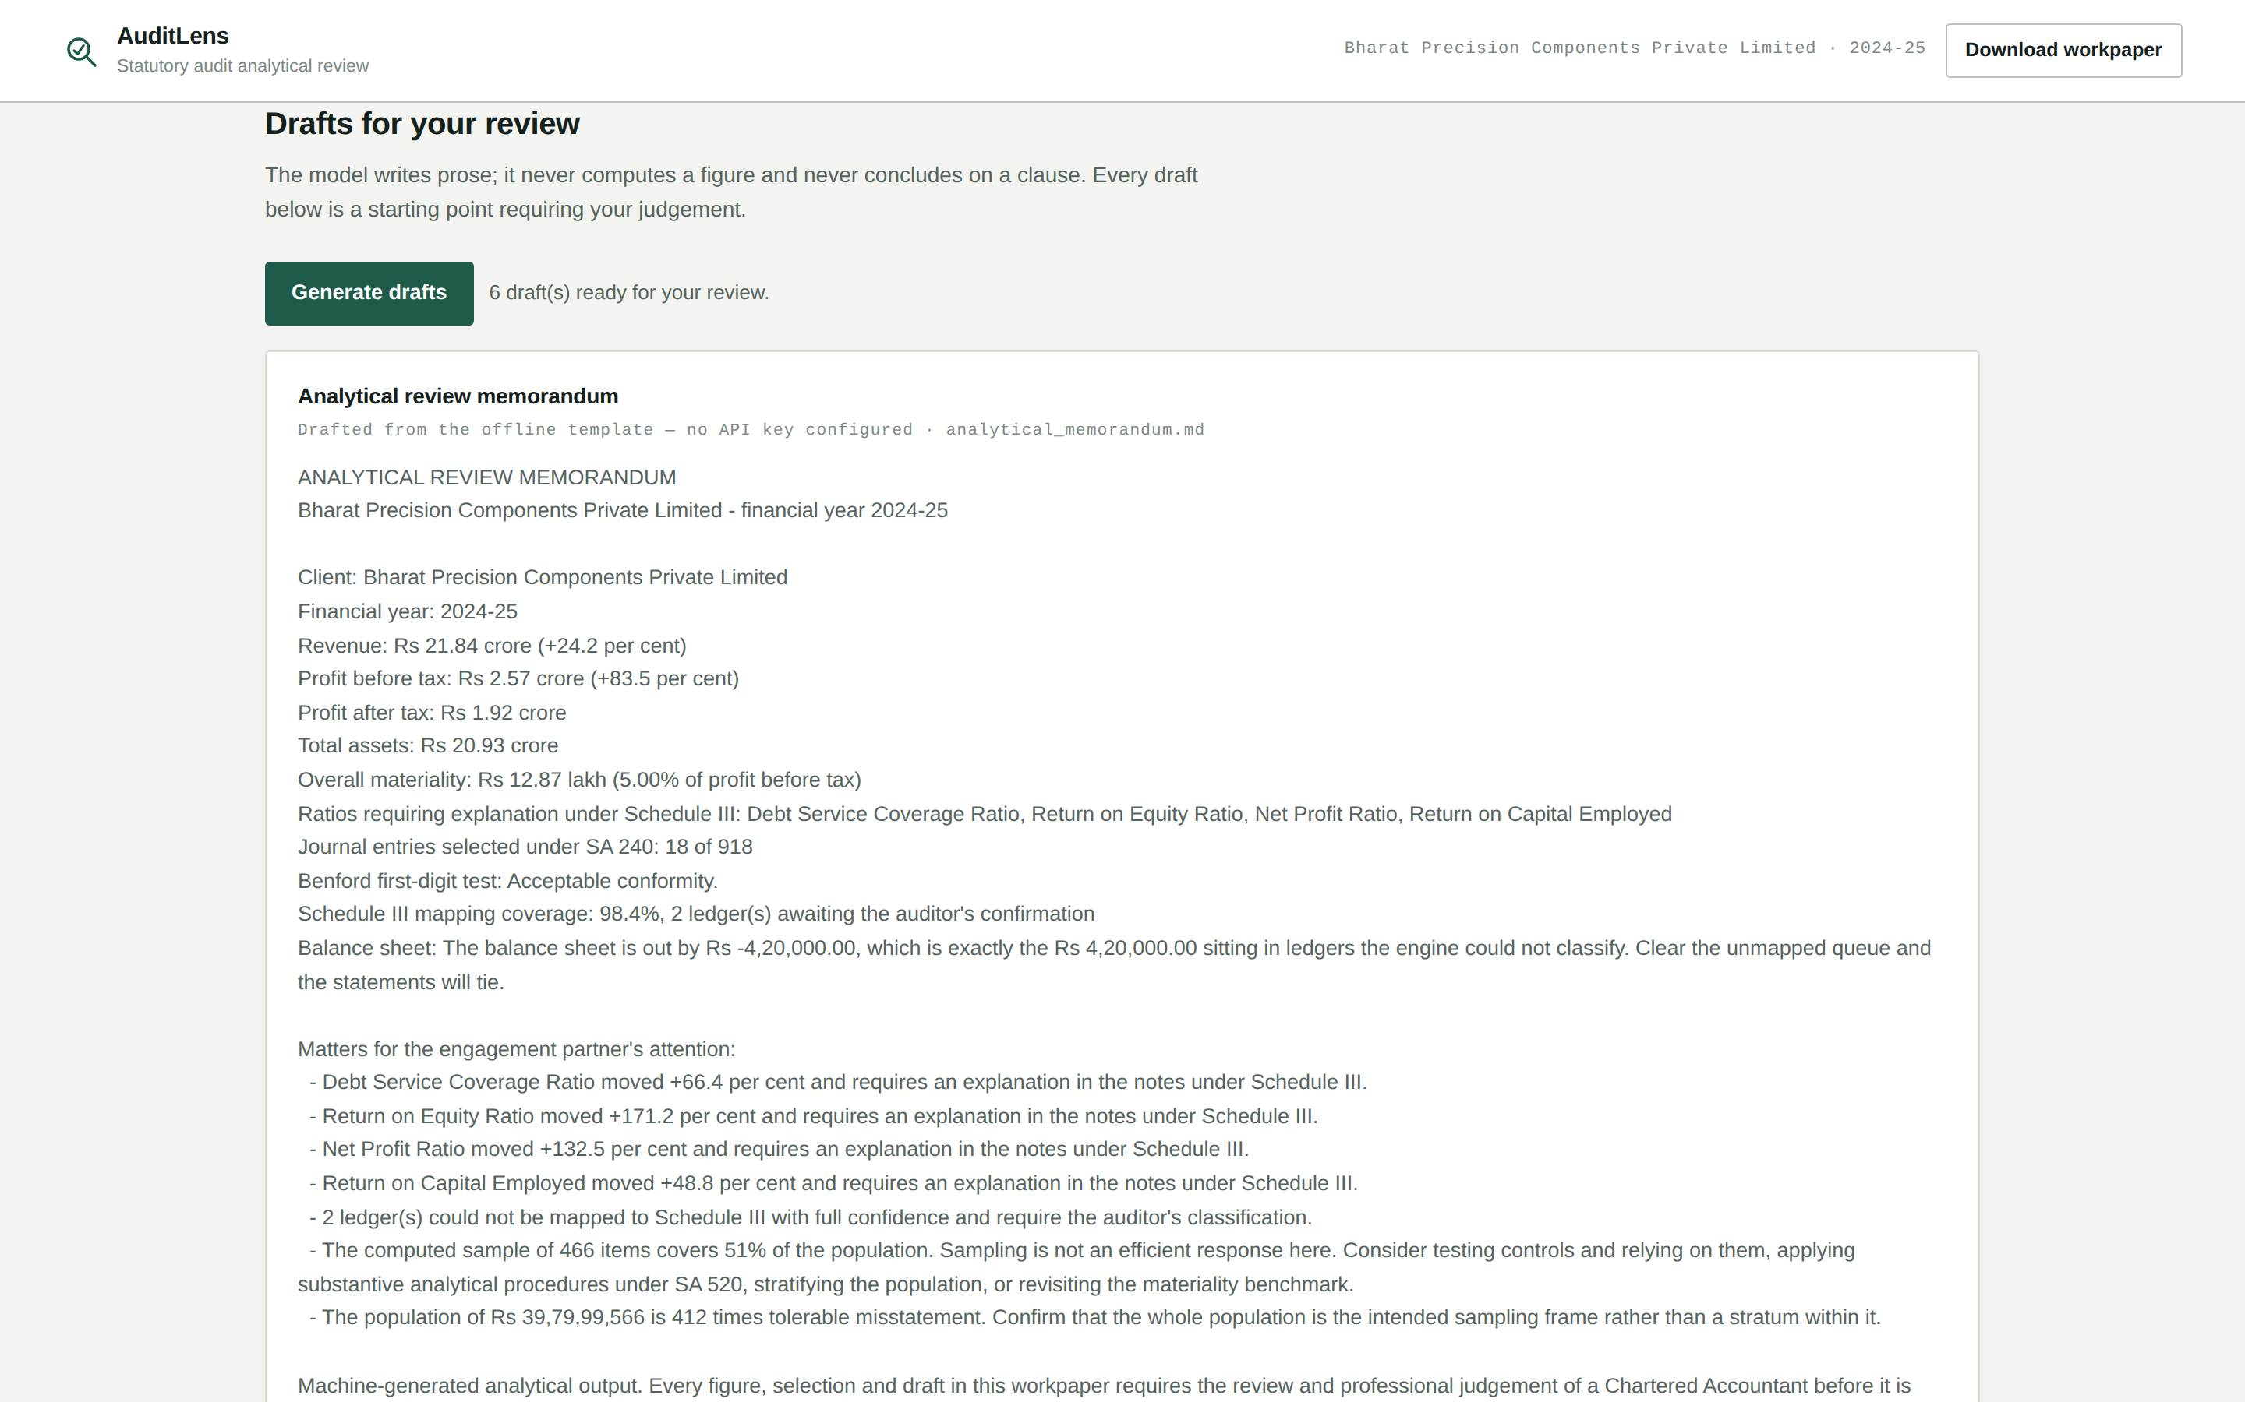
LIVE DEMO
What the model is actually allowed to do
Day 1 · Day 2
The memorandum, the ratio variance notes and the enquiry letter to management — drafted from versioned system instructions held as files in the repository.
Notice the bracketed instruction: management to state the commercial reason. The prompt forbids inventing one.
Open Drafts and click Generate
Read one ratio note and point at the bracketed instruction
Switch to the repo and open prompts/ — show the four files and a changelog
AuditLens · AICA Level 2, Module C · CA. Rajendra Bagade
12
Notes:
[6:10 - 6:45] SCREEN SHARE. "Now the drafting. The memorandum, the notes explaining each ratio movement, and the enquiry letter to management under SA 240. Read this ratio note carefully. It states the movement, it says which of the numerator and denominator drove it - and then it stops, with a bracketed instruction: management to state the commercial reason. The prompt explicitly forbids inventing a reason like 'improved operational efficiency'. [switch to the repository, open prompts/] These are the four system instructions, versioned, with changelogs. This one records why version 1.3 banned the words fraud, irregularity, manipulation and override from the enquiry letter - because an earlier draft called a round-sum entry 'irregular', and a selection is not an allegation." DELIVERY: The changelog is your Day 1 evidence. Show it - most participants will not have versioned their prompts at all.

Slide 13
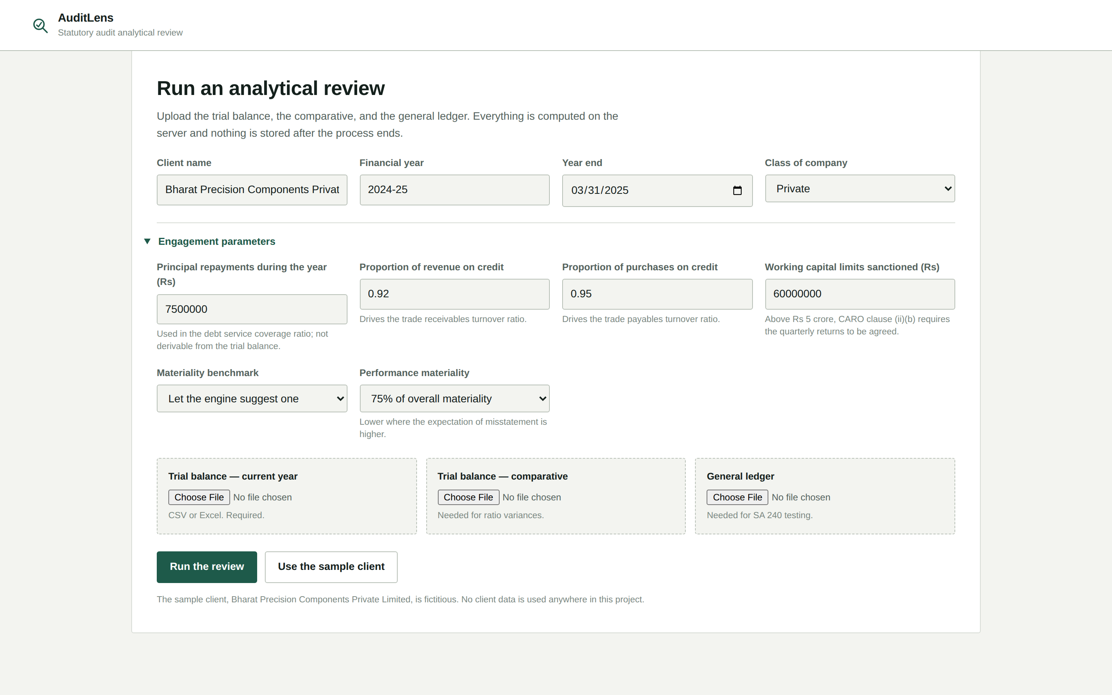
LIVE DEMO
Automation, deployment, and how it is verified
Day 4 · Day 5
Two n8n workflows: a quarterly analytical review that emails the engagement partner only when there is something to see, and a journal entry alert.
The application installs as a progressive web app. And the whole engine is covered by one hundred and twenty-four tests.
Show the n8n canvas and an execution log
Install the PWA on a phone or from the browser address bar
Run python -m pytest in a second terminal window; let the 124 tests pass on camera
AuditLens · AICA Level 2, Module C · CA. Rajendra Bagade
13
Notes:
[6:45 - 7:10] SCREEN SHARE. "Two n8n workflows. The first runs the analytical review every quarter and emails the engagement partner - but only when there is actually something to see. The second watches for a new general ledger and alerts the audit manager to the entries graded elevated. The application installs as a progressive web app - here it is on my phone. And finally, the part I would ask you to weigh most heavily. [run pytest] One hundred and twenty-four tests. Every one of the eleven ratios is checked against a figure I computed by hand, so a change that would alter a disclosed ratio fails here, in the test suite, rather than in a client's financial statements." DELIVERY: Have the terminal already open in a second window. The tests run in about three seconds - let the green line appear on camera.

Slide 14
Where each day of Level 2 appears
Day | Learning | Where it is used | Evidence in the repository
Day 1 | Agent architecture, advanced prompting | Four versioned system instructions with changelogs | prompts/
Day 2 | Gemini API, system instructions, model parameters, local models | The drafting layer, with an LM Studio path for confidential engagements | narrate.py
Day 3 | Python fundamentals and core libraries | The whole engine — thirteen modules | src/auditlens/
Day 4 | Full-stack build, PWA, deployment | Installable dashboard and workpaper download | web/
Day 5 | n8n workflow automation | Quarterly review and journal entry alert | automation/
This table is in the README as well, so the evaluator can find each day’s evidence without hunting for it.
AuditLens · AICA Level 2, Module C · CA. Rajendra Bagade
14
Notes:
[7:10 - 7:30] SLIDE ON SCREEN. "To tie it back to the course. Day one gave me agent architecture and prompting - that is the prompts folder. Day two, the Gemini API and system instructions - the drafting layer. Day three, Python - the engine. Day four, the full-stack build and the PWA. Day five, n8n. This table is in the README too, so you can find the evidence for each day without hunting for it." DELIVERY: Twenty seconds. Do not read the whole table - name the five days and let the slide do the rest.

Slide 15
What it does not do
Stated here rather than left for a reviewer to find.
Division I only
It forms no opinion
Ind AS (Division II) and NBFC presentation (Division III) are not implemented. The head list would be replaced; the engine around it would not.
And concludes on no CARO clause.
It does not set materiality
It asserts no reason
It computes it from the benchmark and rate the auditor chooses, and flags a rate outside the customary range.
For any movement in a ratio. The draft carries a bracketed instruction to management instead.
It verifies nothing
No client data
Existence, completeness and valuation remain the auditor’s to establish. It analyses what the books say.
Anywhere — not in the repository, the samples or this video. Everything is built on a synthetic company.
AuditLens · AICA Level 2, Module C · CA. Rajendra Bagade
15
Notes:
[7:30 - 7:50] CAMERA FULL FRAME, or slide with camera inset. "Finally, what it does not do - and I would rather say this than have you find it. Schedule III Division I only; there is no Ind AS. It forms no opinion and concludes on no CARO clause. It does not determine materiality, it computes it from the benchmark I choose. It asserts no commercial reason for any ratio movement. And it verifies nothing - it analyses what the books say; the audit evidence is still mine to obtain. And no client data is used anywhere - not in the repository, not in the samples, not in this video." DELIVERY: Naming your own limitations unprompted reads as confidence, not weakness. Say it plainly and do not hedge.

Slide 16
Thank you
AuditLens turns the opening week of a statutory audit into a review the engagement team can start from — without ever putting a figure on the file that a Chartered Accountant cannot re-perform.
124
11
5
tests
sheets in the workpaper
days of Level 2 used
CA. Rajendra Bagade · Senior Partner, SARC & Associates · AICA Level 2, Module C, Batch 104
Notes:
[7:50 - 8:00] CAMERA FULL FRAME. Screen share off. "AuditLens turns the opening week of a statutory audit into a review the engagement team can start from - without ever putting a figure on the file that a Chartered Accountant cannot re-perform. Thank you." DELIVERY: Stop talking. Hold the frame for two seconds before you stop the recording, so the cut is clean. --- BEFORE YOU UPLOAD --- 1. Camera visible throughout? The brief requires face AND technical content. 2. Upload UNLISTED to YouTube, or to Drive set to "Anyone with the link - Viewer". 3. Open the link in an incognito window and confirm it plays. 4. Submit the link through the Google Form.

