Slide 1
CAPSTONE PROJECT
Capex Investment Appraisal
A 10-Year NPV Model for Capital Investment Decisions
AICA Level 2 | Presented by [Your Name] | [Date]

Slide 2
Objective
Should a proposed capital investment be accepted or rejected — based on its projected 10-year cash flows?
1
2
3
Model Real Decisions
Instant Answers
Test What-Ifs
Replace a static spreadsheet calculation with a dynamic engine driven by live assumptions.
Surface NPV, IRR, Payback and a clear Accept / Reject call the moment inputs change.
Stress-test the investment across a WACC × growth sensitivity grid.
2

Slide 3
How the Model Works
Five steps from raw assumptions to an investment decision.
1
2
3
4
5
Assumptions
Revenue Build
Free Cash Flow
Discounting
Decision
Capex, growth,
margin, tax, WACC
Project 10-year
revenue & EBITDA
NOPAT + Dep.
− Capex − ΔWC
Bring every year
back to today
NPV, IRR, Payback
→ Accept / Reject
3

Slide 4
Key Inputs
Every number a user can flex, grouped into four categories.
%
Growth & Margin
₹
Financing & Tax
Sales growth and EBITDA margin — a flat rate, or a custom rate for each of the 10 years.
Discount rate (WACC), tax rate, and useful life used for straight-line depreciation.
Δ
Working Capital & Capex
t
Terminal Value
Ongoing maintenance capex and working-capital drag, each as a % of revenue.
Optional perpetuity growth and salvage value applied beyond Year 10.
4

Slide 5
The Core Formulas
Free Cash Flow (per year)
FCF = NOPAT + Depreciation − Capex − ΔWC
What's actually left over in cash after tax, reinvestment, and funding growth.
Net Present Value
NPV = −Capex + Σ [ FCFₜ / (1+r)ᵗ ] + Terminal Value
Every future rupee is discounted back to today at the required rate of return (WACC).
5

Slide 6
What We Built
Three deliverables sharing one underlying valuation engine.
{ }
Python Valuation Engine
A reusable CapexNPVModel class computing NPV, IRR, Payback Period and Profitability Index from any set of assumptions.
▤
Interactive Dashboard
A browser-based app (Streamlit) with live sliders, KPI cards, and a cash-flow chart that update instantly.
≡
Sensitivity Analysis
A colour-coded NPV grid across a range of WACC and sales-growth scenarios, to see how fragile the decision is.
6

Slide 7
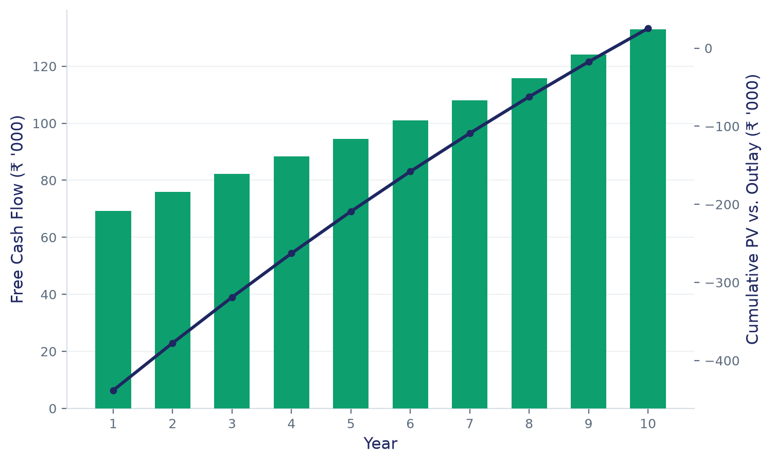
Sample Run
Capex ₹5.0 L · Revenue ₹4.0 L · Growth 15%/10%/10%/8% · Margin 20% · WACC 12%
NPV
₹25,283
IRR
13.1%
PAYBACK
5.89 yrs
DECISION
ACCEPT
The stronger early-year growth (15% / 10% / 10%) is enough to clear the 12% hurdle rate — a thinner early ramp would flip the call.
7

Slide 8
Key Takeaways
1
Translated core DCF mechanics — NPV, IRR, Payback, WACC — into working, reusable Python code.
2
Built a CLI tool and an interactive dashboard on top of the same underlying engine.
3
Learned how sensitivity analysis reveals how fragile — or robust — an investment decision really is.
Thank You
Questions?

