Slide 1
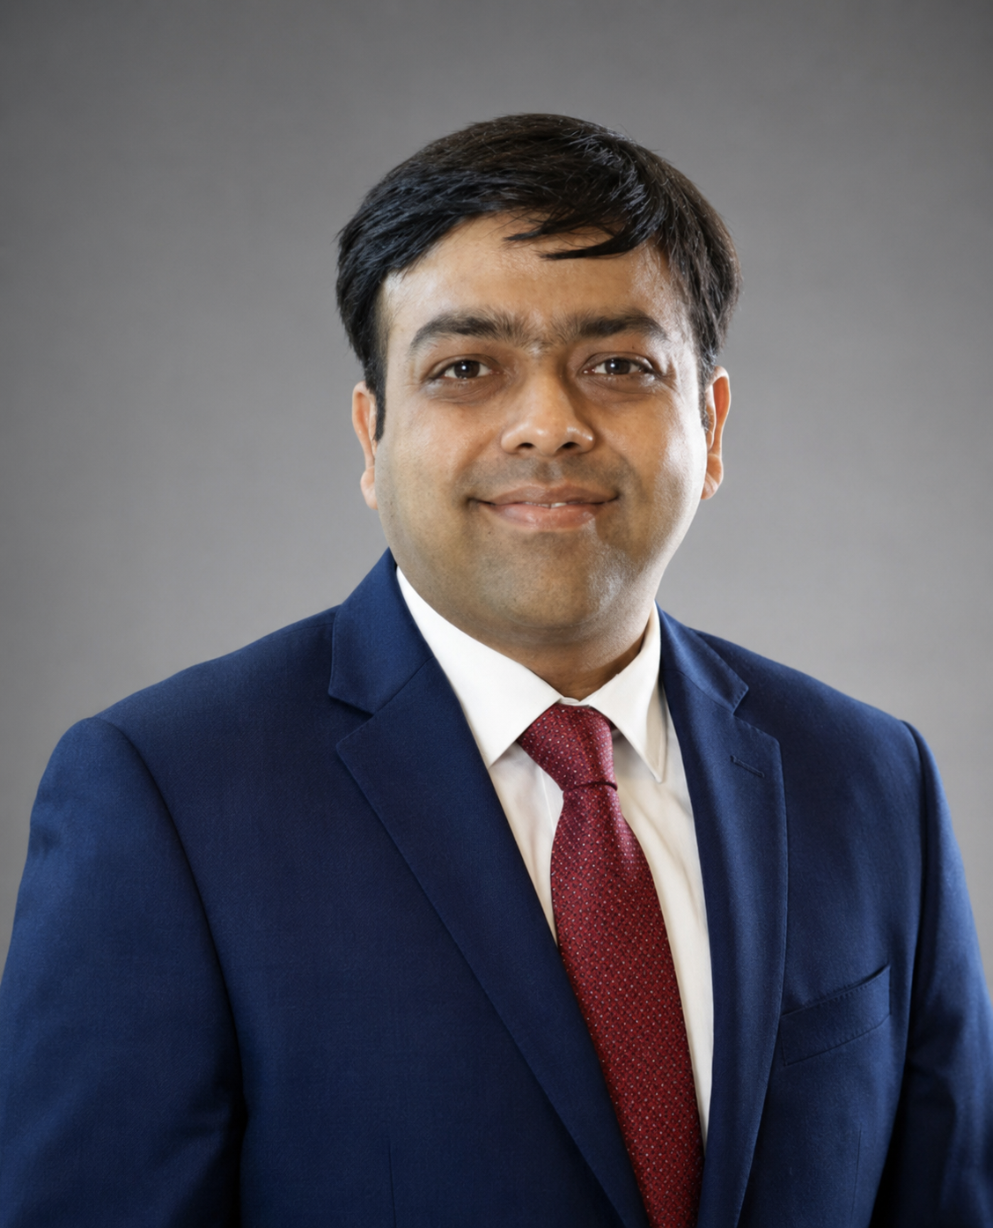
1-Click Tax Notice Decoder
Income Tax & GST notice analysis
Educational project
AICA Level 2 Course of ICAI
CA. Vaibhav Jain
An AI-assisted workflow for professional review
CA. Vaibhav Jain
ICAI Membership No - 515700
AICA Level 2 course project
01
Notes:
Hello, I am Vaibhav Jain, a Chartered Accountant. I prepared this educational project as part of the AICA Level 2 Course of ICAI. The application explores how AI can support notice analysis and response preparation while keeping the professional in control. This is an independent course project, with no claim of institutional endorsement.

Slide 2
The need
A useful reply starts well before drafting
Understanding the notice
Collecting the evidence
Issues, amounts and response dates can be spread across several pages.
The client may provide only some of the records needed to explain each issue.
Considering both sides
Maintaining control
Relevant law and adverse judgments need attention alongside supporting authorities.
The professional needs source excerpts, visible gaps and an editable final reply.
AICA Level 2 course project
02
Notes:
The problem goes beyond summarising a PDF. A response depends on a correct understanding of the notice, the evidence actually available and the applicable law. Missing records and adverse authorities can change the position. The project organises these activities in one guided workflow. The intended benefit is more consistent preparation. No measured time-saving or accuracy claim is made.

Slide 3
Steps followed
Development approach
Seven stages in the application
01
Define the notice-to-reply process
1. Upload notice
2. Understand the issues
02
Build extraction and OCR handling
3. Gather client documents
03
Add evidence, research and strategy
4. Research applicable provisions
5. Examine case law on both sides
04
Test sample flows and package setup
6. Prepare the response strategy
7. Review and export the reply
AICA Level 2 course project
03
Notes:
I first mapped the professional process and then implemented document extraction, including OCR for scanned pages. I added structured analysis, client-document review, legal research and an issue-wise strategy before drafting. The interface follows seven stages, ending with an editable reply and Word export. I tested the sample workflow and packaged the application with installation instructions. Source: project README.md and CHECKS.md.

Slide 4
Technology used
Application
Python and Streamlit
Local browser interface and session workflow
Document processing
pdfplumber, PDFium and Tesseract
PDF extraction, scanned-page rendering and OCR
AI and research
OpenAI SDK and Pydantic
Structured responses and live web-search integration
Evidence and output
openpyxl and python-docx
Excel evidence reading and editable Word export
AICA Level 2 course project
04
Notes:
The app runs locally in a browser through Streamlit. PDF tools extract text and render scanned pages for Tesseract OCR. The AI integration uses structured responses validated with Pydantic. A separate research service uses web search. Excel and Word libraries support evidence processing and output. Local hosting does not mean live AI runs offline. Live requests require internet and the user's API credentials. Source: requirements.txt and README.md.

Slide 5
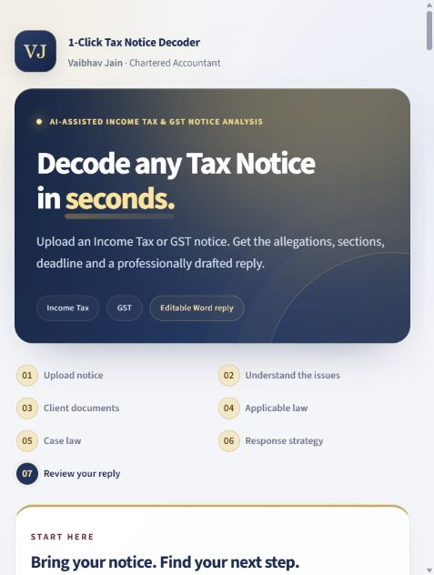
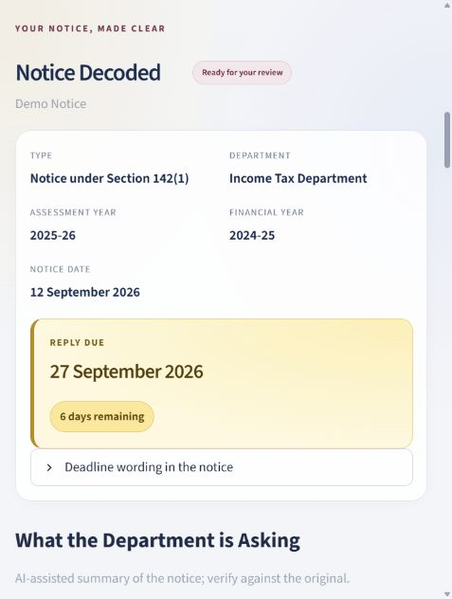
Walkthrough: notice and issues
Homepage
Decoded notice
A clear starting point
Upload a PDF or open the fictional sample.
Review notice details, deadline wording and issue summaries.
Source excerpts support comparison with the original notice.
Actual interface in fictional sample mode
AICA Level 2 course project
05
Notes:
These are actual screenshots from the app, using the fictional sample notice. The homepage shows the colour palette and seven-stage navigation. The decoded view identifies the notice type and relevant period, and highlights the reply date. The user must verify dates and OCR text against the original. Sample dates are fixed fictional dates. The interface wording about speed is not a performance guarantee. Screenshots captured from the local app on 21 September 2026.

Slide 6
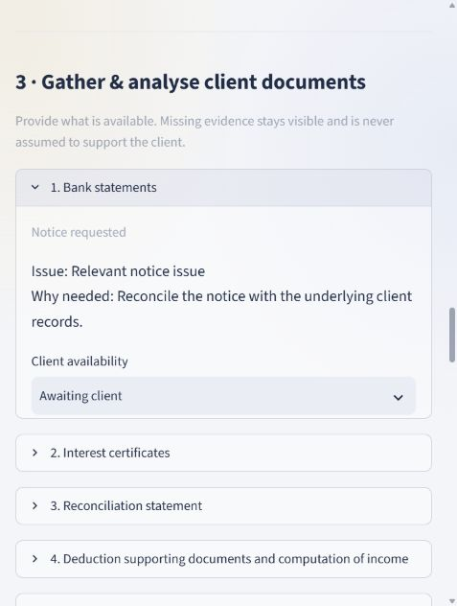
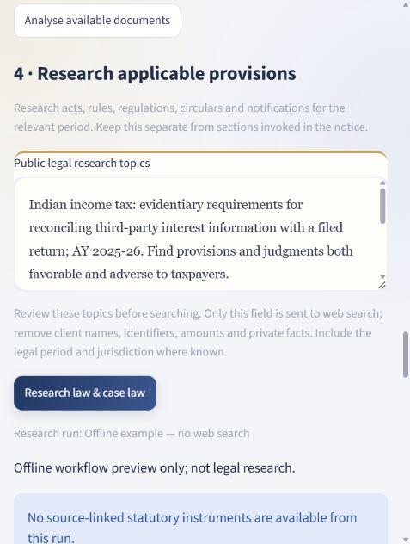
Walkthrough: evidence and research
Client documents
Legal research
Visible evidence gaps
Mark document availability and upload what the client provides.
Review public legal topics before searching.
Examine supporting and adverse authorities in live mode.
Sample mode shows research gaps and supplies no legal authorities
AICA Level 2 course project
06
Notes:
The client-document stage distinguishes notice requests from additional suggestions and allows the user to record availability and missing-document notes. Live review uses the records actually supplied. Research starts with editable public legal topics that the user checks for private details. The live research design considers statutory instruments and cases on both sides. The sample deliberately shows an offline research gap rather than invented authorities. Source: actual local sample screens and README.md.

Slide 7
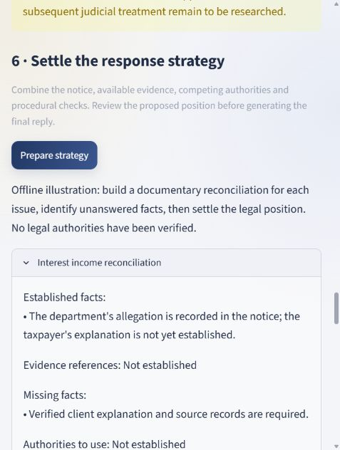
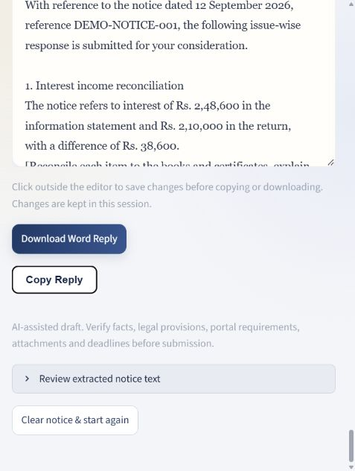
Walkthrough: strategy and reply
Response strategy
Reply editor
An editable outcome
Organise the proposed position issue by issue.
Review missing facts and alternative arguments.
Edit the reply, then copy it or download Word.
Changed inputs require a refreshed strategy.
Fictional sample content with explicit verification placeholders
AICA Level 2 course project
07
Notes:
The strategy stage combines the available facts and gaps into an issue-wise plan. In live mode, drafting includes a separate AI critical-review pass. The user edits the reply before downloading Word. Uploaded records are not automatically attached or filed. The application flags stale strategy when key inputs change. These screenshots use the prewritten sample and do not demonstrate a completed live AI call. Source: local sample screens, case_service.py and case_workflow.py.

Slide 8
Achievements and learning
Working educational prototype
Complete guided workflow
Usable and shareable
Seven stages connect notice analysis with evidence, research, strategy and reply review.
Readable highlights, editable replies, Word export and a ZIP with setup instructions.
Verification completed
Clear validation boundary
40 automated tests passed across recorded runs, including extraction and workflow checks.
Live provider calls remain unverified. Research tests use mocked responses.
AICA Level 2 course project
08
Notes:
The achievement is a working educational prototype with a complete sample workflow, OCR integration and editable Word output. The recorded checks report 40 tests passed across a full run and subsequent targeted tests. This is not a production certification. Live provider calls were not verified because credentials were unavailable. An important learning was to make uncertainty and missing evidence visible instead of treating a polished draft as proof of correctness. Source: CHECKS.md, verified on Windows with Python 3.14.6 on 21 September 2026.

Slide 9
Educational use and disclaimers
Course project
Prepared for educational purposes as part of the AICA Level 2 Course of ICAI. No claim of ICAI endorsement, certification or official product status.
Professional judgment
AI output may be incomplete or incorrect. Verify facts, current law, case citations, deadlines and attachments before submission.
Confidentiality and access
Live analysis sends extracted content to the configured AI provider. Use permitted data and the user’s own API key. Internet and usage charges may apply.
Demonstration limits
Screenshots use fictional, prewritten sample results. The app does not file replies. It offers no guarantee of legal correctness, exhaustive research or outcomes.
AICA Level 2 course project
09
Notes:
This project is an educational submission and carries no claim of institutional endorsement. It supports professional work but does not provide a certified legal opinion. Users remain responsible for confidentiality and review. The demonstration uses fictional, prewritten results. Real AI analysis and research require internet and API access. The app does not submit a reply to any tax portal, and no legally watertight result is promised.

Slide 10
With gratitude for the learning opportunity
CA. Charanjot Singh Nanda
Chairman AI in ICAI and Immediate Past President ICAI
CA. Umesh Ramnarayan Sharma
Vice-Chairman, AI in ICAI
CA. Vipin Agarwal
Thank you
Chairperson, Gurugram Branch (NIRC) of ICAI
CA. Nishant Kumar
Chairperson, Information Technology Committee,
Gurugram Branch (NIRC) of ICAI
And all faculty members and fellow colleagues
CA. Vaibhav Jain
ICAI Membership No - 515700
AICA Level 2 course project
10
Notes:
I express my sincere gratitude to CA. Charanjot Singh Nanda, CA. Umesh Ramnarayan Sharma, CA. Vipin Agarwal and CA. Nishant Kumar. I also thank all faculty members and fellow colleagues for their guidance and shared learning. Thank you for your time. Acknowledgement names and designations reproduce the presenter's supplied wording.

