Slide 1
Audit Observation & Query Tracker
Visual System Walkthrough & User Guide for Chartered Accountancy Audit Practice
ICAI SA 230 & SA 260 Aligned
5-Element Structured Findings
Strict Terminal Gate & Step-Up Auth
Automated Word (.docx) Summary Memo
DELIVERABLE HIGHLIGHTS & ARCHITECTURE SUMMARY
• Full Audit Query Lifecycle: Draft -> Maker-Checker Review -> Issued -> Client Response -> Closed Satisfactory / Info Awaited.
• Engagement-Level RBAC: Role mapping per engagement (Partner, Manager, Senior, Article Assistant, Client Coordinator).
• Strict Memo Generation Gate (FR-11): Blocks Word memo generation if any open queries remain, overridden only via approved EX-03.
• Append-Only Audit Trail (FR-14): Immutable logging tracking user IPs, timestamps, before/after values, and password verifications.
Audit Observation & Query Tracker | CA Practice Academic Deliverable | Slide 1 of 14

Slide 2
ARCHITECTURE
System Architecture & End-to-End Workflow Diagram
High-level pictorial breakdown of presentation tier, business logic layer, state machine, and document generator
PRESENTATION TIER (UI / UX)
CORE APPLICATION & BUSINESS LOGIC ENGINE
DATA PERSISTENCE & COMPLIANCE TIER
Partner Dashboard
KPI metrics, overdue alerts, exceptions queue
Engagement RBAC
Dynamic role mapping & maker-checker enforcement
SQLite DB Schema
Clients, Staff, Engagements, Queries, Exceptions
Audit Team Portal
Maker-checker drafting, observation register
State Machine
Draft -> Under Review -> Issued -> Responded -> Closed
Append-Only AuditTrail
Immutable change logs with user, IP & before/after
Client Portal
PBC request response, evidence upload
ICAI Rules & Gate (FR-11)
Terminal-status gate & Partner step-up auth
Evidence Storage
Secure media attachments & versioned DOCX memos
Admin Master UI
Client, contact & staff provisioning
Document Generator
python-docx Memo & openpyxl Excel Exporter
Session / Auth Store
Encrypted passwords, failed login lockouts
Audit Observation & Query Tracker | CA Practice Academic Deliverable | Slide 2 of 14

Slide 3
AuditTrack 2.0 | TECH STACK & ARCHITECTURE
End-to-End System Flow, Runtime Matrix, Front-End Stack & Core Architectural Decisions
Aligned with ICAI Standards on Auditing (SA 230 / SA 260) & Enterprise Python Standards
SYSTEM FLOW: Local Desktop Execution & Browser-Based In-Process Runtime
Launcher (.bat)
Double-Click setup_and_run.bat (Auto-detects Python)
Django Server
In-process WSGI 0.0.0.0:8000 (Multi-user access)
Browser UI
Auto-opens Edge/Chrome http://127.0.0.1:8000 (Interactive UI)
Core Engine
RBAC + State Machine FR-11 Gate Validation Docx Memo Engine
Storage Layer
Single SQLite DB (db.sqlite3 - Zero Setup) + Secure Media Files
Runtime & Backend Technology Matrix
Front-End Presentation & Interactive UI Architecture
Layer | Choice | Version | Purpose
Language | CPython Runtime | 3.10 - 3.14 | Core cross-platform execution
Framework | Django Full-Stack | 6.1.1 | ORM, WSGI, RBAC & Auth middleware
Database | SQLite 3 Engine | 3.45+ | Single-file zero-config relational store
Word Engine | python-docx | 1.2.0 | Auto-generates Summary Memos (.docx)
Excel Engine | openpyxl | 3.1.5 | Styled Query Register XLSX exporter
UI Testing | Selenium WebDriver | 4.49.0 | Automated UI walkthrough screenshot engine
🎨 UI Framework: Bootstrap 5.3 (Responsive Grid, Modals, Dynamic Tables & Badges)
📊 Visual Analytics: Chart.js 4.4 (Live Query Ageing Donut & Risk Rating Bar Charts)
⚡ Zero-Node SSR: Django Server-Side Templates: Zero npm/Node build step required on host
👥 Quick Persona Bar: Top floating navbar for 1-click role simulation (Partner/Manager/CFO/Admin)
Packaging, Verification & Code Metrics
Deliberate Architectural Decisions (Compliance & Governance)
• 1-Click Launchers: setup_and_run.bat & start_server.bat with Python fallback (py, python, py -3)
• Test Coverage: 7 Automated Django TestCase Test Suites verifying RBAC, State Machine & Gates
• Codebase Statistics: ~8,460 Total Lines of Code
[Python Core Logic: 5,226 lines] | [HTML Templates: 2,860 lines] | [Unit Tests: 375 lines]
STRICT GATE (FR-11)
Summary Memo (.docx) generation hard-blocked if open queries remain; override only via Partner EX-03 exception.
IMMUTABLE TRAIL (FR-14)
Append-only AuditTrail records IP, timestamp, old/new values & step-up password verification.
ENGAGEMENT RBAC
Dynamic role resolution per engagement prevents Article Assistant from self-issuing queries.
ZERO CLOUD DEPENDENCY
Local single-file SQLite database + local media storage; runs 100% offline with zero recurring cost.
Audit Observation & Query Tracker | CA Practice Deliverable | Tech Stack & Architecture Overview

Slide 4
SECURITY & ROLES
Role-Based Access Control (RBAC) & Maker-Checker Matrix
Strict segregation of duties enforced dynamically based on engagement team allocation
Audit Partner | Login: partner1@firm.com (CA Rajesh Sharma)
Full engagement oversight, EX-01 to EX-07 exception approvals with step-up auth, Word Memo generation & final sign-off lock.
Audit Manager | Login: manager1@firm.com (CA Amit Verma)
Draft observation review, issuing queries to client, query closure validation, exception request submission, team assignment.
Senior Auditor | Login: senior1@firm.com (Rohan Deshmukh)
Structured 5-element query creation, PBC tracking, fieldwork documentation, submitting draft queries for manager review.
Article Assistant | Login: article1@firm.com (Vikram Malhotra)
Observation logging & draft queries. Maker-Checker Rule strictly blocks articles from directly issuing queries to clients.
Client Coordinator | Login: cfo@apexindustries.com (Ramesh Gupta)
Client Management Portal: view issued queries, assign to team, submit official management response and document evidence.
System Admin | Login: admin@firm.com (Firm Administrator)
Master data maintenance (Clients, Staff, Contacts), user lockouts reset, and system-wide append-only audit trail inspection.
Audit Observation & Query Tracker | CA Practice Academic Deliverable | Slide 3 of 14

Slide 5
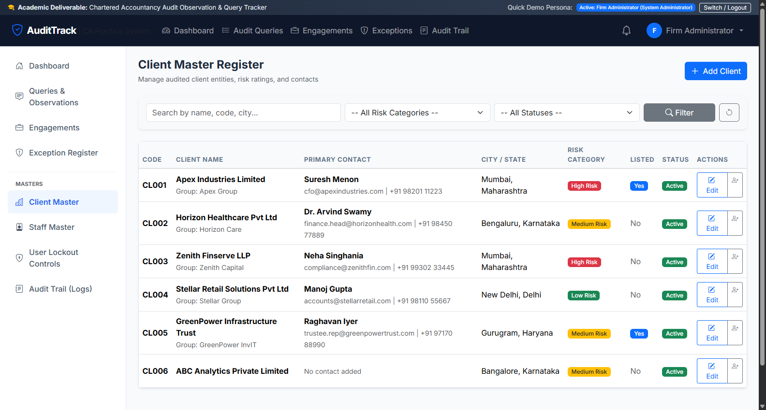
STEP 1: MASTERS
Client Master Register & Corporate Profiling
Admin Master table showing audited corporate entities, risk ratings, and primary contact details
Client Master Overview
1. Entity Master: Displays Client Code (CL001), Corporate Name, Industry, and SEBI Listed Status.
2. Risk Categorization: High (Red), Medium (Yellow), Low (Green) risk ratings drive engagement materiality.
3. Primary Contact Display: Lists CFO / Finance Head email & mobile for quick communication.
4. Action Shortcuts: Edit client profile or click '+ Contact' icon to add new authorized contact persons.
KEY FIELDS & CONTROLS:
• Client Code & Legal Name
• Primary Contact (Email & Mobile)
• Risk Category Badge
• Listed Status (SEBI LODR)
• Edit & Add Contact Buttons
Audit Observation & Query Tracker | CA Practice Academic Deliverable | Slide 4 of 14

Slide 6
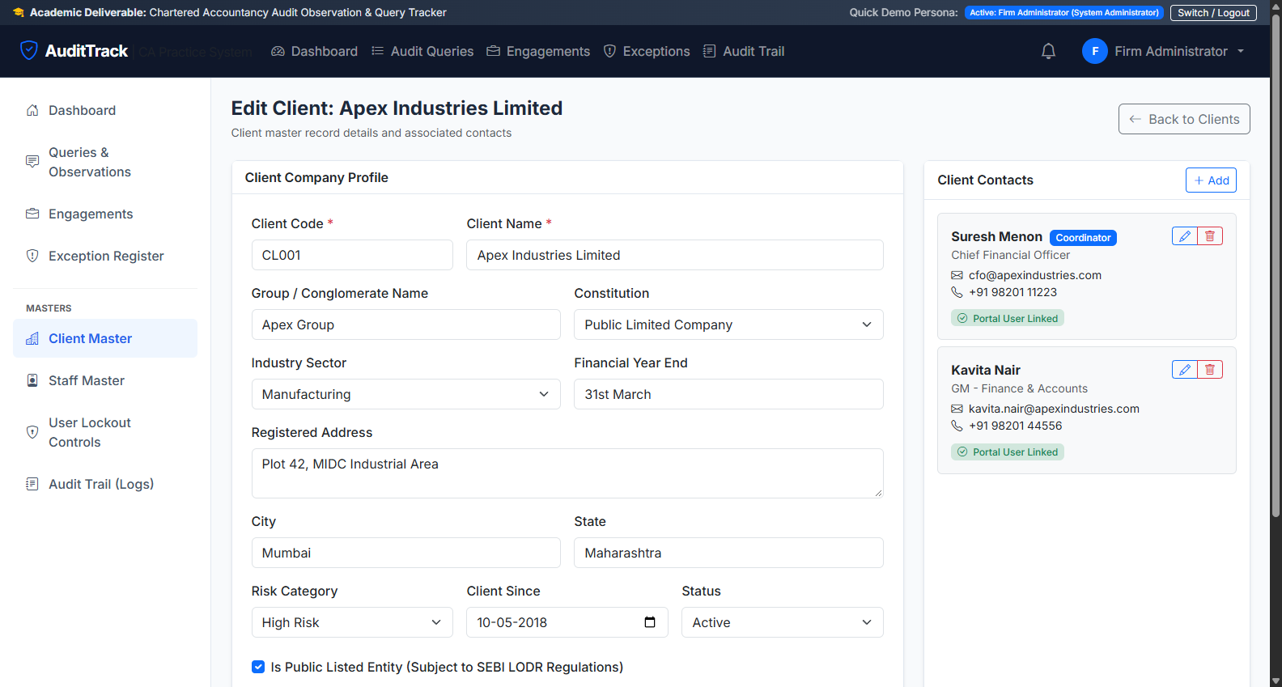
STEP 1 (CONTD.)
Client Contact & Portal User Provisioning
Managing authorized client personnel, primary coordinator designation, and automated portal user provisioning
Contact & User Provisioning
1. Client Company Profile: Left form allows updating corporate details, registered address, and remarks.
2. Contact Management Panel: Right sidebar lists all contact persons with direct Edit (pencil) and Delete buttons.
3. Primary Audit Coordinator: Flag indicating this contact reviews other internal client responses.
4. Auto-Provision Portal Account: Automatically generates login user with default password (Password@123).
KEY FIELDS & CONTROLS:
• Contact Person Name & Designation
• Official Email (Portal Username)
• Mobile Number
• Primary Coordinator Checkbox
• Portal User Linked Badge
• Edit & Delete Contact Buttons
Audit Observation & Query Tracker | CA Practice Academic Deliverable | Slide 5 of 14

Slide 7
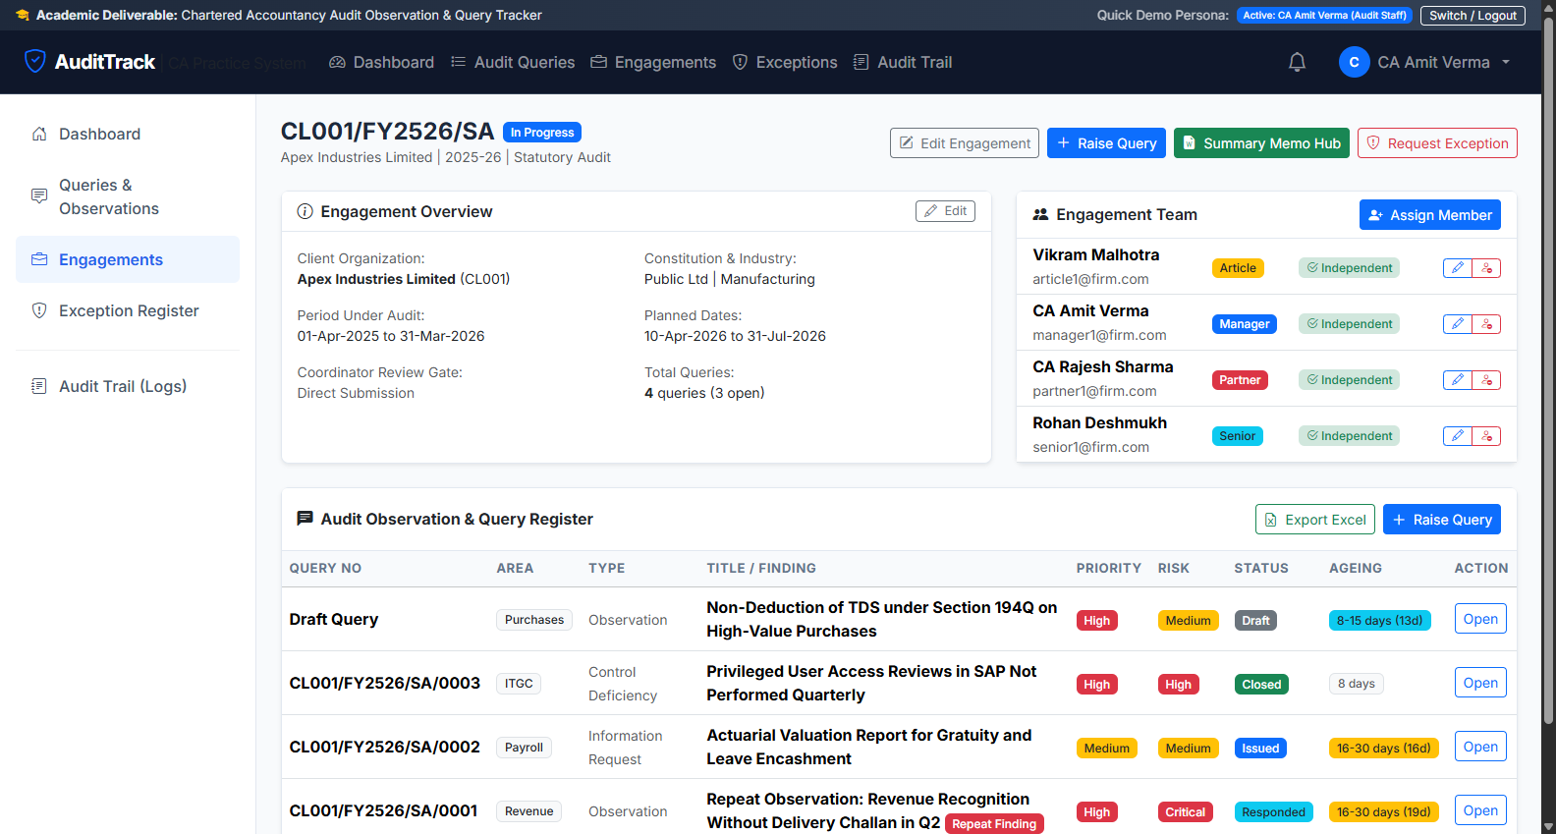
STEP 2: ENGAGEMENTS
Engagement Scoping & Team Allocation
Assigning Partners, Managers, Seniors, and Articles with mandatory lead partner enforcement
Engagement Governance
1. Engagement Code & Overview: Code (CL001/FY2526/SA), FY, Period under audit, and status.
2. Mandatory Lead Partner Rule (Sec 5.5): Enforces exactly one active Audit Partner before memo sign-off.
3. Engagement Team Table: Allocates Partners, Managers, Seniors, and Articles with independence status.
4. Edit Role & Release Controls: Direct buttons to reassign roles or release team members safely.
KEY FIELDS & CONTROLS:
• Period Under Audit (From/To)
• Planned Dates (Start/Completion)
• Engagement Team List (Role Badges)
• Assign Member Button
• Edit Role & Release Buttons
• Independence Declaration Status
Audit Observation & Query Tracker | CA Practice Academic Deliverable | Slide 6 of 14

Slide 8
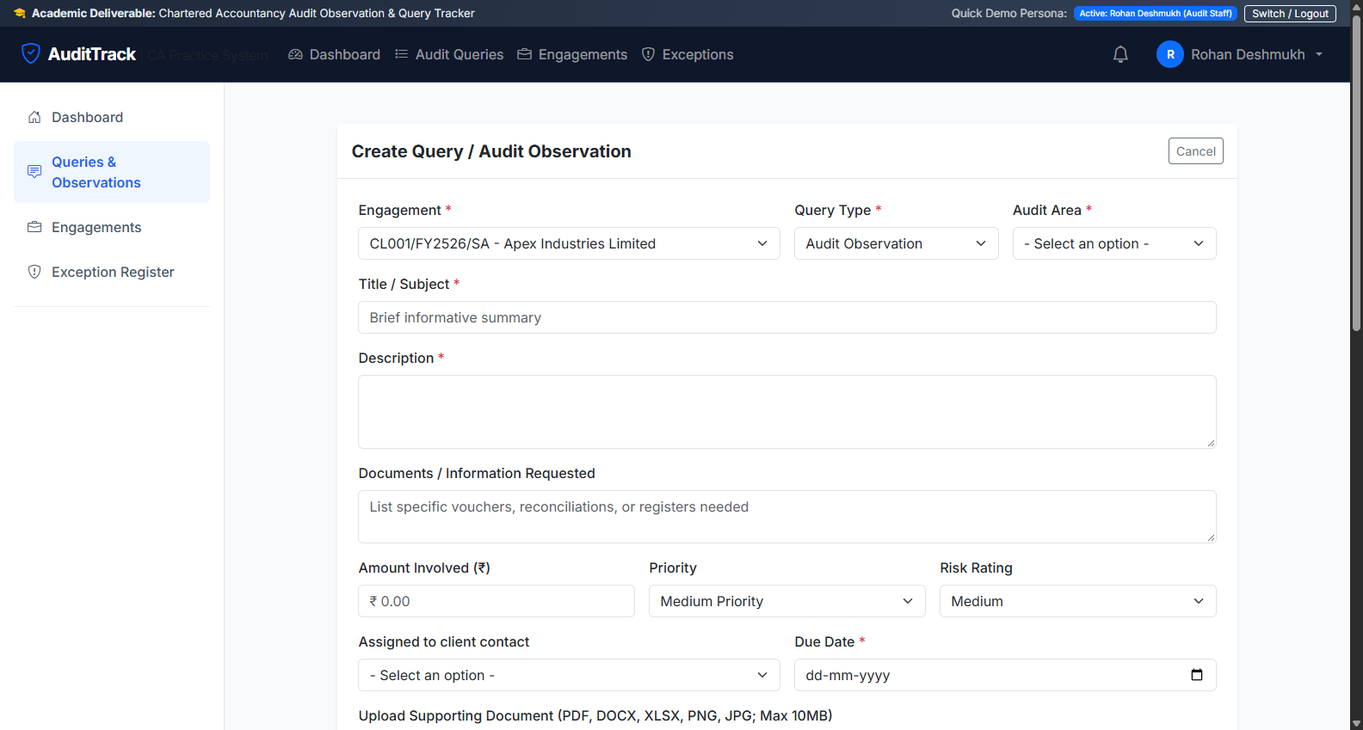
STEP 3: OBSERVATIONS
Structured 5-Element Observation Drafting (SA 230)
Standardized audit findings aligned with ICAI SA 230, Ind AS, and CARO 2020 reporting standards
5-Element Finding Structure
1. Condition (What was found): Factual audit finding supported by verifiable sampling evidence.
2. Criteria (What should be): Accounting Standards (Ind AS / AS) or statutory provisions.
3. Cause (Root Cause): Why deficiency occurred (e.g. lack of automated ERP cutoff controls).
4. Effect / Risk: Financial statement impact or exposure in INR (₹).
5. Recommendation: Actionable corrective measures for management.
KEY FIELDS & CONTROLS:
• Audit Area (Revenue, Fixed Assets, GST, etc.)
• Priority (High, Medium, Low)
• Risk Rating (Critical, High, Medium, Low)
• Amount Involved (₹)
• Supporting Evidence Upload (PDF/DOCX/XLSX)
Audit Observation & Query Tracker | CA Practice Academic Deliverable | Slide 7 of 14

Slide 9
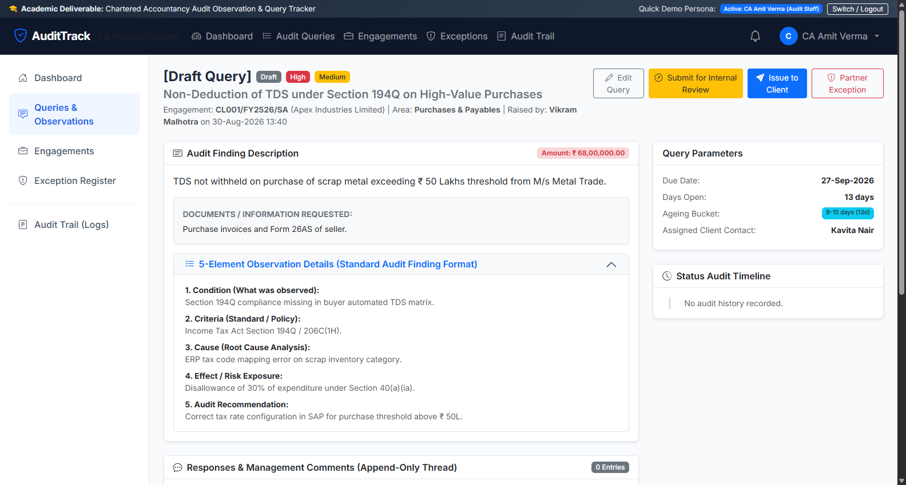
STEP 4: MAKER-CHECKER
Maker-Checker Review & Client Issuance
Segregation of duties: Articles draft observations; Seniors/Managers review and officially issue
Maker-Checker Controls
1. Draft Review: Manager/Senior inspects 5-element findings and supporting attachments.
2. Maker != Checker Rule: Article who drafted the query cannot self-approve its issuance.
3. Issue to Client: Manager clicks 'Issue to Client', triggering client portal visibility and email notification.
4. Auto-Reference & Due Date: Query reference (e.g. CL001/FY2526/SA/0001) and deadline set.
5. Response Timeline: Real-time status tracker shows audit lifecycle progression.
KEY FIELDS & CONTROLS:
• Status: Draft -> Under Review -> Issued
• Issue to Client Action Button
• Target Response Due Date
• Assigned Client Contact
Audit Observation & Query Tracker | CA Practice Academic Deliverable | Slide 8 of 14

Slide 10
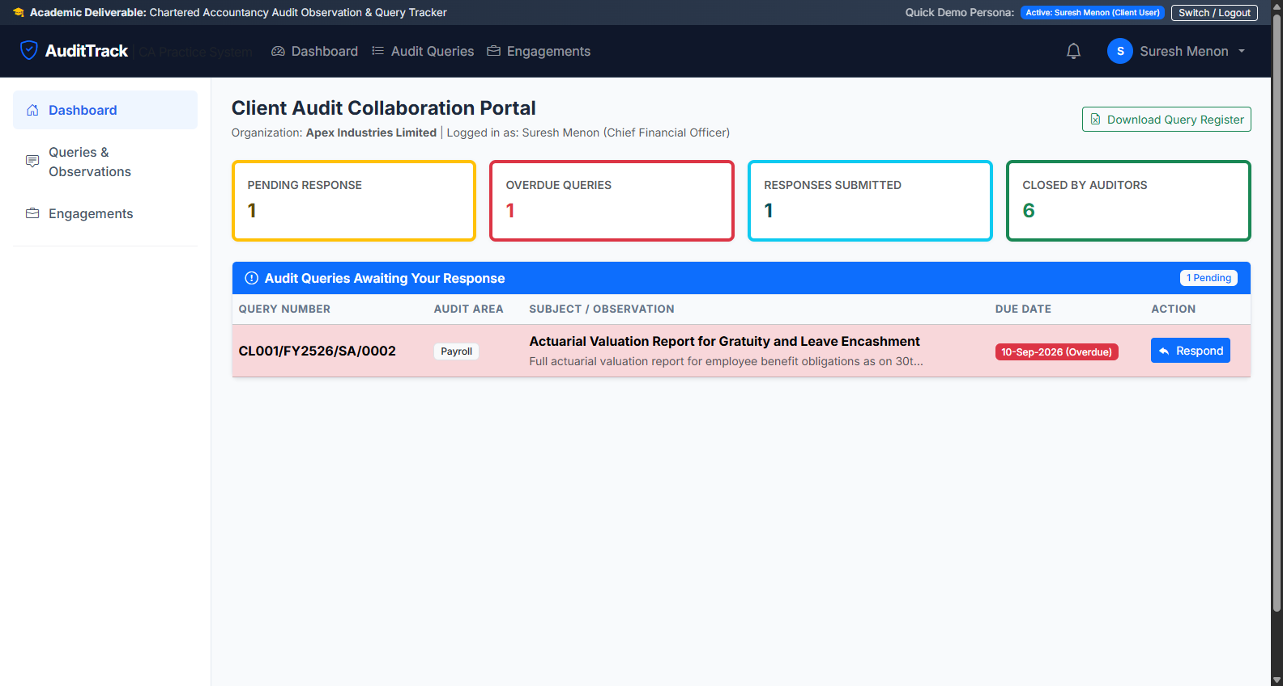
STEP 5: CLIENT PORTAL
Client Response Capture & Evidence Upload
Client CFO portal for transparent communication, submitting management replies, and uploading evidence
Client Portal Features
1. Filtered Client View: Clients only see queries officially marked as 'Issued to Client'.
2. Actionable Query Queue: Color-coded overdue badges highlight immediate response priorities.
3. Management Response: CFO submits written explanation and attaches reconciliation files.
4. Status Progression: Submitting changes query status to 'Responded by Client'.
5. Audit Team Alert: Automatically alerts engagement manager of new response.
KEY FIELDS & CONTROLS:
• Management Response Input Text
• Supporting Document Upload (PDF/XLSX)
• Overdue Ageing Indicators
• Submit Management Response Button
Audit Observation & Query Tracker | CA Practice Academic Deliverable | Slide 9 of 14

Slide 11
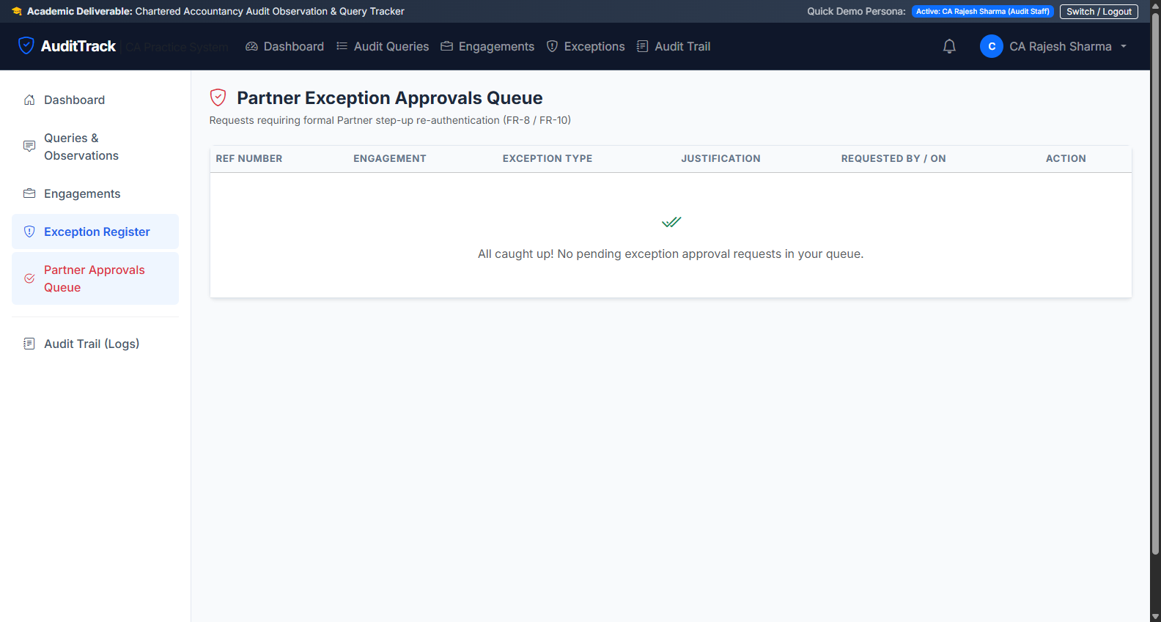
STEP 6: EXCEPTIONS
Partner Exception Approval Queue & Step-Up Auth
Formal governance for exceptions (EX-01 to EX-07) with partner password re-verification
Exception Framework (EX-01 to EX-07)
1. Exception Request: Manager requests exception when alternative procedures are performed.
2. Justification Threshold: Minimum 100-character detailed audit justification mandatory.
3. Partner Step-Up Authentication: Partner must re-enter their password to authorize exceptions.
4. EX-03 Gate Override: Special exception allowing Summary Memo generation with open queries.
5. Immutable Audit Log: All approved/rejected decisions recorded with timestamp and partner notes.
KEY FIELDS & CONTROLS:
• Exception Type (EX-01 to EX-07)
• Audit Justification Text
• Step-Up Password Prompt Modal
• Approve / Reject Action Buttons
Audit Observation & Query Tracker | CA Practice Academic Deliverable | Slide 10 of 14

Slide 12
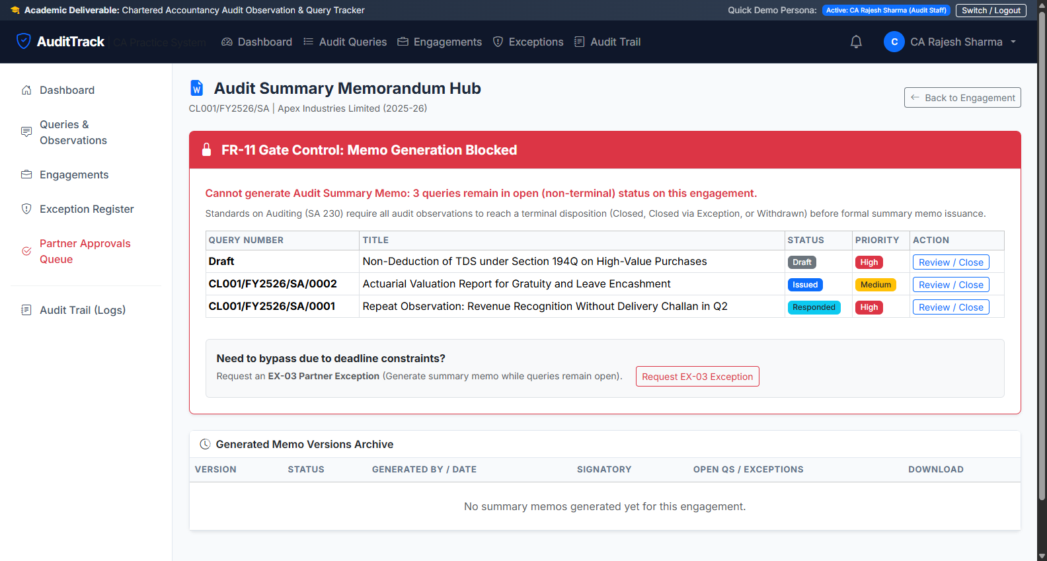
STEP 7: WORD MEMO
Audit Summary Memo (.docx) & FR-11 Gate Check
Automated generation of Microsoft Word Summary Memos with Annexures A–D and Partner Sign-Off locking
Summary Memo Features
1. FR-11 Terminal-Status Gate: Generation blocked if non-terminal queries exist without approved EX-03.
2. Word (.docx) Document: Firm letterhead, executive scope, stats table, Annexures A–D.
3. Watermark Controls: Unsigned memos watermarked 'DRAFT'; signed memos marked 'FINAL COPY'.
4. Partner Sign-Off & Lock: Partner re-enters password to sign off, locking the engagement.
5. One-Click Download: Download ready-to-print .docx memo directly from the portal.
KEY FIELDS & CONTROLS:
• FR-11 Gate Validation Check
• Generate Draft Memo Button
• Download Word (.docx) Button
• Partner Sign-off with Password Lock
Audit Observation & Query Tracker | CA Practice Academic Deliverable | Slide 11 of 14

Slide 13
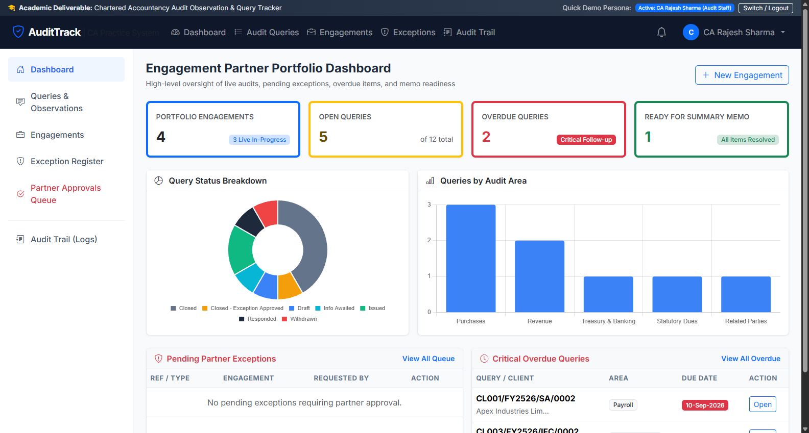
STEP 8: ANALYTICS
Interactive Dashboards & Real-time Metrics
Role-customized dashboards with ageing buckets, risk matrices, and overdue tracking
Dashboard Capabilities
1. Role-Tailored Perspectives: Dedicated dashboards for Partners, Managers, Articles, and Clients.
2. Query Ageing Breakdown: Visual tracking across buckets (0-7 days, 8-15 days, 16-30 days, >30 days).
3. Risk Rating Matrix: Real-time counts of Critical, High, Medium, and Low risk observations.
4. Quick Persona Switcher: Top demo bar allows instant switching between demo personas during presentations.
5. Excel Export: One-click export of styled query registers with conditional formatting.
KEY FIELDS & CONTROLS:
• Ageing Chart (Chart.js)
• Risk Rating Breakdown
• Overdue Queries Action Table
• Quick Persona Switch Bar
Audit Observation & Query Tracker | CA Practice Academic Deliverable | Slide 12 of 14

Slide 14
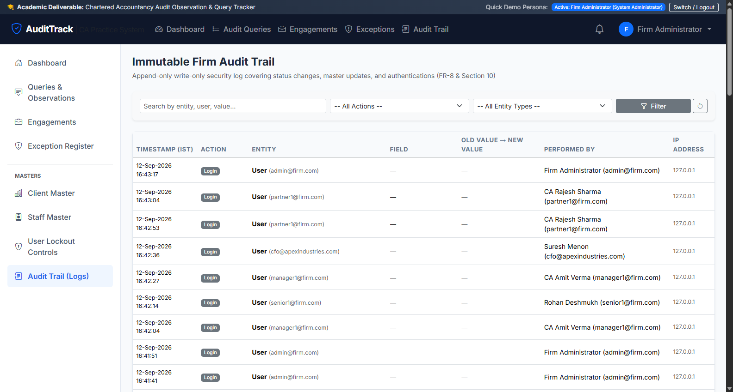
STEP 9: COMPLIANCE
Append-Only Audit Trail (FR-14) & Security Controls
Immutable event logging tracking all state transitions, user logins, and memo operations
Compliance & Governance
1. Append-Only Architecture: Audit log entries cannot be modified or deleted by any user, including admins.
2. Comprehensive Event Capture: Records entity type, action, before/after values, user email, and client IP.
3. User Account Security: Failed login attempt counter locks accounts after 5 consecutive failed attempts.
4. Force Password Change: Temporary passwords must be updated upon first login for all staff and clients.
5. Session Inactivity Timeout: Automatic session termination after 30 minutes of inactivity.
KEY FIELDS & CONTROLS:
• Event Timestamp & Performed By
• Action (Create/Update/Transition/Sign-off)
• Field Changed & Old/New Values
• Client IP Address Tracking
Audit Observation & Query Tracker | CA Practice Academic Deliverable | Slide 13 of 14

Slide 15
QUICK START
1-Click Setup & Demo Guide
Simple instructions to run the application on any computer
HOW TO RUN & DEMONSTRATE THE APPLICATION
Step 1: Extract Project ZIP
Extract the complete project folder to your Desktop or Documents.
Step 2: Ensure Python is Installed
Ensure Python 3.10+ is installed with 'Add python.exe to PATH' checked.
Step 3: Double-Click 'setup_and_run.bat'
Automatically installs dependencies, applies migrations, seeds demo data, and opens http://127.0.0.1:8000/.
Step 4: Login with Demo Accounts (Password for all: Password@123)
Partner: partner1@firm.com | Manager: manager1@firm.com | Article: article1@firm.com | Client CFO: cfo@apexindustries.com | Admin: admin@firm.com
Step 5: Automated Verification Test Suite
Run 'python manage.py test' to execute all 7 automated unit & integration test suites.
Audit Observation & Query Tracker | CA Practice Academic Deliverable | Slide 14 of 14

