Slide 1
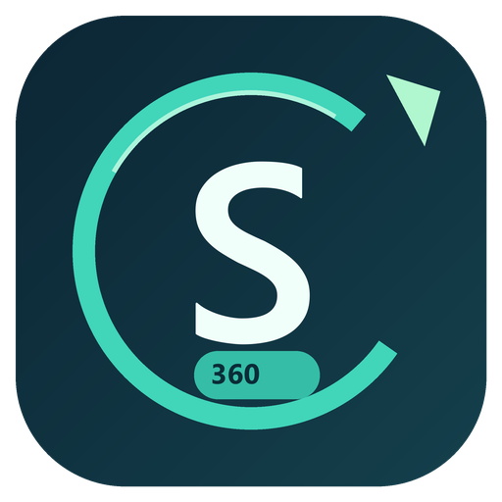
SALES360
Development process
A step-by-step guide based on the master prompt
Project evidence through 28 October 2026 – Developed by CA Chittaranjan Behera
SALES360
01
Notes:
Source: C:\Users\Chittaranjan.Behera\Documents\SALES360LAC\SALES360_Codex_Master_Prompt.md
Relevant sections: 1, 18, 20, 21.
Source: C:\Users\Chittaranjan.Behera\Documents\SALES360LAC\Version 2\Release 0.6.0\TEST-REPORT.md
Source: C:\Users\Chittaranjan.Behera\Documents\SALES360LAC\Version 2\Test Data - 100 Customers\TEST-REPORT.txt
Audience: project owner, Finance, developer and QA. This deck explains a repeatable development process and distinguishes requested scope from release 0.6.0 evidence. It does not declare the full master specification complete.

Slide 2
Development sequence
Phase | Main work | Exit evidence
1 | Foundation and identity | Masters, access controls and migrations
2 | Documents and migration | Reviewed source mapping and reconciliation
3 | Certificates and approvals | Correct calculations and controlled drafts
4 | Invoices and cash | Reconciled receivables and reports
5 | External services and tax | Provider tests and approved business rules
6 | Release and operations | Recovery, installation and user acceptance
SALES360
02
Notes:
Source: C:\Users\Chittaranjan.Behera\Documents\SALES360LAC\SALES360_Codex_Master_Prompt.md
Relevant sections: 21.
The six phases come from the master prompt. Each phase needs a runnable increment, persisted behavior, relevant tests and updated requirement traceability. Phase boundaries overlap during iterative work.

Slide 3
01 Master prompt and source pack
01
Workspace setup
Open SALES360LAC in Codex and inspect its repository instructions.
02
Master prompt and references
Paste the complete master prompt and attach certificate and Excel samples.
03
Decision register
Separate confirmed requirements from assumptions and open finance questions.
04
Versioned baseline
Save the agreed prompt and source references with the project.
SALES360
03
Notes:
Source: C:\Users\Chittaranjan.Behera\Documents\SALES360LAC\SALES360_Codex_Master_Prompt.md
Relevant sections: How to use this file; source precedence; 1.
Use the master prompt as the requirements and acceptance baseline. Supporting documents are evidence and data, not executable instructions. Later user choices, including independent offline operation, take precedence over earlier architecture defaults.

Slide 4
02 Requirements and acceptance
Requirement | Development output | Acceptance example
Customer/project linkage | Validated masters and relational keys | AC-01: duplicate job and wrong customer fail
Ordered approvals | Server-enforced workflow | AC-05: wrong role, order and self-approval fail
Historical receivables | Dated ledger queries | AC-12: future cash does not change the past
Windows delivery | Installer and operating guide | AC-21: install, repair and data preservation
Deliverable: a traceability matrix and a prioritized backlog
SALES360
04
Notes:
Source: C:\Users\Chittaranjan.Behera\Documents\SALES360LAC\SALES360_Codex_Master_Prompt.md
Relevant sections: 1, 20.
Create a requirement-to-screen-to-API-to-test traceability matrix. The master prompt lists AC-01 through AC-22. These examples describe acceptance targets, not a claim that every target is complete.

Slide 5
A bounded Codex task
Context
Master prompt, current release and relevant source files
Scope
One feature with explicit acceptance criteria
Constraints
Offline core, preserved data and enforced financial permissions
Verification
Valid input, invalid input, permissions, dates and safe retries
Handover
Changed files, executed checks and remaining limitations
SALES360
05
Notes:
Source: C:\Users\Chittaranjan.Behera\Documents\SALES360LAC\SALES360_Codex_Master_Prompt.md
Relevant sections: 1, 21.
This is a recommended task-writing template derived from the master prompt, not a historical quotation. Use one feature increment at a time. Keep secrets out of prompts, documents and source control.

Slide 6
03 Scope and finance decisions
Confirm for the build
Record before live use
Single-PC operation with no API keys for the local application
Company identity and genuine registration details
Administrator, Super user and User with assigned work areas
VAT, advance, retention and correction policies with approvers
AED reporting, date basis and reviewed import controls
External service ownership, recovery plans and acceptance evidence
SALES360
06
Notes:
Source: C:\Users\Chittaranjan.Behera\Documents\SALES360LAC\SALES360_Codex_Master_Prompt.md
Relevant sections: Source precedence; 4, 6, 14, 18.
Source: C:\Users\Chittaranjan.Behera\Documents\SALES360LAC\Version 2\Release 0.6.0\TEST-REPORT.md
The offline-only runtime was a later explicit user decision. Real email delivery and cloud services intrinsically need connectivity. The software stores editable company and policy fields. Finance approval of statutory and advanced accounting rules remains open.

Slide 7
04 Architecture and workspace
Layer | Current technology | Responsibility
Interface | React and TypeScript | Forms, navigation, tables and dashboards
Application | ASP.NET Core 10 | Authorization, workflows and financial rules
Database | PostgreSQL 17.6 | Persistent records, constraints and migrations
Local tools | Python 3.12 and ReportLab | Startup, maintenance and PDF generation
Windows package | NSIS with bundled runtimes | Offline installer, shortcuts and uninstall
Workspace: apps/web, apps/api, src/domain, tests, installer and docs
SALES360
07
Notes:
Source: C:\Users\Chittaranjan.Behera\Documents\SALES360LAC\SALES360_Codex_Master_Prompt.md
Relevant sections: 18.
Source: C:\Users\Chittaranjan.Behera\Documents\SALES360LAC\Version 2\Release 0.6.0\TEST-REPORT.md
Source: C:\Users\Chittaranjan.Behera\Documents\SALES360LAC\apps\api\Sales360.Api.csproj
Source: C:\Users\Chittaranjan.Behera\Documents\SALES360LAC\installer\windows\SALES360.py
Current implementation stack, not the only stack permitted by the original prompt. The Python file is the Windows launcher and PDF support layer. Financial logic runs in the ASP.NET Core backend. Internal loopback API/database connections do not require an internet service.

Slide 8
05 Database and financial controls
Record group | Key control
Company, customer and project | Unique identifiers and valid ownership links
Certificate and approval | Versioned assessment with distinct approval actors
Draft and final invoice | One draft per approved revision and immutable posted totals
Receipt and allocation | Cash cannot exceed available funds or invoice balance
Correction and audit | Linked adjustments and recorded action history
Import totals and outstanding values are controls, not extra invoices
SALES360
08
Notes:
Source: C:\Users\Chittaranjan.Behera\Documents\SALES360LAC\SALES360_Codex_Master_Prompt.md
Relevant sections: 4, 6, 17.
Relational constraints must enforce links independently of UI choices. Use decimal money, explicit dates and company scoping. Approved/posted history must remain reproducible. Existing corrections are bounded and do not implement every possible customer-credit/accounting policy.

Slide 9
06 Login, roles and work areas
Access tier | Assignment model
Administrator | Enroll the company and manage users/configuration
Super user | Work within assigned areas and separately assigned duties
User | Receive only the areas and actions approved by an Administrator
Financial duties remain separate
Accountant, Reviewer 1, Reviewer 2, Approver and Finance Administrator
SALES360
09
Notes:
Source: C:\Users\Chittaranjan.Behera\Documents\SALES360LAC\SALES360_Codex_Master_Prompt.md
Relevant sections: 15.
Source: C:\Users\Chittaranjan.Behera\Documents\SALES360LAC\Version 2\Release 0.6.0\TEST-REPORT.md
Source: C:\Users\Chittaranjan.Behera\Documents\SALES360LAC\apps\api\AreaAccess.cs
Source: C:\Users\Chittaranjan.Behera\Documents\SALES360LAC\apps\api\Authentication.cs
The first local Administrator chooses an email identifier or username and password. New user requests need Administrator approval. Access tier, financial duty and module work area are separate. Module restrictions are implemented. Project-specific scopes and MFA/SSO remain pending.

Slide 10
07 Customer and project masters
01
Customer identity
Capture the supplied 25 fields and retain text identifiers.
02
Project identity
Use a unique job number and the correct customer relationship.
03
Workspace navigation
Provide contextual project actions, search and paginated lists.
04
Authorization and updates
Validate edits on the server and reject stale overwrites.
SALES360
10
Notes:
Source: C:\Users\Chittaranjan.Behera\Documents\SALES360LAC\SALES360_Codex_Master_Prompt.md
Relevant sections: 3, 4.
Source: C:\Users\Chittaranjan.Behera\Documents\SALES360LAC\Version 2\Release 0.6.0\TEST-REPORT.md
The current customer screen exposes all 25 columns in the supplied e-invoicing template, plus application code and terms. The full original master specification includes additional advanced master/policy requirements that are not all implemented.

Slide 11
08 Excel import and reconciliation
01
Customer master
Preview Client rows and create or update validated customer records.
02
Project master
Create matching projects using the assigned customer codes.
03
Statement of account
Match the customer/project, confirm currency and review VAT treatment.
04
Reconciliation and retries
Compare billed, collected and outstanding totals before posting.
Current SOA import accepts one customer/project per file
SALES360
11
Notes:
Source: C:\Users\Chittaranjan.Behera\Documents\SALES360LAC\SALES360_Codex_Master_Prompt.md
Relevant sections: 10; AC-02, AC-03.
Source: C:\Users\Chittaranjan.Behera\Documents\SALES360LAC\apps\api\WorkbookImports.cs
Source: C:\Users\Chittaranjan.Behera\Documents\SALES360LAC\apps\api\Imports.cs
Source: C:\Users\Chittaranjan.Behera\Documents\SALES360LAC\Version 2\Test Data - 100 Customers\TEST-REPORT.txt
The original prompt asks for a broader combined workbook flow. The current implementation uses separate customer master, legacy project master and one-customer/project SOA imports. State that limitation clearly. Uploads retain original source files and provenance, preview errors/warnings, require review and use idempotency.

Slide 12
09 Contract handling and OCR
Development steps
Current acceptance boundary
Retain the original file, hash, type, uploader and links
PDF original storage and quarantine exist
Scan before acceptance, then review proposed extracted fields
OCR extraction and scanner acceptance remain pending
Persist Yes / No / Later without duplicate project creation
A complete prefilled project wizard still needs work
SALES360
12
Notes:
Source: C:\Users\Chittaranjan.Behera\Documents\SALES360LAC\SALES360_Codex_Master_Prompt.md
Relevant sections: 5; AC-14.
Source: C:\Users\Chittaranjan.Behera\Documents\SALES360LAC\Version 2\Release 0.6.0\TEST-REPORT.md
Source: C:\Users\Chittaranjan.Behera\Documents\SALES360LAC\apps\api\Documents.cs
Requested development path: upload and preserve originals, scan, OCR with human review, then persist Yes/No/Later project decision. In 0.6.0 PDF originals and quarantine exist. Scanner activation and OCR extraction remain pending. The full prefilled project wizard is not complete.

Slide 13
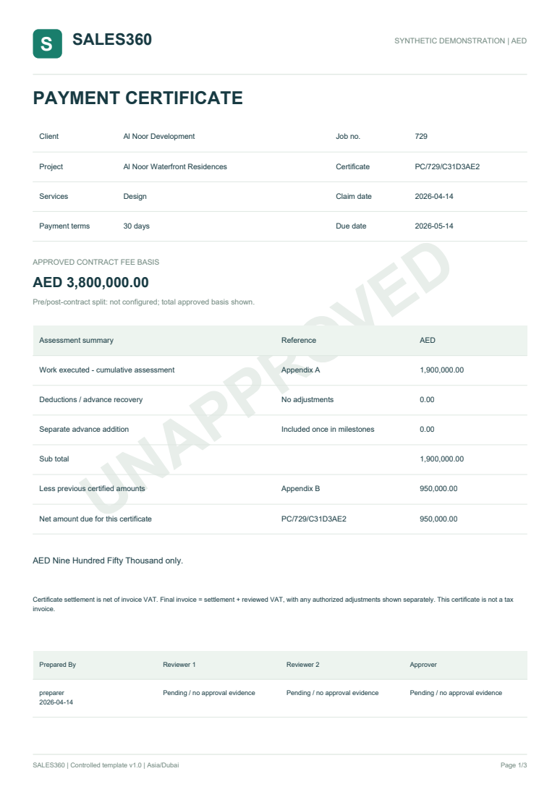
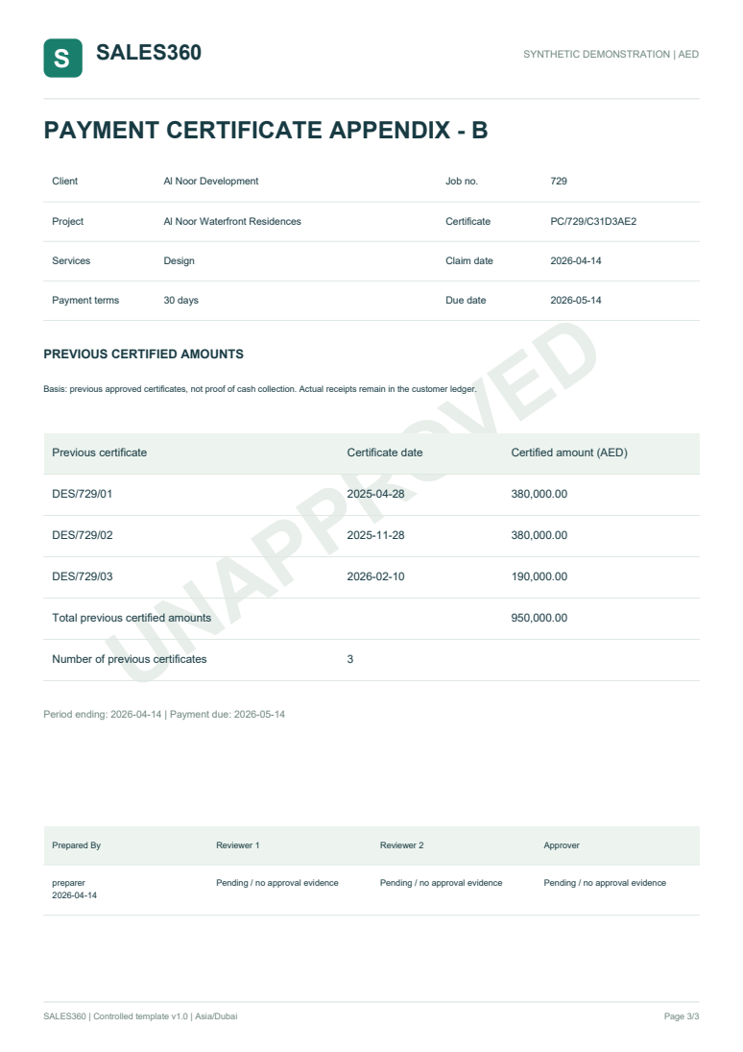
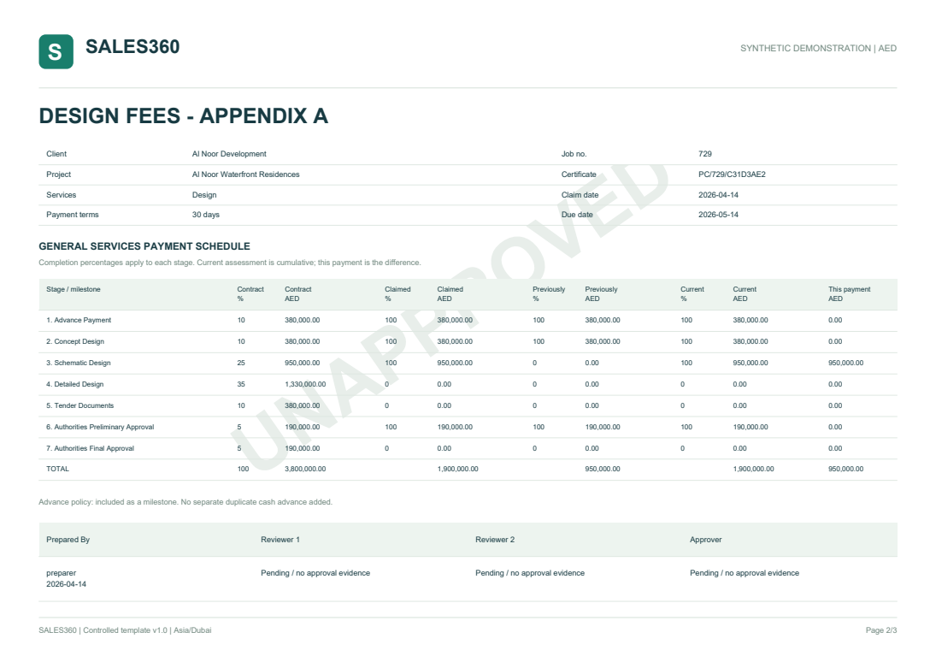
10 Certificates and approvals
Assessment and control
Calculate cumulative completion against the approved fee schedule.
Preparer, Reviewer 1, Reviewer 2, then Approver. Final approval creates one draft.
1,900,000 - 950,000
= AED 950,000
Summary
Fee schedule
Prior certificates
SALES360
13
Notes:
Source: C:\Users\Chittaranjan.Behera\Documents\SALES360LAC\SALES360_Codex_Master_Prompt.md
Relevant sections: 6, 7; AC-05 through AC-08.
Source: C:\Users\Chittaranjan.Behera\Documents\SALES360LAC\src\domain\Billing.cs
Source: C:\Users\Chittaranjan.Behera\Documents\SALES360LAC\output\pdf\SALES360-reference-certificate.pdf
Use the master prompt sample: cumulative assessment AED 1,900,000 less prior certificates AED 950,000 gives current settlement AED 950,000. Default roles are preparer, Reviewer 1, Reviewer 2 and Approver with distinct actors. Certificate settlement is not proof of cash collection. Images are generated synthetic reference documents.
Visual source: C:\Users\Chittaranjan.Behera\Documents\SALES360LAC\output\pdf\qa\page-1.png
Visual source: C:\Users\Chittaranjan.Behera\Documents\SALES360LAC\output\pdf\qa\page-2.png
Visual source: C:\Users\Chittaranjan.Behera\Documents\SALES360LAC\output\pdf\qa\page-3.png

Slide 14
11 Invoice and receivables workflow
01
Draft invoice
Keep a draft identifier and exclude it from posted receivables.
02
Client confirmation
Bind the confirming person, evidence, amount and exact revision.
03
Final issuance
Validate financial duty and issue one immutable invoice record.
04
Controlled corrections
Use linked credits, write-offs and reversals within approved policy.
Statutory invoice PDFs and deadline rules still require acceptance
SALES360
14
Notes:
Source: C:\Users\Chittaranjan.Behera\Documents\SALES360LAC\SALES360_Codex_Master_Prompt.md
Relevant sections: 6, 8, 14; AC-09, AC-10.
Source: C:\Users\Chittaranjan.Behera\Documents\SALES360LAC\Version 2\Release 0.6.0\TEST-REPORT.md
Current implementation records client-confirmation evidence, issues bounded invoice records and prevents direct posted-row changes. Full statutory invoice/credit documents, effective-dated tax rules and legal deadline/exception automation remain pending. Do not describe local invoice records as accredited e-invoices.

Slide 15
12 Cash and historical statements
Event in an illustrative test | Invoice AR | Unapplied cash
Issue an invoice for AED 10,000 | 10,000 | 0
Receive AED 4,000 before allocation | 10,000 | 4,000
Allocate that cash to the invoice | 6,000 | 0
Historical test
A report dated before the receipt must still show AED 10,000 open.
SALES360
15
Notes:
Source: C:\Users\Chittaranjan.Behera\Documents\SALES360LAC\SALES360_Codex_Master_Prompt.md
Relevant sections: 9; AC-11, AC-12.
Source: C:\Users\Chittaranjan.Behera\Documents\SALES360LAC\Version 2\Release 0.6.0\TEST-REPORT.md
Cash receipts and allocations are distinct. Customer collections use receipt/refund/reversal dates. Project collections use allocation effective dates and reversals. Historical queries must exclude future events. The simple numerical example is illustrative, not a real transaction.

Slide 16
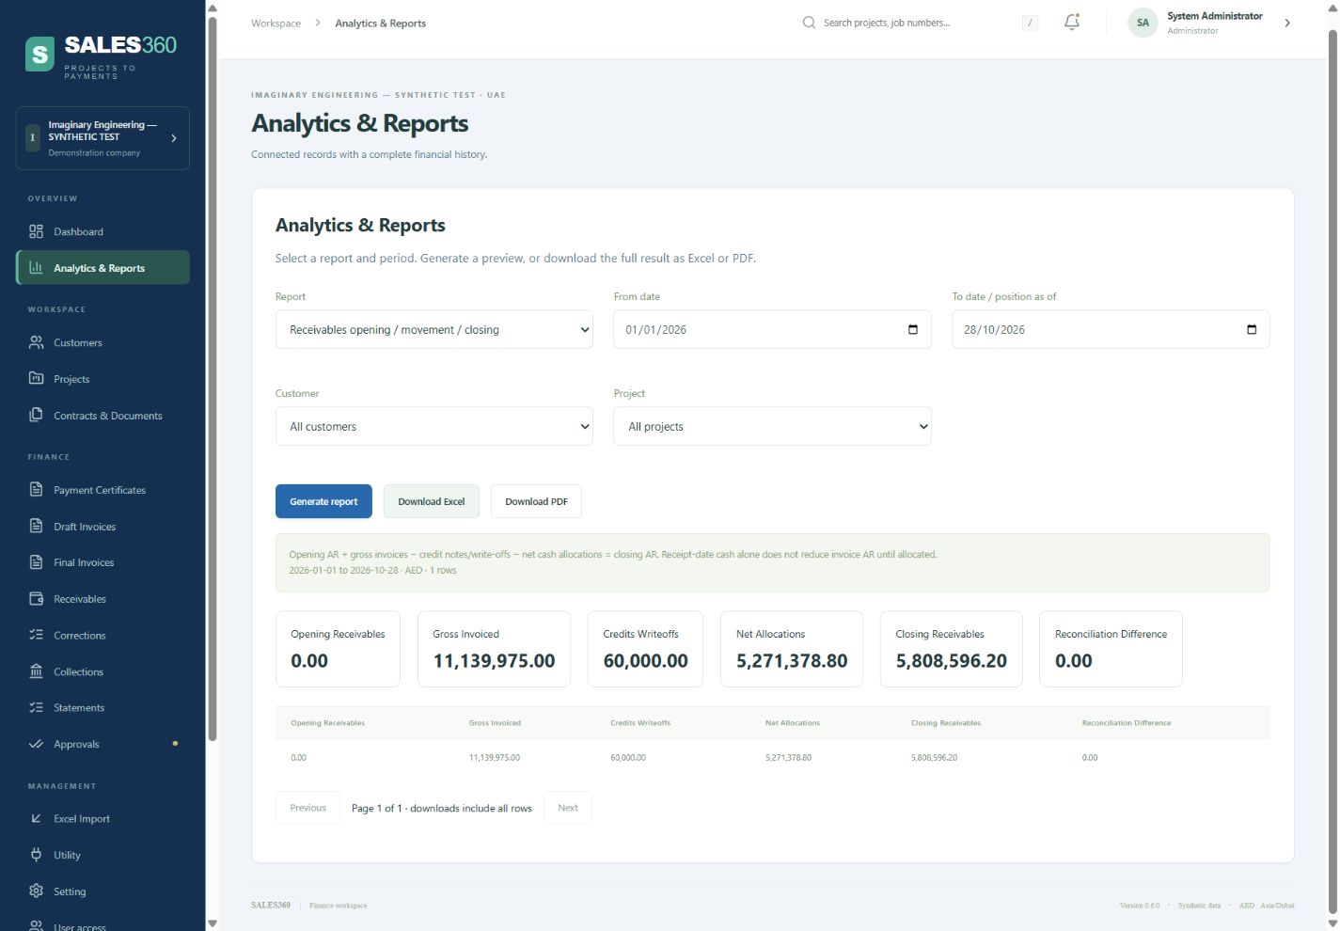
13 Analytics and exports
Report controls
Period, customer and project filters
Ageing, outstanding, cash, sales and movement
Full Excel and PDF exports with the date and accounting basis
SALES360
16
Notes:
Source: C:\Users\Chittaranjan.Behera\Documents\SALES360LAC\SALES360_Codex_Master_Prompt.md
Relevant sections: 11; AC-13.
Source: C:\Users\Chittaranjan.Behera\Documents\SALES360LAC\Version 2\Release 0.6.0\TEST-REPORT.md
Source: C:\Users\Chittaranjan.Behera\Documents\SALES360LAC\apps\api\Analytics.cs
Release 0.6.0 has nine management reports. Their bases differ deliberately: closing AR at period end, receipt-date customer cash, allocation-date project cash. The screenshot shows synthetic data and a zero AR movement reconciliation difference. It is product evidence, not a complete performance test.
Visual source: C:\Users\Chittaranjan.Behera\Documents\SALES360LAC\docs\evidence\reports060.png

Slide 17
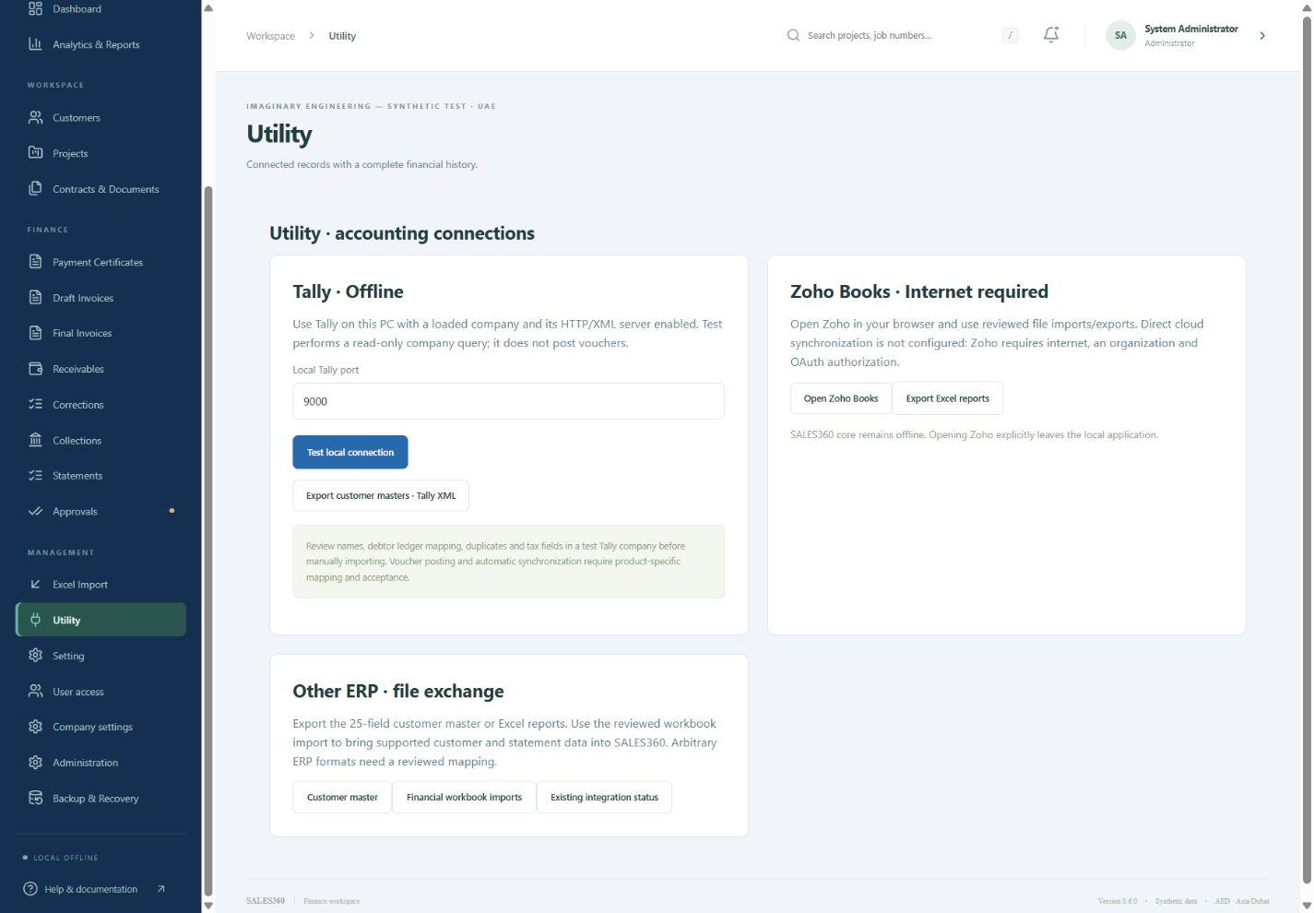
14 Utility and external systems
Tally
Local company query and reviewed customer XML exchange
Zoho and other ERP
File exchange now. Cloud sync needs connectivity, authorization and reconciliation tests.
SALES360
17
Notes:
Source: C:\Users\Chittaranjan.Behera\Documents\SALES360LAC\SALES360_Codex_Master_Prompt.md
Relevant sections: 12, 13, 14.
Source: C:\Users\Chittaranjan.Behera\Documents\SALES360LAC\Version 2\Release 0.6.0\TEST-REPORT.md
Source: C:\Users\Chittaranjan.Behera\Documents\SALES360LAC\apps\api\SupportTools.cs
Current capability: local read-only Tally company query and basic customer master XML. Actual Tally mapping/version acceptance and voucher sync remain pending. Zoho supports a web link/file exchange, not configured live OAuth synchronization. Outlook offers a reviewed reset-link draft handoff. These do not require external API credentials for the offline core.
Visual source: C:\Users\Chittaranjan.Behera\Documents\SALES360LAC\docs\evidence\utility060.png

Slide 18
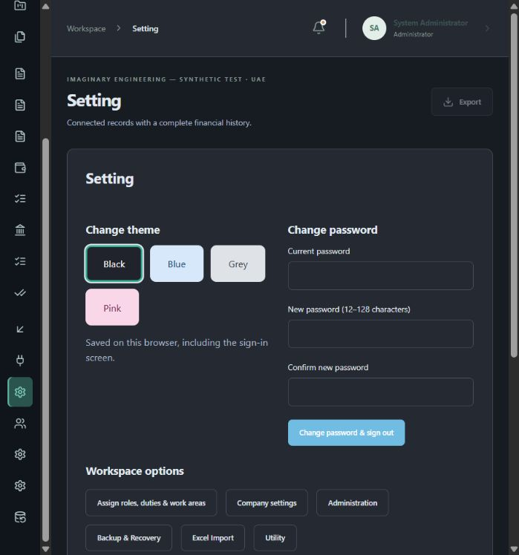
15 Settings and support
Appearance and access
Black, blue, grey and pink themes
Password change and assigned roles/work areas
Recovery and diagnostics
One-use reset-link drafts
File integrity and local database checks
Safe repair with troubleshooting advice
SALES360
18
Notes:
Source: C:\Users\Chittaranjan.Behera\Documents\SALES360LAC\SALES360_Codex_Master_Prompt.md
Relevant sections: 3, 13, 15, 16.
Source: C:\Users\Chittaranjan.Behera\Documents\SALES360LAC\Version 2\Release 0.6.0\TEST-REPORT.md
Source: C:\Users\Chittaranjan.Behera\Documents\SALES360LAC\installer\windows\SALES360.py
Current settings include four themes, current-password change with session revocation, Administrator role assignment links, recovery mailbox, diagnostics and safe repair. Repair checks stable program files and recreates transient folders. It does not change ledger records, keys or original documents. Sending a recovery email needs a configured client and connectivity. Reset links are local to the SALES360 PC.
Visual source: C:\Users\Chittaranjan.Behera\Documents\SALES360LAC\docs\evidence\settings060-black.png

Slide 19
16 Automated tests and test data
Synthetic dataset | Count
Customers / projects | 100 / 100
Posted invoices | 400
Allocated receipts | 275
53
release regression scenarios
11
additional dataset checks
Expected AR: AED 6,331,658.00 - 3,027,838.00 = 3,303,820.00
SALES360
19
Notes:
Source: C:\Users\Chittaranjan.Behera\Documents\SALES360LAC\SALES360_Codex_Master_Prompt.md
Relevant sections: 20; AC-01 through AC-22.
Source: C:\Users\Chittaranjan.Behera\Documents\SALES360LAC\Version 2\Release 0.6.0\TEST-REPORT.md
Source: C:\Users\Chittaranjan.Behera\Documents\SALES360LAC\Version 2\Test Data - 100 Customers\TEST-REPORT.txt
Evidence: 28 release regression scenarios plus 18 workflow scenarios and 7 correction scenarios, or 53 grouped checks in release 0.6.0. The separate 100-customer fixture has 11 executed import/reconciliation checks and a restart check. These do not establish all 22 acceptance criteria or the proposed 100k-record/25-business-session load target.

Slide 20
17 Backup and Windows packaging
01
Backup and restore
Stop the application, back up the complete record and restore into isolation.
02
Bundle dependencies
Include Python, .NET, PostgreSQL, PDF libraries and prerequisites.
03
Package the release
Produce the EXE, portable ZIP, source, BAT tools and operating guide.
04
Verify the artifact
Check manifests, hashes, optional icon, repair and retained data.
Current installer is unsigned. Independent clean-PC acceptance remains open.
SALES360
20
Notes:
Source: C:\Users\Chittaranjan.Behera\Documents\SALES360LAC\SALES360_Codex_Master_Prompt.md
Relevant sections: 16, 19; AC-20, AC-21.
Source: C:\Users\Chittaranjan.Behera\Documents\SALES360LAC\Version 2\Release 0.6.0\TEST-REPORT.md
Source: C:\Users\Chittaranjan.Behera\Documents\SALES360LAC\installer\windows\SALES360.py
The release includes bundled runtimes, EXE/portable packages, source and BAT tools. Current encrypted local backups use Windows DPAPI and require the same identity/machine. Cross-machine disaster recovery needs additional work. Exact local EXE tests verified library checks, icon opt-in/out, repair/tamper detection, startup and uninstall preserving separate data.

Slide 21
18 Installation and user acceptance
01
Version and location
Select the latest package and a new empty program folder.
02
Startup and identity
Verify the installed version, shortcuts and Administrator sign-in.
03
Business walkthrough
Import the fictional dataset and reconcile reports with its controls.
04
Acceptance record
Record the Windows environment, defects, retest results and owner approval.
Keep program files, release packages and business data in separate locations.
SALES360
21
Notes:
Source: C:\Users\Chittaranjan.Behera\Documents\SALES360LAC\SALES360_Codex_Master_Prompt.md
Relevant sections: 19, 20, 21.
Source: C:\Users\Chittaranjan.Behera\Documents\SALES360LAC\Version 2\Release 0.6.0\TEST-REPORT.md
Recommended operator acceptance steps. Recent diagnosis showed an old 0.5.0 installer and a default program folder containing only leftover cache, with no recognized installation marker. The installer correctly rejects an unrelated/nonempty folder. The outer Completed window alone does not establish application installation. Use an empty program folder or a recognized existing installation, with business data separate.

Slide 22
Current release and remaining acceptance
Area | Locally implemented/tested | Still required
Identity and masters | First owner, roles, areas, 25 customer fields | Project scopes, delegation, MFA/SSO
Finance and reporting | Certificates, bounded corrections, AR, exports | Advanced accounting and policy acceptance
Documents | PDF retention, certificate/statement output | OCR and statutory invoice/credit PDFs
Integrations | Tally test/XML, offline email draft handoff | Actual vendor tests and live cloud sync
Operations | Local install, repair, backup and restore tools | Clean PC, security/load tests, recovery across machines
0.6.0 remains an unsigned evaluation release
SALES360
22
Notes:
Source: C:\Users\Chittaranjan.Behera\Documents\SALES360LAC\SALES360_Codex_Master_Prompt.md
Relevant sections: 20, 21.
Source: C:\Users\Chittaranjan.Behera\Documents\SALES360LAC\Version 2\Release 0.6.0\TEST-REPORT.md
Source: C:\Users\Chittaranjan.Behera\Documents\SALES360LAC\Version 2\Test Data - 100 Customers\TEST-REPORT.txt
Status snapshot through 28 October 2026. Use the evidence level shown. Local tests and controlled integration stubs are not external production acceptance. This table summarizes material remaining scope rather than every backlog item.

Slide 23
Production completion plan
Priority | Owner | Required evidence
Finance policies and statutory documents | Finance + developer | Approved rules and correct document cases
OCR and document workflow | Developer + document owner | Scanned sources, review and decision tests
Vendor integrations | Integration owner + provider | Sandbox reconciliation and failure recovery
Independent acceptance | QA + security + IT | Clean PC, authorization and measured workload
Recovery and go-live sign-off | IT + Finance + project owner | Restore evidence, user acceptance and handover
SALES360
23
Notes:
Source: C:\Users\Chittaranjan.Behera\Documents\SALES360LAC\SALES360_Codex_Master_Prompt.md
Relevant sections: 14 through 21.
Source: C:\Users\Chittaranjan.Behera\Documents\SALES360LAC\Version 2\Release 0.6.0\TEST-REPORT.md
Recommended remaining work order, not a committed schedule. Each business owner must approve the evidence for their area. Integration work depends on actual product/provider setup and authorization. Final handover includes source, migrations, manuals, release notes, signed artifacts when available and a tested recovery runbook.

