Slide 1

GRADUATION PROJECT · SWE492
Double Exposure
Darkroom Studio
A browser-based, AI-assisted kiosk for double exposure photography — entirely client-side, no backend.
Presented by Omar Shanaa
Supervisor Prof. Dr. Fadi Al-Turjman
Near East University · Faculty of Engineering · Department of Software Engineering

Slide 2







OVERVIEW
Agenda
01
02
Problem
Objectives
03
04
Technology
Architecture
05
06
Challenges
Results
Double Exposure Darkroom Studio
02 / 11

Slide 3




CHAPTER 1 · PROBLEM
Why a new tool?
Too complex
Hard to deploy
Photoshop-level skill required
Installs, accounts, cloud
Browser freezing
Camera limits
Heavy work blocks the UI
Secure-context only
Double Exposure Darkroom Studio
03 / 11

Slide 4

CHAPTER 2 · OBJECTIVES
Objectives
Client-side, no backend
AI subject segmentation
Responsive, no freezing
Ten blend modes
Cinematic effects
QR phone upload
Live camera capture
PNG / JPG / WEBP export
Double Exposure Darkroom Studio
04 / 11

Slide 5





CHAPTER 3 · TECHNOLOGY
Technology stack
Core
HTML5 · CSS3 · Vanilla JavaScript
Processing
Canvas · Web Workers · OffscreenCanvas
AI
MediaPipe Selfie Segmentation
Real-time
Ably Realtime channels
Support
ImgBB · QR codes · http.server
Double Exposure Darkroom Studio
05 / 11

Slide 6



CHAPTER 4 · ARCHITECTURE
Architecture
Fully client-side — the browser is both interface and rendering engine.
Main Thread
Web Worker
Smartphone
UI & interaction
OffscreenCanvas
Scan QR
MediaPipe
→
Blend modes
→
Upload
Camera
Effects
Transfer
QR / Ably
Final image
No contact
AI segmentation runs on the main thread — MediaPipe is not fully Web Worker compatible.
Double Exposure Darkroom Studio
06 / 11

Slide 7

CHAPTER 4 · RENDERING
Rendering pipeline
1
›
2
›
3
›
4
›
5
›
6
›
7
Grayscale
AI Mask
Blend
Effects
Grain
Vignette
Output
Runs inside a Web Worker — the interface never freezes, even during high-resolution compositing.
Double Exposure Darkroom Studio
07 / 11

Slide 8



CHAPTER 5 · CHALLENGES
Key challenges
Main-thread blocking
Fix: Web Workers + OffscreenCanvas
MediaPipe cold start
Fix: Downsampling + fallback mask
Camera security
Fix: localhost + ?lanip= parameter
Ably sync issues
Fix: Random IDs + sessionStorage
Double Exposure Darkroom Studio
08 / 11

Slide 9



CHAPTER 6 · RESULTS
Results
1–3 s
300–800 ms
10
0
Standard render
AI segmentation
Blend modes
Backend servers
No backend · AI-assisted · Phone upload · Real-time
Modern browsers can run advanced, AI-driven multimedia entirely on the client side.
Double Exposure Darkroom Studio
09 / 11

Slide 10
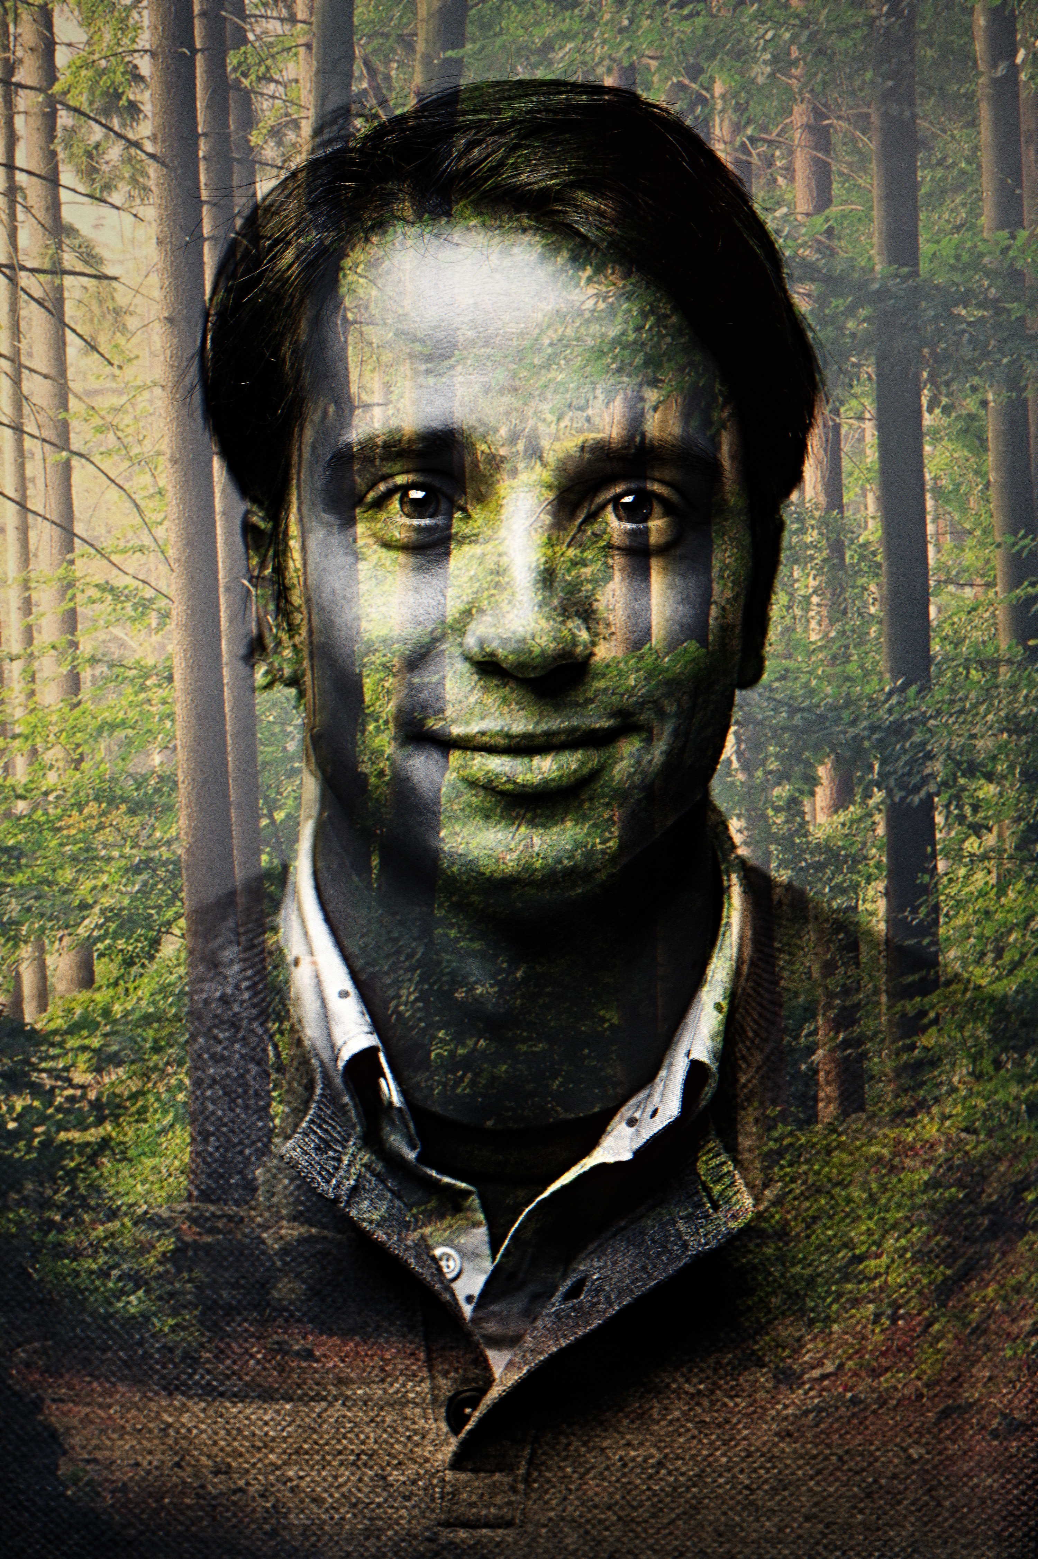
CHAPTER 6 · RESULTS
Example output
Portrait merged with a forest scene — rendered entirely in the browser.
RENDER DETAILS
Portrait ✕ Forest
BLEND MODE
AI SEGMENTATION
RENDER TIME
Multiply + Screen
MediaPipe Selfie
~2.1 s
EFFECTS APPLIED
Grain
Vignette
Grayscale
Soft Mask
The subject is preserved by the AI mask while the forest texture fills the silhouette — producing a single composition where person and landscape become inseparable.
Double Exposure Darkroom Studio
10 / 11

Slide 11



CHAPTER 7 · CONCLUSION
Conclusion
A lightweight, browser-native, AI-assisted kiosk that produces professional double exposure artwork with no backend.
FUTURE WORK
Offline AI bundling
PWA integration
Multi-layer compositing
Wider browser support
Thank you — questions welcome.

