Slide 1

Development of digital networking for preventive and predictive environmental and climatic warning solutions - Building an Entrepreneurial ecosystem for addressing Environmental Issues
Funded by Ministry of Electronics & Information Technology (MeitY), Govt. of India
Duration- 3 Years | Budget Overlay: 298.66 Lakhs
PRSG MEETING - III
Joint Proposal
Dr. AJAY KUMAR
Adi Shankara
Institute of Engineering and Technology
Kalady, Ernakulam, Kerala
Dr. M N MURALIDHARAN
Center For Materials For Electronics Technology
Mulagunnathukavu, Thrissur, Kerala

Slide 2
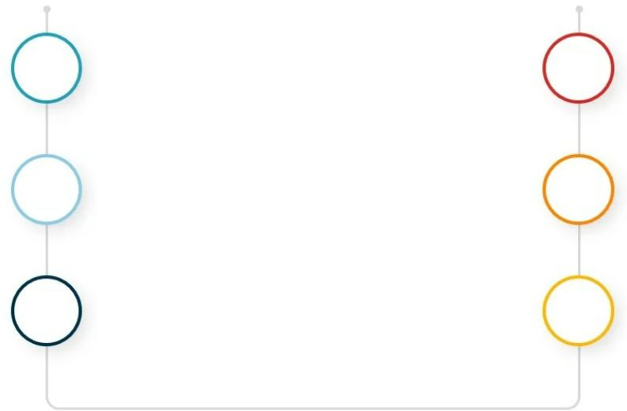
Outline
01
Project Overview
06
Works Completed & Action Plan
02 Timeline and Deliverables
05
Financial Progress
03
Outcomes
04
Technical Progress
2

Slide 3
Overview of Proposed System
Development of Digital networking for preventive and predictive environmental and climatic warning solutions
Explainable AI based analysis
software
I
Intelligent sensor module for monitoring and managing environmental pollution
II
Smart water level monitoring solution with an associated alert for floods.
Digital system that effectively monitors and distributes drinking water in the local area
III
Start-up ecosystem and skill development
3

Slide 4
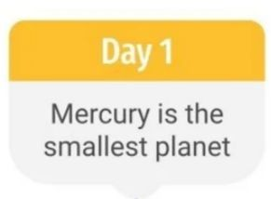
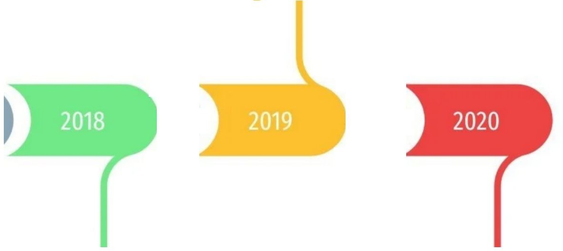
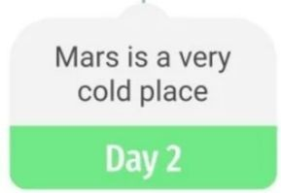
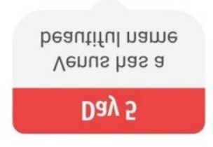
Timeline & Deliverables
(B) Flood alert
system,
(c) Smart Water supply system
Design and deployment of User Interface.
Deploying Explainable AI to the model and Testing
Intelligent IoT
solution
1st Year
2nd Year
3rd Year
Deploying the project, Monitoring and Evaluation
Entrepreneurial ecosystem and skill development
Developing a design plan, Database building, Training and Equipment procuring.
Building the project
Intelligent IoT solution
IPR, ToT
Start-Ups
(A) Environment Monitoring
Entrepreneurial Ecosystem
7

Slide 5
Technical Progress
Processes
LSTM-based flood forecasting model for river level prediction
Integrated machine learning techniques to forecast AQI.
9

Slide 6
Technical Progress
Products
Deployed 2 AQM stations (v2&v3), capable of sensing PM2.5, PM10, SO2, NH3, CO, O3, NO2, Pressure, Temperature and Humidity.
Web-based application for real-time AQI monitoring and health risk assessment
Developed Weather Station v1 and a draft web page to showcase key weather parameters
including rainfall, wind speed, wind direction, temperature, humidity, and pressure.
10

Slide 7
Outcomes (1st Mar 2025 to 30 ^{th} Sep 2025)
Deployed AQM station(v2&v3) , capable of sensing PM2.5, PM10, SO2, NH3, CO, O3, NO2, Pressure, Temperature and Humidity.
Deployed Outdoor LoRa Gateway for communicating with Sensor nodes
A1
Hardware Development
A2
Web Development & User Interface
Deployed real-time Air Quality Index (AQI) monitoring system(airaware.it.com)

Slide 8
Outcomes (25th May 2024 to 28th Feb 2025)
A3
Software / AI Development
Indigenous Sensor Development
8

Slide 9
Outcomes (1st Mar 2025 to 30 ^{th} Sep 2025)
Collected responses from residents of flood-prone areas in Kalady
Researched existing flood prediction technologies and ongoing studies in water flow monitoring and control to identify effective strategies for managing flood risks.
B1
Literature Review and Field Survey
B1
Indigenous
Hardware Design and Prototype development
Developed Weather Station v1&v2 and a draft web page to showcase key weather parameters including rainfall, wind speed, wind direction, temperature, humidity, and pressure.
B2
B3
Developed a comprehensive LSTM neural network system for real-time river level forecasting at target location-Kalady, integrating multi-source data from dam operations, rainfall, and historical measurements to deliver accurate 6-hour ahead predictions.
B3
Exploration of AI Algorithms
B4
9

Slide 10
Outcomes (1st Mar 2025 to 30th Sep 2025)
Conducted 7 Workshops benefitting 316 Students.
Conducted a 15 day intensive Summer Internship program benefitting 49 students providing hands on training and conducted a project exhibition and distributed prizes.
Six month Internship program benefitting 9 interns.
Research Outputs:
1 paper communicated
2 papers presented
D1
IP & Skill development in IoT solutions

Slide 11
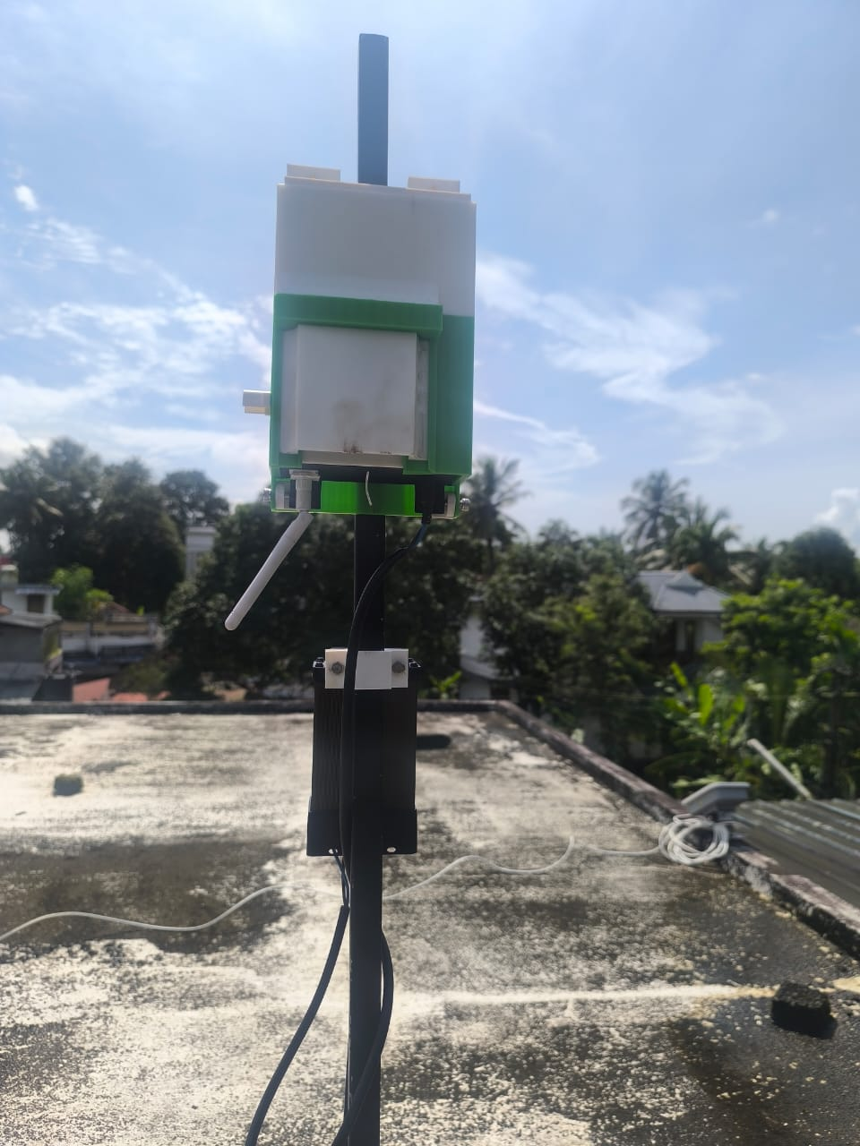
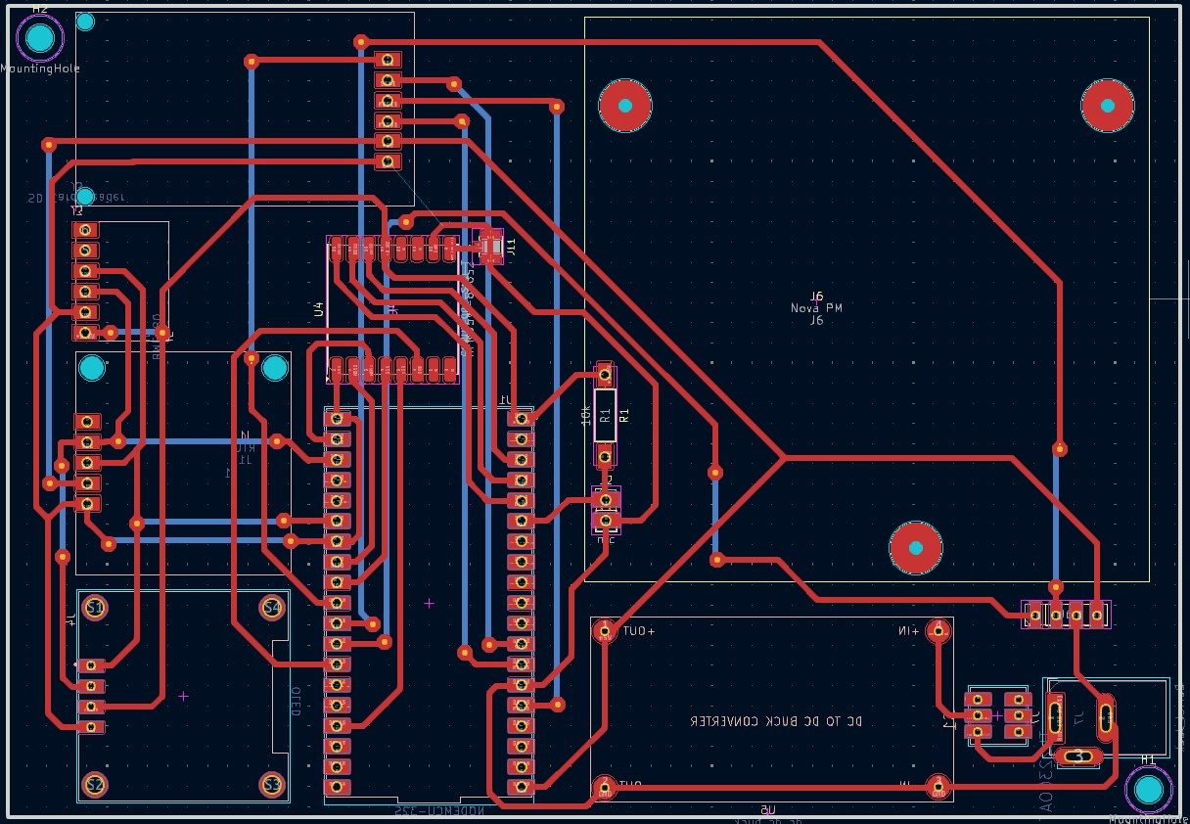
AQM v3
Hardware Design and Prototype development
Expanded Sensing: It now measures key pollutant gases PM₂.₅, PM₁₀ using high-precision laser dispersion sensors and standard weather data.
Temperature Sensing: Utilizes NTC thermistor provided by CMET for accurate and reliable temperature measurements.
Constant Connection: We added a dual LoRa and cellular (GSM) system, so it has a backup connection to ensure no data is ever lost.
Rugged Build: The entire system is housed in a compact, IP65 weatherproof case with a 24+ hour battery to handle power cuts.

Slide 12
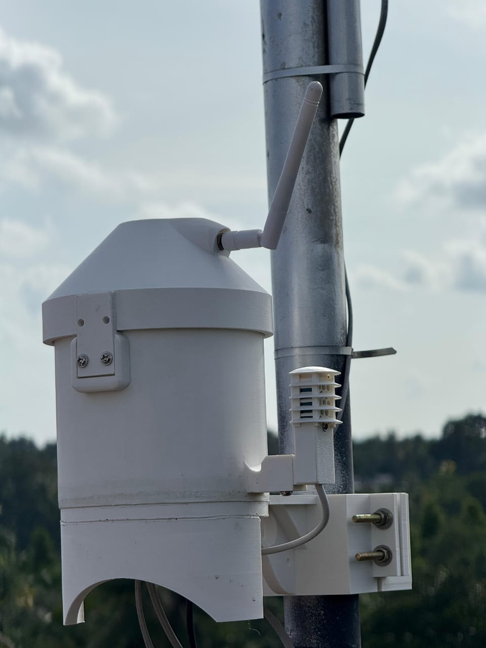
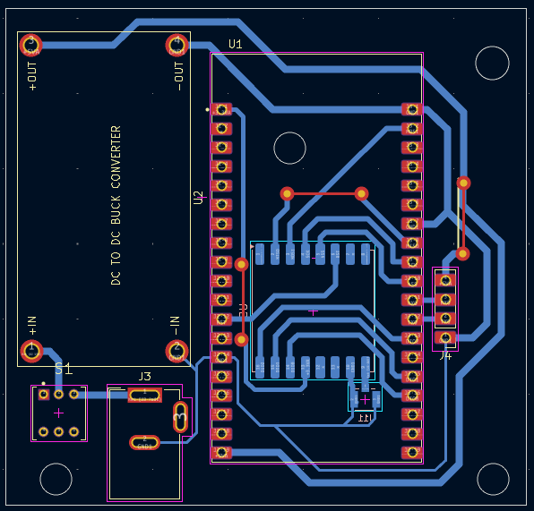
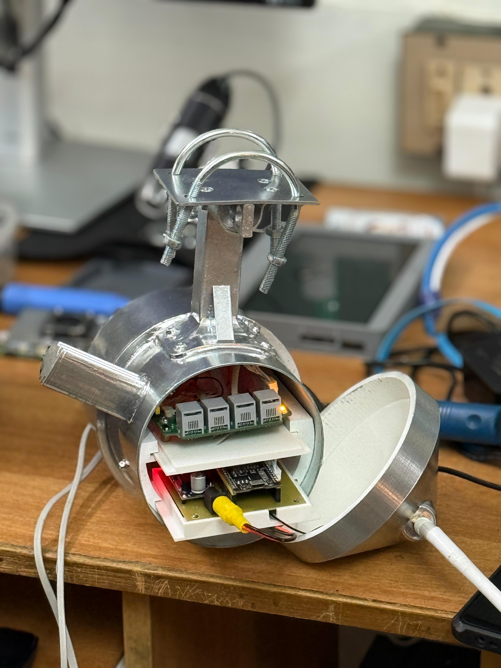
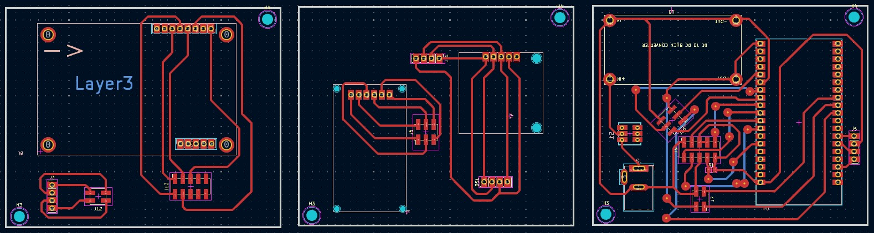
AWS v1 & AWS v2: Field-Ready Meteorological Stations
Comprehensive Sensing & Data Integrity
Core Metrics: Measures temperature, humidity, wind speed, wind direction, and rainfall.
Onboard Systems: Features an RTC for precise timestamping, local storage for data redundancy, and an OLED display for on-site diagnostics.
Robust Design for Autonomous Operation
Dual Connectivity: Equipped with both LoRaWAN and GSM modules, featuring automatic network failover.
Uninterrupted Power: Includes a high-capacity UPS backup supply for operational continuity.
All-Weather Durability: Housed in a rugged, IP67-rated waterproof enclosure built to withstand monsoon conditions.
AWS v1
AWS v2

Slide 13
PREDICTING WATER LEVELS 6 HOURS AHEAD USING DEEP LEARNING FOR NEELESWARAM, KERALA
The Challenges
6-Hour Prediction
Accurate river level forecasting up to 6 hours in advance for flood prevention
Multi-Source Data
Integrating dam operations, rainfall patterns, and historical river measurements
Real-Time Operation
Continuous data updates and instant predictions for emergency response

Slide 14
Data Sources & Architecture
Why LSTM Networks?
Dam Operations
Water levels and release rates from upstream dam facilities
Long-Term Memory:Captures complex temporal dependencies in water flow patterns over extended periods
Rainfall Data
Precipitation measurements from upstream weather stations
Multi-Variable Input:Processes multiple data streams simultaneously for comprehensive analysis
River Levels
Historical water level measurements from Neeleswaram monitoring station
Sequence Prediction:Excels at forecasting future values based on historical sequences
Real-Time Ready:Optimized for continuous operation with streaming data updates
Temporal Patterns
Seasonal, daily, and hourly patterns for comprehensive forecasting

Slide 15
Data Quality Pipeline
LSTM Network Architecture
Raw Data Ingestion
Multi-source data collection from sensors and monitoring stations
Input Layer
24-hour sequences of multivariate time series data
1
LSTM Stack
3 stacked layers: 128→64→32 units with memory cells
Quality Checks
Missing value imputation and outlier detection algorithms
2
Feature Engineering
Temporal alignment and transformation for model input
Dense Layers
Fully connected layers with dropout regularization
3
Prediction Ready
Processed data fed into LSTM network for forecasting
Output
6-hour ahead river level predictions
4

Slide 16
Training Configuration
100
Max Epochs
With early stopping
Optimization Strategy
Adam optimizer with 0.001 learning rate
Adaptive learning rate scheduling
Early stopping to prevent overtraining
Dropout layers for regularization
100
Max Epochs
With early stopping
32
Batch Size
Training samples
Data Split
Training: 60% of historical data
Validation: 20% for model tuning
Testing: 20% for final evaluation

Slide 17
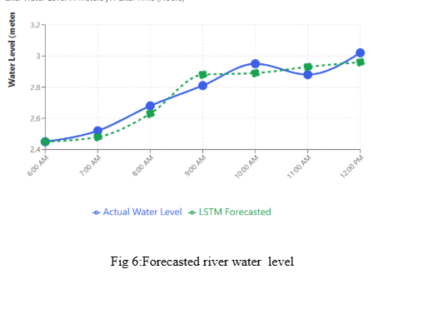
Results
MAE(Mean Absolute Error)
0.09
RMSE
(Root Mean Square Error)
0.3
R²
(Coefficient of Determination)
0.8

Slide 18
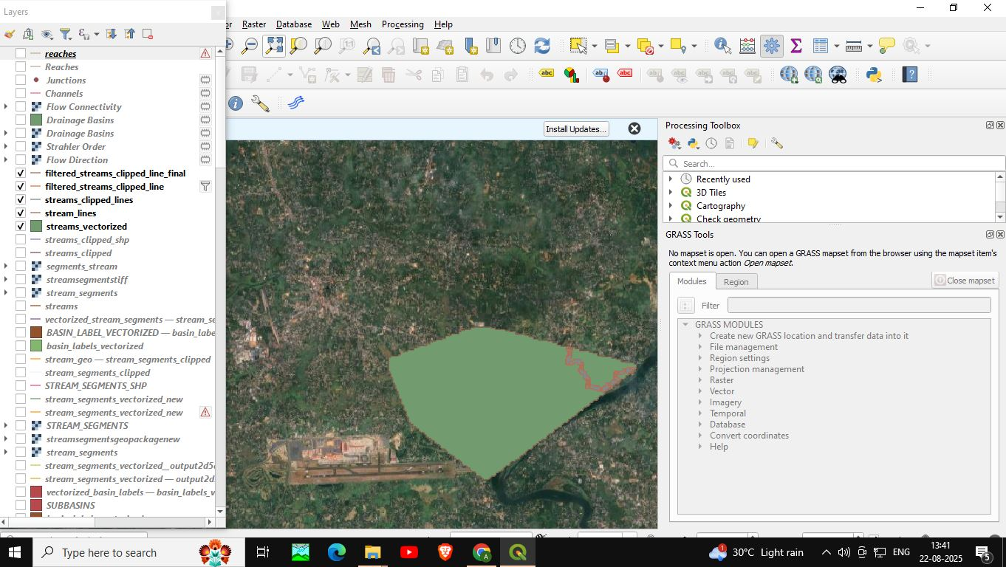
HYDROLOGICAL MODELLING FOR FLOOD FORECASTING USING HEC-HMS AND QGIS
For the Kalady region, flood forecasting was carried out using the HEC-HMS model with inputs prepared in QGIS. A DEM derived from USGS SRTM data was processed to delineate the watershed and subbasins. Using QGIS tools as shown Figure.1, stream networks and reaches were extracted and clipped to the Kalady boundary to provide basin inputs for HEC-HMS.
Figure. 1: Clipped Kalady from QGIS with layers

Slide 19
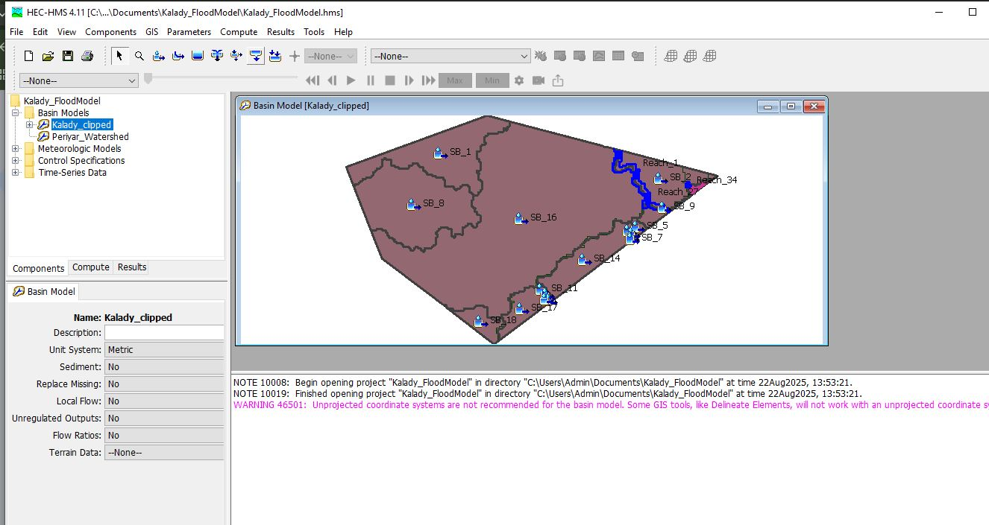
The Basin Model in HEC-HMS shows subbasins (SB_1, SB_2, etc.) as shown in Figure.2, and their corresponding reaches, representing how rainfall from each area contributes to streamflow.
Figure.2: Basin Model

Slide 20
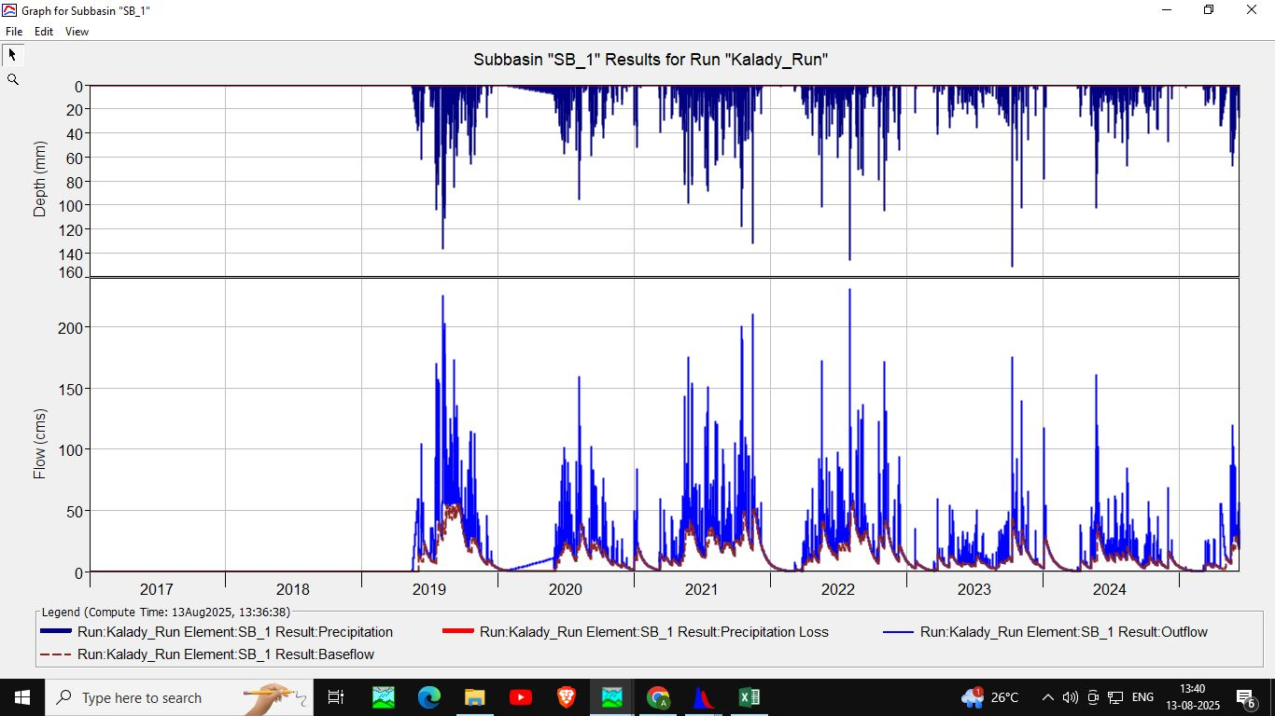
Simulations produced hydrographs and time-series tables that describe rainfall, losses, runoff, baseflow, and peak discharge values as shown in Figure. 3-6. These outputs help identify when and where peak flows occur, supporting early warning and flood management decisions in Kalady.
Together, the maps, graphs, and tables provide a clear picture of when, where, and how much water flows through the watershed, enabling the identification of peak flows and supporting effective flood forecasting and management strategies for Kalady.
Figure.3: Hydrographs

Slide 21
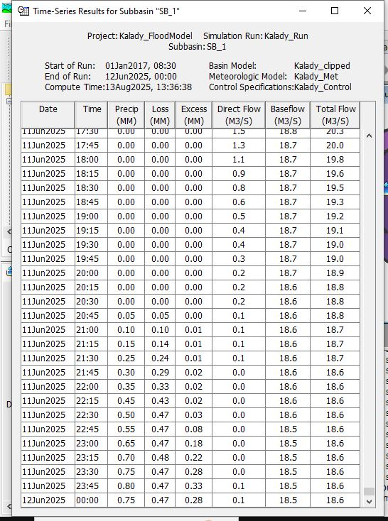
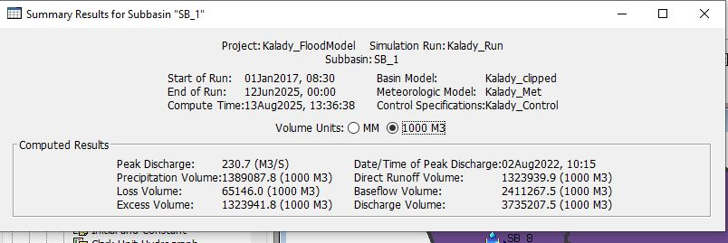
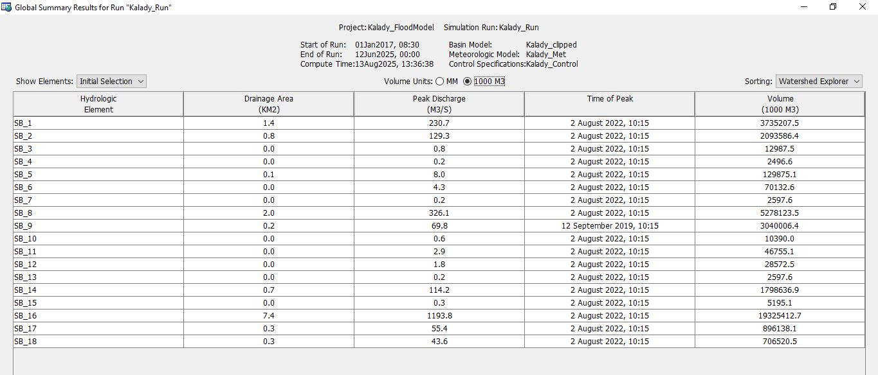
Figure. 5: Summary Results for Subbasin “SB_1”
Figure.6: Global Summary Results
Figure. 4: Time-Series Results for Subbasin “SB_1”

Slide 22
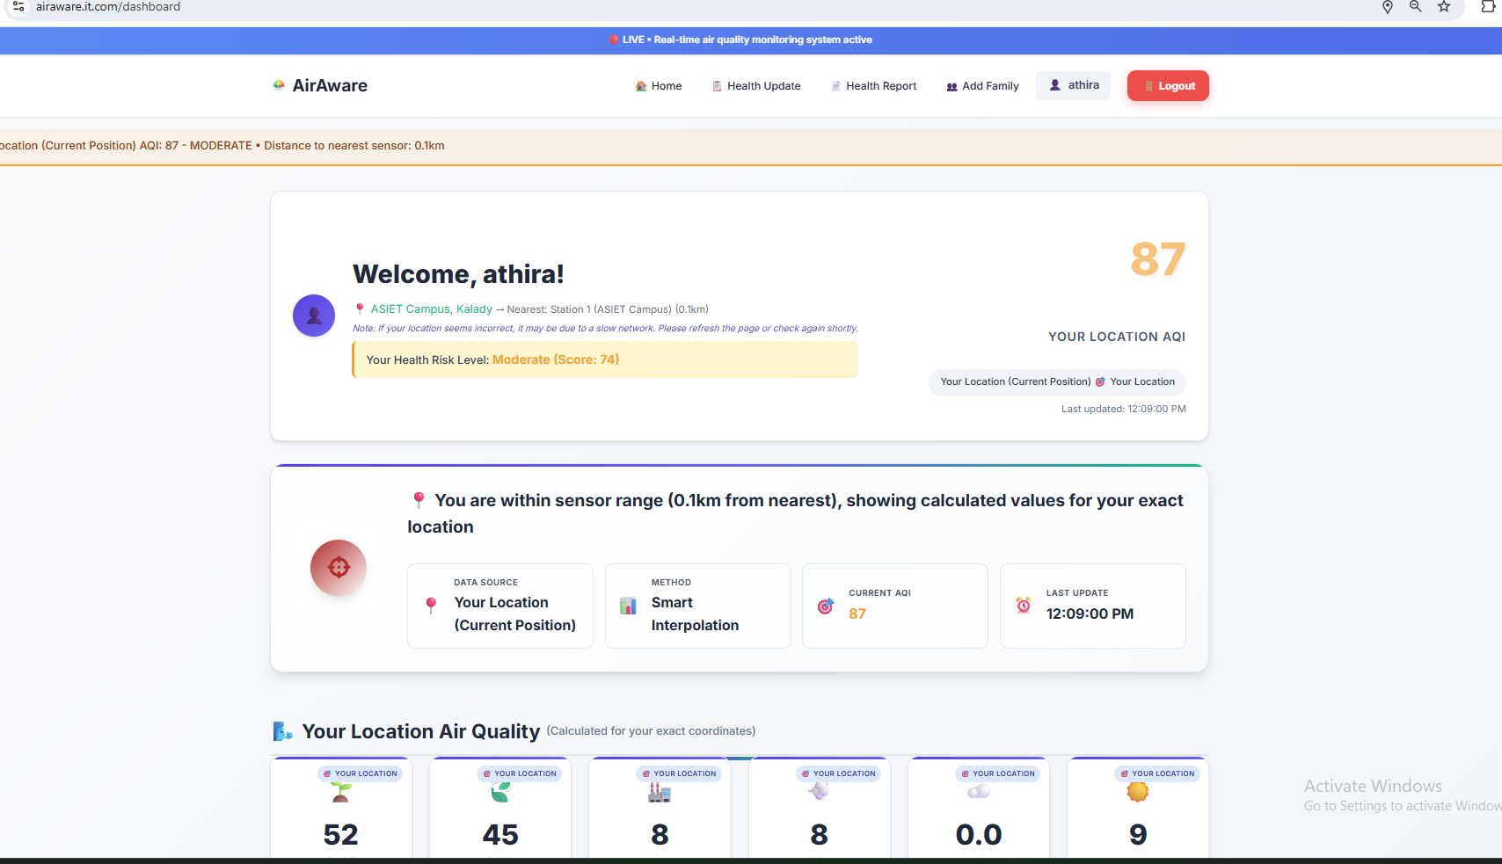
Web Application
1.Air Quality Monitoring System – AirAware (🌐 https://airaware.it.com)
Displays live air quality data collected from IoT-based environmental sensors..
Predicts air quality trends for the next 4 days using advanced machine learning.
Detects the user’s current geolocation and calculates AQI using interpolation from nearby monitoring stations.
Provides personalized health risk assessments and recommendations based on the user’s current AQI.
Publicly deployed on Render at https://airaware.it.com for global access and real-time updates.
Fig 7:Air Quality Monitoring User Profile Page

Slide 23
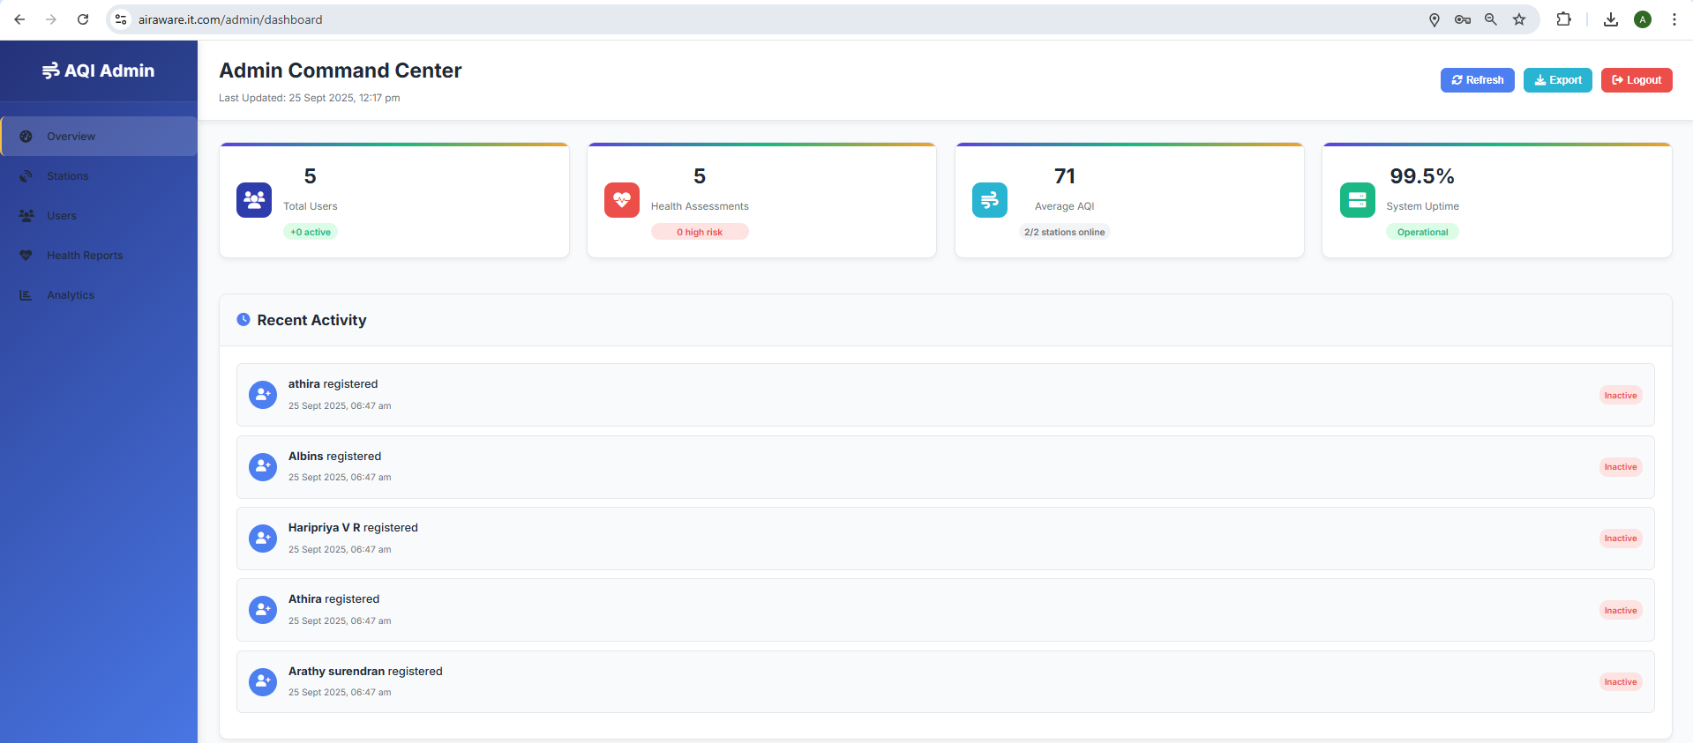
Admin Features
User Management – Admin can view, manage, and update all registered user details.
Health Assessments – Admin has access to health risk assessment records of users.
Real-Time Monitoring – Admin can track real-time air quality parameters from all connected sensors.
Activity Logs – Admin can monitor logged-in users and their system activities.
Fig 8: Admin Control & Monitoring Panel
AirAware Mobile Application
Developed a Flutter application replicating the AirAware web system, offering real-time AQI monitoring, AI-based 4-day forecasts, and personalized health insights.
The app is in development, aiming to extend AirAware’s web functionalities to mobile devices for wider accessibility.

Slide 24
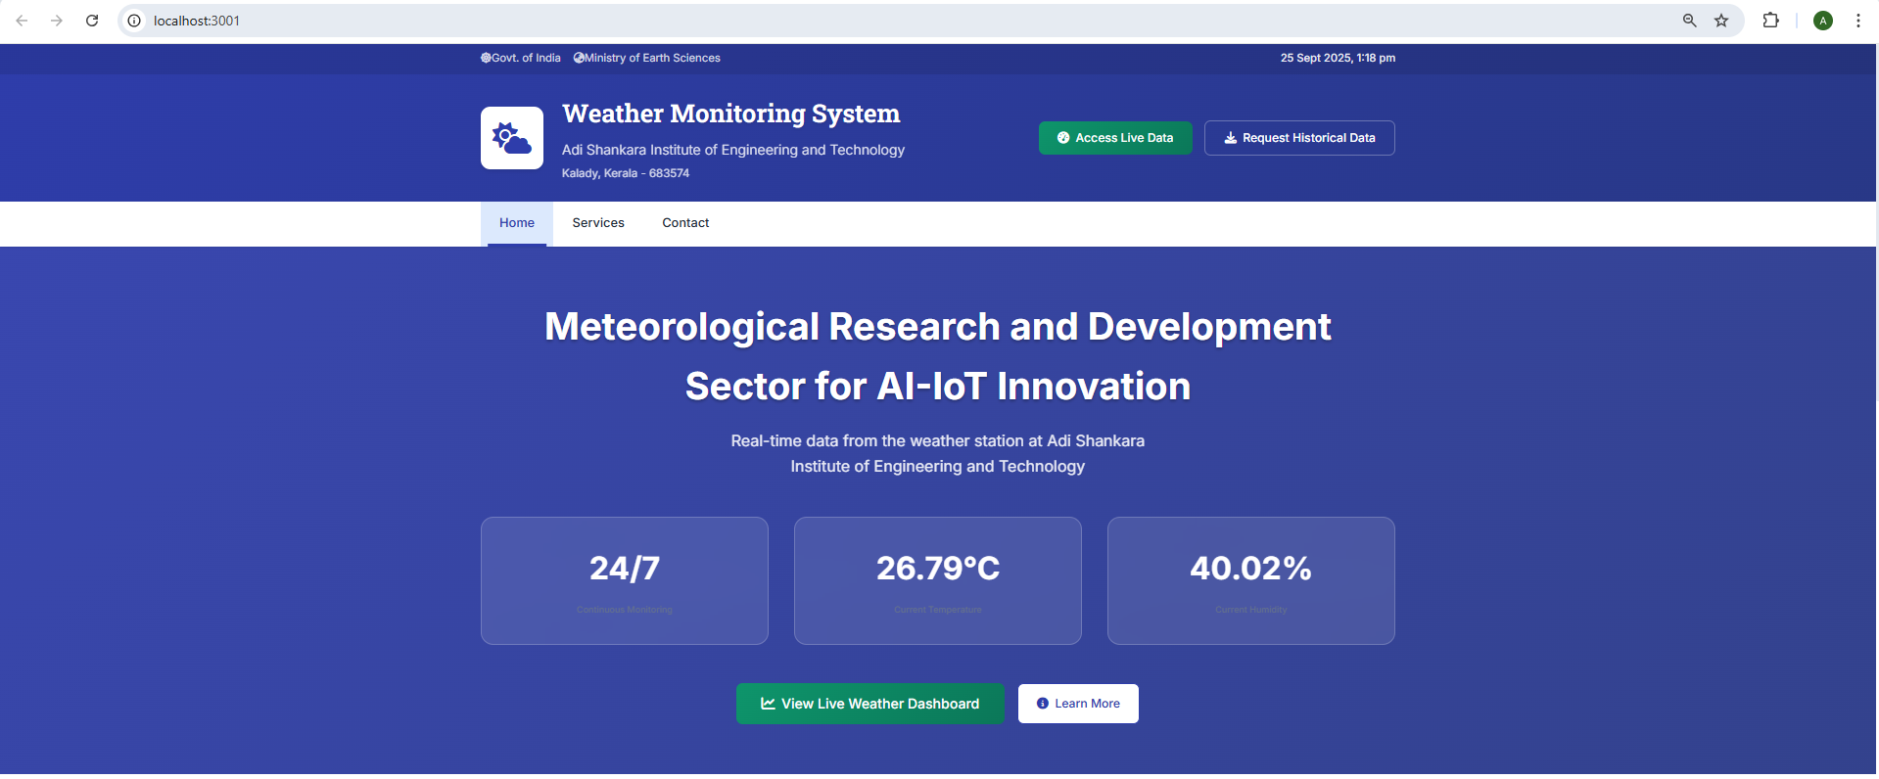
2.Weather Monitoring System Overview
The system collects data from multiple weather stations in real time.
It monitors key parameters such as temperature, humidity, pressure, wind speed, and rainfall.
Historical Data Management
Stores past weather records.
Allows users to view trends.
Enables downloading datasets for offline analysis.
Fig 9:Live Weather Monitoring Portal

Slide 25
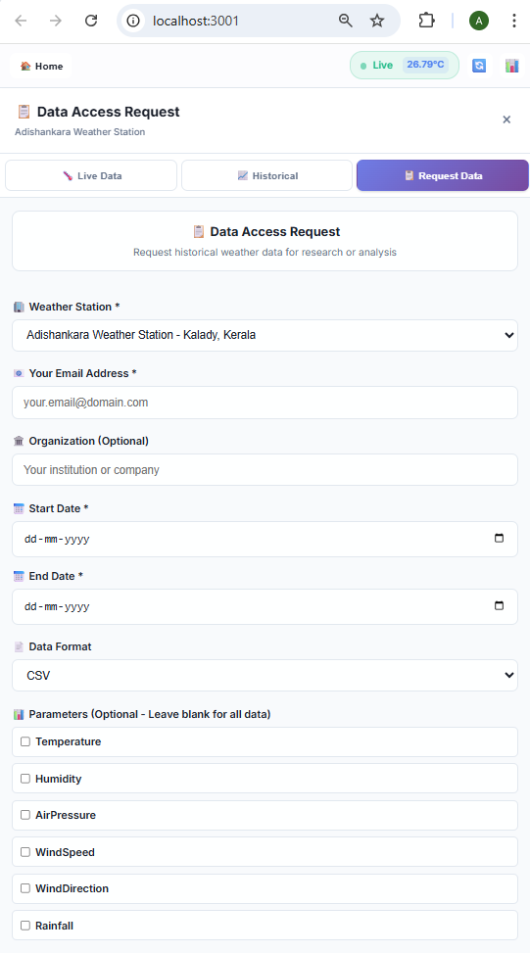
Data Request & Delivery
Users can request specific historical weather data.
Requests are verified by administrators
Approved data is automatically emailed in CSV format.
Benefits of the System
Provides reliable weather insights for researchers, students, and decision-makers.
Combines real-time updates, historical data, and secure delivery for easy and accurate information use.
Fig 10:User Weather Data Request Process

Slide 26
CENTER FOR AI-IOT INNOVATION: KEY ACHIEVEMENTS (MARCH - SEPTEMBER 2025)
I. Impact & Reach
Total Participants: Over 450 students and faculty trained across various programs.
Internship Program Success: Trained 9 interns who, in turn, independently conducted training sessions, demonstrating a successful "learn-to-teach" model.
II. Research Achievements
Published: “Comparative Analysis of RNN Models for Air Pollution Forecasting” – ICICDS 2025
Communicated: “A Comparative Analysis of Conventional Methods for Sensor-Driven Spatial Interpolation for Air Quality Monitoring” – Engineering, Technology & Applied Science Research (ETASR
Accepted for Presentation: “AI-Based Environmental Pollution Monitoring with Personalized Health Risk Assessment” – Second International Conference on Security, Surveillance and Artificial Intelligence (ICSSAI-2025)

Slide 27
III. Core Training Programs
Program Title | Type | Duration | Dates | Participants | Key Focus Areas
IoT Impression – Arduino & Raspberry Pi | Hands-on Workshop | 1 Day | March 19, 2025 | 40 Participants | Foundational understanding and practical skills in Arduino and Raspberry Pi.
Electronic Prototyping & IoT Solutions | Summer Internship | 15 Days | June 2 - 24, 2025 | 49 Students (9 Teams) | Microcontrollers, PCB Design, IoT Development, culminating in a Project Expo.
IoT Powered Robotics: ESP8266 to Raspberry Pi | Workshop | 3 Days | June 25 - 27, 2025 | 37 Participants | Integrating ESP8266 and Raspberry Pi for smart, connected robotic systems.
Technical Workshop on IoT-Powered Robotics | Faculty Development Programme (FDP) | 3 Days | June 25 - 27, 2025 | Faculty, Staff, Scholars | Enhancing expertise in leveraging ESP8266 and Raspberry Pi for robotic control.
IoT Prototyping and PCB Design | Value-Added Course | 4 Days | July 1 - 4, 2025 | S3 EEE Students | Hands-on with IoT Hardware, Embedded Systems, and KiCad for PCB Design.
Edge Hardware Design: Prototyping and PCB Workshop | Comprehensive Workshop | 10 Days | July 7 - 17, 2025 | 84 Students | Advanced IoT Prototyping and professional PCB Design for Edge Computing.
Edge Hardware Design: IoT Prototyping and PCB Workshop | Value-Added Course | 8 Days | July 7 - 14, 2025 | 94 Students | Intensive, hands-on training in Embedded Systems, Arduino programming, and KiCad PCB Design.
Embedded System and Digital Design | Workshop | 5 Days | July 16 - 21, 2025 | 51 Participants | Fundamentals of Embedded Systems and Digital Design principles.
Raspberry Pi Workshop | Hands-on Workshop | 1 Day | September 11, 2025 | Students | Practical skills in GPIO programming, Computer Vision, and OpenCV (hand gesture control).

Slide 28
MINUTES OF THE PREVIOUS PRSG MEETING, SUGGESTIONS, AND ACTIONS TAKEN
Suggestions from PRSG committee | Action taken
The PRSG recommended that the systems and modules under development be appropriately benchmarked, with due attention given to their calibration and validation. The Committee further requested the C-MET's support in facilitating the validation and standardisation processes. | Had discussion with C-MET regarding Calibration and Validation of systems developed.
The PRSG urged the team to uphold data quality by incorporating real-time data acquisition and expanding the dataset, thereby enhancing the system’s overall efficacy and reliability. | Acquired Dam water level and release data from the upstream - Bhoothathankettu Dam and also collected the upstream rainfall data.
C-MET informed that the internal gas calibration at C-MET available at its facility can be made accessible to ASIET for use in the project. | Had discussion with C-MET regarding internal gas calibration facility available at C-MET.
The Committee recommended extending the monitoring duration to ensure the acquisition of accurate and reliable data. | Have been collecting 1minute interval Air quality and Weather data and also regularly monitoring reliability of the received data.

Slide 29
Suggestions from PRSG committee | Action taken
PRSG told the team to strategically identify the locations where WMS has to be placed and finalise the locations at the earliest. | Have identified two upstream locations to the target location and deployed WMS at both the locations.
The PRSG also advised the team to assess and verify the impact of noise on the system’s performance. | Our in-depth analysis identified the root causes of data noise and measured its precise impact on performance, which directly guided our implementation of targeted corrective actions..
The Committee recommended that the team spend time in flood-prone regions such as Assam to gain a comprehensive understanding of the existing flood control mechanisms. This would enable the identification of potential areas where the project could contribute meaningfully, as well as assess the adaptability of current practices for integration into the project. | Visited and did Ground study in Assam and Kolkata.
The team informed the Committee that a company had expressed interest in the technology being developed under the project. The Committee recommended that any technology transfer be carried out on a non-exclusive basis, subject to prior presentation and approval by the PRSG. | Ongoing talks with the Company

