Slide 1
Eclipse Notes:
Abstract Syntax Tree
Hisashi Yoshida

Slide 2
Our usage
When we need "detailed" structure of Java code
  example: "nearest legal point"
May not fit if we only need class name, method name, field name etc.
  use Java Model instead
Limitations: AST currently does not support comment and ignores comments. (except Javadoc comments which is /** */)

Slide 3
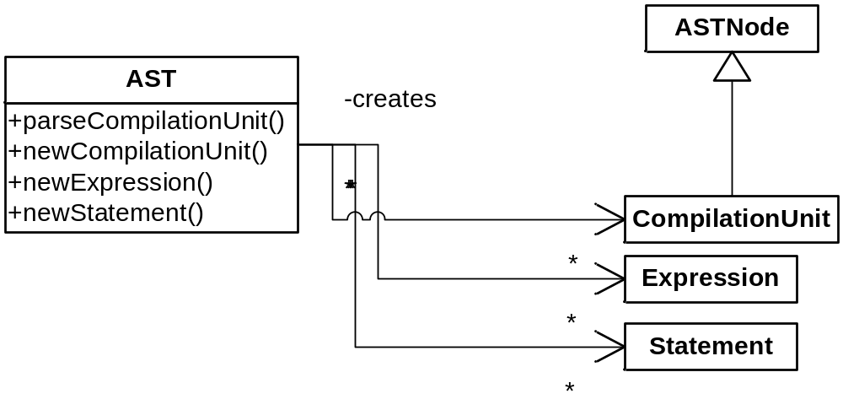
Creating Java constructs
"Factory" role
Motivation: hide details of creating ASTNode
To use, simply,
  Use parseCompilationUnit (or newCompilationUnit) method to create a CompilationUnit
  Then one can use factory methods provided in AST to create new ASTNode

Slide 4
Creating Java constructs
"Factory" role
Example
//After creating CompilationUnit from AST class, do:
PackageDeclaration packageDeclaration = ast.newPackageDeclaration();
packageDeclaration.setName(ast.newSimpleName("example"));
unit.setPackage(packageDeclaration);
ImportDeclaration importDeclaration = ast.newImportDeclaration();
QualifiedName name = ast.newQualifiedName(
ast.newSimpleName("java"),
ast.newSimpleName("util"));
importDeclaration.setName(name);
importDeclaration.setOnDemand(true);
unit.imports().add(importDeclaration);
...
//One ways to create a CompilationUnit: from scratch
AST ast = new AST();
CompilationUnit unit = ast.newCompilationUnit();
//Other way to create a CompilationUnit: existing class or java files
//example is from char[] obtained from document
CompilationUnit unit = AST.parseCompilationUnit(document.get().toCharArray());

Slide 5
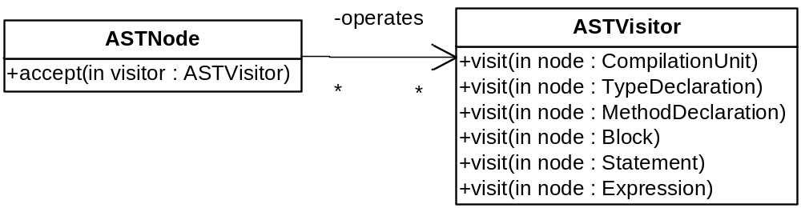
Analysis of the code
Using "Visitor"
Motivation: to add a function, developer needs to add a Visitor class (no modification to AST itself)
To analyze the ASTNode's,
  Develop a subclass of abstract class ASTVisitor
  Let it be a argument of accept method on the root ASTNode you wish to analyze

Slide 6
Analysis of the code
Using "Visitor"
ASTNode's implementation of accept()
ASTVisitor usage example
//CompilationUnit has accept method that accepts for its children
boolean visitChildren = visitor.visit(this);
if (visitChildren) {
// visit children in normal left to right reading order
acceptChild(visitor, getPackage());
acceptChildren(visitor, imports);
acceptChildren(visitor, types);
}
visitor.endVisit(this);
inside these, recursively there is visitor.visit(this)
ASTNode node = ...;
PositionSearchVisitor visitor = new PositionSearchVisitor(position);
node.accept(visitor);
visitor.getNearestNode(); //PositionSearchVisitor's method

Slide 7
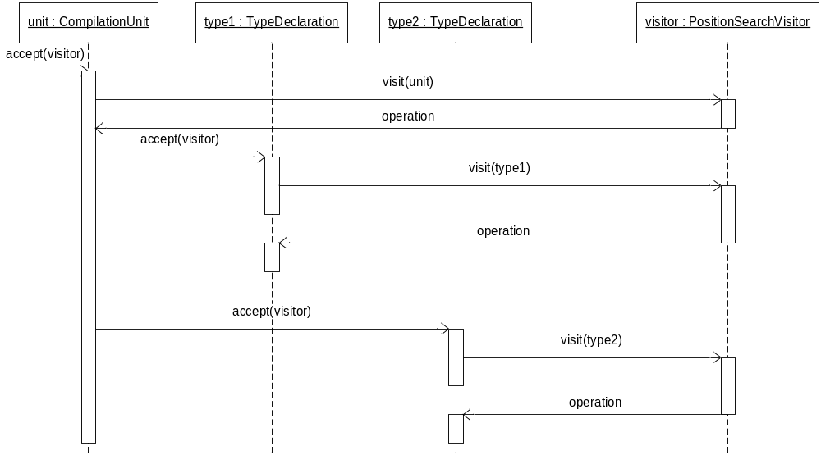
Analysis of the code
Using "Visitor"
Visitor sequence example

Slide 8
Eclipse Notes:
Java Model
Hisashi Yoshida

Slide 9
Our usage
Simpler and straightforward interface to use
Enough function if we only need class name, method name, field name etc.
  example: retrieving contextual information from code

Slide 10
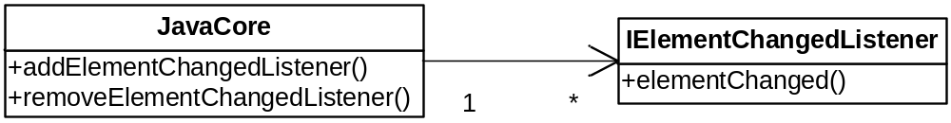
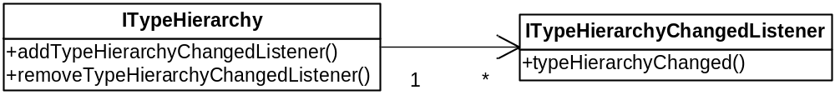
Hook when code is modified
Use "Observer/Observable"
To hook "element" change, use
To hook "type hierarchy" change, use

Slide 11
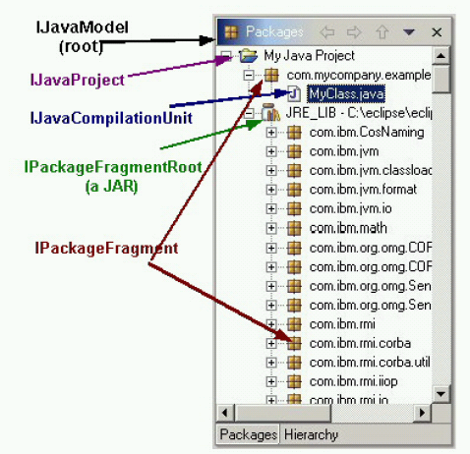
Traversing Java Elements
Use "composite" structure
Java model provides API for navigating Java element tree (All subtype of IJavaElement)
  The Java element tree represents projects in terms of Java-centric element types
    Package fragment roots
      project's source folders and JAR libraries
    Package fragments
      specific packages within a package fragment root
    Compilation units and binary classes
      Java source (*.java) and binary class (*.class) files

Slide 12
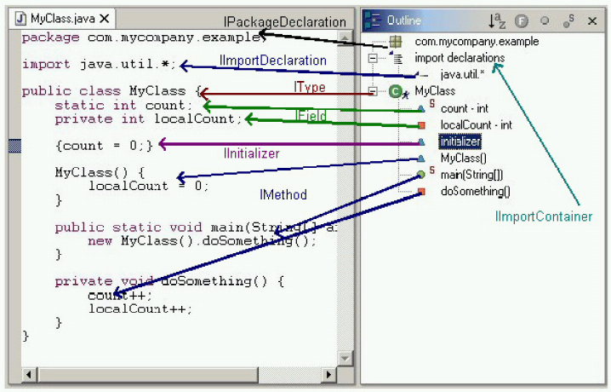
Traversing Java Elements
Use "composite" structure
Others
  Various types of Java declarations that appear within a compilation unit or class file
    Package declarations
    Import declarations
    Class and interface declarations
    Method and constructor declarations
    Field declarations
    Initializer declarations

Slide 13
Traversing Java Elements
Use "composite" structure
Retrieving JavaModel (the root object)
With IParent interface & IJavaElement
IWorkspace workspace = ResourcesPlugin.getWorkspace();
IJavaModel javaModel = JavaCore.create(workspace.getRoot());
if (parent.exists()) {
IJavaElement[] elements = parent.getChildren();
for (int i = 0; i < elements.length; i++) {
//use element[i]
}
}

