Slide 1
Training bits

Slide 2
outline
2d hld-ift scan (direct)
Experiment: characterization of unknown surfactant
Indirect scan
Mixtures/mixing
Dilution scans
…

Slide 3
Basic dripping experiment
Normal (dripping):
Aqueous phase dripped into oil phase
Inverse (floating):
Oil phase dripped into aqueous phase

Slide 4
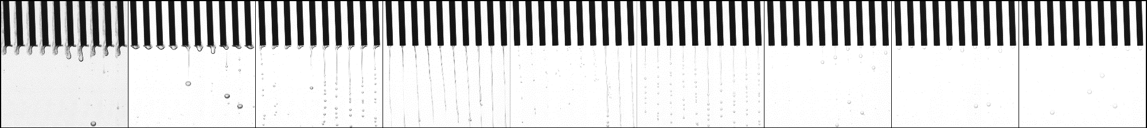
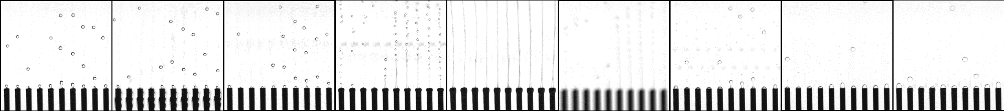
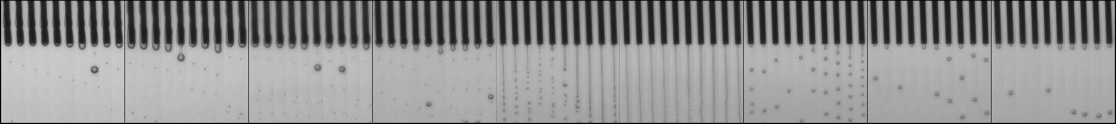
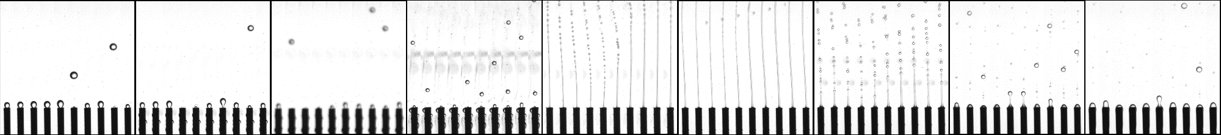
g/100mL NaCl
0.00
3.75
7.50
11.25
15.00
18.75
22.50
26.25
30.00
C7
5 g / 100 ml Ecosurf EH-3
C16

Slide 5
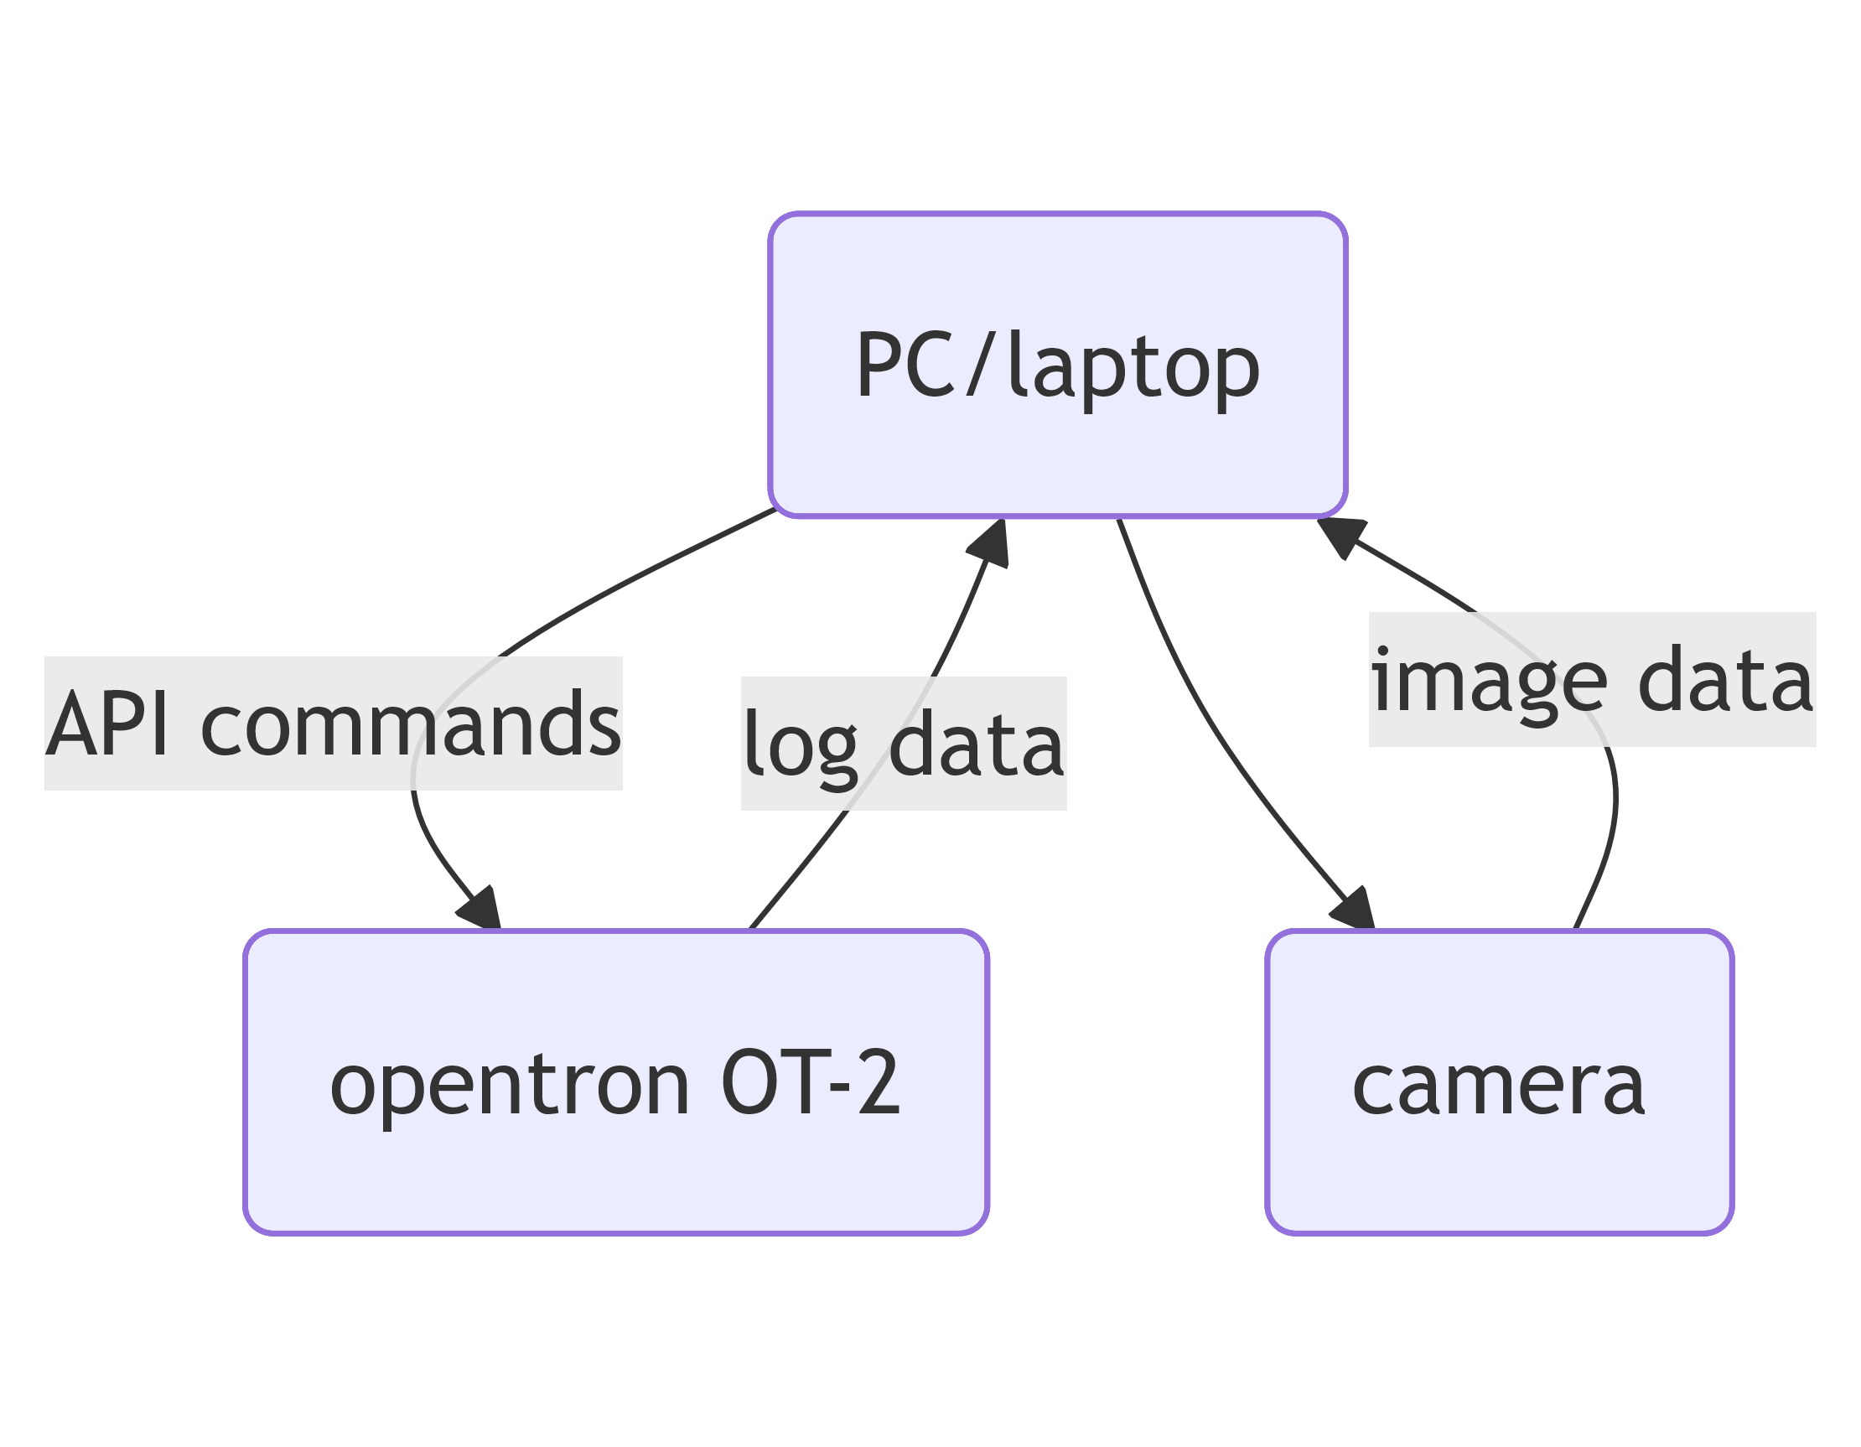
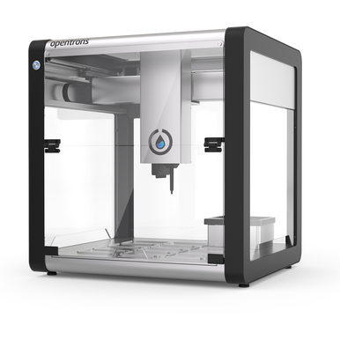
Setup
Format of API commands depend on OT-2 software version!!!
Updating OT-2 software might mean breaking hld-ift scripts …

Slide 6
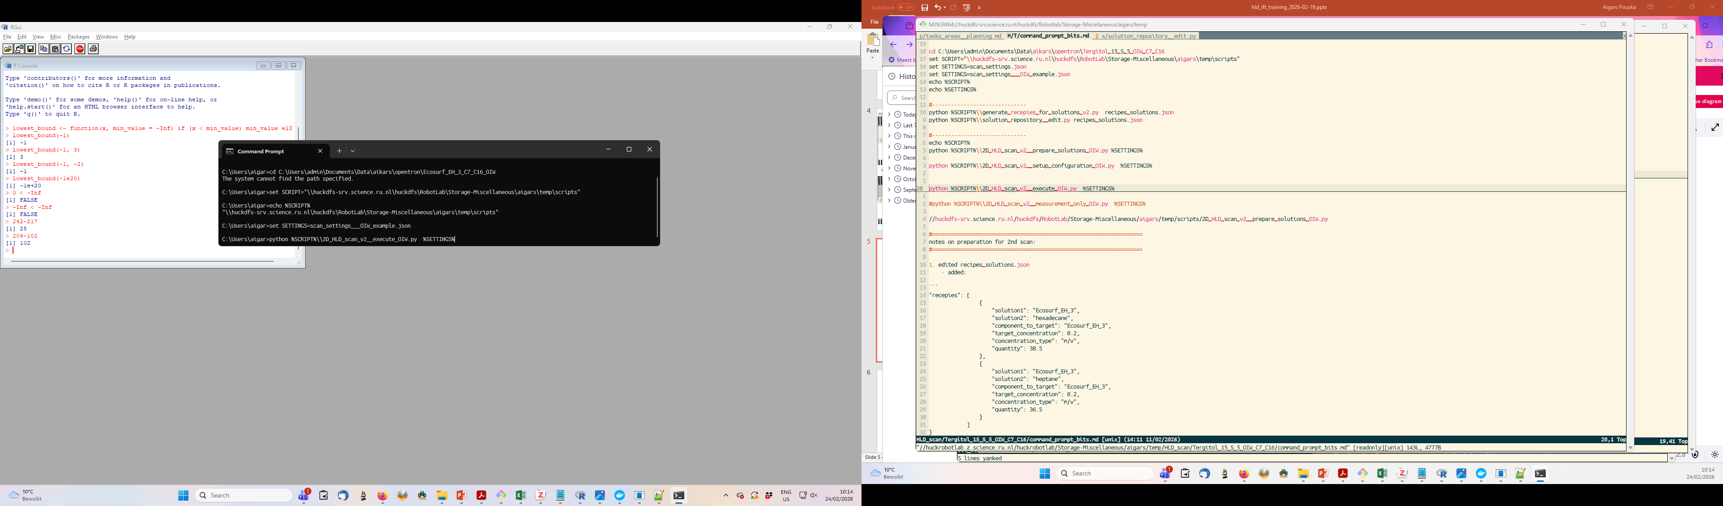
Running scripts on command line
Call python language
Extra parameters
(mostly a file with extra parameters)
Specify script to call

Slide 7
Direct 2D HLD-IFT scan

Slide 8
Outer stock
Inner stock
Slot 9
Slot 2
Opentron

Slide 9
Outer stock
Inner stock
Slot 9
Mix all combinations of
inner phase
Slot 2
Opentron

Slide 10
conc_0.00000
Outer stock
Inner stock
conc_0.02500
conc_0.50000
Mix 1st outer liquid in a cuvette
Test dripping w/ all inner solutions
conc_0.75000
Slot 9
conc_1.00000
Scan_001
Slot 2
Opentron

Slide 11
conc_0.00000
Outer stock
Inner stock
conc_0.02500
conc_0.50000
Repeat until all combination are done
conc_0.75000
Slot 9
conc_1.00000
Scan_001
Scan_002
Scan_003
Scan_004
Slot 2
Opentron

Slide 12
conc_0.00000
Outer stock
Inner stock
conc_0.02500
conc_0.50000
conc_0.75000
Slot 9
conc_1.00000
Scan_001
Scan_002
Scan_003
Scan_004
Slot 2
Opentron

Slide 13
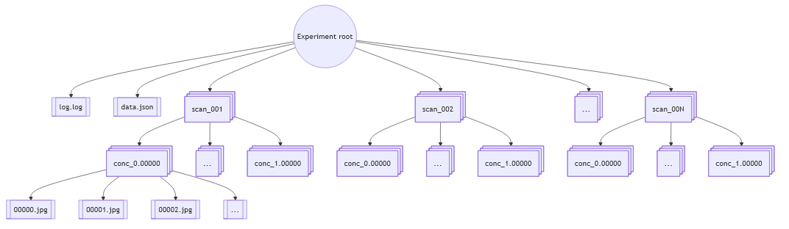
Anatomy of experiment data

Slide 14
Complete SOW experiment for `uncharacterized` surfactant

Slide 15
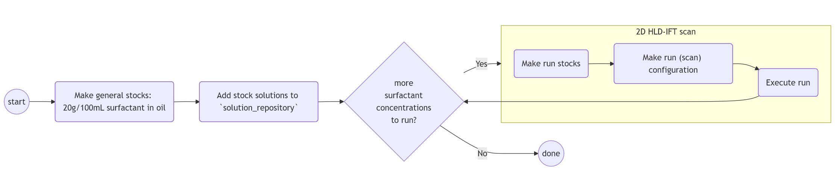
Experimental workflow: surfactant characterization
Notes:
flowchart TB
Z1((start))
Z2((done))
Z1 --> A(Make general stocks: 20g/100mL surfactant in oil) --> B(Add stock solutions to `solution_repository`)
B --> C{more<br>surfactant<br>concentrations<br>to run?}
C -->|No|Z2
subgraph exp [2D HLD-IFT scan]
direction TB
S1(Make run stocks)
S2("Make run (scan) configuration")
S3(Execute run)
S1 --> S2 --> S3
end
C -->|Yes|exp
S3 --> C

Slide 16
S
C7
S
C16
C7
C16
WT
Slot 9
Slot 2
Opentron

Slide 17
S
C7
S
C16
C7
C16
WT
Adjust surfactant concentration!
Run stock in C7
Run stock in C16
Slot 9
Washing solutions
Slot 2
Opentron

Slide 18
NaCl
Run stock in C7
All stocks: 12500 uL
2D HLD-IFT scan: starting config
DI WT
Slot 9
500 uL
1400 uL
Run stock in C16
Slot 2
Opentron

Slide 19
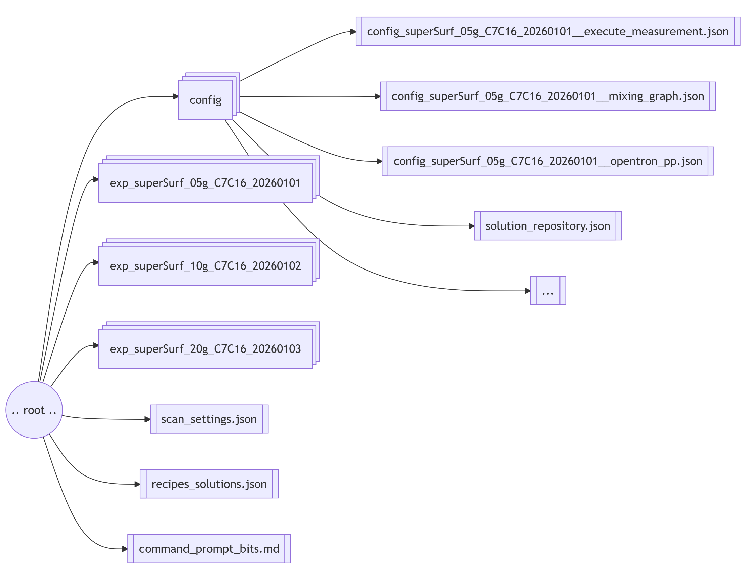
Experimental data: surfactant characterization

Slide 20
Inverse 2D HLD-IFT scan
Notes:
flowchart TB
A(Make general stocks: 20g/100mL surfactant in oil) --> B(Make run stocks, e.g. 5g/100mL)
B --> C(Make oil blends: 100/0, 80/20, .. , 0/100)
subgraph an_exp ["Set of experiments"]
direction LR
E1(Run experiment: 100/0, 80/20)
E2(Run experiment: 60/40, 40/60)
E3(Run experiment: 20/80, 0/100)
E1 --> E2
E2 --> E3
end
C --> an_exp

Slide 21
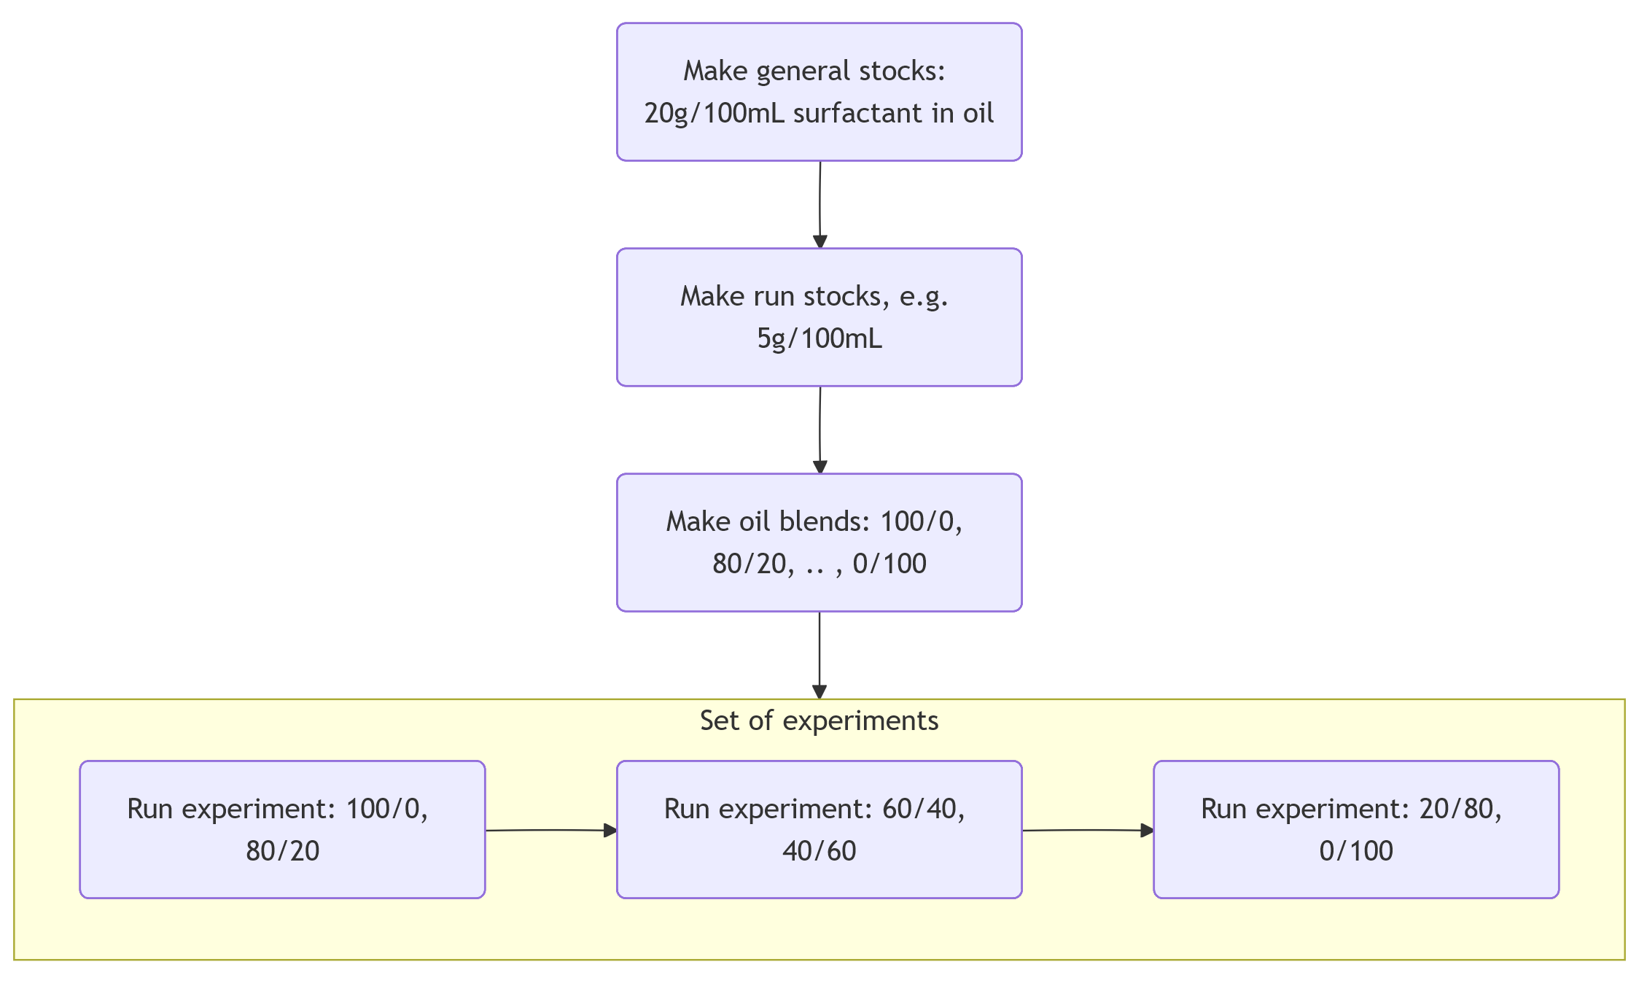
Inverse 2D HLD-IFT scan
Notes:
flowchart TB
A(Make general stocks: 20g/100mL surfactant in oil) --> B(Make run stocks, e.g. 5g/100mL)
B --> C(Make oil blends: 100/0, 80/20, .. , 0/100)
subgraph an_exp ["Set of experiments"]
direction LR
E1(Run experiment: 100/0, 80/20)
E2(Run experiment: 60/40, 40/60)
E3(Run experiment: 20/80, 0/100)
E1 --> E2
E2 --> E3
end
C --> an_exp

Slide 22
Outer stock
Slot 9
Inner stock
Slot 2
Opentron

Slide 23
Outer stock
conc_0.00000
Mix 1st outer liquid in a cuvette
Test dripping w/ 2 inner stocks
conc_1.00000
Scan_001
Slot 9
Inner stock
Slot 2
Opentron

Slide 24
Outer stock
conc_0.00000
conc_1.00000
Scan_001
Scan_002
Scan_003
Scan_004
Scan_005
Repeat until all combination are done
Slot 9
Inner stock
Slot 2
Opentron

Slide 25
Outer stock
conc_0.00000
conc_1.00000
Scan_001
Scan_002
Scan_003
Scan_004
Scan_005
Slot 9
Inner stock
Slot 2
Opentron

Slide 26
Inverse 2D HLD-IFT scan
Notes:
flowchart TB
A(Make general stocks: 20g/100mL surfactant in oil) --> B(Make run stocks, e.g. 5g/100mL)
B --> C(Make oil blends: 100/0, 80/20, .. , 0/100)
subgraph an_exp ["Set of experiments"]
direction LR
E1(Run experiment: 100/0, 80/20)
E2(Run experiment: 60/40, 40/60)
E3(Run experiment: 20/80, 0/100)
E1 --> E2
E2 --> E3
end
C --> an_exp

Slide 27
Surfactant stocks
S
C7
S
C16
C7
C16
C16
Slot 9
Neat oil stocks
Slot 2
Opentron

Slide 28
S
C7
S
C16
C7
C16
C16
Adjust surfactant concentration!
Run stock in C7
Run stock in C16
Slot 9
Washing solutions
Slot 2
Opentron

Slide 29
S
C7
S
C16
C7
C16
C16
Create oil blends
4:1
3:2
2:3
1:4
Run stock in C7
Run stock in C16
Slot 9
v(C7) : v(C16)
Washing solutions
Slot 2
Opentron

Slide 30
All stocks: 14500 uL
DI WT
NaCl
Inverse 2D HLD-IFT scan: starting config
Slot 9
Part 1
Part 2
Part 3
500 uL
1400 uL
All: 1400 uL
C7
4:1
3:2
2:3
1:4
C16
Slot 2
Part 1
Part 2
Part 3
Opentron

Slide 31
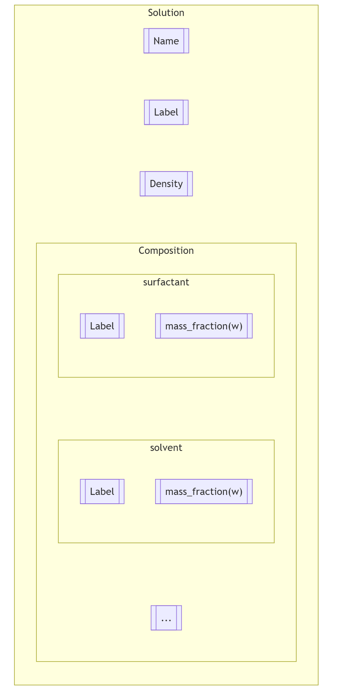
Mixture: how is it represented
Notes:
flowchart TB
subgraph Solution
direction TB
name[[Name]]
label[[Label]]
ro[[Density]]
subgraph Composition
direction TB
subgraph surfactant
direction TB
labelsurf[[Label]]
wsurf[["mass_fraction(w)"]]
end
subgraph compoundA [solvent]
direction TB
labelscA[[Label]]
wcA[["mass_fraction(w)"]]
end
compoundB[[...]]
surfactant ~~~ compoundA ~~~ compoundB
end
name ~~~ label ~~~ ro ~~~ Composition
end

Slide 32
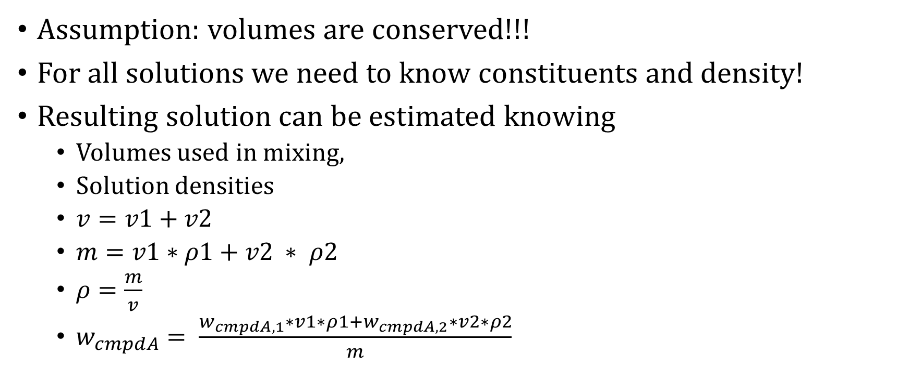
Mixing
Assumption: volumes are conserved!!!
For all solutions we need to know constituents and density!
Resulting solution can be estimated knowing
Volumes used in mixing,
Solution densities
$v=v1+v2$
$m=v1∗ρ1+v2 ∗ ρ2$
$ρ=\frac{m}{v}$
$w_{cmpdA}= \frac{w_{cmpdA,1}∗v1∗ρ1+w_{cmpdA,2}∗v2∗ρ2}{m}$

Slide 33
Settings

Slide 34
Scan settings
Are used explicitly in command line as an input to python scripts:
<give an example here>
Data on:
Input and output locations
Scan settings
Solutions to be made/used in a scan

Slide 35
`How to` section

Slide 36
Create recipe for stock solution
Run …
Output …

Slide 37
Add recipe to solution repository
Run …
Ouput …

Slide 38
Edit/create scan settings

Slide 39
Prepare run (scan) stocks [direct]

Slide 40
Slot 9
Slot 2
Opentron

Slide 42
Prepare auxiliary settings

Slide 43
Execute scan

Slide 44
Weird bits
Restart opentron every day or after 2 to 3 days
We have seen that api stops to respond for unknown reason

