Slide 1

Windows Environment Variables
Understanding how Windows stores, manages, and uses dynamic system values — and why every developer and power user should know them.

Slide 2
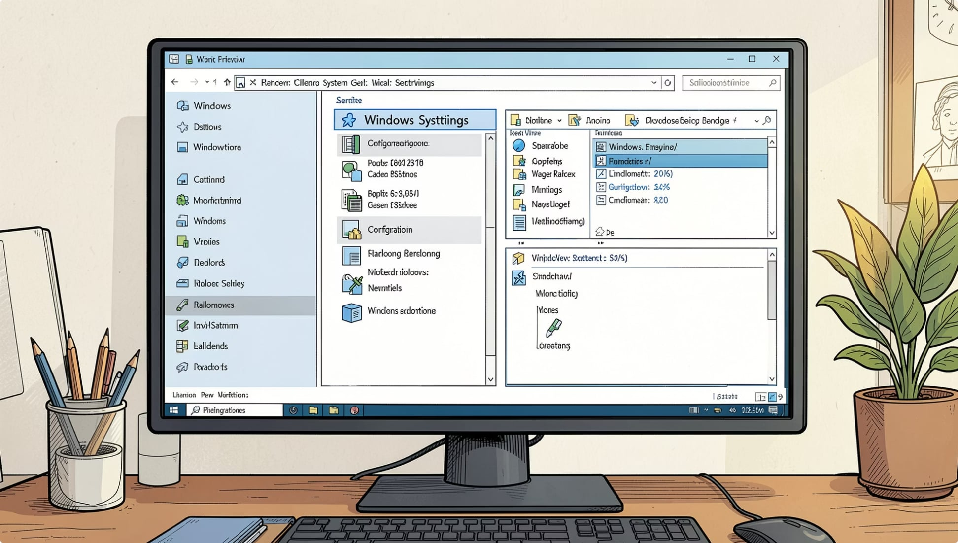
DEFINITION
What Are Environment Variables?
Environment Variables are dynamic values stored by the operating system. They provide information about the system environment and help applications find important files, folders, and executable programs — without hardcoding their locations.

Slide 3





Why Environment Variables Matter
Locate Executables
Store Settings
Portable Code
Find programs automatically without full paths
Hold user-specific and system-wide configurations
Software runs without changing source code
Temporary Storage
Tool Support
Provide temporary file locations for apps
Used by Python, Git, and C

Slide 4
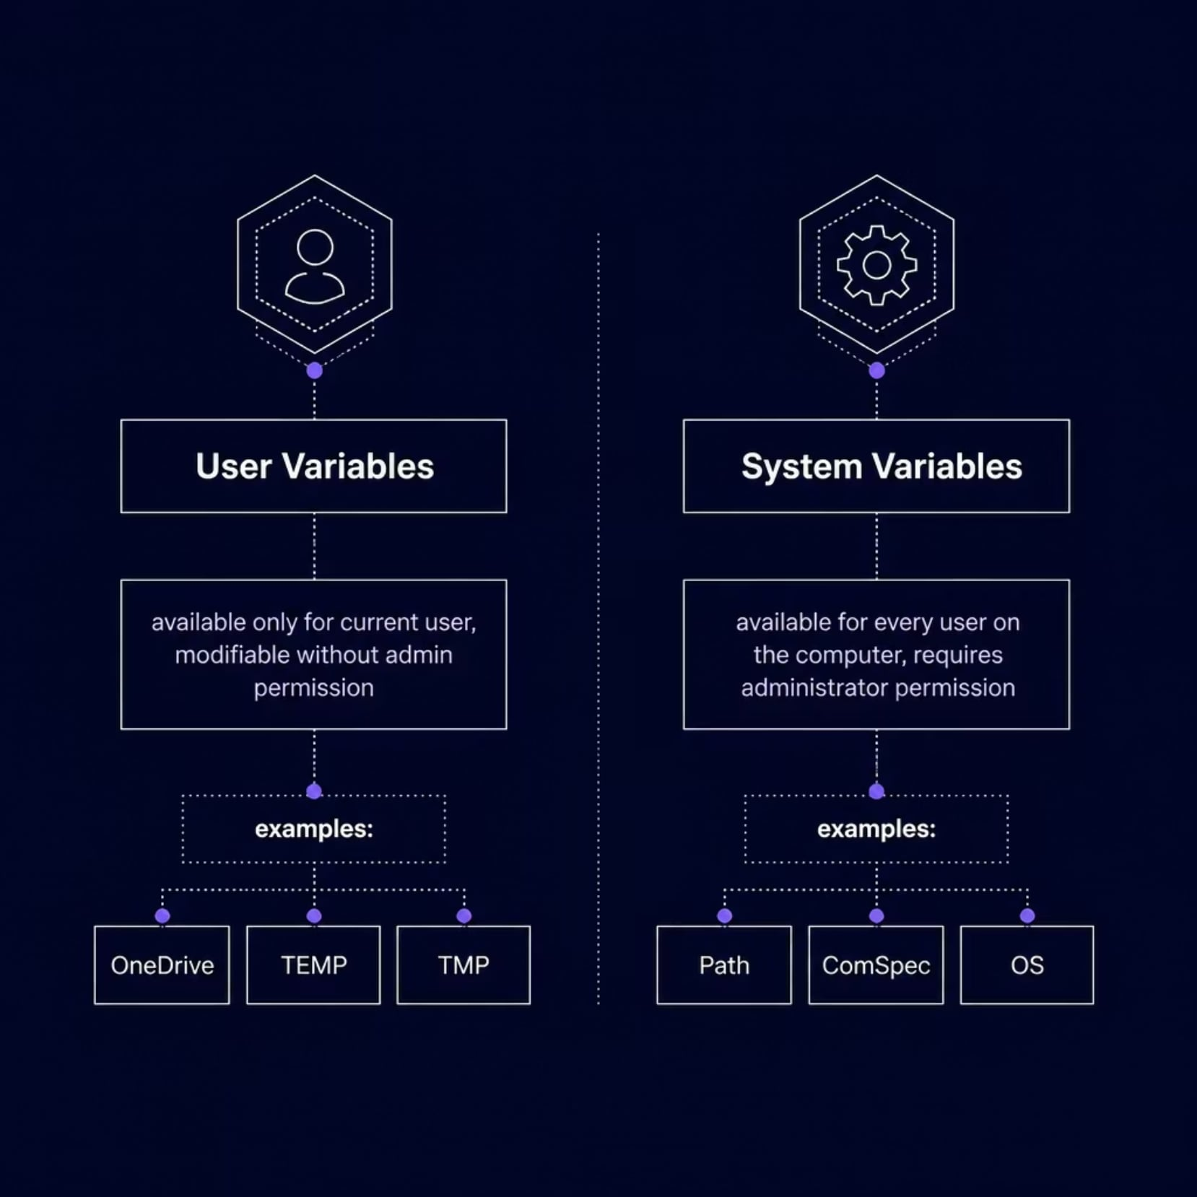
User Variables vs. System Variables
Key Differences
User Variables apply only to your account and can be changed without admin rights. Common examples include TEMP, TMP, and OneDrive.
System Variables affect every user on the machine and usually require administrator permission to edit. Common examples include Path, ComSpec, and OS.

Slide 5
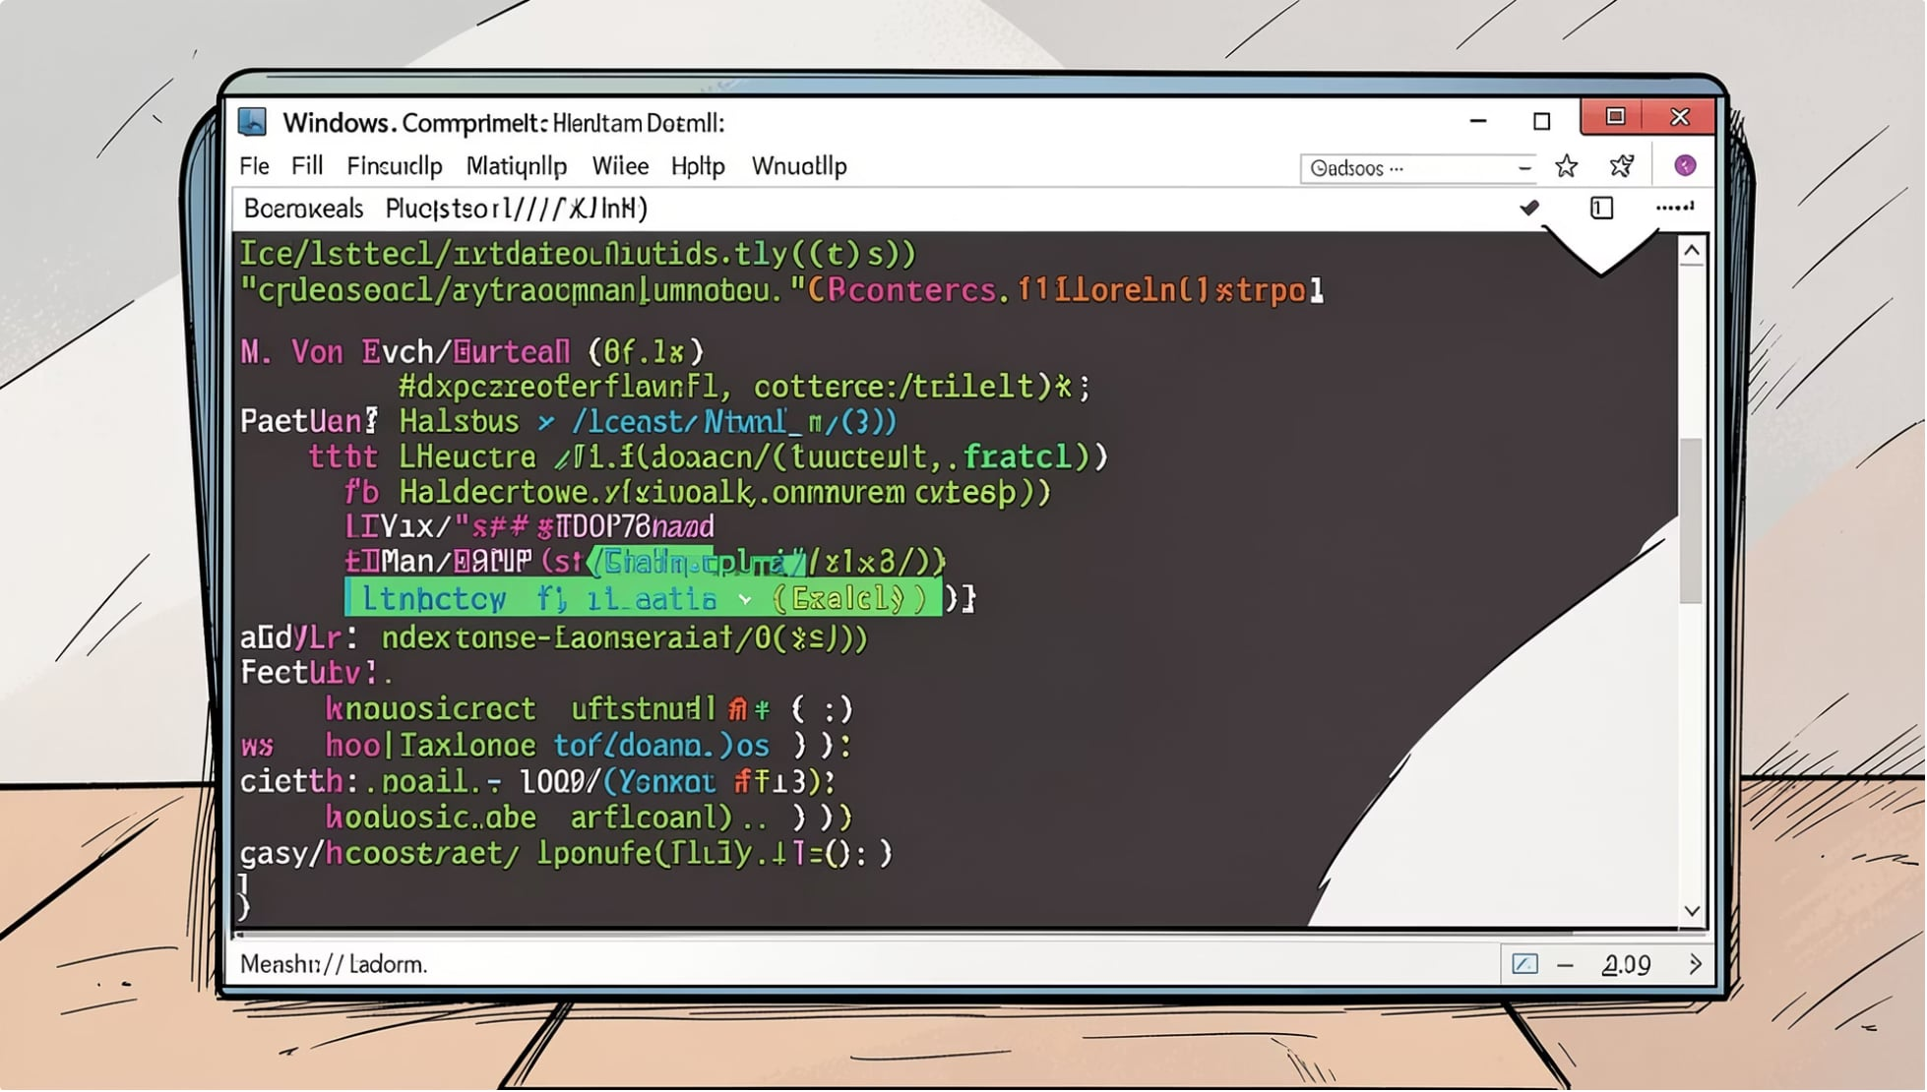

CORE VARIABLE
The Path Variable
The Path variable tells Windows where to search for executable programs when you type a command in the terminal. Without it, you would need to type the full file path every time.
Typical Path
Purpose
C:\Windows\System32; C:\Python313\Scripts;
Searches for executable programs across listed directories

Slide 6


Temporary File Variables
TEMPORARY FILES (TEMP)
TEMPORARY DIRECTORIES (TMP)
Stores temporary files created by applications during runtime.
C:\Users\User\AppData\Local\Temp
Alternate temporary directory, often pointing to the same location as TEMP as.
C:\Users\User\AppData\Local\Temp

Slide 7
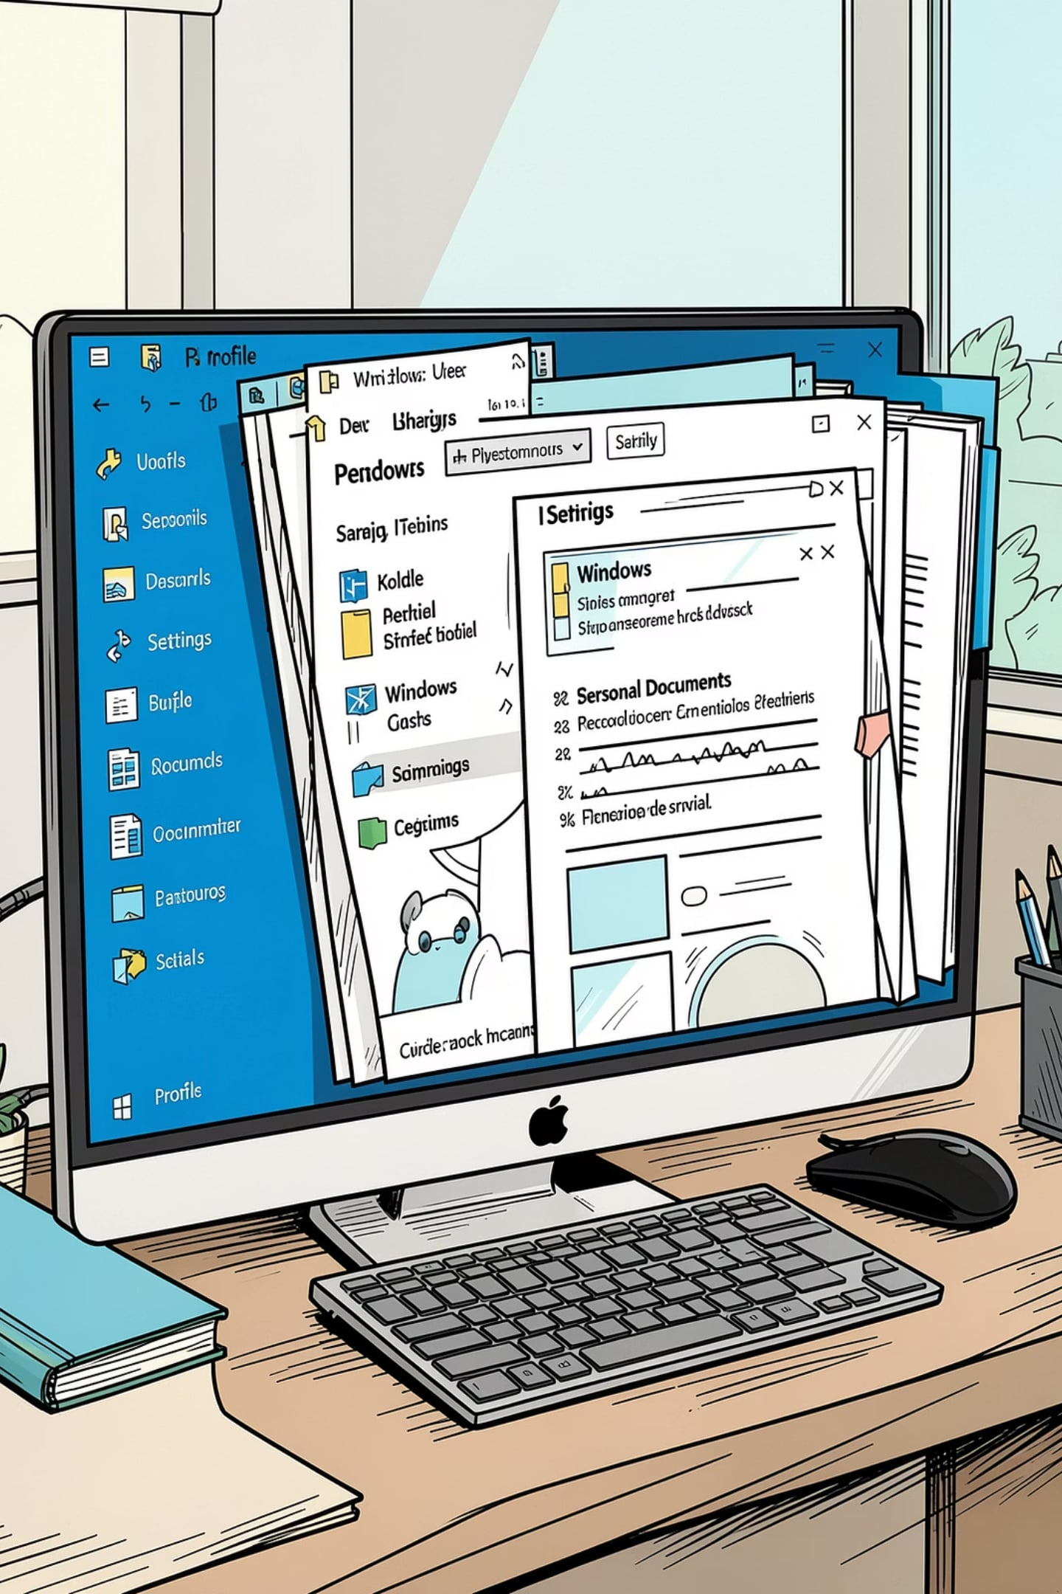
User Variables & Profile Variables
USERNAME
USERPROFILE
The current logged-in user account name.
Example: priya
The root folder of the current user's profile.
Example: C:\Users\priya
OneDrive
The local OneDrive sync folder for the current user.
Example: C:\Users\priya\OneDrive

Slide 8
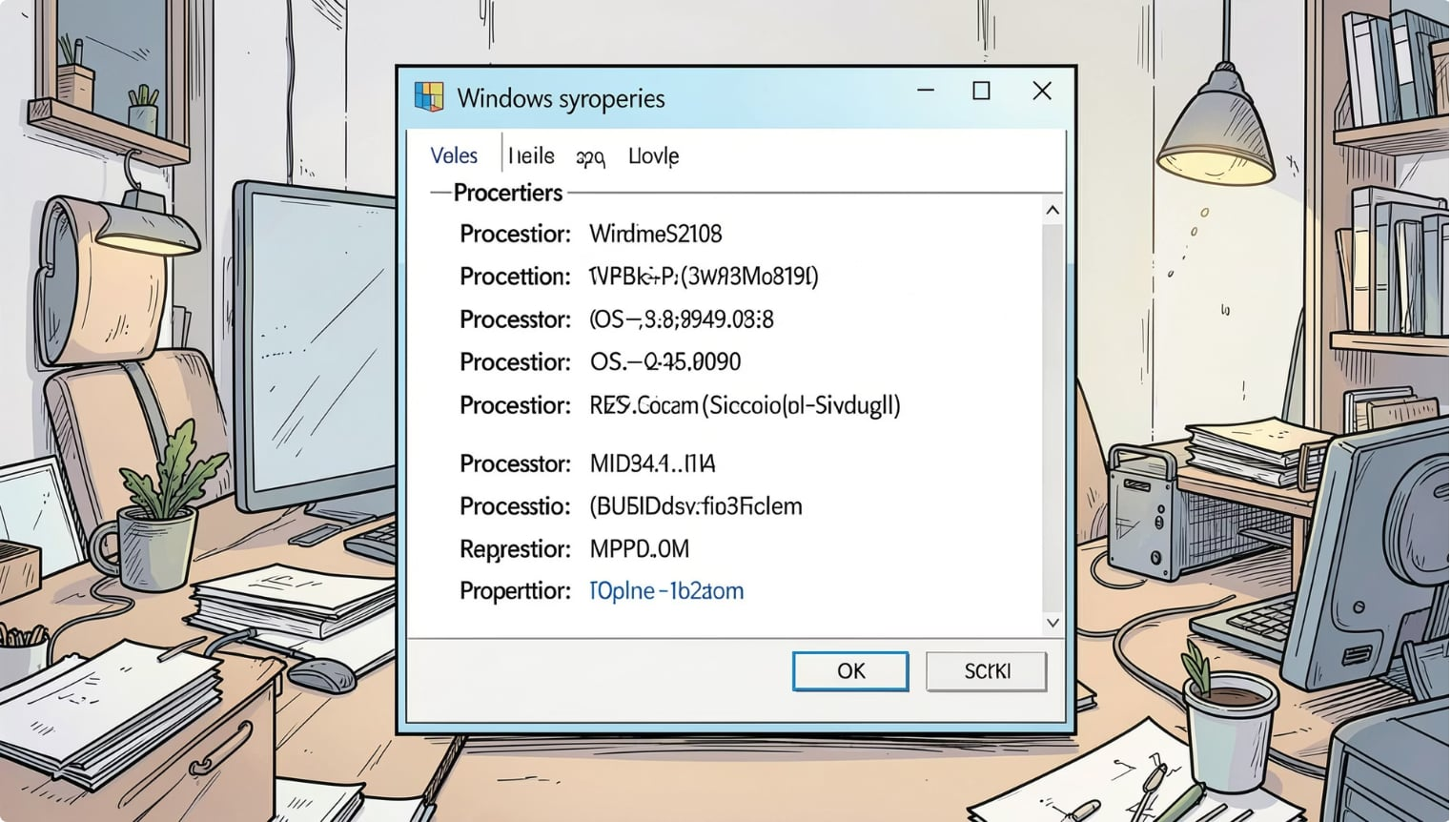
System & Command Variables
OS
ComSpec
Identifies the operating system.
Windows_NT
Path to Command Prompt executable.
C:\Windows\System32\cmd.exe
PATHEXT
NUMBER_OF_PROCESSORS
Recognized executable file extensions.
.COM .EXE .BAT .CMD .MSI
Count of logical CPU cores available.
12

Slide 9



Application-Specific Variables
Many development tools create their own environment variables to locate installations and resources.
C_HOME
C compiler installation directory.
C:\Program Files\MinGW\bin
PYTHONHOME
Python installation directory.
C:\Python313
APPDATA / LOCALAPPDATA
Roaming and local application data folders.
C:\Users\priya\AppData\Roaming

Slide 10

Key Takeaways
Store Dynamic Values
1
Environment variables hold system and application settings.
User vs System
2
User variables are personal, while system variables affect all users.
PATH Finds Executable
3
The PATH variable locates executable programs automatically.
Tools Depend on Them
4
Development tools rely on environment variables for configuration.

