Slide 1
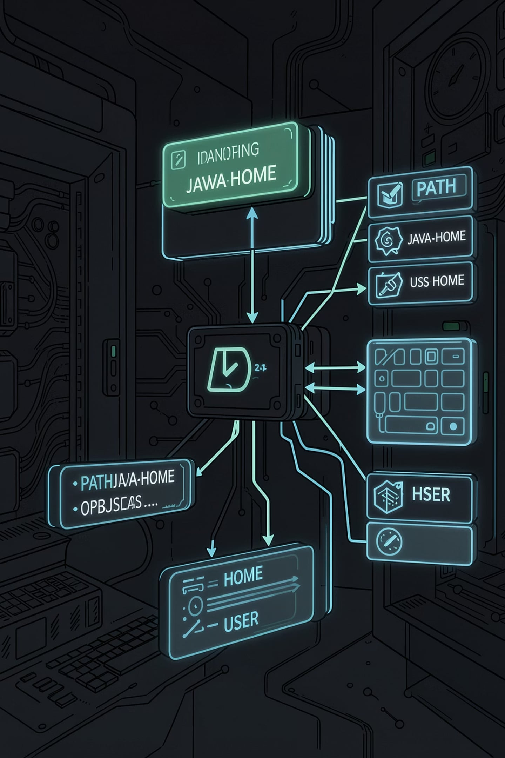
Environment Variables
A simple way for the Operating System to store important information that programs can read and use while running.

Slide 2
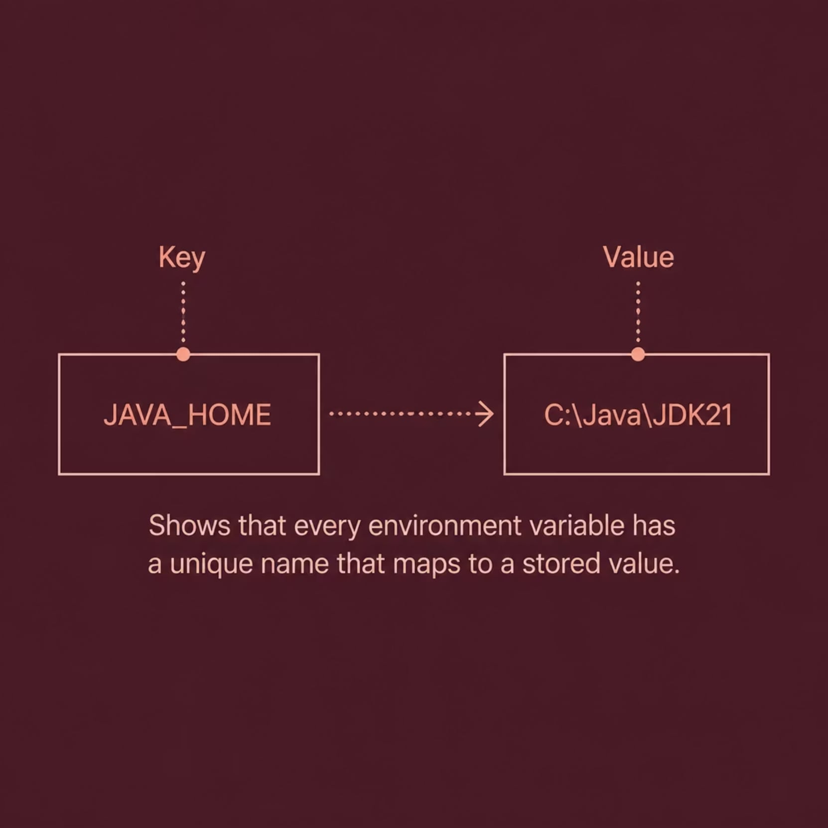

What are Environment Variables?
Environment Variables are Name = Value pairs. Every Environment Variable has a unique name (Key) and stores a value. Programs access these values whenever they need information.
Example
JAVA_HOME = C:\Java\JDK21

Slide 3

Think of it as Labeled Boxes
Imagine your computer keeps many labeled storage boxes. Each box has a label (Variable Name) and stores useful information (Value). Whenever a program needs information, it simply opens the correct box.
HOME
PATH
User's home directory path
Executable search locations
JAVA_HOME
Java installation folder

Slide 4


How Environment Variables Work
Program Starts
Runtime Replacement
Create
Uses Value
When a program starts, it checks whether an environment variable exists. If found, it replaces the variable name with its stored value — a process called runtime replacement.
$HOME → /Users/Sai

Slide 5





PATH Variable
PATH stores the locations where the operating system searches for programs. Instead of searching the whole computer, it checks only these folders.
User types
chrome
PATH searches
listed folders
Found
Chrome.exe
Launch
Chrome opens

Slide 6

JAVA_HOME
JAVA_HOME stores the location of the Java installation. Programs automatically use this location whenever Java is required.
JAVA_HOME set
1
Points to Java installation folder
Java Compiler
2
Locates javac via JAVA_HOME
Application Starts
3
JVM launches using the path

Slide 7
Common Commands
Linux / macOS
Windows
env
printenv
echo $HOME
echo $PATH
echo $USER
set
echo %PATH%
echo %USERNAME%
set PATH

Slide 8
Temporary vs Permanent Variables
Temporary Variables
Permanent Variables
Exist only for the current terminal session.
Remain available even after restarting the terminal.
Linux/macOS
export my_var=hello
echo $my_var
unset my_var
vi .zshrc
export JAVA_HOME=...
export PATH=$PATH:$JAVA_HOME/bin
Windows
System Properties
→ Environment Variables
→ New / Edit
→ Restart Terminal

Slide 9
Common Environment Variables
Variable
Purpose
PATH
Search executable programs
HOME
User Home Directory
USER
Current User
USERNAME
Windows Username
JAVA_HOME
Java Installation Path
TEMP / TMP
Temporary Files
ANDROID_HOME
Android SDK Location
PYTHONPATH
Python Module Search Path

Slide 10

Linux vs Windows
Linux / macOS
Windows
Reference: $PATH
List all: printenv
Path separator: :
Not found: command not found
Reference: %PATH%
List all: set
Path separator: ;
Not found: 'command' is not recognized
Summary
Environment Variable = Name + Value
Programs read values while running
PATH stores executable locations
HOME stores the user folder
JAVA_HOME stores Java installation
Temporary variables disappear after terminal closes

