Slide 1





A COMPLETE LEARNING JOURNEY
Fundamentals of Web,
Algorithms & Systems
From GitHub & Web Hosting to Algorithms, Flowcharts, C Programming,
Linux, Compilation, Number Systems & Debugging

Slide 2




VERSION CONTROL & PUBLISHING
GitHub: Account, Repository & Daily Notes
1
2
3
4
Create Account
Create Repository
Add index.html
Update Daily Notes
Sign up at github.com with a username, email & password
New repo to hold your project files & notes
Create the entry-point HTML file for your site
Log progress daily using semantic HTML tags
Repository Essentials
HTML Tags for Daily Notes
Repository = a folder that Git tracks for version history
README.md describes the project for visitors
Commits save snapshots of your changes over time
Branches let you work on features without breaking main code
<h1>–<h6> — headings for date & section titles
<p> — paragraph text for each note entry
<ul>/<li> — bullet list of tasks or learnings
<strong> / <em> — emphasize key takeaways
GITHUB FUNDAMENTALS
1

Slide 3




GOING LIVE ON THE WEB
Custom Domain + GitHub Pages Hosting
1
2
3
4
Buy Domain
Enable Pages
Point DNS
Site is Live
Purchase a domain name from BigRock
Turn on GitHub Pages in repo Settings
Add A / CNAME records in BigRock DNS panel
Your domain now serves the GitHub Pages site
BigRock Domain Purchase
Connecting to GitHub Pages
Search for an available domain name & add to cart
Complete registration & payment (typically 1 year+)
Access the DNS management panel after purchase
Domain ownership is verified via your BigRock account
In BigRock DNS: add CNAME record → username.github.io
In repo Settings → Pages: set the custom domain
GitHub auto-generates a CNAME file in the repository
Enable HTTPS once DNS propagation completes
HOSTING & DOMAINS
2

Slide 4
INTERACTIVE UI DEVELOPMENT
2048 Game — Micro Animations & Transitions
Core Motion Principles
2
4
Tile Move — CSS transform: translate() slides tiles smoothly to their new grid position
Tile Merge — a quick scale-up (1 → 1.15 → 1) + fade gives a satisfying 'pop' when two tiles combine
New Tile Spawn — scale from 0 → 1 with ease-out so new tiles appear naturally
8
16
32
2
Transition Timing
Duration: 100–150ms for moves, keeps the game feeling responsive
Easing: ease-out for merges, ease-in-out for slides
Score pop: brief translateY + fade-out on the +points indicator
Merge → Scale + Fade | Slide → Transform Translate
UI MICRO-INTERACTIONS
3

Slide 5




CORE CONCEPT
What Is an Algorithm?
Expressing a known process as a set of sequential steps — such that anyone who follows those steps will arrive at similar results.
Sequential
Repeatable
Well-Defined
Followable
Steps happen in a defined, ordered sequence
Same steps → same result, every time
Each step is clear & unambiguous
Anyone can execute it & get the same outcome
ALGORITHMS
4

Slide 6




CORE CONCEPT
★ IMPORTANT
Algorithm Principles
1. End-User Experience
2. Meaningful Variables Names
Design the algorithm around how it will actually be used
Variable names should clearly reflect their purpose
3. Coding Style
4. Correctness
Follow one consistent set of rules across the whole team
The algorithm must produce the right result every time
5. Multiple Solutions
6. No Duplicate Code
Explore more than one approach before choosing one
Reuse logic instead of repeating it (DRY principle)
7. Code Optimization
Refine for speed & efficiency once it is correct
ALGORITHM PRINCIPLES
5

Slide 7
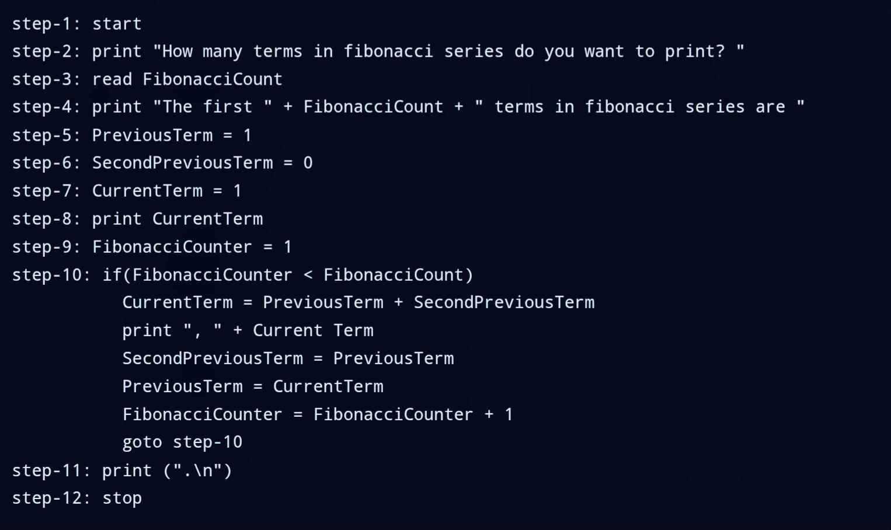
WORKED EXAMPLE
Fibonacci Series — Algorithm
ALGORITHM — FIBONACCI SERIES
6

Slide 8
VISUAL REPRESENTATION
Flowchart Symbols & Rules
Capsule (Terminator)
Start / Stop — marks the beginning and end of the flowchart
Parallelogram
Print / Read — Input & Output operations
Rectangle
Assignment statements — where a variable is given a value
Rhombus
If conditions — decision points with Yes / No branches
FLOWCHART NOTATION
7

Slide 9
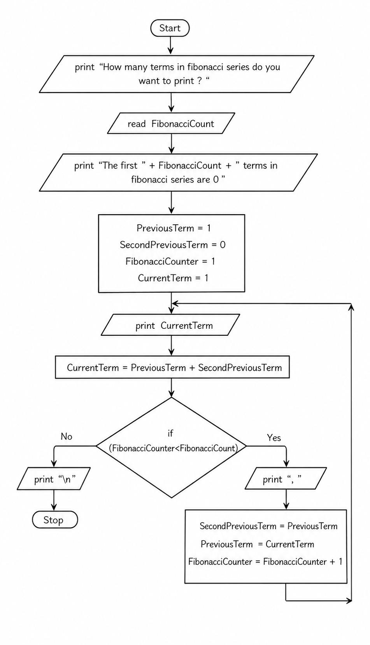
WORKED EXAMPLE
Fibonacci Series — Flowchart
FLOWCHART — FIBONACCI SERIES
8

Slide 10
COMMAND LINE BASICS
Essential Linux Commands
Navigation
Files
Inspect & Permissions
pwd
touch <file>
cat <file>
Print current working directory
Create an empty file
Print file contents to screen
ls -la
cp a b
grep 'x' f
List all files, incl. hidden, with details
Copy file a to b
Search for text 'x' inside file f
cd <dir>
mv a b
sudo apt install
Change into a directory
Move / rename file a to b
Run a command as administrator
mkdir <dir>
rm <file>
Create a new directory
Remove a file (rm -r for folders)
LINUX COMMANDS
9

Slide 11
VERSION CONTROL WORKFLOW
Git & GitHub Commands
Local Git Setup
Remote / GitHub
SSH Trust
git config
git clone <url>
ssh-keygen
Set your name & email identity
Copy a remote repo to your machine
git init
Generate a public/private key pair
Start tracking a folder with Git
git remote -v
git status
List connected remote repositories
Add key to GitHub
Show tracked / untracked & staged files
git add <f>
git pull
Paste public key into account Settings
Stage changes for the next commit
Fetch & merge remote changes
git commit -m
Save a snapshot with a message
git push
git log / diff
Send local commits to the remote
View history / see line-by-line changes
Tracked vs Untracked · Staged vs Unstaged
Untracked — a new file Git has never seen | Tracked — Git is watching it for changes
Unstaged — modified but not yet added | Staged — added with git add, ready to commit
GIT & GITHUB
10

Slide 12
C PROGRAMMING
Variables & Statements in C
Declaring Variables
Syntax: type variable_name; e.g. int count;
Common types: int, float, double, char
Initialize at declaration: int total = 0;
Multiple variables: int x, y, z;
Names must start with a letter or underscore, no spaces
Use meaningful, descriptive names (see Algorithm Principles)
C VARIABLES & STATEMENTS
11

Slide 13
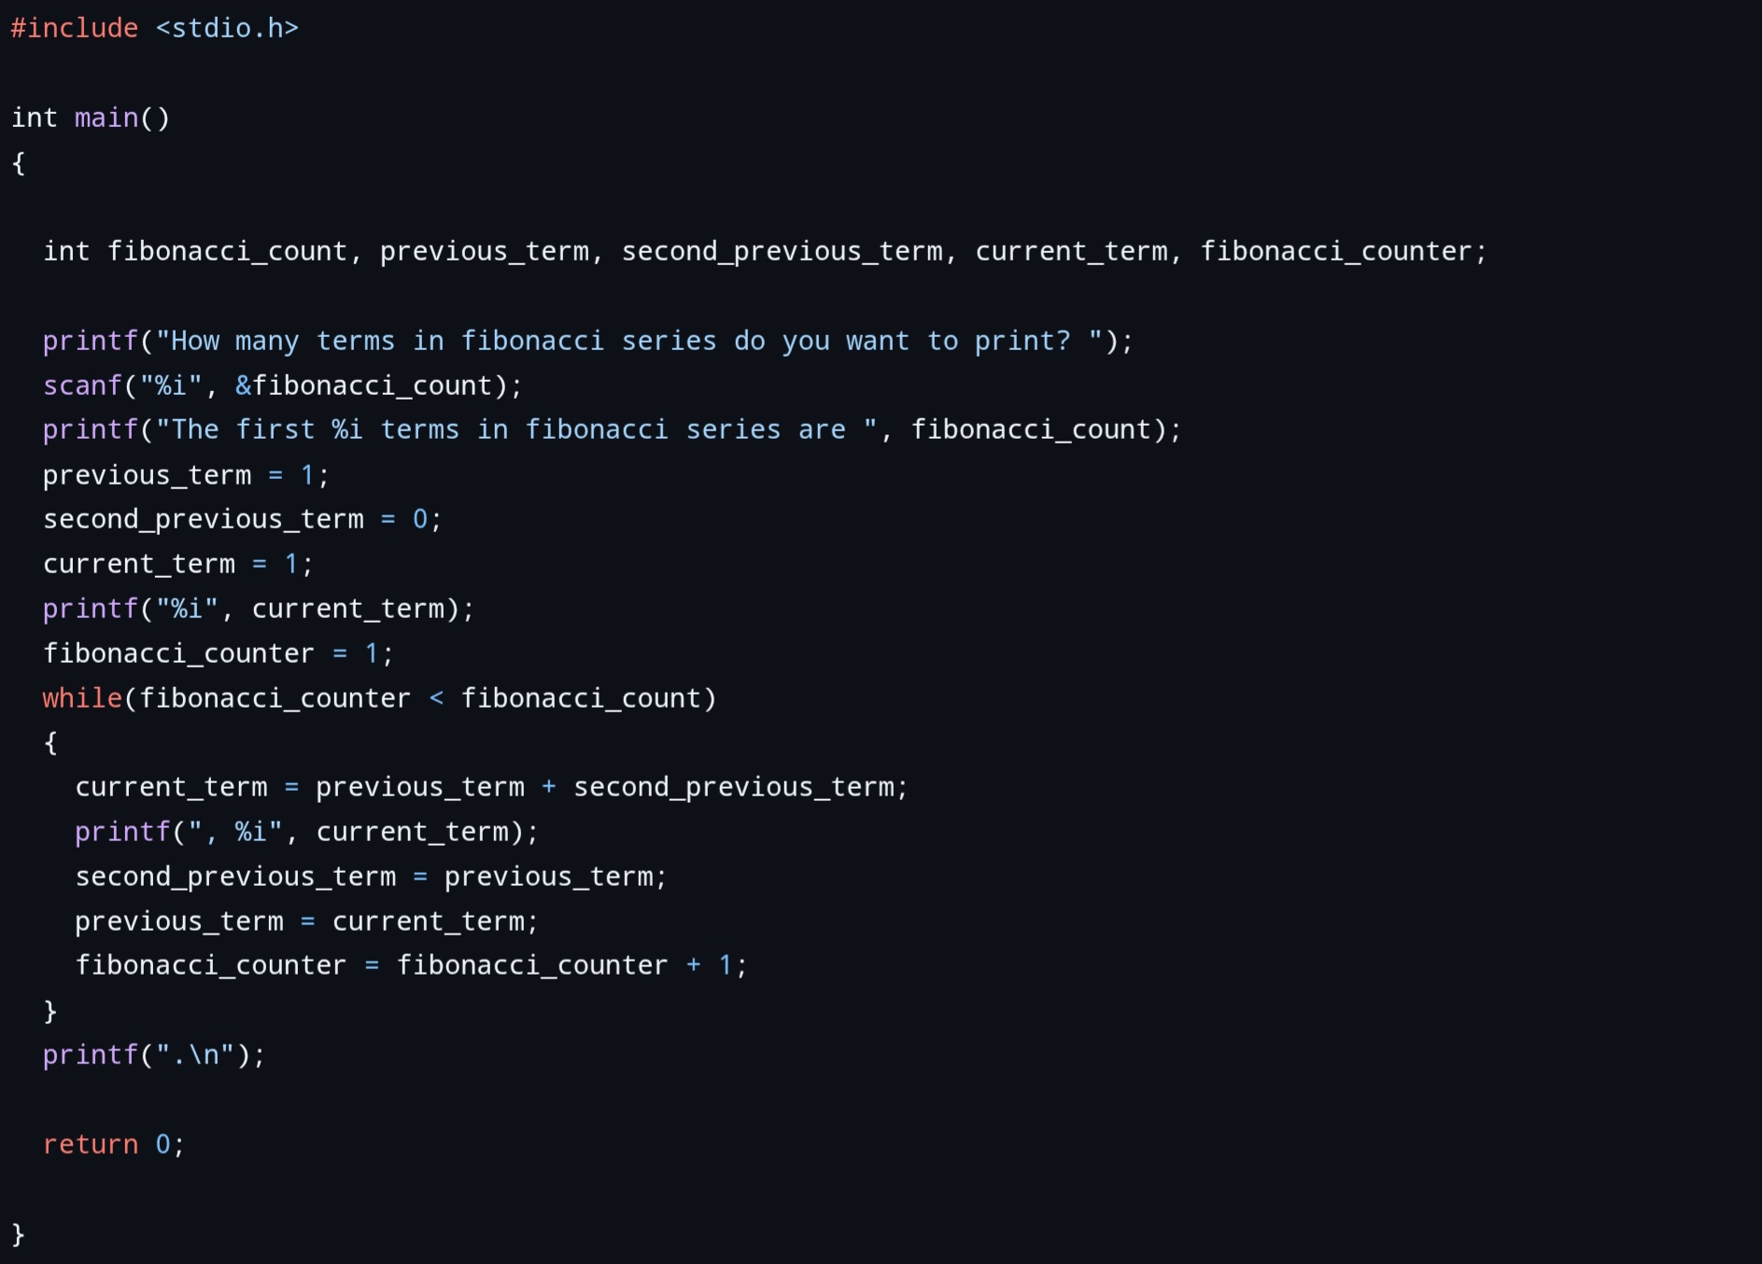
WORKED EXAMPLE
Fibonacci Series — C Program
C PROGRAM — FIBONACCI SERIES
12

Slide 14


DEBUGGING BASICS
Reading Error Messages in the Command Line
fibonacci.c:12:5: error: use of undeclared identifier 'fibonacci_counter'
File : Line : Column
error vs warning
Read Top-to-Bottom
Runtime Errors
Pinpoints exactly where the problem was found
Errors stop compilation; warnings don't (but should be fixed)
Fix the first error first — later ones may just cascade
e.g. 'Segmentation fault' — a crash while the program runs
Quick Tips
Compile often — a small change is easier to debug than a hundred lines at once · Copy the exact error text into a search engine when stuck · Check for missing semicolons, brackets & declared variables first
COMMAND LINE ERRORS
13

Slide 15
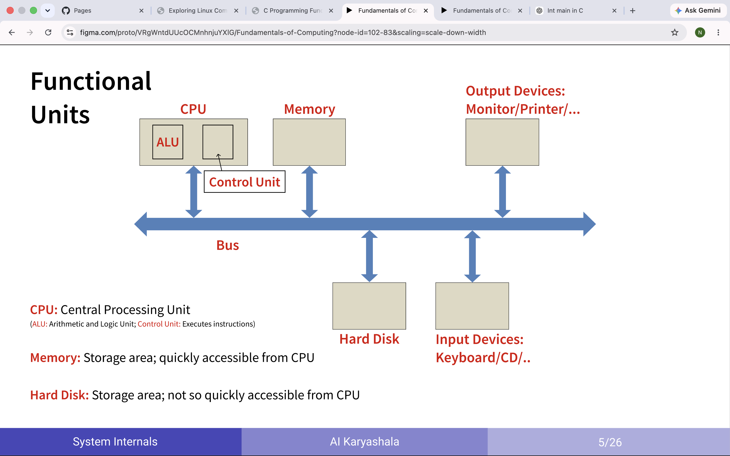

Slide 16
SYSTEM INTERNALS · PART 1 OF 2
Inside the Computer: CPU & Memory
The CPU
Memory Hierarchy
Control Unit (CU) — fetches instructions & directs data flow
ALU — performs arithmetic (+, -) and logic (comparisons)
Clock speed (GHz) — how many cycles the CPU runs per second
Cache (L1/L2/L3) — very fast memory close to the CPU
RAM — main memory; fast but volatile (cleared on power-off)
Disk / SSD — large, permanent storage; much slower than RAM
SYSTEM INTERNALS I
14

Slide 17


SYSTEM INTERNALS · PART 2 OF 2
Inside the Computer: OS, Processes & I/O
1
2
3
4
Fetch
Decode
Execute
Store
CPU fetches the next instruction from memory
Control unit decodes what the instruction means
ALU/CU carry out the instruction
Result is written back to a register or memory
Operating System's Job
Input / Output
Manages hardware resources (CPU, memory, devices)
A process is a running instance of a program
Processes move through states: ready → running → waiting
System calls let programs ask the OS for services
Files, keyboard & network are accessed through the OS
The file system organizes data on permanent storage
I/O is far slower than CPU/RAM — often the real bottleneck
SYSTEM INTERNALS II
15

Slide 18



FROM SOURCE TO EXECUTABLE
The Compilation Process — Overview
1
2
3
4
5
Source Code
Preprocessing
Compilation
Assembly
Linking
.c file — human-readable C code
.i file — macros & #includes expanded
.s file — translated to assembly code
.o file — assembler turns it into machine code
executable — libraries linked into one binary
Related Formats & Tools
.bc / .ll — LLVM bitcode & intermediate representation (IR), produced by Clang between source and assembly
Assembler — converts assembly code (.s) into machine code (.o)
Disassembler — reverses the process: reads machine code and shows the assembly instructions
COMPILATION — OVERVIEW
16

Slide 19

LINUX FILE SYSTEM
Absolute vs. Relative Paths
Absolute Path
Relative Path
Always starts from the root directory ( / ). It works no matter where you currently are.
Starts from your current working directory. Shorter, but depends on where you are.
/home/user/project/index.html
../images/logo.png
cd /home/user/project
./index.html ( . = current dir, .. = parent )
Best for: scripts & links that must always resolve correctly, regardless of the current directory.
Best for: links within a project you might move to another location or machine.
ABSOLUTE & RELATIVE PATHS
18

Slide 20
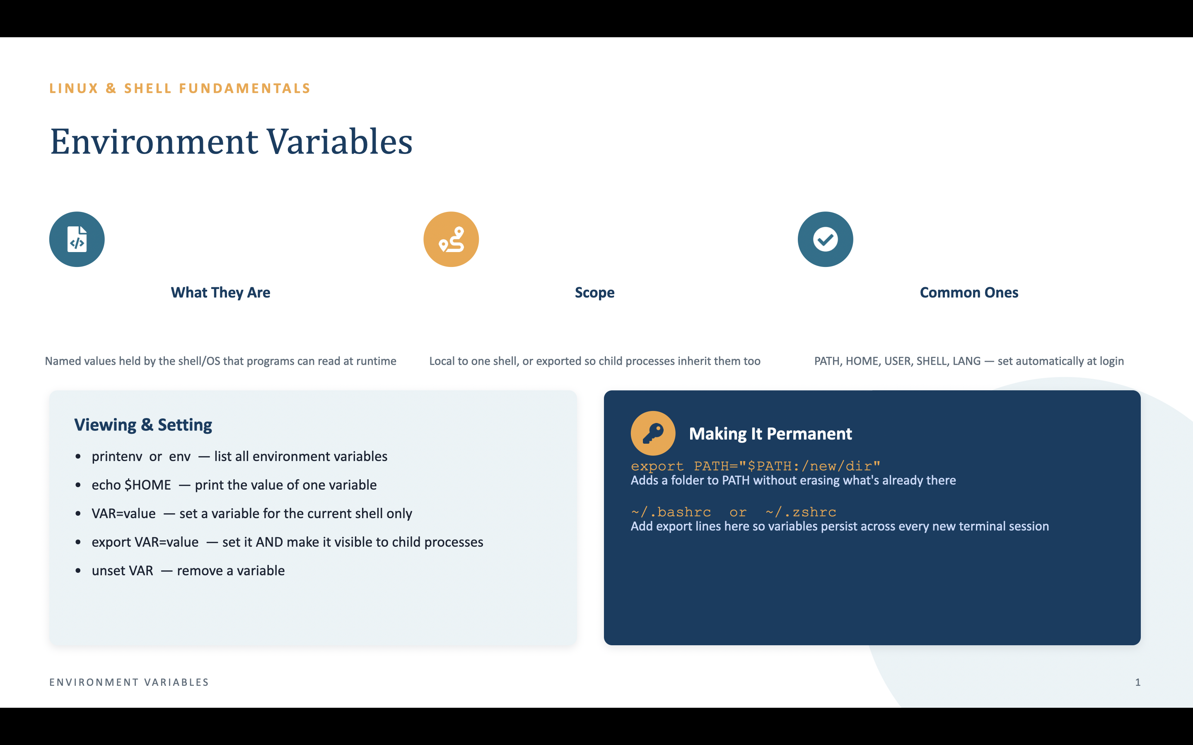

Slide 21

LINUX FILE SYSTEM
Where Commands Live & How to Learn Them
Finding a Command
The man Command
Commands are just executable files stored on disk
Common folders: /bin, /usr/bin, /usr/local/bin, /sbin
which ls → shows the exact path used, e.g. /bin/ls
echo $PATH → lists all folders the shell searches
type <cmd> → shows whether it's a program, alias or built-in
man ls
Opens the manual page for a command — full syntax, flags & examples.
man -k "copy"
Searches manual page descriptions for a keyword.
<cmd> --help
Quick summary of options, without the full manual.
COMMAND LOCATIONS & HELP
19

Slide 22



NUMBER SYSTEMS · PART 1 OF 2
Binary, Decimal, Octal & Hexadecimal
Decimal
Binary
Octal
Hexadecimal
Base 10
Base 2
Base 8
Base 16
Digits 0–9
Digits 0–1
Digits 0–7
Digits 0–9, A–F
The number 42 → 42
The number 42 → 101010
The number 42 → 52
The number 42 → 2A
Place Value — How a Base Works
Each digit's value = digit × (base ^ position), counted right-to-left starting at position 0
Example (binary 101010): (1×2⁵)+(0×2⁴)+(1×2³)+(0×2²)+(1×2¹)+(0×2⁰) = 32+8+2 = 42
Computers use binary natively; hex is a compact, human-friendly way to write binary (4 bits = 1 hex digit)
NUMBER SYSTEMS I
20

Slide 23
NUMBER SYSTEMS · PART 2 OF 2
Converting Between Number Systems
Decimal → Binary
Binary → Decimal
Repeatedly divide by 2, record the remainders
Read the remainders bottom-to-top
42 ÷ 2 → 21 r0 → 10 r1 → 5 r0 → 2 r1 → 1 r0 → 0 r1
Result: 101010
Multiply each bit by 2^(position), then sum
101010 = 1·32 + 0·16 + 1·8 + 0·4 + 1·2 + 0·1
= 32 + 8 + 2 = 42
Decimal → Hexadecimal
Binary ↔ Hexadecimal (fast path)
Repeatedly divide by 16, record remainders (0–9, A–F)
42 ÷ 16 → 2 r10(A) → 0 r2
Read bottom-to-top: 2A
Group binary digits in sets of 4, convert each group
1010 10 → pad to 0010 1010 → groups: 0010 = 2, 1010 = A
Result: 2A — this is why hex is popular in computing
NUMBER SYSTEMS II
21

Slide 24

DEBUGGING IN C · PART 1 OF 2
The Clang Debugger — LLDB
What Is LLDB?
Setting a Breakpoint
The debugger that ships with Clang / LLVM
Lets you pause a running program and inspect it
Compile with debug symbols first: clang -g program.c -o program
Launch it with: lldb ./program
Debugging turns 'guessing' into 'observing' — you watch the program's real state instead of assuming it
breakpoint set --name main
Pauses execution at the start of main()
breakpoint set --file f.c --line 12
Pauses execution at a specific line
run (or r)
Starts the program — it halts at your breakpoint
DEBUGGING — LLDB I
22

Slide 25

DEBUGGING IN C · PART 2 OF 2
Stepping Through Code & Watching Variables
next (n)
step (s)
print x (p x)
continue (c)
Execute the current line, step OVER function calls
Execute the current line, step INTO function calls
Show the current value of variable x
Resume running until the next breakpoint
1
2
3
4
Hit Breakpoint
Inspect State
Step Line by Line
Confirm Behavior
Execution pauses at the chosen line
print variables to see their current values
next / step to move forward one line at a time
Watch values update exactly as expected — or spot the bug
Why Step-by-Step Matters
Watching previous_term, second_previous_term & current_term update after every next confirms the Fibonacci logic is correct — or reveals exactly where it diverges
DEBUGGING — LLDB II
23

