Slide 1


Evaluating Realistic Adversarial Evasion in Machine-Learning-Based Network Intrusion Detection
D2
Preparation &
Feasibility Video
Research question
How does constraining adversarial perturbations to operationally feasible network changes affect the measured robustness of ML-based NIDS?
Aimukhanbetova Aimzhan
Preparation already demonstrated
BSc Computational Sciences
with Software Engineering
2.52M
99.35%
29 Oct
Supervisor: Inkar Zhumay
clean CICIDS2017 flows
pilot attack recall
ethics approval
D2 Preparation & Feasibility
Aimukhanbetova Aimzhan
1
Notes:
0:00–0:42 — Keep Slide 1 on screen.
Narration:
My project evaluates adversarial evasion against machine-learning-based network intrusion detection systems. The key question is not simply whether an ML detector can be fooled, but whether the measured vulnerability remains when the attacker is restricted to operationally feasible network changes. I have already completed the main feasibility work: CICIDS2017 has been cleaned and prepared, a Random Forest pilot baseline has been trained, preliminary constrained and unconstrained perturbation prototypes have been implemented, and ethical approval was obtained on 29 October. This video shows why the proposed D3 study is technically feasible and realistically scoped.
1

Slide 2
Method and tool choices
The method was chosen to answer the research question with a reproducible, manageable experimental design.
PIPELINE
CICIDS2017
2
Preprocess
3
Baseline
4
Perturb
5
Evaluate
1
Labelled flow data
Clean + binary target
Random Forest
Constrained vs
unconstrained
Robustness + FPR
CHOICES
Selected
Why selected
Alternative considered
Why not core now
CICIDS2017
Established labelled flow benchmark
Newer benchmark dataset
Keep first-semester scope controlled
Random Forest
Strong tabular baseline; efficient; interpretable
XGBoost / neural model
Second model is D3 extension, not feasibility blocker
Python + scikit-learn
Reproducible, mature ML tooling
PyTorch / TensorFlow
Deep-learning stack unnecessary for pilot
Constraint-aware features
Directly tests realism question
Packet-level replay only
Packet-level validation is higher cost and optional
D2 Preparation & Feasibility
Aimukhanbetova Aimzhan
2
Notes:
0:42–1:34 — Keep Slide 2 on screen.
Narration:
The experimental pipeline starts with CICIDS2017 flow records, followed by reproducible preprocessing, baseline modelling, adversarial perturbation and robustness evaluation. CICIDS2017 was selected because it provides labelled flow-level traffic and is widely used in NIDS research. A newer benchmark could be added later, but doing so is not required to establish feasibility. Random Forest was selected for the pilot because it performs well on tabular data, trains efficiently and provides feature-importance diagnostics. XGBoost or a neural model are realistic alternatives, but they are better treated as extensions rather than prerequisites. Python and scikit-learn provide a reproducible implementation with lower setup cost than a deep-learning stack. Most importantly, the constraint-aware design directly addresses the research question; fully packet-level replay would be more realistic, but it is substantially more expensive and is not necessary for the core comparison.
2

Slide 3
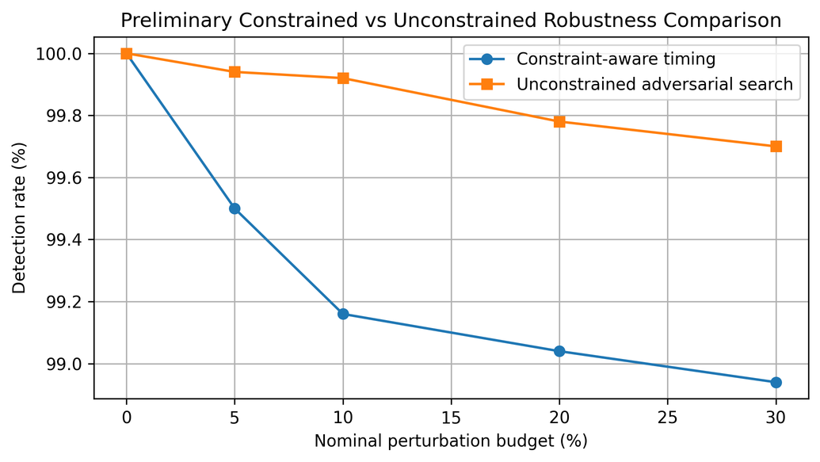
Feasibility evidence
Executed notebooks show that the data, model and preliminary adversarial evaluation pipeline are operational.
A. Data preparation
B. Pilot baseline
C. Preliminary adversarial prototype
2,830,743
99.35%
raw flows
attack recall / detection rate
0.08%
2,867 invalid rows removed
307,078 exact duplicates removed
false-positive rate
Confusion matrix
Pred. BENIGN
Pred. ATTACK
2,520,798
BENIGN
49,777
42
At nominal 30% budget
1.06% constrained evasion
0.30% unconstrained evasion
clean binary flows
ATTACK
66
10,115
Feasibility evidence only — budgets are not yet physically equivalent.
D2 Preparation & Feasibility
Aimukhanbetova Aimzhan
3
Notes:
1:34–2:48 — Start on Slide 3. At about 2:03, briefly switch to GitHub or Jupyter for 12–15 seconds, then return to Slide 3.
What to open during the cutaway:
GitHub repository → 04-Implementation → adversarial_perturbation_prototype.ipynb. Scroll to the constrained-versus-unconstrained comparison output/plot. Do not show private tabs, emails, tokens or personal data.
Narration:
The feasibility evidence comes from executed notebooks rather than literature values. The eight CICIDS2017 files contained about 2.83 million raw flows. After removing invalid rows and exact duplicates, the cleaned dataset contains about 2.52 million flows with a binary BENIGN-versus-ATTACK target. A pilot Random Forest was trained on a 300,000-flow stratified sample. It achieved 99.35 percent attack recall and a false-positive rate of 0.08 percent. This establishes a strong clean baseline, although I do not treat the random split as a final estimate of real-world generalisation. I then implemented preliminary constrained timing perturbations and a model-guided unconstrained search. On the same 5,000 initially detected malicious flows, the 30 percent nominal setting produced 1.06 percent and 0.30 percent evasion respectively. These values are not a final scientific comparison because the budgets are not yet physically equivalent. Their purpose is to show that the full adversarial evaluation pipeline works.
3

Slide 4
D3 plan, dependencies and quantified risks
The core study is staged so that later experiments depend on validated earlier outputs.
PLAN
Nov–Dec
Jan
Jan–Feb
Feb–Mar
Mar
1 Apr
Final baseline
Final constraints
Attack evaluation
Defence
Final analysis
D3 submit
Source/day-aware split
+ optional second model
Timing + packet-size
dependency rules
Unconstrained reference
vs constrained attacks
Adversarial training
+ feature restriction
Robustness, FPR,
write-up
Final dissertation
RISKS
Risk
L×I
Mitigation
Fallback
Constraint scope becomes too broad
4×4
Fix core scope to timing + packet-size transformations
Use timing-only constrained attack as minimum viable study
Source-aware split has poor attack coverage
3×4
Inspect labels per source file before freezing split
Use grouped-source split preserving attack coverage
Attack search is too computationally expensive
3×3
Use 5k-flow samples and bounded candidate counts
Run core experiments on Random Forest only
Defence does not improve robustness
2×3
Compare adversarial training with feature restriction
Report negative result and clean/adversarial trade-off
D2 Preparation & Feasibility
Aimukhanbetova Aimzhan
4
Notes:
2:48–3:48 — Keep Slide 4 on screen.
Narration:
The D3 plan is dependency-driven. First, I will replace the pilot random split with a stricter source- or day-aware baseline evaluation. Once the baseline is fixed, I can finalise the constraint model, then run matched constrained and unconstrained attacks, then evaluate defences, and only then perform the final analysis and write-up. The largest risk is scope expansion in the constraint model, scored four by four for likelihood and impact. I will therefore keep the core scope to timing and packet-size transformations; if necessary, timing alone remains a viable minimum study. A second major risk is insufficient attack coverage in a source-aware split. I will inspect class coverage before freezing the split and use a grouped-source fallback if required. Computational cost will be controlled by bounded samples and candidate counts, with Random Forest as the minimum core model. Finally, if a defence does not improve robustness, that negative result is still valid provided the clean-versus-adversarial trade-off is reported clearly.
4

Slide 5
PLES controls and measurable success criteria
The project is designed as defensive, offline research with explicit minimum completion criteria.
PLES
SUCCESS
Professional
Version-controlled code, reproducible notebooks, transparent limitations
1
✓
Final clean baseline under a stricter source/day-aware evaluation
Public research data only; no unauthorised scanning, exploitation or live-system testing
✓
One unconstrained reference attack implemented and reproducible
Legal
2
✓
Two constraint-aware transformation families: timing + packet-size/padding
Ethical
Dual-use risk controlled through offline experiments; ethics approved 29 Oct 2026
3
✓
Robustness compared across multiple perturbation levels using detection/evasion and FPR
Avoid overstating laboratory evasion as real-world insecurity; focus on defensive implications
✓
At least one defence evaluated on both clean and adversarial traffic
Social
4
Core pipeline operational. D3 now focuses on rigorous refinement, comparison and evaluation.
Feasibility conclusion
Thank you
D2 Preparation & Feasibility
Aimukhanbetova Aimzhan
5
Notes:
3:48–4:48 — Keep Slide 5 on screen. Finish by about 4:45–4:50, leaving safety margin before 5:00.
Narration:
The professional, legal, ethical and social controls are straightforward but important. The work is version controlled and reproducible, and limitations will be reported transparently. Only public research data is used, with no unauthorised scanning, exploitation or testing of live systems. The main ethical issue is dual use, so all adversarial experiments remain offline; the project received ethics approval on 29 October 2026. Socially, I will avoid presenting laboratory evasion rates as evidence that deployed systems are automatically insecure.
I also define measurable success criteria. The final study must include a stricter clean baseline, an unconstrained reference attack, constraint-aware transformations covering timing and packet-size or padding, comparisons across multiple perturbation levels, and at least one defence evaluated on both clean and adversarial traffic. Therefore, the feasibility stage has already demonstrated that the core pipeline works. D3 is now a controlled refinement and evaluation problem rather than an untested proof of concept. Thank you.
5

