Slide 1
Automated High-depth Privacy-preserving Polynomial Approximation Evaluation
September, 2024

Slide 2
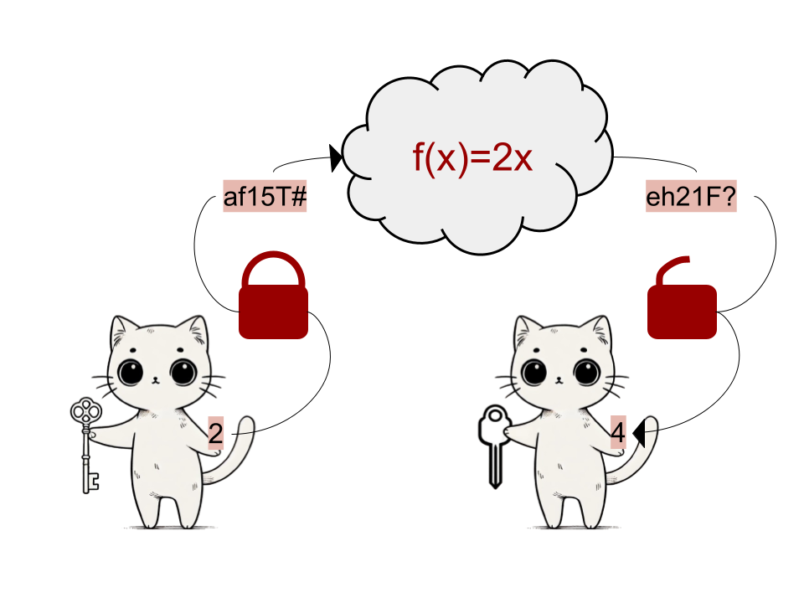
Homomorphic encryption
September, 2024

Slide 3
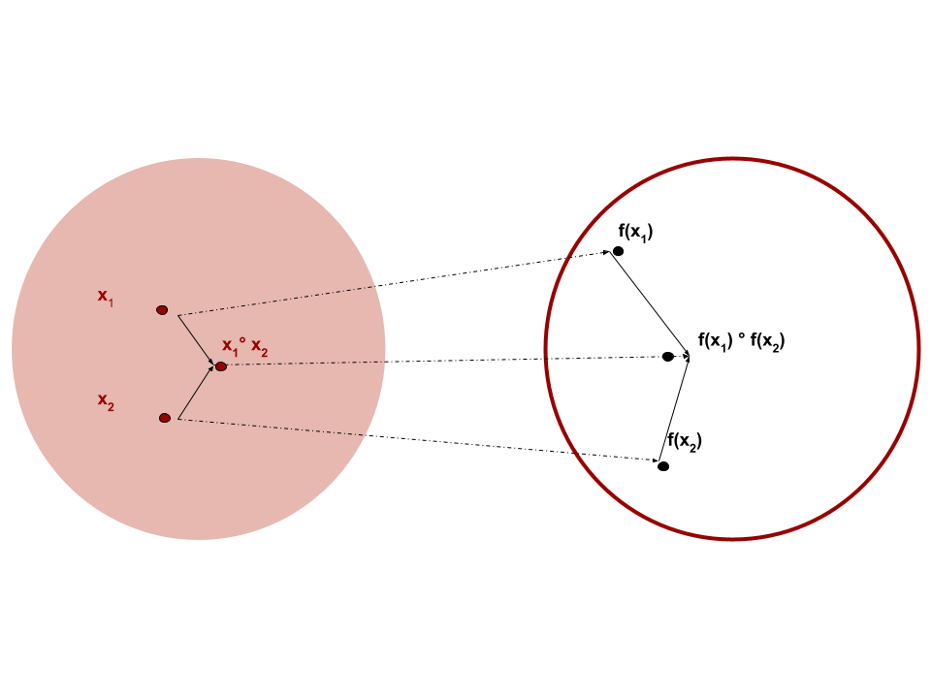
Homomorphism
Homomorphism = map between two algebraic sets if the same type.
An encryption scheme is homomorphic if:
September, 2024

Slide 4

OpenFHE
Framework
Has all of the schemes
User-friendly
Tutorials
September, 2024
Notes:
logos

Slide 5
CKKS Scheme
approximate FHE
supports computations of real numbers
applicable for Privacy-Preserving Machine Learning
September, 2024

Slide 6
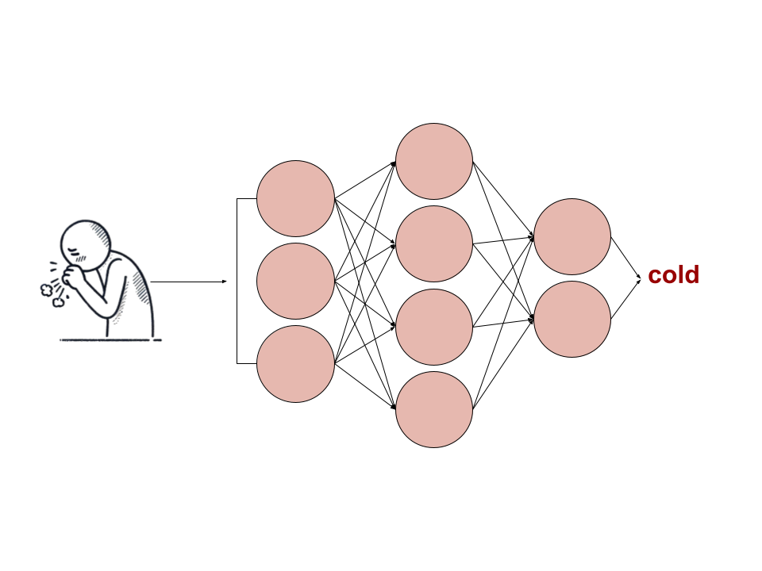


Privacy-preserving Machine Learning
September, 2024
Notes:
example privacy preserving -> a person can encrypt their symptoms or a firm/ hostpital that offers a model, cant reveal data but wants to train the model

Slide 7
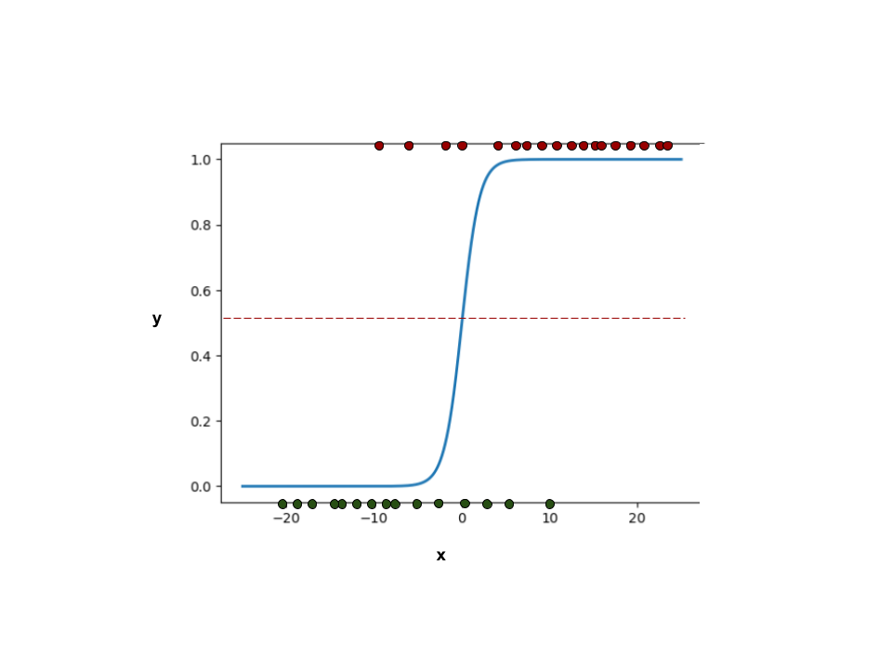
Logistic regression
x is combination of all learned parameters: ex.
= w1​ * color + w2​ * shape + b
learned parameters, weights, affect the position of the sigmoid on the x axis
September, 2024

Slide 8
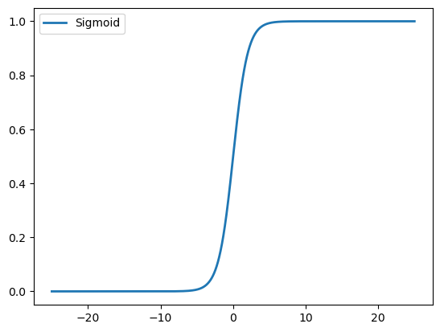
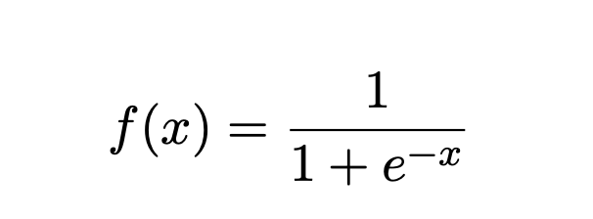
Sigmoid Function
activation function in logistic regression
cannot be represented as a polynomial and needs to be approximated
September, 2024
Notes:
also used in neutral networkd, high performing fhe schemes ckks

Slide 9
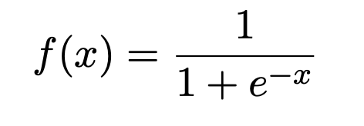
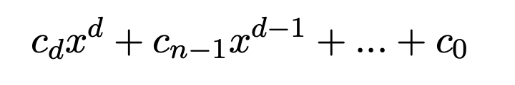
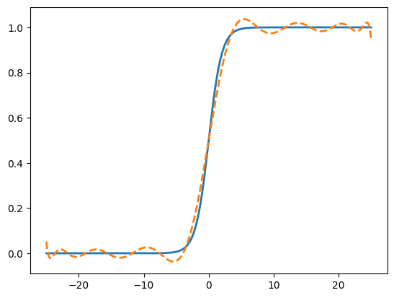
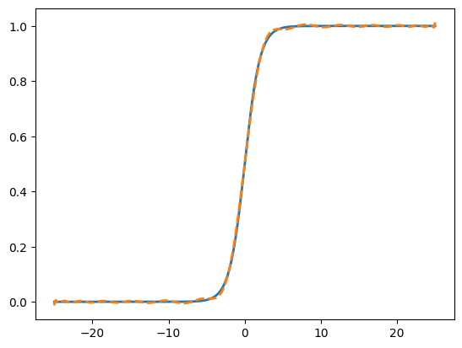
Sigmoid - Polynomial Approximation
Numpy Polynomial.fit()
least-squares fit
September, 2024
Notes:
numpy polyfit -> least-squared, remove text from figires

Slide 10
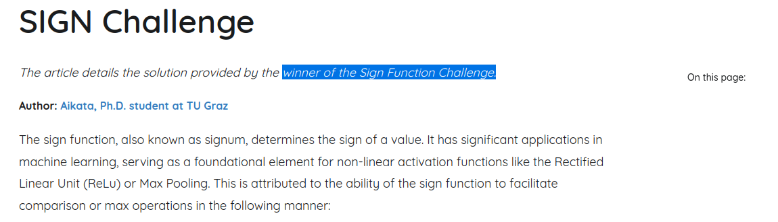
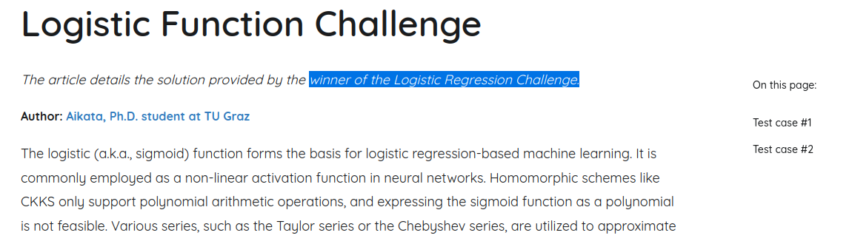
FHERMA Challenges
September, 2024
Notes:
https://fherma.io/about
Fherma: platform for FHE challenges to help developing an open-source FHE library with the main focus on components for machine learning and blockchain.
where AIKATA presented the solutions:
sign challenge:
sigmoid: implemented polynomial evaluation of the sigmoid activation function for the restricted parameters: max depth of 4 and degree 13 and get the accuracy 98.297%
we want to automate the process for any given degree

Slide 11
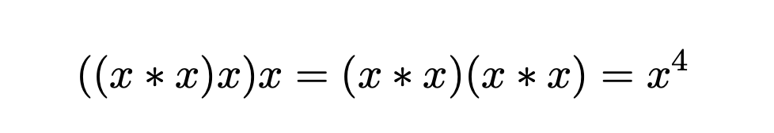
Multiplicative Depth
September, 2024
Notes:
the more depth is left for remaining computation

Slide 12
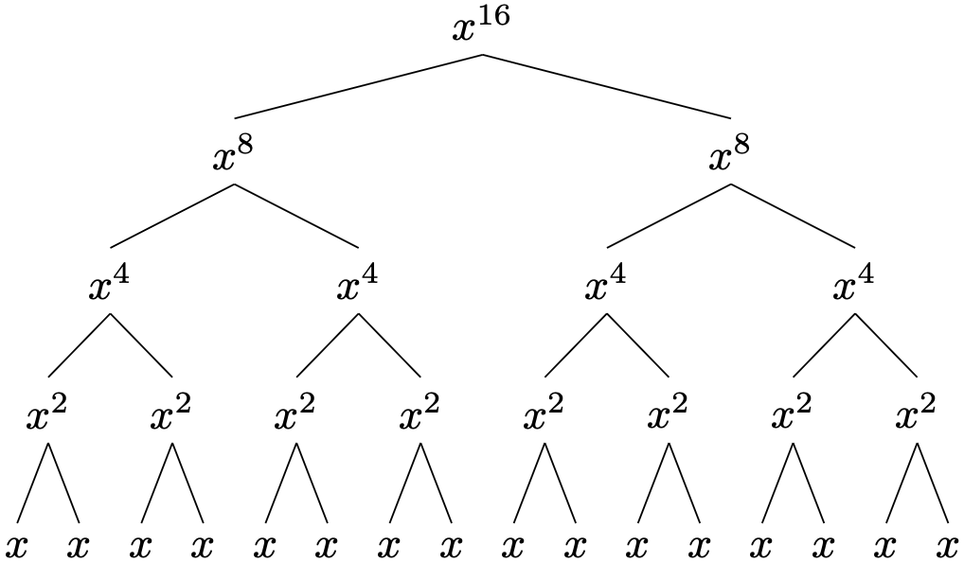
Multiplicative Depth
binary tree decomposition technique
September, 2024
Notes:
binary tree decomposition technique
c * x^15 if we multiply by c at the end depth -> 5, but if we insert it into the tree it stays depth of 4

Slide 13
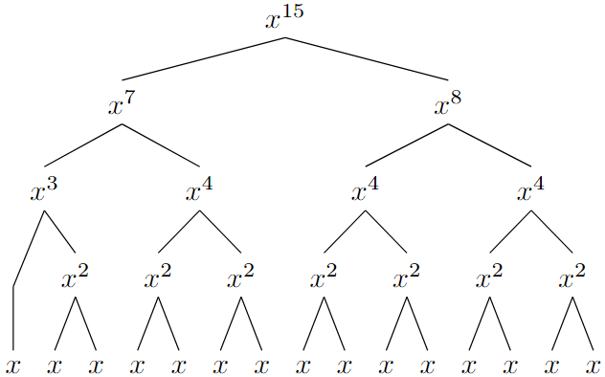
Multiplicative Depth
depth = 4
September, 2024
Notes:
binary tree decomposition technique
c * x^15 if we multiply by c at the end depth -> 5, but if we insert it into the tree it stays depth of 4

Slide 14
Multiplicative Depth
c*
depth = 5
September, 2024
Notes:
binary tree decomposition technique
c * x^15 if we multiply by c at the end depth -> 5, but if we insert it into the tree it stays depth of 4

Slide 15
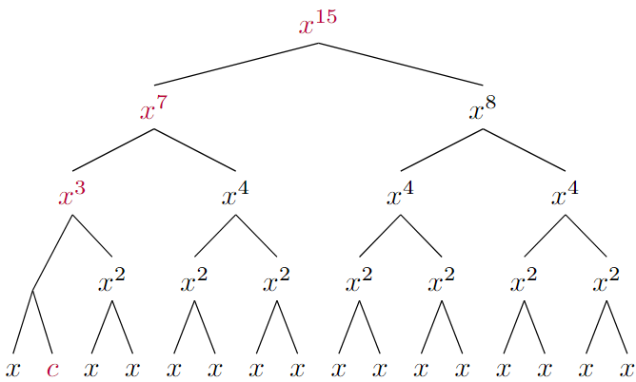
Multiplicative Depth
depth = 4
September, 2024
Notes:
binary tree decomposition technique
c * x^15 if we multiply by c at the end depth -> 5, but if we insert it into the tree it stays depth of 4

Slide 16
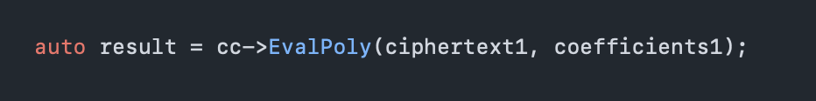
EvalPoly
September, 2024

Slide 17
Our Implementation
sum
recursive tree evaluation
  base case: power = 1 with a flag coeffUsed set to true
  if power odd => eval()
September, 2024

Slide 18
Coefficient Splitting
array([ 5.00000000e-01, 2.26806207e-01, 7.10213751e-11, -1.07117796e-02,
-1.41439692e-12, 3.52123146e-04, 1.27758476e-14, -7.05240408e-06,
-4.73856319e-17, 8.99429984e-08, -2.05300071e-18, -7.61584637e-10,
5.04075306e-20, 4.39092971e-12, -5.50984144e-22, -1.73238634e-14,
3.58582142e-24, 4.55363924e-17, -1.51640495e-26, -7.13526075e-20,
4.28088613e-29, 3.14409283e-23, -7.95812290e-32, 1.26765549e-25,
9.05003211e-35, -3.19383668e-28, -4.70167613e-38, 3.58641738e-31,
-1.54055379e-41, -2.09459946e-34, 3.37570182e-44, 5.15557487e-38,
-1.31014816e-47])
September, 2024

Slide 19
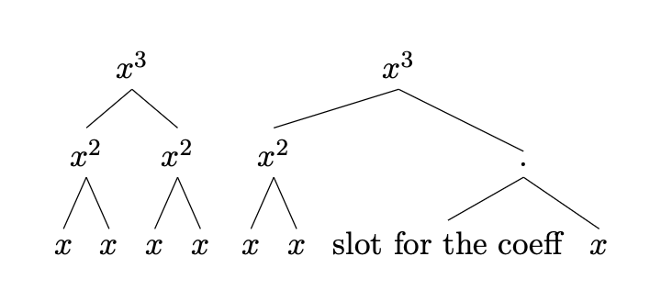
Coefficient Splitting - Thresholds
10⁻¹⁰ -> {c*10¹⁰, 10⁻⁵, 10⁻⁵ }
10⁻²⁰ -> {c*10²⁰, 10⁵, 10⁵, 10⁵, 10⁵}
10⁻⁴⁰ -> {c*10⁴⁰, 10⁵, 10⁵ …}
10⁻⁸⁰ -> {c*10⁸⁰, 10⁵, 10⁵ … }
September, 2024

Slide 20
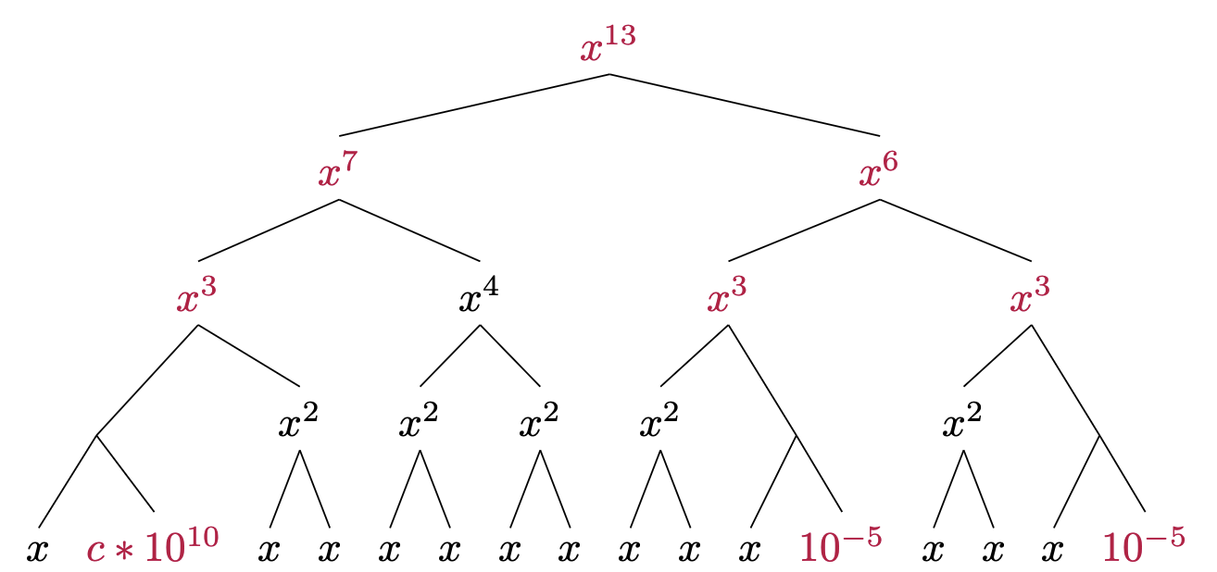
Coefficient Splitting
depth = 4
September, 2024
Notes:
binary tree decomposition technique
c * x^15 if we multiply by c at the end depth -> 5, but if we insert it into the tree it stays depth of 4

Slide 21
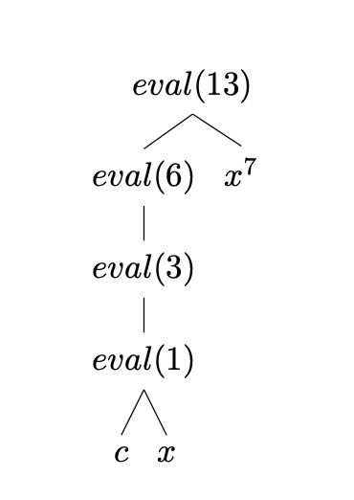
Term pre-generation
September, 2024

Slide 22
Results
Depth | EvalPoly - max. available degree | Our Implementation - max. available degree
3 | 5 | 7
4 | 13 | 15
5 | 27 | 31
6 | 60 | 63
September, 2024

Slide 23
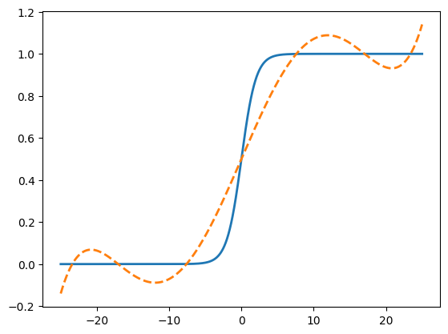
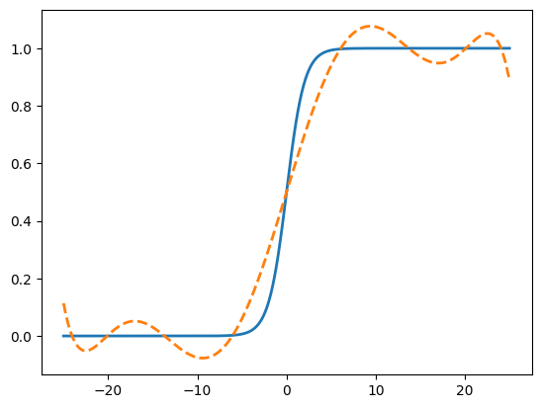
Results
99.04%
99.47%
99.94%
Degree 5
Degree 7
Degree 15
September, 2024

Slide 24
Results
Degree 27: 99.9977%
Degree 31: 99.9969% -> +0.0008%
Degree 63: 99.9985% -> +0.0016%
> jump from degree 28 to 31 half as significant as the jump from degree 31 to 63.
September, 2024

Slide 25
Automated High-depth Privacy-preserving Polynomial Approximation Evaluation
September, 2024

