Slide 1
Workflow Management
Modeling, executing and monitoring of workflow tasks.
A task can be:
- A javascript
- A java process
- A web service
- A manual task
- and etc….

Slide 2
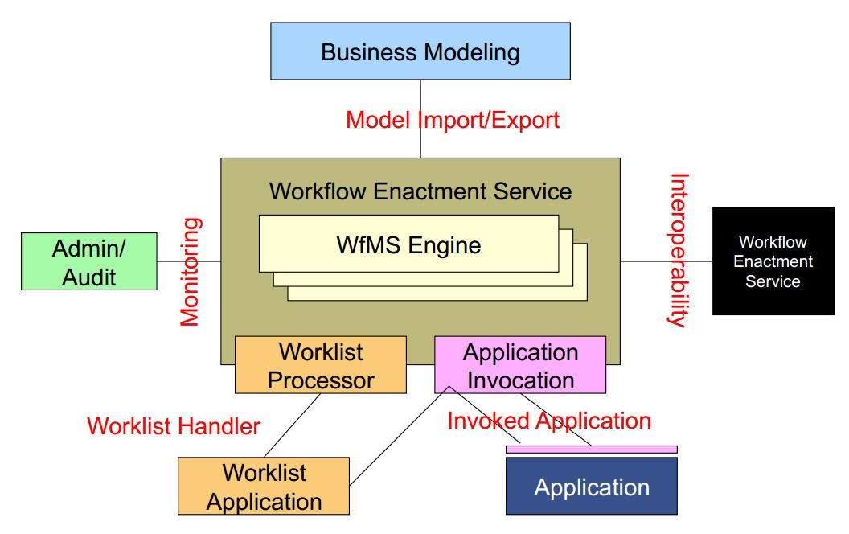
WfMS
Workflow Management System
Allow the user to define different workflows for different types of jobs or processes.
Picture taken from a lecture of Frank Leymann

Slide 3
OrbWork
A project from LSDIS* lab, University of Georgia
Support dynamic changes to workflow
- Task insertion, substitution, detection
- Flow edge detection, change, deletion
- Combination of previous two
How to make it more adaptive?
* Large-Scale Distributed Information System

Slide 4
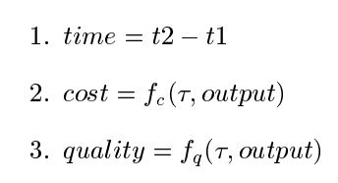
OrbWork
WfMS needs to support adaption
- Detecting the need for change
- Type of change to be made
Before a change is made, they simulate the result
Quality Metrics

Slide 5
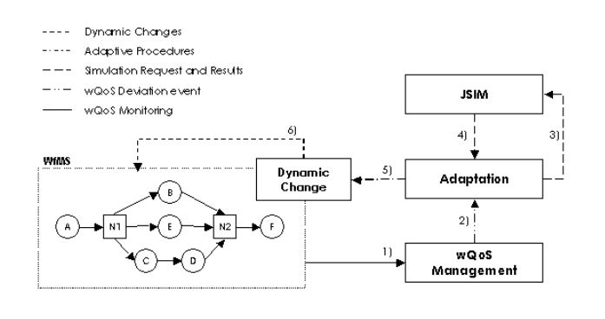
Integration
WfMS is integrated with a simulation tool JSIM

Slide 6
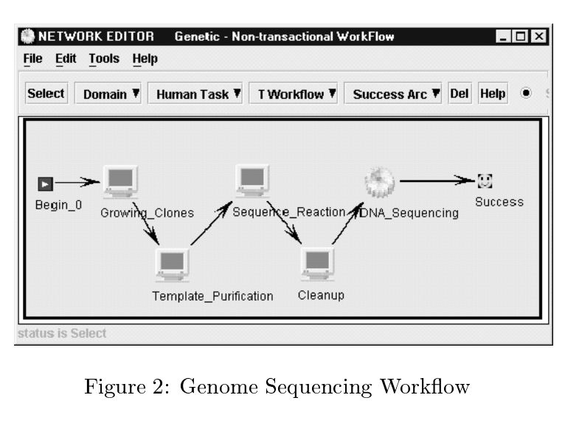
An Example

Slide 7
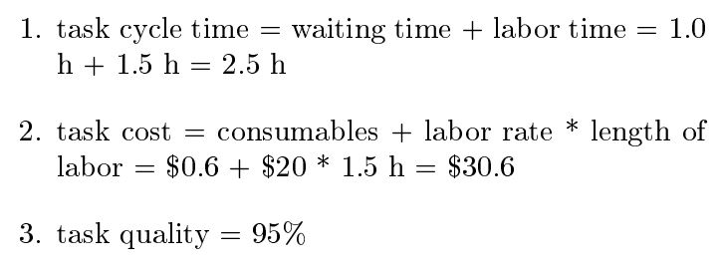
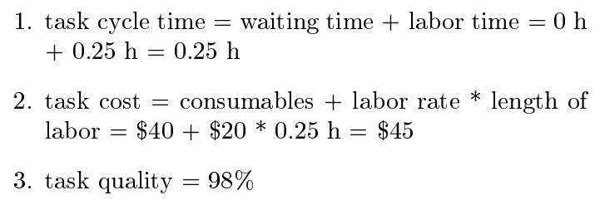
An Example
Quality metrics for cleanup task:
Quality metrics after substituting a task:

Slide 8
Decisions
The following decisions will be taken:
- Whether a workflow should be adapted
- What changes should actually be made

