Slide 1
Analysis, Simulation and Verification of Web Services

Slide 2
Semantic Web
An extension of the web though standards defined by the World Wide Web Consortium
Standards promote and define:
common data formats
exchange protocols
Resource Description Framework (RDF)
Principles applicable to Web services

Slide 3




Semantic Web Services
Web services, are the server end of a client–server system via the World Wide Web
They use markup which makes data machine-readable in a detailed way and sophisticated way.
Languages like: OWL, DAML, OIL and others

Slide 4
Web Services Languages
State of the art
Web Ontology Language(OWL)
Allows data and service providers to semantically describe their resources using third-party ontologies
Based on:
DARPA Agent Markup Language (DAML)
Ontology Inference Layer (OIL)
Combination of DAML and OIL, DAML+OIL

Slide 5
DAML & DAML-S
DAML (DARPA Agent Markup Language)
Started at 1999 as a US Defense Advanced Research Projects Agency project
At 2002 DAML+OIL is submitted at W3C
DAML+OIL was a syntax, layered on RDF and XML
DAML-S
A markup language based on DAML+OIL that was created to specifically describe services.

Slide 6
DAML-S 1/2
DAML-S process model types:
Atomic (non-decomposable Web-accessible)
Composite (is composed of other composite or atomic processes)
Simple (a view or abstraction of a atomic or composite process)
Example
<daml : Class rdf : ID="Process">
<daml : unionOf rdf : parseType="daml : collection">
<daml : Class rdf : about="#Atomic Process"/>
<daml : Class rdf : about="#Simple Process"/>
<daml : Class rdf : about="#Composite Process"/>
</daml : unionOf>
</daml : Class>

Slide 7
DAML-S (2/2)
Inputs can be either mandatory or optional
Output is usually optional
<rdf:Propertyrdf:ID="bookName">
<rdfs:subPropertyOf rdf:resource="&process;#input"/>
<rdfs:domainrdf:resource="#LocateBook"/>
<rdfs:rangerdf:resource="&xsd;#string"/>2
</rdf:Property>

Slide 8
Situation Calculus
Used for representing dynamically changing worlds where changes are done by agents
Situations are sequences of actions evolving from a specific situation
For an action a and a situation s is given by do(a,s)

Slide 9
Petri Net 1/3
A Petri Net is a bipartite graph containing:
places (drawn as circles)
transitions (drawn as rectangles)
Places hold tokens and represent predicates about the world state or internal state.
Transitions are the active component.
The important feature of Petri Net is the ability to model events and states in a distributed environment.

Slide 10
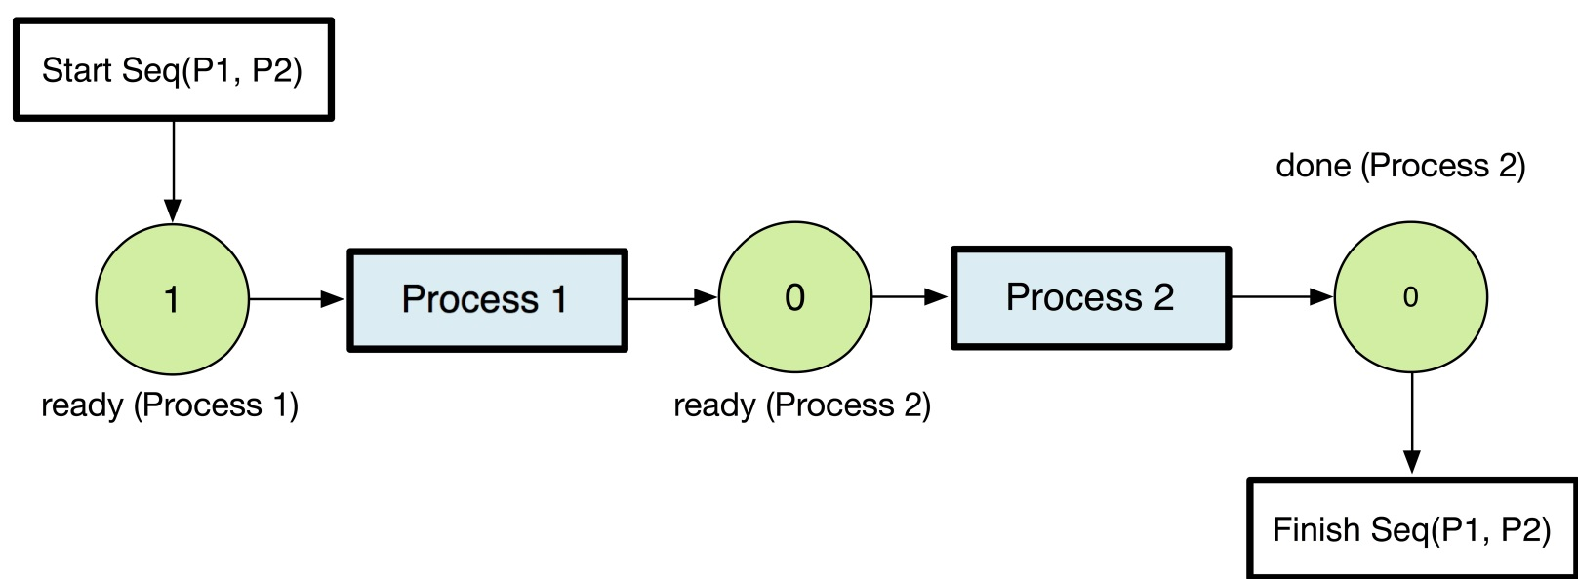
Petri 2/3
Definitions of a Petri Net (PN)
Constructs of a Petri Net (PN)
Finite set of places, P
Finite set of transitions, N
Markings μ / Tokens
Firable transitions at markings μ
Occurrence sequence
Sequence
Split
Split and Join
Choice
If-then-Else
Repeat Condition

Slide 11
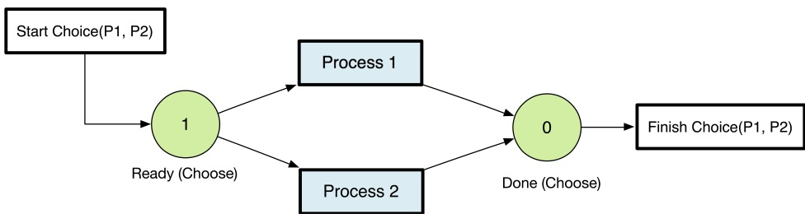
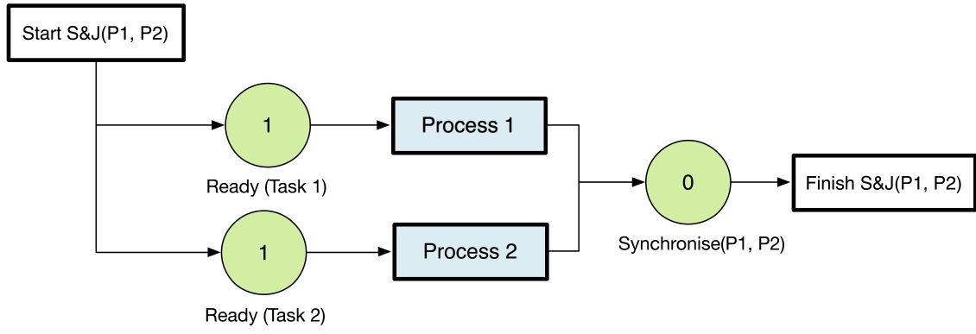
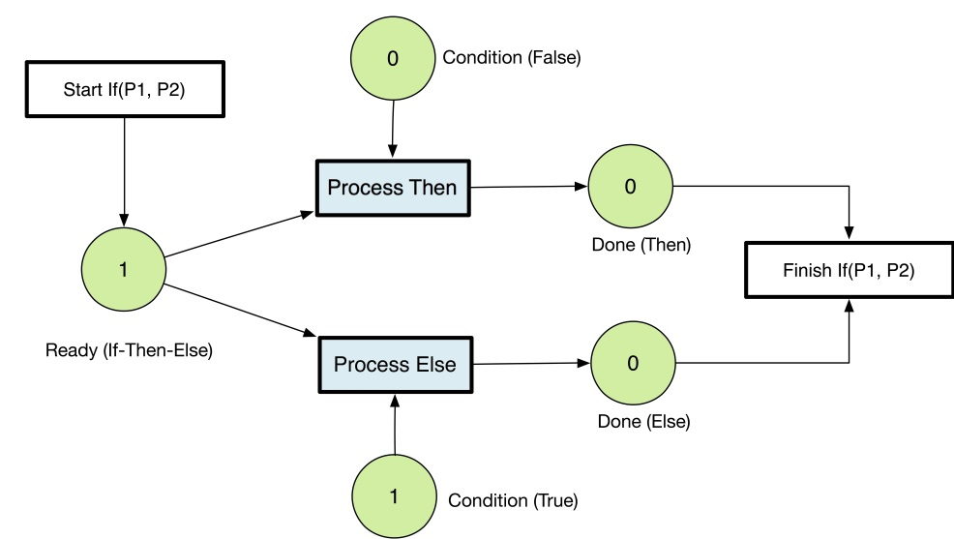
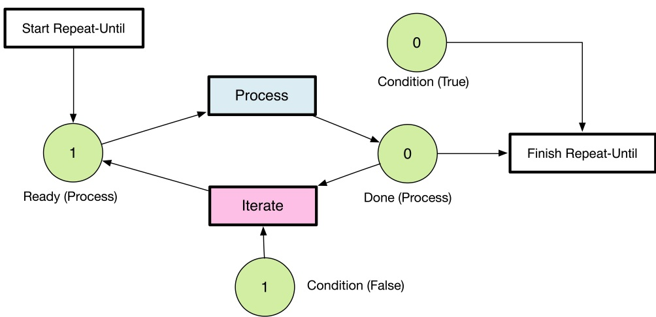
Petri Net 3/3
Choice
If-Then-Else
Split & Join
Iterative

Slide 12
Analysis of Web Services using Petri Net
Simulation – Simulate the evolution of a Web service under different conditions
Validation – Test whether a service behaves as expected
Verification – Establish the upholding of properties
Composition – Generate a composition of services that achieves a specific goal
Performance Analysis – Evaluate the ability of a service to meet requirments

Slide 13
Challenges of Verification
Reachability
Safety of a distributed system is dened as lack of reachability to an unsafe state
Safety of Web Service Compositions
Automated Composition of Web Services

Slide 14
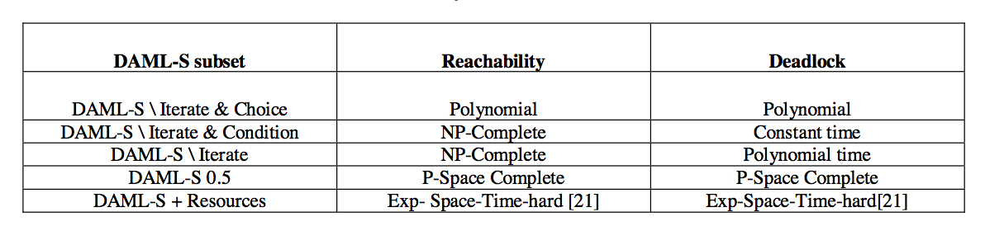
Complexity of DAML-S services tasks

Slide 15
Implementations
Simulation, Verification and Automated Composition of Web Services - Narayanan, McIlraith
A Java DAML-S Interpreter
DAML-S limited markup language
Modeling environment KarmaSIM

