Slide 1
Analysis, Simulation and Verification of Web Services
cs565 presentation by
Munasir Mahtab Priom
Kostas Plelis
Mike Athanasakis

Slide 2
Semantic Web
An extension of the web though standards defined by the World Wide Web Consortium
Standards promote and define:
common data formats
exchange protocols
Resource Description Framework (RDF)
Principles applicable to Web services

Slide 3




Semantic Web Services (1/2)
Web services, are the server end of a client–server system via the World Wide Web

Slide 4
Semantic Web Services (2/2)
A Web service is a software application identified by a URI, whose interfaces and binding are capable of being defined, described and discovered by XML artifacts and supports direct interactions with other software applications using XML based messages via Internet-based protocols. (W3C definition)
Web Services allow
reuse software components
integrate distributed applications
create loosely-coupled applications

Slide 5
Web Services Technologies
XML Messaging
Simple Object Access Protocol (SOAP) - is an XML Messaging Protocol that allows software running on disparate operating systems and different environments to make Remote Procedure Calls (RPC)
Web Services Description
Web Service Description Language (WSDL) – is a language that defines the interface of a Web service, required for interaction between a requester and a service provider
Web Services Registry
Universal Description, Discovery and Integration (UDDI) serves as a “business and service” registry essential for the widespread use of Web services

Slide 6
Web Services Languages
State of the art
Web Ontology Language(OWL)
WSFL, XLANG, BPEL4WS
Allows data and service providers to semantically describe their resources using third-party ontologies
Based on:
DARPA Agent Markup Language (DAML)
Ontology Inference Layer (OIL)
Combination of DAML and OIL, DAML+OIL

Slide 7
DAML & DAML-S
DAML (DARPA Agent Markup Language)
Started at 1999 as a US Defense Advanced Research Projects Agency project
At 2002 DAML+OIL is submitted at W3C
DAML+OIL was a syntax, layered on RDF and XML
DAML-S
A markup language based on DAML+OIL that was created to specifically describe services.

Slide 8
DAML-S 1/2
DAML-S process model types:
Atomic (non-decomposable Web-accessible)
Composite (is composed of other composite or atomic processes)
Simple (a view or abstraction of a atomic or composite process)
Example
<daml : Class rdf : ID="Process">
<daml : unionOf rdf : parseType="daml : collection">
<daml : Class rdf : about="#Atomic Process"/>
<daml : Class rdf : about="#Simple Process"/>
<daml : Class rdf : about="#Composite Process"/>
</daml : unionOf>
</daml : Class>

Slide 9
DAML-S (2/2)
Inputs can be either mandatory or optional
Output is usually optional
<rdf:Propertyrdf:ID="bookName">
<rdfs:subPropertyOf rdf:resource="&process;#input"/>
<rdfs:domainrdf:resource="#LocateBook"/>
<rdfs:rangerdf:resource="&xsd;#string"/>2
</rdf:Property>

Slide 10
Situation Calculus
Used for representing dynamically changing worlds where changes are done by agents
Situations are sequences of actions evolving from a specific situation
For an action a and a situation s is given by do(a,s)

Slide 11
Workflow Management
Modeling, executing and monitoring of workflow tasks.
A task can be:
- A JavaScript script
- A Java process
- A Web Service
- A manual task
- etc …

Slide 12
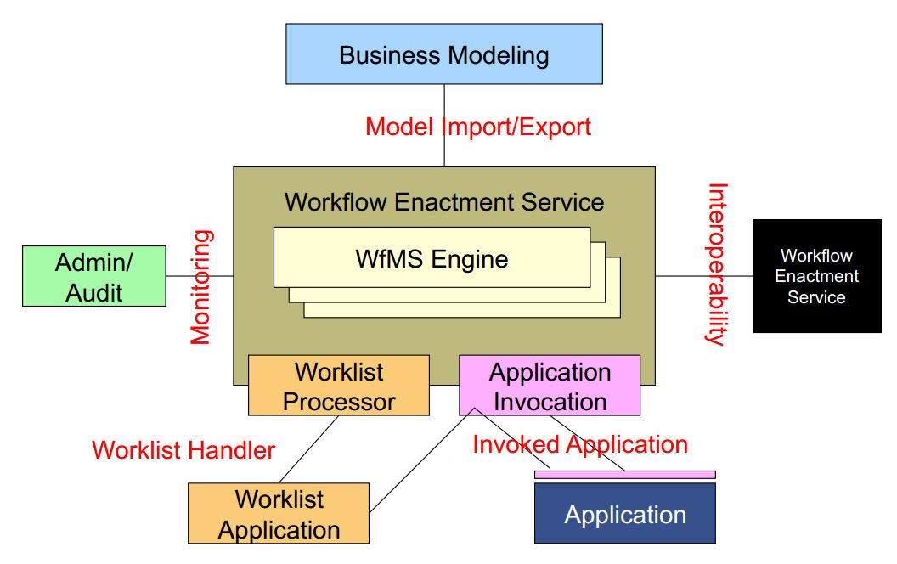
WfMS
Workflow Management System
Allow the user to define different workflows for different types of jobs or processes.
Picture taken from a lecture of Frank Leymann

Slide 13
Petri Net 1/3
A Petri Net is a bipartite graph containing:
places (drawn as circles)
transitions (drawn as rectangles)
Places hold tokens and represent predicates about the world state or internal state.
Transitions are the active component.
The important feature of Petri Net is the ability to model events and states in a distributed environment.

Slide 14
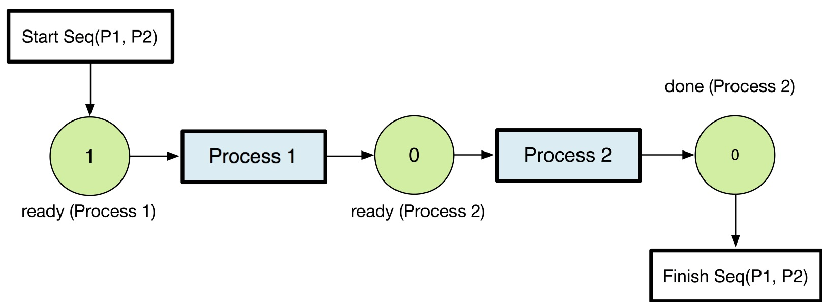
Petri 2/3
Definitions of a Petri Net (PN)
Constructs of a Petri Net (PN)
Finite set of places, P
Finite set of transitions, N
Markings μ / Tokens
Firable transitions at markings μ
Occurrence sequence
Sequence
Split
Split and Join
Choice
If-then-Else
Repeat Condition

Slide 15
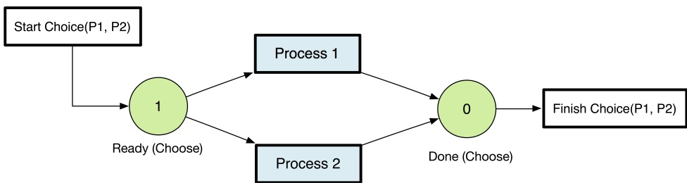
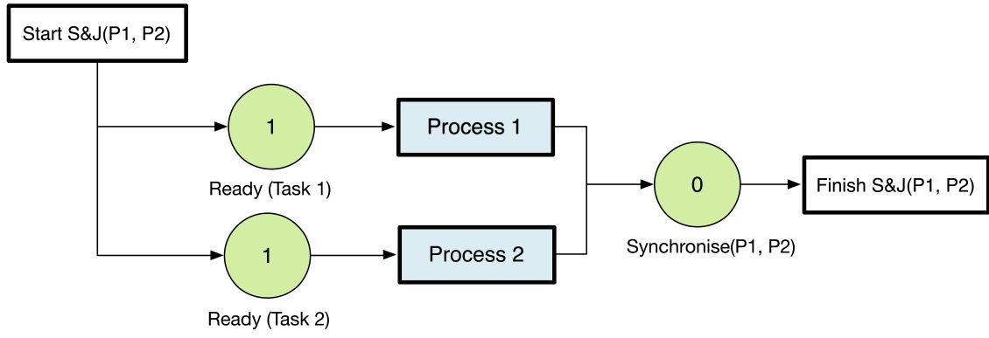
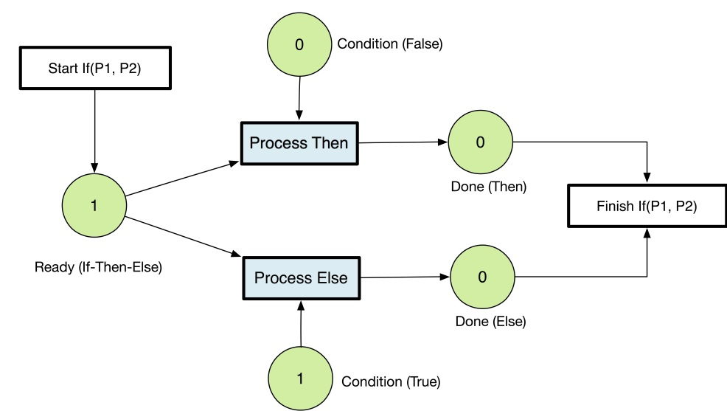
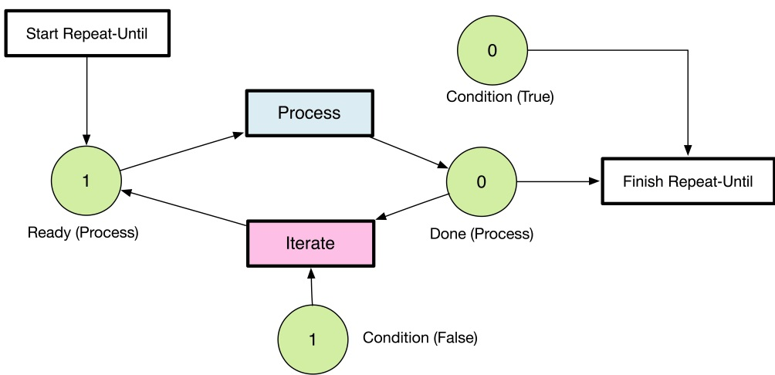
Petri Net 3/3
Choice
If-Then-Else
Split & Join
Iterative

Slide 16
Analysis of Web Services
Simulation – Simulate the evolution of a Web service under different conditions
Validation – Test whether a service behaves as expected
Verification – Establish the upholding of properties
Composition – Generate a composition of services that achieves a specific goal
Performance Analysis – Evaluate the ability of a service to meet requirments

Slide 17
Challenges of Verification
Reachability
Safety of a distributed system is dened as lack of reachability to an unsafe state
Safety of Web Service Compositions
Automated Composition of Web Services

Slide 18
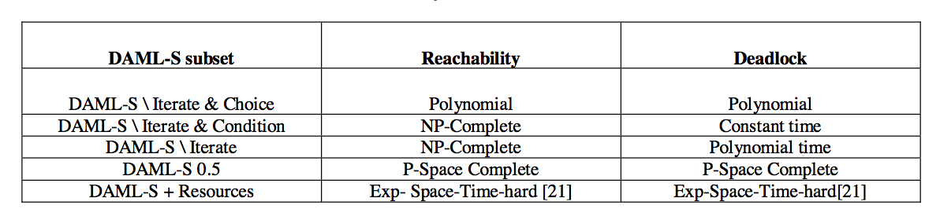
Complexity of DAML-S services tasks

Slide 19
Possible implementations
Simulation, Verification and Automated Composition of Web Services - Narayanan, McIlraith
A Java DAML-S Interpreter
DAML-S limited markup language
Modeling environment KarmaSIM

Slide 20
OrbWork
A project from LSDIS* lab, University of Georgia
Support dynamic changes to workflow
- Task insertion, substitution, detection
- Flow edge detection, change, deletion
- Combination of previous two
How to make it more adaptive?
* Large-Scale Distributed Information System

Slide 21
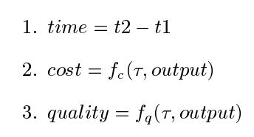
Improvement of OrbWork
WfMS needs to support adaption
- Detecting the need for change
- Type of change to be made
Before a change is made, they simulate the result
Quality Metrics

Slide 22
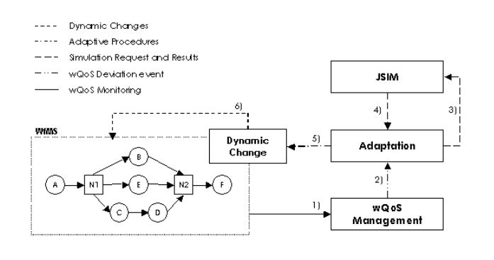
Integration
WfMS is integrated with a simulation tool JSIM

Slide 23
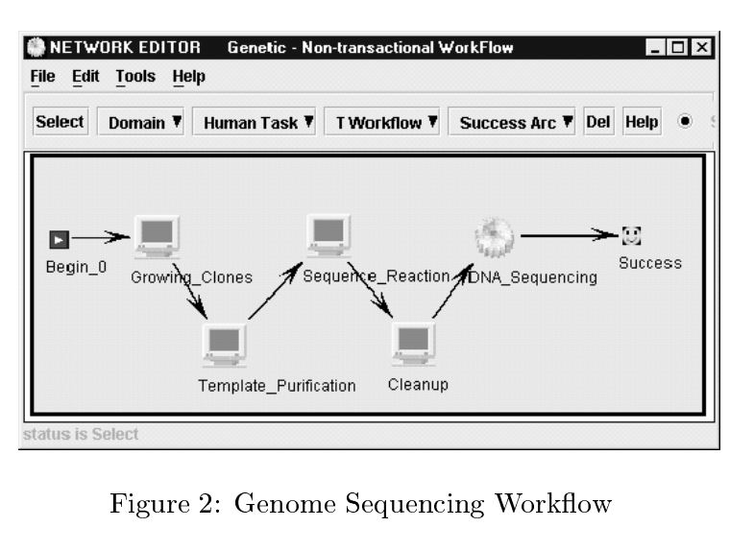
An Example

Slide 24
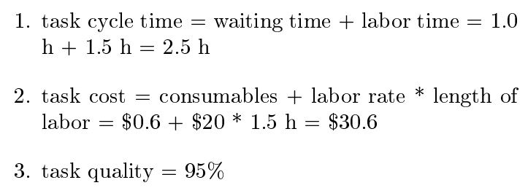
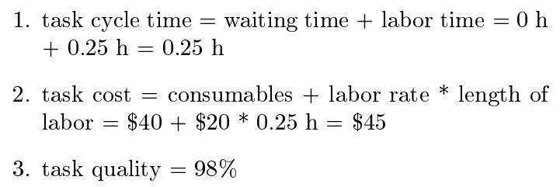
An Example
Quality metrics for cleanup task:
Quality metrics after substituting a task:

Slide 25
Decisions
The following decisions will be taken:
- Whether a workflow should be adapted
- What changes should actually be made

Slide 26
Web Service Composition (1/3)
Is the task of combining and linking existing
Web services to create new Web processes
It adds value to the collection of services, by orchestrating them according to the requirement of the problem
Types of Composition
Static Composition - services to be composed are decided at design time
Dynamic Composition - services to be composed are decided at run-time

Slide 27
Web Service Composition (2/3)
Service Requestor
Service Broker
Individual Service
Invocation
Remote
Web Service
Repository
Search
(SOAP)
Web Service
Lookup
SOAP
(UDDI)
Invoke WS
Invoke
Composite Service
Execution
WSFL
Service Providers
Compose
Abstract Process
Search
(SOAP)
Remote
Web service
(WSDL)
Web Service
Lookup
Published
Web
Services
(SOAP)
Remote
Web service
Execute
Compose
Concrete Process
Remote
Web service
Execute

Slide 28
Web Service Composition (3/3)
Representation of a Abstract Web Process
Representing/specifying the abstract process in a proper form
Discovery and Interoperability of Services
Need to manually or automatically search for appropriate services
The discovered services should interoperate
Process Execution
Adopting a suitable technique for executing the composed concrete process
Process Monitoring
Using a monitoring technique for run time analysis of the Web process execution
Efficiency of a Composed Web Process
Need to compose processes which are efficient in terms of performance

Slide 29
SCET (Service Composition and Execution Tool)
SCET allows
to compose services statically by modeling the process as a digraph in a graphical designer
stores the process description as WSFL based specification
allows execution of the composed process using Perl
supports a simple execution monitoring feature
supports performance estimation using JSIM simulation

Slide 30
Composition Representation (1/2)
Similar to Workflow representations, a Web Process in SCET is represented as a digraph consisting of
Activities
Represent tasks involved in the process
Each activity stores information about the Web service implementing the task (WSDL File Location, Operation, Input Message, Output Message etc.,)
Control Links
Specify the control flow (sequencing conditions) within the process
Currently, SCET supports XOR splits in the process specification

Slide 31
Composition Representation (2/2)
Data Links
Specify the flow of information between activities
Data Routing (SCET)
Routes the output data of a Web service to the input of another Web service without modifying the data
Data Mapping (Future Work)
Maps the output of the first Web service to a subsequent Web service by applying a transformation function (e.g. indexing in an array, extracting a particular field, etc.)
WS1
WS2
Data

Slide 32
Discovery of Services (1/2)
The Web service which is to implement an activity needs to be discovered
Static Discovery of Web Services (SCET)
Composer manually discovers the services from service repositories (e.g., UDDI registry, ebXML registry, Web sites)
Interoperability between services
Data Routing
The user specifies which Web service’s output needs to be routed to which Web service’s input (as done in SCET using data links)
Data Mapping
The user can provide adapters which transforms the output of a Web service into a form that can be consumed by the input of another Web service
SCET can be enhanced to provide this adapter feature for performing data mapping

Slide 33
Discovery of Services (2/2)
Dynamic Discovery of Web Services (Future Work)
Automated service discovery from Web service registries
Registries need to provide semantic information about services
Support for dynamic negotiation of costs, service level agreements and contracts etc.
Interoperability between services
Data Routing & Data Mapping
Requires understanding the semantics of the service’s inputs and outputs in order to automate the interoperability of discovered services

Slide 34
Service Composition Designer

Slide 35
Discovery of Services (2/2)
Dynamic Discovery of Web Services (Future Work)
Automated service discovery from Web service registries
Registries need to provide semantic information about services
Support for dynamic negotiation of costs, service level agreements and contracts etc.
Interoperability between services
Data Routing & Data Mapping
Requires understanding the semantics of the service’s inputs and outputs in order to automate the interoperability of discovered services

Slide 36

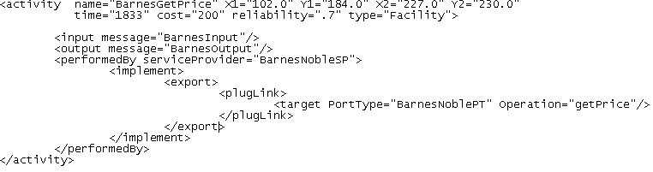
Web Service Flow Language (WSFL – 1/2)
SCET uses WSFL for specifying processes
WSFL is IBM’s XML language for describing Web Services Composition
Extended WSFL to include Quality of Service specification such as time, cost and reliability
Constructs
Activity Elements
Message Elements
QoS specification
(time, cost, reliability)

Slide 37

Web Service Flow Language (WSFL – 2/2)
Web Service Information
Service Provider Elements
Control Link Elements
Data Link Elements
Conditional Branching
Data Routing

Slide 38
Process Execution
Centralized approach (SCET)
The services involved in the process are
coordinated by a centralized scheduler
Advantage
Suitable where coordination between
Web services is difficult to be achieved
Easy to implement
Disadvantage
Creates bottle neck at the coordinator as
all messages need to propagate back
and forth between the controller and
other services
Distributed approach
The entities participating in a composite
service execution coordinate among themselves
C
WS1
WS3
WS2
C
WS1
WS2
WS3

Slide 39
Performance Analysis (1/5)
Performance evaluation of Web services can help implementers understand the behavior of the activities in a composed process
Web services performance evaluation techniques
Time Analysis
Load Analysis
Process Execution Monitoring

Slide 40
Performance Analysis (2/5)
Time Analysis
Time taken by a Web service invocation has three components:
Message Delay Time (M)
Waiting Time (W)
Service Time (S)
T(σ) = M(σ) + W(σ) + S(σ), where σ is a Web service
Performing tests to measure the above components for each service involved in a process will indicate a measure of their efficiency

Slide 41
Performance Analysis (3/5)
Load Analysis
Performed by gradually loading
each Web service involved in the
process, and then measuring
their invocation times
After a certain load point, the
performance of the Web service will start degrading.
This point is the load range to which the Web service is able to perform effectively

Slide 42
Performance Analysis (4/5)
Process Execution Monitoring
Monitoring the total number of Web service invocations present at a host will help in analyzing the process
SCET is capable of visually displaying the expected number of Web service invocations present in Web service σ’s host
(represented by L_{n}(σ) )
L_{n}(σ) = W(σ_{n}) + S(σ_{n}) S_{n}(σ) = ∑ (T(σ_{i}) – M(σ_{i}))
n
i=1
S_{n}(σ)
n

Slide 43
Performance Analysis (5/5)
Difficulties in Conducting Performance Analysis Tests
For conducting performance analysis tests, we require the Web services to be managed by the composer
If the services involved are real world services (e.g., Flight Booking Service), then performance analysis by conducting real tests is not feasible
To overcome these problems, Simulation could be used as an alternative technique to do performance estimation

Slide 44
Simulation (1/3)
Simulation helps in determining how composed Web services
will perform under various hypothetical conditions
Simulation can provide feedback on the process that was composed allowing the composer to modify his process design by
Replacing services which do not satisfy the expected simulation service time means, with better Web services
Modifying the process structure (control flow) based on the simulation runs
SCET Process
Composition
Execution
WSFL
JSIM
Model
Simulation Model
Generator
JSIM Simulation
Feedback from Simulation

Slide 45
Simulation (2/3)
The JSIM simulation model takes as input the service time distribution and the mean service time for each activity involved in the process
The Simulation Model Generator of SCET converts the WSFL based specification into JSIM Model
As both WSFL process and JSIM Model are represented as digraph the mapping is done as follows
WSFL process
JSIM Model
Activity
Facility
Control Links
Transports
Execution
Simulation Entity

Slide 46
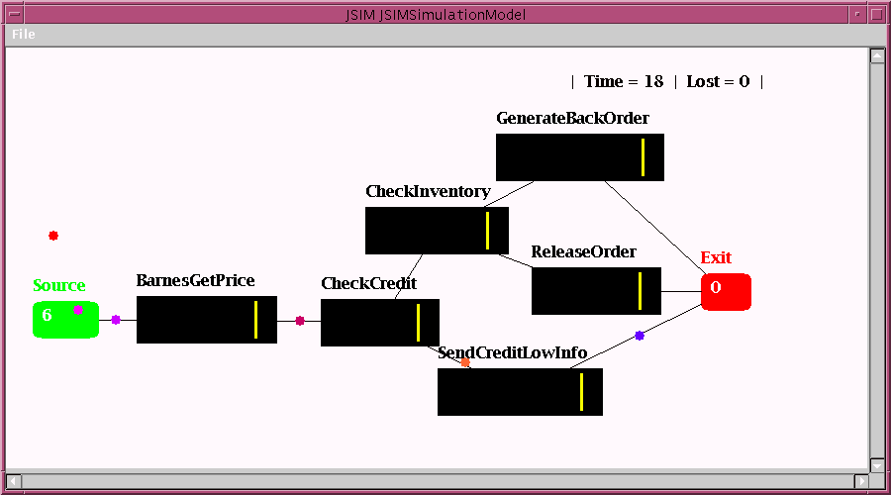
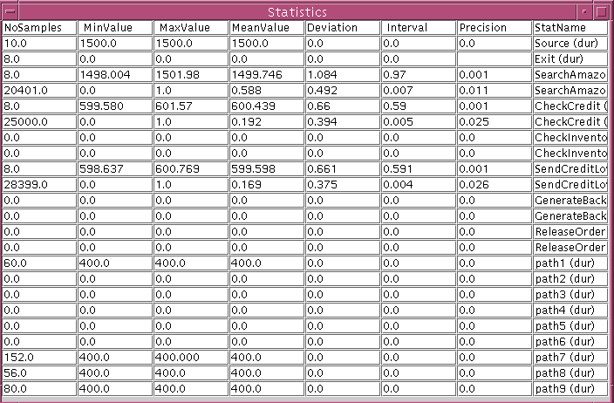
Simulation (3/3)
JSIM
Simulation
Statistical
Simulation
Results

Slide 47
Conclusions
Issues and Problems
Static composition
Users need to discover services manually analyzing the Web service descriptions provided by the service provider
Dynamic composition
Dynamic discovery requires Web service Descriptions and Web service registries need to provide more semantic description
Control Flow and Data Flow Among Services
Need to support control flow constructs such as XOR splits, XOR joins, AND splits, AND joins, and WHILE loops in the process composition
In static compositions the composer manually specifies the Data Routing/Mapping between services, while in dynamic compositions the machine has to automate this task

