Slide 1

看
狗
门
Ⅱ
Watch DogⅡ
Notes:
字库选择，汉仪字库，方正字库，造字工坊。的字库比较齐全

Slide 2

看门狗第二部
Watch DogⅡ

Slide 3

静夜湖

Slide 4

SKY IN FLY

Slide 5
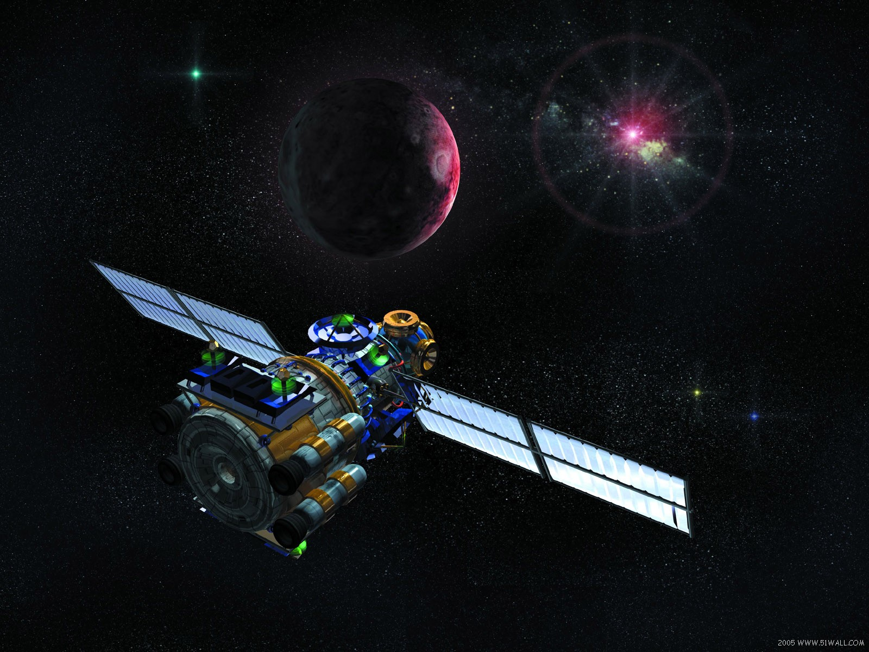
无
线
通
信
与
网
络

Slide 6
仰望星空

Slide 7

Notes:
组合，拆分。编辑顶点 shift+图形等边长放大、

Slide 8
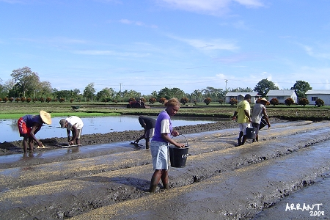
《悯农二首》
唐代李绅
春种一粒粟，秋收万颗子。
四海无闲田，农夫犹饿死。
锄禾日当午，汗滴禾下土。
谁知盘中餐，粒粒皆辛苦？
Notes:
版面排版：左右，上下，文本加蒙版，加框线等

Slide 9


色调值
0
25
40
70
130
150
200
240

Slide 10
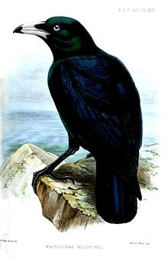
Birds are usually feathered and oviparous animals with extremely high metabolic rate and mostly hollow long bones, so most birds can fly. Birds evolved from reptiles. There are more than 9,000 species of birds in the world, all of which have wings and feathers. Even those birds that have lost their flight ability ( such as ostriches, penguins, etc. ) are no exception. The earliest birds appeared 150 million years ago. The body is spindle - shaped, forelimbs are specially shaped into wings, the body surface has feathers, the body temperature is constant, the muscle chest is developed, the bone is healed, thin and hollow, and the brain is relatively developed
Great
Great tits are " guardians of orchards". A great tits preys on pests equivalent to its own weight in a day.
Bird love is a virtue.
Birds can not only bring infinite vitality to nature and add infinite pleasure to human life, but also the vast majority of birds are beneficial birds, which is beneficial to maintaining ecological balance.
Notes:
制作图表

Slide 11
2018年度汇总表

Slide 13
45%
Made in china

