Slide 1
Cluster/Grid Computing
Maya Haridasan

Slide 2
Motivation for Clusters/Grids
Many science and engineering problems today require large amounts of computational resources and cannot be executed in a single machine.
Large commercial supercomputers are very expensive…
A lot of computational power is underutilized around the world in machines sitting idle.

Slide 3

Overview: Clusters x Grids
Network of Workstations (NOW) - How can we use local networked resources to achieve better performance for large scale applications?
How can we put together geographically distributed resources (including the Berkeley NOW) to achieve even better results?

Slide 4
Is this the right time?
Did we have the necessary infrastructure to be trying to address the requirements of cluster computing in 1994?
Do we have the necessary infrastructure now to start thinking of grids?
  More on this later…

Slide 5
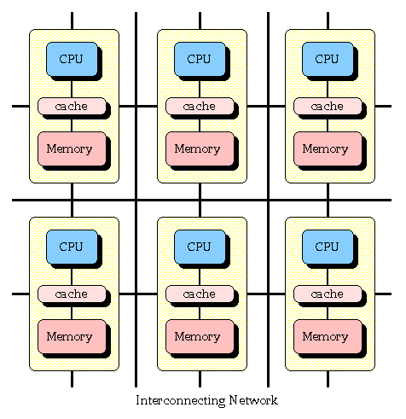
Overview – existing architectures
1980s → It was believed that computer performance was best improved by creating faster and more efficient processors.
Since the 1990s → Trend to move away from expensive and specialized proprietary parallel supercomputers
MPP – Massively Parallel Processor

Slide 6
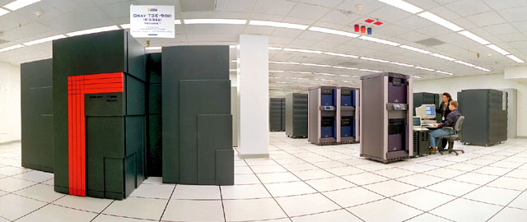
MPP - Contributions
It is a good idea to exploit commodity components.
  Rule of thumb on applying curve to manufacturing:
“When volume doubles, costs reduce 10%”
Communication performance
Global system view

Slide 7
MPP-Lessons
It is a good idea to exploit commodity components. But it is not enough.
  Need to exploit the full desktop building block
Communication performance can be further improved through the use of lean communication layers (von Eicken et al.)

Slide 8

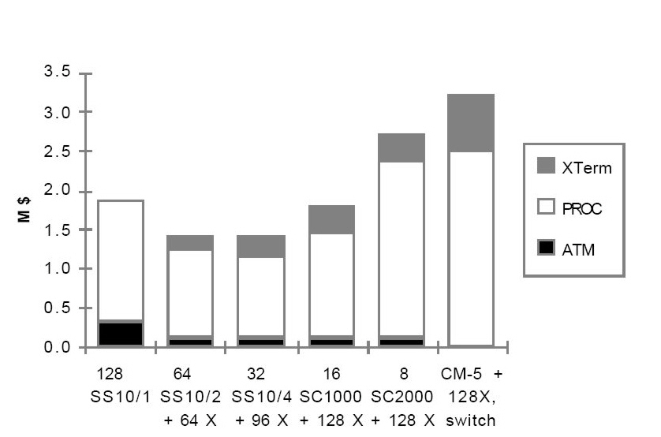
Cost of integrating systems

Slide 9
Definition of cluster computing
Fuzzy definition
Collection of computers on a network that can function as a single computing resource through the use of additional system management software
Can any group of Linux machines dedicated to a single purpose can be called a cluster?
Dedicated/non-dedicated, homogeneous/non-homogeneous, packed/geographically distributed???

Slide 10
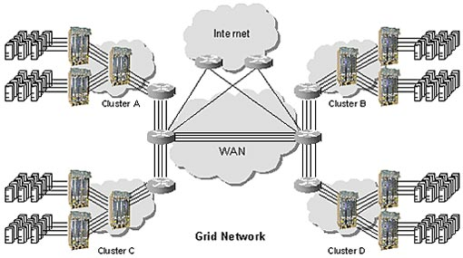

Ultimate goal of Grid Computing
Maybe we can extend this concept to geographically distributed resources…

Slide 11
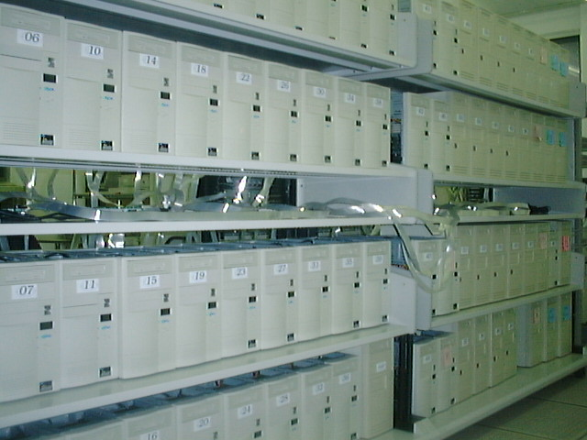
Why are NOWs a good idea now?
The “killer” network
  Higher link bandwidth
  Switch based networks
  Interfaces simple & fast
The “killer” workstation
  Individual workstations are becoming increasingly powerful

Slide 12

NOW - Goals
Harness the power of clustered machines connected via high-speed switched networks
Use of a network of workstations for ALL the needs of computer users
Make it faster for both parallel and sequential jobs

Slide 13

NOW - Compromise
It should deliver at least the interactive
performance of a dedicated workstation…
While providing the aggregate resources of
the network for demanding sequential and
parallel programs

Slide 14
Opportunities for NOW
Memory: use aggregate DRAM as a giant cache for disk
 | Ethernet |  | 155 Mbit/s ATM
 | Remote Memory | Remote Disk | Remote Memory | Remote Disk
Mem. Copy | 250 μs | 250 μs | 250 μs | 250 μs
Net Overhead Data | 400 μs 6250 μs | 400 μs 6250 μs | 400 μs 800 μs | 400 μs 800 μs
Disk | -- | 14,800 μs | -- | 14,800 μs
TOTAL | 6,900 μs | 21,700 μs | 1,450 μs | 16,250 μs
How costly is it to tackle coherence problems?

Slide 15
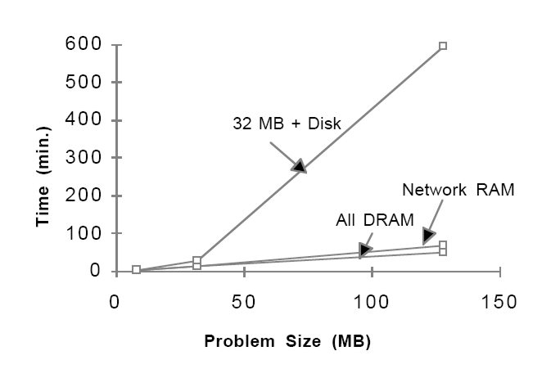
Opportunities for NOW
Network RAM: can it fulfill the original promise of virtual memory?

Slide 16
Opportunities for NOW
Cooperative File Caching
  Aggregate DRAM memory can be used cooperatively as a file cache
Redundant Arrays of Workstation Disks
  RAID can be implemented in software, writing data redundantly across an array of disks in each of the workstations on the network

Slide 17
NOW for Parallel Computing
Machine | ODE | Transport | Input | Total | Cost
C-90 (16) | 7 | 4 | 16 | 27 | $30M
Paragon (256) | 12 | 24 | 10 | 46 | $10M
RS-6000 (256) | 4 | 23340 | 4030 | 27374 | $4M
“ + ATM | 4 | 192 | 2015 | 2211 | $5M
“ + Parallel file system | 4 | 192 | 10 | 205 | $5M
“ + low overhead messages | 4 | 8 | 10 | 21 | $5M

Slide 18
NOW Project - communication
Low overhead communication
  Target: perform user-to-user communication of a small message among one hundred processors in 10 μs.
  Focus on the network interface hardware and the interface into the OS – data and control access to the network interface mapped into the user address space.
    Use of user level Active Messages

Slide 19
OS for NOW - Tradeoffs
Build kernel from scratch
  possible to have a clean, elegant design
  hard to keep pace with commercial OS development
Create layer on top of unmodified commercial OS
  struggle with existing interfaces
  work-around may exist for common cases

Slide 20
GLUnix
Effective management of the pool of resources
  Built on top of unmodified commercial UNIXs – glues together local UNIXs running on each workstation
  Requires a minimal set of changes necessary to make existing commercial systems “NOW-ready”

Slide 21
GLUnix
Catches and translates the application’s system calls, to provide the illusion of a global operating system
The operating system must support gang-scheduling of parallel programs, identify idle resources in the network (CPU, disk capacity/bandwidth, memory capacity, network bandwidth), allow for process migration to support dynamic load balancing, and provide support for fast inter-process communication for both the operating system and user-level applications.

Slide 22
Architecture of the NOW System
Parallel Applications
Sequential Applications
Sockets, MPI, HPF, …
GLUnix (Global Layer Unix)
(Resource Management, Network RAM, Distributed Files, Process Migration
Unix
Workstation
Unix
Workstation
Unix
Workstation
Unix
Workstation
AM
AM
AM
AM
Net. Interface HW
Net. Interface HW
Net. Interface HW
Net. Interface HW
Myrinet

Slide 23

xFS: Serverless Network File Service
Drawbacks of central server file systems (NFS, AFS): performance, availability, cost
Goal of xFS:
  High performance, highly available network file system that is scalable to an entire enterprise, at low cost.
Client workstations cooperate in all aspects of the file system

Slide 24
Cluster Computing - challenges
Software to create a single system image
Fault tolerance
Debugging tools
Job scheduling
All these have been/are being addressed since then and are leading towards a successful era for cluster computing

Slide 25
NOW - Similar work
Beowulf project: approaches the use of dedicated resources (PCs) to achieve higher performance, instead of using idle resources - (more targeted towards high performance computing?). Tries to achieve the best overall cost/performance ratio.
What is the best approach? Is sharing of idle cycles (as opposed to a dedicated cluster) actually a practical and scalable idea? How to control the use of resources?

Slide 26
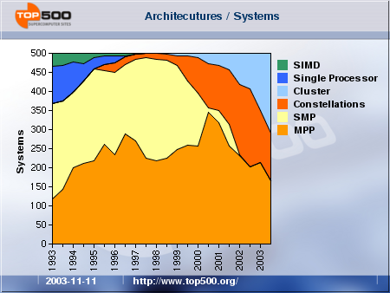
Architecture trends – top500.org

Slide 27
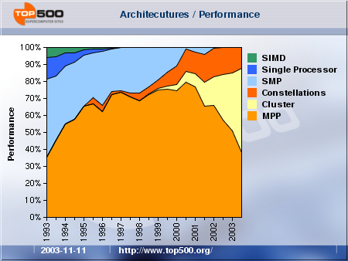
Performance – top500.org

Slide 28
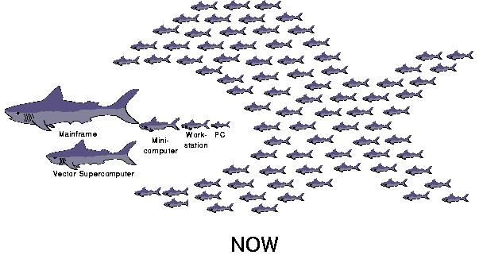
NOW (and the future?)
NOWs are pretty much consolidated by now.
What about Grids?

Slide 29
Why are Grids a good idea now?
Our computational needs are infinite, whereas our financial resources are finite.
Extends the original ideas of Internet to share widespread computing power, storage capacities, and other resources
Ultimate goal of turning computational power seamlessly accessible the same way as electrical power. Imagine connecting to an outlet and being able to use the computational resources you need. Challenging and attractive, isn't it?

Slide 30

But are we ready for grid computing?
Can we ignore the communication cost in a large area setting?
  Only embarrassingly parallel applications could possibly achieve better performance
And once again: sharing idle resources can be unfair – can we control the use of resources?
Many large scale applications deal with large amounts of data. Doesn’t this stress the weaker link between the end user and the grid?
And what about security???

Slide 31
Up-to-Date Definition of a Grid (Ian Foster)
A grid should satisfy three requirements:
  Coordinates resources that are not subject to centralized control
  Uses standard, open, general-purpose protocols and interfaces
  Delivers nontrivial qualities of service
Does Legion satisfy these requirements???

Slide 32
Legion: Goals
To design and build a wide-area operating system that can abstract over a complex set of resources and provide a high-level way to share and manage them over the network, allowing multiple organizations with diverse platforms to share and combine their resources.
  Share and manage resources
    Maintain the autonomy of multiple administrative domains
      Hide the differences between incompatible computer architectures
        Communicate consistently as machines and network connections are lost
        Respect overlapping security policies
  …

Slide 33
Legion and its peers
  Representative current grid computing environments:
Legion: Provides a high-level unified object model out of new and existing components to build a metasystem
Globus: Provides a toolkit based on a set of existing components with which to build a grid environment
WebFlow: Provides a web-based grid environment

Slide 34
Legion: overview
No administrative hierarchy
Component-based system
  Simplifies development of distributed applications and tools
  Supports a high level of site autonomy - flexibility
All system elements are objects
  Communication via method calls
  Interface specified using an IDL
  Host/Vault objects

Slide 35
Legion: Managing tasks and objects
Class Manager object type (Classes)
  Supports a consistent interface for object management
  Actively monitors their instances
  Supports persistence
    Acts as an automatic reactivation agent
Create()
Object placement
Binding requests
Class C
C1
C3
C2

Slide 36
Legion: Naming
All entities are represented as objects
Three-level naming scheme
  LOA (Legion object address): defines the location of an object
    But Legion objects can migrate…
  LOIDs (Legion object identifiers): globally unique identifiers
    But they are binary…
  Context space: hierarchical directory service
Binding Agents, Context objects

Slide 37
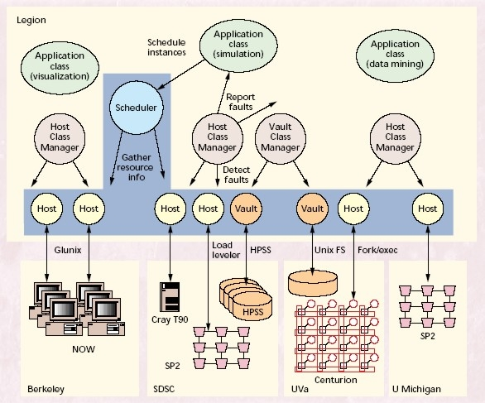
Legion

Slide 38

Legion: Security
RSA public keys in the object’s LOIDs
  Key generation in class objects
  Inclusion of the public key in the LOID
May I? – access control at the object level
Encryption and digital signatures in communication

Slide 39

Legion: questions
Is a single virtual machine the best model? It provides transparency, but is transparency desired for wide area computing? (Same issue as in RPC) Faults can't be made transparent.
Why not use DNS as an universal naming mechanism? Are universal names a good idea?
There is no performance analysis in the text. Can’t the network links between distributed resources become a bottleneck?

Slide 40
Conclusions?
Cluster computing has already been consolidating its place in the realm of large scale applications – prone to be used in several different settings.
Grid computing is still a very new field and has only been successfully used for embarassingly parallel applications.
Do we know where we are heading (grid computing)?
  It’s hard to predict if grid computing will actually become a reality as originally envisioned. Many challenges still need to be overcome, and the role it should play is still not very clear.

