Slide 1
Grid Computing Software Infrastructure I:
Web services
Slides for Grid Computing: Techniques and Applications by Barry Wilkinson, Chapman & Hall/CRC press, © 2009.
Chapter 6, pp. 179-196. For educational use only. All rights reserved. Sept 13, 2009
6-1.<number>

Slide 2
Distributed Computing
Software Techniques
Adopted for grid infrastructure components
Object oriented approaches
CORBA (Common Request Broker Architecture)
Java Remote Method Invocation (RMI)
Web services
Remote Procedure calls (RPC)
Concept of service registry
Beginnings of service oriented architecture
Sockets
Client-server model
XML
Mark-up languages, HTML
Networks
Internet
WWW
1985
1990
1995
2000
2005
6-1.<number>

Slide 3
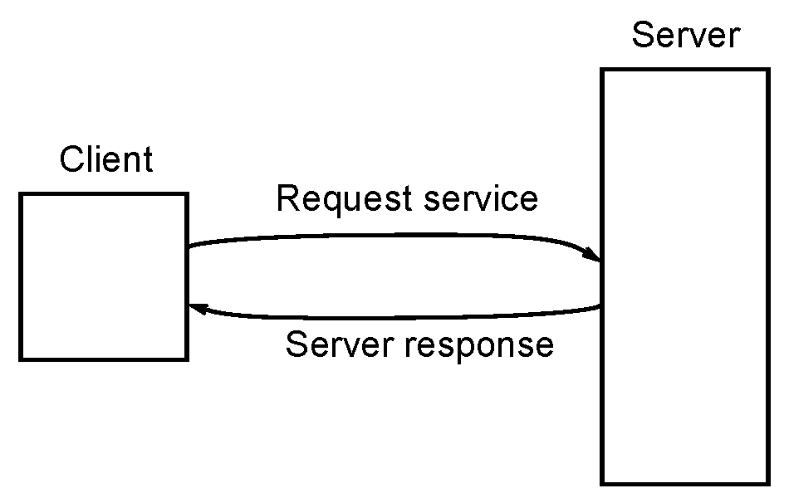
Client-server model
One of the underlying concepts of distributed computing introduced in 1980s
Fig 6.1
6-1.<number>

Slide 4
Remote Procedure Call
Early “client-server” system (1980’s).
Allows a local program to execute a procedure on a remote computer and get back results from the procedure.
Basis of certain remote operations such as mounting remote files in a shared file system.
6-1.<number>

Slide 5
Remote Procedure Call Fundamental issues
We need to know where and how to make the call.
Where - Calling program needs to know where to send request.
How - Basic RPC requires calling program to know details about how to make the call (meaning and types augments and return value)
6-1.<number>

Slide 6
Where to find service
Service Registry
RPC introduced concept of a service registry, a third party used to identify location of “service” (procedure).
Using a service registry part of what is now called a Service-Oriented Architecture.
6-1.<number>

Slide 7
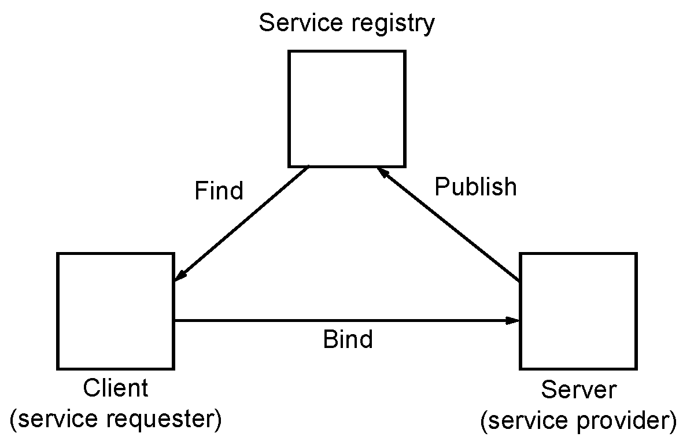
Service-Oriented Architecture
Steps:
Services “published” in a Service registry.
Service requestor asks Service Registry to locate service.
Service requestor “binds” with service provider to invoke service.
6-1.<number>

Slide 8
Later “RPC” systems
(1990’s)
Later forms of remote procedure calls in 1990’s introduced distributed objects:
Examples
CORBA (Common Request Broker Architecture)
Java RMI (Remote Method Invocation)
6-1.<number>

Slide 9
How to make call
Fundamental disadvantage of remote procedures:
Need for calling programs to know implementation-dependent details of remote procedural call.
  Parameters with specific meanings and types
  Return value(s) have specific meaning and type.
Each remote procedure could have different and incompatible arrangements.
6-1.<number>

Slide 10
Interface Definition Languages (IDLs)
Enabled interface to be described in a language/machine-independent manner.
Allow programs to interact in different languages (e.g. between C and Java).
However, not always completely platform/language independent.
6-1.<number>

Slide 11
Some aspects for a better system
Need:
Universally agreed standardized interfaces
Inter-operability
Flexibility
Agreed network communication standards/protocols
Enter Web services and XML
6-1.<number>

Slide 12
Web Services
Introduced in 2000.
Software components designed to provide specific operations (“services”) accessible using standard Internet technologies and standardized protocols.
For machine interaction over a network.
6-1.<number>

Slide 13
Key aspects
Has similarities with RMI and other distributed object technologies (CORBA etc.) but:
Web Services are platform independent. They use:
  Standardized XML languages
  Standardized Internet network protocols.
6-1.<number>

Slide 14
Locating a Web service
(Where)
Web services usually addressed by a URL (Uniform Resource Locator)
Example
http://coit-grid01.uncc.edu/webservices/math1
This particular URL would only be meaningful to Web service software.
(We will describe more advanced addressing later.)
6-1.<number>

Slide 15
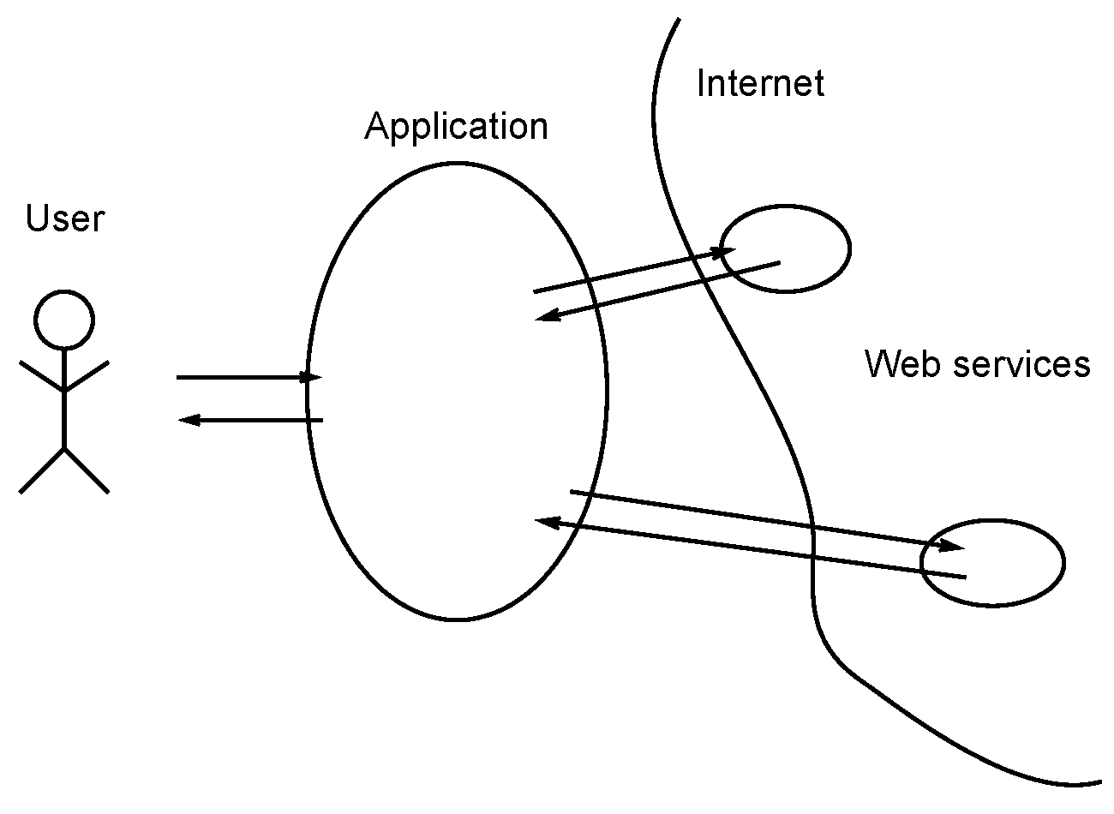
Application employing Web services
Fig 6.3
6-1.<number>

Slide 16
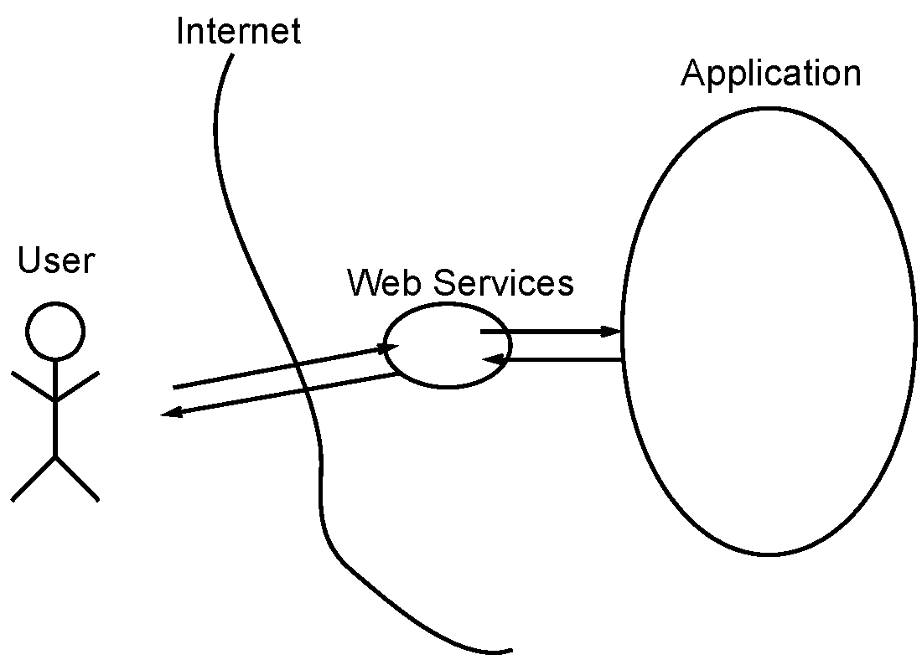
Web service front-end to an application
Fig 6.4
6-1.<number>

Slide 17
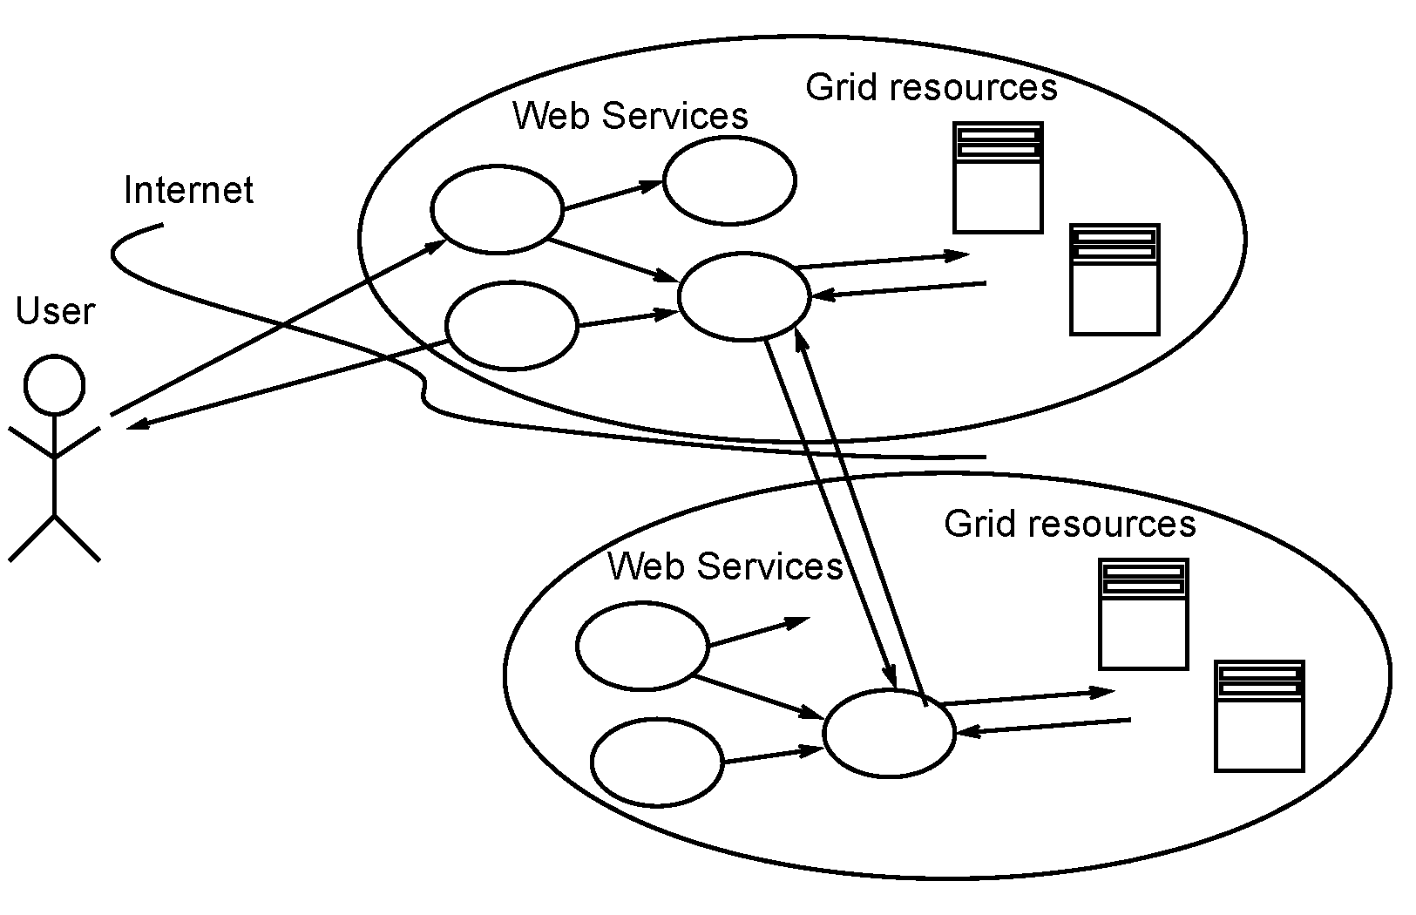
Web services for distributed Grid components
Fig 6.5
6-1.<number>

Slide 18
Stateless Web services
Generally Web services regarded as stateless.
They do not remember or store information themselves from one invocation to another.
Reasonable since a Web service might be accessed by many requestors in no specific order.
Same characteristic found accessing Web pages. One can move from one Web page to another, so can other users without interference.
6-1.<number>

Slide 19
Stateful Web services
Web service can be a “front-end” to stateful resource.
Example
  A retail business inventory accessed through a Web service. Web service can return information to requestor about say a product.
Web services can incorporate state in Web Service Resource Framework (WSRF)
  Needed in Grid computing
  Consider later.
6-1.<number>

Slide 20
Communication protocols for Web services
Web services use XML documents.
Hence need a communication protocol for passing XML documents.
6-1.<number>

Slide 21
Simple Object Access Protocol (SOAP)
Communication protocol for passing XML documents.
SOAP originally abbreviation of Simple Object Access Protocol, but now simply SOAP.
6-1.<number>

Slide 22
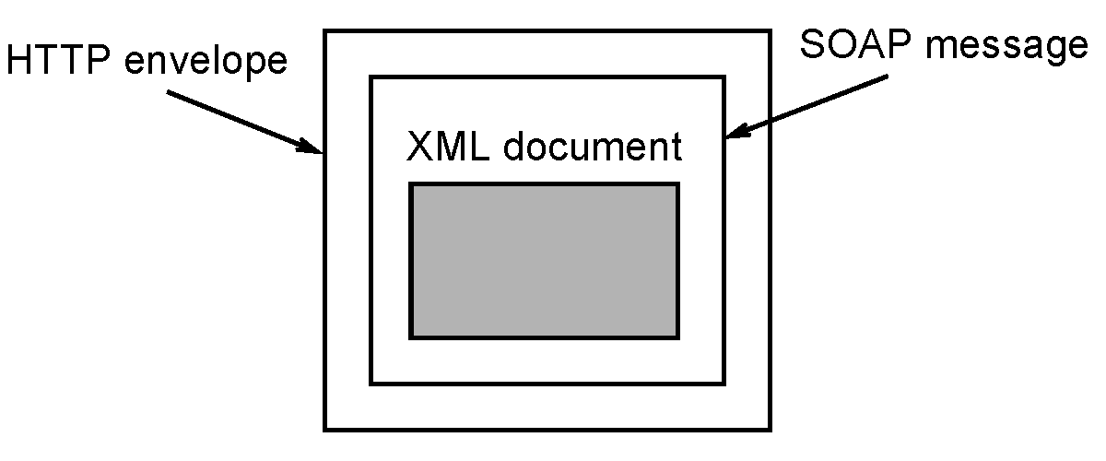
Web Service Protocols
Usually a HTTP transport protocol carries SOAP messages holding XML documents.
Fig 6.6
6-1.<number>

Slide 23
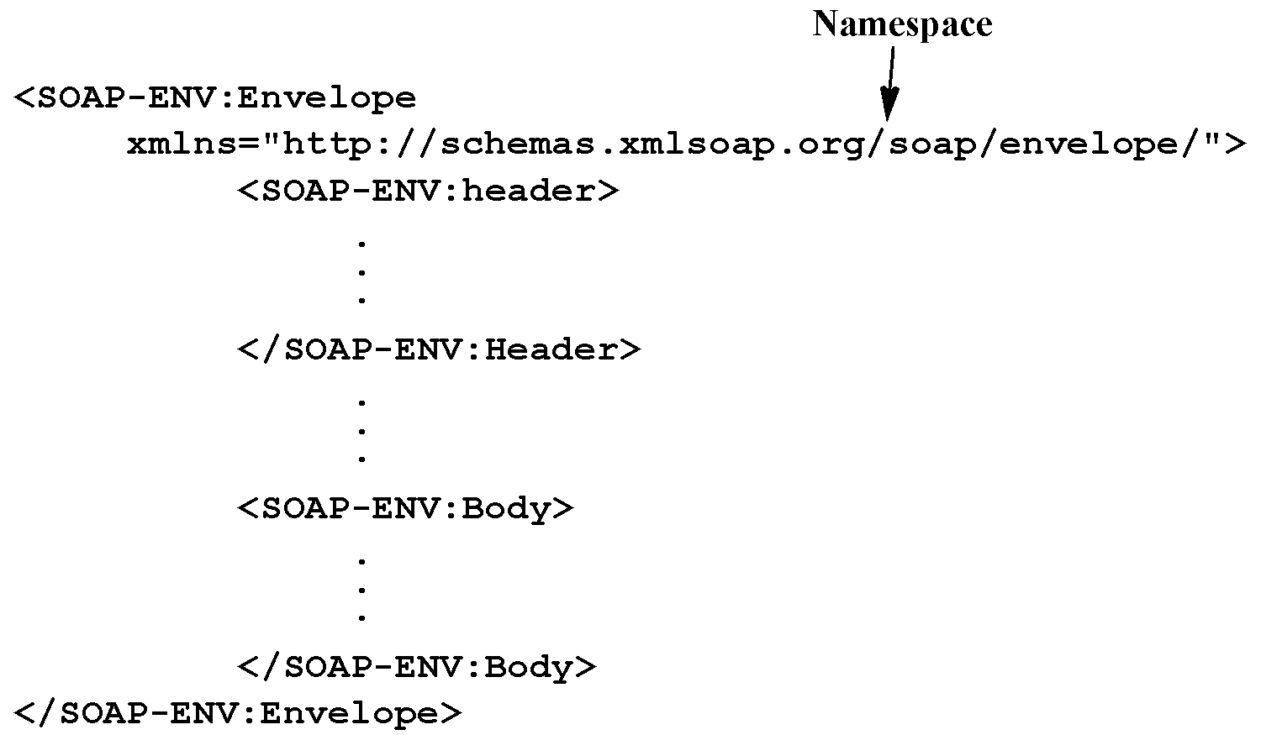
SOAP Envelope
Fig 6.7
6-1.<number>

Slide 24
What goes down the Wire
HTTP packet containing:
  Stuff about context, transactions, routing, reliability, security
  SOAP message
  Attachments
XML/SOAP standardization body, World Wide Web Consortium (W3C) covers SOAP and attachments.
6-1.<number>

Slide 25
Defining a Web Service Interface
Need a way of formally describing a service, what is does, how it is accessed, etc.
Need an Interface Description Language (IDL)
For Web services, this IDL is an XML language
6-1.<number>

Slide 26
Web Service Description Language (WSDL)
A W3C standard XML document that describes three fundamental properties of a service:
What it is - operations (methods) it provides.
How it is accessed - data format, protocols.
Where it is located - protocol specific network address.
W3C -- The World Wide Web Consortium (W3C), www.w3c.org
6-1.<number>

Slide 27
WSDL
Version 1.1 introduced in 2001
Version 1.2 proposed in 2003 and renamed as WSDL version 2 in 2004
  Official W3C recommendation in June 2007.
  Intended to improve on WSDL 1.1
  Significant differences to WSDL 1.1 - not compatible
WSDL 1.1 widely used and adopted in Grid computing software (together with WSRF to make service stateful).
WSDL 2.0 beyond scope of course.
6-1.<number>

Slide 28
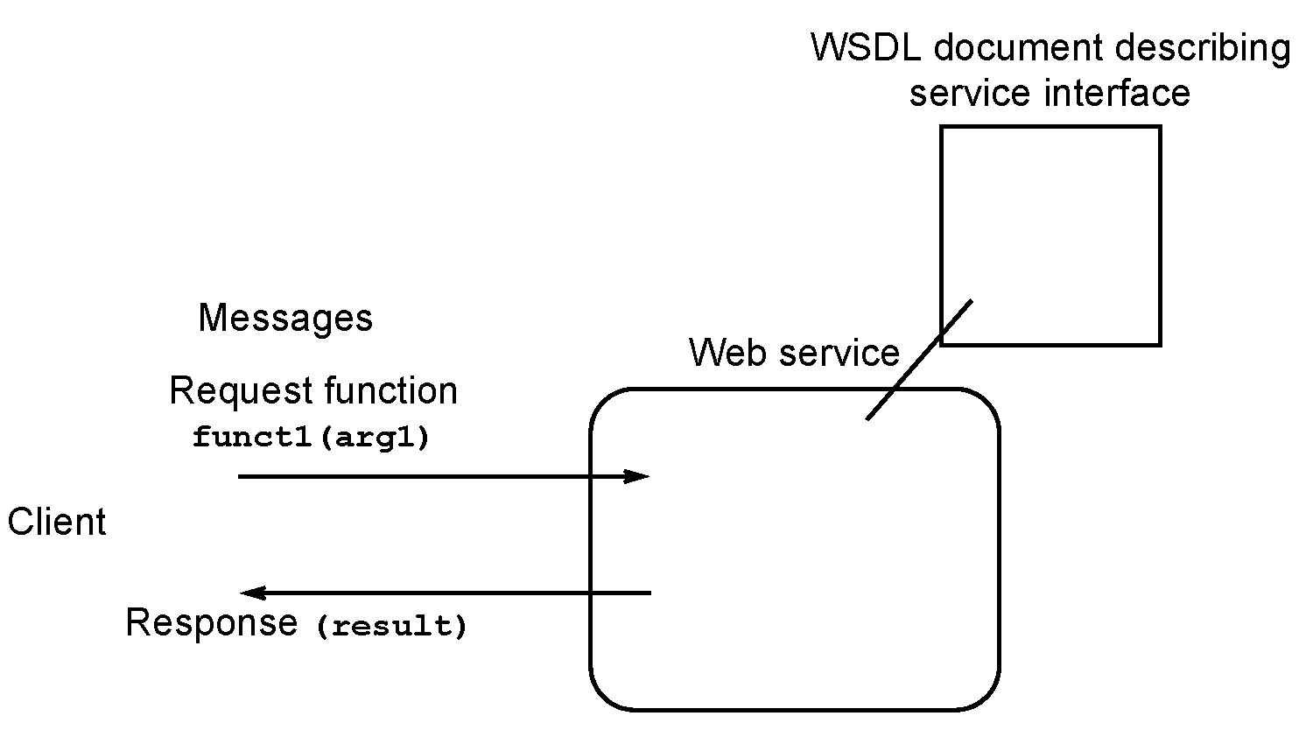
Example - Generic Web service
One function (operation) called funct1
  One arguments: arg1
  Returns result based only upon argument
Fig 6.8
6-1.<number>

Slide 29
Parts of a WSDL 1.1 Document
Root definitions - namespaces
portType definitions - abstract service definition
Message definitions - parameters in method signature
Type definitions - data types
Binding definitions – protocols, i.e. SOAP over HTTP
Service definitions - where service is, ports
6-1.<number>

Slide 30
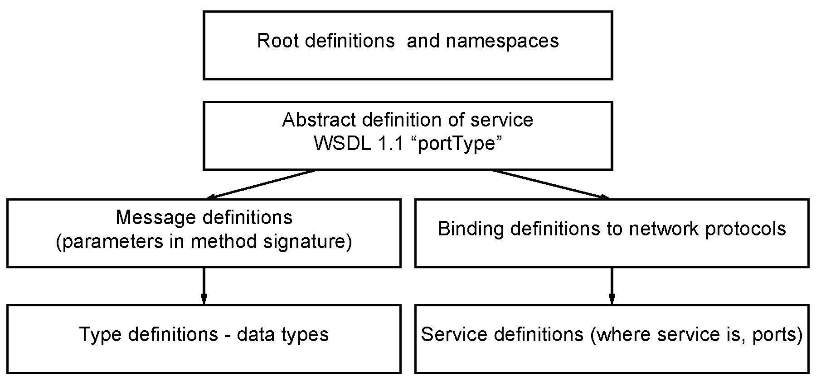
Basic parts of a WSDL 1.1 document
Fig 6.9
6-1.<number>

Slide 31
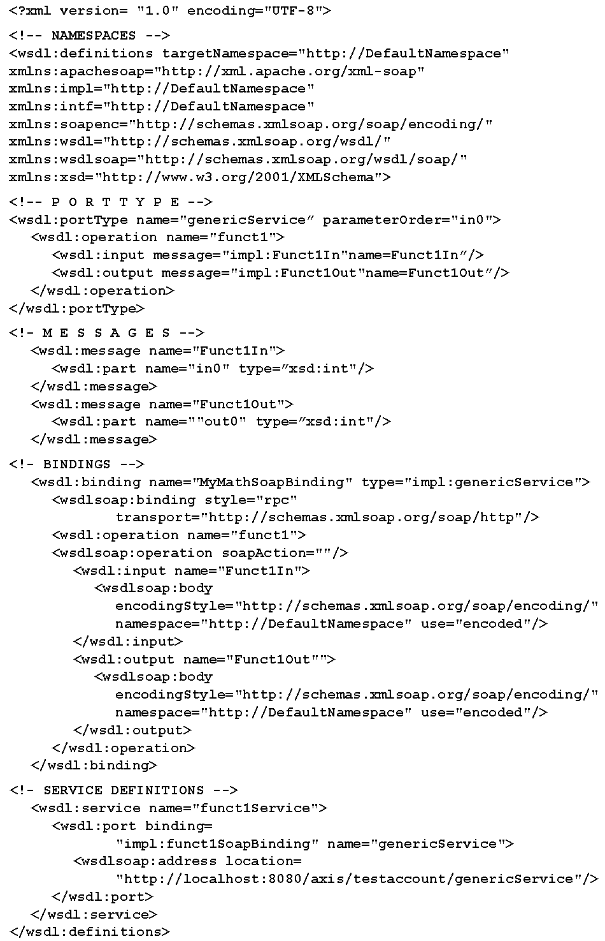
WSDL document for generic Web Service
Fig 6.10
6-1.<number>

Slide 32
Root Definitions Namespaces
<?xml version= "1.0" encoding="UTF-8">
<!-- NAMESPACES -->
<wsdl:definitions targetNamespace="http://DefaultNamespace"
xmlns:apachesoap="http://xml.apache.org/xml-soap"
xmlns:impl="http://DefaultNamespace"
xmlns:intf="http://DefaultNamespace"
xmlns:soapenc="http://schemas.xmlsoap.org/soap/encoding/"
xmlns:wsdl="http://schemas.xmlsoap.org/wsdl/"
xmlns:wsdlsoap="http://schemas.xmlsoap.org/wsdl/soap/"
xmlns:xsd="http://www.w3.org/2001/XMLSchema">
6-1.<number>

Slide 33
portType
Describes “What” - an abstract definition of service operation.
Uses elements:
message definitions - a set of parameters referred to by method signature, decomposed into parts
type definitions - defines all data types used
6-1.<number>

Slide 34
<portType> (interface) element
Provides name for operation and describes message pattern.
Our function funct1 has an input message and output message, i.e.:
<!-- P O R T T Y P E -->
<wsdl:portType name="genericService” parameterOrder="in0">
<wsdl:operation name="funct1">
<wsdl:input message="Funct1In“ />
<wsdl:output message="Funct1Out”/>
</wsdl:operation>
</wsdl:portType
Messages called Funct1In and Funct1Out, see messages next.
6-1.<number>

Slide 35
<message> element
Defines contents and names of messages.
One of more <part> elements, which constitute message:
<!- M E S S A G E S -->
<wsdl:message name="Funct1In">
<wsdl:part name="in0" type=”xsd:int"/>
</wsdl:message>
<wsdl:message name="Funct1Out">
<wsdl:part name=""out0" type=”xsd:int"/>
</wsdl:message>
Here each message has single part and carries a single integer value using primitive datatype (xsd:int) predefined in XML schema.
6-1.<number>

Slide 36
Binding
Describes “how” elements in abstract interface (portType) converted in actual data representations and protocols e.g. “SOAP over HTTP”.
6-1.<number>

Slide 37
<!- BINDINGS -->
<wsdl:binding name="MyMathSoapBinding“ type="impl:genericService">
<wsdlsoap:binding style="rpc“
transport="http://schemas.xmlsoap.org/soap/http"/>
<wsdl:operation name="funct1">
<wsdlsoap:operation soapAction=""/>
<wsdl:input name="Funct1In">
<wsdlsoap:body encodingStyle=http://schemas.xmlsoap.org/soap/encoding/
namespace="http://DefaultNamespace" use="encoded"/>
</wsdl:input>
<wsdl:output name="Funct1Out"">
<wsdlsoap:body encodingStyle=http://schemas.xmlsoap.org/soap/encoding/
namespace="http://DefaultNamespace" use="encoded"/>
</wsdl:output>
</wsdl:operation>
</wsdl:binding>
6-1.<number>

Slide 38
port and service
Describe “where” service is.
port - describes how a binding is deployed at the endpoint of a network
service - a named collection of ports
6-1.<number>

Slide 39
Service Definitions
Will collect ports together and also specify location of service. In our example, single port:
<!- SERVICE DEFINITIONS -->
<wsdl:service name="funct1Service">
<wsdl:port binding="impl:funct1SoapBinding“
name="genericService">
<wsdlsoap:address location=
"http://localhost:8080/axis/testaccount/genericService"/>
</wsdl:port>
</wsdl:service>
Where math service is
6-1.<number>

Slide 40
Message Patterns
In previous example, request made to Web service and Web service replies with the result.
There are actually four message “patterns”:
6-1.<number>

Slide 41
Request-response - a client makes request and gets a response from the server (service).
This pattern requires both the input and output messages (the previous example).
6-1.<number>

Slide 42
One-way - a client makes a request and the server acts upon it but it does not request a response.
This pattern only requires an input message. There is no output message.
6-1.<number>

Slide 43
3 Notification - the server (service) initiates a message to the client.
This pattern only requires an output message. There is no input message.
6-1.<number>

Slide 44
Solicit-response - the server (service) initiates a message to the client and the client responds.
To indicate this pattern, the output message (from the server) written first in WSDL document and input message (from the client) written second.
Patterns that do not have a response may still create request/acknowledge messages if required by transport mechanism such as HTTP.
6-1.<number>

Slide 45
Service registries
6-1.<number>

Slide 46
Universal Description Discovery, and Integration
(UDDI) Registry
Introduced as a standardized Web service registry by OASIS (Organization for the Advancement of Structured Information Standards) in 2001.
Can be:
Globally accessible (public registries), or
Accessed by selected partners or internally to organization (private registries)
6-1.<number>

Slide 47
Public UDDI registries provided by a few companies targeted towards business-to-business interaction.
Example
Two businesses, a manufacturer of products and a purchaser of the products.
Business wishing to purchase products might generate purchase orders sent to manufacturer’s Web services identified by a UDDI registry.
6-1.<number>

Slide 48
Notes
UDDI registry is a Web service itself.
UDDI registry itself has to be known to both client(s) and service.
6-1.<number>

Slide 49
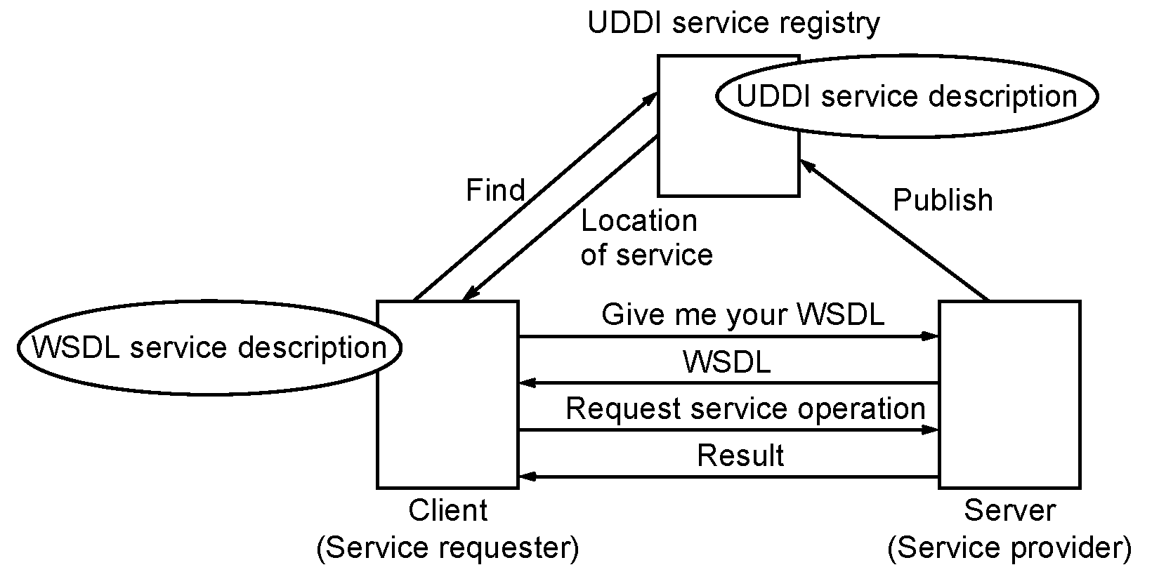
Steps to access a Web service
in a Service-Oriented Architecture
Fig 6.11
6-1.<number>

Slide 50
Question
Could the WDSL document be provided by the registry, and if so, is that better?
Answer
6-1.<number>

Slide 51
Web Services “Stack”
HTTP transport
SOAP message carrying XML documents
WSDL (Web Services Description Language) used as IDL.
UDDI (Universal Description, Discovery and Integration) used as Web service discovery mechanism.
6-1.<number>

Slide 52
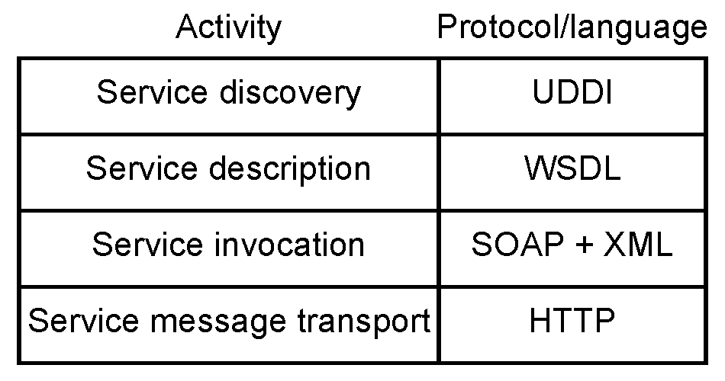
Web Services Stack
Fig 6.12
6-1.<number>

Slide 53
Web Service Implementation
6-1.<number>

Slide 54
Web Service Container
Web Services generally “hosted” in a Web service container
  Software environment that provides communication mechanisms to and from the Web services and clients.
6-1.<number>

Slide 55
  Several possible software environments designed for web services:
Apache Axis
  (Apache eXtensible Interaction System)
IBM Websphere
Microsoft .NET
J2EE (Java 2 Enterprise Edition) server container
    Candidate for hosting web services especially in enterprise (business) applications.
6-1.<number>

Slide 56
Apache Axis available for free down (Windows or Linux):
http://ws.apache.org/axis
Used for a Web service assignment in Fall 2004/Fall 2005 grid course, see home page.
Apache Axis requires an application server.
  For 2004/5 assignment installed on top of servlet engine Apache Jakarta Tomcat.
  However, could be installed on top of a fully-fleldged J2EE server.
6-1.<number>

Slide 57
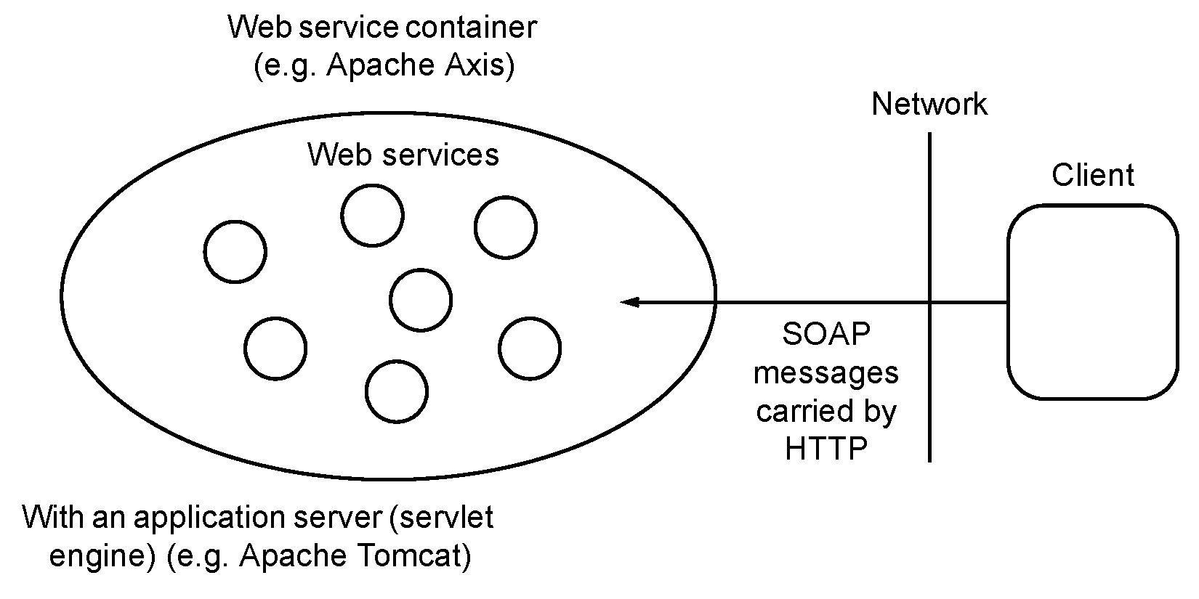
Web service environment
Fig 6.13
6-1.<number>

Slide 58
Client-Service Implementation
Convenient to use client and service stubs:
  Java classes for interfacing to Web service SOAP messaging.
6-1.<number>

Slide 59
Client Stub
Between client code and network is a client stub, sometimes called client proxy.
Responsible for taking request from client and converting request into a SOAP request on network.
Also responsible for receiving SOAP responses on network and converting to a suitable form for client.
6-1.<number>

Slide 60
Server Stub
Between service and network is a server stub, sometimes called a skeleton.
Responsible for receiving SOAP request from client stub and converting it into a suitable form for the service
Also converts response from service into a SOAP message for client stub.
6-1.<number>

Slide 61
Marshalling: Process of converting source data to XML (SOAP message)
Unmarshalling: Process of converting XML (SOAP message) to data for destination
6-1.<number>

Slide 62
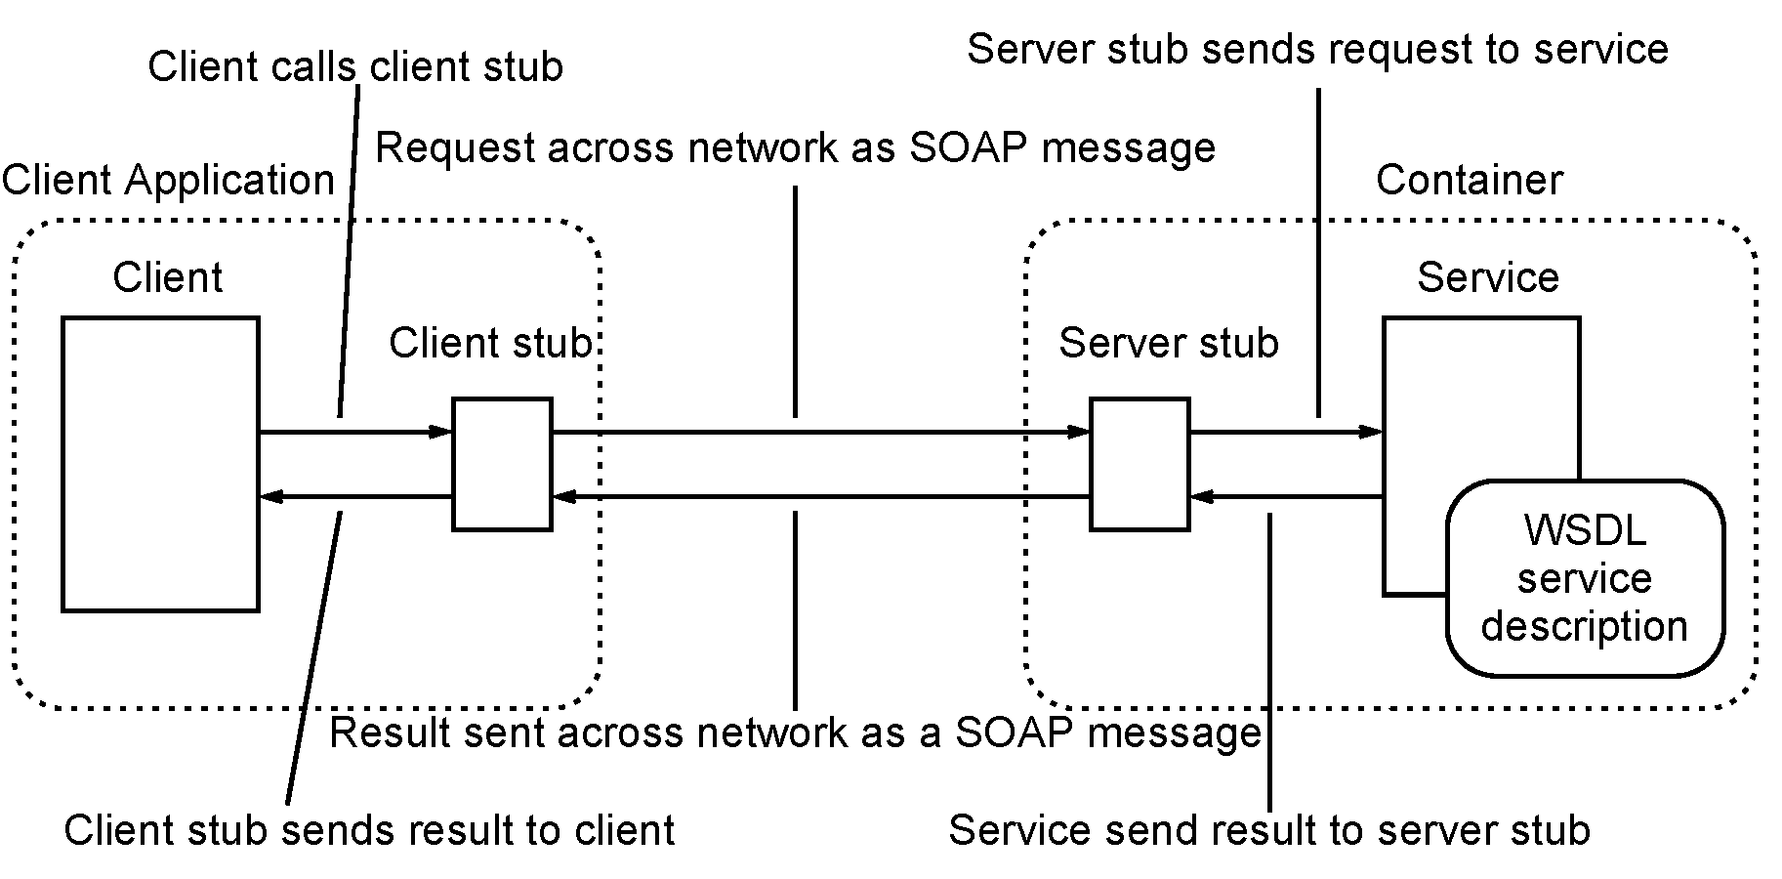
Web Service Application
Fig 6.14
6-1.<number>

Slide 63
Steps
Client calls client stub.
SOAP request sent across network
Server stub receives request and sends request to service
Service send result to serve stub
Server stub sends result across network to client stub.
Client stub sends result to client.
6-1.<number>

Slide 64
Web Service Description
Recall an Interface Description language (IDL) called WSDL used to formally describe a service, what is does, how it is accessed, etc.
6-1.<number>

Slide 65
Terms
Building (a Web service) - process of compiling components ready for execution.
Deploying – Establishing Web service in container, after which it can be communicated with.
6-1.<number>

Slide 66
Build and deploy a web service
Several ways to create web service within a container and have accessible by clients.
Fundamental service components to build:
    Web service code
    WDSL service description file
    Web service stub
and client components:
    Client stub
    Client code
6-1.<number>

Slide 67
What to create to deploy and test a service
Client Applications
Container
Client
Client stub
Server stub
Service
WSDL
service
description
Web service stub
Client stub
Client code
Web service code
WDSL service description file
6-1.<number>

Slide 68
In the following, will assume that we are using Apache Axis, which has several tools for building and deploying a Web service.
6-1.<number>

Slide 69
Java Web Service (JWS) deployment facility
Simple way in Axis to deplore a Web service:
Web service class file created.
Renamed as .jws and dropped into specific Axis directory.
From service code, WSDL file and stubs created using Axis tools.
Components compiled (built) effecting deployment.
Simple but has restrictions/limitations on Web service code. e.g. using data types known to Axis.
6-1.<number>

Slide 70
Java Web Service (JWS) deployment facility
Instant deployment
.jws file is automatically compiled if necessary when service called.
One could actually use it without WSDL file or stubs.
Service URL would have a .jws extension.
But then, client and service needs code to make SOAP calls (mashalling) and convert SOAP messages back to application data (unmashalling).
Hence, normally create WSDL file and stubs to handle SOAP.
6-1.<number>

Slide 71
Creating WSDL file
Several ways this can be approached:
Create service code first and use as basis for WSDL file
or
Create WSDL file first and use this as basis for the service code
Second method probably better from a Software Engineering perspective, but we will describe first method.
6-1.<number>

Slide 72
WSDL from Service Code
Java2WSDL Tool
  Axis Java2WSDL program generates WSDL file from service code.
6-1.<number>

Slide 73
Obtaining WSDL from deployed services
If services already deployed, Axis provides a way of getting its WSDL, by adding ?wsdl after service URL, i.e.:
http://localhost:8080/axis/testaccount/MyMath.jws?wsdl
will return the WSDL file of service MyMath.jws
6-1.<number>

Slide 74
Stubs from WSDL
Once we have WSDL document for service, can use tools to generate client and server stubs.
  Axis WSDL2Java program generates stubs for use on client and server.
Could use with ?wsdl feature to do in one composite command from JWS deployed service.
6-1.<number>

Slide 75
Web Service Deployment Descriptor (WSDD)
WSDD is an XML language used to describe how to deploy a service.
Provides for greater flexibility than with jws deployment facility.
6-1.<number>

Slide 76
WSDD file for MyService
<deployment xmlns="http://xml.apache.org/axis/wsdd/
xmlns:java=
"http://xml.apache.org/axis/wsdd/providers/java">
<service name="MyService" provider="java:RPC">
<parameter name="className" value="... MyService"/>
<parameter name="allowedMethods" value="*"/>
</service>
</deployment>
6-1.<number>

Slide 77
Deployment with WSDD file
Once WSDD file created, can deploy service with Axis tool, AdminClient:
java org.apache.axis.client.AdminClient service.wsdd
6-1.<number>

Slide 78
Client side programming
Depending upon details of service and environment, a simple Java program can be used to access service such as:
import localhost.axis.yourusername.MyMath_jws.MyMathServiceLocator;
import localhost.axis.yourusername.MyMath_jws.MyMathService;
import localhost.axis.yourusername.MyMath_jws.MyMath;
public class MyMathClient {
public static void main(String args[]) throws
Exception {
MyMathService service = new MyMathServiceLocator();
MyMath myMath = service.getMyMath();
int x = (new Integer(args[0])).intValue();
System.out.println("The square of " + args[0] + " is "
+ myMath.squared(x));
}
}
6-1.<number>

Slide 79
Quiz
(Multiple Choice)
6-1.<number>

Slide 80
What is a remote procedure call?
(a) A procedure call that is not very friendly
(b) A procedure call on a local computer that is executed on a remote computer
(c) A procedure held in the disk memory of a computer
(d) A procedure call that is called and executed on a remote computer
SAQ 6-1
6-1.<number>

Slide 81
How are Web services addressed?
(a) By URIs
(b) By programmer-defined Web service names
(c) By memory addresses
(d) By port numbers
Fig 6-2
6-1.<number>

Slide 82
What is meant by a service-oriented architecture?
(a) The concept of using services to get oriented to each other
(b) The way that services are organized within a container
(c) A client-server model in which servers publish their services in a registry and clients access the registry to find services
(d) A business model focused on providing service to customers
FAQ 6-3
6-1.<number>

Slide 83
How does one determine what operations can be invoked on a service?
(a) Guess
(b) Each operation is given a predefined name agreed to by a standard of W3C
(c) Invoke the operation tellMe()
(d) Look at the WSDL interface document
FAQ 6-4
6-1.<number>

Slide 84
What is a WSDL document?
  (a) One that describes how to access a service and use it
  (b) One that describes the data of a service
  (c) One that describes how to use the client code
  (d) None of the other answers
FAQ 6-6
6-1.<number>

Slide 85
    What is SOAP?
(a) Something you use to clean yourself
(b) A protocol for passing XML documents
(c) A protocol for passing object-oriented programs
(d) Service-oriented architecture protocol
(e) None of the other answers
FAQ 6-9
6-1.<number>

Slide 86
What can UDDI be used for?
(a) To transmit data between computers
(b) As a universal data description interface
(c) For modeling information in a Web services registry
(d) To encode the characters of the world
FAQ 6-7
6-1.<number>

Slide 87
    What is Apache Axis?
(a) A hosting environment for Web services
(b) A tool used by American Indians
(c) A compiler
(d) A type of make tool
FAQ 6-8
6-1.<number>

Slide 88
Which of the following contains all the services that have been deployed in a system?
(a) Class
(b) Shell
(c) Container
(d) Blob
(e) Bucket
FAQ 6-10
6-1.<number>

Slide 89
    What is a client stub?
      (a) A way of offending a customer
      (b) Code between the client code and the network
      (c) A document that explains the client code
      (d) None of the other answers
FAQ 6-11
6-1.<number>

Slide 90
What is a .jws file?
(a) A Java Web Service file, a type of source file for a service that is automatically compiled if necessary when the service called
(b) A Java Web Service file, which is the final compiled service
(c) A Java Web Service file, which is the server stub
(d) A Job Worker Service file
FAQ 6-12
6-1.<number>

Slide 91
What is meant by the term portType?
(a) The types of ports available to be used
(b) The type of data passed through a port
(c) A specific port chosen to be used by a container
(d) An abstract interface definition of a service
FAQ 6-13
6-1.<number>

Slide 92
Questions
6-1.<number>

