Slide 1




Panda Server
Sheepy
Panda Server
Sheepy
Panda Server
Sheepy

Slide 2
Panda Server
Sheepy
Panda Server
Sheepy
Sheepy

Slide 3

Panda Server
Sheepy
Panda Server
Sheepy
Make It!

Slide 4


Slide 5
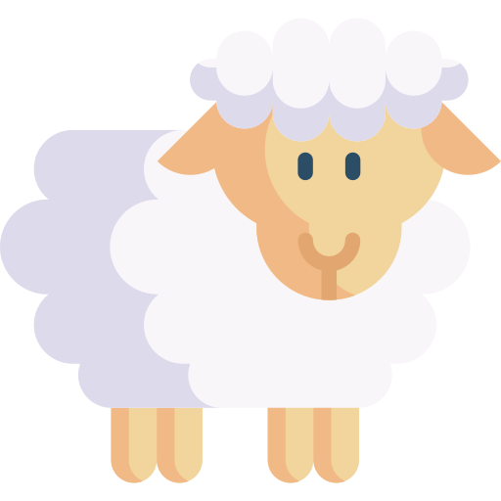
Sheepy

Slide 6
Sheepy

Slide 7
Sheepy

Slide 8
Sheepy

Slide 9
Sheepy

