Slide 1

Course assignment “Predicting a user's musical preferences based on their social networks profile”
Students
Aleksei Korneev, J42332c
Ruslan Alagov, J42325c

Slide 2
Main goal
Musical preferences predicting based on the analysis of social media users activity
Motivation
Integration into various recommendation systems:
official pages with information about genre news and future artists releases
non-official fan pages with users discussions
friends with similar musical tastes
Integration into contextual advertising system (offering concert tickets, etc.)
2

Slide 3
Data
4 most popular music genres;
5 most popular (with the largest number of VK subscribers) artists for each genre;
For each artist we collect data from all users who are subscribed to the page:
Basic personal information;
User’s interests;
Privacy settings;
etc.
More than 40 features for each user
Total size of the data – 4.5 GB.
3

Slide 4
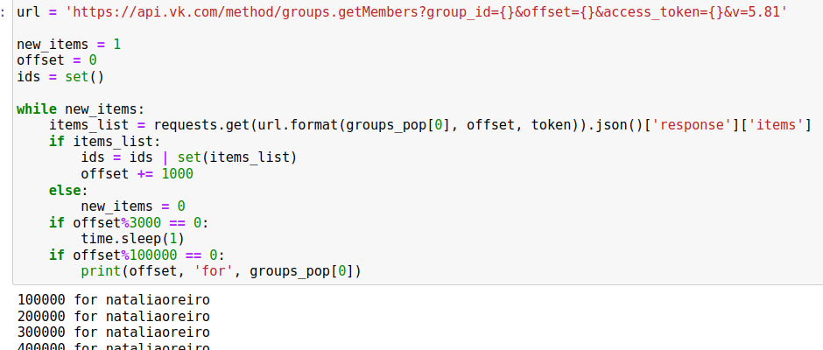
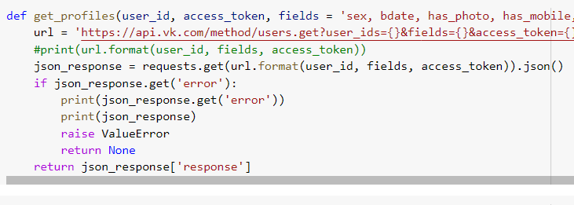
Data mining
We have used requests library and VK API to collect data:
Collecting IDs of subscribers
Collecting information for each ID
4

Slide 5
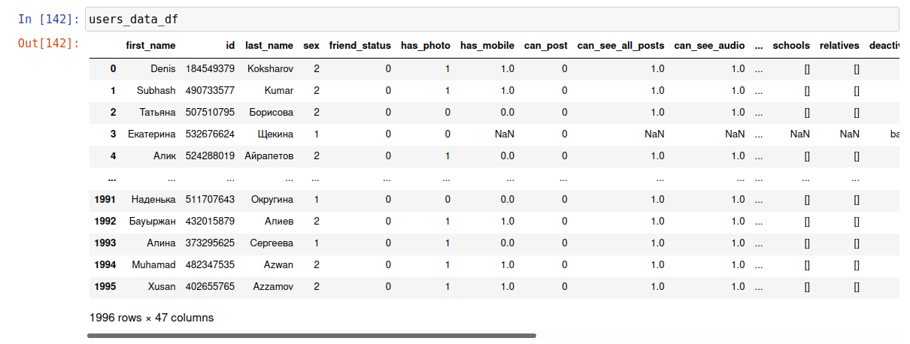
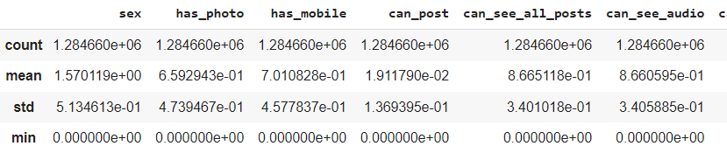
Data preprocessing
Raw data overview: using of data describing methods, data statistics obtaining
5

Slide 6
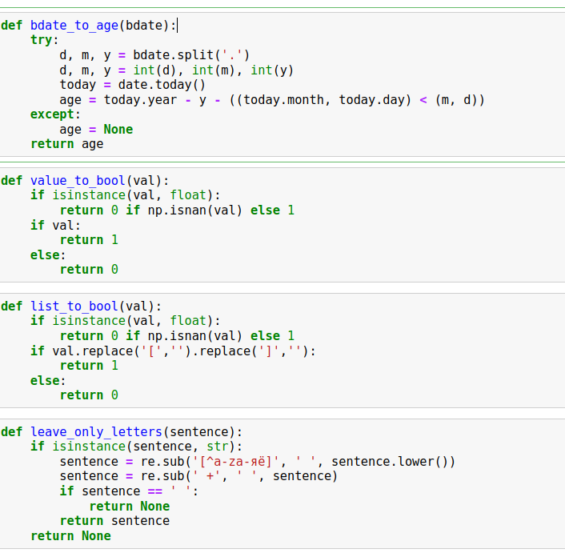
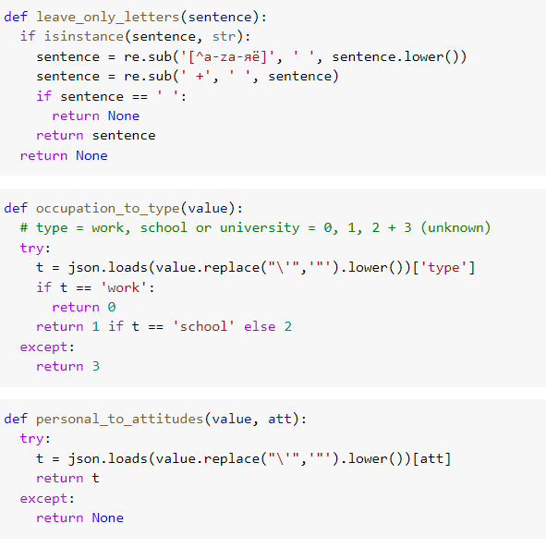
Data preprocessing
Cleaning raw data, features transforming to quantitative and categorical values
6

Slide 7
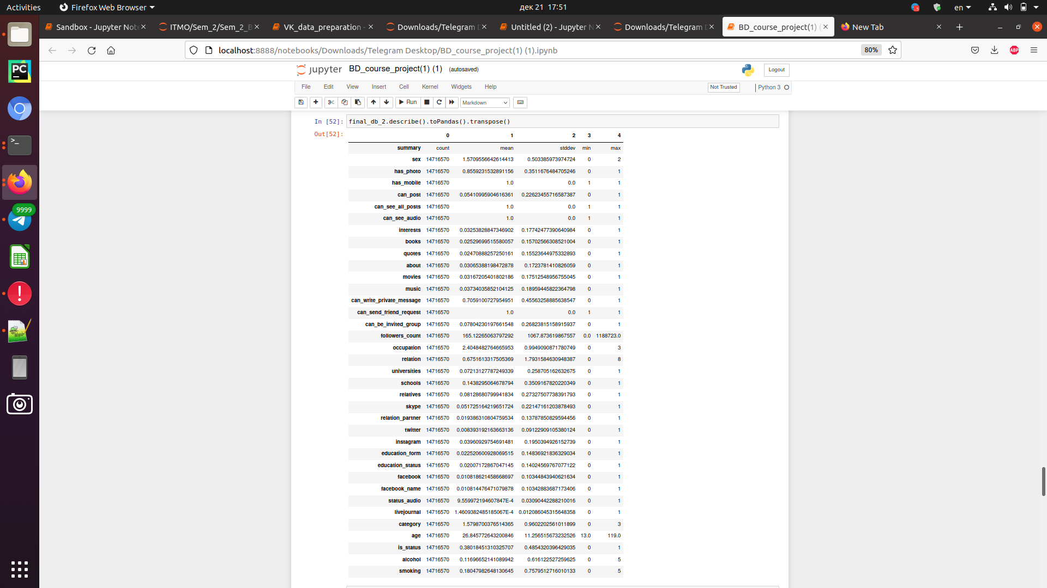
Final features dataframe
7

Slide 8
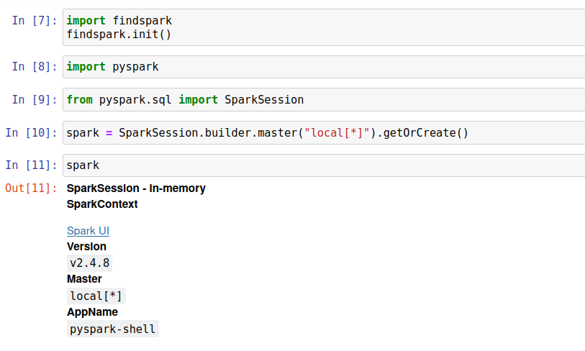
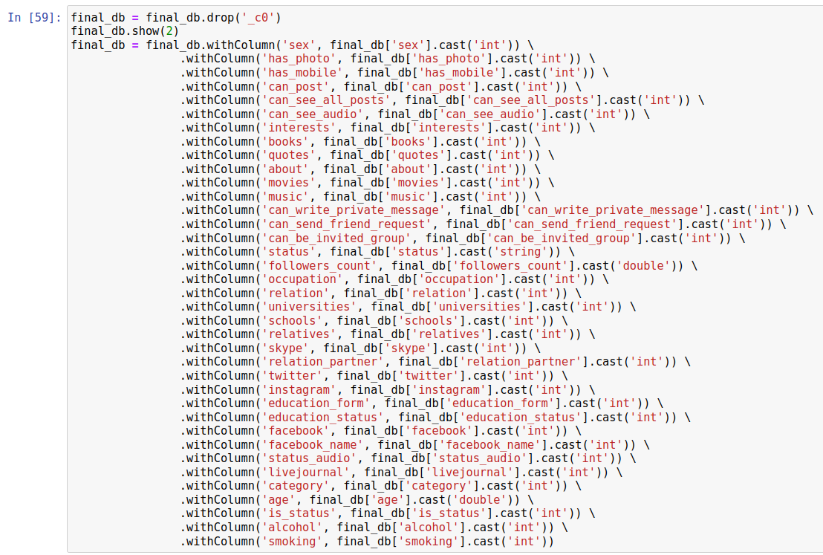
Read and processing DF with PySpark
Launching Spark
Creating a DF from a final table
Columns type casting
8

Slide 9
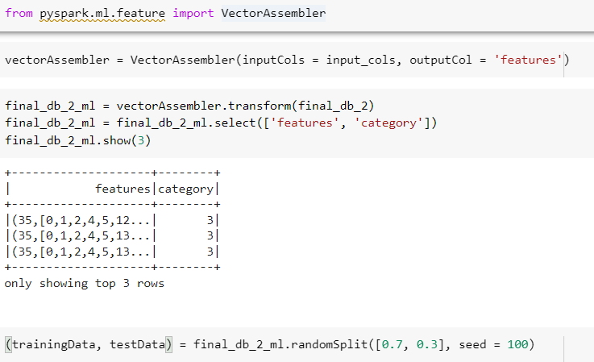
Read and processing DF with PySpark
VectorAssembler and RandomSplit using
9

Slide 10
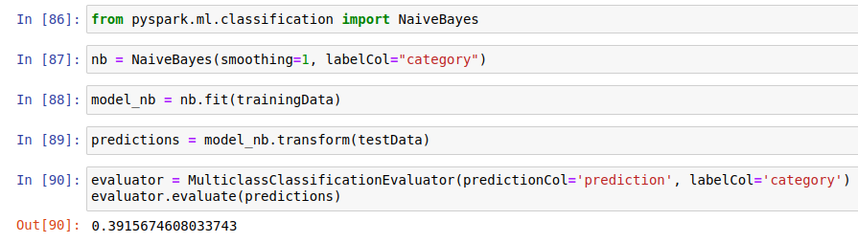
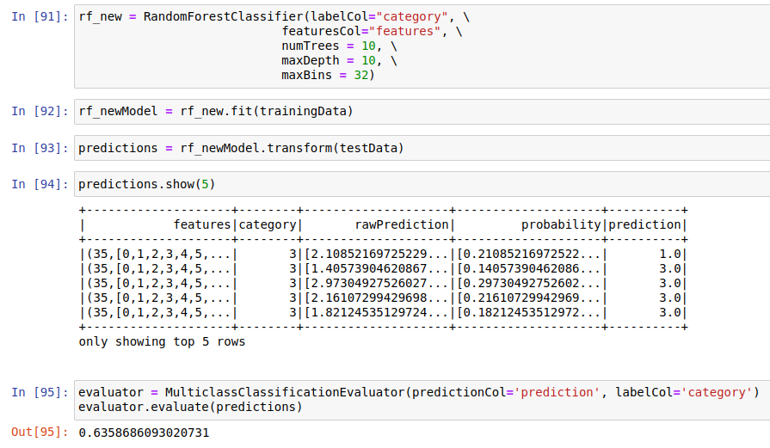
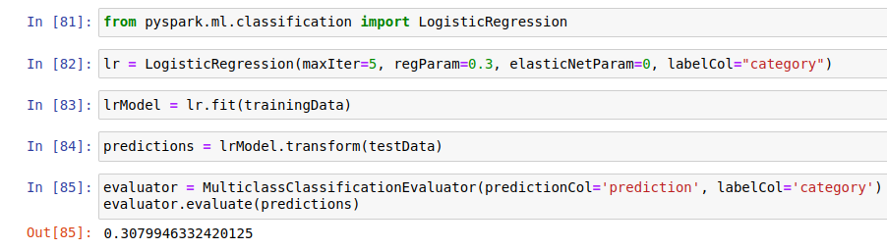
Machine Learning (SparkML module)
Naive Bayes
Random Forest
Logistic Regression
10

Slide 11
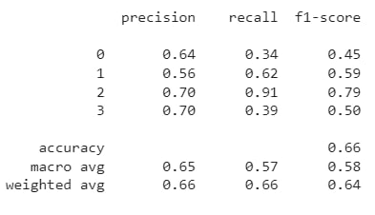
Final results
Accuracy metric for all models:
Random Forest metrics for all genres:
Model | Accuracy
Logistic Regression | 0.3080
Naive Bayes | 0.3916
Random Forest | 0.6359
* electro:0, pop:1, rap:2, rock:3
11

Slide 12
Project improving ideas
Taking into account more genres
Models hyper-parameters tuning
Using of NLP methods for text data
Communities analyzing
Friends information analyzing
Using of other social networks data
12

Slide 13

Thank you for your attention

