Slide 1
Djikstra’s Algorithm
Slide Courtesy: Uwash, UT

Slide 2
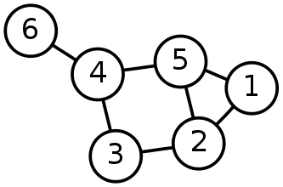
Single-Source Shortest Path Problem
Single-Source Shortest Path Problem - The problem of finding shortest paths from a source vertex s to all other vertices in the graph.

Slide 3
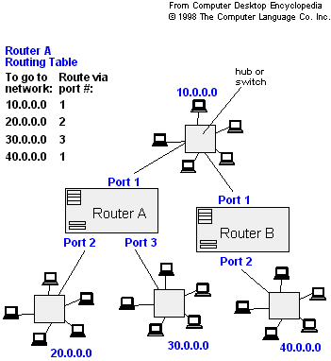
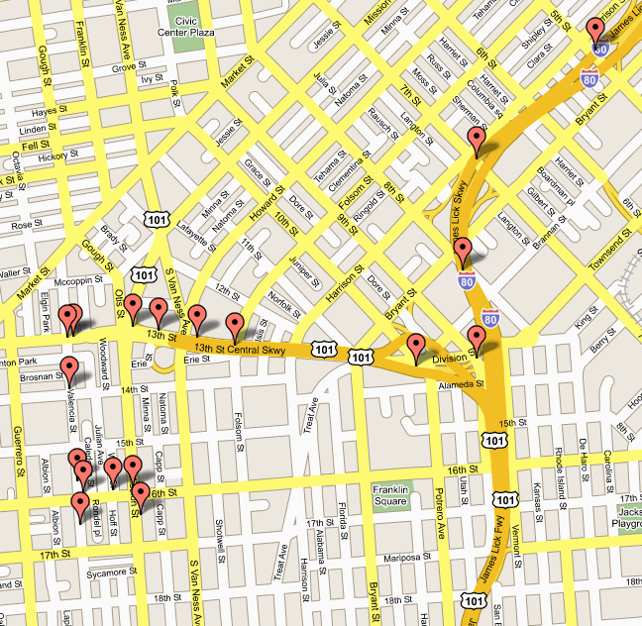
Applications
- Maps (Map Quest, Google Maps)
- Routing Systems

Slide 4
Dijkstra's algorithm
Dijkstra's algorithm - is a solution to the single-source shortest path problem in graph theory.
Works on both directed and undirected graphs. However, all edges must have nonnegative weights.
Input: Weighted graph G={E,V} and source vertex s∈V, such that all edge weights are nonnegative
Output: Lengths of shortest paths (or the shortest paths themselves) from a given source vertex s∈V to all other vertices

Slide 5
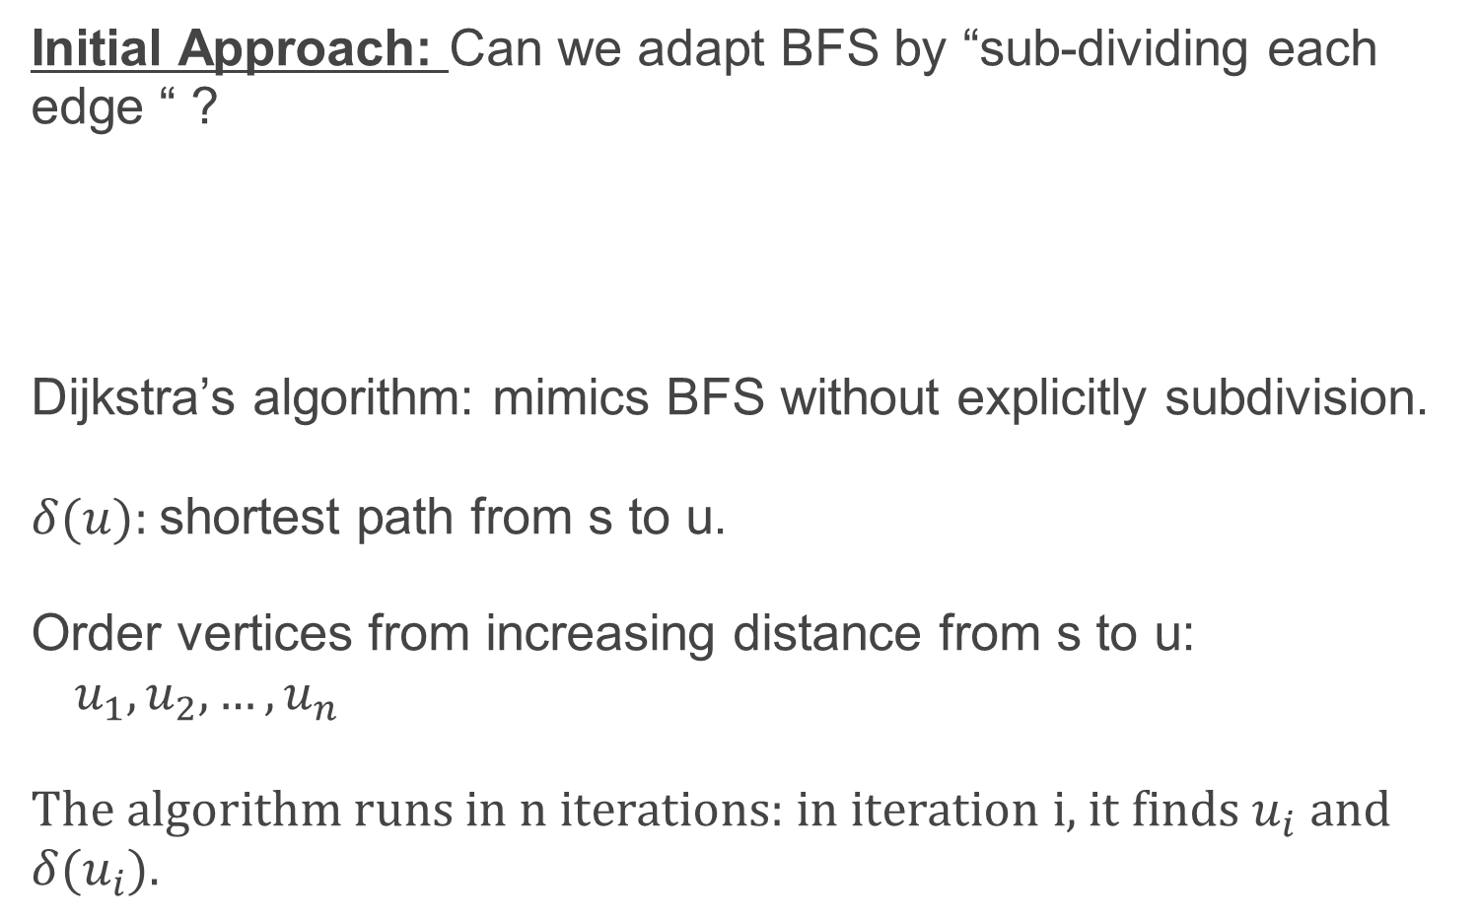
Dijkstra's algorithm
Initial Approach: Can we adapt BFS by “sub-dividing each edge “ ?
Dijkstra’s algorithm: mimics BFS without explicitly subdivision.
$δ(u):$shortest path from s to u.
Order vertices from increasing distance from s to u:
$u_{1}, u_{2}, …, u_{n}$
The algorithm runs in n iterations: in iteration i, it finds $u_{i}$ and
$$δ(u_{i}).$$

Slide 6
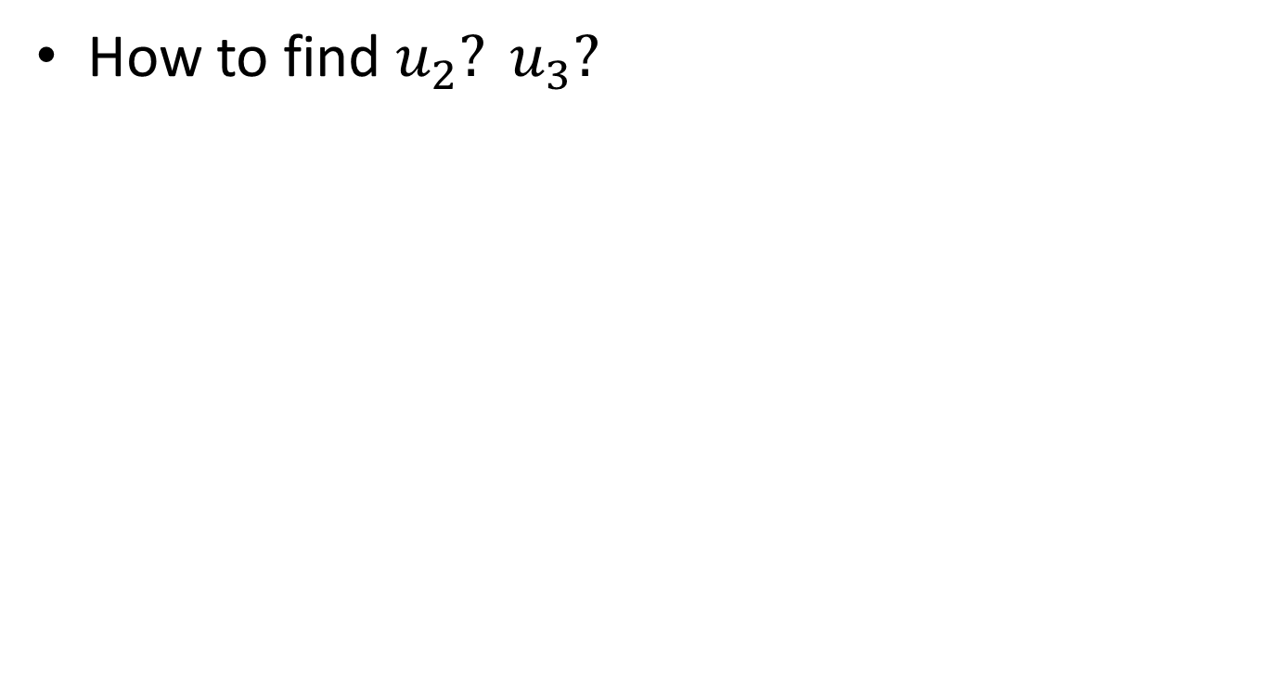
Dijkstra's algorithm: motivation
How to find $u_{2}? u_{3}?$

Slide 7
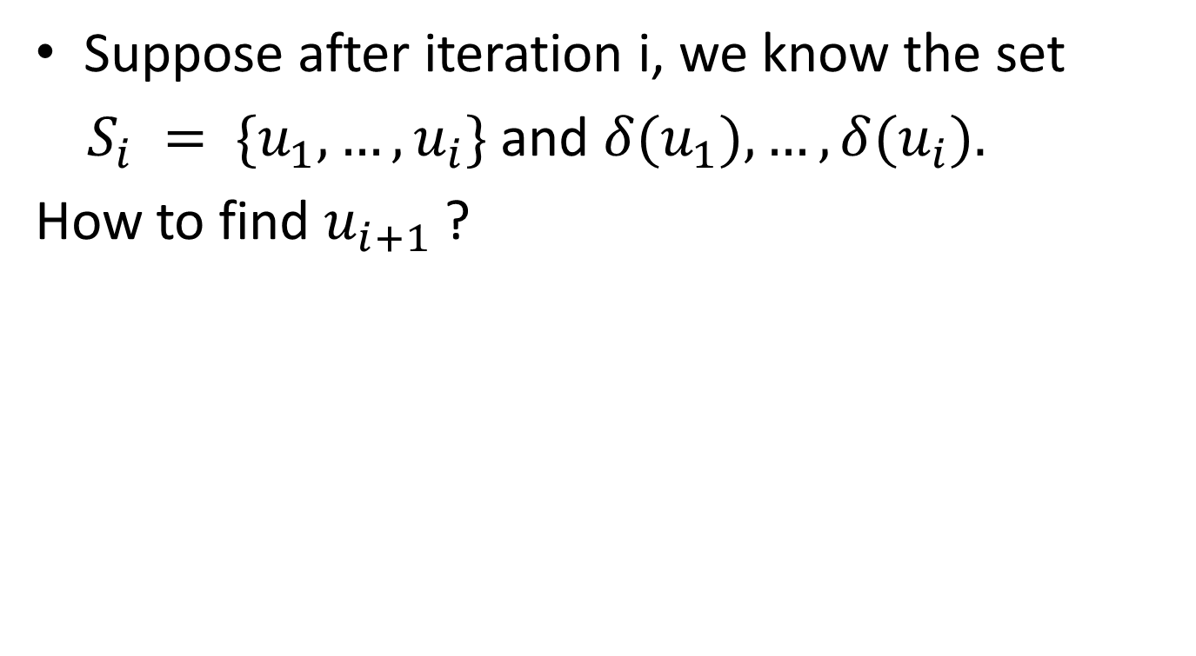
Dijkstra's algorithm
Suppose after iteration i, we know the set
$S_{i} = \{u_{1}, …, u_{i}\}$and $δ(u_{1}), …, δ(u_{i}).$
How to find $u_{i+1}$?

Slide 8
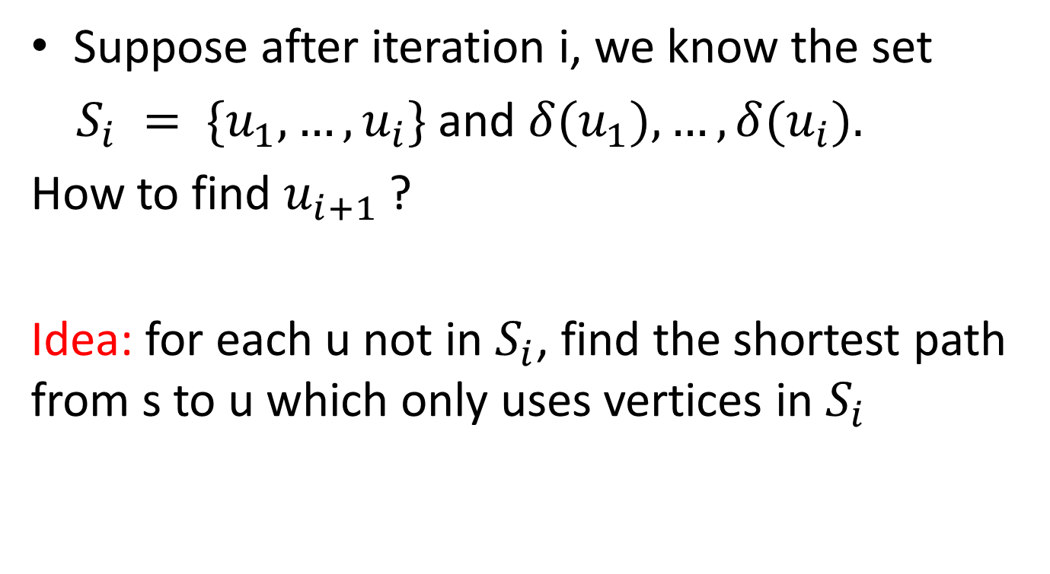
Dijkstra's algorithm
Suppose after iteration i, we know the set
$S_{i} = \{u_{1}, …, u_{i}\}$and $δ(u_{1}), …, δ(u_{i}).$
How to find $u_{i+1}$?
Idea: for each u not in $S_{i}$, find the shortest path from s to u which only uses vertices in $S_{i}$

Slide 9
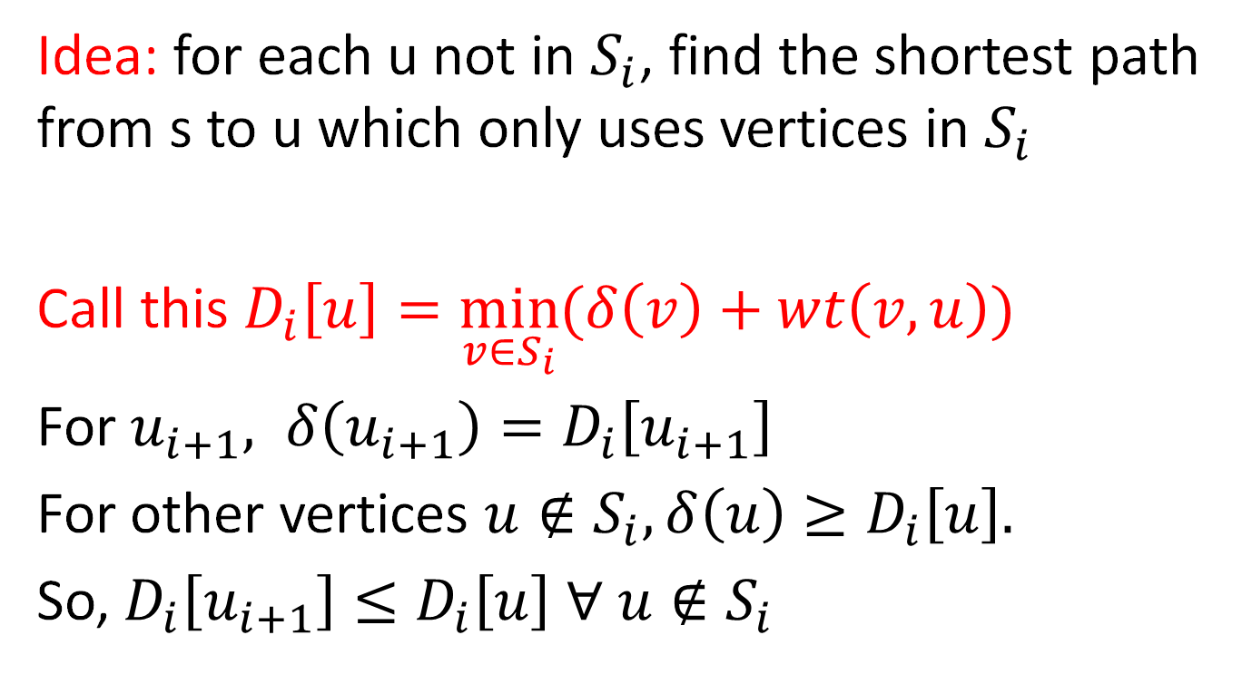
Dijkstra's algorithm
Idea: for each u not in $S_{i}$, find the shortest path from s to u which only uses vertices in $S_{i}$
Call this $D_{i}\left[u\right]=\min_{v∈S_{i}}{(δ\left(v\right)+wt\left(v,u\right))}$
For $u_{i+1}, δ\left(u_{i+1}\right)=D_{i}\left[u_{i+1}\right]$
For other vertices $u∉S_{i}, δ\left(u\right)≥D_{i}\left[u\right].$
So, $D_{i}\left[u_{i+1}\right]≤D_{i}\left[u\right] ∀ u∉S_{i}$
≤

Slide 10
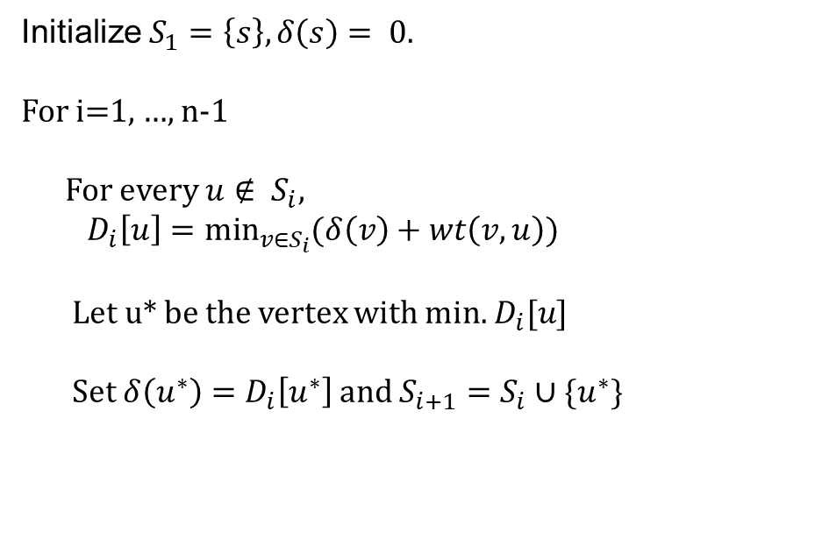
Dijkstra's algorithm
Initialize $S_{1}=\left\{s\right\}, δ\left(s\right)= 0.$
For i=1, …, n-1
For every $u∉ S_{i},$
$D_{i}\left[u\right]=\min_{v∈S_{i}}{(δ\left(v\right)+wt\left(v,u\right))}$
Let u* be the vertex with min. $D_{i}[u]$
Set $δ\left(u^{∗}\right)=D_{i}\left[u^{∗}\right]$and $S_{i+1}=S_{i}∪\{u^{∗}\}$

Slide 11
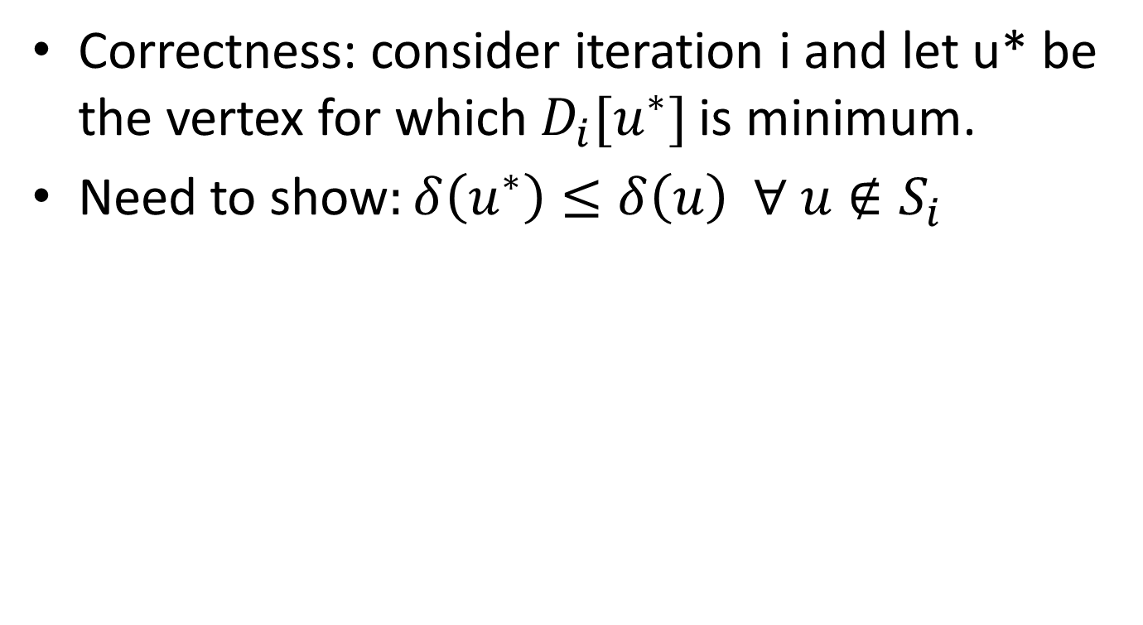
Dijkstra's algorithm
Correctness: consider iteration i and let u* be the vertex for which $D_{i}[u^{∗}]$is minimum.
Need to show$:δ\left(u^{∗}\right)≤δ\left(u\right) ∀ u∉S_{i}$

Slide 12
Dijkstra's algorithm
Initialize $S_{1}=\left\{s\right\}, δ\left(s\right)= 0.$
For i=1, …, n-1
For every $u∉ S_{i},$
$D_{i}\left[u\right]=\min_{v∈S_{i}}{(δ\left(v\right)+wt\left(v,u\right))}$
Let u* be the vertex with min. $D_{i}[u]$
Set $δ\left(u^{∗}\right)=D_{i}\left[u^{∗}\right]$and $S_{i+1}=S_{i}∪\{u^{∗}\}$

Slide 13
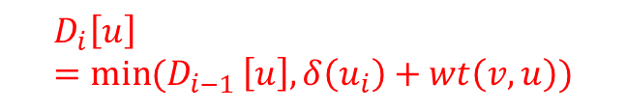
Dijkstra's algorithm
Initialize $S_{1}=\left\{s\right\}, δ\left(s\right)= 0.$
For i=1, …, n-1
For every $u∉ S_{i},$
$D_{i}\left[u\right]=\min_{v∈S_{i}}{(δ\left(v\right)+wt\left(v,u\right))}$
Let u* be the vertex with min. $D_{i}[u]$
Set $δ\left(u^{∗}\right)=D_{i}\left[u^{∗}\right]$and $S_{i+1}=S_{i}∪\{u^{∗}\}$
Can we improve this code ?
$$D_{i}\left[u\right]=\min{(D_{i−1 }\left[u\right], δ\left(u_{i}\right)+wt\left(v,u\right))}$$

Slide 14
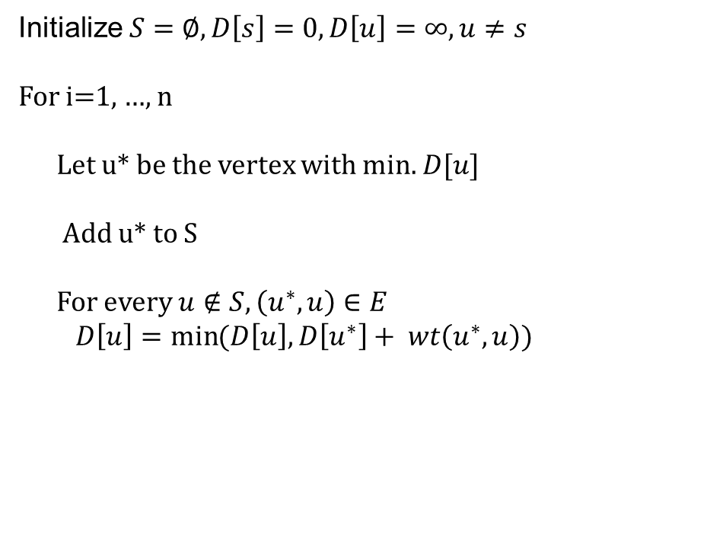
Dijkstra's algorithm
Initialize $S=∅, D\left[s\right]=0, D\left[u\right]=∞, u≠s$
For i=1, …, n
Let u* be the vertex with min. $D[u]$
Add u* to S
For every $u∉S, \left(u^{∗},u\right)∈E$
$D\left[u\right]=\min{(D\left[u\right], D\left[u^{∗}\right]+ wt\left(u^{∗},u\right))}$

Slide 15
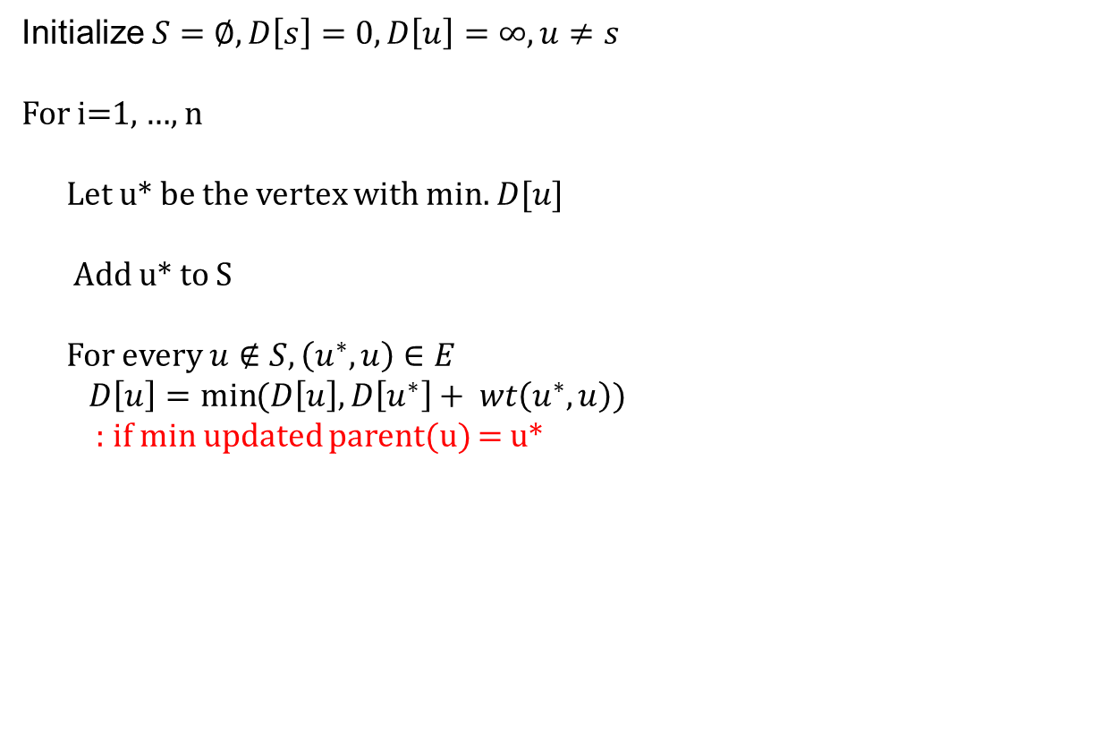
Dijkstra's algorithm
Initialize $S=∅, D\left[s\right]=0, D\left[u\right]=∞, u≠s$
For i=1, …, n
Let u* be the vertex with min. $D[u]$
Add u* to S
For every $u∉S, \left(u^{∗},u\right)∈E$
$D\left[u\right]=\min{(D\left[u\right], D\left[u^{∗}\right]+ wt\left(u^{∗},u\right))}$
: if min updated parent(u) = u*
How to find actual paths ?

Slide 16
Implementation Details
Initialize $S=∅, D\left[s\right]=0, D\left[u\right]=∞, u≠s$
For i=1, …, n
Let u* be the vertex with min. $D[u]$
Add u* to S
For every $u∉S, \left(u^{∗},u\right)∈E$
$D\left[u\right]=\min{(D\left[u\right], D\left[u^{∗}\right]+ wt\left(u^{∗},u\right))}$
: if min updated parent(u) = u*
Store S (and D[u] values) in a heap, : deletemin and decrease key
Maintain whether a vertex is in S using a Boolean array.
Running time: O(m log n)

Slide 17
Example: Initialization
Distance(source) = 0
0
∞
Distance (all vertices but source) = ∞
A
2
B
4
1
3
10
∞
C
2
D
2
E
∞
5
8
∞
4
6
F
1
G
∞
∞
Pick vertex in List with minimum distance.

Slide 18
Example: Update neighbors' distance
0
2
A
2
B
4
1
3
10
∞
C
2
D
2
E
∞
5
8
1
4
6
Distance(B) = 2
F
1
G
Distance(D) = 1
∞
∞

Slide 19
Example: Remove vertex with minimum distance
0
2
A
2
B
4
1
3
10
∞
C
2
D
2
E
∞
5
8
1
4
6
F
1
G
∞
∞
Pick vertex in List with minimum distance, i.e., D

Slide 20
Example: Update neighbors
0
2
A
2
B
4
1
3
10
3
C
2
D
2
E
3
5
8
1
4
6
Distance(C) = 1 + 2 = 3 Distance(E) = 1 + 2 = 3 Distance(F) = 1 + 8 = 9 Distance(G) = 1 + 4 = 5
F
1
G
9
5

Slide 21
Example: Continued...
Pick vertex in List with minimum distance (B) and update neighbors
0
2
A
2
B
4
1
3
10
3
C
2
D
2
E
3
5
8
1
4
6
Note : distance(D) not updated since D is already known and distance(E) not updated since it is larger than previously computed
F
1
G
9
5

Slide 22
Example: Continued...
Pick vertex List with minimum distance (E) and update neighbors
0
2
A
2
B
4
1
3
10
3
C
2
D
2
E
3
5
8
1
4
6
F
1
G
No updating
9
5

Slide 23
Example: Continued...
Pick vertex List with minimum distance (C) and update neighbors
0
2
A
2
B
4
1
3
10
3
C
2
D
2
E
3
5
8
1
4
6
Distance(F) = 3 + 5 = 8
F
1
G
8
5

Slide 24
Example: Continued...
Pick vertex List with minimum distance (G) and update neighbors
0
2
A
2
B
4
1
3
10
3
C
2
D
2
E
3
5
8
1
4
6
F
1
G
Previous distance
6
5
Distance(F) = min (8, 5+1) = 6

Slide 25
Example (end)
0
2
A
2
B
4
1
3
10
3
C
2
D
2
E
3
5
8
1
4
6
F
1
G
6
5
Pick vertex not in S with lowest cost (F) and update neighbors

Slide 26
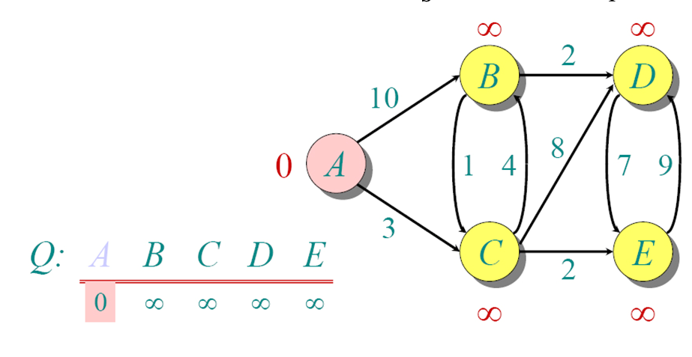
Another Example

Slide 27
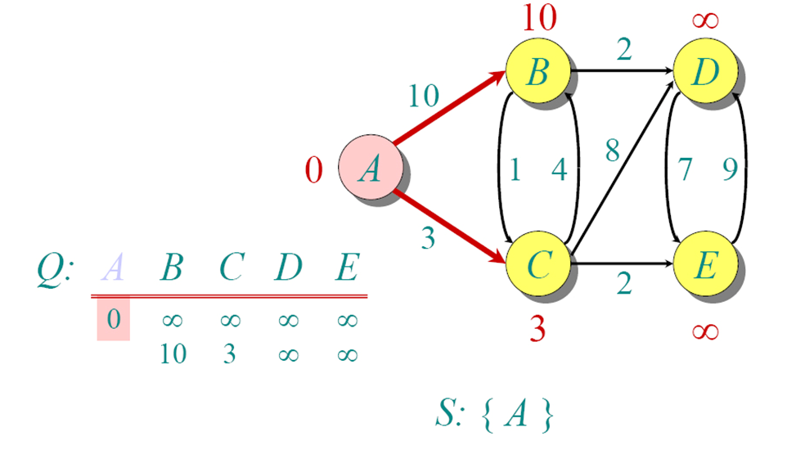
Another Example

Slide 28
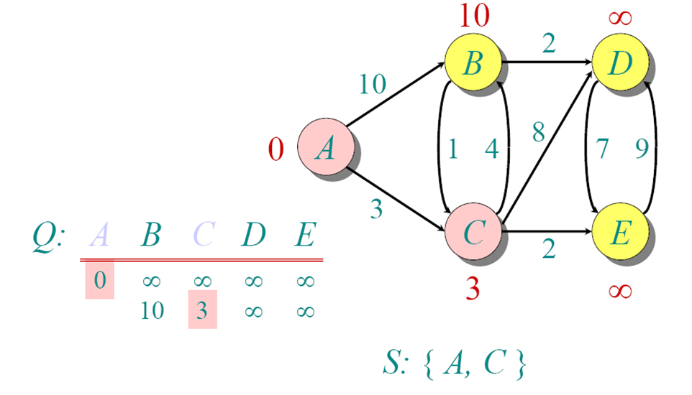
Another Example

Slide 29
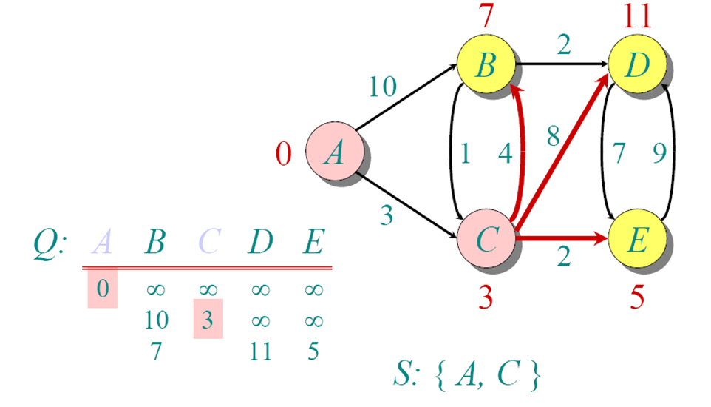
Another Example

Slide 30
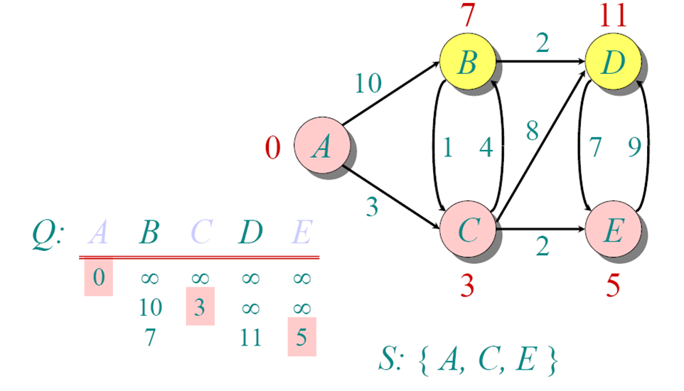
Another Example

Slide 31
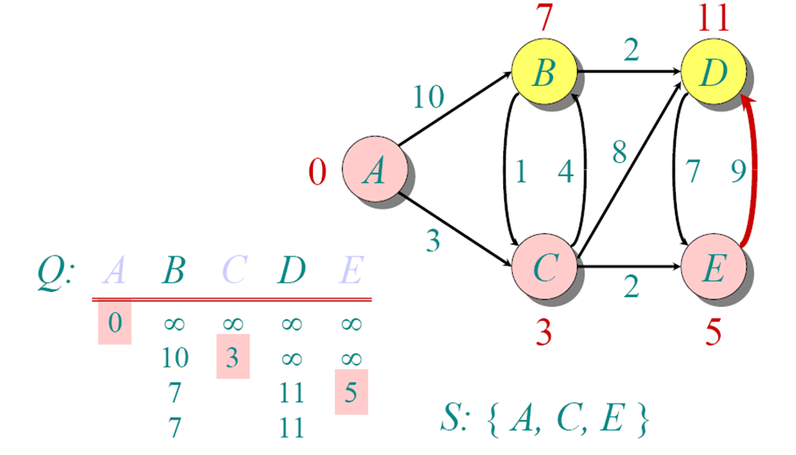
Another Example

Slide 32
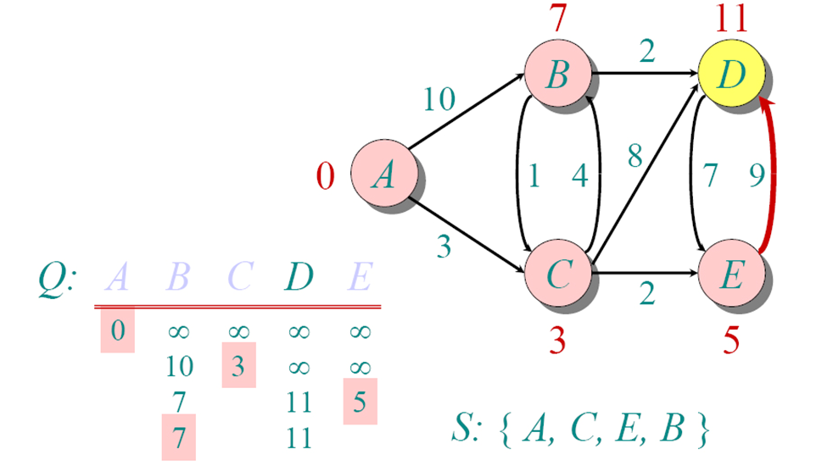
Another Example

Slide 33
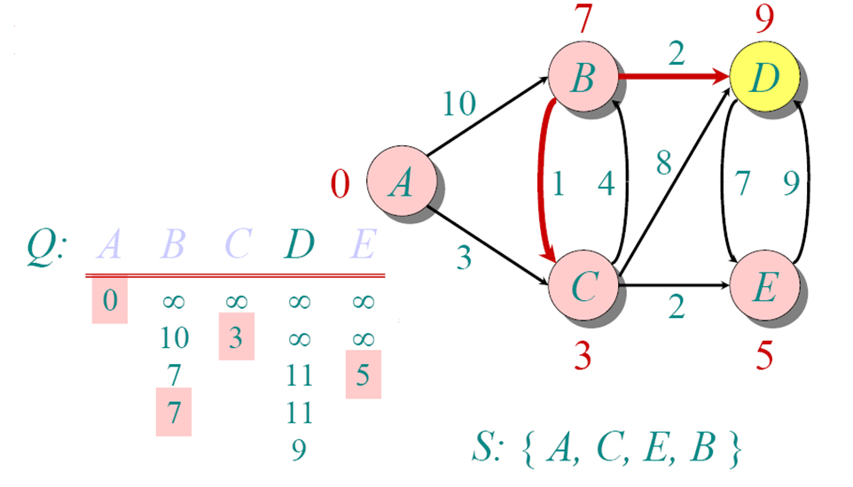
Another Example

Slide 34
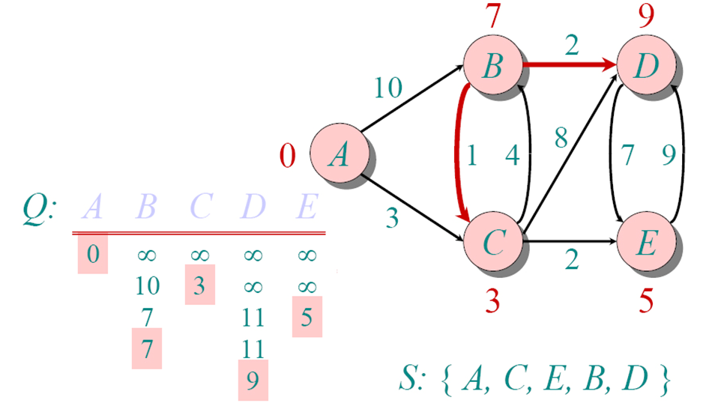
Another Example

