Slide 1



A Policy Gradient Method for Uplift Modeling
Chenchen Li
Shanghai Jiao Tong University
Joint work with Xiang Yan, Xiaotie Deng, Yuan Qi, Wei Chu, Le Song, Junlong Qiao, Jianshan He, Junwu Xiong

Slide 2
Contents
Background
Problem Scenario
Uplift Modeling
Existing Evaluation Metrics
Existing Methods
Methods
Offline Evaluation
Policy Gradient Method
Experiments
Simulation
Real-World Dataset
Notes:
In this presentation, I would like to mainly introduce the interesting problem Price war with its game theoretical model. Then I shall introduce the methods we use, followed by experiments results.

Slide 3
Contents
Background
Problem Scenario
Uplift Modeling
Existing Evaluation Metrics
Existing Methods
Methods
Offline Evaluation
Policy Gradient Method
Experiments
Simulation
Real-World Dataset
Notes:
In this presentation, I would like to mainly introduce the interesting problem Price war with its game theoretical model. Then I shall introduce the methods we use, followed by experiments results.

Slide 4


Motivation
Internet Marketing:
Come
Come
No coupon
$5 red packet
……..
Not Come
Not Come
$10 red packet
Buy
Buy

Slide 5
The characteristic of Uplift Modeling
Each time we can only observe one response at one time.
We can never know the exact response of one action if we didn’t offer them.
We want to maximize the uplift response instead of the action response, thus we can never know them.

Slide 6

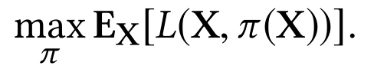
Problem Setting
Dataset: a lot of <X, A, Y>
X: User features
A: The action
Y: Response
Uplift Modeling
Objective

Slide 7
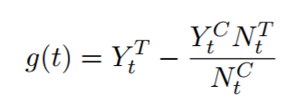
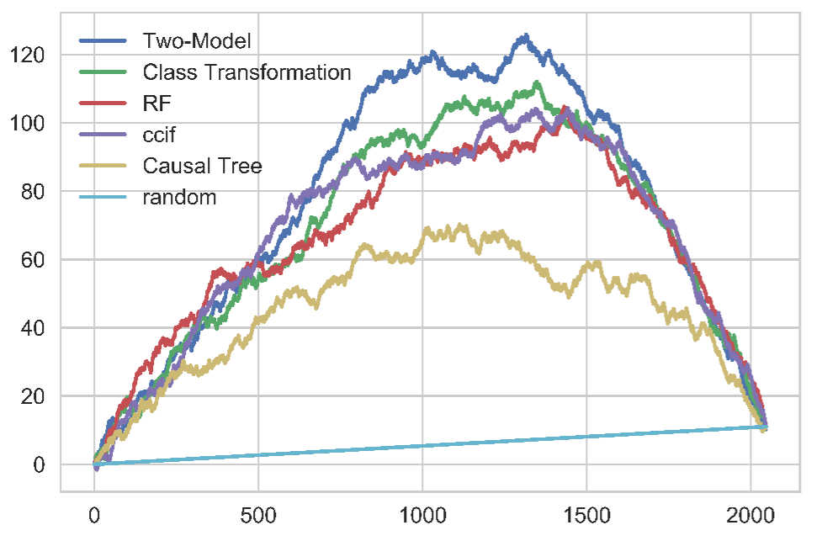
Existing Evaluation Metric
Qini Curve
The offers need to be assigned randomly.
Disadvantage:
Only applied for two action.
The response need to be binary value.
No theoretical guarantee.

Slide 8
Existing Methods (1)
Separate Models Approach:
Split the dataset into several groups according to action.
Build a regressor on each action group.
Disadvantage:
It performs very poor in the practice, because it pay attention to predict the action response instead of uplift response. Thus, when the patterns of uplift response and action response are different, it performs badly.

Slide 9
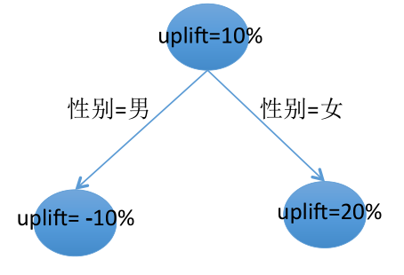

Existing Methods (2)
Uplift Decision Tree
Disadvantage:
Compared with deep learning methods, it performs worse on the generalization ability.
Notes:
Uplift树在进行分裂的时候需要权衡3个点：
p 最大化分叉后各个客户群体的uplift差异（判别性）
p 最小化分叉后各个客户群体的人数差异（泛化性、稳健性）
p 避免系统性地倾向于分叉点多的分裂

Slide 10
Contents
Background
Problem Scenario
Uplift Modeling
Existing Evaluation Metrics
Existing Methods
Methods
Offline Evaluation
Policy Gradient Method
Experiments
Simulation
Real-World Dataset
Notes:
In this presentation, I would like to mainly introduce the interesting problem Price war with its game theoretical model. Then I shall introduce the methods we use, followed by experiments results.

Slide 11
Methods
1. Offline Evaluation
Estimate the reward for each policy
2. Policy Gradient Method
Optimize the policy according the reward calculated by offline evaluation

Slide 12
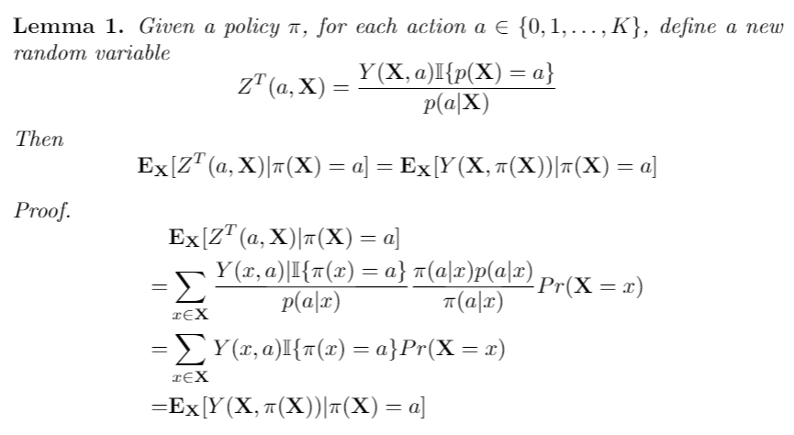
Offline Evaluation

Slide 13
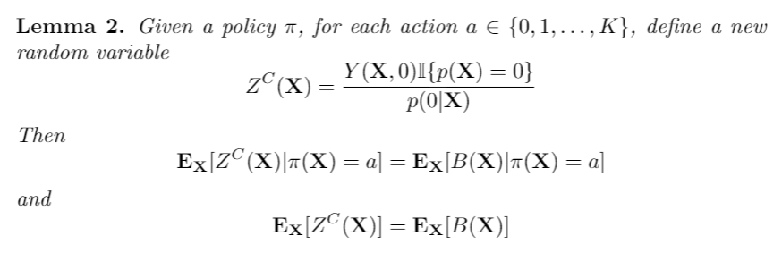
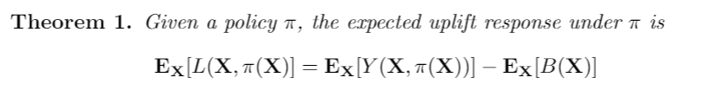
Offline Evaluation

Slide 14
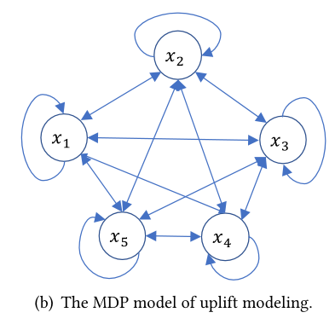
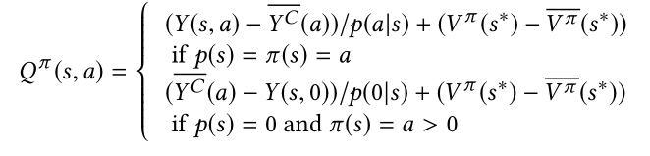
Policy Optimization
Policy Gradient Method

Slide 15
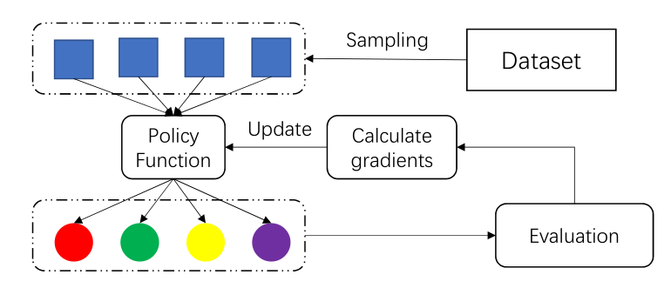
Overall Framework

Slide 16
Contents
Background
Problem Scenario
Uplift Modeling
Existing Evaluation Metrics
Existing Methods
Methods
Offline Evaluation
Policy Gradient Method
Experiments
Simulation
Real-World Dataset
Notes:
In this presentation, I would like to mainly introduce the interesting problem Price war with its game theoretical model. Then I shall introduce the methods we use, followed by experiments results.

Slide 17
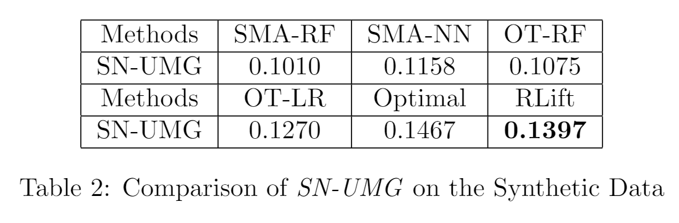
Synthetic Experiment
Baseline:
1. Separate Models Approach (SMA)
2. Random Forests (Uplift RF)
3. Offset Tree (OT)

Slide 18
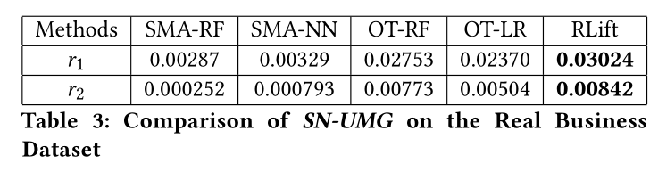
Real-World Datasets Experiment (2)
Dataset: Jiebei
Notes:
我们选了一个数据最多的商户作为代表的公司，把其它所有的商户作为对手。

Slide 19
Contributions and Conclusions
We propose a new evaluation metric of multiple actions and general response types for the uplift modeling and prove its unbiasedness
We solve the uplift modeling problem through a deep reinforcement learning method.

Slide 20
Future Work
The relationship between bandit, individual treatment effect and uplift modeling.
Better deep learning for individual treatment effect.

Slide 21



Future Work
The relationship between bandit, individual treatment effect (ITE) and uplift modeling.
Bandit:
Uplift Modeling:
ITE :

Slide 22
Future Work
Deep learning for individual treatment effect.
There is only random forest for ITE.

Slide 23
Thank you!

