Slide 1
Benchmarking Reinforcement Learning Algorithms on Real-World Robots
Reporter: Mai Jing, EECS Peking University

Slide 2
Motivation
Many recent successes in simulation, model-free reinforcement learning has emerged as a promising approach to solving continuous control robotic tasks.
However, reinforcement learning research with physical robots faces substantial resistance due to the lack of benchmark tasks and supporting source code.

Slide 3
Difficulties of real-world robot learning
Mahmood et al. (2018) recently brought to attention some of the difficulties of real-world robot learning and showed that learning performance can be highly sensitive to different elements of the task setup.
such as the action space(velocities or target accelerations?), the action cycle time defined by the time between two subsequent actions, and system delays.

Slide 4
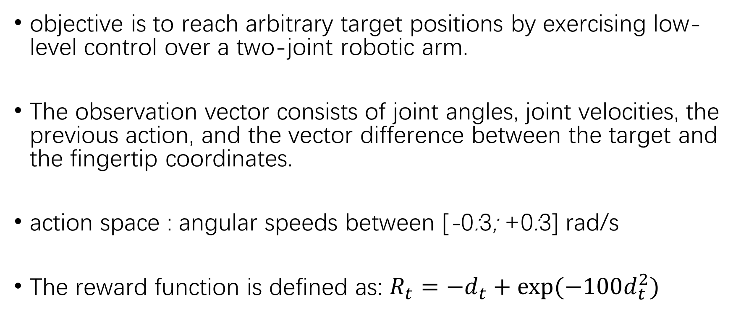
UR-Reacher-2
objective is to reach arbitrary target positions by exercising low-level control over a two-joint robotic arm.
The observation vector consists of joint angles, joint velocities, the previous action, and the vector difference between the target and the fingertip coordinates.
action space : angular speeds between [-0:3; +0:3] rad/s
The reward function is defined as: $R_{t}=−d_{t}+exp⁡(−100d_{t}^{2})$

Slide 5
UR-Reacher-6
is analogous to URReacher-2 with the exceptions that all six joints are actuated
Higher dimensionality of the action and observation spaces
physical limitations of reaching locations from various configurations of the arm joints in 3D space
a much more complex policy space and substantially increase the learning problem difficulty.

Slide 6
DXL-Reacher
similar to UR-Reacher-2 with current control of the DXL actuator
one-dimensional current control signals between [−100; 100] mA, making the task simpler than UR-Reacher

Slide 7
DXL-Tracker
The objective here is to precisely track a moving target position with current control signals between [-50; 50] mA.
The observation vector includes the actuator position (in radians), moving speed, current target position, target position from 50 milliseconds in the past and the previous action.

Slide 8
Create-Mover
the agent needs to move the robot forward as fast as possible within an enclosed arena
arena is built using white shelving boards for the walls and a white hardboard for the floor
The action space is [-150mm/s; 150mm/s]^2 for actuating the two wheels with speed control.
The reward function is the summation of the directed distance values over 10 most recent sensory packets.

Slide 9
Create-Docker
In this task the objective is to dock to a charging station attached to the middle of one of the wider walls of the Create-Mover arena.
The reward function is a large positive number for successful docking with penalty for bumping and encouragement for moving forward and facing the charging station perpendicularly.

Slide 10
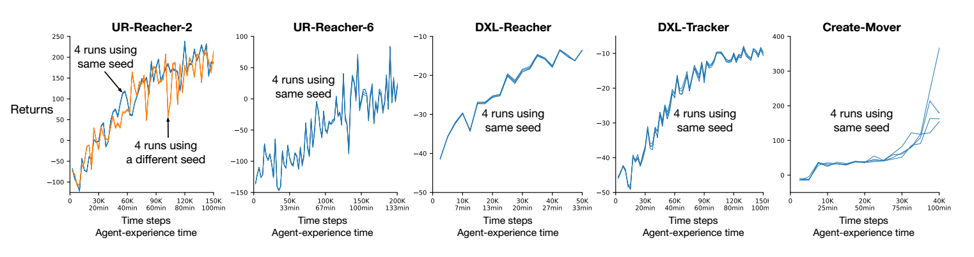
Repeatability of learning on five robotic tasks

Slide 11
Repeatability of learning on five robotic tasks
The plots show the returns over time of multiple learning experiments that would be identical for the same color if they had been run in simulation.
The robot hardware introduces some non-determinism, but not enough to significantly impact repeatability in the natural ups and downs of exploration and learning
except in CreateMover, where the physical location of the robot can diverge over time across the runs.

Slide 12
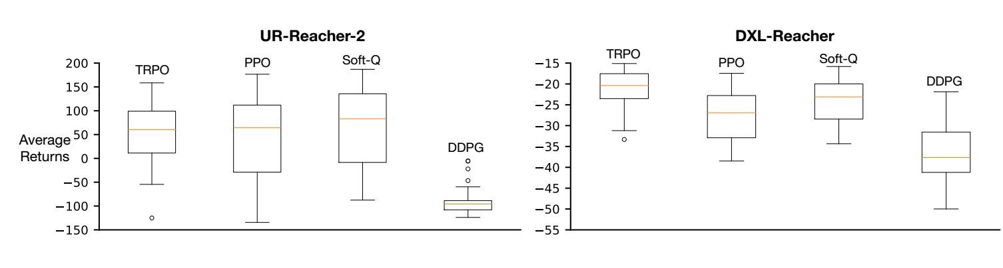
The effect of hyper-parameter choices in two robotic tasks

Slide 13
The effect of hyper-parameter choices in two robotic tasks
For each algorithm, performance varied widely with different hyper-parameter configurations, ranging from learning visually-confirmed effective behavior to no learning at all.
these results show that hyper-parameter choices are important, as they may make a much bigger difference than the choice of the algorithm.

Slide 14
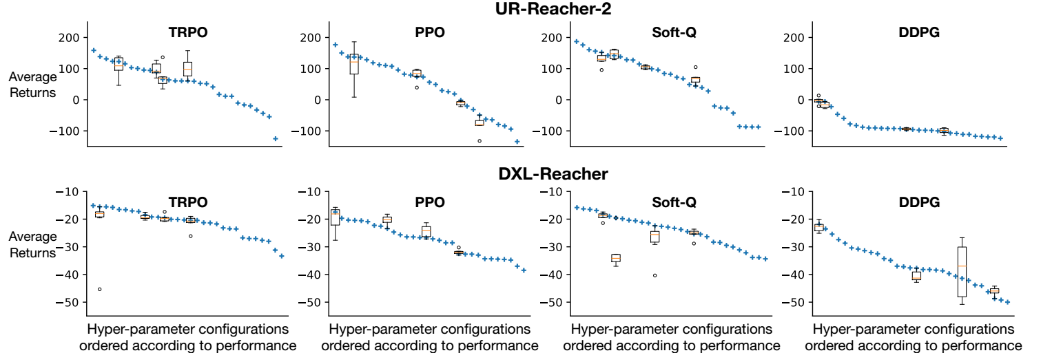
The effect of random network initializations on DXL-Reacher

Slide 15
The effect of random network initializations on DXL-Reacher
The box plots the effect of variations in network initialization with four randomly chosen hyper-parameter configurations.
The overall effect of network initialization, shown in Tukey’s box plots for four randomly chosen hyper-parameter values, was smaller than that of the choice of the hyper-parameters.

Slide 16
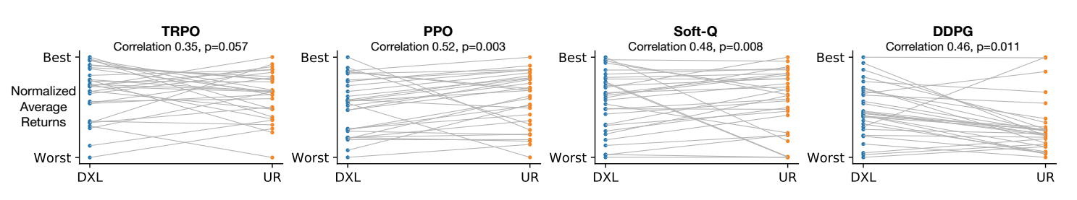
Hyper-parameter consistency between two robotic tasks

Slide 17
Hyper-parameter consistency between two robotic tasks
The gray lines connect experiments with identical hyperparameter choices.
all four algorithms had hyper-parameter consistency between the tasks, evident by the correlation of performance shown above each plot, which varied from weakly positive to moderately positive relationships.

Slide 18
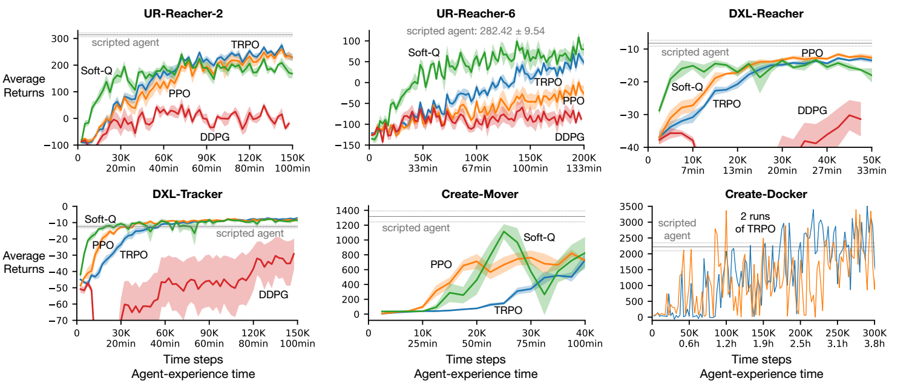
Learning performance of different algorithms on all six tasks

Slide 19
Learning performance of different algorithms on all six tasks
We used the best hyper-parameters based on UR-Reacher-2. TRPO, PPO and Soft-Q learned effectively, with Soft-Q being the fastest learner and TRPO achieving near-best final learning performance in all tasks.

