Slide 1


MIS Program Overview
MIS

Slide 2
Management Information Systems
MIS Definition: (1) management oriented (organization, context); (2) information centric (data, knowledge); (3) systems driven (interconnected, design)
Selected past successes in MIS, Arizona examples:
  J. Nunamaker, GroupSystems, GDSS, 1984-: EBS, idea divergence/convergence; $67M funding (IBM/Intel/VC), $84M sales; 41 dissertations, 220 pubs; 5000+ worldwide installations
  H. Chen, COPLINK, security informatics, 1997-: information sharing and crime data mining; $7M funding (DOJ/NSF/VC), $30M sales; 55 pubs, 70 students; 3,500+ public safety/security agencies ➔ i2/COPLINK acquired by IBM in September 2011 (newest BI & Analytics acquisition)

Slide 3
MIS Disciplines
Organizational behavior, management, sociology, strategy (Minnesota, MIT)
Management science, OR, supply chain, economic modeling (UT Austin, CMU)
Design science, computer science, system, database, algorithm, interface (Arizona, NYU)

Slide 4

Top Five UA MIS Programs
MIS
MIT: economics, social, IT consulting
CMU: economics, MS/OR, social
UT Austin: economics, MS/OR
Arizona: system, technical
Minnesota: social, behavioral

Slide 5
CS vs. MIS
CS: science-based, computer driven, core foundations (compiler, networking, OS), theories, algorithms, databases
MIS Design Science: (emerging, relevant, high-impact) applications, problem-driven, information-centric, multi-disciplinary, organization relevant

Slide 6
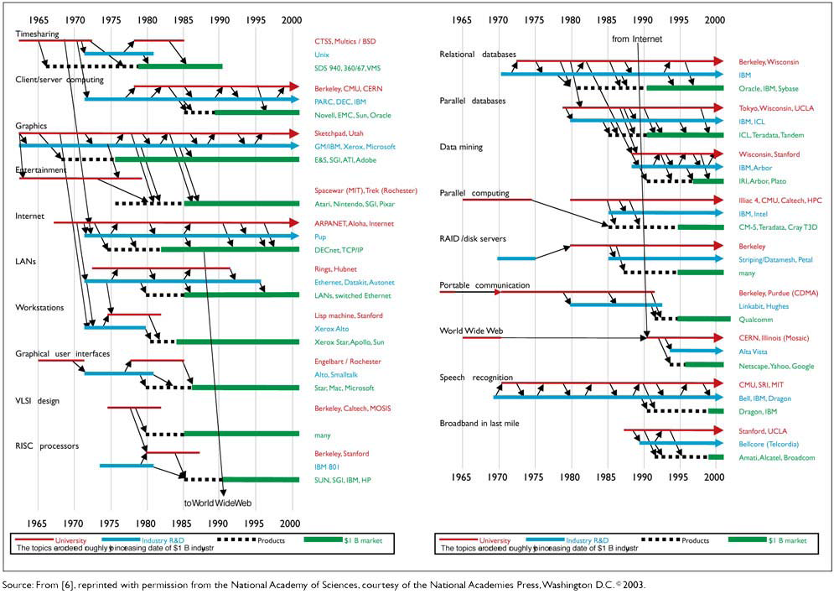
CS Ecosystem and Impacts
University research ➔ Industry R&D ➔ Products ➔ $1B Market (job and wealth creation)

Slide 7
Data, Text, and Web Mining
Data Mining: ID3, neural networks, genetic algorithms, SVM; Weka, SPSS, SAS, Microsoft SQL server data mining, IBM Intelligent Miner, IBM Cognos
World Wide Web: ftp, http/html, browser, digital library, search engines; Mosaic, Alta Vista, Lycos, Yahoo, Google
Social Media: collaboration, participation, filtering, multimedia, social networks; Facebook, Youtube, Twitter, Second Life

Slide 8
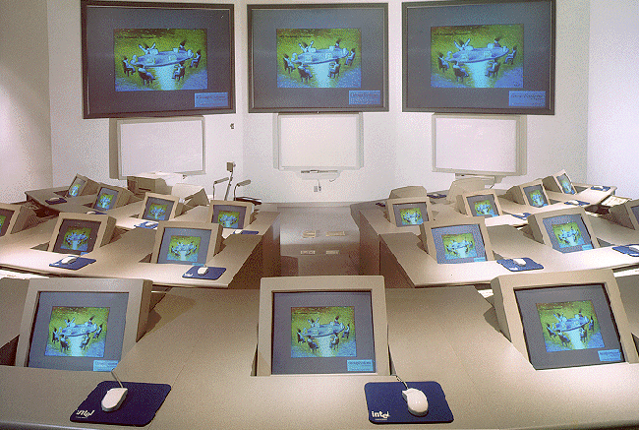
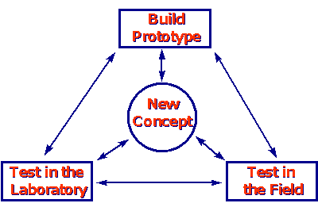


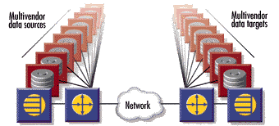
Vision for UA-MIS
To establish leadership in information technology education, research and outreach that accentuate innovation, hands-on experience and strategic values of information management, intelligence and technology.
MIS

Slide 9
Historical Overview
BS, MS and Ph.D. programs were first offered in 1974.
The department was established in 1977. 30th year celebration in 2004 on November 3-6, 2004
20 faculty members, 45 Ph.D., 50 MS, 120 MBA, 600 BS students
Unique values of our program
  Successful innovations and technology transfer
  Hands-on learning about synergies among development, application and management
  Applied and relevant
MIS

Slide 10
MIS Recognition
MIS
US News & World Report: ranked among top 5 programs for more than 15 consecutive years
External Peer Review (1998): “a jewel”
Decision Line rankings (1998, 1999):
  Dept. research productivity: #1 by far
  Dr. Nunamaker: #2
Comm. of AIS (2005):
  Institution publication productivity: #4
  Dr. Nunamaker #6; Dr. Chen #8

Slide 11
UA-MIS is highly ranked versus competitors and has the broadest scope - Andersen Consulting Report
Andersen Consulting 1999 Market Analysis
MIS
BS Program: 1100 Majors
MBA Program: 180 Students
UofA
Broad
UofA
NYU
Broad
Michigan
Michigan
Texas
Texas
ASU
MIT
ASU
MIT
Minnesota
Scope
Scope
Minnesota
Carnegie Mellon
Carnegie Mellon
U Penn
Narrow
Narrow
High
Ranking
Low
High
Ranking
Low
MS Program: 90 Students
PhD Program: 35 Students
UofA
NYU
Broad
UofA
Broad
NYU
Michigan
MIT
Texas
ASU
Scope
Illinois
Scope
Minnesota
Carnegie Mellon
Berkeley
Stanford
Carnegie Mellon
Irvine
Narrow
High
Ranking
Low
Narrow
High
Ranking
Low

Slide 12
Faculty
20 faculty members
Total Research Funding: $100+ million
Pioneers and leaders in
  Collaboration technology and science
  Knowledge management and artificial intelligence
  Large scale data management and mining
  Global eCommerce and Internet security issues
  Economics and technology management issues
Featured in Fortune, Business Week, Forbes, Sciences and New York Times articles
MIS

Slide 13
UA-MIS Board of Advisors
Provide guidance and support
Established in summer 1998
Inkind, scholarship, infrastructure and fund donations exceeding $10 million
Members include:
  AOL, Ameristar Casinos, Andersen Consulting, Arthur Andersen, Cap Gemini, Cargill, Commerce One, Compaq, EMC², Farmers Insurance, HP, Harvard Group, Honeywell, IBM, IFS, Intel, Oracle, PWC, Raytheon, RCM Technologies, SoftQuad, Ultralife Batteries
MIS

Slide 14
Partnership Outcomes
MIS
Mark and Susan Hoffman E-Commerce Lab
Harvard Group and Honeywell Scholarships
E-business Executive education program
Specialized co-op program
Student and faculty projects

Slide 15
Major UA/MIS Research Centers
MIS
Center for the Management of Information (CMI): Collaborative computing and group systems research, border security, deception detection
Artificial Intelligence Lab: Web computing, business intelligence, security and health informatics research
Hoffman E-Commerce Lab: E-Commerce and Internet computing research, education, outreach
Advanced Database Research Group: Data modeling and management research, business intelligence

Slide 16
UA/MIS Research Focuses:
MIS
Technical/design: artificial intelligence, web computing, GDSS, databases, deception detection, business intelligence, health and security informatics
Management sciences/OR/Econ: workflow, supply-chain, project management; applied econometrics, auctioning, modeling
Social/behavioral/cognitive: social impacts, computer-mediated communication, human-computer interactions (HCI)

Slide 17
AI Lab Background
Founded in 1989 by Dr. Hsinchun Chen (H-index 59. top 3 in MIS)
Excellence in Digital Library, Web Computing, Biomedical Informatics, and Security and Intelligence Informatics
Funding, $20M: federal (NSF, NIH, NIJ, DARPA, etc.) and industries (SAP, HP, IBM, etc.)
25+ researchers: 8 researchers/staff, 8 Ph.D. students, 10 MS/BS students (and 10+ affiliated faculty)
Research infrastructure: NT/UNIX/Linux workstations, servers, supercomputers (SGI); Java/C/C++, DBMS (Oracle/MS SQL), web protocols
MIS

Slide 18
AI Lab Projects: Web Intelligence and Mining
MIS
Meta searching, multi-lingual support, post-retrieval analysis, knowledge map visualization
Scientific portals: NanoPort (for Nano Technology), DGPort (for digital government)
Intelligence portals: (English/Chinese) business intelligence and medical intelligence, Spanish/Arabic/Chinese
CMC visualization by Glyphs, MDS/SOM visualization for financial management and Internet survey, financial data/text mining, GetSmart e-learning concept map, recommender systems

Slide 19
AI Lab Projects: Security Informatics
MIS
Digital government application, information sharing and analysis, social network analysis, data/text mining
COPLINK, Dark Web, and GeoPolitical Web research
Criminal and terrorism social network analysis (SNA): centrality, block-modeling, clustering
Criminal and terrorism data/text mining: criminal element association mining and clustering (time, place, objects)
Deception detection: criminal identities, missing information, fuzzy string comparison

Slide 20
AI Lab Projects: Health Informatics
MIS
Medical data and text mining, gene pathway analysis, medical ontologies, eletcronic health records (EHR) analysis
Medical portals: HelpfulMed and MedTextus, medical thesaurus (48M terms) and medical knowledge map (MED and Cancer)
Gene pathway text mining, computational linguistics; GeneArray data mining, clustering
Infectious disease and bioagent information sharing, analysis, and visualization
EHR temporal data mining and disease progression; patient social media and personalization

Slide 21
Research Opportunities
MIS
Ph.D. Program: excellent GPA (top 5 in class), strong GRE/GMAT (top 5%), strong research record, strong faculty personal recommendation ($18,000 annual financial support, 5 years) ➔ become professor ($100,000 + 2/9)
MS Program: good GPA and GRE/GMAT (top 10%), good recommendation (good chance for financial support after first semester, $14,000 per year, 2 years) ➔ become IT professional ($60,000)
Need good to excellent English communication skills (speaking and writing)
Joint faculty research, sabbatical exchange, visitor program

Slide 22
For more information
MIS
Eller College: http://eller.arizona.edu
AI Lab: http://ai.arizona.edu
Hsinchun Chen: hchen@eller.arizona.edu

