Slide 1

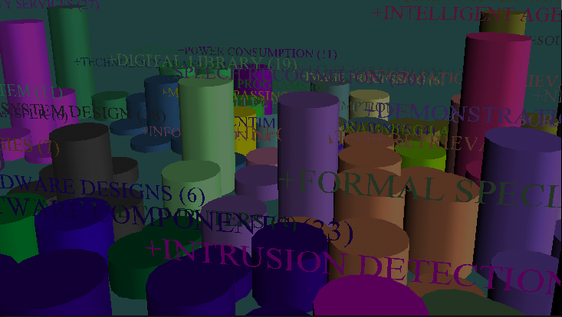
Information Visualization for Digital Library
Hsinchun Chen
McClelland Professor
University of Arizona
PI, NSF DLI-1, DLI-2
http://ai.bpa.arizona.edu/
hchen@bpa.arizona.edu

Slide 2
Outline
Information visualization overview
Textual visualization
  Visualization techniques
  Research on evaluating visualization systems
Visualization research in AI Lab
Research opportunities

Slide 3
Information Visualization Overview
Definition
  Information visualization is the two-way and interactive interface between humans and their information resources. Visualization technologies meld the human’s capacity with the computational capacity for analytical computing. (P1000 report)

Slide 4
Information Visualization Overview
Why visualization?
  Exploring information collections becomes increasingly difficult as the volume grows
  With minimal effort, the human visual system can process a large amount of information in a parallel manner
  The occurrence of advanced graphical software and hardware enables the large-scale visualization and the direct manipulation of interfaces

Slide 5
Information Visualization Overview
The goal of information visualization is to
  Relieve the cognitive overload
  Provide insight
Present information by combining visual dimensions
  Spatial location, size, color, texture, color hue, orientation, and shape (Bertin, 1983)
  Color saturation, arrangement, and focus (McCleary, 1983)
  Animation (Dibiase, 1991)

Slide 6
Information Visualization Overview
Information visualization can be categorized as
  Scientific visualization
  Software visualization (i.e., CAD)
  Textual visualization
Related research discipline
  Computer graphics
  Human computer interaction
  Information analysis
  Art and design

Slide 7
Information Visualization Overview
Scientific Visualization
  Numerical data
  Maps
  Modeling (i.e., molecular modeling)
Techniques in Scientific Visualization
  2D approach: Histograms, Scatter Plot, Glyphs/Icons, Contour lines (Isolines), Color Transformation
  3D approach: Surface View, Volume Slices
  Streamlines, Particle Motion, Stream Surface

Slide 8
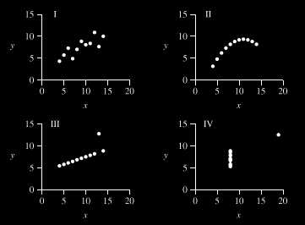
Information Visualization Overview
An example of scatter plot

Slide 9
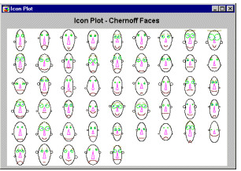
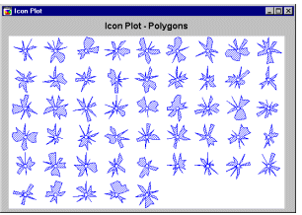
Information Visualization Overview
Examples of Glyphs/Icons

Slide 10
Textual Visualization
Textual document is an important information source
Electronic publishing created by Internet/Intranet, business intelligence, and corporate memory generates huge amounts of textual data
Textual visualization is still in its infancy

Slide 11
Textual Visualization
Conventional information retrieval model
  Index document, establish a similarity measure, process a user’s query, and find all documents related to this query
Challenges faced by IR and digital libraries that can be addressed by visualization technologies:
  Information overload
  User cognitive demand

Slide 12
Textual Visualization
The objectives of textual visualization research
  (1) Develop scalable visualization technologies, and principles.
  (2) Create user/task-centered visualization systems & methodology.

Slide 13
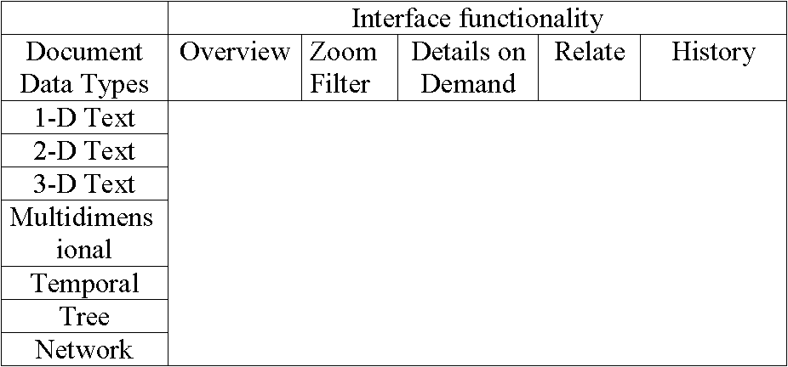
Textual Visualization
Shneiderman (1996) proposed a framework that categorizes visualization systems according to their data type and the interface functionality

Slide 14
Textual Visualization
Data types proposed ( Shneiderman, 1996; Morse, 1998)
  1-dimensional text
  2-dimensional text
  3-dimensional text
  Multi-dimensional
  Temporal
  Tree
  Network

Slide 15
Textual visualization
1-D text
  View documents as streams of words
  Use various text segmentation techniques:
    Salton and Buckley (1991) segment document according to author supplied orthographic markup
    Stanfill and Waltz (1992) divided documents in 30-word blocks
    Hearst and Plaunt (1993); Hearst (1994) used a statistical parser to segment document into topical elements

Slide 16
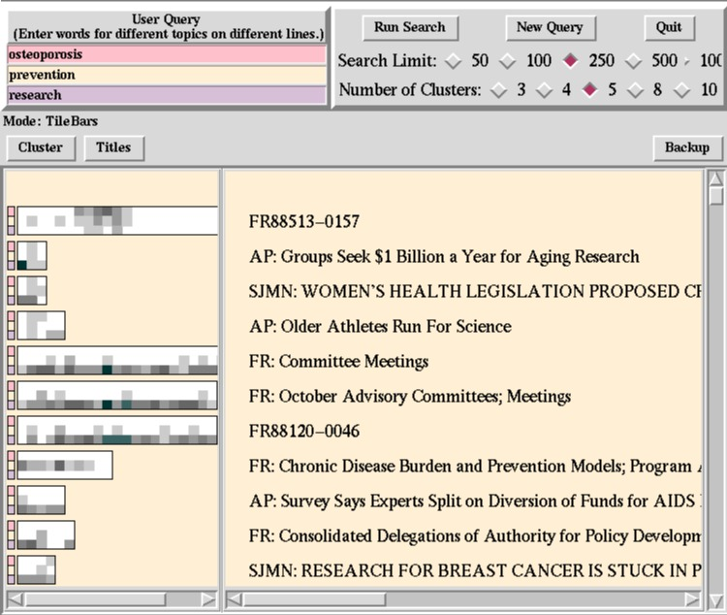
Textual Visualization
TileBars (Hearst, 1995)

Slide 17
Textual Visualization
2-dimensional text
  Focus on the characteristics of the layout on a page
  Represent a document with a low-dimensional vector
  Example systems
    Hemmje et al., 1993; Wise et al., 1995
    Pad++ (Bederson and Hollan, 1994)

Slide 18
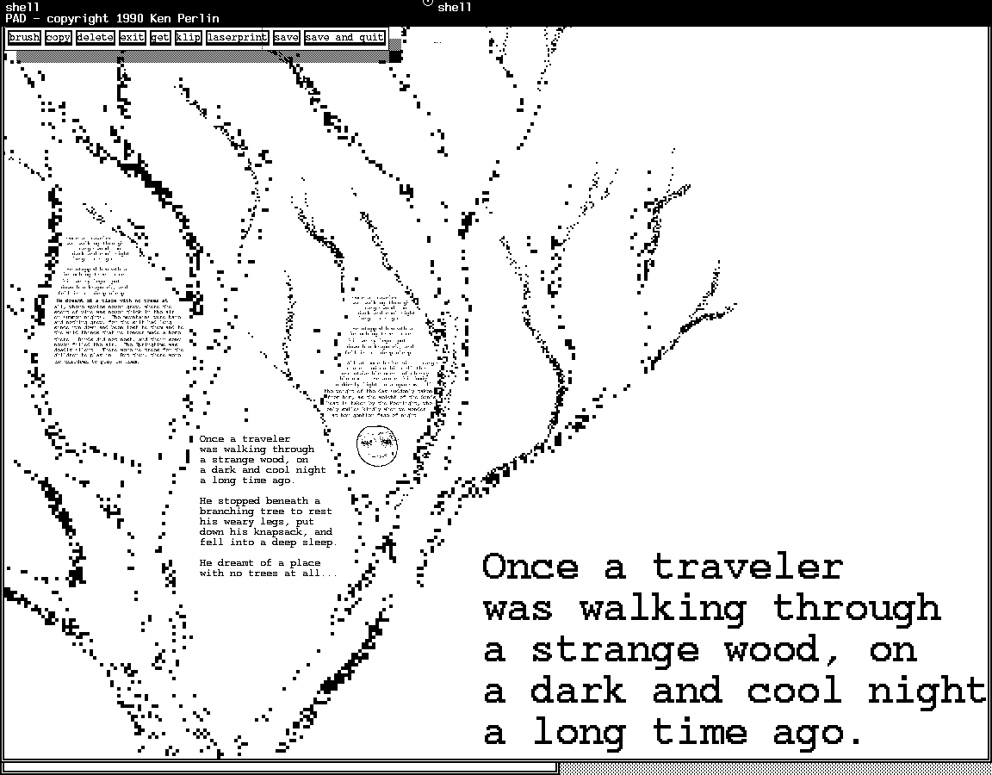
Textual Visualization
Pad++ system (Bederson and Hollan, 1994)

Slide 19
Textual Visualization
3-D text
  View documents as 3D objects
  example systems
    WebBook and WebForager system (Card, et al., 1996)

Slide 20
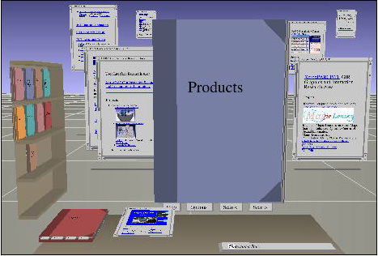
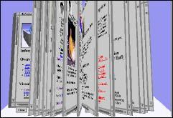
Textual Visualization
WebBook and WebForager System (Card et al., 1996)

Slide 21
Textual Visualization
Multidimensional Text
  Use information analysis technologies
  Represent the content of document with high-dimensional vector of terms
  Employ cluster algorithms to layout the vector sets
  Example systems
    VIBE (Olsen et al., 1993)
    SPIRE (Wise et al., 1995)
    ET Map (Chen et al., 1998)

Slide 22
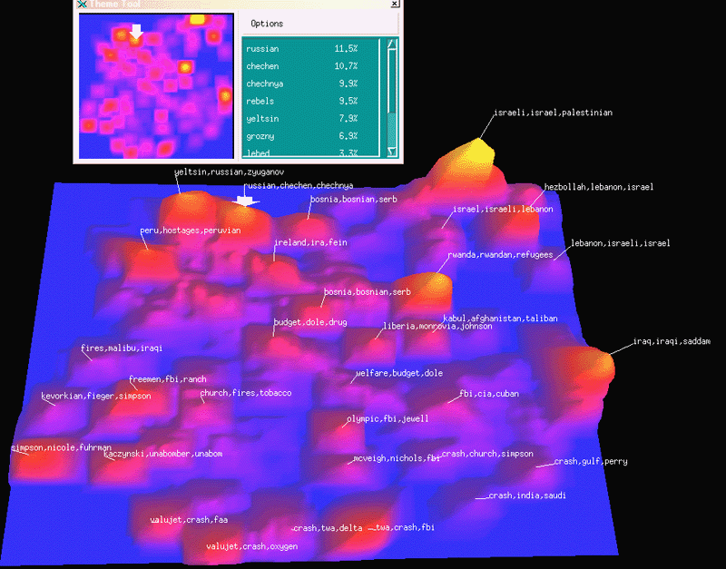
Textual Visualization
SPIRE system (Wise et al., 1995)

Slide 23
Textual Visualization
Temporal
  Documents are items that have a start and end time and may overlap with each other
  Example systems:
    Perspective Wall (Robertson et al., 1993)
    LifeLines (Plaisant et al., 1996)

Slide 24
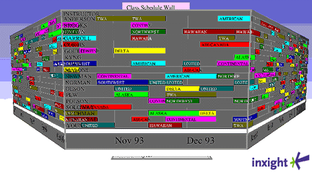
Textual Visualization
Perspective Wall (Robertson et al., 1993)

Slide 25
Textual Visualization
Trees
  Use tree structure to represent the hierarchical structure of a document set or a single document
  Example systems:
    Cone/Cam-Tree (Robertson et al., 1991)
    Hyperbolic Trees (Lamping et al., 1995)
    3-D Hyperbolic Trees (Munzer, 1997)

Slide 26
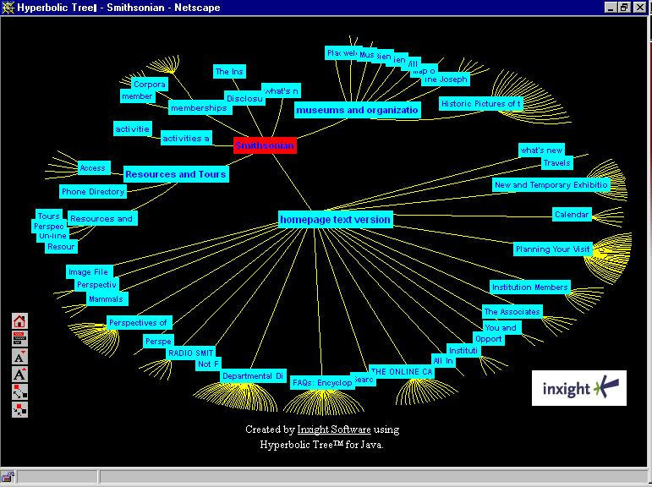
Textual Visualization
Hyperbolic Trees (Lamping et al., 1995)

Slide 27
Textual Visualization
Network
  Display the semantic relationships among textual documents
  Example systems:
    Multi-Trees (Furnas and Zacks, 1994)
    Butterfly Citation Browser (Mackinlay et al., 1995)
    Navigation View Builder (Mukherjea and Foley, 1995)

Slide 28
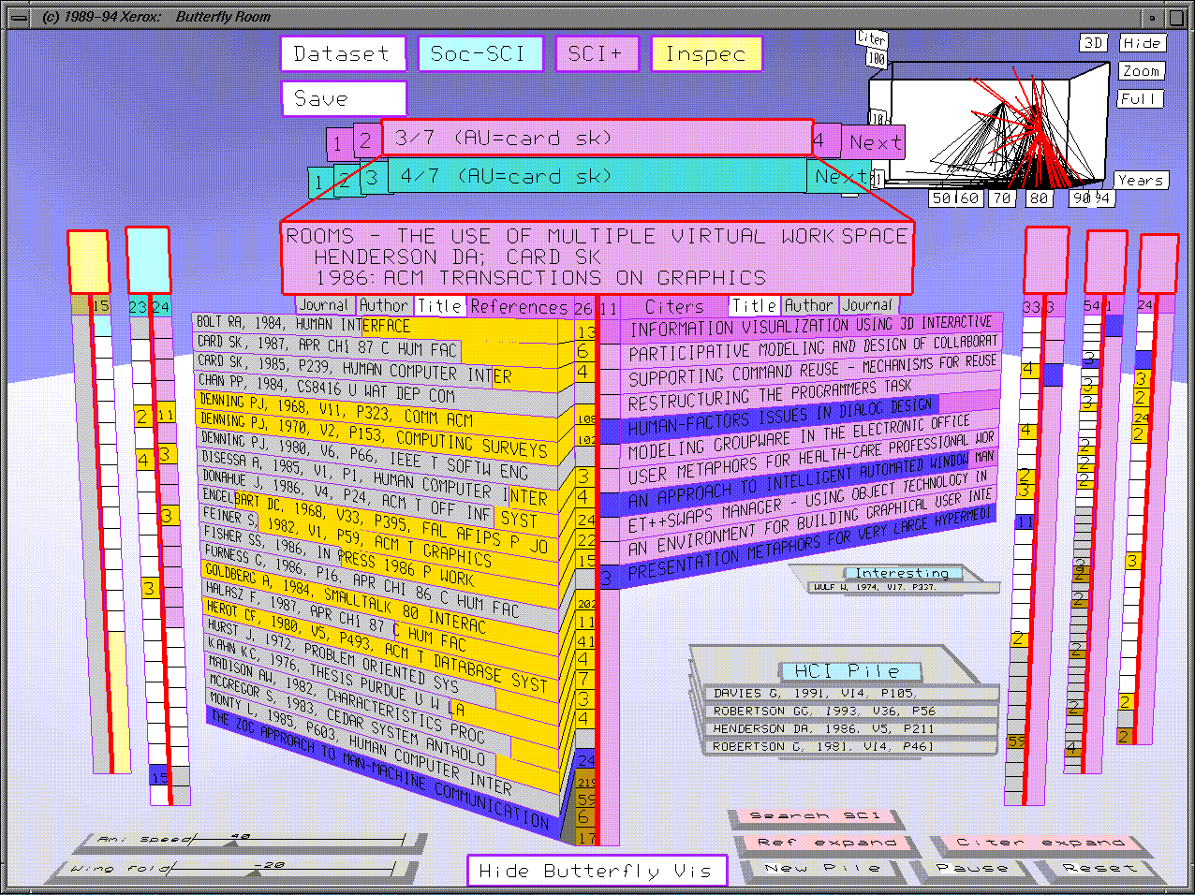
Textual Visualization
Butterfly Citation Browser (Mackinlay et al., 1995)

Slide 29
Textual Visualization
Functionality of a visualization system (Shneiderman, 1996):
  Overview
  Zoom
  Filtering
  Details-on-Demand
  Relate
  History

Slide 30
Textual Visualization
Overview
  Provide the overall composition and layout of the space
  Zoomed out techniques
  Fish-eye view technique (Furnas, 1986; Sarkar et al., 1994)
  Projection onto a hyperbolic surface (Lamping et al., 1995)
Zoom
  Allow user to select a region of the screen to display
  Enable user to fly through from larger portion to smaller portion and vice versa
  Implement Zooming as a discrete number of intermediate views
  PAD++ (Bederson and Hollan, 1994) and Document Lens (Robertson and Mackinlay, 1993)

Slide 31
Textual Visualization
Filtering
  Allow users to weed out uninteresting elements
Details-on-Demand
  Users may get lost when detail is provided and the larger picture is lost
  The details provided is not what users expect
Relate
  Relationships between objects in a display
  relationships between data in multiple associated windows
History
  Keeping history is important for user to retrace steps on a particular path

Slide 32
Textual Visualization
Studies about the tasks users may perform in a visual environment (important for user-centered design):
  Wehrend & Lewis (1990): a low-level, domain-independent approach (too low-level to understand the complex goal of a user)
  Task models from Library Environment (may be biased by how libraries work)
    Marchionini (1992)
    Bates (1989)
    Belkin et al. (1995)
  No task model covers the tasks of information browsing

Slide 33
Visualization Research in AI Lab
Research Objective
  Develop and select information analysis and visualization technologies to support large-scale visualization
Focus on facilitating
  Information browsing
  Specifying information need
Evaluate the effectiveness and efficiency of various visualization techniques

Slide 34
Visualization Research in AI Lab
Techniques:
  Arizona Noun Phraser: indexing based on identification of noun phrases in text
  Automatic Indexing: stop wording and algorithmic index phrase formation; mutual information/PAT-Tree based indexing
  Concept Space: index phrase co-occurrence information is used to generate an automatic thesaurus
  Kohonen Self-Organization Map (SOM) Algorithms:1-D, 2-D, 3-D (VRML) displays for information categorization and visualization
  Visualization: magnification with Fisheye view or Fractal view

Slide 35
Visualization Research in AI Lab
Illinois DLI-1 project:
“Federated Search of Scientific Literature”
Foundation from NSF/DARPA/NASA Digital Library Initiative-1
Research goal:
Semantic interoperability across subject domain
Technologies:
Semantic retrieval and analysis technologies
Text Tokenization
Part-of-speech-tagging
Noun phrase generation
Natural Language Processing

Slide 36
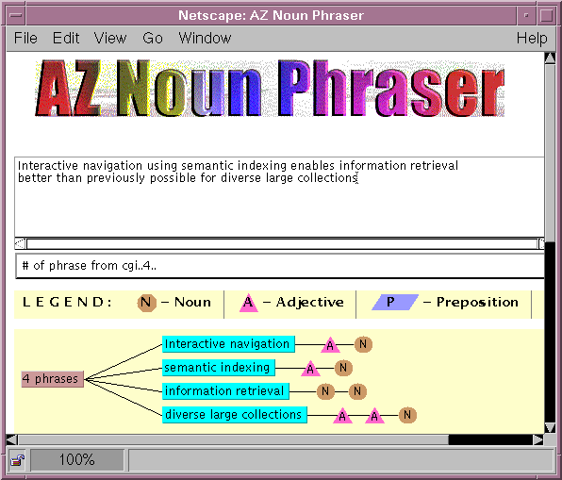
Visualization Research in AI Lab
Text Tokenization
Part-of-speech-tagging
Noun phrase generation
Natural Language Processing

Slide 37
Visualization Research in AI Lab
Illinois DLI project:
“Federated Search of Scientific Literature”
Foundation from NSF/DARPA/NASA Digital Library Initiative-1
Research goal:
Semantic interoperability across subject domain
Technologies:
Semantic retrieval and analysis technologies
Natural Language Processing
Heuristic term weighting
Weighted co-occurrence analysis
Co-occurrence analysis

Slide 38
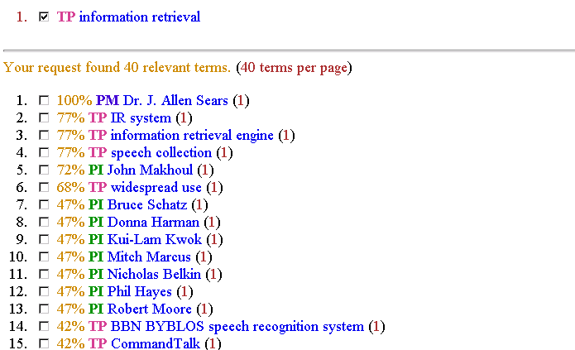
Visualization Research in AI Lab
Heuristic term weighting
Weighted co-occurrence analysis
Co-occurrence analysis

Slide 39
Visualization Research in AI Lab
Illinois DLI project:
“Federated Search of Scientific Literature”
Foundation from NSF/DARPA/NASA Digital Library Initiative-1
Research goal:
Semantic interoperability across subject domain
Technologies:
Semantic retrieval and analysis technologies
Natural Language Processing
Co-occurrence analysis
Document clustering
Category labeling
Optimization and parallelization
Neural Network Analysis

Slide 40
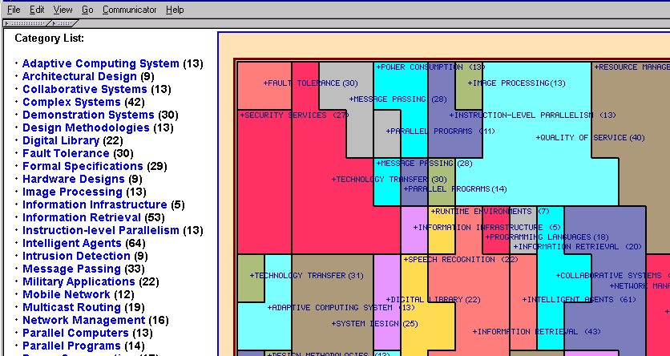
Visualization Research in AI Lab
Document clustering
Category labeling
Optimization and parallelization
Neural Network Analysis

Slide 41
Visualization Research in AI Lab
Techniques
Illinois DLI project:
“Federated Search of Scientific Literature”
Foundation from NSF/DARPA/NASA Digital Library Initiative-1
Research goal:
Semantic interoperability across subject domain
Technologies:
Semantic retrieval and analysis technologies
Natural Language Processing
1D: alphabetic listing of categories
2D: semantic map listing of categories
3D: interactive, helicopter fly-through using VRML
Co-occurrence analysis
Neural Network Analysis
Advanced Visualization

Slide 42
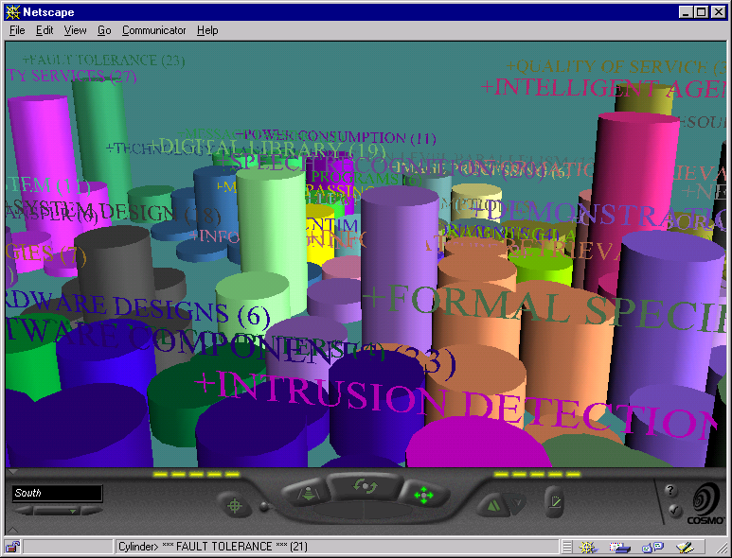
Visualization Research in AI lab
Advanced Visualization
1D, 2D, 3D

Slide 43
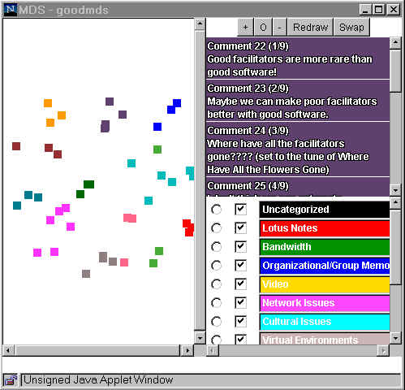
Visualization Research in AI Lab
MDS Visualization

Slide 44
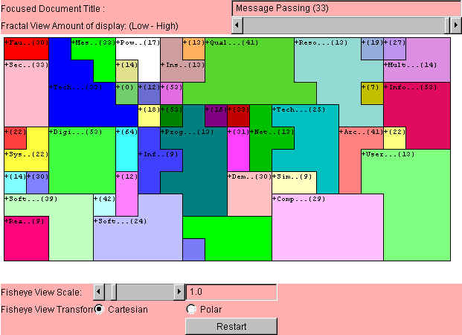
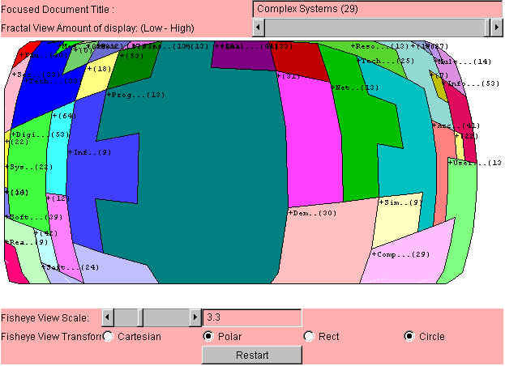
Visualization Research in AI Lab
Fisheye View
2D SOM

Slide 45
Visualization Research in AI Lab
Also apply SOM to support queries in image format
Conventional image representation: text annotation
  Requires manual efforts
  Failed to represent the content concisely
Represent an image it is low-level features, such as color, texture, and shape
  Users are not expert about low-level features
  Interface should be able to translate users’ query to low-level features: query by examples

Slide 46
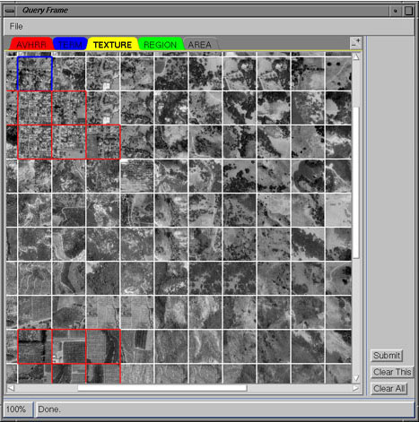
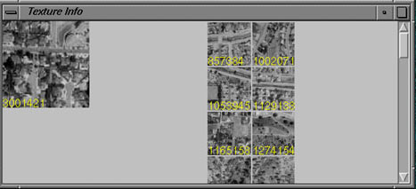
Visualization Research in AI Lab

Slide 47
Visualization Research in AI Lab
Evaluate the effectiveness and efficiency of 3D and 2D interface tin conveying geographical knowledge
3D interface has been proposed to be a promising approach to solve the small-screen problem (Robertson et. al, 1994)
  Con Tree (Robertson et. al, 1991)
  Information Cube (Feiner & Beshers, 1990)
  information landscape (Chalmers et. al, 1996).
While more and more research is devoted to developing 3D prototype system to visualize large-scale information, there is little in terms of systematic comparison of the effectiveness and efficiency of the 2D and 3D approaches

Slide 48
Visualization Research in AI Lab
Three types of spatial knowledge (MacEachren, 1991; Golledge & Stimson, 1987)
  Declarative knowledge: the knowledge about places and their attribute (i.e., place name and location)
  Procedural knowledge: characterized by the knowledge of how to get one place to another place, the routing knowledge
  Configurational knowledge: the spatial relationships among places and the knowledge of geographical patterns

Slide 49
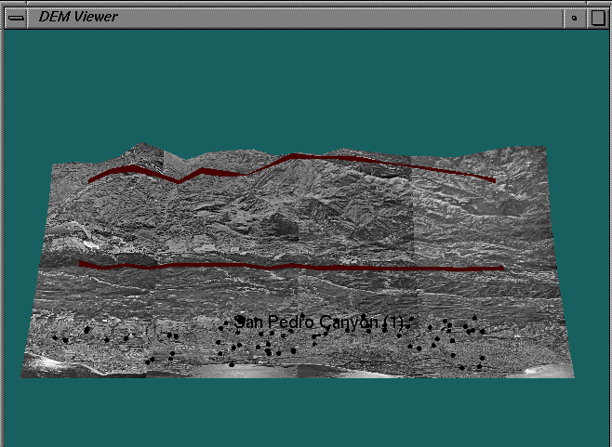
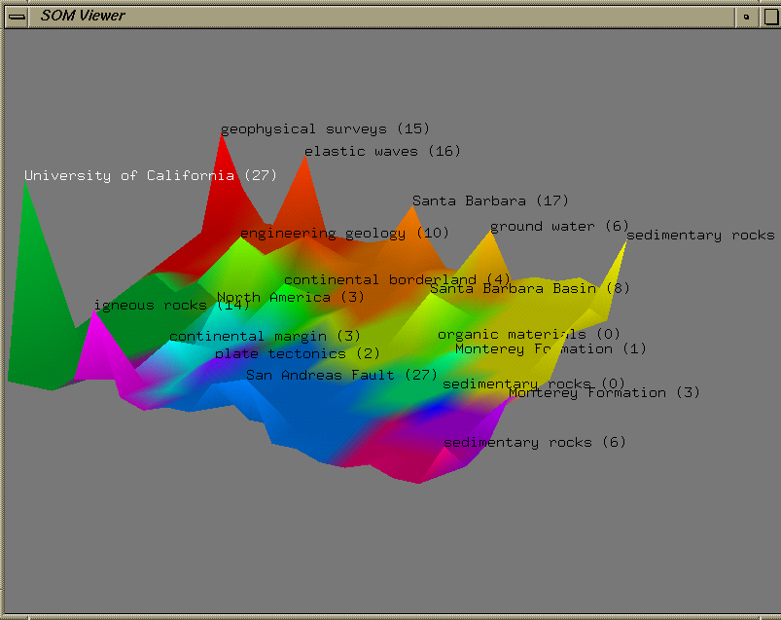
Visualization Research in AI Lab

Slide 50
Visualization Research in AI Lab
Results:
  With the assistance of interactive animation, 3D aerial photo is at least as effective and efficient in conveying declarative and configurational knowledge as 2D interface
  With the assistance of interactive animation, 3D aerial photo is more effective and efficient in conveying procedural knowledge than 2D interface
  With the assistance of interactive animation, 3D SOM is as effective and efficient as 2D SOM
  With the assistance of interactive animation, the 3D system is as effective and efficient in conveying declarative and configurational knowledge as 2D interface

Slide 51
Visualization Research in AI Lab
From YAHOO! To OOHAY?
Y
A
H
O
O
!
Y
A
H
O
O
Y
A
H
O
O
Y
A
H
O
O
Object
Oriented
Hierarchical
Automatic
Yellowpage
A
Y
H
O
O
O
O
H
A
Y
O
O
H
A
Y
O
O
H
A
Y
?
O
O
H
A
Y

Slide 52
Visualization Research in AI Lab
Arizona DLI-2 project:
“From Interspace to OOHAY?”
OOHAY: Visualizing the Web
Research goal:
automatic and dynamic categorization and visualization of ALL the web pages in US (and the world, later)
Technologies:
OOHAY techniques
Multi-threaded spiders for web page collection
High-precision web page noun phrasing and entity identification
Multi-layered, parallel, automatic web page topic directory/hierarchy generation
Dynamic web search result summarization and visualization
Adaptive, 3D web-based visualization

Slide 53
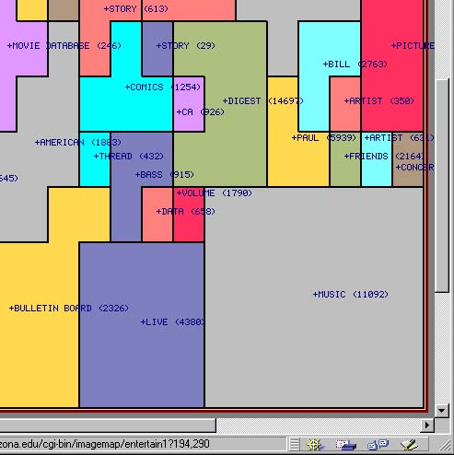
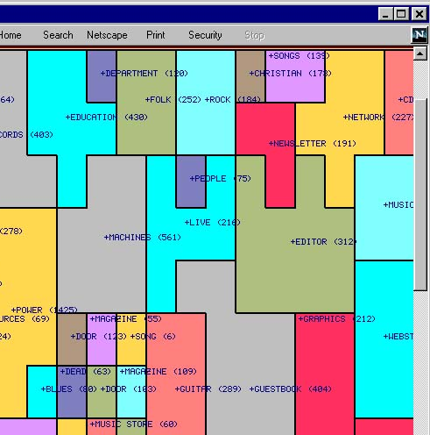
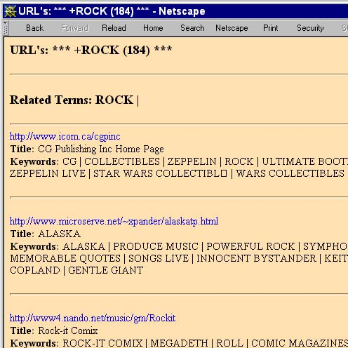
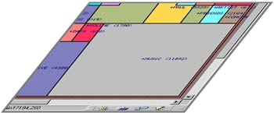
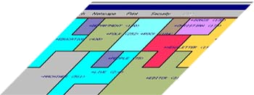
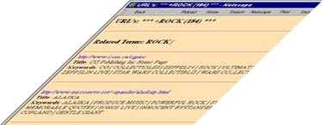
Visualization Research in AI Lab
OOHAY: Visualizing the Web
ROCK
MUSIC
… 50
6

Slide 54
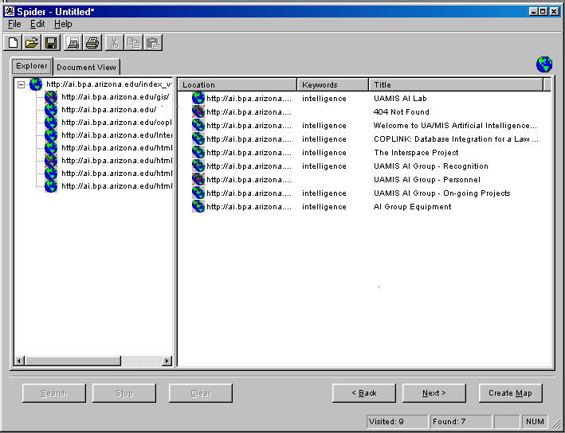
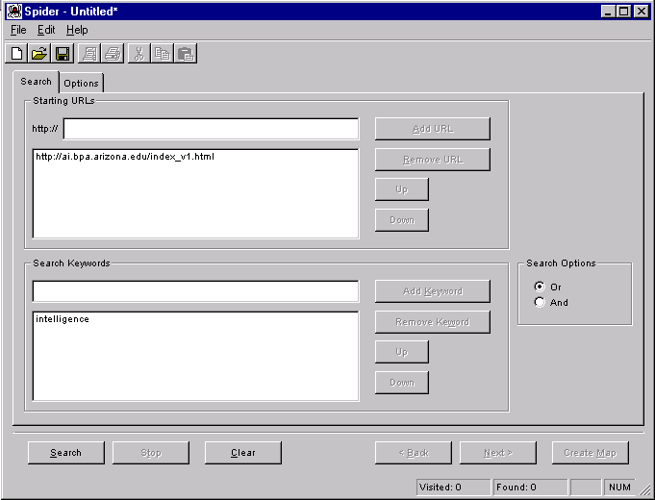
Visualization Research in AI Lab
OOHAY: CI Spider, Meta Spider, Med Spider
1. Enter Starting URLs and Key Phrases to be searched
2. Search results from spiders are displayed dynamically

Slide 55
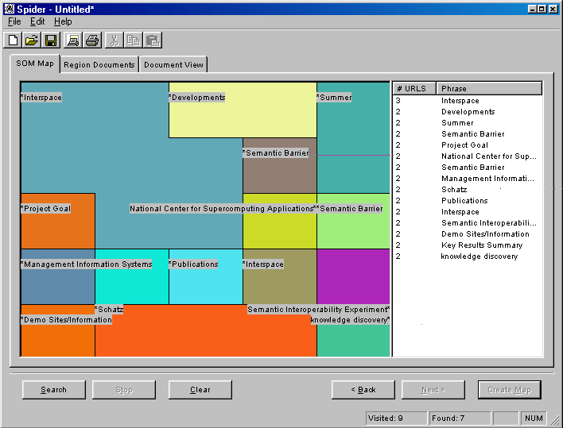
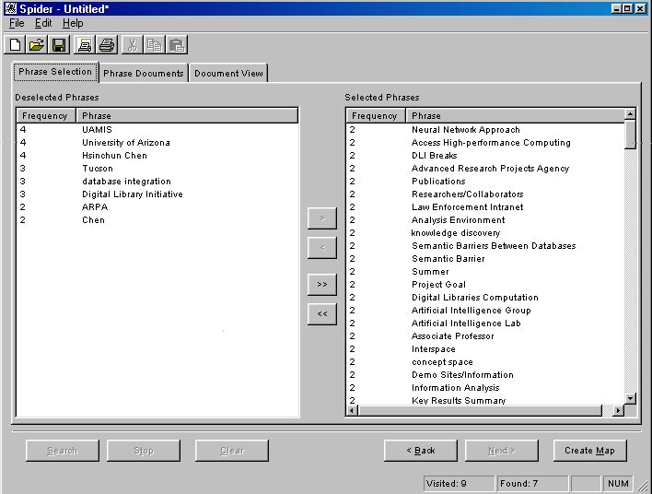
Visualization Research in AI Lab
OOHAY: CI Spider, Meta Spider, Med Spider
3. Noun Phrases are extracted from the web ages and user can selected preferred phrases for further summarization.
4. SOM is generated based on the phrases selected. Steps 3 and 4 can be done in iterations to refine the results.

Slide 56
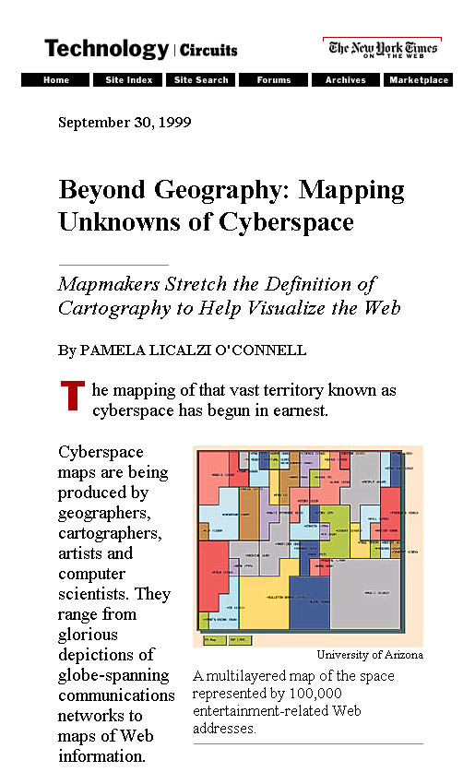
Visualization Research in AI Lab
Digital Library Research on New York Times,
Cover article,
Sep 30, 1999

Slide 57
Visualization Research in AI Lab
DL Special Issues and Activities:
IEEE Computer, May 1996 (Schatz/Chen)
IEEE Computer, February 1999 (Schatz/Chen)
Second Asia DL Workshop, November 8-9, 1999, Taipei, Taiwan
JASIS, 2000, forthcoming (Chen)
Berkeley (Wilensky), UCSB (Hill/Smith), Maryland (Greene/Shneiderman), Xerox PARC (Baldonado), IBM (Liu), Texas A&M (Shipman/Furuta), NASA (Kaplan), NTU (Oyong), Academia Sinica (Chien), HK Chinese U. (Yen)

