Slide 1
Hacker Web and Shodan A Tutorial for Accessing the Data

Slide 2
Outline
This tutorial consists of two components:
Accessing Hacker Web Forums.
Accessing Shodan.

Slide 3
Accessing Hacker Web Forums

Slide 4
Hacker Web Database Overview
The Hacker Web forums are hosted by MySQL database, which includes 18 forums:
Forum names:
2cto,anon, antichat, arhack, ashiyane, cnhonkerarmy, elitehack, exploit, hackdark, hackhound, icode, mihandownlaod, shabgard, unpack, v4team, vctool, xakepok, xeksec
Each forum has four tables storing information about users, threads, posts, and code attachments. The table names are:
[FORUMNAME]author
[FORUMNAME]thread
[FORUMNAME]posts
[FORUMNAME]code
For example, the table names for anon’s thread, posts, authors, and codes are (pay attention to pluralities):
anonthreads, anonposts, anonauthor, anoncode

Slide 5
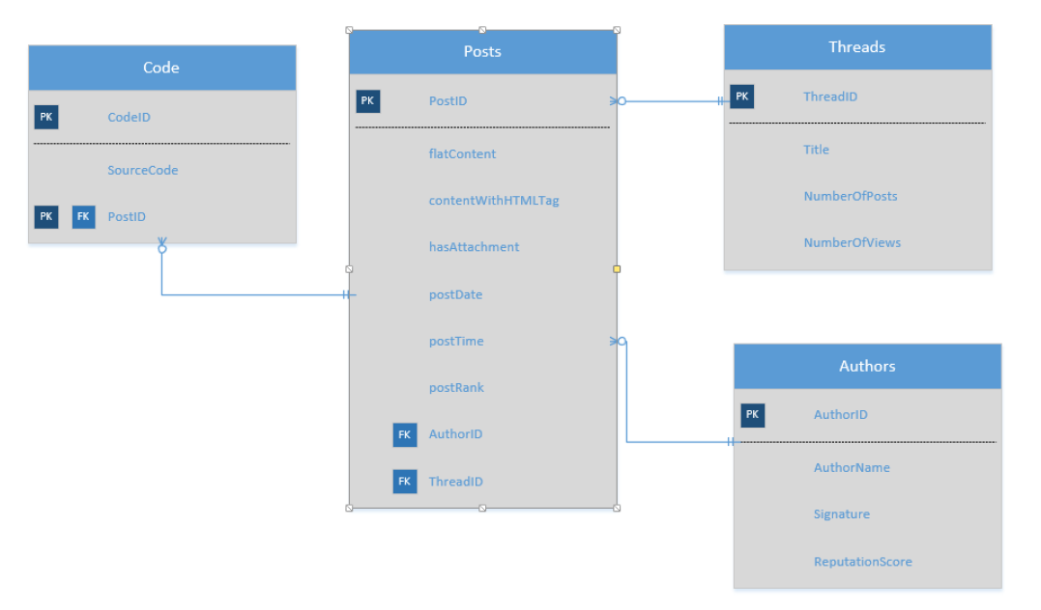
Hacker Web Database Schema
The following diagram shows the database schema for these tables.

Slide 6
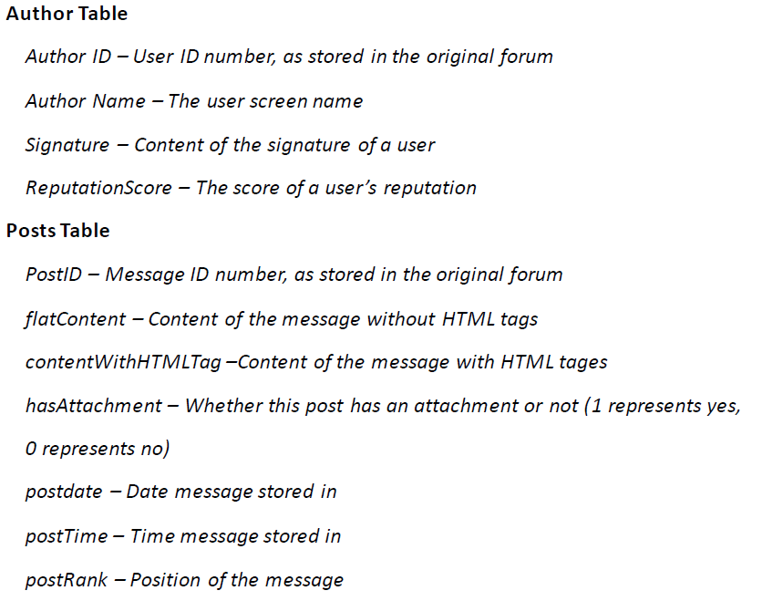
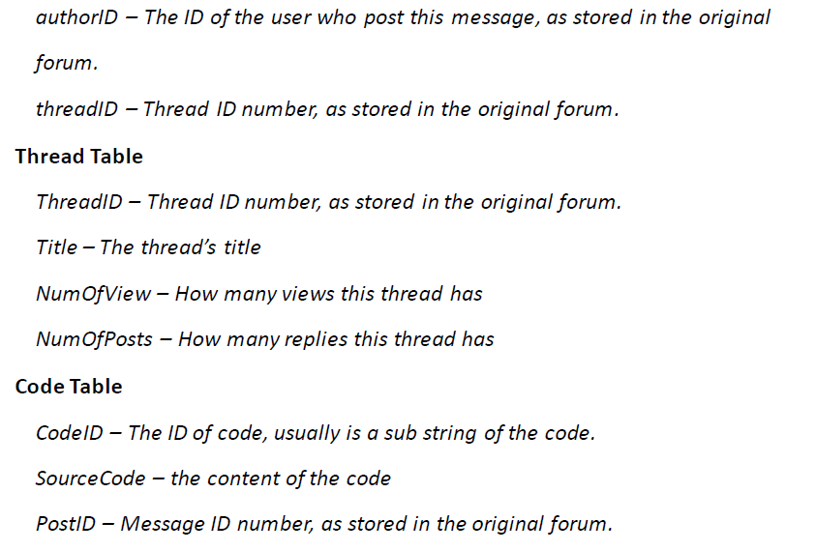
Hacker Web Database Schema
The definitions of the table columns are:

Slide 7
Accessing Hacker Web via MySQL Client
1) Download a database client.
HeidiSQL
http://www.heidisql.com/download.php
Other alternatvies:
MySQL Workbench
http://dev.mysql.com/downloads/
2) Connect to Hacker Web Database using the following credentials:
Host | 10.128.50.157
Port | 3306
Username: | mis510
Password | mis510
Database name | cybersecurity
*Alternatively, you can use usernames mis510_1 or mis510_2, with passwords still be “mis510”.

Slide 8
Accessing Hacker Web via MySQL Client
Now you can use GUI to browse the tables, or execute some SQL queries
Syntax for SQL queries has slight differences between MySQL, MS SQL Server, and Oracle. See the differences at:
http://troels.arvin.dk/db/rdbms/

Slide 9
Accessing Hacker Web via Java program
It’s recommended to access the database and process the data programmatically. The following steps show a simple example of connecting Hacker Web database in Java program. Please refer to http://dev.mysql.com/doc/connector-j/en/connector-j-installing.html for a more comprehensive guide.
1) Download the MySQL Connector that suits for you from http://dev.mysql.com/downloads/connector/j/5.1.html, and extract the jar file.
*You may need to register an account to see the page content.

Slide 10
Accessing Hacker Web via Java program
2) Add the Connector jar file to your Java Project Build Path.
For example, if you use Eclipse, right click the project, select [Build Path]->[Configure Build Path’, then add the extracted jar file (e.g. “mysql-connector-java-commercial-x.x.x-bin.jar”, ) onto the path.
3) Write codes to build connections, and execute queries.
The sample code in next slide shows an example of connecting to the database and do SELECT queries in anon forum’s thread table.

Slide 11
Accessing Hacker Web via Java program
import java.sql.*; public class DBAccess { public static void main(String[] args) throws SQLException, ClassNotFoundException { String url="jdbc:mysql://10.128.50.157:3306/cybersecurity"; String username="mis510"; String password="mis510"; Connection conn=null; Class.forName("com.mysql.jdbc.Driver"); conn=DriverManager.getConnection(url,username, password); System.out.println("Connected"); Statement stmt = null; ResultSet rs = null; stmt = conn.createStatement(); //select top 10 most viewed threads: rs = stmt.executeQuery("SELECT * from anonthread order by 'NumberOfViews' DESC limit 10"); while(rs.next()){ System.out.println(rs.getString(1)); //ID System.out.println(rs.getString(2)); //title System.out.println(rs.getString(3)); //number of views System.out.println(rs.getString(4)+'\n'); //number of posts } //search total number of posts that talk about specific topics. rs = stmt.executeQuery("SELECT count(*) from arhackposts where flatContent like '%bomb%'"); rs.next(); System.out.println("total number of posts in arhack.com talking about bomb is "+ rs.getInt(1)); } }

Slide 12
Accessing Shodan

Slide 13
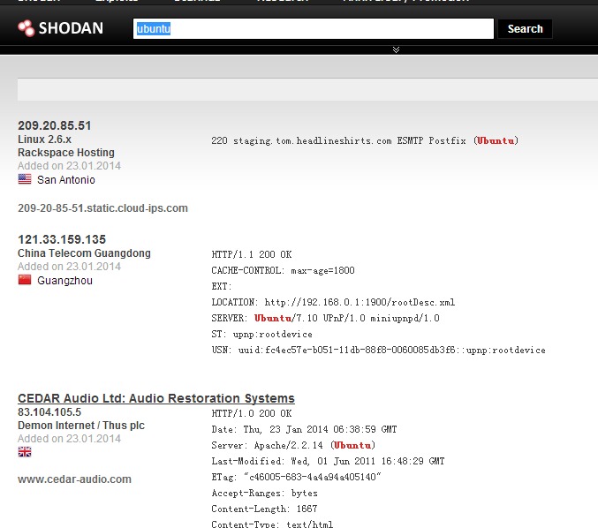
Shodan Overview
Shodan can be used to search many online devices based on software, geography, operating system, IP address and more.
You can use the Shodan search engine directly at http://www.shodanhq.com/. The snapshot shows example search results:

Slide 14
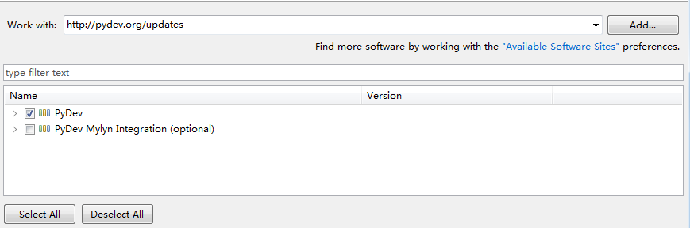
Accessing Shodan via Python
Shodan also provides Python, Perl, and Ruby APIs for programmatic access. A complete tutorial can be found at https://developers.shodan.io/index.html .
In this tutorial, we show how to access Shodan by its Python API.
1) Download Python
http://www.python.org/download/releases/2.7.6/
Add the python root folder to your system environment PATH variable.
2) Download PyDev (Python IDE in Eclipse)
In Eclipse, Help->Install New Software, then type http://pydev.org/updates inside “Work with”, press enter. Choose “PyDev”for download.

Slide 15
Accessing Shodan via Python
3) Obtain an API key
Register an account ( or use existing Google/Facebook/Twitter accounts) at http://www.shodanhq.com/account/register
Click on the create API key in the right column of the Shodan home page. Your API key will be located here.

Slide 16
Accessing Shodan via Python
4) Install Shodan Python library.
https://pypi.python.org/pypi/shodan/0.9.1
Depending on the version of Python and the Shodan API version downloaded, simplejson may need to be installed as well.
https://pypi.python.org/pypi/simplejson/
They will be added to your Eclipse PyDev project.

Slide 17
Accessing Shodan via Python
5) Create a new PyDev project in Eclipse
File->New->Other, then type “PyDev” to search for “PyDev Project” wizard.
If a pop-up window appears syaing you haven’t specified python interpreters, choose “Quick/automatic configuration”.
Link the unzipped libraries from last step to the project.
Right click on the project folder, select properties->Resource->PyDev->PYTHONPATH, choose “External Libraries” tab, and “add source folder”, then choose the two extracted library folders.

Slide 18
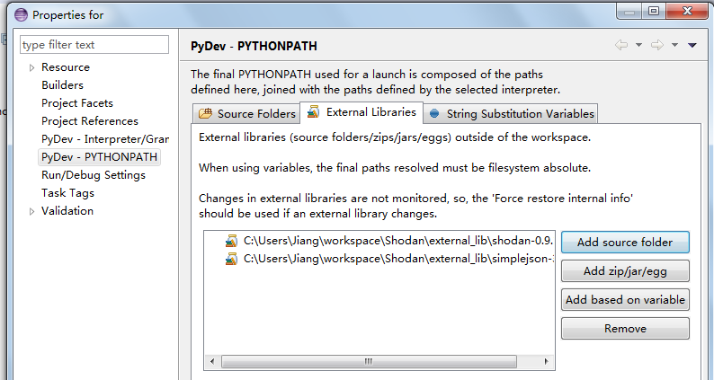
Accessing Shodan via Python

Slide 19
Accessing Shodan via Python
6) Run Shodan search (Example 1).
Create a new PyDev Module in the project folder, and copy the following codes.
The sample code searches “apache” in Shodan database, and return the relevant results.
You should replace” the API_KEY component with your own API key.
from shodan import WebAPI SHODAN_API_KEY = “Copy Your API Key here" api = WebAPI(SHODAN_API_KEY) # Wrap the request in a try/ except block to catch errors try: # Search Shodan results = api.search('apache') # Show the results print 'Results found: %s' % results['total'] for result in results['matches']: print 'IP: %s' % result['ip'] print result['data'] print '' except Exception, e: print 'Error: %s' % e

Slide 20
Accessing Shodan via Python
In addition to result[ip] and result[data] shown in the above example, you can also access information returned by Shodan based on the sample json object shown below:
'''{ 'total': 8669969, 'countries': [ { 'code': 'US', 'count': 4165703, 'name': 'United States' }, {'code': 'DE', 'count': 610270, 'name': 'Germany'}, {'code': 'JP', 'count': 496556, 'name': 'Japan'}, {'code': 'RO', 'count': 486107, 'name': 'Romania'}, {'code': 'GB', 'count': 273948, 'name': 'United Kingdom'} ], 'matches': [ { 'country': 'DE', 'data': 'HTTP/1.0 200 OK\r\nDate: Mon, 08 Nov 2010 05:09:59 GMT\r\nSer...', 'hostnames': ['pl4t1n.de'], 'ip': '89.110.147.239', 'os': 'FreeBSD 4.4', 'port': 80, 'updated': '08.11.2010' }, ... ] } '''
For a complete documentation, see
https://developers.shodan.io/python/index.html

Slide 21
Accessing Shodan via Python
7) Looking up a specific host (Example 2).
This sample code retrieves detailed information from a list of hosts, and count how many of them are accessible.
You should replace” the API_KEY component with your own API key.
from shodan import WebAPI SHODAN_API_KEY = "Copy Your API Key here" api = WebAPI(SHODAN_API_KEY) # This example retrieves detailed information from a list of hosts, and count how many of them are accessible. count=0 for i in range(41,50): try: host = api.host('217.140.75.'+str(i)) print 'accessing host %s' % host['ip'] print '%s' % host # print the entire jason object for the host. count+=1 except Exception, e: print 'Error: %s 217.140.75.%s' % (e,i) print 'total # of available hosts in the rage is %s' % count

Slide 22
Accessing Shodan via Python
A complete PyDev sample code up to this step can be found at our course website.
shodan_python_example.zip

Slide 23
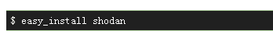
Accessing Shodan via Python
7) Alternative way to install Shodan
Download “easy_install” program at https://bitbucket.org/pypa/setuptools/raw/bootstrap/ez_setup.py
Run the above python script first, then add %PYTHON_HOME%\Scripts as PATH environment variable.
In command line mode, type:

