Slide 1

Introduction to
SVM (Support Vector Machine) and
CRF (Conditional Random Field)
MIS510
Spring 2009

Slide 2
Outline
SVM
  What is SVM?
  How does SVM Work?
  SVM Applications
  SVM Software/Tools
CRF
  What is CRF?
  CRF Applications
  CRF++: A tool for CRF
  Other CRF Related Tools

Slide 3
SVM
(Support Vector Machine)

Slide 4
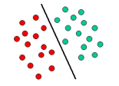
What is SVM?
Support Vector Machines (SVMs) are a set of machine learning approaches used for classification and regression, developed by Vladimir Vapnik and his co-workers at AT&T Bell Labs in the mid 90's.
SVM is based on the concept of decision planes that define decision boundaries.
A decision plane is one that separates between a set of objects having different class memberships.
Detailed definitions, descriptions, and proofs can be found from the following book:
  Vladimir Vapnik. The Nature of Statistical Learning Theory. Springer-Verlag, 1995. ISBN 0-387-98780-0
The decision plane

Slide 5
How does SVM Work?
SVM views the input data as two sets of vectors in an n-dimensional space. It constructs a separating hyperplane in that space, one which maximizes the margin between the two data sets.
To calculate the margin, two parallel hyperplanes are constructed, one on each side of the separating hyperplane.
A good separation is achieved by the hyperplane that has the largest distance to the neighboring data points of both classes.
The vectors (points) that constrain the width of the margin are the support vectors.

Slide 6
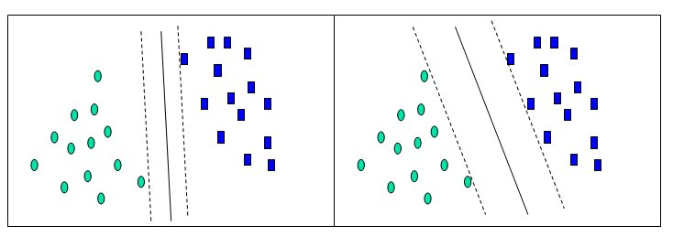
A Two-Dimensional Example
In this idealized example (http://www.dtreg.com/svm.htm), the cases with one category are in the lower left corner and the cases with the other category are in the upper right corner; the cases are completely separated. The SVM analysis attempts to find a 1-dimensional hyperplane (i.e., a line) that separates the cases based on their target categories. There are an infinite number of possible lines; two candidate lines are shown above. The question is which line is better, and how do we define the optimal line.
Solution 1
Solution 2
Hyperplane 1
Hyperplane 2
The separating hyperplane

Slide 7
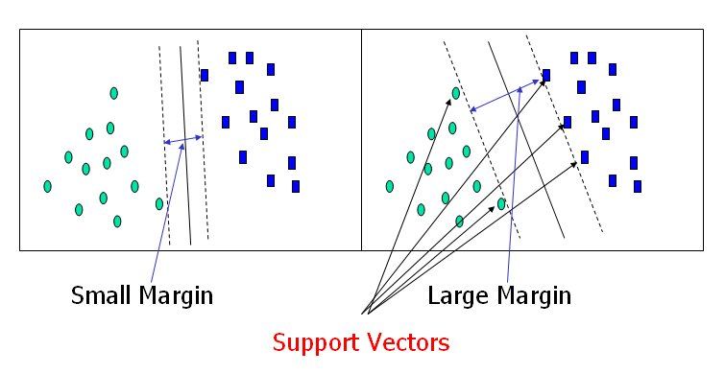
An SVM analysis finds the line (or, in general, hyperplane) that is oriented so that the margin between the support vectors is maximized. In the figure above, the line in the right panel is superior to the line in the left panel
Solution 1
Solution 2
Solution 2 has a larger margin than solution 1; therefore, solution 2 is better.

Slide 8
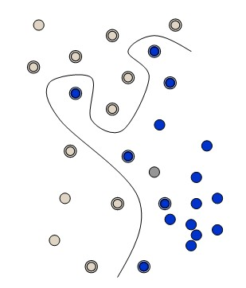
What if a Straight Line or Flat Plane Dose Not Fit? Kernel Functions
The simplest way to divide two groups is with a straight line, flat plane or an N-dimensional hyperplane. But what if the points are separated by a nonlinear region?
Rather than fitting nonlinear curves to the data, SVM handles this by using a kernel function to map the data into a different space where a hyperplane can be used to do the separation.
Nonlinear, not flat

Slide 9
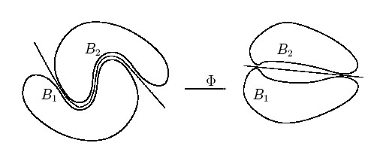
Kernel function Φ: map data into a different space to enable linear separation.
Kernel function is very powerful. It allows SVM models to perform separations even with very complex boundaries.
  Some examples of basic kernel functions are a linear kernel, a polynomial kernel, and a radial basis kernel.
  For data in structured representation, convolution kernels are frequently used. Convolution kernels are a family of kernel functions, including string kernels, tree kernels, and so on.
  You may construct your own kernel functions according to the data structure. An example of Escrow kernel will be provided in the following slides.

Slide 10
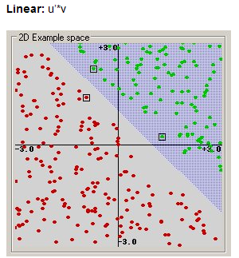
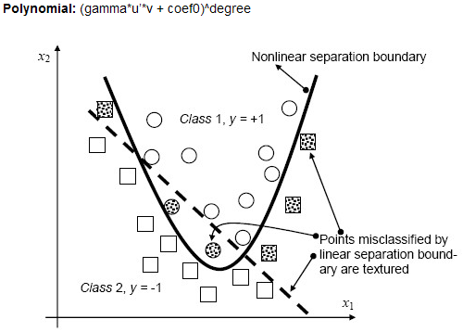
Examples of Basic Kernel Functions
(from http://www.dtreg.com/svm.htm )

Slide 11
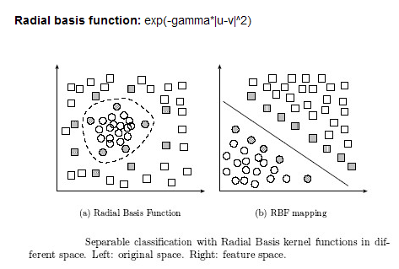
Examples of Basic Kernel Functions
(from http://www.dtreg.com/svm.htm )

Slide 12
Support Vector Machine: Classification
Basic kernel functions have been widely adopted for Text Categorization. Examples are:
    Topic Categorization
      Classifying a set of documents by topic
    Sentiment Classification
      Classifying online movie and/or product reviews as “positive” or “negative”
    Style Classification
      Categorizing text based on authorship (writing style)

Slide 13
SVM Applications:
An Example on Sentiment Classification
(Polynomial Kernel)

Slide 14
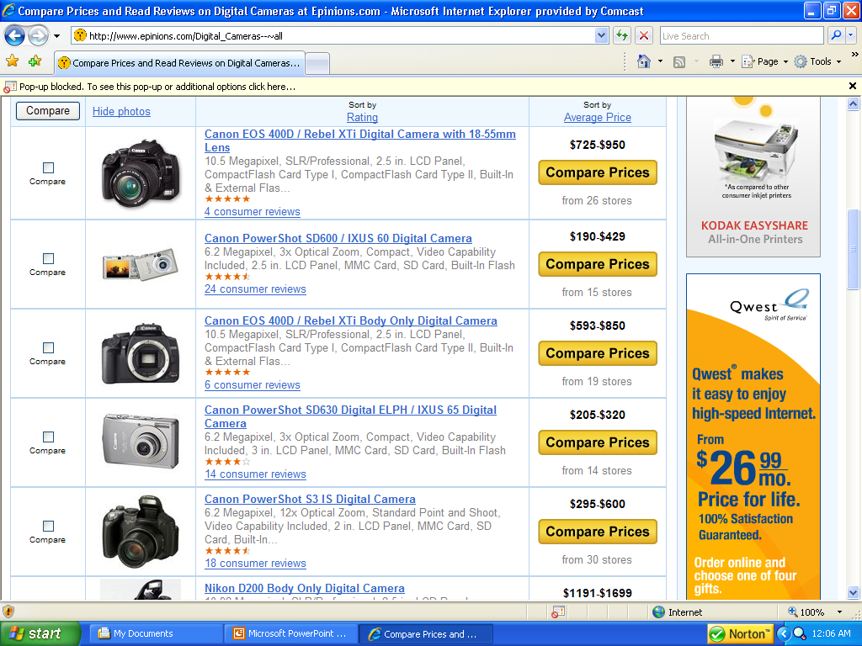
Sentiment Classification
Sentiment Categorization
  Motivation: Market Research!!!
    Gathering consumer preference data is expensive
    Yet its also essential when introducing new products or improving existing ones.
  Software for mining online review forums….$10,000
  Information gathered…….priceless.
(www.epinions.com)

Slide 15
Sentiment Classification
Experiment
  Objective to test effectiveness of features and techniques for capturing opinions.
  Test bed of 2000 digital camera product reviews taken from www.epinions.com.
    1000 positive (4-5 star) and 1000 negative (1-2 star) reviews
    500 for each star level (i.e., 1,2,4,5)
  Two experimental settings were tested
    Classifying 1 star versus 5 star (extreme polarity)
    Classifying 1+2 star versus 4+5 star (milder polarity)
  Feature set encompassed a lexicon of 3000 positive or negatively oriented adjectives and word n-grams.
  Compared C4.5 decision tree against SVM. A polynomial kernel can be used for this type of application.
    Both run using 10-fold cross validation.

Slide 16
Sentiment Classification
Sentiment Classification Experimental Results
  SVM significantly outperformed C4.5 on both experimental settings.
  The improved performance of SVM was attributable to its ability to better detect reviews containing sentiments with less polarity.
  Many of the milder (2 and 4 star) reviews contained positive and negative comments about different aspects of the product.
    It was more difficult for the C4.5 technique to detect the overall orientation of many of these reviews.
 | Techniques
Sentiments | SVM | C4.5
Extreme Polarity | 93.00 | 91.05
Mild Polarity | 89.40 | 85.20

Slide 17
SVM Applications:
An Example on Fraudulent Escrow Website Categorization
(Escrow Kernel)

Slide 18
Fraudulent Escrow Website Categorization
The Web Page Feature Matrix
Features
Ensemble Classifiers
  Also referred to as voting based techniques.
  Use multiple SVMs to distribute complex features.
  This is called a feature based ensemble.
  Each SVM classifier is an “expert” on one feature category.
Attributes used to classify web pages
 | Body Text Features | HTML Features | URL Features | Image Features
Real Page (C1) | 1,2,1,4 | 3,4,5,2 | 9,2,3 | Image1: 1,3,5,5
 |  |  |  | Image2: 8,3,4,1
 |  |  |  | Image3: 9,4,2,4
Fake Page (C2) | 63,50,4,5 | 49,10,5,2 | 3,2,4 | Image1: 43,43,6,4
 |  |  |  | Image2: 92,54,6,3
Prior instances used to classify future pages
Instances
Body
Text
SVM
HTML
SVM
URL
SVM
Image
SVM

Slide 19
Fraudulent Escrow Website Categorization
The Web Page Feature Matrix
 | Body Text Features | HTML Features | URL Features | Image Features
Real Page (C1) | 1,2,1,4 | 3,4,5,2 | 9,2,3 | Image1: 1,3,5,5
 |  |  |  | Image2: 8,3,4,1
 |  |  |  | Image3: 9,4,2,4
Fake Page (C2) | 63,50,4,5 | 49,10,5,2 | 3,2,4 | Image1: 43,43,6,4
 |  |  |  | Image2: 92,54,6,3
Real Page (C1) | 2,3,5,5 | 4,7,8,2 | 9,3,1 | Image1: 4,5,5,3
Nonlinear kernel
  We can define our own kernel function.
  Using this function, we can compute the similarity score between every page.
  This matrix can then be input into a linear SVM.
  Notice that the features are now the similarity scores for the pages.
Kernel Function
 | Similarity P1 | Similarity P2 | Similarity P3
Real Page (C1) | 1.000 | 0.134 | 0.531
Fake Page (C2) | 0.134 | 1.000 | 0.157
Real Page (C1) | 0.531 | 0.157 | 1.000

Slide 20
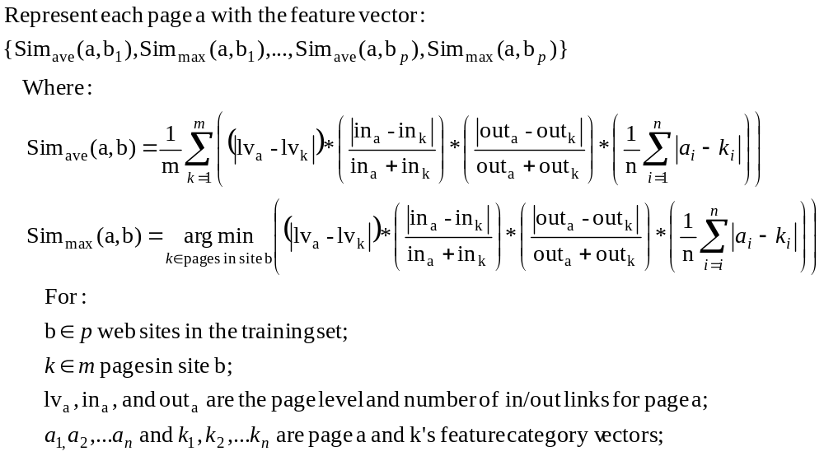
Fraudulent Escrow Website Categorization
Fraudulent Escrow Website Categorization
  An example kernel called “Escrow Kernel”
  This kernel is customized to handle fraudulent escrow pages.
  It considers the page structure, average page-site similarity, and max page-site similarity.
    The Escrow Kernel is defined as follows:

Slide 21
Fraudulent Escrow Website Categorization
  Experimental Design
  50 bootstrap instances
    Randomly select 50 real escrow sites and 50 fake web sites in each instance.
      Use all the web pages from the selected 100 sites as the instances.
    Each instance, use 10-fold CV for page categorization.
      90% pages used for training, 10% for testing in each fold.
    Compare different feature categories discussed as well as use of all features with ensemble and kernel approach.

Slide 22
Fraudulent Escrow Website Categorization
Fraudulent Escrow Website Categorization
  Experimental Results (Page level)
  The linear kernel outperformed the escrow kernel on the text and html features.
  The escrow kernel outperformed linear SVM on all other feature sets.
    Both ensemble and all feature kernels outperformed the use of individual feature categories.
Average classification accuracy (%) across 50 bootstrap runs
Kernel/Features | Body Text | HTML | URL | Image | All
Linear SVM | 96.92 | 97.08 | 93.99 | 72.26 | 97.69*
Escrow Kernel | 95.98 | 95.98 | 95.93 | 78.18 | 98.85
*Linear Ensemble with 4 SVM Classifiers

Slide 23
SVM Software/Tools
There are a lot of SVM software/tools have been developed and commercialized.
Among them, Weka SVM package and LIBSVM are two of the most widely used tools. Both are free of charge and can be downloaded from the Internet.
  Weka is available at http://www.cs.waikato.ac.nz/ml/weka/
  LIBSVM can be found at http://www.csie.ntu.edu.tw/~cjlin/libsvm/

Slide 24

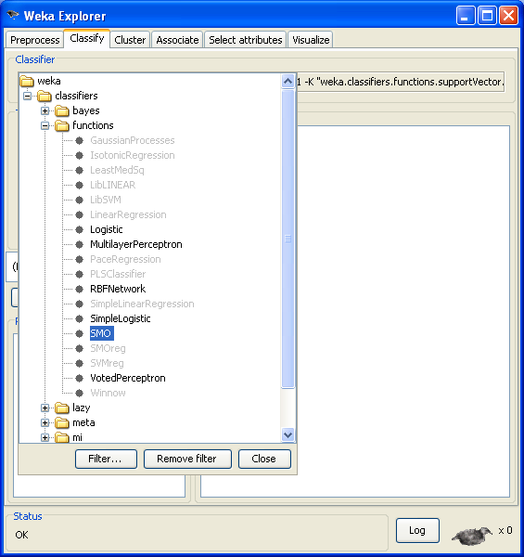
Weka SVM Package
Weka is a machine learning toolkit that includes an implementation of an SVM classifier.
Weka can be used both interactively though a graphical interface (GUI) or as a software library (a Java library).
The SVM implementation is called "SMO". It can be found in the Weka Explorer GUI, under the "functions" category.

Slide 25
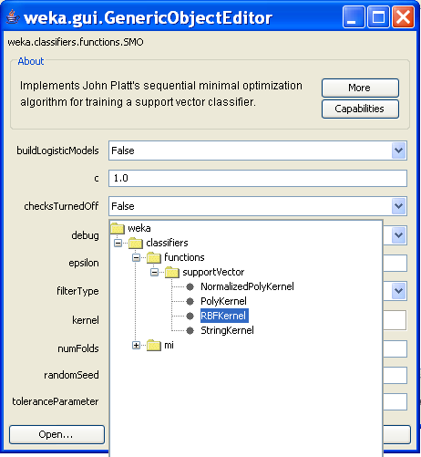
Kernel Functions in Weka
There are four kernel functions provided in Weka:
  Normalized Polynomial Kernel
  Polynomial Kernel
  Radial Basis kernel
  String Kernel

Slide 26
LIBSVM
LIBSVM is a library for Support Vector Machines, developed by Chih-Chung Chang and Chih-Jen Lin.
It can be downloaded as zip file or tar.gz file from http://www.csie.ntu.edu.tw/~cjlin/libsvm/
The above Web page also provides user guide (for beginners) and the GUI interface.
The supported packages for different programming languages (such as Matlab, R, Python, Perl, Ruby, LISP, .NET, and C#) can be downloaded from the Web page.

Slide 27
Other SVM Software/Tools
In addition to Weka SVM package and LIBSVM, there are many other SVM software/tools developed for different programming languages.
Algorithm::SVM
  Perl bindings for the libsvm Support Vector Machine library
  http://search.cpan.org/~lairdm/Algorithm-SVM-0.11/lib/Algorithm/SVM.pm
LIBLINEAR
  A Library for Large Linear Classification, Machine Learning Group at National Taiwan University
  http://www.csie.ntu.edu.tw/~cjlin/liblinear/
Lush
  A Lisp-like interpreted/compiled language with C/C++/Fortran interfaces that has packages to interface to a number of different SVM implementations.
  http://lush.sourceforge.net/
LS-SVMLab
  Matlab/C SVM toolbox
  http://www.esat.kuleuven.ac.be/sista/lssvmlab/
SVMlight
  A popular implementation of the SVM algorithm by Thorsten Joachims; it can be used to solve classification, regression and ranking problems.
  http://svmlight.joachims.org/
TinySVM
  A small SVM implementation, written in C++
  http://chasen.org/~taku/software/TinySVM/

Slide 28
CRF
(Conditional Random Field )

Slide 29
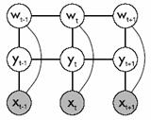
What is CRF?
A conditional random field (CRF) is a type of discriminative probabilistic model most often used for the labeling or parsing of sequential data, such as natural language text or biological sequences.
It is one of the state-of-the-art sequence labeling techniques.
CRF is based on HMM (Hidden Markov Model) but more powerful than HMM.
Detailed definitions, descriptions, and proofs can be found from the following book:
  Sutton, C., McCallum, A.: An Introduction to Conditional Random Fields for Relational Learning. In "Introduction to Statistical Relational Learning". Edited by Lise Getoor and Ben Taskar. MIT Press. (2006).

Slide 30
An Example of Sequence Labeling Problem
X is a random variable over data sequences to be labeled
Y is a random variable over corresponding label sequences
Y_{i} is assumed to range over a finite label alphabet set ∑ (In the following example, ∑={noun, verb, adjective, and so on})
The problem:
  Learn how to give labels from a closed set Y to a data sequence X
x₁
x₂
x₃
X:
Thinking
is
being
data
Y:
noun
verb
noun
labels
y₁
y₂
y₃

Slide 31
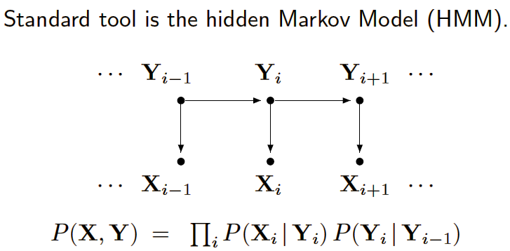
HMM vs. CRF
Hidden Markov Model (HMM)
  Assigns a joint probability to paired observation and label sequences
  The parameters typically trained to maximize the joint likelihood of train examples

Slide 32
HMM—Why Not?
Advantages of HMM:
  Estimation very easy.
  The parameters can be estimated with relatively high confidence from small samples.
Difficulties and disadvantages of HMM:
  Need to enumerate all possible observation sequences.
  Not practical to represent multiple interacting features or long-range dependencies of the observations.
  Very strict independence assumptions on the observations.

Slide 33
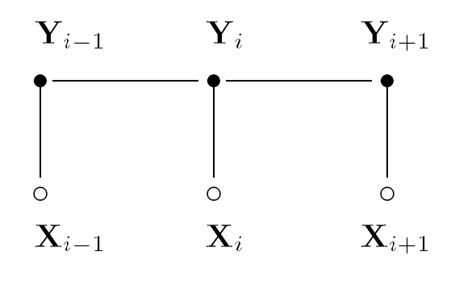
HMM vs. CRF
CRF uses the conditional probability P(label sequence y | observation sequence x) rather than the joint probability P(y, x) adopted by HMM.
  It specifies the probability of possible label sequences given an observation sequence.
CRF allows arbitrary, non-independent features on the observation sequence X.
The probability of a transition between labels may depend on past and future observations.
  CRF relaxes the strong independence assumptions in HMM.
CRF: undirected and acyclic

Slide 34
CRF Applications
As a form of discriminative modeling, CRF has been used successfully in various domains.
Application in computational biology include:
  DNA and protein sequence alignment,
  Sequence homolog searching in databases,
  Protein secondary structure prediction, and
  RNA secondary structure analysis.
Application in computational linguistics & computer science include:
  Text and speech processing, including topic segmentation, part-of-speech (POS) tagging,
  Information extraction, and
  Syntactic disambiguation.

Slide 35
Examples of Previous Studies Using CRF
Named Entity Recognition
  Andrew McCallum and Wei Li. Early Results for Named Entity Recognition with Conditional Random Fields, Feature Induction and Web-Enhanced Lexicons. Seventh Conference on Natural Language Learning (CoNLL), 2003.
  The paper has investigated named entity extraction with CRFs.
Information Extraction
  Fuchun Peng and Andrew McCallum. Accurate Information Extraction from Research Papers using Conditional Random Fields. Proceedings of Human Language Technology Conference and North American Chapter of the Association for Computational Linguistics (HLT-NAACL), 2004. (University of Massachusetts)
  The paper applies CRFs to extraction from research paper headers and reference sections, to obtain current best-in-the-world accuracy. Also compares some simple regularization methods.
Object Recognition
  Ariadna Quattoni, Michael Collins, and Trevor Darrell. Conditional Random Fields for Object Recognition. NIPS 2004. (MIT)
  The authors present a discriminative part-based approach for the recognition of object classes from unsegmented cluttered scenes.
Biomedical Named Entities Identification
  Tzong-han Tsai, Wen-Chi Chou, Shih-Hung Wu, Ting-Yi Sung, Sunita Sarawagi, Jieh Hsiang, and Wen-Lian Hsu. Integrating Linguistic Knowledge into a Conditional Random Field Framework to Identify Biomedical Named Entities. Journal of Expert Systems with Applications. 2005. (Institute of Information Science, Acdemia Sinica, TaiPei.)
  The paper makes use of CRFs for solving biomedical named entities identification. In this work, they try to utilize available resources including dictionaries, web corpora, and lexical analyzers, and represent them as linguistic features in the CRFs model.

Slide 36
CRF++:
A tool to do Named Entity Recognition, Information Extraction and Text Chunking by using CRF

Slide 37
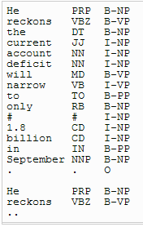
CRF++
CRF++ is a simple, customizable, and open source implementation of Conditional Random Fields (CRFs) for segmenting/labeling sequential data. It is written in C++. CRF++ is designed for generic purpose and can be applied to a variety of NLP tasks, such as Named Entity Recognition, Information Extraction and Text Chunking (http://crfpp.sourceforge.net/).
Training and Test file formats
  Both the training file and the test file need to be in a particular format for CRF++ to work properly.
  Generally speaking, training and test file must consist of multiple tokens. In addition, a token consists of multiple (but fixed-numbers) columns. The definition of tokens depends on tasks, however, in most of typical cases, they simply correspond to words. Each token must be represented in one line, with the columns separated by white space (spaces or tabular characters). A sequence of token becomes a sentence.
  You can give as many columns as you like, however the number of columns must be fixed through all tokens. Furthermore, there are some kinds of "semantics" among the columns. For example, 1st column is 'word', second column is 'POS tag' third column is 'sub-category of POS' and so on.
  The last column represents a true answer tag which is going to be trained by CRF.
Example: Training and Test file formats

Slide 38
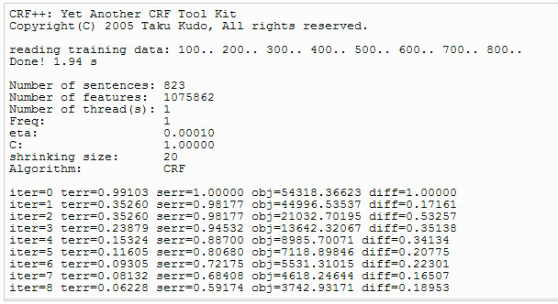
Training a CRF by using CRF++
Use crf_learn command:
    % crf_learn template_file train_file model_file
  where template_file and train_file are the files you need to prepare in advance. crf_learn generates the trained model file in model_file.
crf_learn outputs the following information
iter: number of iterations processed
terr: error rate with respect to tags. (# of error tags/# of all tag)
serr: error rate with respect to sentences. (# of error sentences/# of all sentences)
obj: current object value. When this value converges to a fixed point, CRF++ stops the iteration.
diff: relative difference from the previous object value.

Slide 39
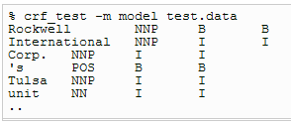
Testing a CRF by using CRF++
Use crf_test command:
  % crf_test -m model_file test_files ...
  where model_file is the file crf_learn creates.
  In the testing, you don't need to specify the template file, because the model file has the same information for the template.
  test_file is the test data you want to assign sequential tags. This file has to be written in the same format as training file.
an example output of crf_test

Slide 40
Other CRF Related Tools
The Stanford Named Entity Recognizer
  A Java implementation of a Conditional Random Field sequence model, together with well-engineered features for Named Entity Recognition.
  Available at: http://nlp.stanford.edu/software/CRF-NER.shtml
Stanford Chinese Word Segmenter
  A Java implementation of a CRF-based Chinese Word Segmenter.
  Available at: http://nlp.stanford.edu/software/segmenter.shtml
MALLET
  For Java. MALLET includes tools for sequence tagging for applications such as named-entity extraction from text. Algorithms include Hidden Markov Models, Maximum Entropy Markov Models, and Conditional Random Fields.
  Available at: http://mallet.cs.umass.edu/

Slide 41
Other CRF Related Tools
MinorThird
  For Java
  http://minorthird.sourceforge.net/
Sunita Sarawagi's CRF package
  For Java
  http://crf.sourceforge.net/
HCRF library (including CRF and LDCRF)
  For C++ and Matlab
  http://sourceforge.net/projects/hcrf/
CRFSuite
  For C++
  http://www.chokkan.org/software/crfsuite/

