Slide 1

Introduction to
SVM (Support Vector Machine) and
CRF (Conditional Random Field )
MIS510
Spring 2009

Slide 2
Outline
SVM
  What is SVM?
  How does SVM Work?
  SVM Applications
  SVM Software/Tools
CRF
  What is SVM?
  CRF Applications
  CRF Software/Tools

Slide 3
SVM
(Support Vector Machine)

Slide 4
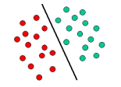
What is SVM?
Support Vector Machines (SVM) are a set of machine learning approaches used for classification and regression, developed by Vladimir Vapnik and his co-workers at AT&T Bell Labs in the mid 90's.
SVM is based on the concept of decision planes that define decision boundaries.
A decision plane is one that separates between a set of objects having different class memberships.
Detailed definitions, descriptions, and proofs can be found from the following book:
  Vladimir Vapnik. The Nature of Statistical Learning Theory. Springer-Verlag, 1995. ISBN 0-387-98780-0
The decision plane

Slide 5
How does SVM Work?
SVM views the input data as two sets of vectors in an n-dimensional space. It constructs a separating hyperplane in that space, one which maximizes the margin between the two data sets.
To calculate the margin, two parallel hyperplanes are constructed, one on each side of the separating hyperplane.
A good separation is achieved by the hyperplane that has the largest distance to the neighboring data points of both classes.
The vectors (points) that constrain the width of the margin are the support vectors.

Slide 6
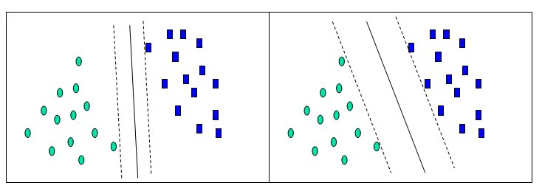
A Two-Dimensional Example
Solution 1
Solution 2
Hyperplane 1
Hyperplane 2
The separating hyperplane

Slide 7
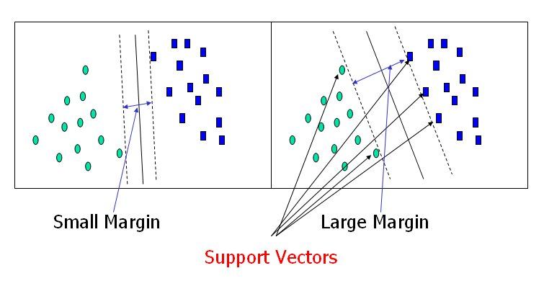
Solution 1
Solution 2
Solution 2 has a larger margin than solution 1; therefore, solution 2 is better.

Slide 8
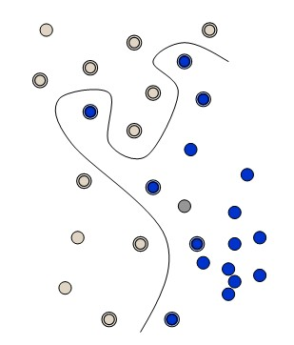
What if a Straight Line or Flat Plane Dose Not Fit? Kernel Functions
The simplest way to divide two groups is with a straight line, flat plane or an N-dimensional hyperplane. But what if the points are separated by a nonlinear region?
Rather than fitting nonlinear curves to the data, SVM handles this by using a kernel function to map the data into a different space where a hyperplane can be used to do the separation.
Nonlinear, not flat

Slide 9
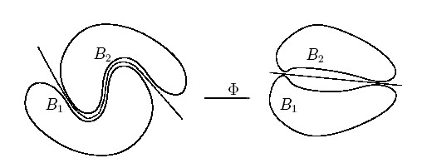
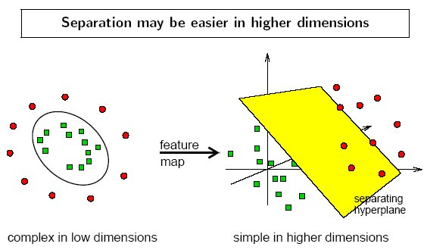
Kernel function Φ: map data into a different space to enable linear separation.
Kernel function is very powerful. It allows SVM models to perform separations even with very complex boundaries.

Slide 10
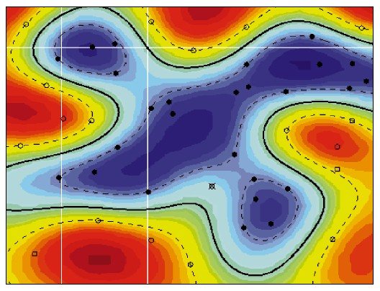
SVM Applications
SVM has been used in various application domains such as:
  Text classification
    E.g., S. Tong and D. Koller, Support Vector Machine Active Learning with Applications to Text Classification, Journal of Machine Learning Research, 2001, 45-66
  Bioinformatics
    E.g., E. Byvatov and G. Schneider, Support Vector Machine Applications in Bioinformatics, Applied Bioinformatics, 2003, 2(2):67-77
  Business and Marketing
    K. Shin, T. Lee, and H. Kim, An Application of Support Vector Machines in Bankruptcy Prediction Model, Expert Systems with Applications, 2005, 28(1): 127-135
  Chemistry
    H. Li, Y. Liang, and Q. Xu, Support Vector Machines and Its Applications in Chemistry, Chemometrics and Intelligent Laboratory Systems, 2009, 95(2): 188-198

Slide 11
SVM Applications
SVM Application List
  Can be found at: http://www.clopinet.com/isabelle/Projects/SVM/applist.html.
The webpage lists different studies applying SVM to various domains. Examples include:
  “Support Vector Decision Tree Methods for Database Marketing,”
  “SVM for Geo- and Environmental Sciences,”
  “3-D Object Recognition Problems,”
  “Facial expression classification,” and
  “Support Vector Machine Classification of Microarray Gene Expression Data.”

Slide 12
SVM Software/Tools
There are a lot of SVM software/tools have been developed and commercialized.
Among them, Weka SVM package and LIBSVM are two of the most widely used tools. Both are free of charge and can be downloaded from the Internet.
  Weka is available at http://www.cs.waikato.ac.nz/ml/weka/
  LIBSVM can be found at http://www.csie.ntu.edu.tw/~cjlin/libsvm/

Slide 13

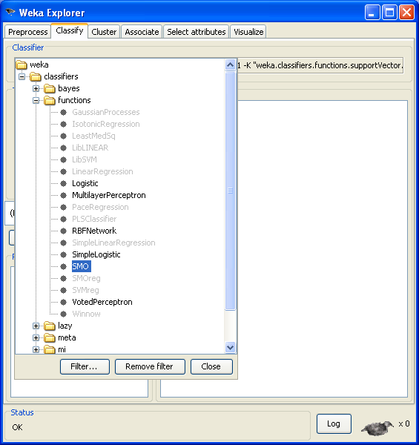
Weka SVM Package
Weka is a machine learning toolkit that includes an implementation of an SVM classifier.
Weka can be used both interactively though a graphical interface (GUI) or as a software library (a Java library).
The SVM implementation is called "SMO". It can be found in the Weka Explorer GUI, under the "functions" category.

Slide 14
LIBSVM
LIBSVM is a library for Support Vector Machines, developed by Chih-Chung Chang and Chih-Jen Lin.
It can be downloaded as zip file or tar.gz file from http://www.csie.ntu.edu.tw/~cjlin/libsvm/
The above Web page also provides user guide (for beginners) and the GUI interface.
The supported packages for different programming languages (such as Matlab, R, Python, Perl, Ruby, LISP, .NET, and C#) can be downloaded from the Web page.

Slide 15
Other SVM Software/Tools
In addition to Weka SVM package and LIBSVM, there are many other SVM software/tools developed for different programming languages.
Algorithm::SVM
  Perl bindings for the libsvm Support Vector Machine library
  http://search.cpan.org/~lairdm/Algorithm-SVM-0.11/lib/Algorithm/SVM.pm
LIBLINEAR
  A Library for Large Linear Classification, Machine Learning Group at National Taiwan University
  http://www.csie.ntu.edu.tw/~cjlin/liblinear/
Lush
  A Lisp-like interpreted/compiled language with C/C++/Fortran interfaces that has packages to interface to a number of different SVM implementations.
  http://lush.sourceforge.net/
LS-SVMLab
  Matlab/C SVM toolbox
  http://www.esat.kuleuven.ac.be/sista/lssvmlab/
SVMlight
  A popular implementation of the SVM algorithm by Thorsten Joachims; it can be used to solve classification, regression and ranking problems.
  http://svmlight.joachims.org/
TinySVM
  A small SVM implementation, written in C++
  http://chasen.org/~taku/software/TinySVM/

Slide 16
CRF
(Conditional Random Field )

Slide 17
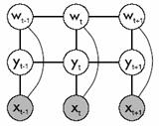
What is CRF?
A conditional random field (CRF) is a type of discriminative probabilistic model most often used for the labeling or parsing of sequential data, such as natural language text or biological sequences.
It is one of the state-of-the-art sequence labeling techniques.
CRF is based on HMM (Hidden Markov Model) but more powerful than HMM.
Detailed definitions, descriptions, and proofs can be found from the following book:
  Sutton, C., McCallum, A.: An Introduction to Conditional Random Fields for Relational Learning. In "Introduction to Statistical Relational Learning". Edited by Lise Getoor and Ben Taskar. MIT Press. (2006).

Slide 18
An Example of
Sequence Labeling Problem
X is a random variable over data sequences to be labeled
Y is a random variable over corresponding label sequences
Yi is assumed to range over a finite label alphabet A
The problem:
  Learn how to give labels from a closed set Y to a data sequence X
x₁
x₂
x₃
X:
Thinking
is
being
data
Y:
noun
verb
noun
labels
y₁
y₂
y₃

Slide 19
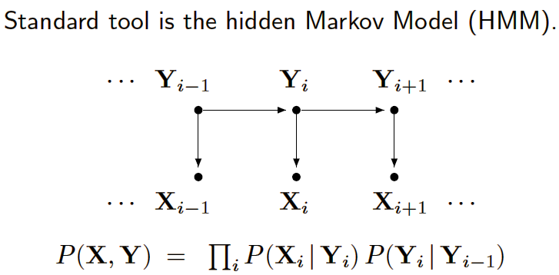
HMM vs. CRF
Hidden Markov Model (HMM)
  Assigns a joint probability to paired observation and label sequences
  The parameters typically trained to maximize the joint likelihood of train examples

Slide 20
HMM—Why Not?
Advantages of HMM:
  Estimation very easy.
  The parameters can be estimated with relatively high confidence from small samples.
Difficulties and disadvantages of HMM:
  Need to enumerate all possible observation sequences.
  Not practical to represent multiple interacting features or long-range dependencies of the observations.
  Very strict independence assumptions on the observations.

Slide 21
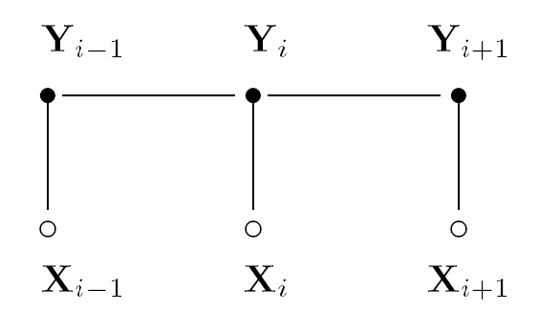
HMM vs. CRF
CRF uses the conditional probability P(label sequence y | observation sequence x) rather than the joint probability P(y, x) adopted by HMM.
  It specifies the probability of possible label sequences given an observation sequence.
CRF allows arbitrary, non-independent features on the observation sequence X.
The probability of a transition between labels may depend on past and future observations.
  CRF relaxes the strong independence assumptions in HMM.
CRF: undirected and acyclic

Slide 22
CRF Applications
As a form of discriminative modeling, CRF has been used successfully in various domains.
Application in computational biology include:
  DNA and protein sequence alignment,
  Sequence homolog searching in databases,
  Protein secondary structure prediction, and
  RNA secondary structure analysis.
Application in computational linguistics & computer science include:
  Text and speech processing, including topic segmentation, part-of-speech (POS) tagging,
  Information extraction, and
  Syntactic disambiguation.

Slide 23
Examples of Previous Studies Using CRF
Named Entity Recognition
  Andrew McCallum and Wei Li. Early Results for Named Entity Recognition with Conditional Random Fields, Feature Induction and Web-Enhanced Lexicons. Seventh Conference on Natural Language Learning (CoNLL), 2003.
  The paper has investigated named entity extraction with CRFs.
Information Extraction
  Fuchun Peng and Andrew McCallum. Accurate Information Extraction from Research Papers using Conditional Random Fields. Proceedings of Human Language Technology Conference and North American Chapter of the Association for Computational Linguistics (HLT-NAACL), 2004. (University of Massachusetts)
  The paper applies CRFs to extraction from research paper headers and reference sections, to obtain current best-in-the-world accuracy. Also compares some simple regularization methods.
Object Recognition
  Ariadna Quattoni, Michael Collins, and Trevor Darrell. Conditional Random Fields for Object Recognition. NIPS 2004. (MIT)
  The authors present a discriminative part-based approach for the recognition of object classes from unsegmented cluttered scenes.
Biomedical Named Entities Identification
  Tzong-han Tsai, Wen-Chi Chou, Shih-Hung Wu, Ting-Yi Sung, Sunita Sarawagi, Jieh Hsiang, and Wen-Lian Hsu. Integrating Linguistic Knowledge into a Conditional Random Field Framework to Identify Biomedical Named Entities. Journal of Expert Systems with Applications. 2005. (Institute of Information Science, Acdemia Sinica, TaiPei.)
  The paper makes use of CRFs for solving biomedical named entities identification. In this work, they try to utilize available resources including dictionaries, web corpora, and lexical analyzers, and represent them as linguistic features in the CRFs model.

Slide 24
CRF Related Tools Provided by the Stanford Natural Language Processing Group
The Stanford Named Entity Recognizer
  A Java implementation of a Conditional Random Field sequence model, together with well-engineered features for Named Entity Recognition.
  Available at: http://nlp.stanford.edu/software/CRF-NER.shtml
Stanford Chinese Word Segmenter
  A Java implementation of a CRF-based Chinese Word Segmenter.
  Available at: http://nlp.stanford.edu/software/segmenter.shtml

Slide 25
Other CRF Software/Tools
MALLET
  For Java
  http://mallet.cs.umass.edu/
MinorThird
  For Java
  http://minorthird.sourceforge.net/
Sunita Sarawagi's CRF package
  For Java
  http://crf.sourceforge.net/
HCRF library (including CRF and LDCRF)
  For C++ and Matlab
  http://sourceforge.net/projects/hcrf/
CRFSuite
  For C++
  http://www.chokkan.org/software/crfsuite/
CRF++
  For C++
  http://crfpp.sourceforge.net/

