Slide 1
An Introduction to Recurrent Neural Networks
Hongyi Zhu and Hsinchun Chen
Artificial Intelligence Lab, University of Arizona

Slide 2
Acknowledgements
Many of the pictures, results, and other materials are taken from:
Andrew Ng, Stanford University
Chris Olah, Google Brain
Fei-Fei Li, Stanford University
Geoffrey Hinton, Google & University of Toronto
Hung-yi Lee, National Taiwan University
Ian Goodfellow, Google Brain
Yann LeCun, New York University
Yoshua Bengio, Universite de Montreal

Slide 3
Outline
Recurrent Neural Networks
Vanilla RNN
Exploding and Vanishing Gradients
Networks with Memory
Long Short-Term Memory (LSTM)
Gated Recurrent Unit (GRU) and Other Variants
Sequence Learning Architectures
Sequence Learning with one RNN Layer
Sequence Learning with multiple RNN Layers
Application: Sequence-to-Sequence Model in Activities of Daily Living (ADL) Recognition
Summary

Slide 4
Recurrent Neural Networks
Human brain deals with information streams. Most data is obtained, processed, and generated sequentially.
E.g., listening: soundwaves → vocabularies/sentences
E.g., action: brain signals/instructions → sequential muscle movements
Human thoughts have persistence; humans don’t start their thinking from scratch every second.
As you read this sentence, you understand each word based on your understanding.

Slide 5
Recurrent Neural Networks
The applications of standard Artificial Neural Networks (and also Convolutional Networks) are limited due to:
They only accepted a fixed-size vector as input (e.g., an image) and produce a fixed-size vector as output (e.g., probabilities of different classes).
These models use a fixed amount of computational steps (e.g. the number of layers in the model).
Recurrent Neural Networks (RNNs) are a family of neural networks introduced for processing sequential data.
Inspired by the temporal-dependent and persistent human thoughts

Slide 6
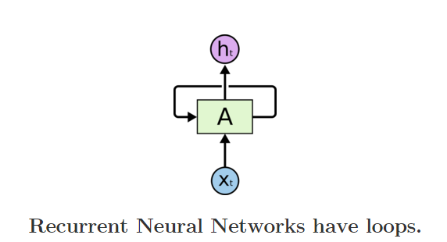
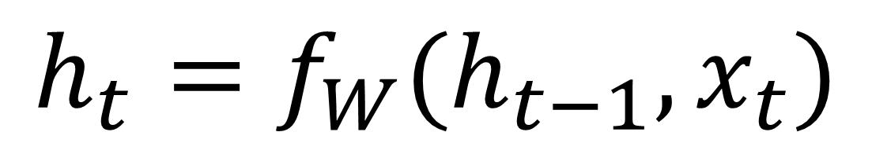
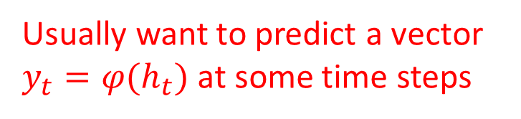
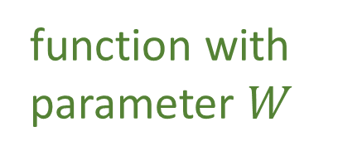
Recurrent Neural Networks
Recurrent Neural Networks are networks with loops in them, allowing information to persist.
Usually want to predict a vector $y_{t}=φ(h_{t})$ at some time steps
new state
old state
$$h_{t}=f_{W}(h_{t−1}, x_{t})$$
In the above diagram, a chunk of neural network, A=f_{W}, looks at some input xt and outputs a value ht.
A loop allows information to be passed from one step of the network to the next.
function with parameter $W$
Input vector at some time step

Slide 7
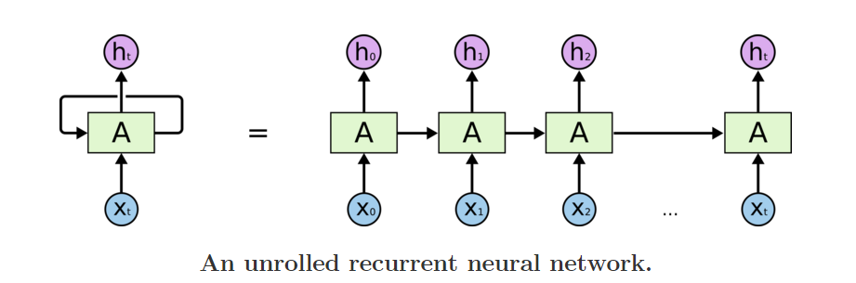
Recurrent Neural Networks
Unrolling RNN
A recurrent neural network can be thought of as multiple copies of the same network, each passing a message to a successor.
The diagram above shows what happens if we unroll the loop.

Slide 8
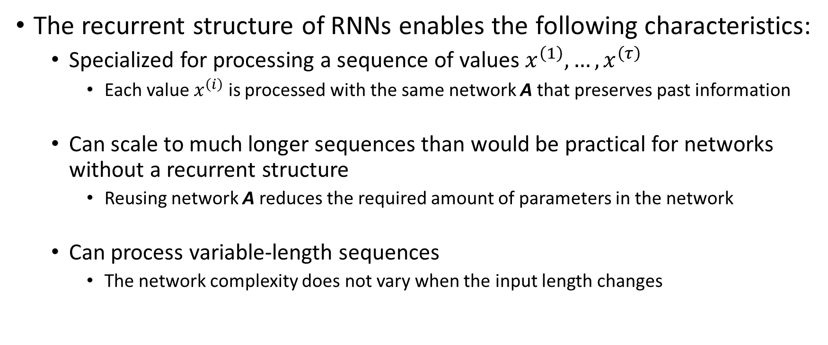
Recurrent Neural Networks
The recurrent structure of RNNs enables the following characteristics:
Specialized for processing a sequence of values $x^{\left(1\right)}, …, x^{\left(τ\right)}$
Each value $x^{\left(i\right)}$ is processed with the same network A that preserves past information
Can scale to much longer sequences than would be practical for networks without a recurrent structure
Reusing network A reduces the required amount of parameters in the network
Can process variable-length sequences
The network complexity does not vary when the input length changes

Slide 9
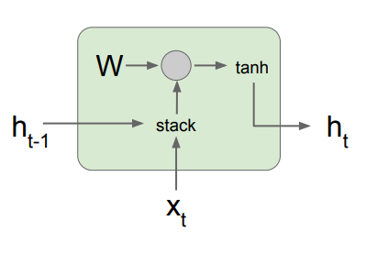
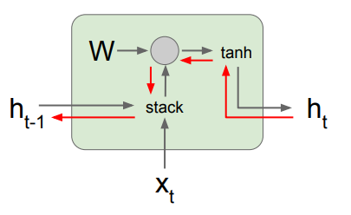

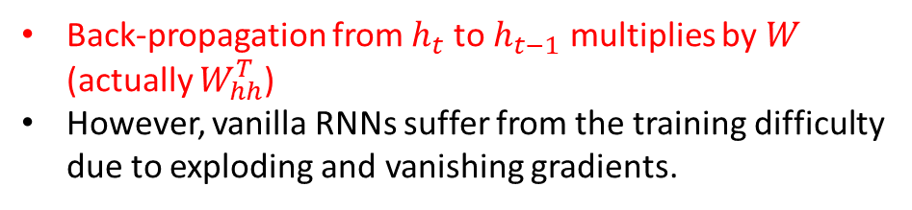
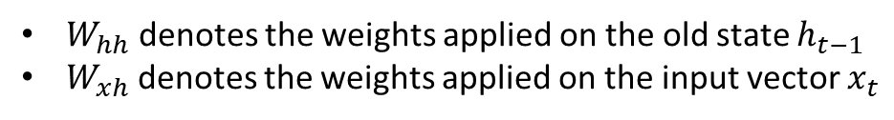
A Vanilla RNN
Feed-forward and back-propagation gradient flow
$$h_{t}=\tanh\left(W_{hh}h_{t−1}+W_{xh}x_{t}\right)$$
$$=\tanh\left(\left(\begin{matrix}W_{hh} & W_{xh}\end{matrix}\right)\left({h_{t−1} \atop x_{t}}\right)\right)$$
$$=\tanh\left(W\left({h_{t−1} \atop x_{t}}\right)\right)$$
$W_{hh}$ denotes the weights applied on the old state $h_{t−1}$
$W_{xh}$ denotes the weights applied on the input vector $x_{t}$
Back-propagation from $h_{t}$ to $h_{t−1}$ multiplies by $W$ (actually $W_{hh}^{T}$)
However, vanilla RNNs suffer from the training difficulty due to exploding and vanishing gradients.

Slide 10
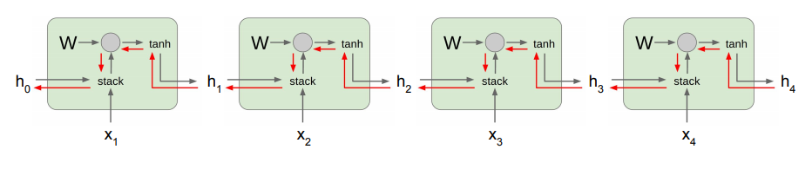
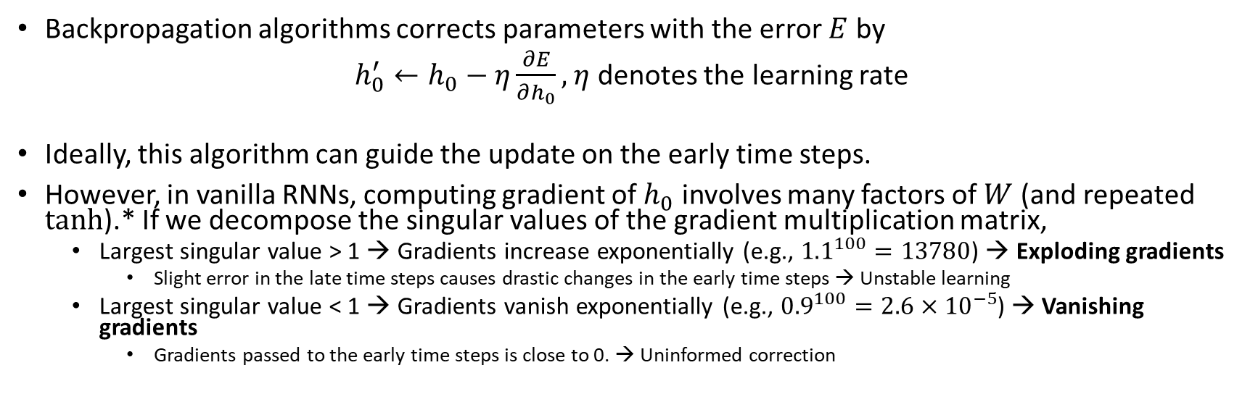
Exploding and Vanishing Gradients
Backpropagation algorithms corrects parameters with the error $E$ by
$h_{0}^{′}←h_{0}−η\frac{∂E}{∂h_{0}},$ $η$ denotes the learning rate
Ideally, this algorithm can guide the update on the early time steps.
However, in vanilla RNNs, computing gradient of $h_{0}$ involves many factors of $W$ (and repeated tanh).* If we decompose the singular values of the gradient multiplication matrix,
Largest singular value > 1 → Gradients increase exponentially (e.g., ${1.1}^{100}=13780$) → Exploding gradients
Slight error in the late time steps causes drastic changes in the early time steps → Unstable learning
Largest singular value < 1 → Gradients vanish exponentially (e.g., ${0.9}^{100}=2.6×{10}^{−5}$) → Vanishing gradients
Gradients passed to the early time steps is close to 0. → Uninformed correction
* Refer to Bengio et al. (1994) or Goodfellow et al. (2016) for a complete derivation

Slide 11
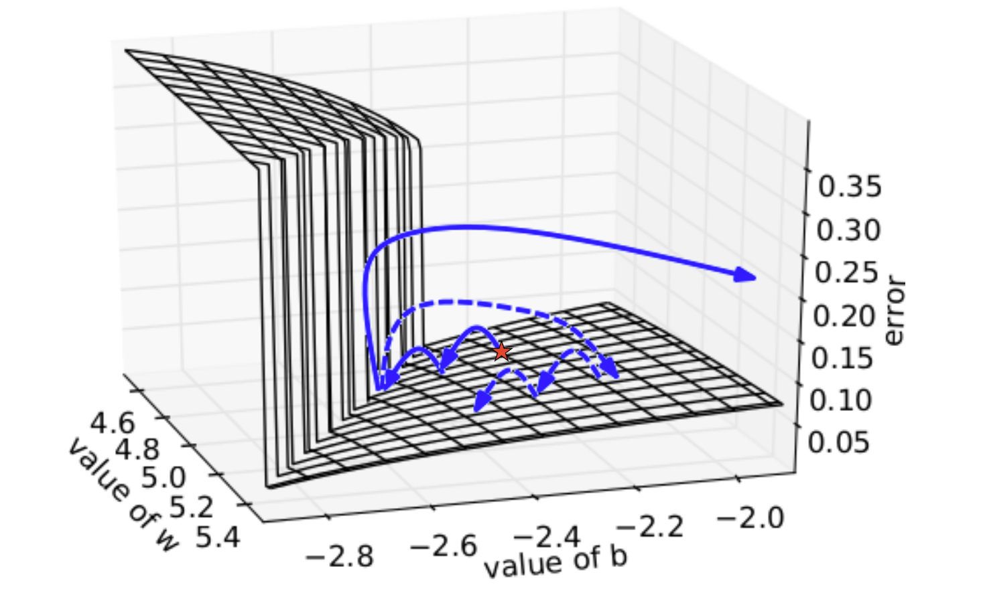
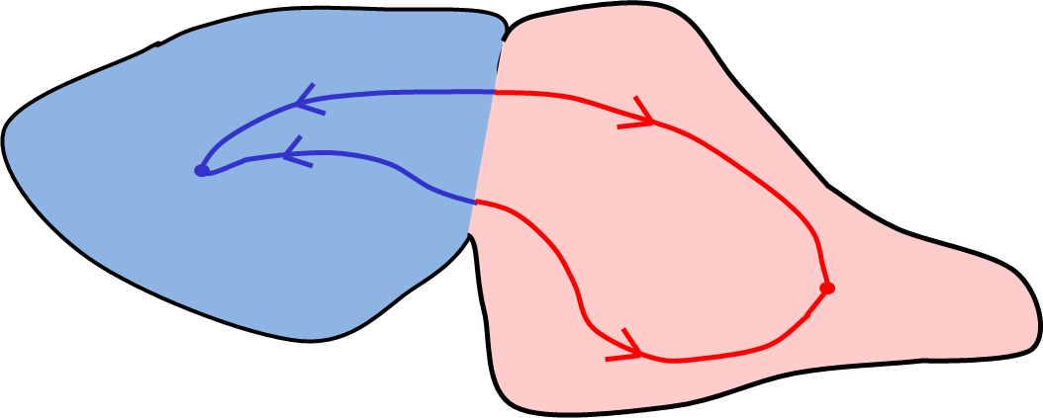
Exploding and Vanishing Gradients
Cliff/boundary
Plane/attractor
Exploding: If we start almost exactly on the boundary, tiny changes can make a huge difference.
Vanishing: If we start a trajectory within an attractor, small changes in where we start make no difference to where we end up.
Both cases hinder the learning process.

Slide 12
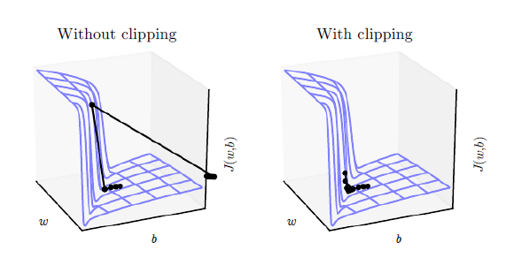

Exploding and Vanishing Gradients
Gradient Clipping (Minkolov 2012) addresses the Exploding Gradient problem.
Scale gradient if its L-2 norm is too big

Slide 13
Exploding and Vanishing Gradients
Four effective ways to avoid Vanishing Gradient problem:
Networks with Memory
Make the RNN out of modules that are designed to remember values for a long time
Hessian Free (HF) Optimization (Martens & Sutskever 2011)
Using HF optimizer that can detect directions with a tiny gradient/curvature
Echo State Networks
Initialize connections between layers very carefully to decouple oscillations driven by the input
Good initialization with momentum
Initialize as Echo State Networks, but then learn all the connections with momentum
Among these, Networks with Memory are the most popular approach.
Universal design generalizable to different applications

Slide 14
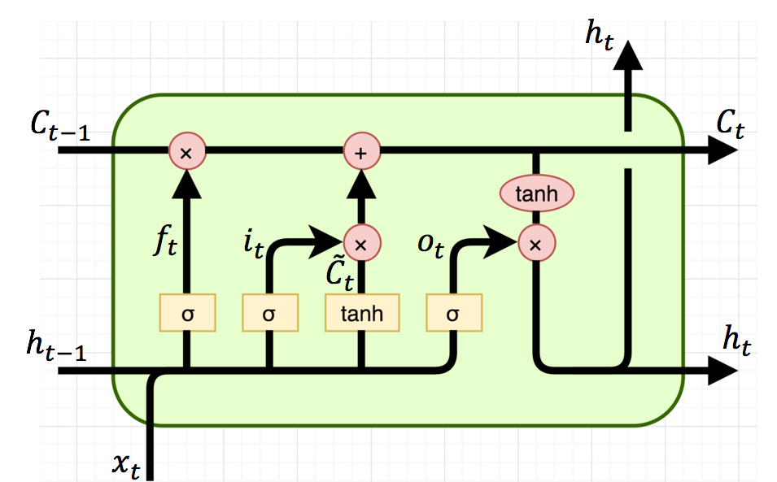
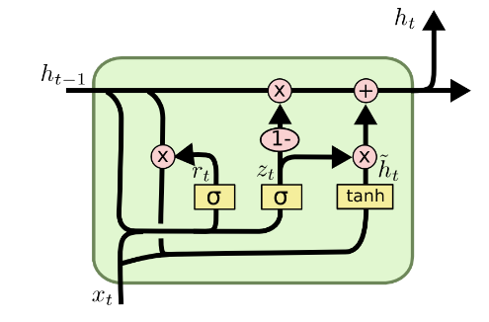
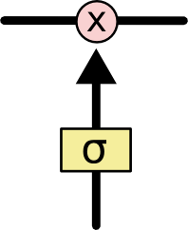
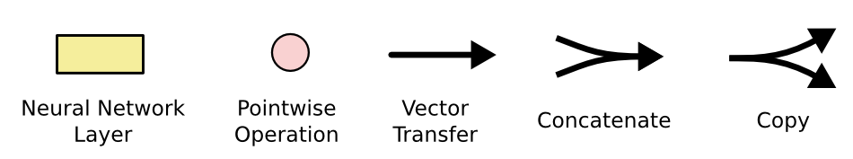
Networks with Memory
Vanilla RNN operates in a “multiplicative” way.
Necessitate new approaches to process information on the network
Two recurrent cell designs are proposed and widely adopted:
Long Short-Term Memory (LSTM) (Hochreiter and Schmidhuber, 1997)
Gated Recurrent Unit (GRU) (Cho et al. 2014)
Both designs process information in an “additive” way with gates to control information flow.
Sigmoid gate outputs numbers between 0 and 1, describing how much of each component should be let through.
Standard LSTM Cell
GRU Cell
A Sigmoid Gate

Slide 15
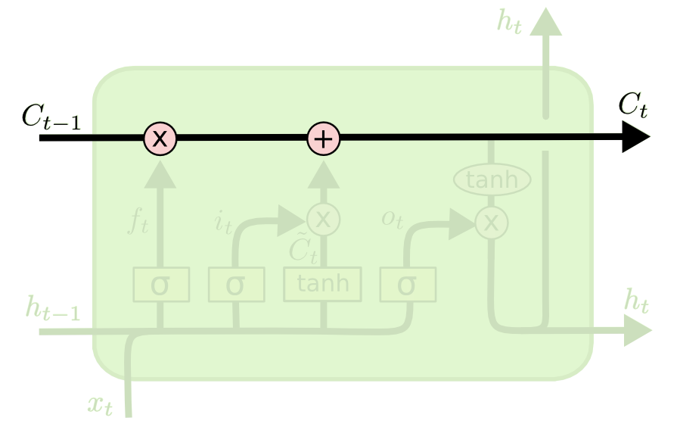


Long Short-Term Memory (LSTM)
The key to LSTMs is the cell state.
Stores information of the past → long-term memory
Passes along time steps with minor linear interactions → “additive”
Results in an uninterrupted gradient flow → errors in the future pertain and impact learning in the past
The LSTM cell manipulates input information with three gates.
Input gate → controls the intake of new information
Forget gate → determines what part of the cell state to be updated
Output gate → determines what part of the cell state to output
Cell State $C_{t}$
Gradient Flow

Slide 16
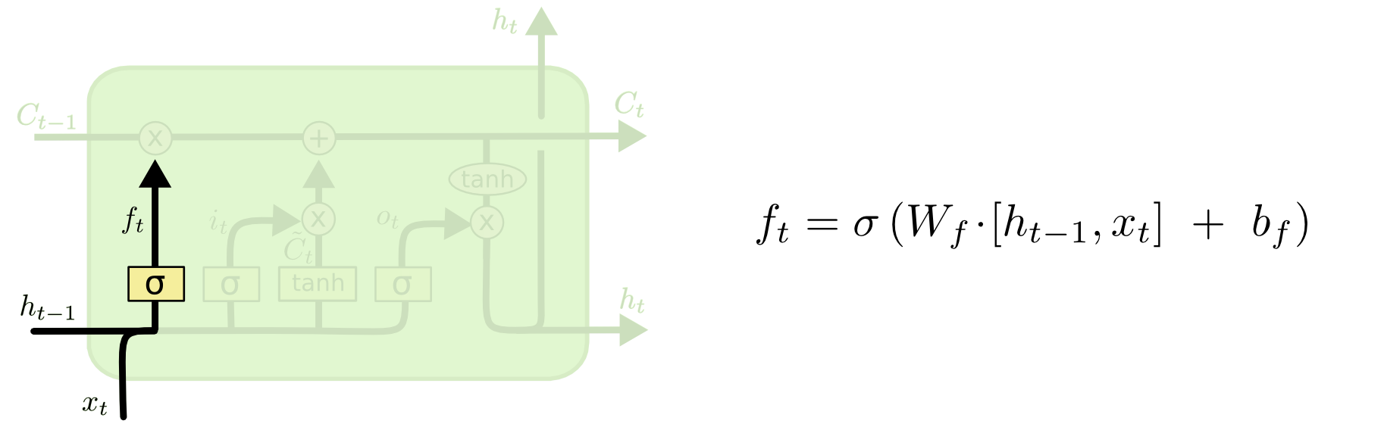
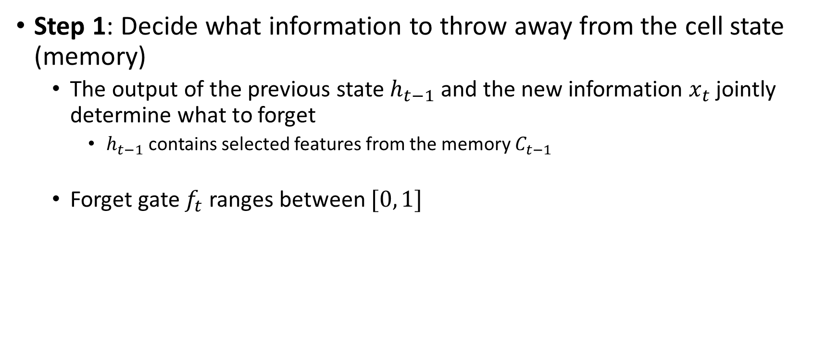
Step-by-step LSTM Walk Through
Step 1: Decide what information to throw away from the cell state (memory)
The output of the previous state $h_{t−1}$ and the new information $x_{t}$ jointly determine what to forget
$h_{t−1}$ contains selected features from the memory $C_{t−1}$
Forget gate $f_{t}$ ranges between $[0, 1]$
Forget gate

Slide 17
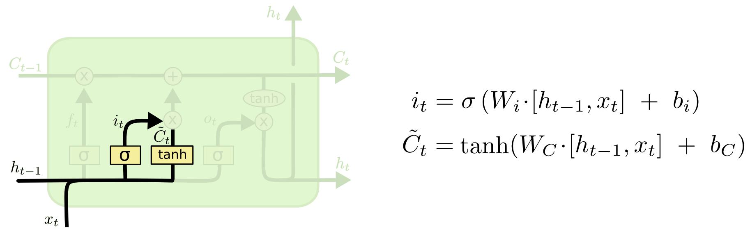

Step-by-step LSTM Walk Through
Step 2: Prepare the updates for the cell state
An alternative cell state $\tilde{C_{t}}$ is created from the new information $x_{t}$ with the guidance of $h_{t−1}$.
Input gate $i_{t}$ ranges between $[0, 1]$
Input gate

Slide 18
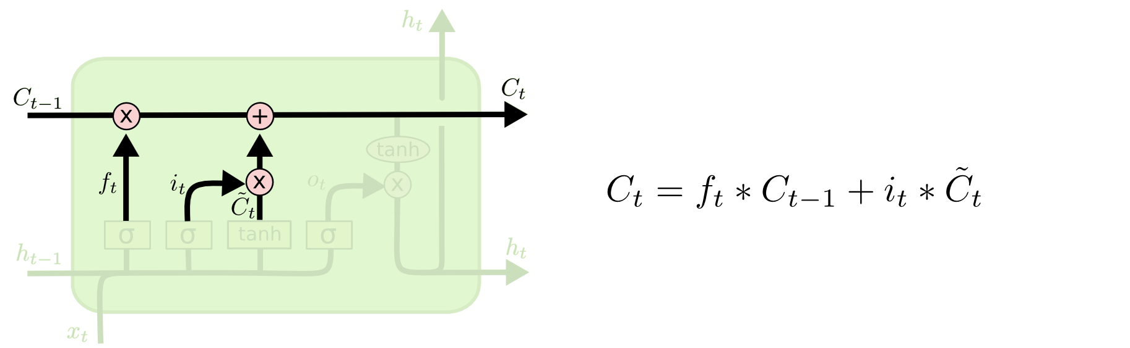

Step-by-step LSTM Walk Through
Step 3: Update the cell state
The new cell state $C_{t}$ is comprised of information from the past $f_{t}∗C_{t−1}$ and valuable new information $i_{t}∗$ $\tilde{C_{t}}$
$∗$ denotes elementwise multiplication

Slide 19
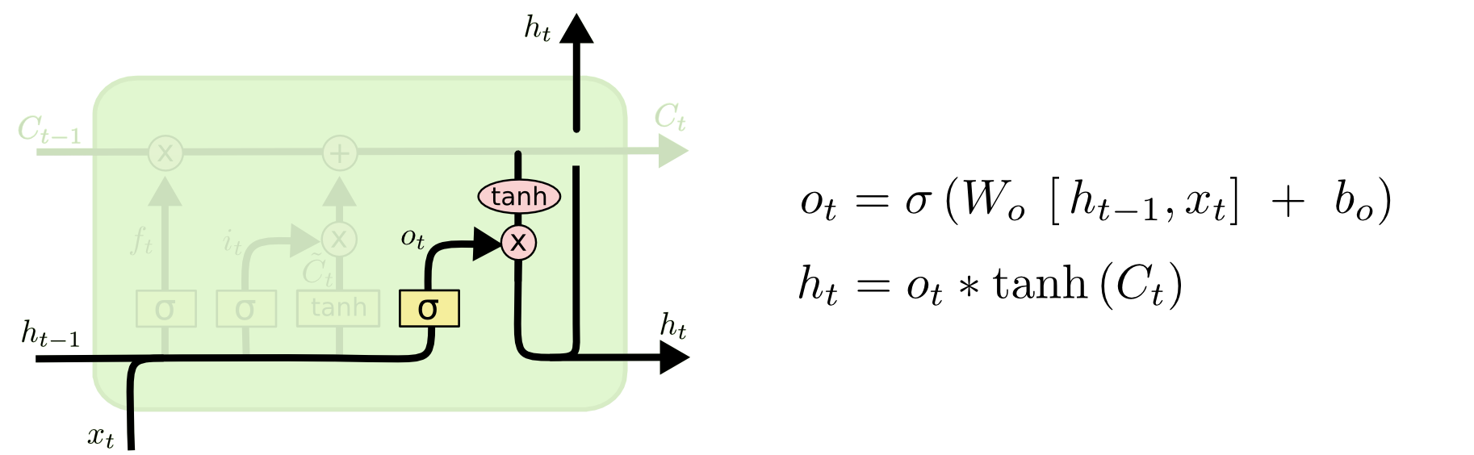
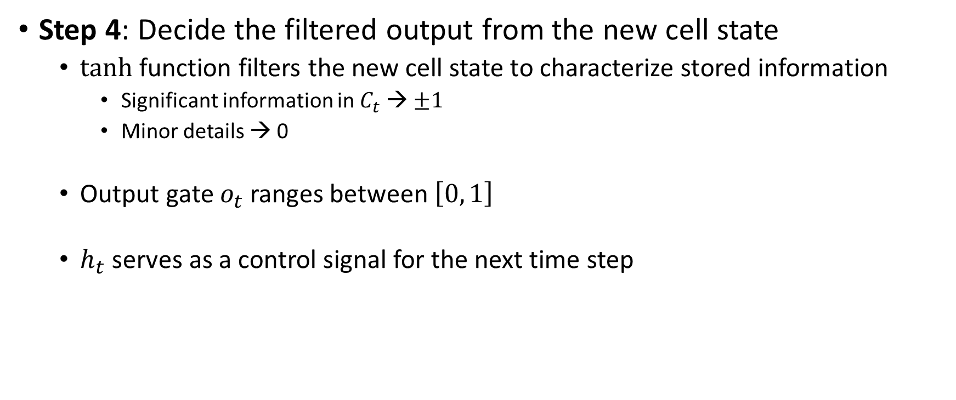
Step-by-step LSTM Walk Through
Step 4: Decide the filtered output from the new cell state
tanh function filters the new cell state to characterize stored information
Significant information in $C_{t}$ → $±1$
Minor details → 0
Output gate $o_{t}$ ranges between $\left[0, 1\right]$
$h_{t}$ serves as a control signal for the next time step
Output gate

Slide 20
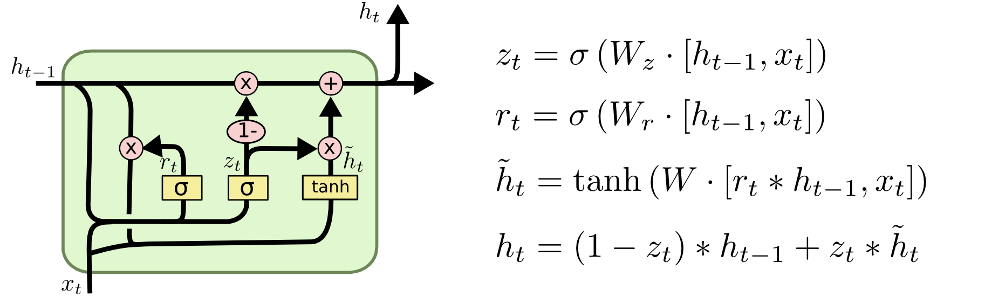
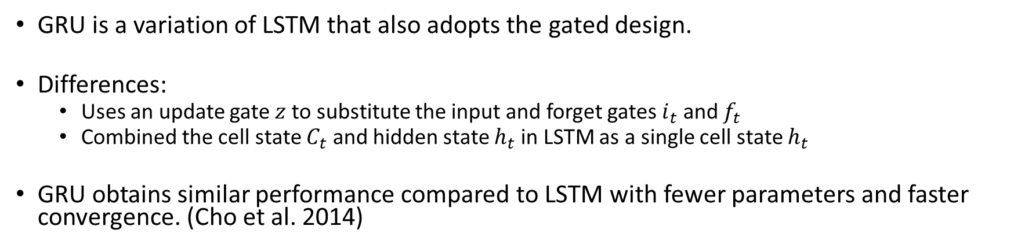
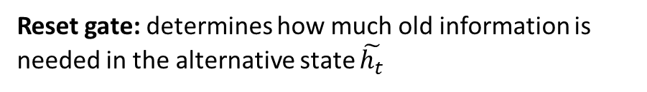
Gated Recurrent Unit (GRU)
GRU is a variation of LSTM that also adopts the gated design.
Differences:
Uses an update gate $z$ to substitute the input and forget gates $i_{t}$ and $f_{t}$
Combined the cell state $C_{t}$ and hidden state $h_{t}$ in LSTM as a single cell state $h_{t}$
GRU obtains similar performance compared to LSTM with fewer parameters and faster convergence. (Cho et al. 2014)
Update gate: controls the composition of new state
Reset gate: determines how much old information is needed in the alternative state $\tilde{h_{t}}$
Alternative state: contains new information
New state: replace selected old information with new information in the new state

Slide 21
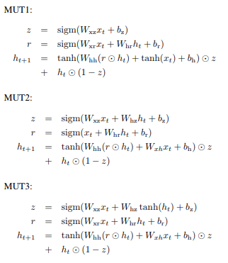
Other Variants
Jozefowicz et al. (2015) use genetic algorithms to explore better RNN designs.
1st generation: LSTM and GRU
Mutations on nodes
E.g., randomly replace the activation function
E.g., remove the node if it has one input and one output
Save the mutated models with the best performance for the next generation
Findings:
The importance of the three gates in LSTM
Measured by performance drop when eliminating a gate
Forget > Input >> Output
The forget gate-like structure is prevalent in best mutated RNN models
Indicates “forgetting” helps the network to extract and store the most valuable information
forget gate-like structure
Three mutated RNN models with the best performance

Slide 22
Implementing RNN in Python
Keras provides an API for the vanilla RNN design:
keras.layers.SimpleRNN(units, activation='tanh', return_sequences=False, …)
API for the standard LSTM recurrent cell:
keras.layers.LSTM(units, activation='tanh', recurrent_activation='hard_sigmoid', …)
API for the GRU cell:
keras.layers.GRU(units, activation='tanh', recurrent_activation='hard_sigmoid', …)
Critical parameters
units: dimensionality of the output space
activation: activation function to use on the recurrent layer, ‘tanh’ by default
recurrent_activation: activation function for the gates
return_sequences:
True to obtain the output on each time step
False to obtain the last output

Slide 23
Sequence Learning Architectures
Learning on RNN is more robust when the vanishing/exploding gradient problem is resolved.
RNNs can now be applied to different sequence learning tasks.
Recurrent network architectures is flexible to operate over various sequences of vectors.
Sequence in the input, the output, or in the most general case both
Architecture with one or more RNN layers

Slide 24
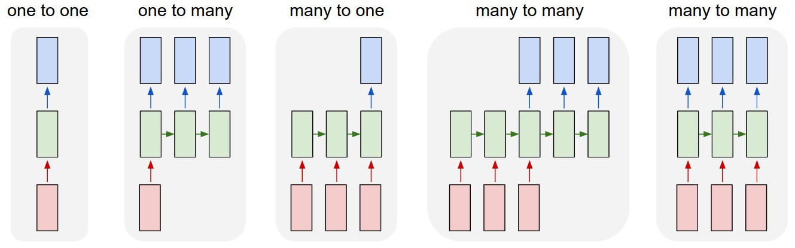
Sequence Learning with One RNN Layer
Each rectangle is a vector and arrows represent functions (e.g. matrix multiply).
Input vectors are in red, output vectors are in blue and green vectors hold the RNN's state
1
2
3
4
5
(1) Standard mode of processing without RNN, from fixed-sized input to fixed-sized output (e.g. image classification).
(2) Sequence output (e.g. image captioning takes an image and outputs a sentence of words).
(3) Sequence input (e.g. sentiment analysis where a given sentence is classified as expressing positive or negative sentiment).
(4) Sequence input and sequence output (e.g. Machine Translation: an RNN reads a sentence in English and then outputs a sentence in French).
(5) Synced sequence input and output (e.g. video classification where we wish to label each frame of the video).

Slide 25
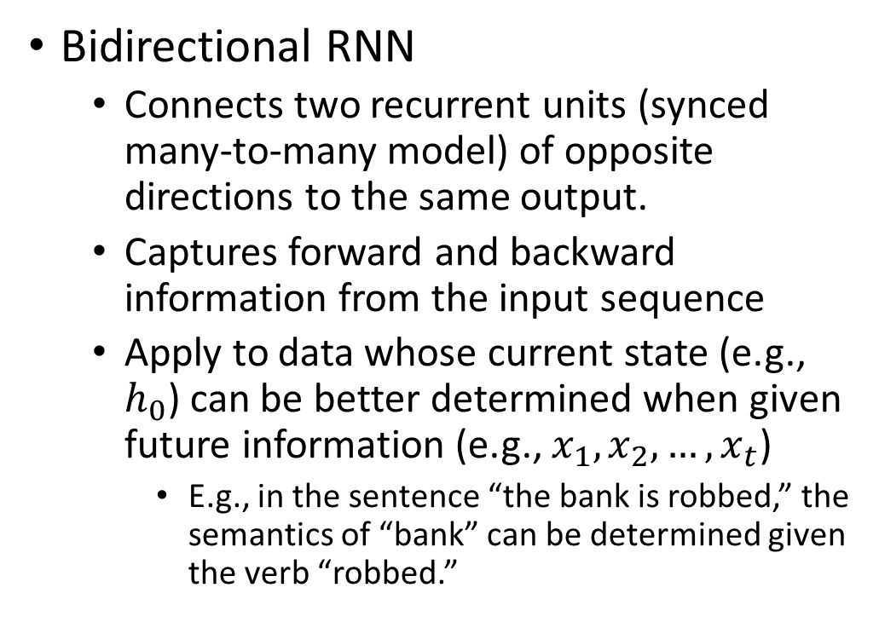
Sequence Learning with Multiple RNN Layers
Bidirectional RNN
Connects two recurrent units (synced many-to-many model) of opposite directions to the same output.
Captures forward and backward information from the input sequence
Apply to data whose current state (e.g., $h_{0}$) can be better determined when given future information (e.g., $x_{1}, x_{2},…, x_{t}$)
E.g., in the sentence “the bank is robbed,” the semantics of “bank” can be determined given the verb “robbed.”
B
B
B
B

Slide 26
Sequence Learning with Multiple RNN Layers
Sequence-to-Sequence (Seq2Seq) model
Concatenate a many-to-one (encoder) and an one-to-many (decoder) RNN with a shared vector
Encoder RNN: extract and compress the semantics from the input sequence
Decoder RNN: generate a sequence based on the input semantics
Lengths of both RNNs can vary.
Apply to tasks such as translation
Similar underlying semantics
E.g., “I love you.” to “Je t’aime.”
Decoded sequence
y₀
y₁
y₂
…
y_{m}
Encoded semantics
B
B
B
B
An RNN as the encoder
An RNN as the decoder
Input sequence

Slide 27
Sequence Learning with Multiple RNN Layers
Multilayer RNN (Deep RNN)
Multiple recurrent network units (hidden layers) are stacked.
Extracts different patterns within the same input sequence
Apply to data that has a hierarchical structure
E.g., soundwave → phoneme → syllable → word
C
C
C
C
B
B
B
B

Slide 28
RNN Applications
Incredible success applying RNNs to language modeling and sequence learning problems
Task | Input Sequence | Output Sequence
Activity Recognition (Zhu et al. 2018) | Sensor Signals | Activity Labels
Machine translation (Sutskever et al. 2014) | English | French
Question answering (Bordes et al. 2014) | Question | Answer
Speech recognition (Graves et al. 2013) | Voice | Text
Handwriting prediction (Graves 2013) | Handwriting | Text
Opinion mining (Irsoy et al. 2014) | Text | Opinion expression

Slide 29
RNN Applications: Activities of Daily Living (ADL) Recognition
Activities of Daily Living (ADLs) are introduced to evaluate the self-care ability of senior citizens (Williams 2014).
Requires consistent monitoring → Sensor-based systems
Sensor-based home monitoring systems
Two major non-invasive type of sensor: environment and wearable
Environment: Placed in the environment to capture changes (e.g., on/off, motion)
Wearable: Attached to the body to measure movements and physiological signals
Sensors can sample at 10 Hz → 0.8 million records per day
Mixed data types: continuous, discrete, …
Machine learning (esp. deep learning) needed to recognize ADLs from the large amount of data.
Mid-level (ML) ADLs: gestures, gait, etc.
High-level (HL) ADLs: preparing food, medical intake, etc.
Past methods recognize ADLs on a specific sensor type.
Not generalizable to setting changes
Data recorded by different sensors during the same activity not utilized jointly for activity recognition
Research Objective: develop a universal ADL recognition framework to extract HL-ADLs from raw sensor data

Slide 30
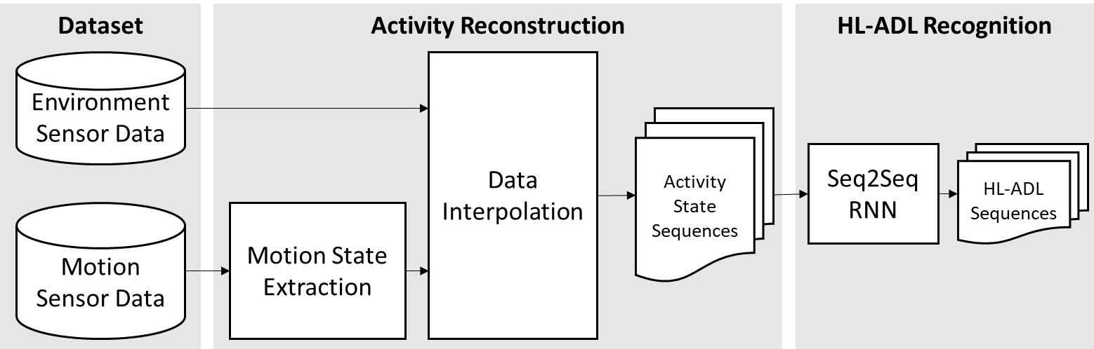
RNN Applications: Activities of Daily Living (ADL) Recognition
Research Design
Intuition: Recognizing the HL-ADLs from the sensor data is similar to captioning/translation. We can generate ADL label sequence with a Seq2Seq model for the input data. The underlying semantics are similar.
Activity reconstruction step creates a consistent representation for any combination of environment and motion sensor data that can be used by the Seq2Seq model to recognize the HL-ADL.
A Seq2Seq model is designed to extract HL-ADLs from the activity state sequence

Slide 31
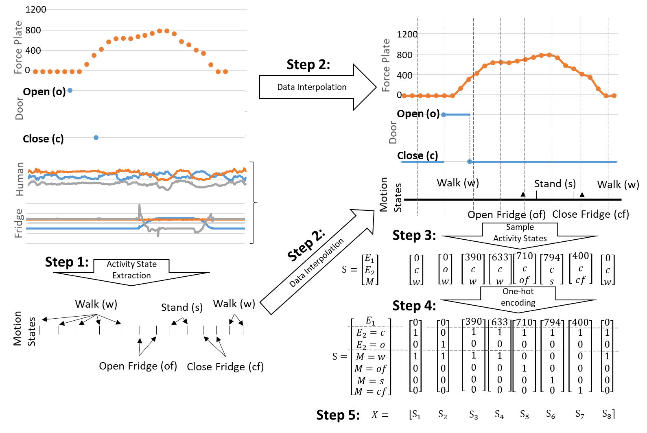
RNN Applications: Activities of Daily Living (ADL) Recognition
Four sensors for demonstration:
a force plate → pressure on the floor
a door on/off sensor → open (o) and close (c) states
a human motion sensor
object motion sensor attached on the fridge
Step 1. Extract motion states from motion data with a gesture recognition model
Steps 2 and 3. Interpolate discrete data and sample each data stream at same timestamps to construct the Activity State representations
Steps 4 and 5. Combine and encode the Activity States with in a matrix.

Slide 32
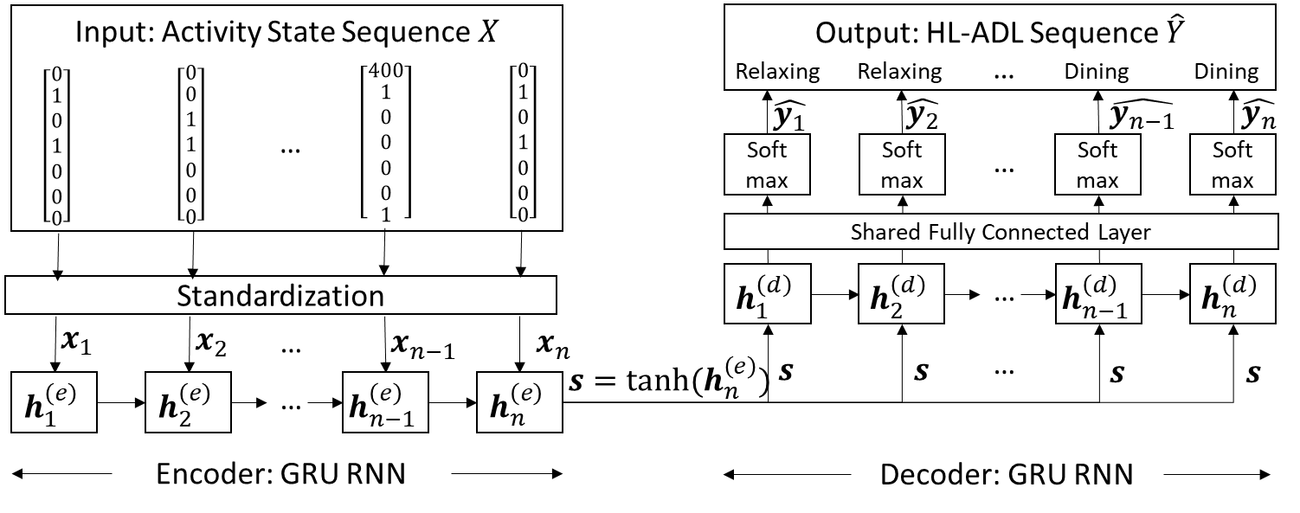
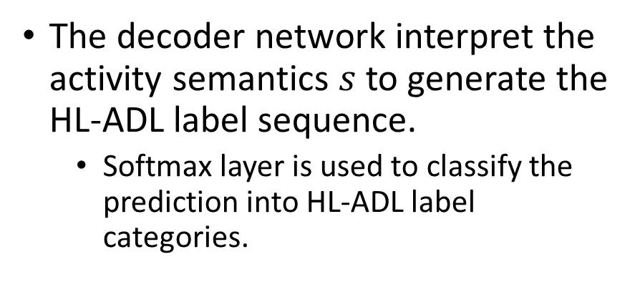
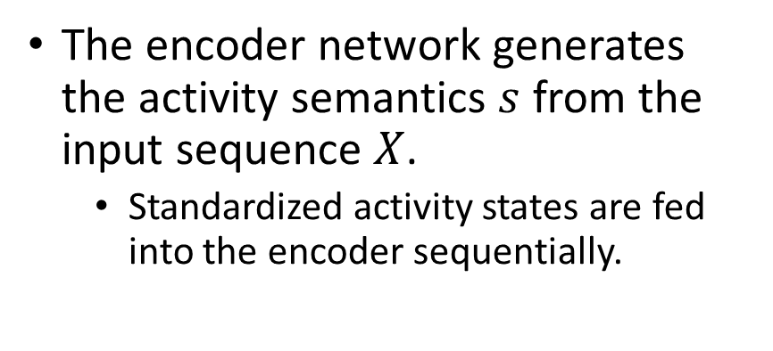
RNN Applications: Activities of Daily Living (ADL) Recognition
The encoder network generates the activity semantics $s$ from the input sequence $X$.
Standardized activity states are fed into the encoder sequentially.
The decoder network interpret the activity semantics $s$ to generate the HL-ADL label sequence.
Softmax layer is used to classify the prediction into HL-ADL label categories.

Slide 33
RNN Applications: Activities of Daily Living (ADL) Recognition
Our proposed model is evaluated on two different datasets
It recognizes different HL-ADLs accurately in different settings
The result suggests that our framework is more flexible in adjusting to different real-life HL-ADL recognition applications.
Recall of S2S_GRU against benchmarks on a wearable/environment motion sensor dataset
Recall (%) | Relaxing | Coffee time | Early morning | Cleanup | Sandwich time
S2S_GRU | 61.7 | 66.5 | 72.1 | 82.6 | 79.1
HMM | 48.8 | 19.5*** | 6.4*** | 17.4*** | 40.9***
S2S_LSTM | 60.0 | 54.9** | 75.9 | 83.2 | 59.9***
Recall of S2S_GRU against benchmarks on a environment sensor dataset
Recall (%) | Filling pillbox | Watch DVD | Water plants | Answer the phone | Prepare gift card | Prepare soup | Cleaning | Choose outfit
S2S_GRU | 88.6 | 79.0 | 58.5 | 80.8 | 92.1 | 71.1 | 85.0 | 58.0
HMM | 33.2*** | 31.6*** | 16.8*** | 22.0*** | 29.9*** | 26.4*** | 20.4*** | 22.5***
S2S_LSTM | 86.1* | 77.8 | 64.3 | 74.9* | 90.8* | 69.6 | 82.5 | 49.5**
*: p-value<0.05, **: p-value<0.01, ***: p-value<0.001

Slide 34
Summary
RNNs reuse the same parameters for different time steps.
Vanilla RNNs face vanishing and exploding gradient problems.
Gradient Clipping addresses the exploding gradient problem.
LSTM and GRU are recurrent units that retain past information and update with a gated design.
The “additive” structure avoids vanishing gradient problem.
Forget gate contributes the most to LSTM & GRU’s performance.
RNNs allow flexible architecture designs to adapt to different sequence learning requirements.
Sequence in the input, the output, or both
One or more RNN layers
RNNs have broad real-life applications.
Text processing, machine translation, signal extraction/recognition, image captioning, …

Slide 35
Important References
Bengio, Y., Simard, P., & Frasconi, P. (1994). Learning long-term dependencies with gradient descent is difficult. IEEE transactions on neural networks, 5(2), 157-166.
Goodfellow, I., Bengio, Y., Courville, A., & Bengio, Y. (2016). Deep learning (Vol. 1). Cambridge: MIT press.
Graves, A. (2012). Supervised sequence labelling with recurrent neural networks. https://www.cs.toronto.edu/~graves/preprint.pdf
Jozefowicz, R., Zaremba, W., & Sutskever, I. (2015, June). An empirical exploration of recurrent network architectures. In International Conference on Machine Learning (pp. 2342-2350).
Lipton, Z. C., Berkowitz, J., & Elkan, C. (2015). A critical review of recurrent neural networks for sequence learning. arXiv preprint arXiv:1506.00019.
Salehinejad, H., Baarbe, J., Sankar, S., Barfett, J., Colak, E., & Valaee, S. (2017). Recent Advances in Recurrent Neural Networks. arXiv preprint arXiv:1801.01078.

