Slide 1
An Introduction to Deep Transfer Learning
Mohammadreza Ebrahimi, Hsinchun Chen
October 29, 2018

Slide 2
Acknowledgment
Some images and materials are from:
Dong Wang and Thomas Fang Zheng, Tsinghua University
Chuanqi Tan, Fuchun Sun, Tao Kong, Wenchang Zhang, Chao Yang, and Chunfang Liu, Department of Computer Science and Technology, Tsinghua University.
Sinno Jialin Pan and Qiang Yang, Department of Computer Science and Engineering, Hong Kong University of Science and Technology.
Prakash Jay, Data scientist

Slide 3
Outline
Introduction
Transfer Learning
Deep Transfer Learning
Types of Deep Transfer Learning
Implementation
Building a Deep Transfer Learning Model with Keras in Python
Research Example 1: Cross-Language Knowledge Transfer with LSTM

Slide 4
Introduction
Deep Transfer Learning

Slide 5
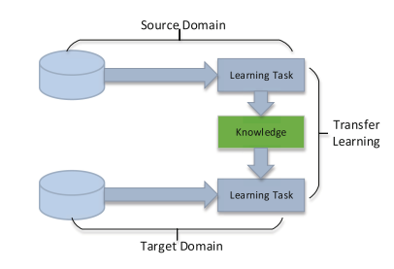
Transfer Learning
Transfer learning aims to leverage the learned knowledge from a resource-rich domain/task to help learning a task with not sufficient training data.
Sometimes referred as domain adaptation
The resource-rich domain is known as the source and the low-resource task is known as the target.
Transfer learning works the best if the model features learned from the source task are general (i.e., domain-independent).

Slide 6
Transfer Learning Examples in Practice
Image Processing: Learning a character recognition system on English and use it for German character recognition.
Which language has more labeled characters?
Do characters in these two languages share common traits?
Sentiment Analysis: Learning a sentiment analysis system on Amazon’s laptops review and apply it to digital camera review.
Should we manually label many camera reviews from scratch?
What are source and target tasks/domain in the above examples?

Slide 7
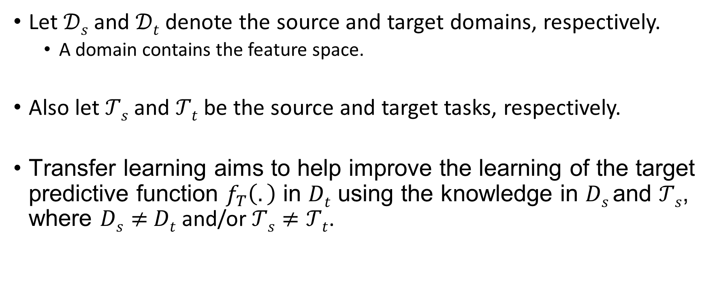
Transfer Learning: Definition
Let $𝒟s$ and $𝒟t$ denote the source and target domains, respectively.
A domain contains the feature space.
Also let $𝒯s$ and $𝒯t$ be the source and target tasks, respectively.
Transfer learning aims to help improve the learning of the target predictive function $f_{T}\left(.\right)$ in $Dt$ using the knowledge in $Ds$and $𝒯s$, where $Ds≠$ $Dt$ and/or$𝒯s≠𝒯t$.

Slide 8
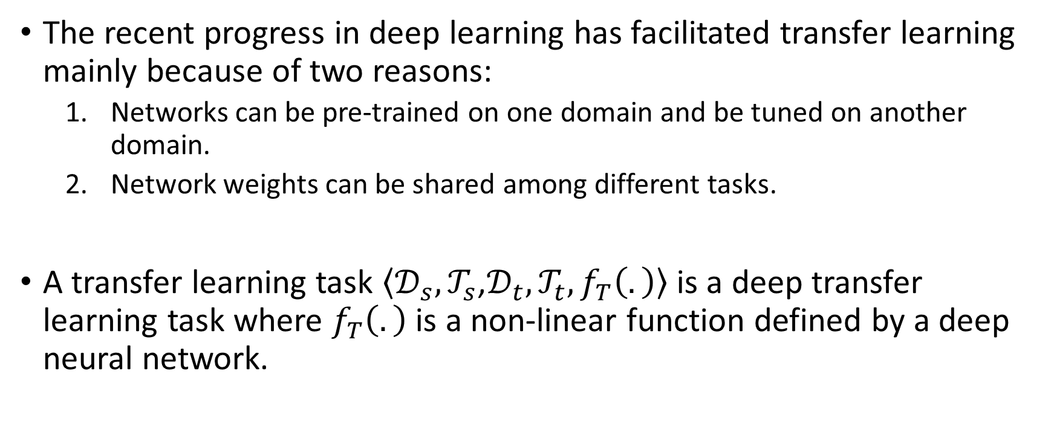
Deep Transfer Learning
The recent progress in deep learning has facilitated transfer learning mainly because of two reasons:
Networks can be pre-trained on one domain and be tuned on another domain.
Network weights can be shared among different tasks.
A transfer learning task $\left\langle 𝒟_{s},𝒯_{s}\text{,}𝒟_{t},𝒯_{t}, f_{T}\left(.\right)\right\rangle$ is a deep transfer learning task where $f_{T}\left(.\right)$ is a non-linear function defined by a deep neural network.

Slide 9
Types of Deep Transfer Learning
There are Four major types of deep transfer learning:
Instance-based: Reusing the instances in source domain by assigning appropriate weight to them
Representation-based: Mapping instances from two domains into a new feature space with higher similarity of source and domain
Model Sharing-based: Reusing part of a network (or its parameters) that is pre-trained in the source domain
Adversarial-based: Using adversarial learning to find transferable features that are suitable for both domains

Slide 10
Instance-Based Deep Transfer Learning
Assumption: ‘Some’ instances in the source domain can be utilized in the target domain with appropriate weights.
Approach:
Filtering out the instances that are not similar to the target.
Re-weighting instances in source domain to obtain a distribution similar to target domain.
Training a deep neural network on the collection of re-weighted instances as well as labeled instances (if any) in the target domain.

Slide 11
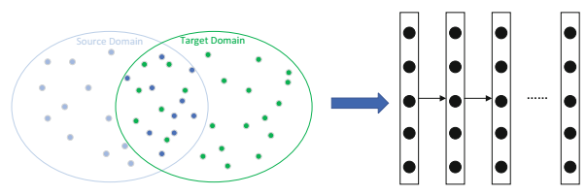
Instance-Based Deep Transfer Learning
Instances shown in light blue in the source domain are not similar to the target domain and therefore are excluded from the training dataset.
Similar instances in the source domain (dark blue) are included in the training dataset with appropriate weights.

Slide 12
Representation-Based Deep Transfer Learning
Assumption: There exists a new feature space/representation in which similar instances from source and target domain are close to each other.
Approach:
Instances from source and target domain are mapped into a new feature space in which similar instances are close to each other.
Instances in the new feature space can be used as the training set of the neural network.

Slide 13
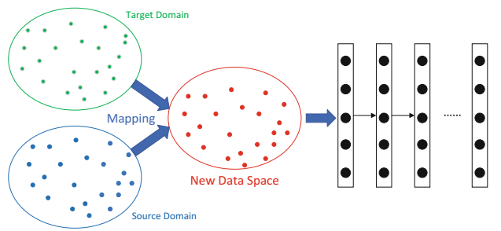
Representation-Based Deep Transfer Learning
New Feature Space

Slide 14
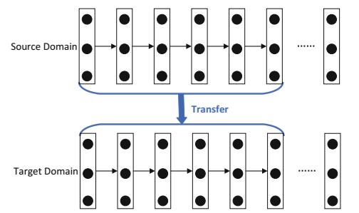
Model Sharing-Based Deep Transfer Learning
Assumption: The layers of a trained model can be treated as feature extractor to extract high-level features from a new domain.
Most common type of transfer learning
Approach:
Network is trained in source domain with large-scale training dataset.
Part/all of the pre-trained network is reused in the architecture of the model for target model.
Weights of the reused part can be updated through training on the target domain (aka fine-tuning).

Slide 15
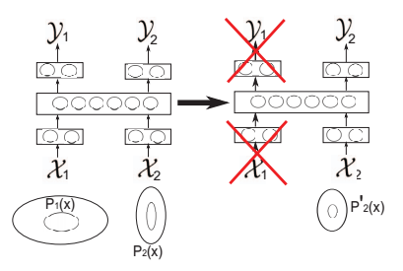
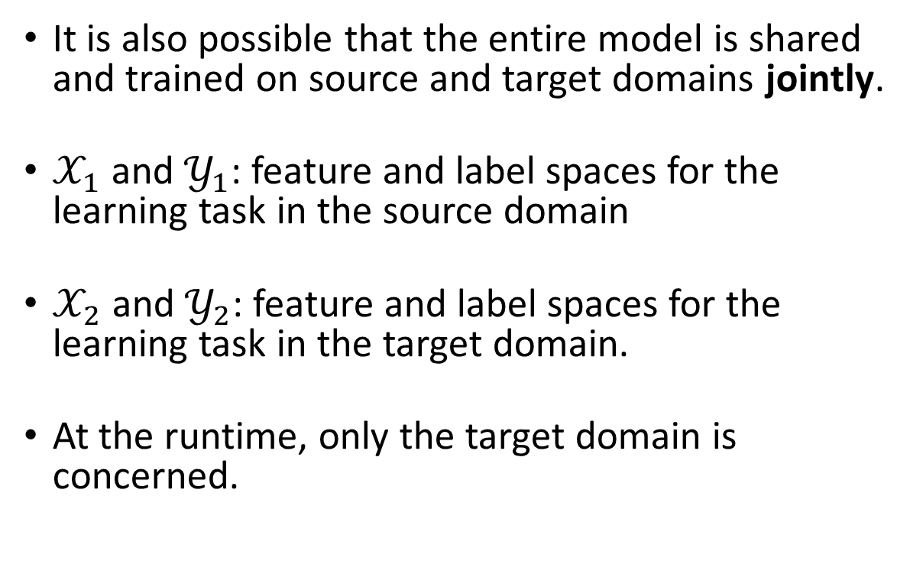
Model Sharing-Based Deep Transfer Learning
It is also possible that the entire model is shared and trained on source and target domains jointly.
$𝒳_{1}$ and $𝒴_{1}$: feature and label spaces for the learning task in the source domain
$𝒳_{2}$ and $𝒴_{2}$: feature and label spaces for the learning task in the target domain.
At the runtime, only the target domain is concerned.

Slide 16
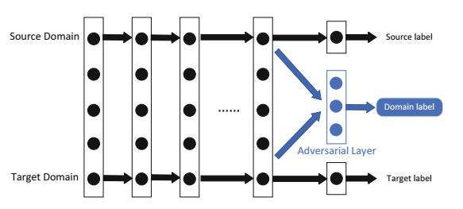
Adversarial-Based Deep Transfer Learning
Assumption: Good representation should be domain-invariant for source and target domain while it is discriminative for the main learning task.
Approach:
The model extracts features from two domains and sent them to the adversarial layer.
The adversarial layer tries to discriminate the origin of the features.
Review the adversarial learning tutorial to refresh your memory.
Domain-invariant representation

Slide 17
Implementing Model Sharing-Based Deep Transfer Learning
Python, TensorFlow, Keras

Slide 18


Deep Transfer Learning Implementation
Prerequisites:
Python 3.5+ (https://www.python.org/)
TensorFlow (https://www.tensorflow.org/)
Keras (https://keras.io/)
A high-level library on top of TensorFlow, CNTK, or Theano.
Recommended:
NumPy
Scikit-Learn
NLTK
SciPy

Slide 19
Implementation
We build a Model Sharing-Based Deep Transfer Learning in Image processing which uses CNN as the core neural network model.
We use VGG-19, a pre-trained CNN on more than a million images from ImageNet.
Review the CNN tutorial to refresh your memory.
VGG-19 pre-trained model is available as a built-in model in Keras.

Slide 20
Implementation – Determining the Libraries
from keras import applications
from keras.preprocessing.image import ImageDataGenerator
from keras import optimizers
from keras.models import Sequential, Model
from keras.layers import Dropout, Flatten, Dense, GlobalAveragePooling2D
from keras import backend as k
Contains VGG trained model in Keras
Keras Builtin library for preprocessing images
Contains different loss Functions used for BackProp
Contains different type of layers

Slide 21
Implementation – Loading the imagenet
img_width, img_height = 256, 256
train_data_dir = "data/train"
validation_data_dir = "data/val"
nb_train_samples = 4125
nb_validation_samples = 466
batch_size = 16
epochs = 50
model = applications.VGG19(weights = "imagenet", include_top=False, input_shape = (img_width, img_height, 3))
Defining model training variables
Loading the pre-trained model as feature extractor without including the top classification layer.

Slide 22
Implementation – Feature Extractor
for layer in model.layers[:5]:
layer.trainable = False
#Adding custom layers
x = model.output
x = Flatten()(x)
x = Dense(1024, activation="relu")(x)
x = Dropout(0.5)(x)
x = Dense(1024, activation="relu")(x)
predictions = Dense(16, activation="softmax")(x)
# Determining the model’s input and output
model_final = Model(input = model.input, output = predictions)
# Compile the model
model_final.compile(loss = "categorical_crossentropy", optimizer = optimizers.SGD(lr=0.0001, momentum=0.9), metrics=["accuracy"])
Freeze the first 5 layers of the model (feature extractor part of the pre-trained model)
Adding custom layers that can be updated.
Adding the classification layer

Slide 23
Implementation – Creating Training and Testing sets
train_datagen = ImageDataGenerator(
rescale = 1./255,horizontal_flip = True,fill_mode = "nearest",
zoom_range = 0.3,width_shift_range = 0.3,height_shift_range=0.3,
rotation_range=30)
test_datagen = ImageDataGenerator(
rescale = 1./255,horizontal_flip = True,fill_mode = "nearest",
zoom_range = 0.3,width_shift_range = 0.3,height_shift_range=0.3,
rotation_range=30)
train_generator = train_datagen.flow_from_directory(
train_data_dir,target_size = (img_height, img_width),
batch_size = batch_size, class_mode = "categorical")
validation_generator = test_datagen.flow_from_directory(
validation_data_dir,
target_size = (img_height, img_width),
class_mode = "categorical")
Pre-process train and test data
Initiate the train and test generators

Slide 24
Implementation – Training the model
# Train the model
model_final.fit_generator(
train_generator,
samples_per_epoch = nb_train_samples,
epochs = epochs,
validation_data = validation_generator,
nb_val_samples = nb_validation_samples)
Train the whole model with
pre-defined training parameters.

Slide 25
Research Example 1
Detecting Cyber Threats in Non-English Dark Net Markets with Cross-Lingual Transfer Learning

Slide 26
Introduction
Proactive Cyber Threat Intelligence (CTI) aims to mitigate the risk of cyber attacks by detecting emerging cyber threats in the hacker community [1].
Dark Net Marketplaces (DNMs) are an integral and unique part of this community.
Their anonymity and profitability provide an environment conducive to cybercriminal activities.
DNMs host purchasable highly-specialized products (listings) that are not available in other platforms (e.g., ransomware, keyloggers, SQL Injection tools, DDos Attack tools, stolen account information, and hacked personal credentials).
These malicious products are viewed as threats to cybersecurity since they are often used by hackers to conduct cyber attacks.
Since 2013, the number of language-specific DNMs have increased [2].

Slide 27
Introduction
Almost 56% of platforms are English, 19% are Russian, 12.5% are French, and the rest are Italian [4].
While English DNMs are geared towards general hacking contents, the Russian DNMs offer specialized hacking services such as personalized email hacking, call flooding, and Distributed Denial of Service (DDoS) attacks (Fig. 1).
Text classification has been used to automate threat detection [5][6].
Require labeled data for training. Labeled data in English is often available, the language barrier results in limited labeled data in non-English DNMs.
Current studies use machine translation (MT) to tackle this challenge [7]–[9].
However, informal, hacker-specific language causes translation errors. Machine translation errors often propagate to the model and deteriorate threat detection performance [10][11].
Results in high false negative rate: overlooking potentially important threats (e.g., missing a DDoS attack tool), and high false positive rate: suggesting non-threats (e.g., a book about hacking) as threats.

Slide 28
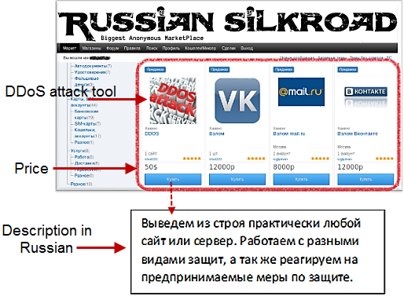
Introduction
These issues motivate developing models that transfer knowledge from high-resource languages (e.g., English) to low-resource ones (e.g., Russian) without relying on MT.
In this study, we propose a novel supervised knowledge transfer method for detecting cyber threats in non-English DNMs.
Leverages the labeled data in English DNMs and limited labeled data in target non-English DNMs simultaneously.
Learns a shared BiLSTM to capture common hacker language representation.
Differs from other deep CLKT approaches. Does not need any external resources such as mono or bilingual word-embeddings, neither machine translation.
Figure 1. Listings of Hacking Tools in a Russian DNM.

Slide 29

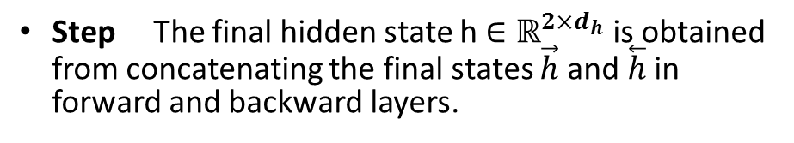
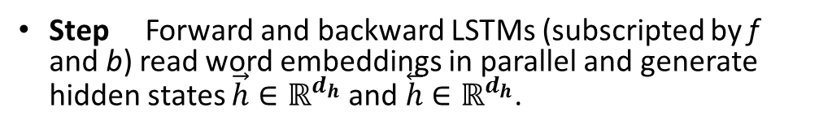
Literature Review – Bidirectional Long Short-Term Memory (BiLSTM)
Step Forward and backward LSTMs (subscripted by f and b) read word embeddings in parallel and generate hidden states $\vec{h}∈ℝ^{d_{h}}$ and $\overset{⃖}{h}$ $∈ℝ^{d_{h}}$.
1
Predicted sequence label
3
Step The final hidden state h$∈ℝ^{{2×d}_{h}}$ is obtained from concatenating the final states $\vec{h}$ and $\overset{⃖}{h}$ in forward and backward layers.
2
2
2
Step Calculate loss ($y−\hat{y}$) and propagate the error gradients.
3
1
1
Step Repeat steps 1-3 until the loss function is minimized.
Word embedding vectors
4
Figure 2. Graphical Illustration of Basic BiLSTM for Text Sequence Classification.

Slide 30
Research Gaps and Questions
Several research gaps are identified from the literature review:
Most DNM studies only identify threats in English DNMs.
Hence, threats in non-English DNMs (e.g., Russian) are understudied, yet critically needed.
Prior studies addressing multiple languages either use independent monolingual models or train monolingual models on machine translated data.
Can lead to poor classification performance on low-resource non-English DNMs.
The following questions are posed to address the identified gaps:
How can CLKT be leveraged for cyber threat detection in non-English DNMs without machine translation?
How can the threat knowledge learned from English DNMs be transferred to non-English DNMs?
Motivated by these questions, we propose a novel transfer learning framework to conduct cross-lingual cyber threat detection in non-English DNMs.

Slide 31
Research Design
Our transfer learning-based cross-lingual cyber threat detection framework has three major components (Figure 3).
Figure 3. Proposed Framework for Transfer Learning-Based Cross-Lingual Cyber Threat Detection

Slide 32
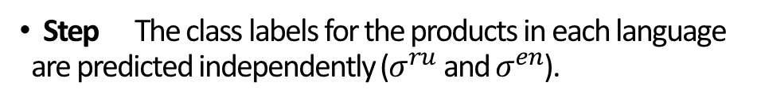
Research Design – Cross-Lingual Cyber Threat Detection
Language-Independent Shared BiLSTM Layer
Language-specific LSTM Layer (Russian)
Step The shared BiLSTM layer reads word embeddings of products in English and Russian DNMs in parallel.
1
3
Step The hidden state vectors emitted by the shared layer at each time-step are fed to language-specific layers.
2
2
1
Step The class labels for the products in each language are predicted independently ($σ^{ru}$ and $σ^{en}$).
3
3
2
1
Step The gradient errors propagate to the shared layer.
4
Step Repeat steps 1-4 until loss is minimized.
Language-specific LSTM Layer (English)
5
Novelty: English- and Russian-specific layers use the same shared weights from language-independent representation.
Figure 4. Graphical Illustration of JL-CLSTM for Joint Cross-Lingual Knowledge Transfer to Russian.

Slide 33
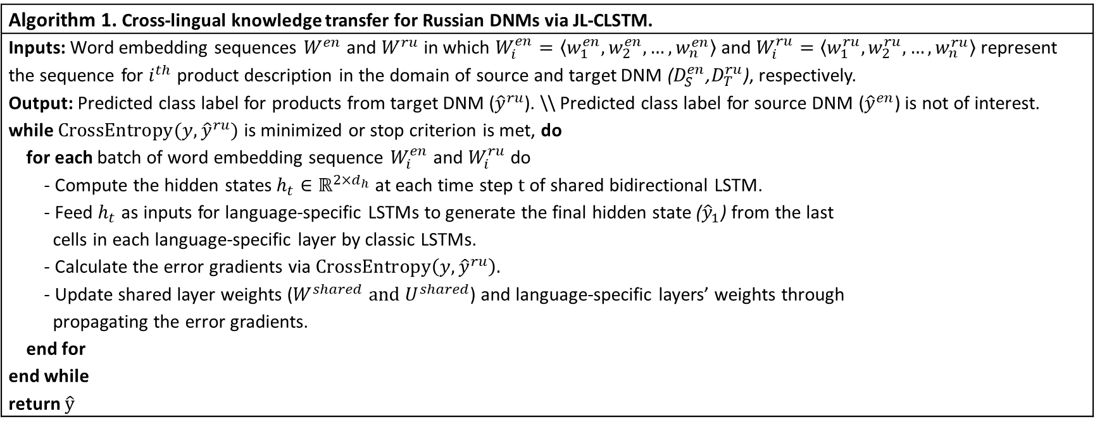
Research Design – JL-CLSTM Procedure
The learning procedure in JL-CLSTM is summarized in Algorithm 1.
Hyperparameters:
Adam optimizer (Kingma & Ba, 2015) was used for minimizing the loss function.
Activation functions: tanh and sigmoid
Algorithm 1. Cross-lingual knowledge transfer for Russian DNMs via JL-CLSTM.
Inputs: Word embedding sequences $W^{en}$ and $W^{ru}$ in which $W_{i}^{en}=〈w_{1}^{en},w_{2}^{en},…,w_{n}^{en}〉$ and $W_{i}^{ru}=〈w_{1}^{ru},w_{2}^{ru},…,w_{n}^{ru}〉$represent the sequence for $i^{th}$ product description in the domain of source and target DNM ($D_{S}^{en}$,$D_{T}^{ru}$), respectively. Output: Predicted class label for products from target DNM (${\hat{y}}^{ru}$). \\ Predicted class label for source DNM (${\hat{y}}^{en}$) is not of interest. while $CrossEntropy(y,{\hat{y}}^{ru})$ is minimized or stop criterion is met, do for each batch of word embedding sequence $W_{i}^{en}$ and $W_{i}^{ru}$ do - Compute the hidden states $h_{t}∈ℝ^{{2×d}_{h}}$ at each time step $t$ of shared bidirectional LSTM. - Feed $h_{t}$ as inputs for language-specific LSTMs to generate the final hidden state (${\hat{y}}_{1}$) from the last cells in each language-specific layer by classic LSTMs. - Calculate the error gradients via $CrossEntropy\left(y,{\hat{y}}^{ru}\right).$ - Update shared layer weights ($W^{shared} and U^{shared}$) and language-specific layers’ weights through propagating the error gradients. end for end while return $\hat{y}$
Learning shared layer (forward pass)
Learning language-specific layers (forward pass)
Error calculation and propagation (backward pass)

Slide 34
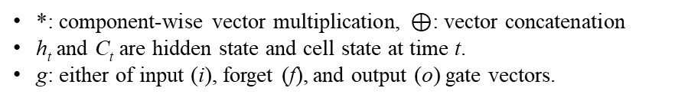

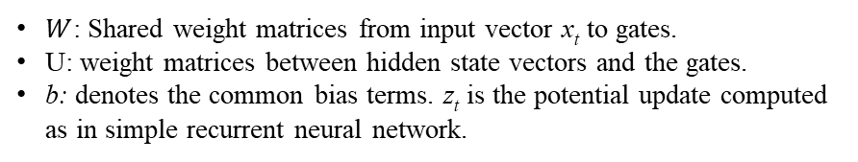
Research Design - Cross-Lingual Cyber Threat Detection (Cont’d)
The weight matrices are shared between Russian- and English-specific layers. While different specifications are available for BiLSTMs we implemented the specification in [32].
*: component-wise vector multiplication, $⊕$: vector concatenation
h_{t} and C_{t} are hidden state and cell state at time t.
g: either of input (i), forget (f), and output (o) gate vectors.
$W$: Shared weight matrices from input vector x_{t} to gates.
U: weight matrices between hidden state vectors and the gates.
b: denotes the common bias terms. z_{t} is the potential update computed as in simple recurrent neural network.
$σ$ can be any non-linearity.
The same specification applies to the backward LSTM.
The final output of the LSTM cell: New Cross-lingual Representation

Slide 35
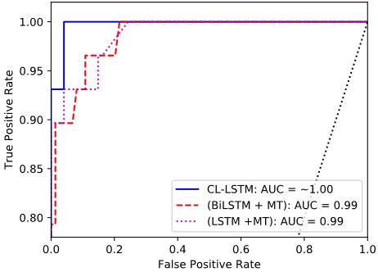
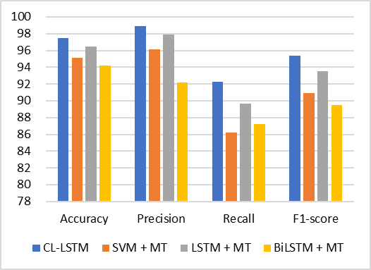
Results - Performance Evaluation
MT-based methods represent the state of the art in cyber threat detection.
We applied the approach used in [7][9] to our dataset. We denote these two methods as SVM + MT and LSTM + MT, respectively.
The methods used in [29][30][8] leverage pre-trained word embeddings and therefore are excluded from our evaluation. Similarly, the unsupervised approaches mentioned in CLKT review [26]–[28] were excluded for a fair comparison.
Method Description | Accuracy | Precision | Recall | F₁-score
SVM + MT | 95.15***ª | 96.15** | 86.21*** | 90.91***
LSTM + MT | 96.50* | 97.88 | 89.66* | 93.52**
BiLSTM + MT | 94.17*** | 92.18** | 87.24* | 89.45***
CL-LSTM | 97.50 | 98.90 | 92.28 | 95.39
Table 1. Evaluating CL-LSTM Against Baselines
Figure 5. CL-LSTM Performance Comparison
Figure 6. Comparing the AUC for deep learning benchmarks

Slide 36
Conclusion and Future Directions
We proposed a novel transfer learning-based cyber threat detection framework for non-English DNMs using deep CLKT.
We showed that threat knowledge learned from English DNMs can be transferred to Russian DNMs.
Our method jointly learns the common hacker-specific representation from Russian and English DNMs and outperforms baselines without relying on MT.
Advances proactive CTI by bridging the gap caused by language barrier in non-English DNMs.
Can help CTI professionals gain a better insight about cyber threats in foreign-language DNMs.
Future research is needed on:
Developing methods to handle very short product descriptions at the character level.
Validating the framework on other platforms (e.g., hacker forums) and other target languages.

Slide 37
Questions
List and explain the four major types of transfer learning.
What is the most common type of transfer learning?
What type of transfer learning has been used in the research example? Can you think of any other approach that can be used to solve the mentioned research problem?

Slide 38
References
[1] J. Robertson et al., Darkweb Cyber Threat Intelligence Mining. Cambridge University Press, 2017.
[2] J. Broséus, D. Rhumorbarbe, M. Morelato, L. Staehli, and Q. Rossy, “A geographical analysis of trafficking on a popular darknet market,” Forensic science international, vol. 277, pp. 88–102, 2017.
[3] Europol and European Monitoring Centre for Drugs and Drug Addiction, “Drugs and the darknet: perspectives for enforcement, research and policy,” 2017.
[4] “DeepDotWeb.” [Online]. Available: http://www.deepdotweb.com. [Accessed: 08-Jun-2018].
[5] E. Nunes et al., “Darknet and deepnet mining for proactive cybersecurity threat intelligence,” in Intelligence and Security Informatics (ISI), 2016 IEEE Conference on, 2016, pp. 7–12.
[6] E. Marin, A. Diab, and P. Shakarian, “Product offerings in malicious hacker markets,” in Intelligence and Security Informatics (ISI), 2016 IEEE Conference on, 2016, pp. 187–189.
[7] S. Samtani, R. Chinn, H. Chen, and J. F. Nunamaker Jr, “Exploring Emerging Hacker Assets and Key Hackers for Proactive Cyber Threat Intelligence,” Journal of Management Information Systems, vol. 34, no. 4, pp. 1023–1053, 2017.
[8] W. Li, H. Chen, and J. F. N. Jr, “Identifying and Profiling Key Sellers in Cyber Carding Community: AZSecure Text Mining System,” Journal of Management Information Systems, vol. 33, no. 4, pp. 1059–1086, 2016.
[9] J. Grisham, S. Samtani, M. Patton, and H. Chen, “Identifying mobile malware and key threat actors in online hacker forums for proactive cyber threat intelligence,” in Intelligence and Security Informatics (ISI), 2017 IEEE International Conference on, 2017, pp. 13–18.
[10] S. Duek and S. Markovitch, “Automatic Generation of Language-Independent Features for Cross-Lingual Classification,” arXiv preprint arXiv:1802.04028, 2018.
[11] S. C. AP et al., “An autoencoder approach to learning bilingual word representations,” in Advances in Neural Information Processing Systems, 2014, pp. 1853–1861.
[12] K. Weiss, T. M. Khoshgoftaar, and D. Wang, “A survey of transfer learning,” Journal of Big Data, vol. 3, no. 1, p. 9, May 2016.
[13] D. Wang and T. F. Zheng, “Transfer learning for speech and language processing,” in Signal and Information Processing Association Annual Summit and Conference (APSIPA), 2015 Asia-Pacific, 2015, pp. 1225–1237.
[14] R. Johnson and T. Zhang, “Supervised and Semi-Supervised Text Categorization using LSTM for Region Embeddings,” in ICML, 2016, pp. 526–534.
[15] Y. Wu et al., “Google’s neural machine translation system: Bridging the gap between human and machine translation,” arXiv preprint arXiv:1609.08144, 2016.
[16] V. Benjamin, W. Li, T. Holt, and H. Chen, “Exploring threats and vulnerabilities in hacker web: Forums, IRC and carding shops,” in Intelligence and Security Informatics (ISI), 2015 IEEE International Conference on, 2015, pp. 85–90.
[17] V. Benjamin and H. Chen, “Developing understanding of hacker language through the use of lexical semantics,” in Intelligence and Security Informatics (ISI), 2015 IEEE International Conference on, 2015, pp. 79–84.

Slide 39
References
[18] L. Duong, H. Kanayama, T. Ma, S. Bird, and T. Cohn, “Learning Crosslingual Word Embeddings without Bilingual Corpora,” arXiv preprint arXiv:1606.09403, 2016.
[19] X. Wan, “Co-training for cross-lingual sentiment classification,” in Proceedings of the Joint Conference of the 47th Annual Meeting of the ACL and the 4th International Joint Conference on Natural Language Processing of the AFNLP: Volume 1-volume 1, 2009, pp. 235–243.
[20] M. Long, J. Wang, Y. Cao, J. Sun, and S. Y. Philip, “Deep learning of transferable representation for scalable domain adaptation,” IEEE Transactions on Knowledge and Data Engineering, vol. 28, no. 8, pp. 2027–2040, 2016.
[21] M. Chen, Z. Xu, and K. Q. Weinberger, “Marginalized Denoising Autoencoders for Domain Adaptation,” in Proceedings of the 29th International Conference on Machine Learning, 2012, pp. 767–774.
[22] X. Glorot, A. Bordes, and Y. Bengio, “Domain adaptation for large-scale sentiment classification: A deep learning approach,” in Proceedings of the 28th international conference on machine learning (ICML-11), 2011, pp. 513–520.
[23] A. Sharif Razavian, H. Azizpour, J. Sullivan, and S. Carlsson, “CNN features off-the-shelf: an astounding baseline for recognition,” in Proceedings of the IEEE conference on computer vision and pattern recognition workshops, 2014, pp. 806–813.
[24] M. Wang and W. Deng, “Deep Visual Domain Adaptation: A Survey,” Neurocomputing, 2018.
[25] B. Zoph, D. Yuret, J. May, and K. Knight, “Transfer learning for low-resource neural machine translation,” in Proceedings of EMNLP, 2016.
[26] M. S. Rasooli, N. Farra, A. Radeva, T. Yu, and K. McKeown, “Cross-lingual sentiment transfer with limited resources,” Machine Translation, pp. 1–23, 2017.
[27] X. Chen, Y. Sun, B. Athiwaratkun, C. Cardie, and K. Weinberger, “Adversarial deep averaging networks for cross-lingual sentiment classification,” arXiv preprint arXiv:1606.01614, 2016.
[28] J. T. Zhou, S. J. Pan, I. W. Tsang, and Y. Yan, “Hybrid Heterogeneous Transfer Learning through Deep Learning.,” in AAAI, 2014, pp. 2213–2220.
[29] J. Tian et al., “An Adversarial Joint Learning Model for Low-Resource Language Semantic Textual Similarity,” in Advances in Information Retrieval, Cham, 2018, pp. 89–101.
[30] O. Adams, A. Makarucha, G. Neubig, S. Bird, and T. Cohn, “Cross-lingual word embeddings for low-resource language modeling,” in Proceedings of the 15th Conference of the European Chapter of the Association for Computational Linguistics: Volume 1, Long Papers, 2017, vol. 1, pp. 937–947.
[31] P. Liu, X. Qiu, and X. Huang, “Recurrent neural network for text classification with multi-task learning,” in International Joint Conferences on Artificial Intelligence, New York city, 2016, pp. 2873–2879.
[32] Y. Goldberg, “Neural Network Methods for Natural Language Processing,” Synthesis Lectures on Human Language Technologies, vol. 10, no. 1, pp. 1–309, 2017.
[33] D. P. Kingma and J. Ba, “Adam: A method for stochastic optimization,” in ICLR, San Diego, CA, 2015.
[34] J. Demšar, “Statistical comparisons of classifiers over multiple data sets,” Journal of Machine learning research, vol. 7, no. Jan, pp. 1–30, 2006.

