Slide 1
Autoencoders: Overview and Selected Application
Sagar Samtani and Hsinchun Chen
Artificial Intelligence Lab, The University of Arizona

Slide 2
Outline
Introduction and Background
Autoencoder: Intuition and Formulation
Autoencoder Variations: Denoising and Sparse
Evaluation Mechanisms
Example Application: Diachronic Linguistics for Cyber Threat Intelligence

Slide 3
Introduction and Background
Autoencoder → unsupervised deep learning algorithm that learns a compressed embedding for a data input (Goodfellow et al. 2016).
Goal: reproduce the input data at the output layer.
Autoencoders are commonly used for dimensionality reduction or to generate an embedding for input into other classification/clustering methods.
In recent years, they have become the preferred method for such tasks, outperforming traditional techniques such as PCA.

Slide 4
Autoencoder: Intuition and Formulation
The autoencoder performs the same feed-forward and backpropagation computations as the standard feed-forward Artificial Neural Network (ANN).
Unlike the ANN, the autoencoder has three major components: encoder, compressed embedding, and decoder.
Moreover, the autoencoder does not require any training data.
Next slide depicts the operations and formulation for a generic, 7-layer autoencoder.

Slide 5
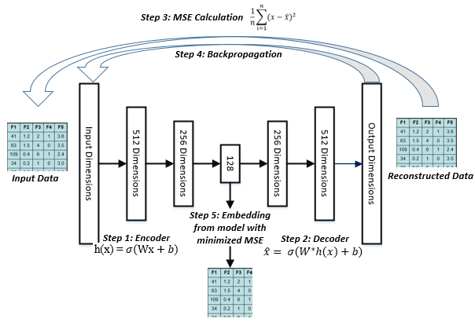
Autoencoders
Step 1: Encoder “encodes” input data into a embedding using non-linear activation functions.
Each layer reduces dimensionality.
Step 2: Decoder reconstructs output by using non-linear layers to “decode” embedding.
Each layer increases dimensionality.
Step 3: Mean Squared Error (MSE) is calculated between the reconstructed output and original input.
Step 4: Error is backpropagated to adjust autoencoder weights.
Step 5: Steps 1-4 are repeated until MSE is minimized.
Embedding with MSE minimized contains the most salient (important) features; can be used as input for other tasks (e.g., classification, clustering)
Notes:
From left: Step 1 reduces dimensionality of inputted data until a bottleneck is reached.
Step 2 aims to reconstruct output from the bottlenecked representation.
Step 3 compares reconstructed output with original input.
Step 4 uses backpropagation to adjust autoencoder weights.
The process continues until error between output and input is minimized.

Slide 6
Autoencoder Variations: Denoising and Sparse
Two variations of the autoencoder exist: denoising and sparse.
Denoising: Corrupts input data by injecting Gaussian noise.
Sparse: Restricts the number of active nodes in the training process.
Intuition: injecting noise or restricting active nodes forces autoencoder to learn the most important features.

Slide 7
Evaluation Mechanisms
Autoencoders are fundamentally an unsupervised learning algorithm.
Generated embedding is task-independent; thus, it can be used as input for multiple machine learning tasks.
No direct evaluation of autoencoders exists; instead, scholars opt to use the generated embedding for a downstream (i.e., subsequent) task:
Classification, with evaluation metrics being accuracy, precision, recall, F1
Clustering, with evaluation metrics being homogeneity, completeness, V-Measure

Slide 8
Evaluation Mechanisms
No “best” or “optimal” autoencoder configuration.
In practice, the best autoencoder can be identified by:
Comparing the autoencoder against the sparse and denoising
Adjusting the depth of the autoencoder (e.g., 3, 5, 7 layers)
Adjusting embedding size (e.g., 128 dimensions, 256 dimensions)
The above adjustments can be dictated by the performance of the generated embeddings in the selected downstream task.

Slide 9
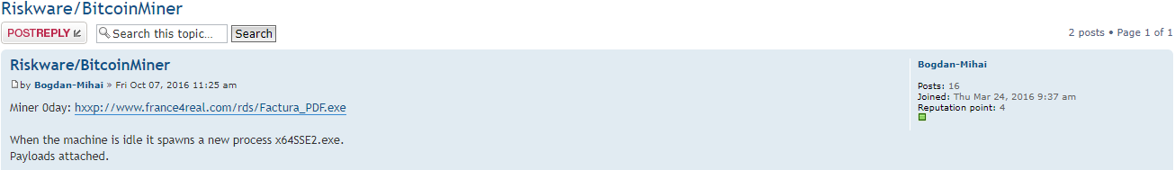
Autoencoder Applications: Diachronic Linguistics to Identify Emerging Threats
Hacker Community Overview and Value:
Forums, DarkNets, IRC, carding shops.
Tens of millions of posts from millions of hackers worldwide.
Free tools in forums have been used in major breaches (e.g., Target) (Kitten, 2014).
Analytical Challenges:
Hundreds of thousands of text records.
Traditional CTI analytics are unsuitable.
Standard text analytics need extensions.
Date when exploit was posted
Exploit available for download
Description of how exploit operates
Research Objective: Develop proactive CTI capabilities by
exploring online hacker forums to identify emerging exploit trends.

Slide 10
Autoencoder Applications: Diachronic Linguistics to Identify Emerging Threats
To achieve this goal, we create a novel deep learning framework, the Diachronic Graph Convolutional Autoencoder (D-GCAE).
D-GCAE customizes Graph Convolutional Network (GCN) operations and integrates them into the autoencoder architecture. This model (GCAE) then:
Operates on a Graph-of-Words (GoW) representation of exploit text.
Goal: generate node (i.e., word) embeddings in an unsupervised manner.
Uses semantic displacement metrics from diachronic linguistics literature.
Goal: Identify emerging exploit terms.
Notes:
The D-GCAE has two major components:
GCAE: creates task-independent (i.e., general) node embeddings for a GoW
Approach: incorporates modified graph convolution operations into the autoencoder
Diachronic operations: maps the evolution (i.e., shift) of hacker exploit terms
Approach: Aligns embeddings spaces using Frobenius norm; calculates semantic displacements

Slide 11
Graph Convolutional Networks (GCNs)
For hacker forum GoWs, deep learning can reveal latent local and global relationships of exploit terms that would otherwise be overlooked.
An emerging deep learning approach operating on text graphs is the GCN.
GCNs use deep learning to learn embeddings from node-attributed networks for supervised learning tasks.
The GCN learns a function f(X, A) where:
X is an NxF input node feature matrix (if nodes have features)
A is the NxN adjacency matrix from graph G

Slide 12
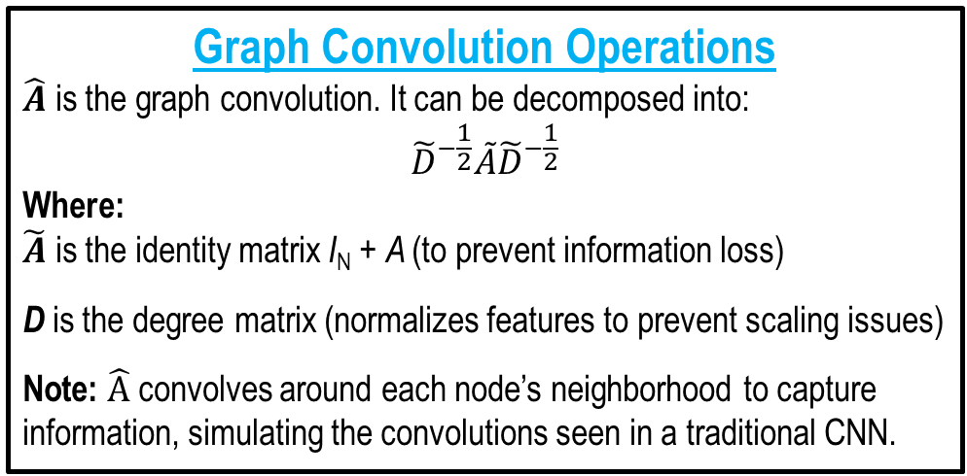
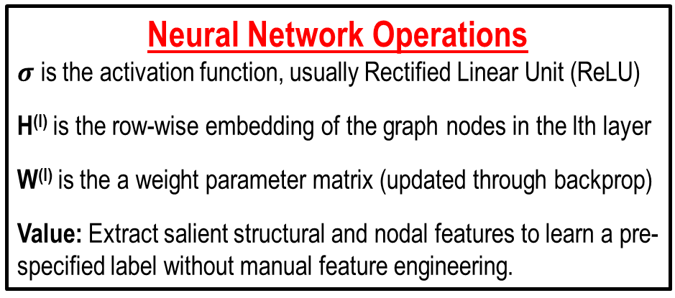
GCN Formulation
Selected studies using GCN’s on text graphs are summarized in Table 2.
$$H^{l+1}=σ (\hat{A}{ H}^{\left(l\right)}W^{\left(l\right)})$$
Graph Convolution Operations
$\hat{A}$ is the graph convolution. It can be decomposed into:
$${\tilde{D}}^{−\frac{1}{2}}\tilde{A}{\tilde{D}}^{−\frac{1}{2}}$$
Where:
$\tilde{A}$ is the identity matrix I_{N} + A (to prevent information loss)
D is the degree matrix (normalizes features to prevent scaling issues)
Note: $\hat{A}$ convolves around each node’s neighborhood to capture information, simulating the convolutions seen in a traditional CNN.
Neural Network Operations
$σ$ is the activation function, usually Rectified Linear Unit (ReLU)
H^{(l)} is the row-wise embedding of the graph nodes in the lth layer
W^{(l)} is the a weight parameter matrix (updated through backprop)
Value: Extract salient structural and nodal features to learn a pre-specified label without manual feature engineering.
Note: While A and X could be concatenated and inputted into an ANN, these operations controls the number of parameters,
appropriately scales features, and is robust to network size changes

Slide 13
GCNs
Year | Author | Dataset(s) | Task | Nodes | Edges
2018 | Haija et al. | Pubmed, Citeseer, Cora | Semi-supervised classification | Documents | Citations
2018 | Chen et al. | Cora, Pubmed, Reddit | Node classification | Documents | Citations
2017 | Kipf et al. | Cora, Citeseer, Pubmed | Link prediction | Documents | Citations
2017 | Hamilton et al. | Citation, Reddit, PPI | Node classification | Documents | Citations
2017 | Yasunaga et al. | Data Understanding Conferences Papers | Document classification | Sentences | Cosine similarity threshold
2017 | Kipf and Welling | Citeseer, Cora, Pubmed, Nell | Semi-supervised classification | Documents | Citations
Table 2. Selected Studies Using GCNs
GCNs have been applied to classify documents semi and fully-supervised settings.
Also applied the GCN for link prediction in document networks (Kipf et al. 2017).
Despite GCNs’ breadth of applications, it is designed for supervised learning tasks.
Thus, the learned embeddings are task-specific; they are the most salient features that create the best mappings between the input data and pre-specified output labels.
As a result, these node embeddings are less suitable for and generalizable to other tasks.

Slide 14
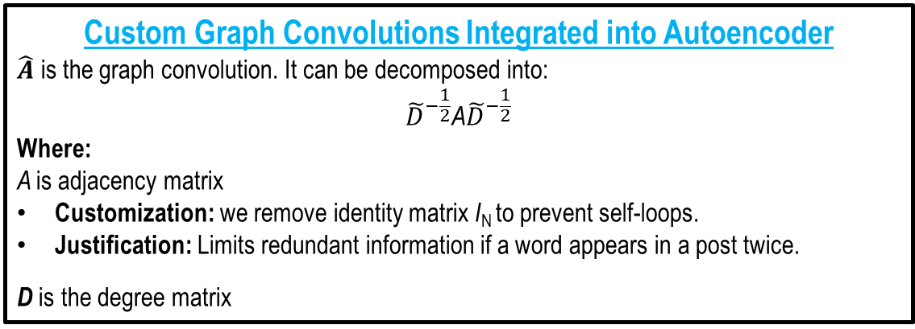
GCAE Architecture
Contribution:
First method (to our knowledge) that learns word embeddings by representing text in as a graph.
Value:
Generated embedding can be used for multiple tasks.
GCAE component can be used in multiple social media contexts and text corpora.
Custom Graph Convolutions Integrated into Autoencoder
$\hat{A}$ is the graph convolution. It can be decomposed into:
$${\tilde{D}}^{−\frac{1}{2}}\text{A}{\tilde{D}}^{−\frac{1}{2}}$$
Where:
A is adjacency matrix
Customization: we remove identity matrix I_{N} to prevent self-loops.
Justification: Limits redundant information if a word appears in a post twice.
D is the degree matrix

Slide 15
GCAE Operations
Note: All areas marked in red are extensions of the standard autoencoder
Step 1: Encoder “encodes” the network’s adjacency matrix into an embedding using custom graph convolutions.
Each layer reduces dimensionality.
Step 2: Decoder “decodes” embedding using graph convolutions to reconstruct graph.
Each layer increases dimensionality.
Step 3: MSE is calculated between the reconstructed and original graphs.
Step 4: Error backpropagates to adjust weights.
Step 5: Repeat steps 1-4 until MSE is minimized.
Graph Convolutional Autoencoder Architecture

Slide 16
Diachronic Operations
Framework Summary (Novelty)
GCAE: Graph convolutions customized for GoW’s integrated into an autoencoder.
D-GCAE: GCAE applies diachronic operations to map embedding shifts.
Step 1
Step 2
Figure 7. Diachronic Graph Convolutional Autoencoder Framework
The second component applies diachronic operations to:
Align generated embedding spaces from each time-spell (Step 1).
Compute semantic displacement of each word across time-spells (Step 2).

Slide 17
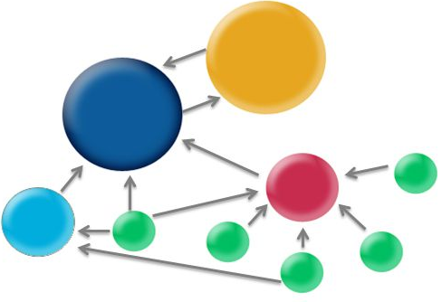
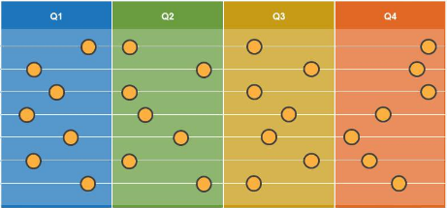

Exploit Trend Identification: Ransomware Case Study
Case study illustrates D-GCAE’s practical utility.
One forum: 24,933 posts (7,245 exploits), 1,418 hackers, 3/11/2010 – 10/20/2017
235/7,245 (3.2%) ransomware exploits.
Low percentage possibly due to ransomware’s complexity and newness.
Follows the steps CTI professionals can take to identify emerging exploits.
Procedure
Time-Spell Construction
Text Graph Formulation
Descriptive Statistics
D-GCAE
Split data into three month intervals
Nodes → words in exploit posts
Edges → if words appeared in same post
Understand overall
network dynamics
Extract word embeddings
Identify emerging exploits
via semantic displacements

Slide 18
Results and Discussion – Ransomware Case Study
Rank | Word | Amount Shifted* | Rank | Word | Amount Shifted*
1 | Initiial | 1.56378 | 11 | Instal | 1.53015
2 | Variant | 1.55563 | 12 | Host | 1.52990
3 | Steal | 1.55430 | 13 | Vari | 1.52902
4 | Touch | 1.55418 | 14 | Strategi | 1.52778
5 | Organ | 1.54652 | 15 | Case | 1.52593
6 | Summer | 1.53727 | 16 | Financi | 1.52273
7 | Wolf | 1.53707 | 17 | August | 1.52201
8 | Mine | 1.53594 | 18 | Major | 1.51968
9 | Bitcoin | 1.53217 | 19 | Establish | 1.51908
10 | multicompon | 1.53145 | 20 | infect | 1.51857
Figure 12 provides a representative
sample post from three time points,
2010, 2014, and 2017, to illustrate how the meaning of “infect” has shifted.
Words with the top 20 average shifts relate to specific ransomware functionalities.
E.g., “bitcoin” for payment mechanisms, “steal,” “variant,” “organ” for exploitation.
One word that can provide actionable CTI is “infect” (rank 20; shift of 1.51857).
Infect appeared in a total of 19/235 (8.0551%) ransomware postings.
Notes:
Each word in the corpus shifted an average amount of 1.2538 in semantic space.
Top 20 terms initially belonged to rootkits

Slide 19
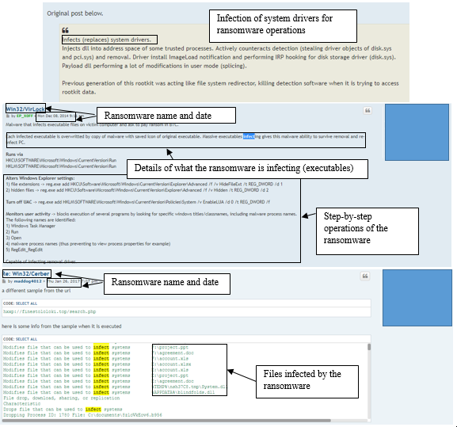
2010
Top ransomware focused specifically on memory injections.
Middle adds in capabilities to infect executables on the victim machines to enable long term access.
Can facilitate APT’s.
The bottom post focuses on infecting specific files.
2014
2017

