Slide 1
An Introduction to Convolutional Neural Networks
Shuo Yu
October 3, 2018

Slide 2
Acknowledgments
Many of the images, results, and other materials are from:
Deep Learning, Ian Goodfellow, Yoshua Bengio, and Aaron Courville
Lee Giles and Alex Ororbia, Penn State University
Yann LeCun, New York University

Slide 3
Outline
Introduction
Neuroscientific Basis
Building Blocks
Convolution Layer
Detector Layer
Pooling Layer
Implementation
Build a CNN with Keras in Python
Research Example: 2D-hetero CNN for Mobile Health Analytics
Introduction
Research Design
Evaluation and Results

Slide 4
Introduction
Convolutional Neural Networks

Slide 5
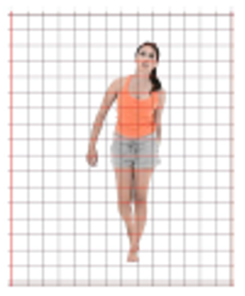
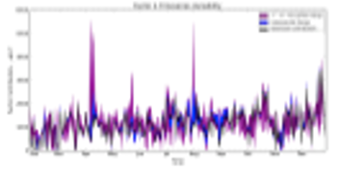
Convolutional Neural Networks
Convolutional Neural Networks, or Convolutional Networks, or CNNs
For processing data with a grid-like topology
1-D grid: time-series data, sensor signal data
2-D grid: image data
CNNs are neural networks with convolution operations.
The most well used deep learning networks

Slide 6
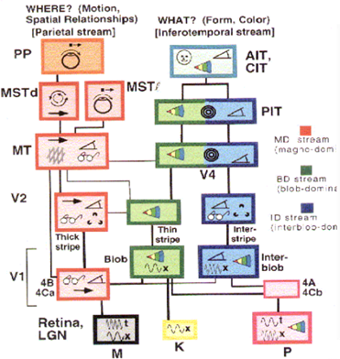
Neuroscientific Basis for CNNs
Inspired by the mammalian vision system
Cells sensitive to small sub-regions of the visual field – receptive field
In the primary visual cortex, or V1, there are:
Simple cells
Responsive to specific edge-like patterns of light in a small receptive field
Complex cells
Invariant to small shifts in the feature position with a larger receptive field
Similar designs can be found in CNNs.

Slide 7
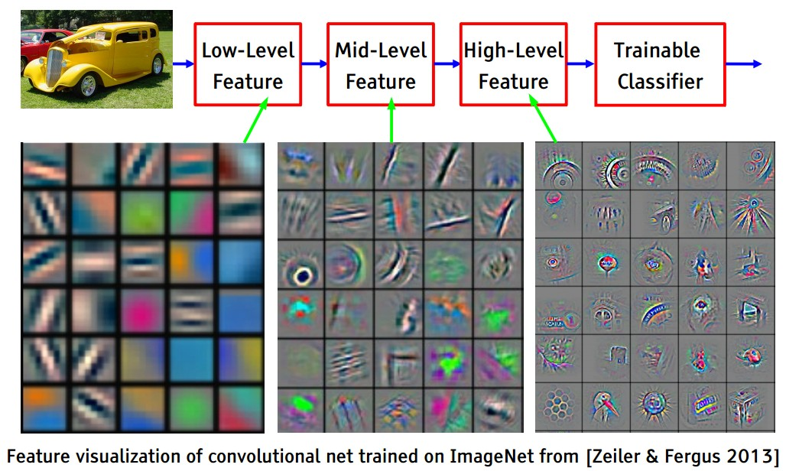
A Deep Classification Network

Slide 8
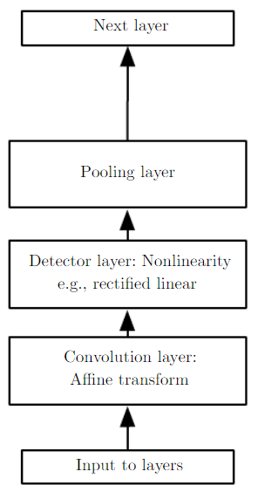
Building Blocks for CNNs
A CNN typically multiples of the following layers:
Convolution layer
“Simple cells”
Learn local features in a small region
Detector layer
Add nonlinearity to the model
Pooling layer
“Complex cells”
Reduce the amount of parameters
Introduce local translation invariance

Slide 9
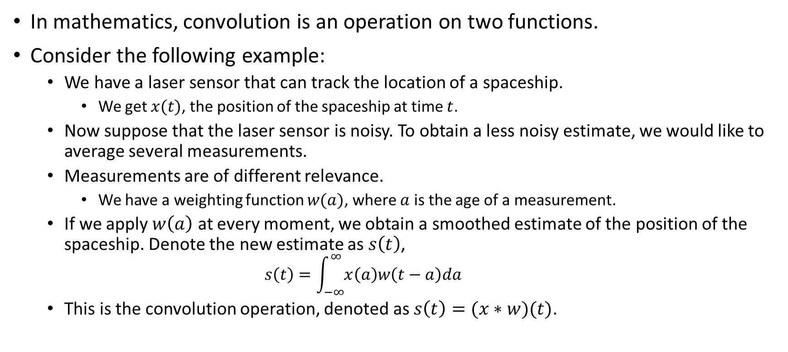
What Is Convolution?
In mathematics, convolution is an operation on two functions.
Consider the following example:
We have a laser sensor that can track the location of a spaceship.
We get $x(t)$, the position of the spaceship at time $t$.
Now suppose that the laser sensor is noisy. To obtain a less noisy estimate, we would like to average several measurements.
Measurements are of different relevance.
We have a weighting function $w(a)$, where $a$ is the age of a measurement.
If we apply $w\left(a\right)$ at every moment, we obtain a smoothed estimate of the position of the spaceship. Denote the new estimate as $s\left(t\right)$,
$$s\left(t\right)=\int_{−∞}^{∞}{x\left(a\right)w\left(t−a\right)da}$$
This is the convolution operation, denoted as $s\left(t\right)=(x∗w)(t)$.

Slide 10
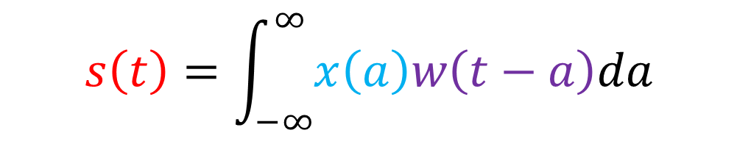
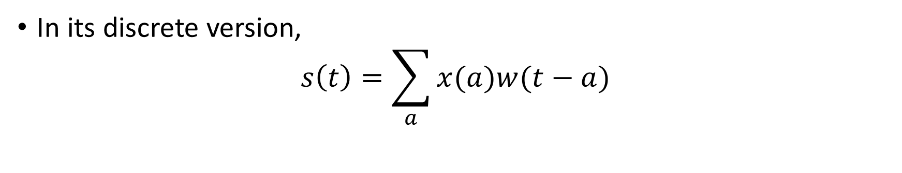
What Is Convolution?
$$s\left(t\right)=\int_{−∞}^{∞}{x\left(a\right)w\left(t−a\right)da}$$
Output, or Feature Map
Input
Kernel
Note: CNN terminology
In its discrete version,
$$s\left(t\right)=\sum_{a}{x(a)w(t−a)}$$

Slide 11
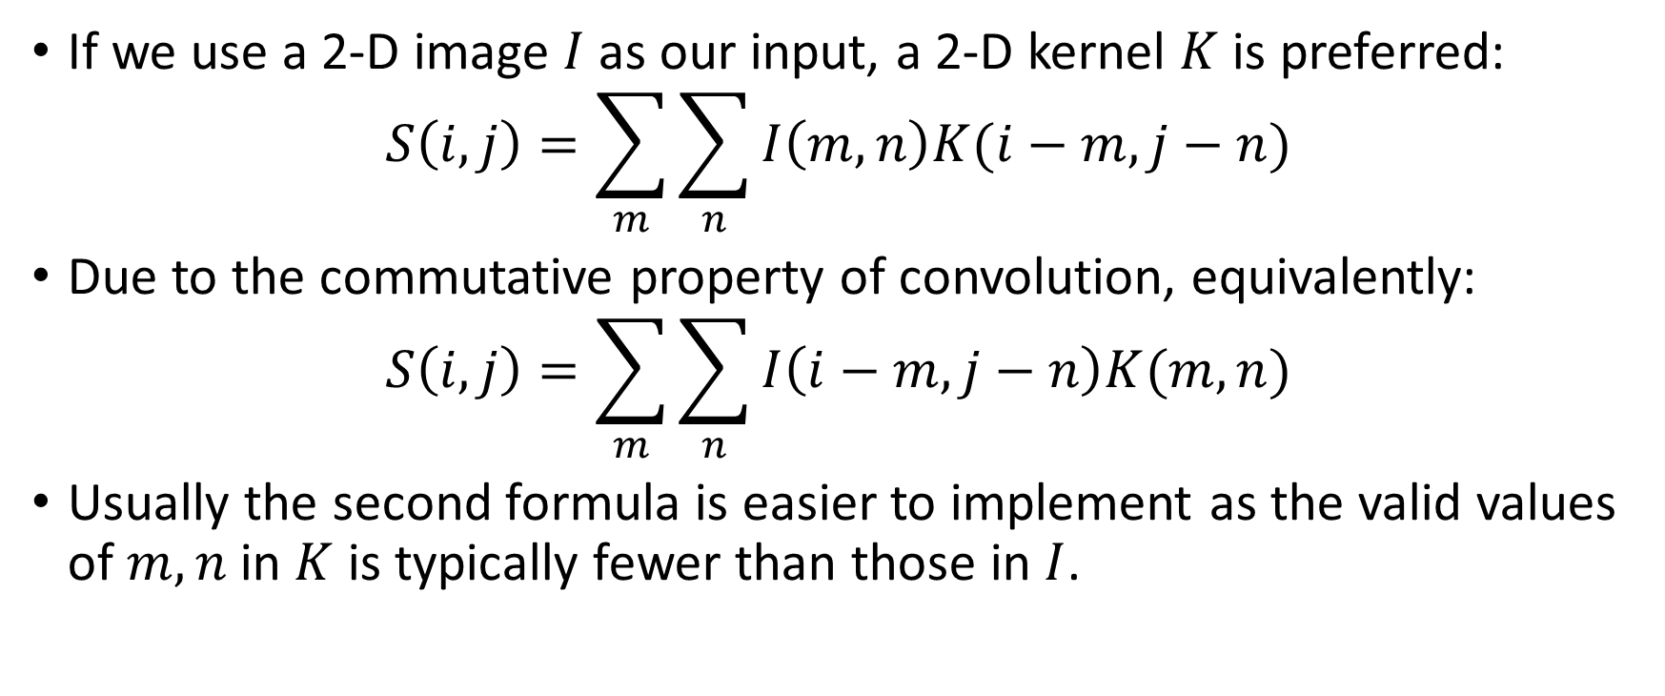
Two-dimensional Convolution
If we use a 2-D image $I$ as our input, a 2-D kernel $K$ is preferred:
$$S\left(i,j\right)=\sum_{m}{\sum_{n}{I\left(m,n\right)K(i−m,j−n)}}$$
Due to the commutative property of convolution, equivalently:
$$S\left(i,j\right)=\sum_{m}{\sum_{n}{I\left(i−m,j−n\right)K(m,n)}}$$
Usually the second formula is easier to implement as the valid values of $m,n$ in $K$ is typically fewer than those in $I$.

Slide 12
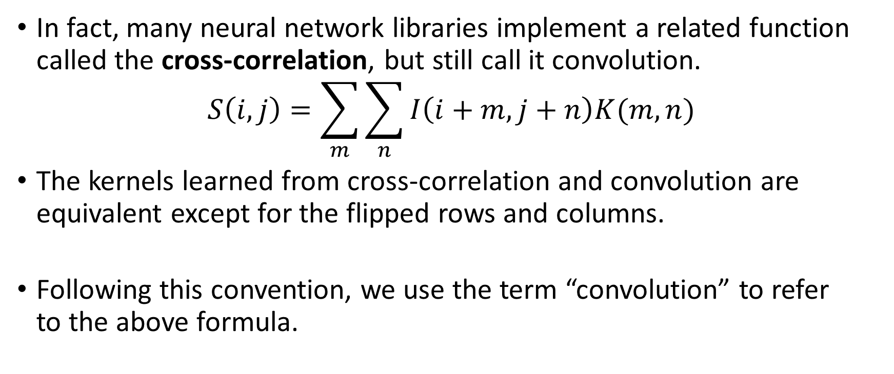
Cross-correlation
In fact, many neural network libraries implement a related function called the cross-correlation, but still call it convolution.
$$S\left(i,j\right)=\sum_{m}{\sum_{n}{I\left(i+m,j+n\right)K(m,n)}}$$
The kernels learned from cross-correlation and convolution are equivalent except for the flipped rows and columns.
Following this convention, we use the term “convolution” to refer to the above formula.
1 | 2 | 3
4 | 5 | 6
7 | 8 | 9
A kernel learned from cross-correlation
9 | 8 | 7
6 | 5 | 4
3 | 2 | 1
A kernel learned from convolution

Slide 13
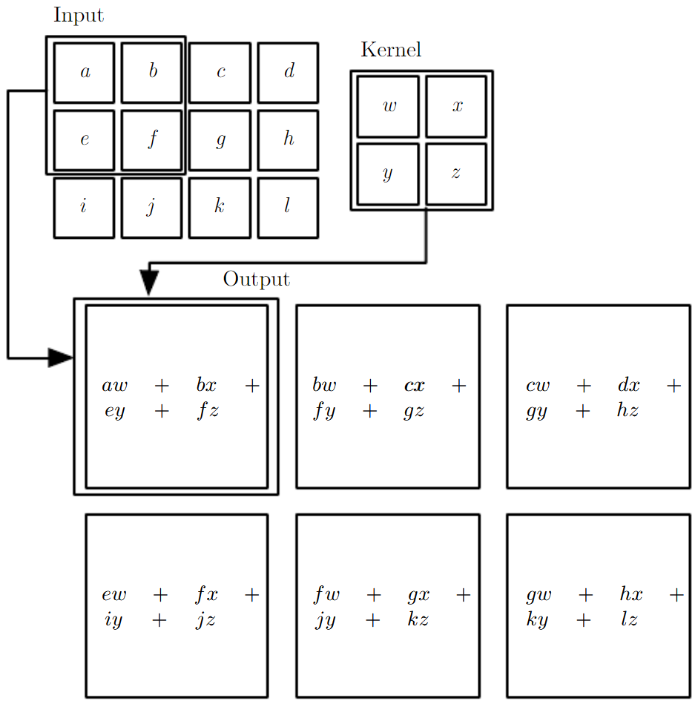
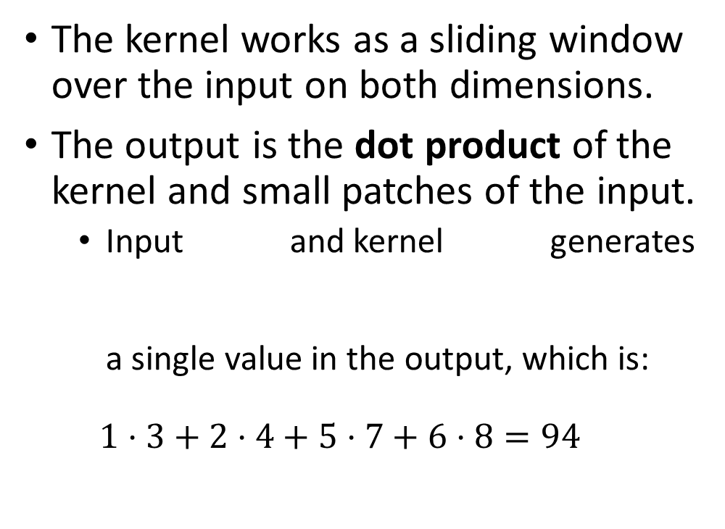
An Example of 2-D Convolution
The kernel works as a sliding window over the input on both dimensions.
The output is the dot product of the kernel and small patches of the input.
Input and kernel generates a single value in the output, which is:
$$1⋅3+2⋅4+5⋅7+6⋅8=94$$
1 | 2
5 | 6
3 | 4
7 | 8

Slide 14
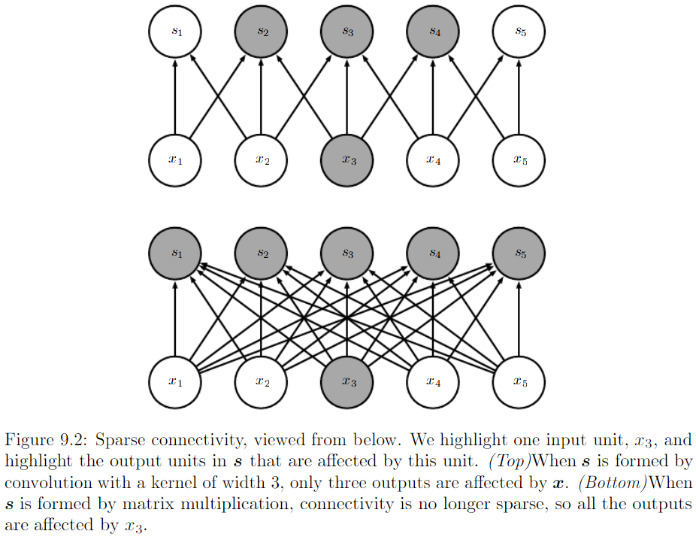
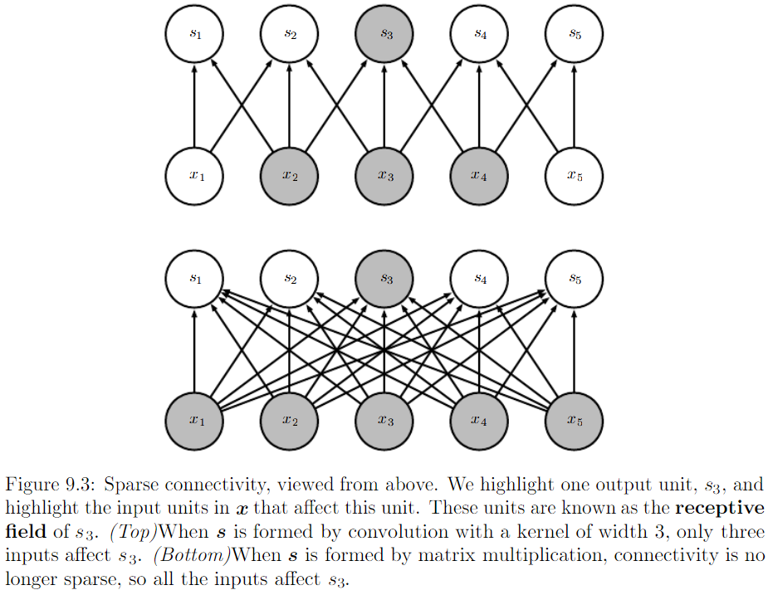
Convolution Layer Properties
Sparse interactions (also referred to as sparse weights)
By making the kernel smaller than the input, we are able to detect small, meaningful features such as edges with only tens or hundreds of pixels.

Slide 15
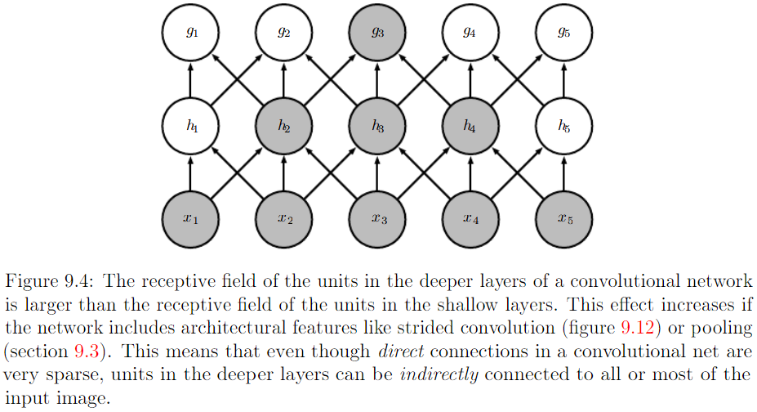
Convolution Layer Properties
Sparse interactions (also referred to as sparse weights)
Units in the deeper layers indirectly interact with a larger portion of the input.
Even though direct connections in a CNN are very sparse, units in the deeper layers can be indirectly connected to all or most of the input.

Slide 16
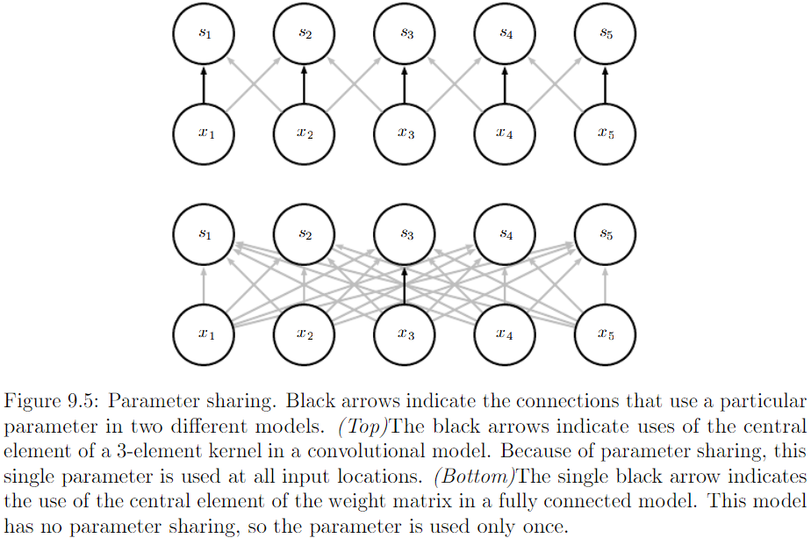
Convolution Layer Properties
Parameter sharing (tied weights)
Rather than learning a separate set of parameters for every location, we learn only one set and reuse it everywhere.

Slide 17
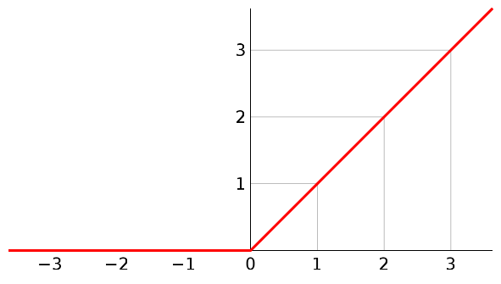
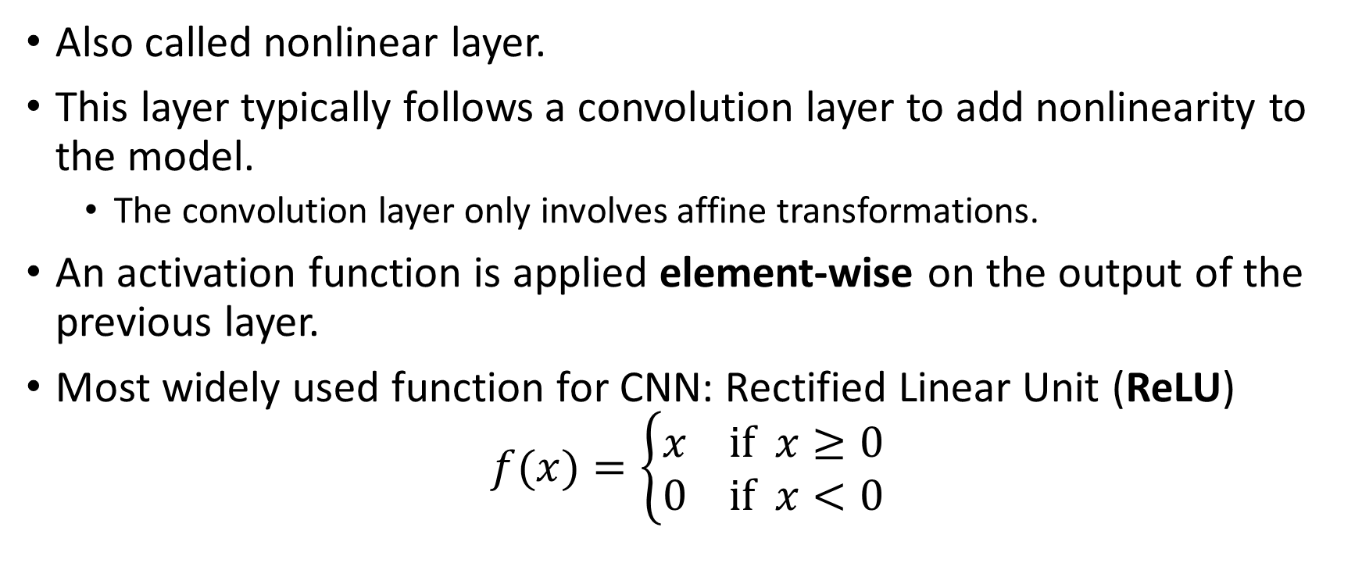


Detector Layer
Also called nonlinear layer.
This layer typically follows a convolution layer to add nonlinearity to the model.
The convolution layer only involves affine transformations.
An activation function is applied element-wise on the output of the previous layer.
Most widely used function for CNN: Rectified Linear Unit (ReLU)
$$f(x)=\left\{\begin{aligned}x if x≥0 \\ 0 if x<0\end{aligned}\right.$$
$$f(x)$$
$$x$$

Slide 18
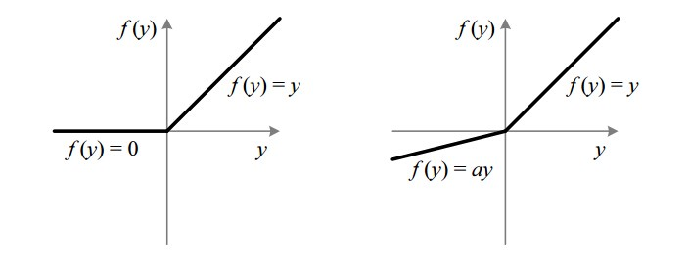
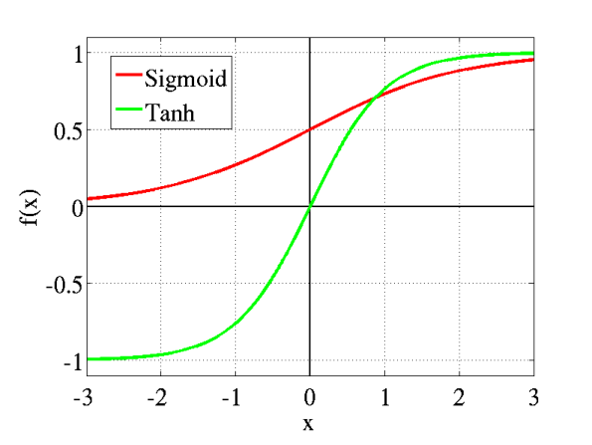
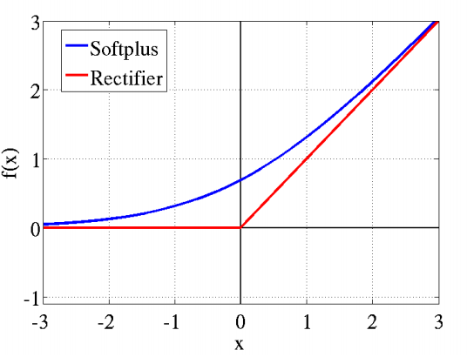

Detector Layer
Other nonlinear functions:
Leaky ReLU
$f(x)=\left\{\begin{matrix}x & if x≥0 \\ 0.01x & if x<0\end{matrix}\right.$
Sigmoid
$f\left(x\right)=\frac{1}{1+e^{−x}}$
Tanh
$f\left(x\right)=\frac{e^{x}−e^{−x}}{e^{x}+e^{−x}}$
Softplus
$f\left(x\right)=log(1+e^{x})$
ReLU
Leaky ReLU (a = 0.01)
Sigmoid vs. Tanh
Softplus vs. ReLU

Slide 19
Pooling Layer
A pooling layer typically follows the detector layer.
We use a pooling function to modify the output of the previous layer.
The pooling function replaces the output at a certain location with a summary statistic of the nearby outputs.
Popular pooling functions:
Max pooling of a rectangular neighborhood
Average of a rectangular neighborhood
L₂ norm of a rectangular neighborhood
Weighted average based on the distance from the central cell
1 | 4
9 | 16
Max pooling
16
Average
L₂ norm
7.5
18.8

Slide 20
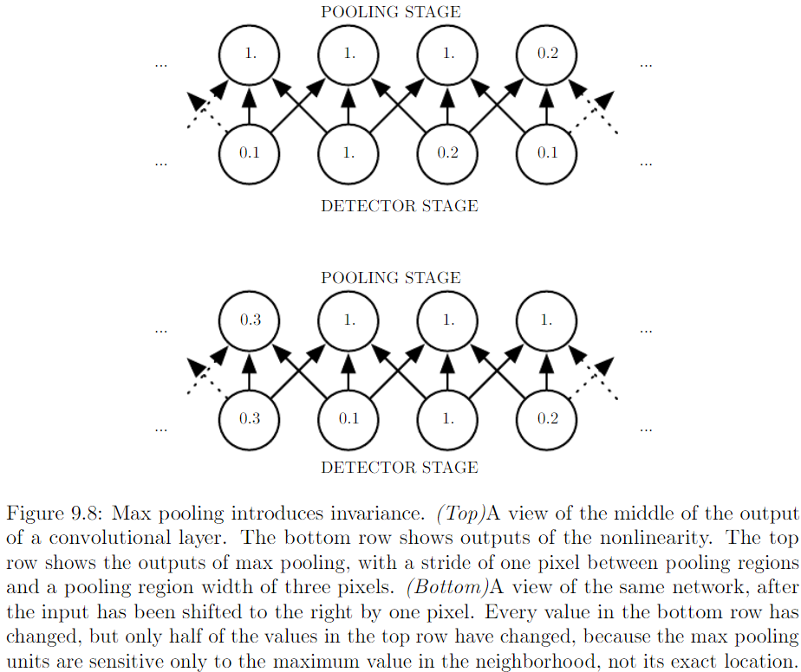
Pooling Layer
Pooling helps to make the output approximately invariant to small translations of the input.
This can be a useful property if we care more about whether some feature is present than exactly where it is.

Slide 21
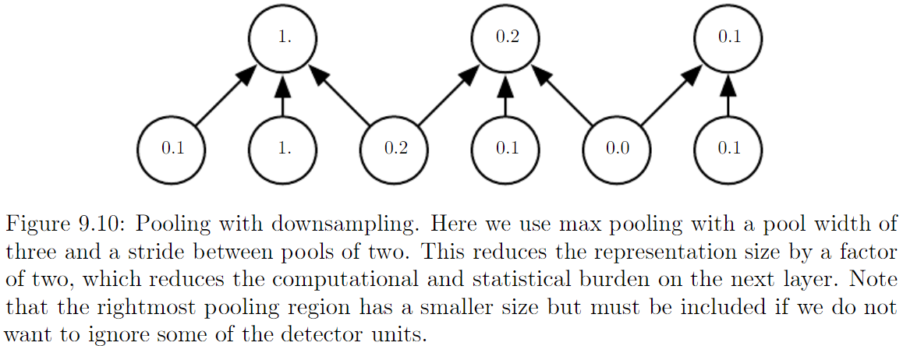

Pooling Layer
Pooling with downsampling
Use fewer pooling units than detector units
Improved computational efficiency
The next layer has roughly $k$ times fewer inputs to process.

Slide 22
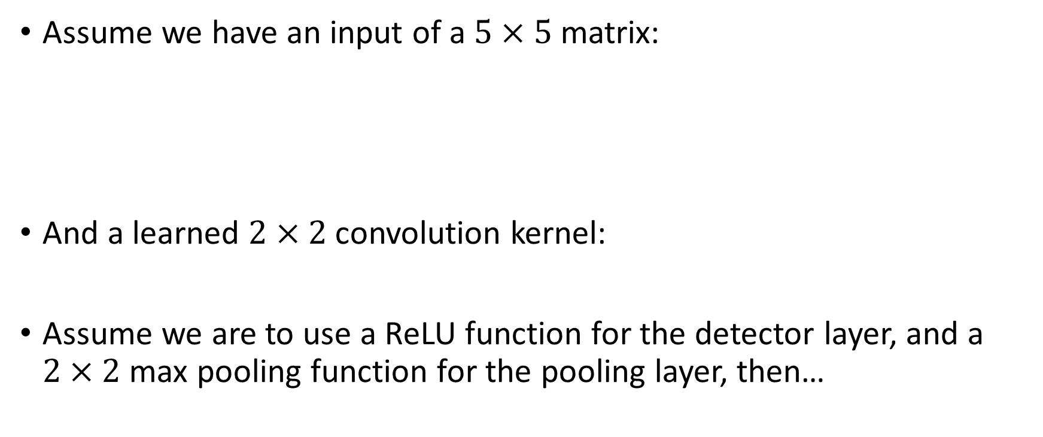
An Example for a Three-Layer Forward Pass
17 | 24 | 1 | 8 | 15
23 | 5 | 7 | 14 | 16
4 | 6 | 13 | 20 | 22
10 | 12 | 19 | 21 | 3
11 | 18 | 25 | 2 | 9
Assume we have an input of a $5×5$ matrix:
And a learned $2×2$ convolution kernel:
Assume we are to use a ReLU function for the detector layer, and a $2×2$ max pooling function for the pooling layer, then…
1 | -2
-3 | 4

Slide 23
An Example for a Three-Layer Forward Pass
17 | 24 | 1 | 8 | 15
23 | 5 | 7 | 14 | 16
4 | 6 | 13 | 20 | 22
10 | 12 | 19 | 21 | 3
11 | 18 | 25 | 2 | 9
-80 | 35 | 20 | 0
25 | 25 | 20 | 10
10 | 20 | 0 | -75
25 | 20 | -90 | 45
Convolution
1 | -2
-3 | 4
Detector
0 | 35 | 20 | 0
25 | 25 | 20 | 10
10 | 20 | 0 | 0
25 | 20 | 0 | 45
ReLU
Pooling
35 | 20
25 | 45
Max 2x2

Slide 24
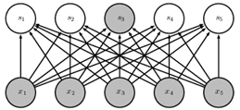
Other Layers
The convolution, detector, and pooling layers are typically used as a set. Multiple sets of the above three layers can appear in a CNN design.
Input -> Conv. -> Detector -> Pooling -> Conv. -> Detector -> Pooling -> …
After a few sets, the output is typically sent to one or two fully connected layers.
A fully connected layer is a ordinary neural network layer as in other neural networks.
Typical activation function is the sigmoid function.

Slide 25
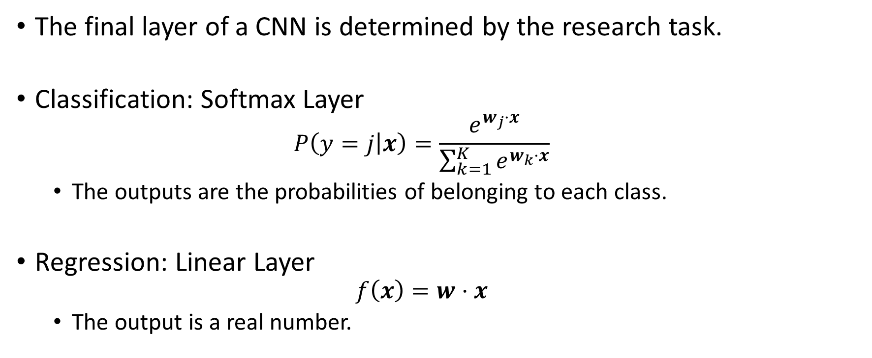
Other Layers
The final layer of a CNN is determined by the research task.
Classification: Softmax Layer
$$P\left(y=j | x\right)=\frac{e^{w_{j}⋅x}}{\sum_{k=1}^{K}{e^{w_{k}⋅x}}}$$
The outputs are the probabilities of belonging to each class.
Regression: Linear Layer
$$f\left(x\right)=w⋅x$$
The output is a real number.

Slide 26
Implementation
Python, TensorFlow, Keras

Slide 27


Python CNN Implementation
Prerequisites:
Python 3.5+ (https://www.python.org/)
TensorFlow (https://www.tensorflow.org/)
Keras (https://keras.io/)
Keras is a high-level neural networks API, written in Python and capable of running on top of TensorFlow, CNTK, or Theano.
Recommended:
NumPy
Scikit-Learn
NLTK
SciPy

Slide 28
Build a CNN in Keras
The Sequential model is used to build a linear stack of layers.
Building a CNN with the Sequential model is straightforward.
The following code shows how a typical CNN is built in Keras.
Note:
Dense is the fully connected layer;
Flatten is used after all CNN layers and before a fully connected layer;
Conv2D is the 2D convolution layer;
MaxPooling2D is the 2D max pooling layer;
SGD is stochastic gradient descent algorithm.
import numpy as np
import keras
from keras.models import Sequential
from keras.layers import Dense, Flatten
from keras.layers import Conv2D, MaxPooling2D
from keras.optimizers import SGD

Slide 29
Build a CNN in Keras
(continued)
model = Sequential()
# We create an empty Sequential model and add layers onto it.
model.add(Conv2D(32, (3, 3), activation='relu', input_shape=(100, 100)))
# We add a Conv2D layer with 32 filters, 3x3 each, followed by a detector layer ReLU.
# This is the first layer we add to the model, so we need to specify the shape of the input. In this case we assume our input is a 100x100 matrix.
model.add(MaxPooling2D(pool_size=(2, 2)))
# We add a MaxPooling2D layer with a 2x2 pooling size.

Slide 30
Build a CNN in Keras
(continued)
model.add(Conv2D(32, (3, 3), activation='relu'))
model.add(MaxPooling2D(pool_size=(2, 2)))
# We can add more Conv2D and MaxPooling2D layers onto the model.
model.add(Flatten())
# After all the desired CNN layers are added, add a Flatten layer.
model.add(Dense(256, activation='sigmoid'))
# Add a fully connected layer followed by a detector layer with the sigmoid function.
model.add(Dense(10, activation='softmax')
# A softmax layer is added to achieve multiclass classification. In this example we have 10 classes.

Slide 31
Build a CNN in Keras
(continued)
sgd = SGD(lr=0.01, decay=1e-6, momentum=0.9, nesterov=True)
# Default SGD training parameters
model.compile(loss='categorical_crossentropy', optimizer=sgd)
# Compile the model and use categorical crossentropy as the loss function, sgd as the optimizer
model.fit(x_train, y_train, batch_size=32, epochs=10)
# Fit the model with x_train and y_train, batch_size and epochs can be set to other values
score = model.evaluate(x_test, y_test, batch_size=32)
# Evaluate model performance using x_test and y_test

Slide 32
Research Example
Two-Dimensional Heterogeneous Convolutional Neural Network (2D-hetero CNN) for Mobile Health Analytics

Slide 33
Introduction
Population aging has been a growing concern in US.
Life expectancy 79.3 years in US (WHO, 2016)
46.2 million of US citizens (14.5%) are 65 or older in 2014 (US Census Bureau).
Falls are one of the most severe threats faced by senior citizens with independent living.
28-35% of people aged 65 and over fall at least once each year;
32-42% for people aged 70 and over (WHO, 2008).
Falls threaten senior citizens’ living both physically and psychologically.
Direct injury (bone fracture), long-lie (hypothermia, dehydration, etc.)
Avoidance of activities, depression, decreased social contact, lower quality of life.
Fall risk assessment is an effective prevention tool in identifying senior citizens with high fall risks.
Appropriate interventions can be provided.
Exercise, review and modification of medication, etc.
Ultimately reduce or eliminate falls.

Slide 34
Introduction
Current clinical assessment tools include (Howcroft et al., 2013):
Survey-based evaluations of fall risk factors
Fried’s Frailty Criteria (Fried et al., 2001); STRATIFY Score (Oliver et al., 1997); Physiological Profile Assessment (PPA) (Lord et al., 2003); Tinetti Performance Oriented Mobility Assessment (POMA) (Tinetti, 1986)
Quantified performance of certain mobility tests
10-meter ground walking; Timed Up and Go (TUG, Shumway-Cook et al., 2000); Sit-to-stand transitions (STS); Alternating Step Test (AST)
The completion time is used as the indicator for assessing fall risks.
Limitations for those tools:
Survey-based evaluations rely on patients’ recall and self-report of recent events, which may be imprecise and omits important clues.
The completion time as the sole indicator for clinical mobility tests oversimplifies the analyses of human motion.

Slide 35
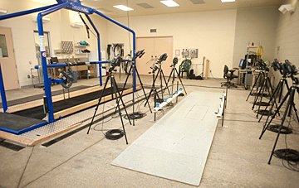
Introduction
Specialized equipment in gait laboratories can provide a thorough and objective assessment, but impractical to integrate into typical clinic schedules.
Cameras, force plates, etc.
Motion sensor-based systems have emerged as a proxy that can efficiently capture and analyze quantitative mobility data for fall risk assessment.
Miniature sensors are attached to senior citizens’ body for a short period of time (5 to 10 minutes) to collect data from mobility tests.
However, most prior studies on motion sensor-based gait analysis focused on deriving single features on signals and evaluating their discriminant power using statistical analysis (e.g., ANOVA).
Features for example: root mean square acceleration, walking speed, stride variability, etc.
Oversimplifies the problem; lacks detailed analysis on signal features
Fig. 1. Gait Laboratory

Slide 36
Introduction
In this work, we developed two-dimensional heterogeneous convolutional neural networks (2D-hetero CNN), a motion sensor-based system for fall risk assessment using convolutional neural networks (CNN).
Five sensor system (chest, left/right thigh, left/right foot) for clinical tests
Comprehensive assessment for gait and balance features
CNNs are powerful in extracting low-level local features as well as integrating them into high-level global features.
Feature-less; avoid feature engineering that is labor intensive, ad hoc, and inconclusive.
Main novelty of this work:
We proposed a novel CNN architecture to extract gait and balance features for fall risk assessment.
Two-dimensional convolution: temporal convolution + cross-axial and cross-locational convolution
To the best of our knowledge, we are the first to apply CNNs for motion sensor-based fall risk assessment.

Slide 37
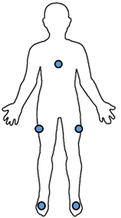

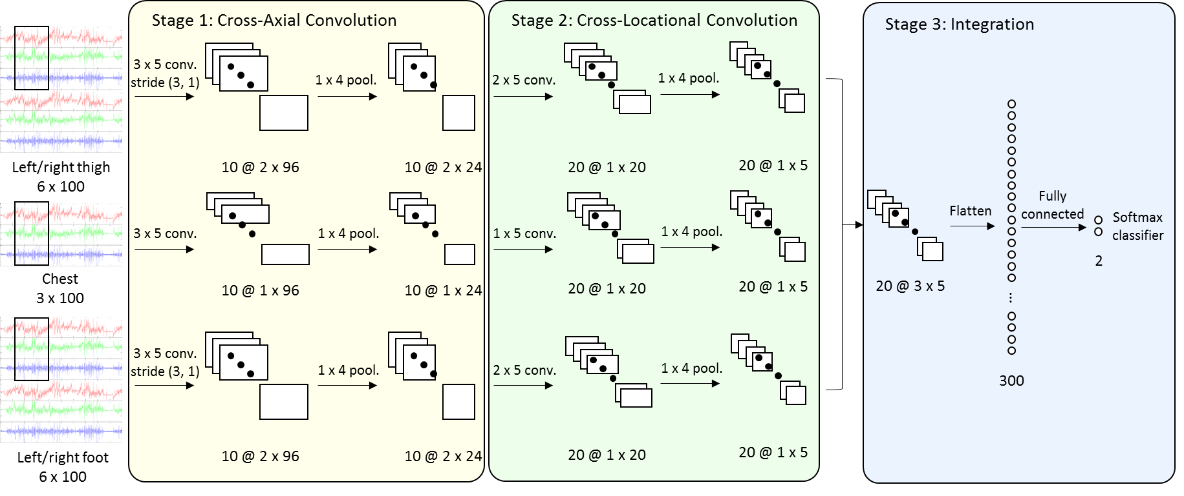

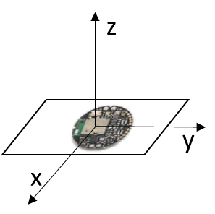
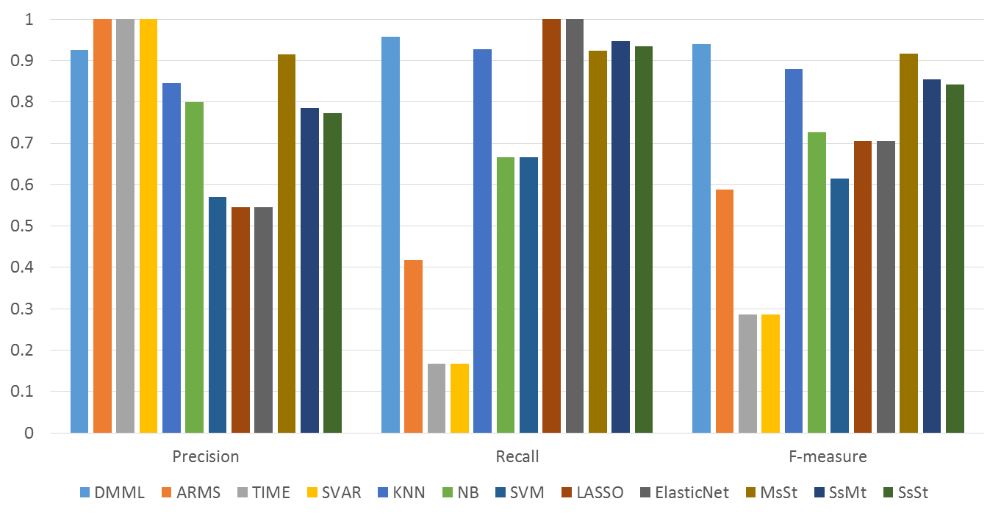

Research Design
Data Collection
Data Preprocessing
Model Design
Sensor Attachment
Signal Segmentation
2D-hetero CNN
Walking Test
Data Augmentation
Evaluation
Fig. 2. Research Design

Slide 38
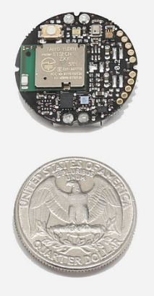
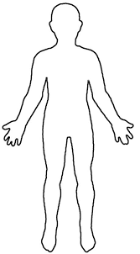
Research Design – Data Collection
In this study, we use the SilverLink sensors for clinical fall risk assessment.
SilverLink is a NSF-funded project run by the Artificial Intelligence Lab.
Twenty-two (22) subjects were recruited at a neurology clinic.
12 with high fall risks, 10 with low fall risks
All are Parkinson’s disease patients
Criterion: Retrospective fall history in the past one year (Silva & Sousa, 2016; Ejupi et al., 2016). Marked as “high fall risks” if any falls occurred, otherwise “low fall risks.”
5 tri-axial accelerometers attached to each subject
Sampling rate: 25 Hz
25 sampling points per second; sufficient for capturing gait cycles (~1 Hz for normal pace)
Chest, left/right thigh, left/right foot (as shown in Fig. 4)
To capture body and lower extremity movement (left/right)
Common setting for gait analysis (Wu et al., 2013)
Arbitrary sensor orientation
Aimed at building a model robust to sensor rotations
10-meter ground walking tests were conducted to collect data for gait and balance.
Subjects are instructed to walk in their comfortable paces for 10 meters in the clinic hallway. Autonomous walking aids are allowed. (Wang et al., 2017, Wu et al., 2013)
Fig. 3. Shape and Size of SilverLink Sensors
Fig. 4. Sensor Locations

Slide 39
Research Design – Data Preprocessing
Fixed-length inputs are preferred by CNNs to simplify model designs.
Past studies used a length of 32 or 64 as a fixed window for inputs (Zeng et al., 2014; Yang et al., 2015).
We subsampled the middle 4 seconds for walking trials, equivalent to a length of 100.
More stable patterns without accelerating and decelerating
A wider window is necessary for assessing fall risks to identify patterns spanning over a few gait cycles.
One major difference between our work and prior studies is that we allowed the arbitrariness of sensor orientations.
We aimed at building a model robust to sensor rotations.
Past studies (Kale et al., 2012) discussed simulated sensor rotations to compensate orientation arbitrariness.
We simulated sensor rotations along the x-, y-, and z-axes to create a simulated dataset for our evaluation.
The simulation works as if we rotate the sensors in some degree and ask the subject to perform the test again.
We rotated data along the three axes independently (0, 90, 180, and 270 degrees) on the 22 samples, yielding a total of 1,408 (= 22 x 4³) samples.

Slide 40
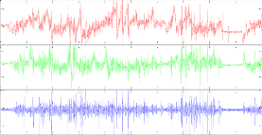

Research Design – 2D-hetero CNN
Stage 1: Cross-Axial Convolution
Stage 2: Cross-Locational Convolution
Stage 3: Integration
3 x 5 conv.
stride (3, 1)
1 x 4 pool.
1 x 4 pool.
2 x 5 conv.
Left/right thigh
6 x 100
10 @ 2 x 96
10 @ 2 x 24
20 @ 1 x 20
20 @ 1 x 5
Fully connected
Flatten
Softmax classifier
3 x 5 conv.
1 x 4 pool.
1 x 5 conv.
1 x 4 pool.
2
Chest
3 x 100
10 @ 1 x 96
10 @ 1 x 24
20 @ 1 x 20
20 @ 1 x 5
20 @ 3 x 5
$$⋮$$
3 x 5 conv.
stride (3, 1)
1 x 4 pool.
2 x 5 conv.
1 x 4 pool.
300
Left/right foot
6 x 100
10 @ 2 x 96
10 @ 2 x 24
20 @ 1 x 20
20 @ 1 x 5
Note: The notation “x @ y x z” denotes x feature maps with height y and width z.
Fig. 8. 2D-hetero CNN Architecture

Slide 41
Research Design – 2D-hetero CNN
We partitioned the data into three parts based on sensor locations.
Chest, left/right thigh, left/right foot
Aim to capture balance features between left/right thighs and feet
Stage 1: Cross-Axial Convolution
Convolve among the three axes of a single sensor
Extract features among axes within a sensor
Stage 2: Cross-Locational Convolution
Convolve between sensors on left/right thighs and left/right feet
Extract balance features between the left and the right
Stage 3: Integration
Integrate extracted features to provide final inference on fall risk assessment
Main novelty compared to traditional 2D CNNs:
Convolutions along the non-temporal dimension with explicit semantics to handle dimension heterogeneity
Cross-axial and cross-locational convolutions

Slide 42
Research Design – 2D-hetero CNN
Technical details:
A rectified linear unit (ReLU) layer is added after each convolutional layer for model non-linearity.
Most widely used non-linear function for CNNs
The maximum is used as the pooling layer.
Common settings for CNNs
A dropping layer is added after each pooling layer and the densely connected layer to avoid over-fitting.
Dataset split:
Training (60%), validation (20%), test (20%)
The validation set is used for model selection.
The test set is used for reporting performance.
As the model training process can get into local maxima, we train the model for five times and report the average performance.

Slide 43
Evaluation
We compare the performance of our 2D-hetero CNN model (2D-hetero CNN) with state-of-the-art benchmarks for fall risk assessment.
Benchmark Set 1: Feature-based fall risk assessment
Most widely used approach for fall risk assessment
We created three benchmark systems based on three most widely investigated features, respectively (Howcroft et al., 2013; Hubble et al., 2015):
Stride variability (SVAR), acceleration root mean square (ARMS), walking speed (SPD)
In each benchmark system, the feature acts as the only indicator for assessing fall risks.
E.g., SVAR > 0.1: high fall risks; SVAR <= 0.1: low fall risks
Benchmark Set 2: CNN models with alternative architectures
2D homogeneous CNN (2D-homo CNN) as applied in medical imaging and other image recognition tasks (Wimmer et al., 2017; Pereira et al., 2016)
1D CNN (1D-CNN) as applied in activity recognition and ECG classification tasks (Kiranyaz et al., 2016; Yang et al., 2015)
Benchmark Set 3: Sensitivity analysis
2D heterogeneous CNN with cross-axial convolutions only (2D-axis CNN)
2D heterogeneous CNN with cross-locational convolutions only (2D-loc CNN).

Slide 44
Evaluation – Benchmark Set 1
The proposed CNN model (2D-hetero CNN) achieved F-measure of 0.962, outperforming all systems in Benchmark Set 1 (0.400 to 0.800).
Some feature-based methods (ARMS, SPD) achieved perfect precision, but low recall (0.250 to 0.667).
Fail to identify many patients with high fall risks
This result shows the advantage in applying CNNs in sensor-based fall risk assessment.
More comprehensive features are extracted in 2D-hetero CNN.
Feature-based systems are oversimplified in coping with the problem.
 | Precision | Recall | F-measure
2D-hetero CNN | 0.940 | 0.984 | 0.962
SVAR | 0.800 | 0.667 | 0.727
ARMS | 1.000 | 0.250 | 0.400
SPD | 1.000 | 0.667 | 0.800
Table 3. Results with Benchmark Set 1

Slide 45
Evaluation – Benchmark Set 2
The proposed CNN model (2D-hetero CNN) achieved F-measure of 0.962, outperforming all systems in Benchmark Set 2 (0.691 to 0.770).
CNN systems with alternative architectures provided relatively high recall, but much lower precision (0.571 to 0.717).
Some predicted high fall risk patients are actually not.
This result shows the advantage of extracting features across sensor axes and locations in a sensible manner.
1D CNN does not extract such features.
2D-homo CNN extracts features across axes, but introduces less interesting features.
E.g., one axis from the chest sensor and two axes from the right thigh sensor.
 | Precision | Recall | F-measure
2D-hetero CNN | 0.940 | 0.984 | 0.962
2D-homo CNN | 0.571 | 0.875 | 0.691
1D CNN | 0.717 | 0.862 | 0.770
Table 4. Results with Benchmark Set 2

Slide 46
Evaluation – Benchmark Set 3
The proposed CNN model (2D-hetero CNN) achieved F-measure of 0.962, outperforming all systems in Benchmark Set 3 (0.808 to 0.819).
Cross-axial convolution or cross-locational convolution alone can achieve high recall (0.919 to 0.953), but low precision (0.718 to 0.721).
Some predicted high fall risk patients are actually not.
This result shows the value of involving cross-axial and cross-locational convolutions simultaneously.
Cross-axial convolution extracts features among axes within a sensor.
Cross-locational convolution extracts features between the left and right sides of human body.
Both of them improve model performance.
 | Precision | Recall | F-measure
2D-hetero CNN | 0.940 | 0.984 | 0.962
2D-axis CNN | 0.721 | 0.919 | 0.808
2D-loc CNN | 0.718 | 0.953 | 0.819
Table 5. Results with Benchmark Set 3

Slide 47
Conclusions and Future Works
In this work, we developed a CNN model to provide fall risk assessment based on motion sensor data.
A novel CNN architecture with cross-axial and cross-locational convolutions was proposed to optimize in our application context of fall risk assessment.
Considered as a general approach for gait/balance assessment
10-meter ground walking test data from patients with Parkinson's disease were collected at a clinic to evaluate our model.
Our model achieved F-measure of 0.962, significantly outperforming the benchmarks.

Slide 48
Conclusions and Future Works
In this work, we collected data from Parkinson’s disease patients.
Fall risk assessment for Parkinson’s disease patients
May not be generalizable for senior citizens with other conditions (e.g., dementia, stroke, etc.)
We collected data from 10-meter walking tests, which only contained walking features.
More complicated clinical tests could be conducted to obtain patterns of standing up, sitting down, turning around, etc.
E.g., timed up and go (TUG) test
Similar approaches could be applied to assess disease severity.
E.g., identifying different stages of Parkinson’s disease by performing TUG tests

