Slide 1
An Introduction to Convolutional Neural Networks: Overview, Implementation, and Example
Shuo Yu and Hsinchun Chen, AI Lab
University of Arizona
April 2019

Slide 2
Acknowledgments
Many of the images, results, and other materials are from:
Deep Learning (2016), Ian Goodfellow, Yoshua Bengio, and Aaron Courville
Lee Giles and Alex Ororbia, Penn State University
Yann LeCun, New York University

Slide 3
Outline
Introduction
Neuroscientific Basis
Building Blocks
Convolutional Layer
Non-linear Layer
Pooling Layer
Implementation
Build a CNN with Keras in Python
Research Example: 2D-hetero CNN for Mobile Health Analytics
Introduction
Research Design
Evaluation and Results

Slide 4
Introduction
Convolutional Neural Networks

Slide 5
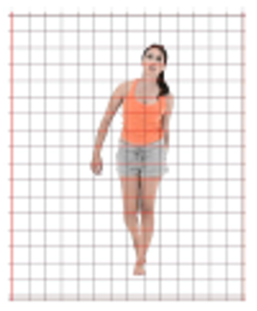
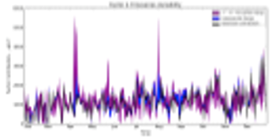
Convolutional Neural Network (CNN)
Convolutional Neural Networks, or Convolutional Networks, or CNNs
For processing data with a grid-like topology
1-D grid: time-series data, sensor signal data
2-D grid: image data
CNNs are neural networks with convolution operations.
The most well used deep learning networks
Image recognition, AlphaGo

Slide 6
Convolutional Neural Network (CNN)
Convolutional Neural Networks are inspired by mammalian visual cortex.
The visual cortex contains a complex arrangement of cells, which are sensitive to small sub-regions of the visual field, called a receptive field.
These cells act as local filters over the input space and are well-suited to exploit the strong spatially local correlation present in natural images.
Two basic cell types:
Simple cells respond maximally to specific edge-like patterns within their receptive field.
Complex cells have larger receptive fields and are locally invariant to the exact position of the pattern.

Slide 7
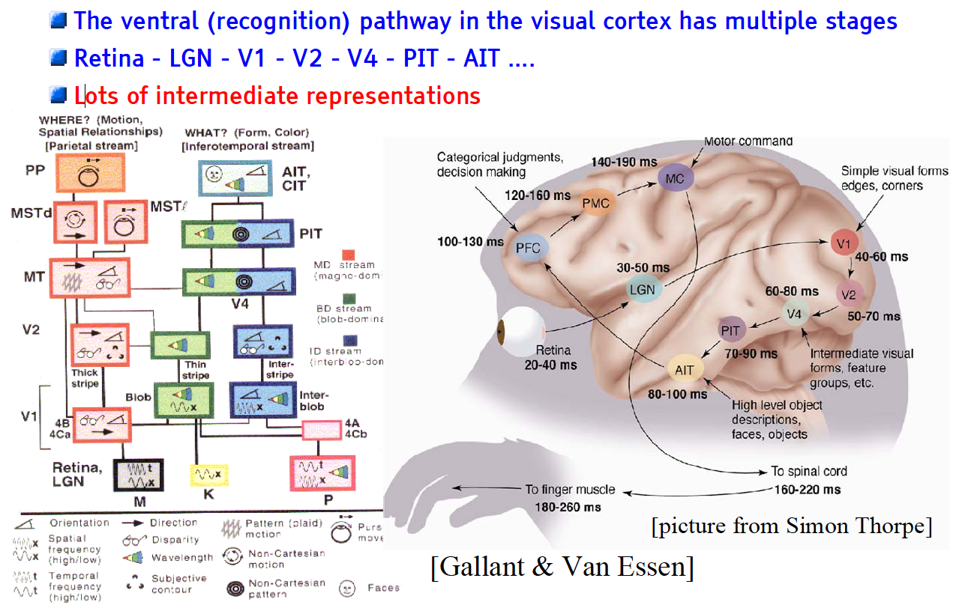
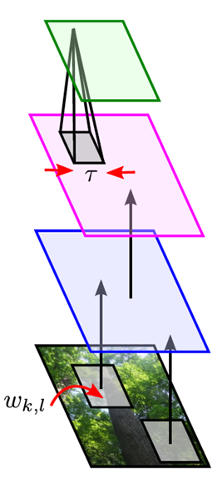
The Mammalian Visual Cortex Inspires CNN
Convolutional Neural Net
output
input

Slide 8
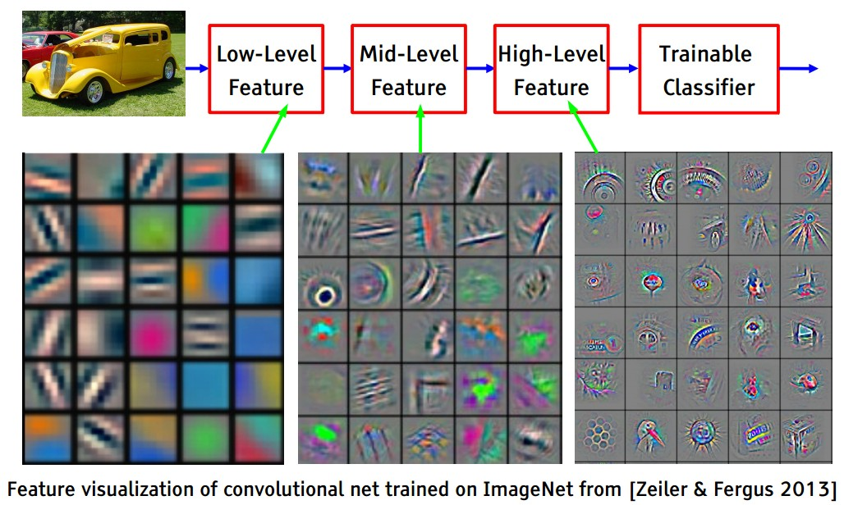
A Deep Classification Network

Slide 9
CNN Architecture
Intuition: Neural network with specialized connectivity structure,
Stacking multiple layers of feature extractors
Low-level layers extract local features.
High-level layers extract learn global patterns.
A CNN is a list of layers that transform the input data into an output class/prediction.
There are a few distinct types of layers:
Convolutional layer
Non-linear layer
Pooling layer

Slide 10
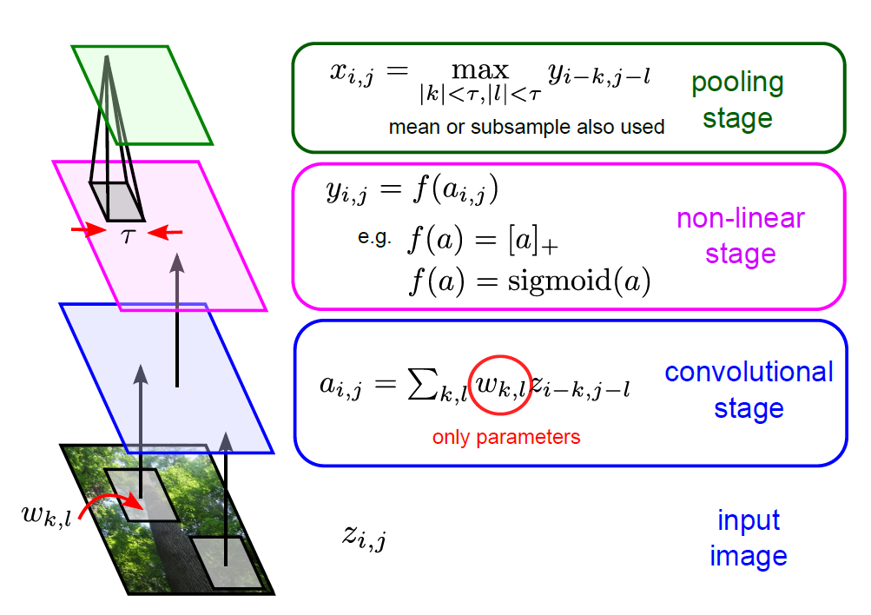
Building-blocks for CNNs
Feature maps of a larger region are combined.
Feature maps are trained with neurons.
Shared weights
Each sub-region yields a feature map, representing its feature.
Images are segmented into sub-regions.

Slide 11
CNN Architecture: Convolutional Layer
The core layer of CNNs
The convolutional layer consists of a set of filters.
Each filter covers a spatially small portion of the input data.
Each filter is convolved across the dimensions of the input data, producing a multidimensional feature map.
As we convolve the filter, we are computing the dot product between the parameters of the filter and the input.
Intuition: the network will learn filters that activate when they see some specific type of feature at some spatial position in the input.
The key architectural characteristics of the convolutional layer is local connectivity and shared weights.

Slide 12
CNN Convolutional Layer: Local Connectivity
Neurons in layer m are only connected to 3 adjacent neurons in the m-1 layer.
Neurons in layer m+1 have a similar connectivity with the layer below.
Each neuron is unresponsive to variations outside of its receptive field with respect to the input.
Receptive field: small neuron collections which process portions of the input data
The architecture thus ensures that the learnt feature extractors produce the strongest response to a spatially local input pattern.

Slide 13
CNN Convolutional Layer: Shared Weights
We show 3 hidden neurons belonging to the same feature map (the layer right above the input layer).
Weights of the same color are shared—constrained to be identical.
Replicating neurons in this way allows for features to be detected regardless of their position in the input.
Additionally, weight sharing increases learning efficiency by greatly reducing the number of free parameters being learnt.

Slide 14
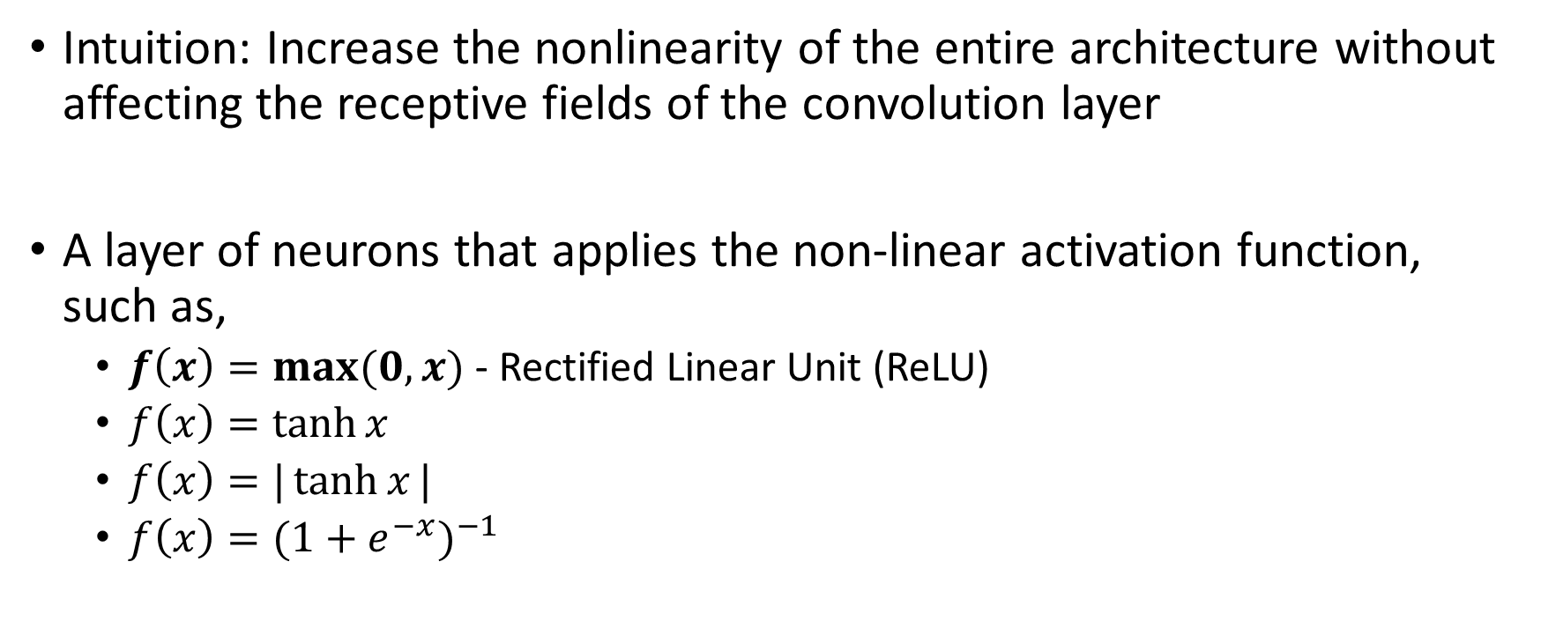
CNN Architecture: Non-linear Layer
Intuition: Increase the nonlinearity of the entire architecture without affecting the receptive fields of the convolution layer
A layer of neurons that applies the non-linear activation function, such as,
$f\left(x\right)=\max{(0,x)}$ - Rectified Linear Unit (ReLU)
$f\left(x\right)=\tanh{x}$
$f\left(x\right)=|\tanh{x}|$
$f\left(x\right)={(1+e^{−x})}^{−1}$

Slide 15
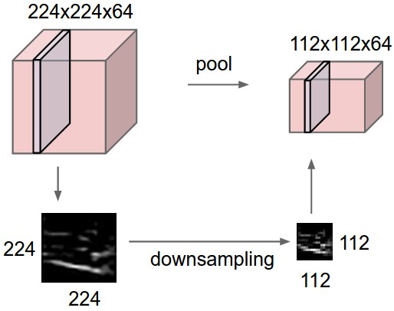
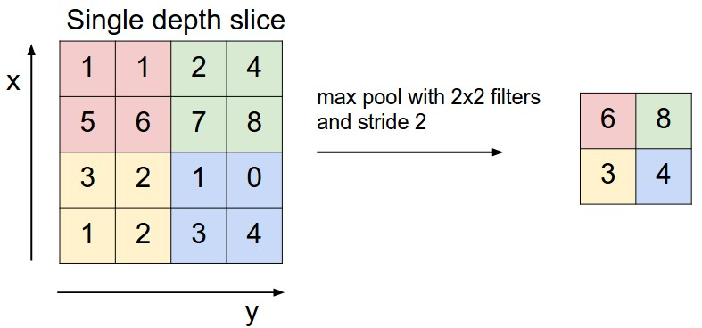
CNN Architecture: Pooling Layer
Intuition: to progressively reduce the spatial size of the representation to reduce the amount of parameters and computation in the network, and hence to also control overfitting
Pooling partitions the input image into a set of non-overlapping rectangles and, for each such sub-region, outputs the maximum value of the features in that region.
Input

Slide 16
Building-blocks for CNNs
Feature maps of a larger region are combined.
Feature maps are trained with neurons.
Shared weights
Each sub-region yields a feature map, representing its feature.
Images are segmented into sub-regions.

Slide 17
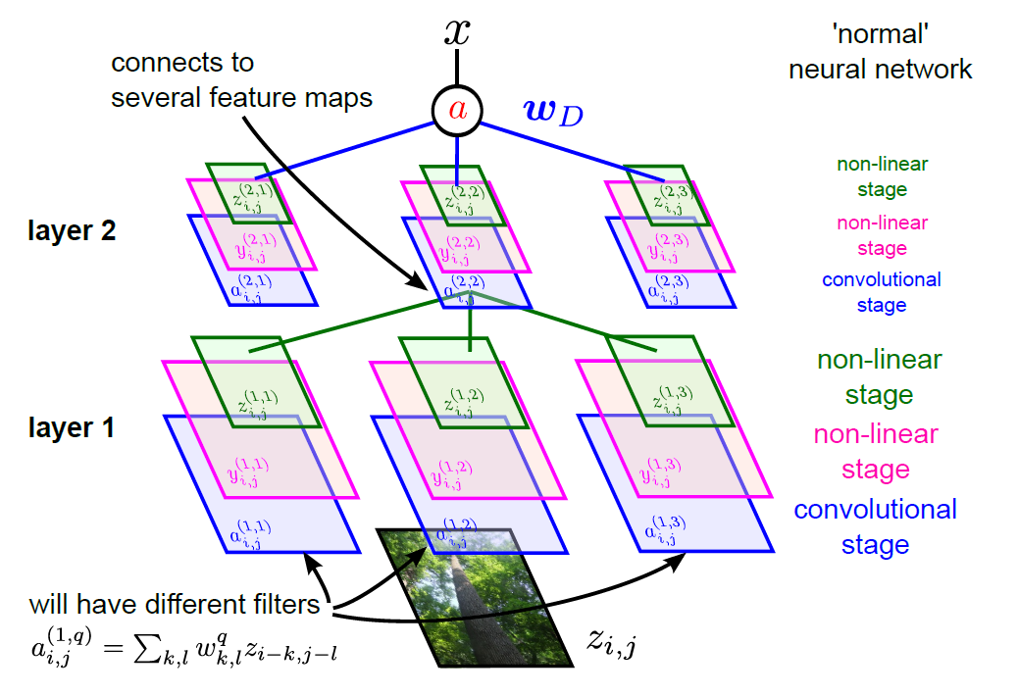
Full CNN
pooling
pooling

Slide 18
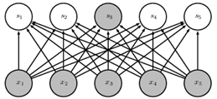
Other Layers
The convolution, non-linear, and pooling layers are typically used as a set. Multiple sets of the above three layers can appear in a CNN design.
Input -> Conv. -> Non-linear -> Pooling -> Conv. -> Non-linear -> Pooling -> …
After a few sets, the output is typically sent to one or two fully connected layers.
A fully connected layer is a ordinary neural network layer as in other neural networks.
Typical activation function is the sigmoid function.

Slide 19
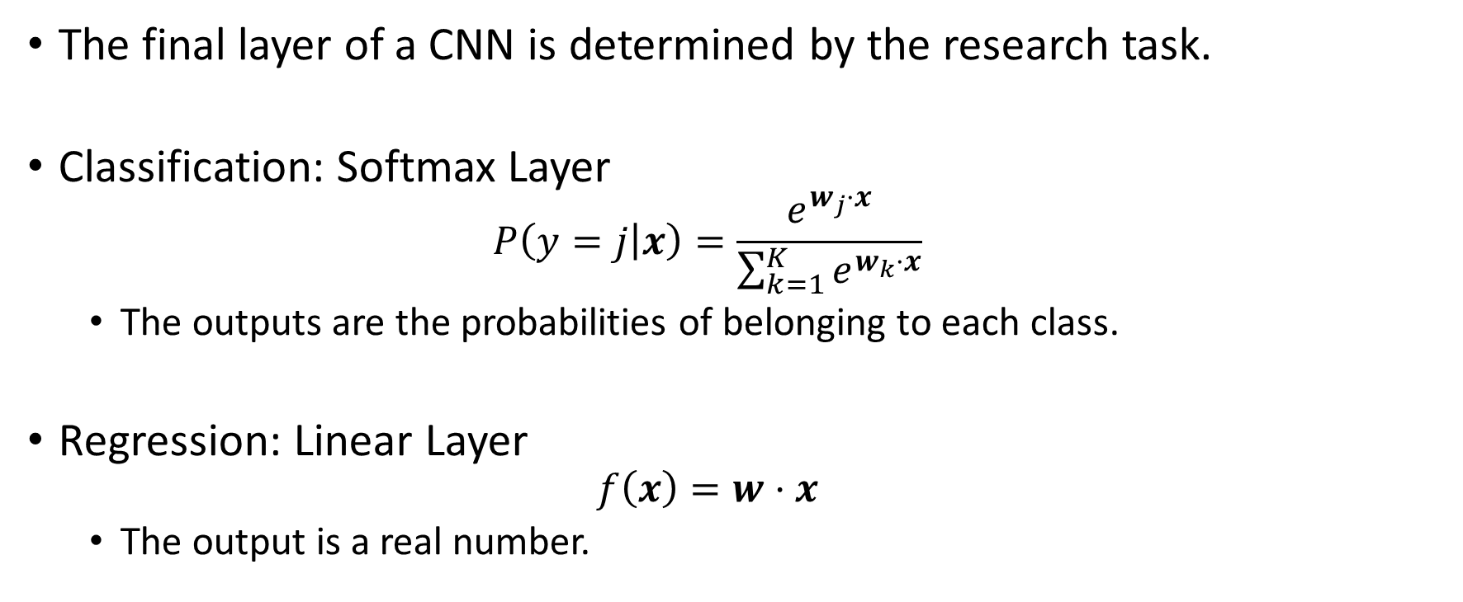
Other Layers
The final layer of a CNN is determined by the research task.
Classification: Softmax Layer
$$P\left(y=j | x\right)=\frac{e^{w_{j}⋅x}}{\sum_{k=1}^{K}{e^{w_{k}⋅x}}}$$
The outputs are the probabilities of belonging to each class.
Regression: Linear Layer
$$f\left(x\right)=w⋅x$$
The output is a real number.

Slide 20
Implementation
Python, TensorFlow, Keras

Slide 21


Python CNN Implementation
Prerequisites:
Python 3.5+ (https://www.python.org/)
TensorFlow (https://www.tensorflow.org/)
Keras (https://keras.io/)
Keras is a high-level neural networks API, written in Python and capable of running on top of TensorFlow, CNTK, or Theano.
Recommended:
NumPy
Scikit-Learn
NLTK
SciPy

Slide 22
Build a CNN in Keras
The Sequential model is used to build a linear stack of layers.
Building a CNN with the Sequential model is straightforward.
The following code shows how a typical CNN is built in Keras.
Note:
Dense is the fully connected layer;
Flatten is used after all CNN layers and before a fully connected layer;
Conv2D is the 2D convolution layer;
MaxPooling2D is the 2D max pooling layer;
SGD is stochastic gradient descent algorithm.
import numpy as np
import keras
from keras.models import Sequential
from keras.layers import Dense, Flatten
from keras.layers import Conv2D, MaxPooling2D
from keras.optimizers import SGD

Slide 23
Build a CNN in Keras
(continued)
model = Sequential()
# We create an empty Sequential model and add layers onto it.
model.add(Conv2D(32, (3, 3), activation='relu', input_shape=(100, 100)))
# We add a Conv2D layer with 32 filters, 3x3 each, followed by a detector layer ReLU.
# This is the first layer we add to the model, so we need to specify the shape of the input. In this case we assume our input is a 100x100 matrix.
model.add(MaxPooling2D(pool_size=(2, 2)))
# We add a MaxPooling2D layer with a 2x2 pooling size.

Slide 24
Build a CNN in Keras
(continued)
model.add(Conv2D(32, (3, 3), activation='relu'))
model.add(MaxPooling2D(pool_size=(2, 2)))
# We can add more Conv2D and MaxPooling2D layers onto the model.
model.add(Flatten())
# After all the desired CNN layers are added, add a Flatten layer.
model.add(Dense(256, activation='sigmoid'))
# Add a fully connected layer followed by a detector layer with the sigmoid function.
model.add(Dense(10, activation='softmax')
# A softmax layer is added to achieve multiclass classification. In this example we have 10 classes.

Slide 25
Build a CNN in Keras
(continued)
sgd = SGD(lr=0.01, decay=1e-6, momentum=0.9, nesterov=True)
# Default SGD training parameters
model.compile(loss='categorical_crossentropy', optimizer=sgd)
# Compile the model and use categorical crossentropy as the loss function, sgd as the optimizer
model.fit(x_train, y_train, batch_size=32, epochs=10)
# Fit the model with x_train and y_train, batch_size and epochs can be set to other values
score = model.evaluate(x_test, y_test, batch_size=32)
# Evaluate model performance using x_test and y_test

Slide 26
Research Example
Two-Dimensional Heterogeneous Convolutional Neural Network (2D-hetero CNN) for Mobile Health Analytics

Slide 27
Introduction
We developed two-dimensional heterogeneous convolutional neural networks (2D-hetero CNN), a motion sensor-based system for fall risk assessment using convolutional neural networks (CNN).
Five sensor system (chest, left/right thigh, left/right foot) for clinical tests
Comprehensive assessment for gait and balance features
CNNs are powerful in extracting low-level local features as well as integrating them into high-level global features.
Feature-less; avoid feature engineering that is labor intensive, ad hoc, and inconclusive.
Main novelty of this work:
We proposed a novel CNN architecture to extract gait and balance features for fall risk assessment.
Two-dimensional convolution: temporal convolution + cross-axial and cross-locational convolution
To the best of our knowledge, we are the first to apply CNNs for motion sensor-based fall risk assessment.

Slide 28
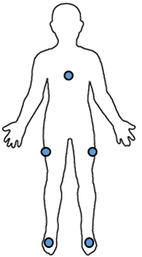

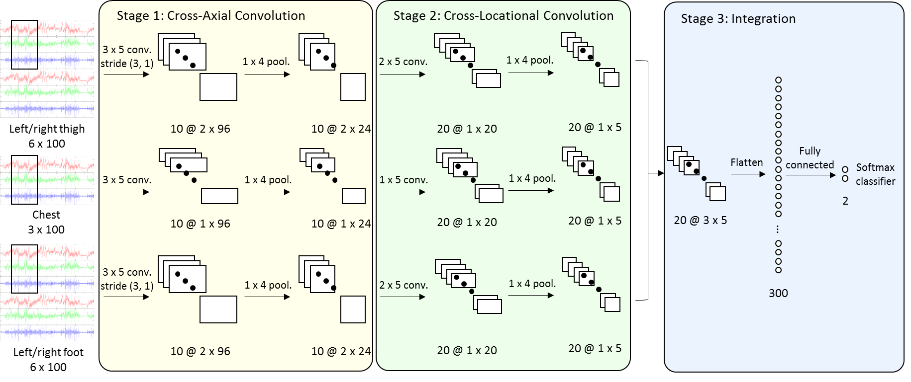

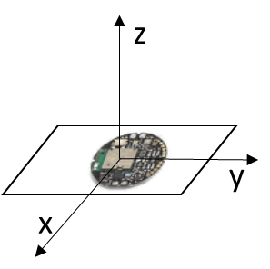
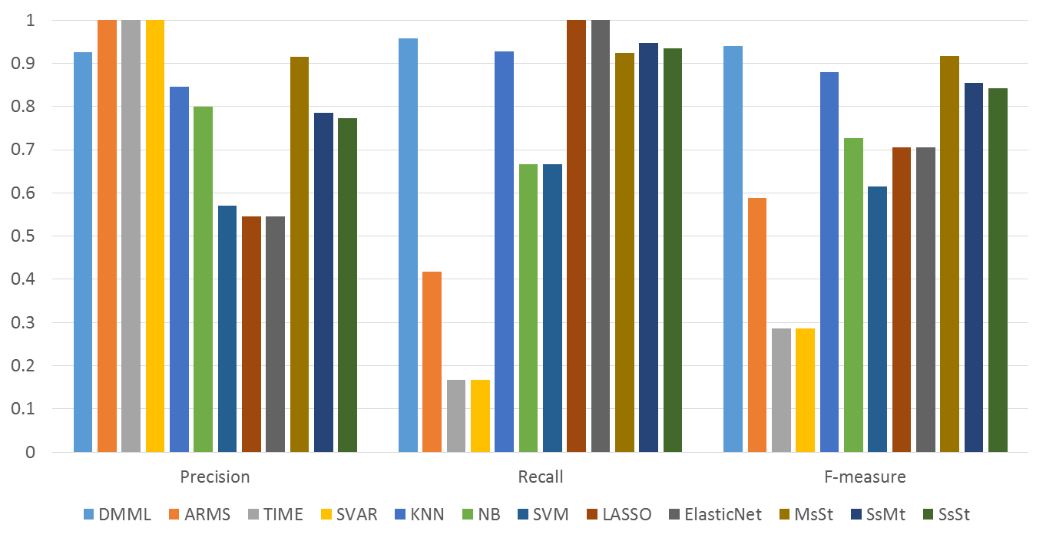

Research Design
Data Collection
Data Preprocessing
Model Design
Sensor Attachment
Signal Segmentation
2D-hetero CNN
Walking Test
Data Augmentation
Evaluation
Fig. 2. Research Design

Slide 29
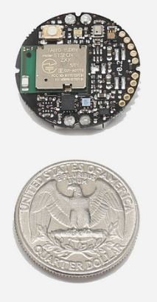
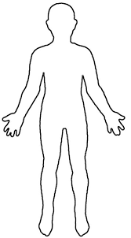
Research Design – Data Collection
Twenty-two (22) subjects were recruited at a neurology clinic.
12 with high fall risks, 10 with low fall risks
5 tri-axial accelerometers attached to each subject
Sampling rate: 25 Hz
25 sampling points per second; sufficient for capturing gait cycles
Chest, left/right thigh, left/right foot (as shown in Fig. 4)
To capture body and lower extremity movement (left/right)
10-meter ground walking tests were conducted to collect data for gait and balance.
Subjects are instructed to walk in their comfortable paces for 10 meters in the clinic hallway.
Fig. 3. Shape and Size of SilverLink Sensors
Fig. 4. Sensor Locations

Slide 30
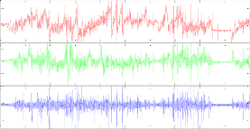

Research Design – 2D-hetero CNN
Stage 1: Cross-Axial Convolution
Stage 2: Cross-Locational Convolution
Stage 3: Integration
3 x 5 conv.
stride (3, 1)
1 x 4 pool.
1 x 4 pool.
2 x 5 conv.
Left/right thigh
6 x 100
10 @ 2 x 96
10 @ 2 x 24
20 @ 1 x 20
20 @ 1 x 5
Fully connected
Flatten
Softmax classifier
3 x 5 conv.
1 x 4 pool.
1 x 5 conv.
1 x 4 pool.
2
Chest
3 x 100
10 @ 1 x 96
10 @ 1 x 24
20 @ 1 x 20
20 @ 1 x 5
20 @ 3 x 5
$$⋮$$
3 x 5 conv.
stride (3, 1)
1 x 4 pool.
2 x 5 conv.
1 x 4 pool.
300
Left/right foot
6 x 100
10 @ 2 x 96
10 @ 2 x 24
20 @ 1 x 20
20 @ 1 x 5
Note: The notation “x @ y x z” denotes x feature maps with height y and width z.
Fig. 8. 2D-hetero CNN Architecture

Slide 31
Research Design – 2D-hetero CNN
We partitioned the data into three parts based on sensor locations.
Chest, left/right thigh, left/right foot
Aim to capture balance features between left/right thighs and feet
Stage 1: Cross-Axial Convolution
Convolve among the three axes of a single sensor
Extract features among axes within a sensor
Stage 2: Cross-Locational Convolution
Convolve between sensors on left/right thighs and left/right feet
Extract balance features between the left and the right
Stage 3: Integration
Integrate extracted features to provide final inference on fall risk assessment
Main novelty compared to traditional 2D CNNs:
Convolutions along the non-temporal dimension with explicit semantics to handle dimension heterogeneity
Cross-axial and cross-locational convolutions

Slide 32
Research Design – 2D-hetero CNN
Technical details:
A rectified linear unit (ReLU) layer is added after each convolutional layer for model non-linearity.
Most widely used non-linear function for CNNs
The maximum is used as the pooling layer.
Common settings for CNNs
A dropping layer is added after each pooling layer and the densely connected layer to avoid over-fitting.
Dataset split:
Training (60%), validation (20%), test (20%)
The validation set is used for model selection.
The test set is used for reporting performance.
As the model training process can get into local maxima, we train the model for five times and report the average performance.

Slide 33
Evaluation
Benchmark 1: Feature-based fall risk assessment
Most widely used approach for fall risk assessment
Stride variability (SVAR), acceleration root mean square (ARMS), walking speed (SPD)
Benchmark 2: CNN models with alternative architectures
2D homogeneous CNN (2D-homo CNN) as applied in image recognition tasks
1D CNN (1D-CNN) as applied in activity recognition and ECG classification tasks
Benchmark 3: Ablation analysis
2D heterogeneous CNN with cross-axial convolutions only (2D-axis CNN)
2D heterogeneous CNN with cross-locational convolutions only (2D-loc CNN)

Slide 34
Results
Our proposed 2D-hetero CNN significantly outperformed all three sets of benchmark systems.
Showing the advantage of 2D-hetero CNN over traditional feature-based and 1D/2D CNN methods.

Slide 35
Conclusions
In this work, we developed 2D-hetero CNN to provide fall risk assessment based on motion sensor data.
A novel CNN architecture with cross-axial and cross-locational convolutions was proposed to optimize in our application context of fall risk assessment.
Considered as a general approach for gait/balance assessment
10-meter ground walking test data from patients with Parkinson's disease were collected at a clinic to evaluate our model.
Our model achieved F-measure of 0.962, significantly outperforming the benchmarks.

