Slide 1
Introduction to Blockchain
And a demo on Financial transactions
Eric Tham, NUS-ISS 13 July 2018

Slide 2
Content
Introduction to Blockchain
What is Blockchain?
Applications for Blockchain
Practical demo of financial applications of Blockchain (Malvin Lo)
Conclusion

Slide 3
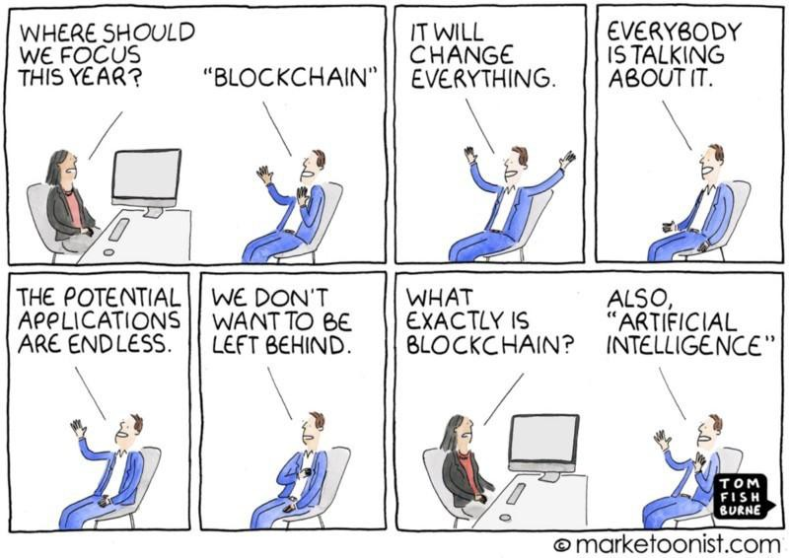

Slide 4
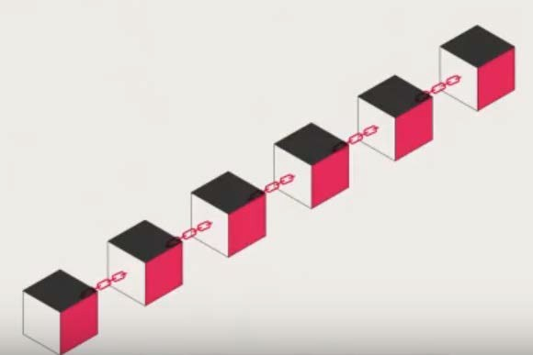
What is Blockchain?
A continuous and growing chain of records in a ledger

Slide 5
What is Blockchain?
3 key principles of Blockchain
Immutable
Distributed
Decentralized

Slide 6
Immutability
Chained blocks cannot be altered
Immutability gives rise to
TRUST

Slide 7
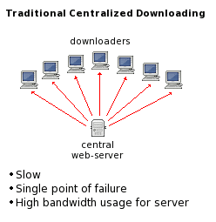
Traditional Centralised Server
Single point of service and control
Highly fail-dependent
Large bandwidth

Slide 8
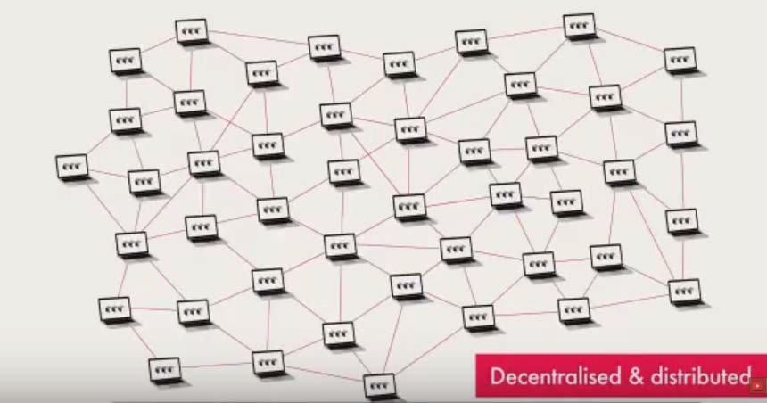
Decentralised
No single point of storage
No single point of control
Distributed
No single point of failure

Slide 9
Why Blockchain?
Peer to peer transaction:
Nodes of the network works to validate
Changes are broadcasted
No central authority
Solves double spending problem
Through consensus protocol

Slide 10
Consensus Rules
Proof of Work (PoW)
Used in Bitcoin Mining
approval of the work (a new block added) that happened and demonstrating it is right
Proof of Stake (PoS)
Ethereum Casper
Forger of new block chosen based on stake in blockchain or some randomized variable

Slide 11
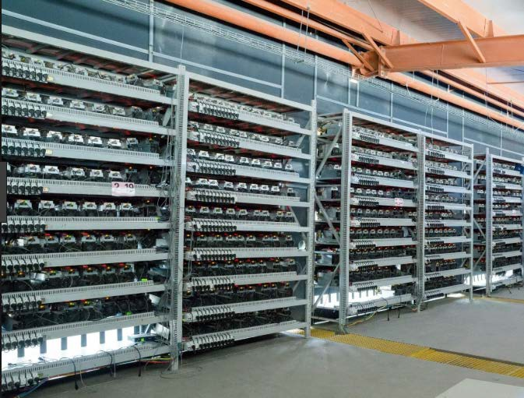
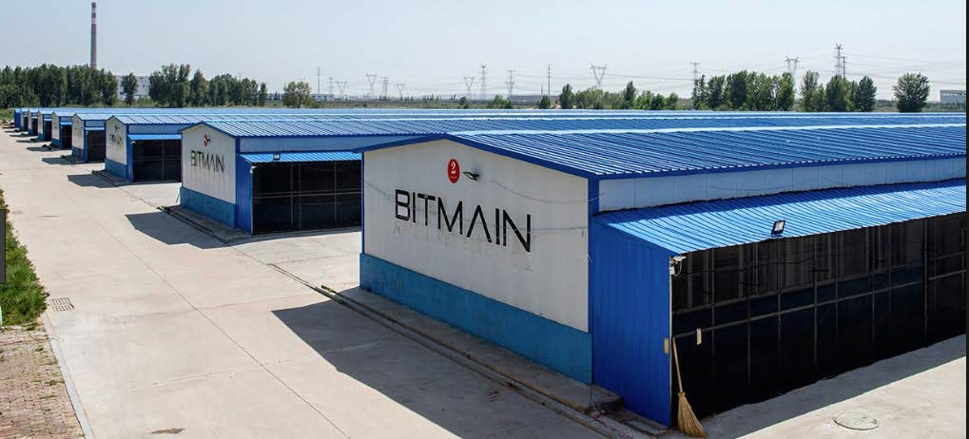
Blockchain Mining
Largest mining farms, Inner Mongolia China

Slide 12
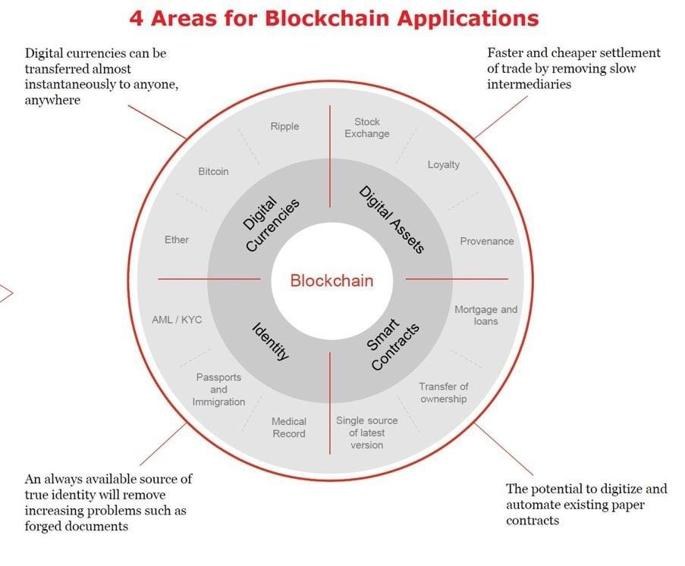
4 general applications of Blockchain
#ISSLearningDay2018

Slide 13
What is a Cryptocurrency?
A digital currency
Peer-to-peer electronic cash
Many types of cryptocurrency
Bitcoin
Ether
Litecoin … …

Slide 14
Bitcoin History
2008 - Satoshi Nakamoto
2009 – Genesis Block created
"The Times 03/Jan/2009 Chancellor on brink of second bailout for banks.” – headline from the British tabloid The Times
First transaction from Satoshi to Hal Finney,

Slide 15
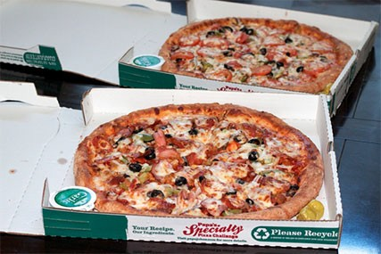
Key Bitcoin Events
Oct 5 2009 - USD 1 = 1309 Bitcoins
May 22 2010 - Pizza
March 9 2011 - Parity with USD
July 12, 2011: Great Bubble of 2011

Slide 16
Key Bitcoin Events
Oct 2013 - Silk Road is clamped down
Feb 2014 - Bankruptcy of Mt Gox
Aug 2017 - Bitcoin into Bitcoin Cash

Slide 17
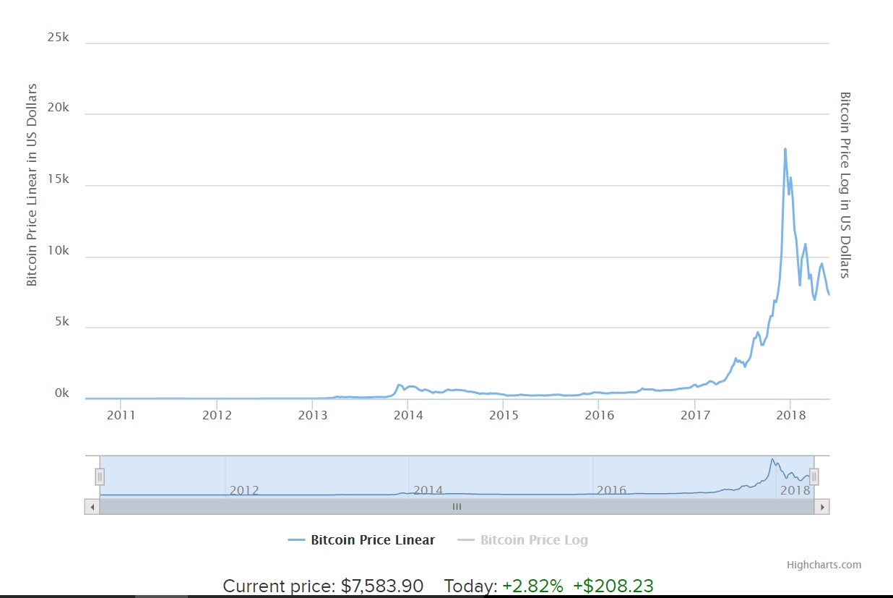
Price History of Bitcoin
(till 31st May 2018)

Slide 18
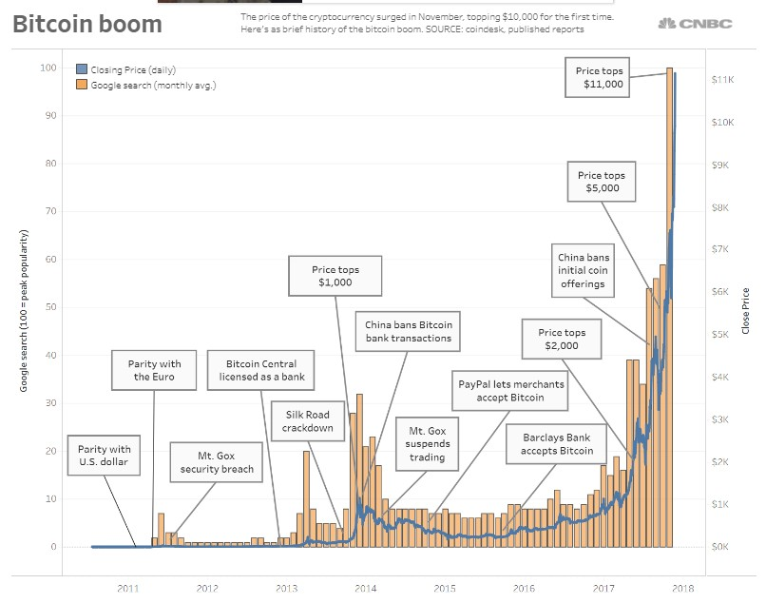
Recent Events of Bitcoin
#ISSLearningDay2018

Slide 19
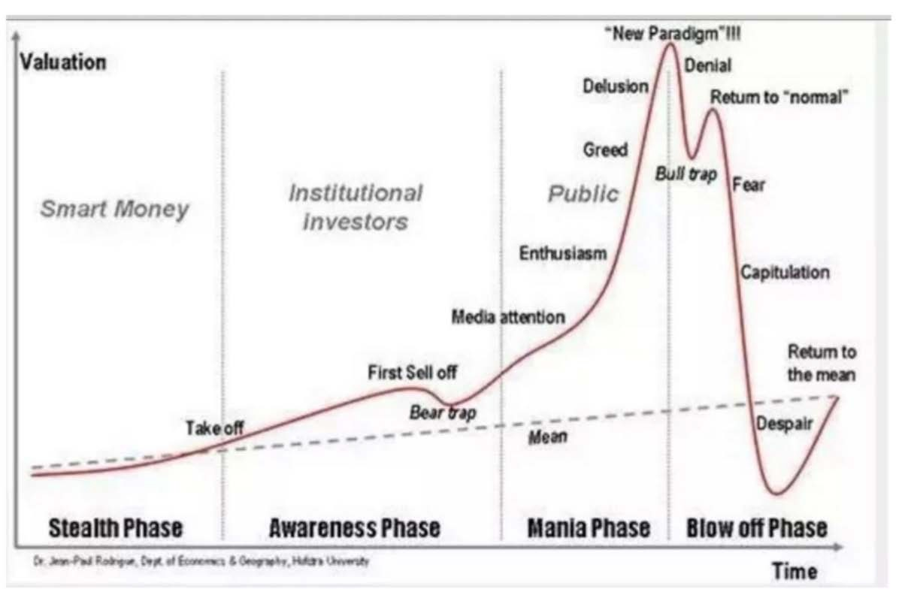
Hype or Value?

Slide 20
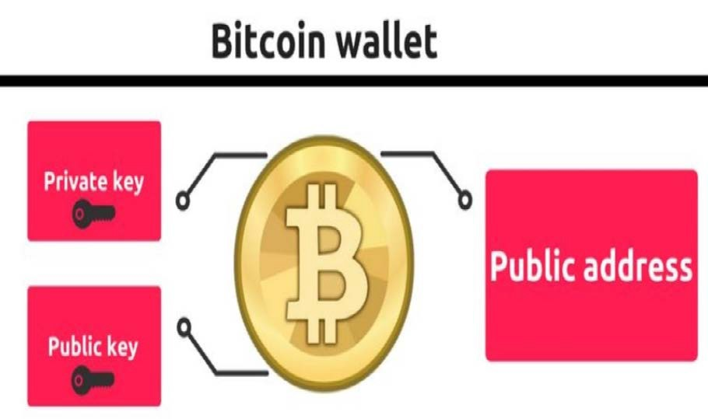
Bitcoin Today
Survived all the scare
Dozens of Bitcoin exchanges
Blockchain wallets

Slide 21
Initial Coin Offerings (ICOs)
Crowdfunding using cryptocurrency tokens
Utility and Security Tokens
Half of the ICOs already failed by 2018 Feb – scams?
Worldwide regulations worldwide

Slide 22
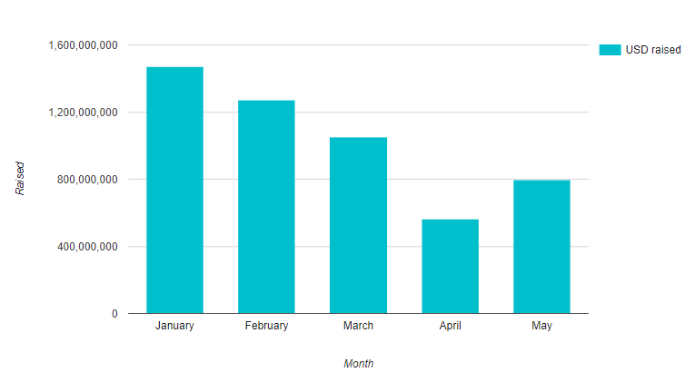
Initial Coin Offerings (ICOs)

Slide 23
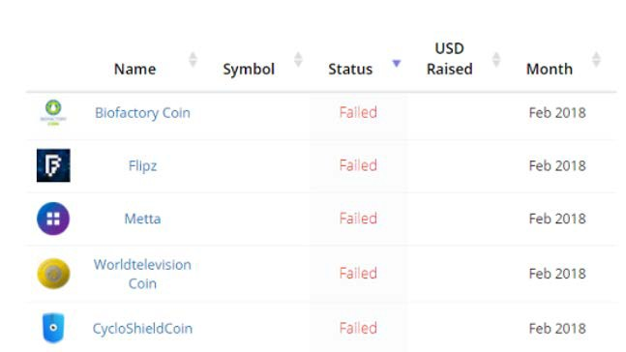
Failed Coin Offerings (ICOs)

Slide 24
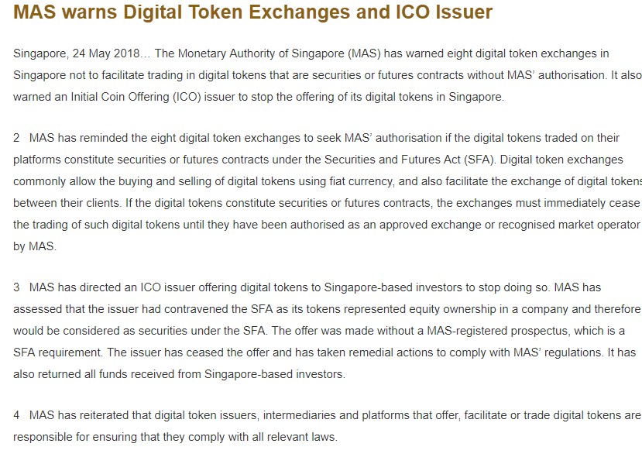
MAS Regulations on ICOs

Slide 25
Demonstration

Slide 26
New York
Notary
Paris
London

Slide 27
Transaction Created
Approvals
Concensus
Recording

Slide 28
Try it
Bit.ly/2Ud3E

Slide 29
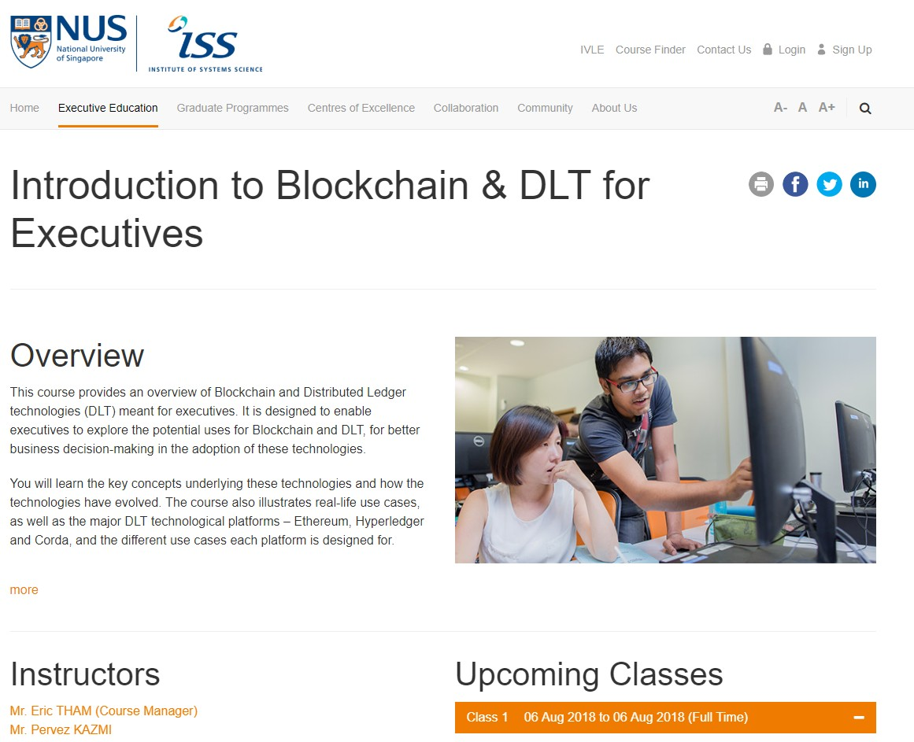

Slide 30
Thank You!
isstyc@nus.edu.sg

