Slide 1
An Introduction to Recurrent Neural Networks: Overview, Implementation, and Application
Hongyi Zhu and Hsinchun Chen
Artificial Intelligence Lab, University of Arizona
April 2019

Slide 2
Acknowledgements
Many of the pictures, results, and other materials are taken from:
Andrew Ng, Stanford University
Chris Olah, Google Brain
Fei-Fei Li, Stanford University
Geoffrey Hinton, Google & University of Toronto
Hung-yi Lee, National Taiwan University
Ian Goodfellow, Google Brain
Yann LeCun, New York University
Yoshua Bengio, Universite de Montreal

Slide 3
Outline
Recurrent Neural Networks
Vanilla RNN
Exploding and Vanishing Gradients
Networks with Memory
Long Short-Term Memory (LSTM)
Gated Recurrent Unit (GRU)
Sequence Learning Architectures
Sequence Learning with one RNN Layer
Sequence Learning with multiple RNN Layers
Implementation using Keras in Python
Application: Sequence-to-Sequence Model in Activities of Daily Living (ADL) Recognition

Slide 4
Recurrent Neural Networks
Human brain deals with information streams. Most data is obtained, processed, and generated sequentially.
E.g., listening: soundwaves → vocabularies/sentences
E.g., action: brain signals/instructions → sequential muscle movements
Human thoughts have persistence; humans don’t start their thinking from scratch every second.
As you read this sentence, you understand each word based on your prior knowledge.

Slide 5
Recurrent Neural Networks
The applications of standard Artificial Neural Networks (and also Convolutional Networks) are limited due to:
They only accepted a fixed-size vector as input (e.g., an image) and produce a fixed-size vector as output (e.g., probabilities of different classes).
These models use a fixed amount of computational steps (e.g. the number of layers in the model).
Recurrent Neural Networks (RNNs) are a family of neural networks introduced to learn sequential data.
Inspired by the temporal-dependent and persistent human thoughts

Slide 6
Real-life Sequence Learning Applications
RNNs can be applied to various type of sequential data to learn the temporal patterns.
Time-series data (e.g., stock price) → Prediction, regression
Raw sensor data (e.g., signal, voice, handwriting) → Labels or text sequences
Text → Label (e.g., sentiment) or text sequence (e.g., translation, summary, answer)
Image and video → Text description (e.g., captions, scene interpretation)
Task | Input | Output
Activity Recognition (Zhu et al. 2018) | Sensor Signals | Activity Labels
Machine translation (Sutskever et al. 2014) | English text | French text
Question answering (Bordes et al. 2014) | Question | Answer
Speech recognition (Graves et al. 2013) | Voice | Text
Handwriting prediction (Graves 2013) | Handwriting | Text
Opinion mining (Irsoy et al. 2014) | Text | Opinion expression

Slide 7
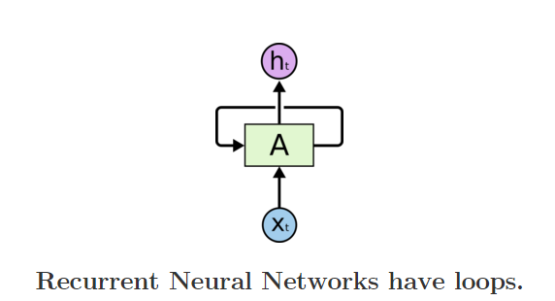
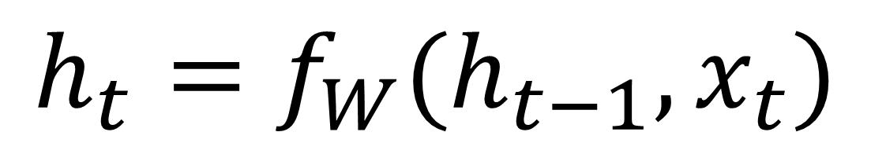
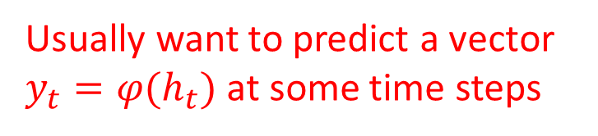
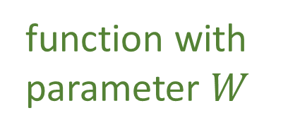
Recurrent Neural Networks
Recurrent Neural Networks are networks with loops in them, allowing information to persist.
Usually want to predict a vector $y_{t}=φ(h_{t})$ at some time steps
new state
old state
$$h_{t}=f_{W}(h_{t−1}, x_{t})$$
In the above diagram, a chunk of neural network, A=f_{W}, looks at some input xt and outputs a value ht.
A loop allows information to be passed from one step of the network to the next.
function with parameter $W$
Input vector at some time step

Slide 8
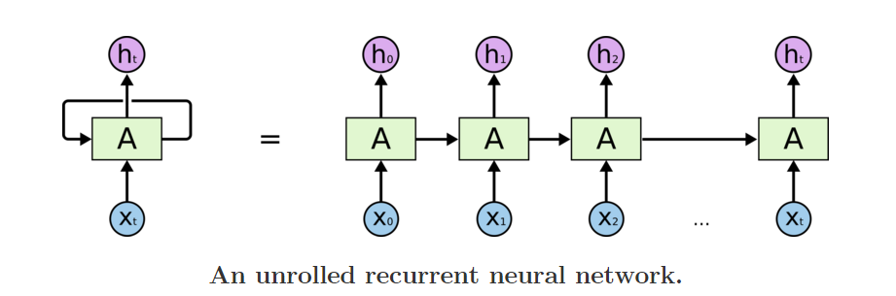
Recurrent Neural Networks
Unrolling RNN
A recurrent neural network can be thought of as multiple copies of the same network, each passing a message to a successor.
The diagram above shows what happens if we unroll the loop.

Slide 9
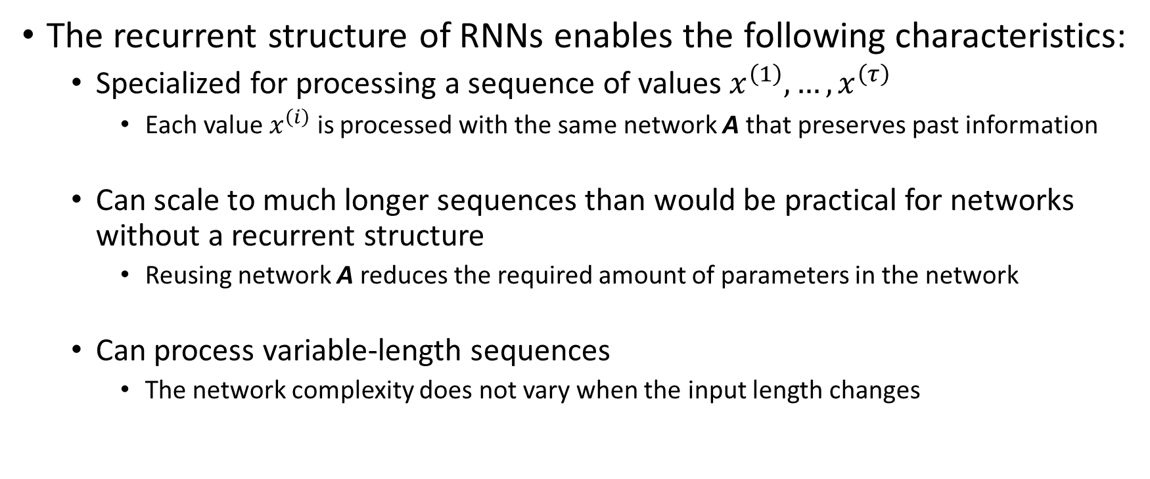
Recurrent Neural Networks
The recurrent structure of RNNs enables the following characteristics:
Specialized for processing a sequence of values $x^{\left(1\right)}, …, x^{\left(τ\right)}$
Each value $x^{\left(i\right)}$ is processed with the same network A that preserves past information
Can scale to much longer sequences than would be practical for networks without a recurrent structure
Reusing network A reduces the required amount of parameters in the network
Can process variable-length sequences
The network complexity does not vary when the input length changes

Slide 10
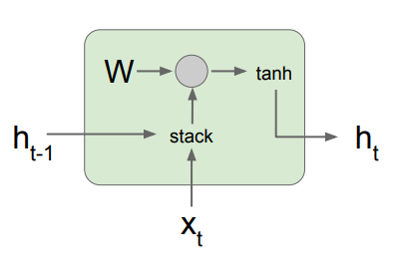
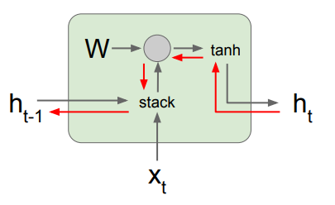

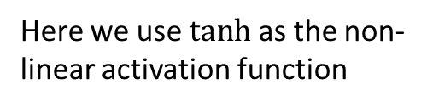
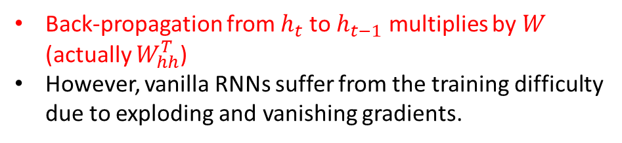
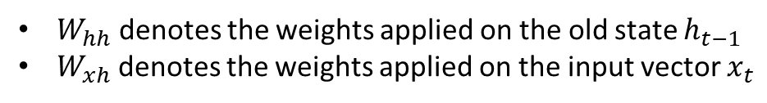
A Vanilla RNN
Here we use $tanh⁡$as the non-linear activation function
Feed-forward and back-propagation gradient flow
$$h_{t}=\tanh\left(W_{hh}h_{t−1}+W_{xh}x_{t}\right)$$
$$=\tanh\left(\left(\begin{matrix}W_{hh} & W_{xh}\end{matrix}\right)\left({h_{t−1} \atop x_{t}}\right)\right)$$
$$=\tanh\left(W\left({h_{t−1} \atop x_{t}}\right)\right)$$
$W_{hh}$ denotes the weights applied on the old state $h_{t−1}$
$W_{xh}$ denotes the weights applied on the input vector $x_{t}$
Back-propagation from $h_{t}$ to $h_{t−1}$ multiplies by $W$ (actually $W_{hh}^{T}$)
However, vanilla RNNs suffer from the training difficulty due to exploding and vanishing gradients.

Slide 11
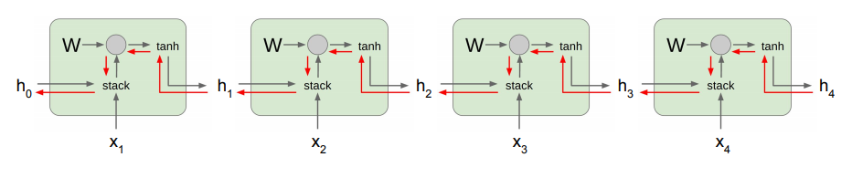
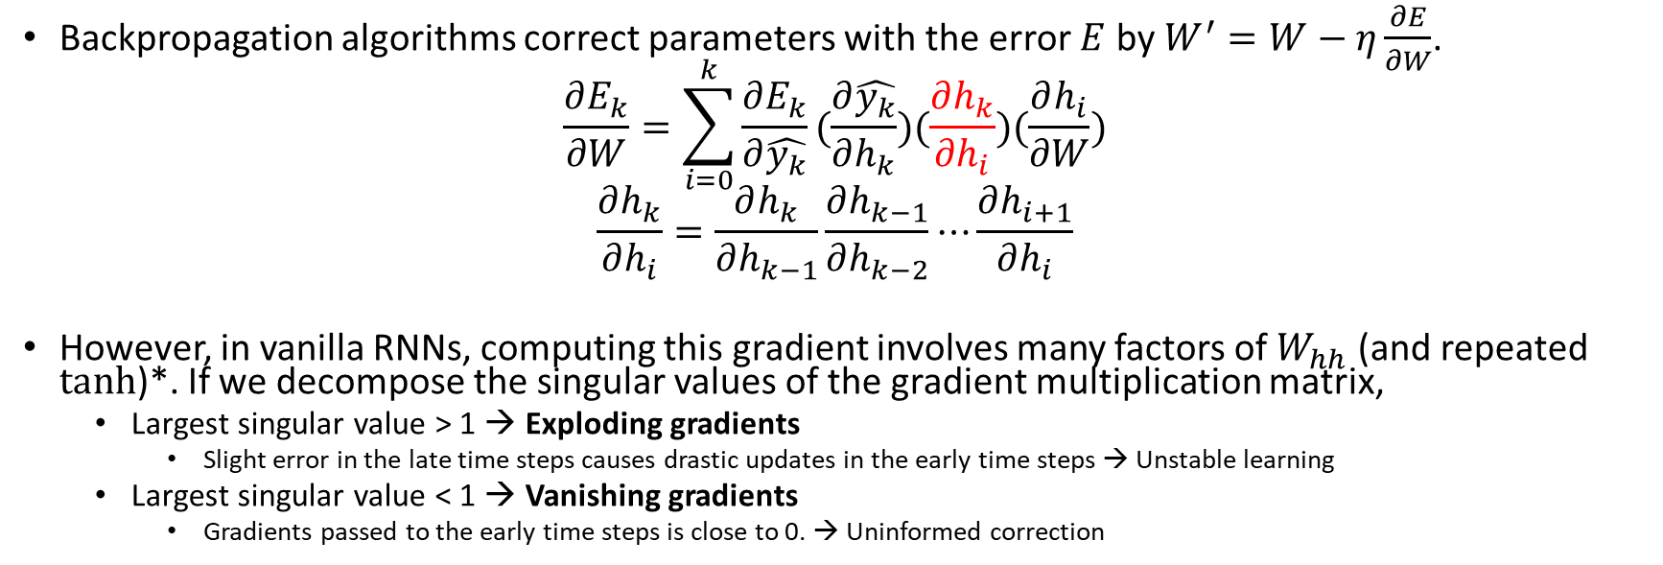
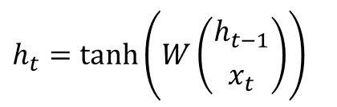

Exploding and Vanishing Gradients
$$E_{4}=J(y_{4}, \hat{y_{4}})$$
Backpropagation algorithms correct parameters with the error $E$ by$W^{′}=W−η\frac{∂E}{∂W}$.
$$\frac{∂E_{k}}{∂W}=\sum_{i=0}^{k}{\frac{∂E_{k}}{∂\hat{y_{k}}}(\frac{∂\hat{y_{k}}}{∂h_{k}})(\frac{∂h_{k}}{{∂h}_{i}})(\frac{∂h_{i}}{∂W})}$$
$$\frac{∂h_{k}}{∂h_{i}}=\frac{∂h_{k}}{∂h_{k−1}}\frac{∂h_{k−1}}{∂h_{k−2}}⋯\frac{∂h_{i+1}}{∂h_{i}}$$
However, in vanilla RNNs, computing this gradient involves many factors of $W_{hh}$ (and repeated tanh)*. If we decompose the singular values of the gradient multiplication matrix,
Largest singular value > 1 → Exploding gradients
Slight error in the late time steps causes drastic updates in the early time steps → Unstable learning
Largest singular value < 1 → Vanishing gradients
Gradients passed to the early time steps is close to 0. → Uninformed correction
$$h_{t}=\tanh\left(W\left({h_{t−1} \atop x_{t}}\right)\right)$$
* Refer to Bengio et al. (1994) or Goodfellow et al. (2016) for a complete derivation

Slide 12
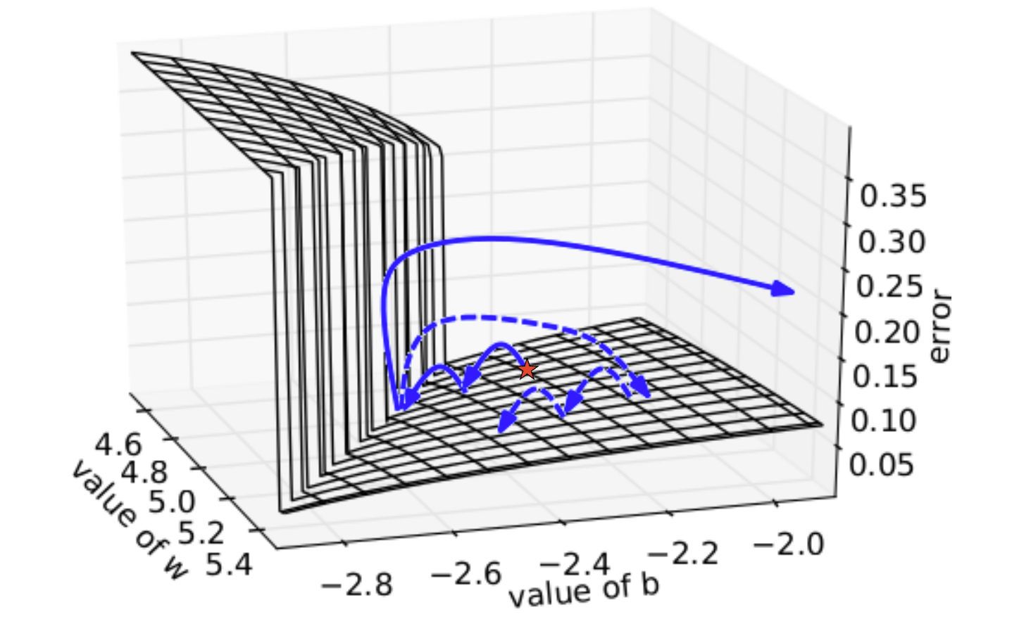
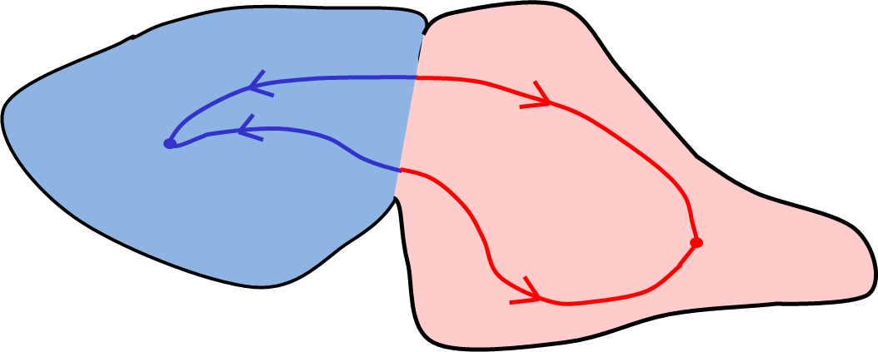
Exploding and Vanishing Gradients
Cliff/boundary
Plane/attractor
Exploding: If we start almost exactly on the boundary, tiny changes can make a huge difference.
Vanishing: If we start a trajectory within an attractor, small changes in where we start make no difference to where we end up.
Both cases hinder the learning process.

Slide 13
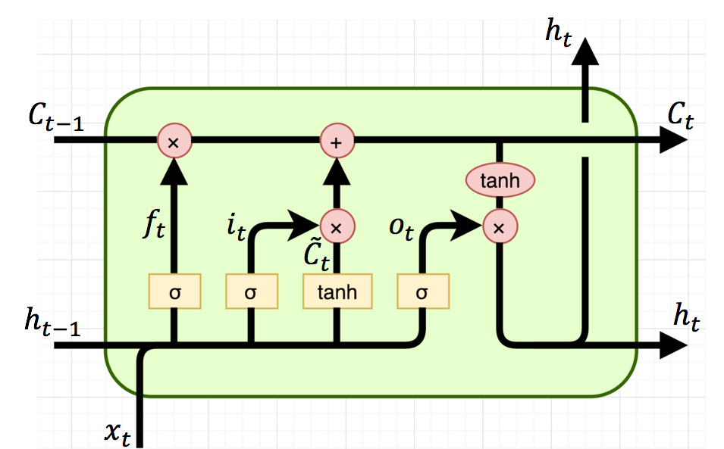
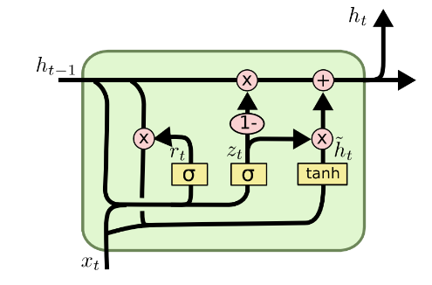
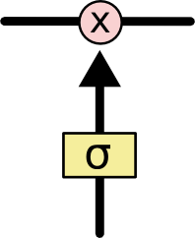
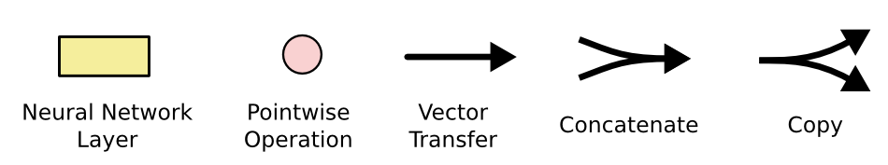
Networks with Memory
Vanilla RNN operates in a “multiplicative” way.
Necessitate new approaches to process information on the network
Two recurrent cell designs are proposed and widely adopted:
Long Short-Term Memory (LSTM) (Hochreiter and Schmidhuber, 1997)
Gated Recurrent Unit (GRU) (Cho et al. 2014)
Both designs process information in an “additive” way with gates to control information flow.
Sigmoid gate outputs numbers between 0 and 1, describing how much of each component should be let through.
Standard LSTM Cell
GRU Cell
A Sigmoid Gate

Slide 14
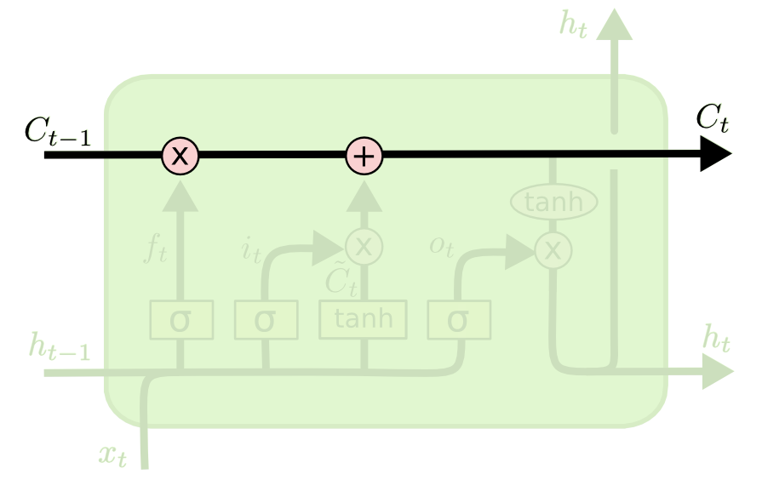


Long Short-Term Memory (LSTM)
The key to LSTMs is the cell state.
Stores information of the past → long-term memory
Passes along time steps with minor linear interactions → “additive”
Results in an uninterrupted gradient flow → errors in the future pertain and impact learning in the past
The LSTM cell manipulates input information with three gates.
Input gate → controls the intake of new information
Forget gate → determines what part of the cell state to be updated
Output gate → determines what part of the cell state to output
Cell State $C_{t}$
Gradient Flow

Slide 15
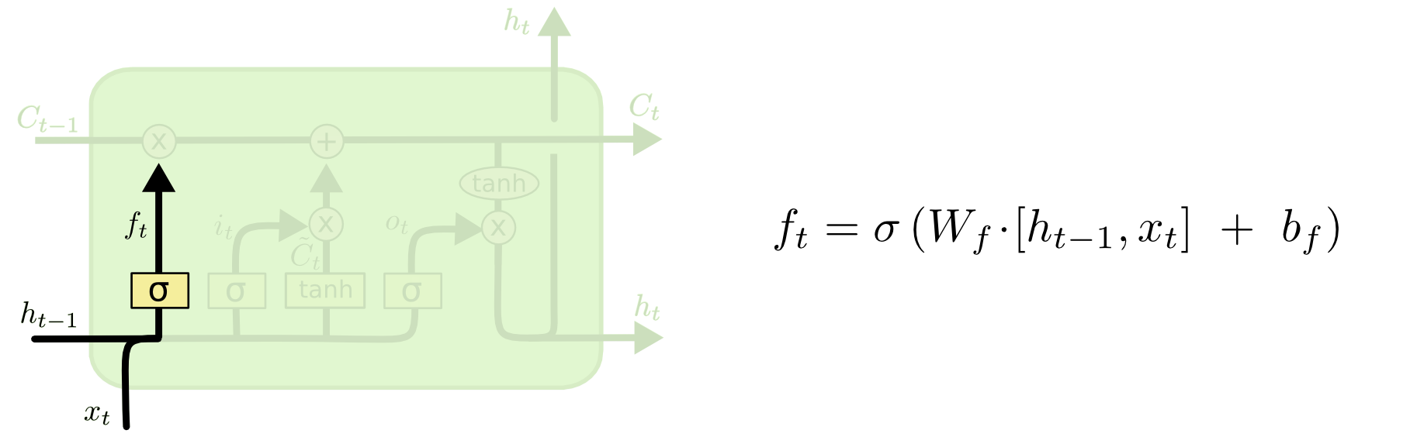


Step-by-step LSTM Walk Through
Step 1: Decide what information to throw away from the cell state (memory)
The output of the previous state $h_{t−1}$ and the new information $x_{t}$ jointly determine what to forget
$h_{t−1}$ contains selected features from the memory $C_{t−1}$
Forget gate $f_{t}$ ranges between $[0, 1]$
Text processing example:
Cell state may include the gender of the current subject ($h_{t−1}$).
When the model observes a new subject ($x_{t}$), it may want to forget ($f_{t}→0$) the old subject in the memory ($C_{t−1}$).
Forget gate

Slide 16
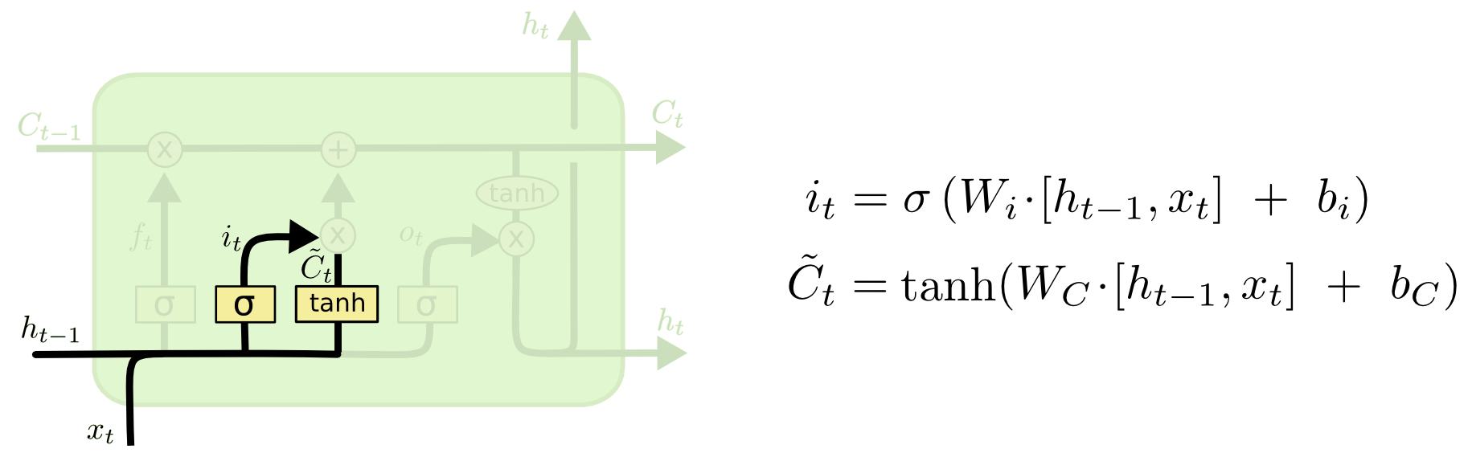

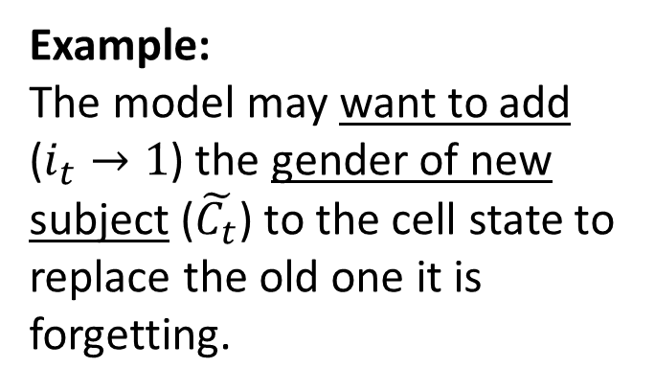
Step-by-step LSTM Walk Through
Step 2: Prepare the updates for the cell state
An alternative cell state $\tilde{C_{t}}$ is created from the new information $x_{t}$ with the guidance of $h_{t−1}$.
Input gate $i_{t}$ ranges between $[0, 1]$
Example:
The model may want to add ($i_{t}→1$) the gender of new subject ($\tilde{C_{t}}$) to the cell state to replace the old one it is forgetting.
Input gate
Alternative cell state

Slide 17
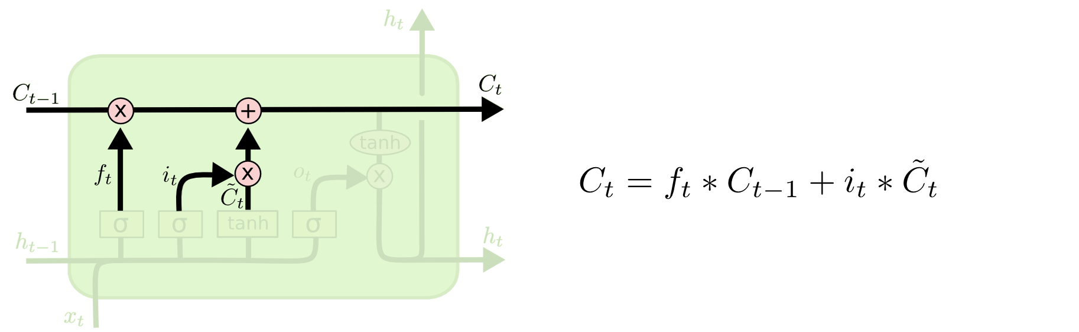

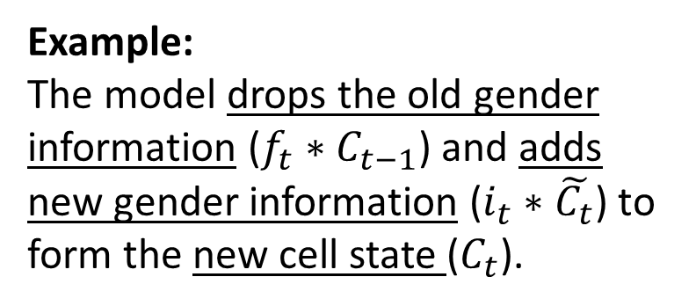
Step-by-step LSTM Walk Through
Step 3: Update the cell state
The new cell state $C_{t}$ is comprised of information from the past $f_{t}∗C_{t−1}$ and valuable new information $i_{t}∗$ $\tilde{C_{t}}$
$∗$ denotes elementwise multiplication
New cell state
Example:
The model drops the old gender information ($f_{t}∗C_{t−1}$) and adds new gender information ($i_{t}∗\tilde{C_{t}}$) to form the new cell state ($C_{t}$).

Slide 18
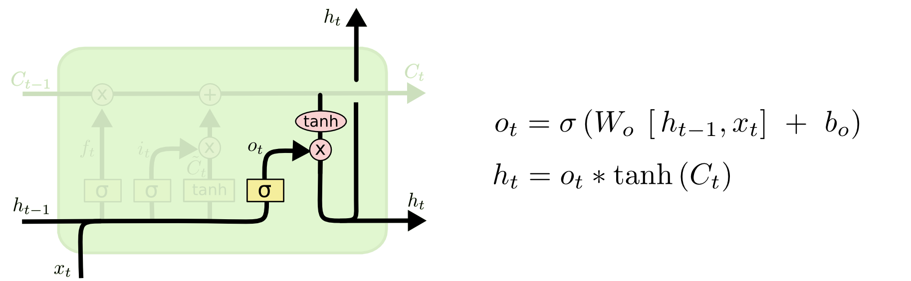
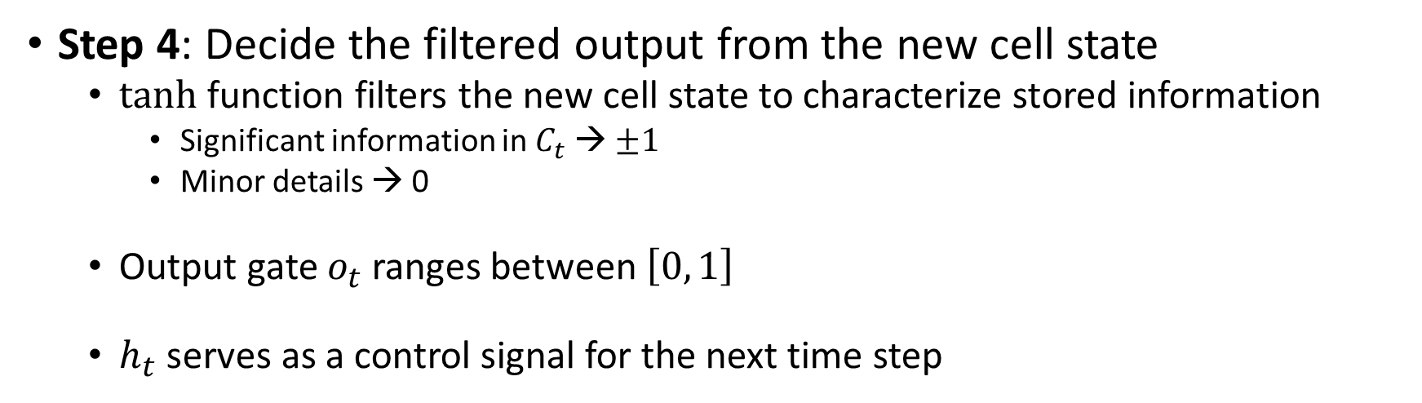

Step-by-step LSTM Walk Through
Step 4: Decide the filtered output from the new cell state
tanh function filters the new cell state to characterize stored information
Significant information in $C_{t}$ → $±1$
Minor details → 0
Output gate $o_{t}$ ranges between $\left[0, 1\right]$
$h_{t}$ serves as a control signal for the next time step
Example:
Since the model just saw a new subject ($x_{t}$), it might want to output ($o_{t}→1$) information relevant to a verb ($tanh⁡(C_{t})$), e.g., singular/plural, in case a verb comes next.
Output gate

Slide 19
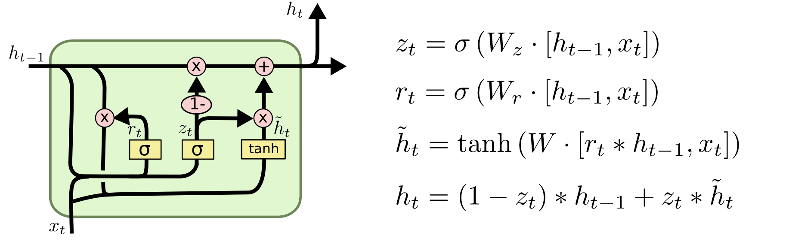
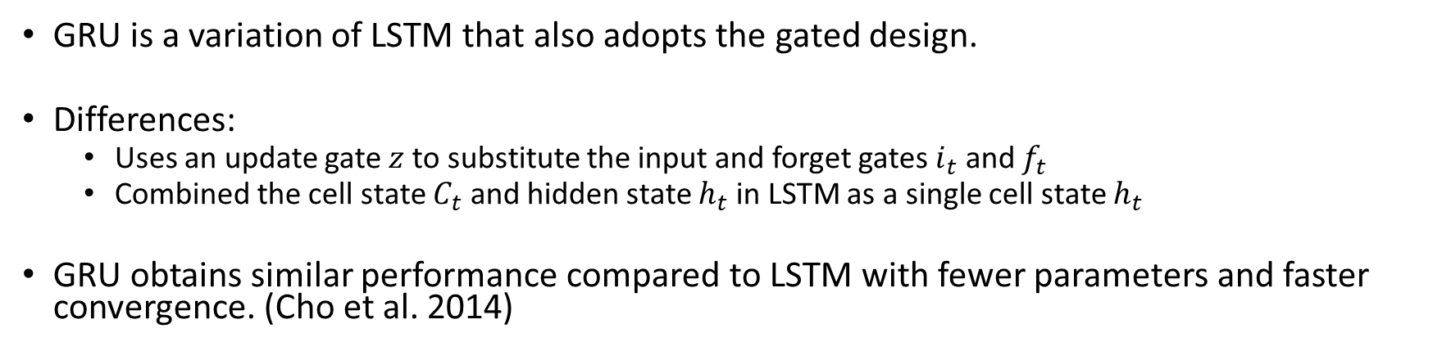
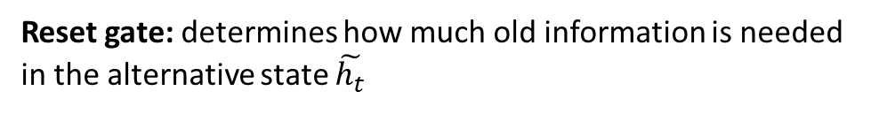
Gated Recurrent Unit (GRU)
GRU is a variation of LSTM that also adopts the gated design.
Differences:
Uses an update gate $z$ to substitute the input and forget gates $i_{t}$ and $f_{t}$
Combined the cell state $C_{t}$ and hidden state $h_{t}$ in LSTM as a single cell state $h_{t}$
GRU obtains similar performance compared to LSTM with fewer parameters and faster convergence. (Cho et al. 2014)
Update gate: controls the composition of the new state
Reset gate: determines how much old information is needed in the alternative state $\tilde{h_{t}}$
Alternative state: contains new information
New state: replace selected old information with new information in the new state

Slide 20
Sequence Learning Architectures
Learning on RNN is more robust when the vanishing/exploding gradient problem is resolved.
RNNs can now be applied to different sequence learning tasks.
Recurrent network architectures is flexible to operate over various sequences of vectors.
Sequence in the input, the output, or in the most general case both
Architecture with one or more RNN layers

Slide 21
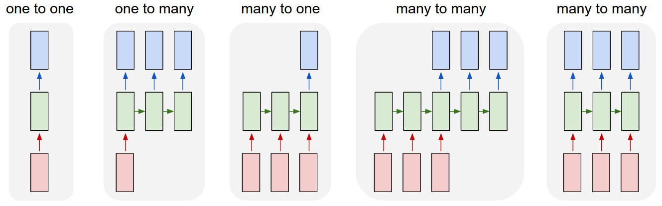
Sequence Learning with One RNN Layer
Each rectangle is a vector and arrows represent functions (e.g. matrix multiply).
Input vectors are in red, output vectors are in blue and green vectors hold the RNN's state
1
2
3
4
5
(1) Standard NN mode without recurrent structure, from fixed-sized input to fixed-sized output (e.g. image classification).
(2) Sequence output (e.g. image captioning takes an image and outputs a sentence of words).
(3) Sequence input (e.g. sentiment analysis where a given sentence is classified as expressing positive or negative sentiment).
(4) Sequence input and sequence output (e.g. Machine Translation: an RNN reads a sentence in English and then outputs a sentence in French).
(5) Synced sequence input and output (e.g. video classification where we wish to label each frame of the video).

Slide 22
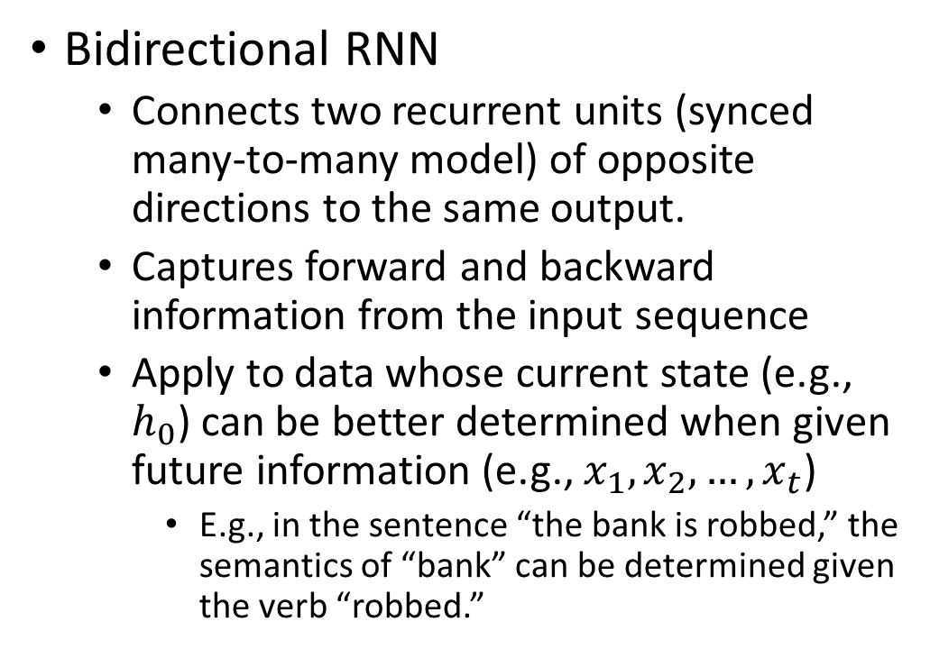
Sequence Learning with Multiple RNN Layers
Bidirectional RNN
Connects two recurrent units (synced many-to-many model) of opposite directions to the same output.
Captures forward and backward information from the input sequence
Apply to data whose current state (e.g., $h_{0}$) can be better determined when given future information (e.g., $x_{1}, x_{2},…, x_{t}$)
E.g., in the sentence “the bank is robbed,” the semantics of “bank” can be determined given the verb “robbed.”
B
B
B
B

Slide 23
Sequence Learning with Multiple RNN Layers
Sequence-to-Sequence (Seq2Seq) model
Concatenate a many-to-one (encoder) and an one-to-many (decoder) RNN with a shared vector
Encoder RNN: extract and compress the semantics from the input sequence
Decoder RNN: generate a sequence based on the input semantics
Lengths of both RNNs can vary.
Apply to tasks such as translation
Similar underlying semantics
E.g., “I love you.” to “Je t’aime.”
Decoded sequence
y₀
y₁
y₂
…
y_{m}
Encoded semantics
B
B
B
B
An RNN as the encoder
An RNN as the decoder
Input sequence

Slide 24

Implementing RNN in Python using Keras
Keras provides APIs for the vanilla RNN design, LSTM, and GRU cells:
keras.layers.SimpleRNN(units, activation='tanh', return_sequences=False, …)
keras.layers.LSTM(units, activation='tanh', recurrent_activation='hard_sigmoid', …)
keras.layers.GRU(units, activation='tanh', recurrent_activation='hard_sigmoid', …)
Critical parameters*
units: dimensionality of the output space
activation: activation function to use on the recurrent layer, ‘tanh’ by default
recurrent_activation: activation function for the gates
return_sequences:
True to obtain the output on each time step
False to obtain the last output
*: More can be found on https://keras.io/layers/recurrent/

Slide 25
Implementation Example: Sequence Classification with LSTM
IMDB movie review sentiment classification problem
Classify each movie review into a sentiment class (positive (1) or negative (0))
import numpy
from keras.datasets import imdb // keras provides this built-in dataset
from keras.models import Sequential
from keras.layers import Dense, LSTM
from keras.layers.embeddings import Embedding
from keras.preprocessing import sequence
# fix random seed for reproducibility
numpy.random.seed(7)
# load the dataset but only keep the top n words, zero the rest // data preprocessing
top_words = 5000
(X_train, y_train), (X_test, y_test) = imdb.load_data(num_words=top_words)
# truncate and pad input sequences
max_review_length = 500
X_train = sequence.pad_sequences(X_train, maxlen=max_review_length)
X_test = sequence.pad_sequences(X_test, maxlen=max_review_length)
https://machinelearningmastery.com/sequence-classification-lstm-recurrent-neural-networks-python-keras/
http://ai.stanford.edu/~amaas/data/sentiment/

Slide 26

Implementation Example: Sequence Classification with LSTM
0/1?
# define word embedding size
embedding_vecor_length = 32
# create a sequential model
model = Sequential()
# transform input sequence into word embedding representation
model.add(Embedding(top_words, embedding_vecor_length, input_length=max_review_length))
# generate a 100-dimention output, can be replaced by GRU or SimpleRNN recurrent cells
model.add(LSTM(100))
# a fully connected layer weight the 100-dimention output to one node for prediction
model.add(Dense(1, activation='sigmoid’))
# use binary_crossentropy as the loss function for the classification
model.compile(loss='binary_crossentropy', optimizer='adam', metrics=['accuracy'])
print(model.summary())
# model training (for 3 epochs)
model.fit(X_train, y_train, validation_data=(X_test, y_test), epochs=3, batch_size=64)
# Final evaluation of the model
scores = model.evaluate(X_test, y_test, verbose=0)
print("Accuracy: %.2f%%" % (scores[1]*100))
100 dims
Fully connected layer
Recurrent cell
Word embeddings
32 dims
Review
… movie fantastic awesome …

Slide 27
RNN Applications: High-level Activities of Daily Living (HL-ADL) Recognition
Activities of Daily Living (ADLs) are introduced to evaluate the self-care ability of senior citizens (Williams 2014).
Requires consistent monitoring → Sensor-based systems
Sensor-based home monitoring systems
Environment: Placed in the environment to capture changes (e.g., on/off, motion)
Wearable: Attached to the body to measure movements and physiological signals
Sensors sample at 10 Hz → 0.8 million records per day
Various data types: continuous, discrete, …
Machine learning (esp. deep learning) needed to recognize ADLs from the large amount of data
Mid-level (ML) ADLs: gestures, gait, etc.
High-level (HL) ADLs: preparing food, medical intake, etc.
Past methods recognize ADLs on a specific sensor type.
Not generalizable to setting changes
Data recorded by different sensors during the same activity not utilized jointly for activity recognition
Research Objective: develop a universal ADL recognition framework to extract HL-ADLs from raw sensor data

Slide 28
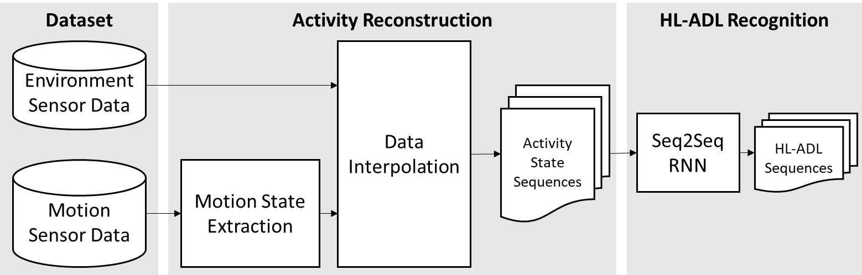
RNN Applications: Research Design
Intuition: Recognizing the HL-ADLs from the sensor data is similar to captioning/translation. We can generate ADL label sequence with a Seq2Seq model for the input data. The underlying semantics are similar.
Activity reconstruction step creates a consistent temporally-aligned representation for any combination of environment and motion sensor data that can be used by the Seq2Seq model to recognize the HL-ADL.
A Seq2Seq model is designed to extract HL-ADLs from the activity state sequence

Slide 29
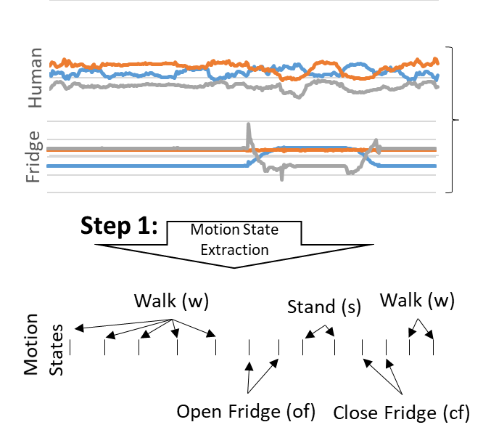
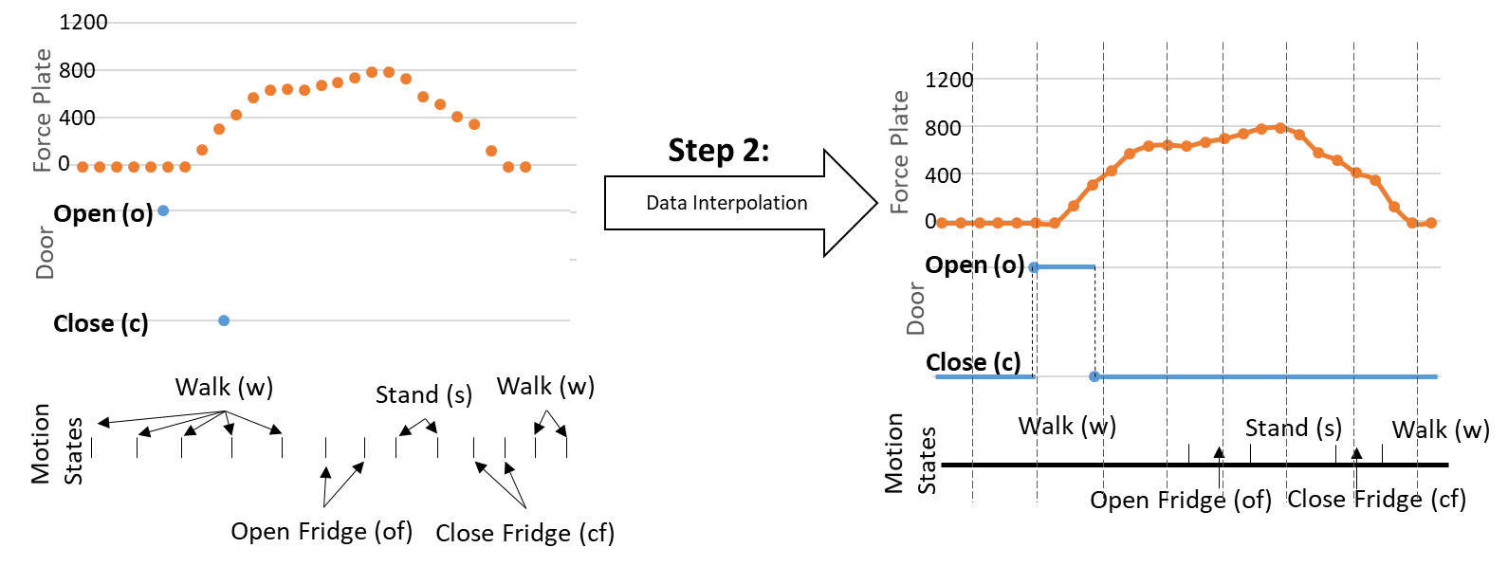
RNN Applications: Activity Reconstruction
Objective: create temporally aligned activity representation from different data sources
Four sensors for demonstration:
a force plate → pressure on the floor
a door on/off sensor → open (o) and close (c) states
a human motion sensor
object motion sensor attached on the fridge
Step 1. Extract discrete motion states from motion sensor data with a state-of-the-art gesture recognition model
Steps 2. Interpolate discrete data from each sensor
Continuous value
Piecewise Cubic Hermite Interpolating Polynomial
Discrete value (event-based sampling)
Latest value interpolation
Discrete value (consistent sampling)
Nearest neighbor interpolation

Slide 30
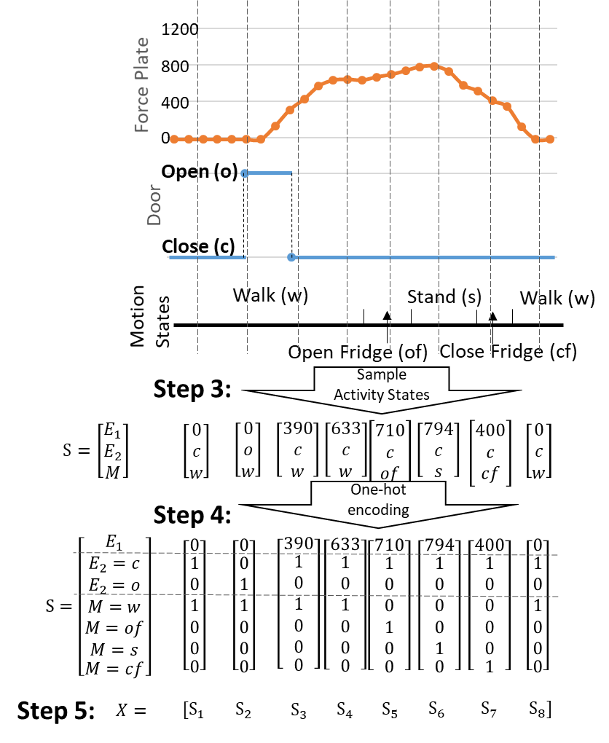
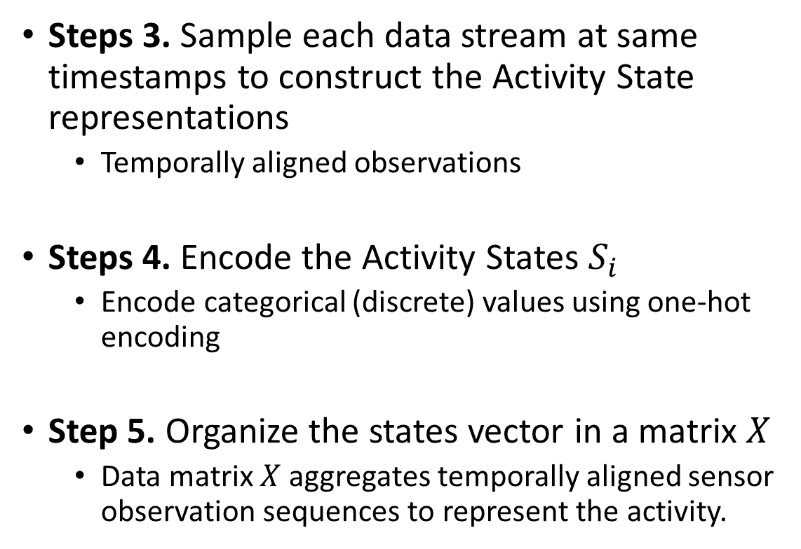
RNN Applications: Activity Reconstruction
Steps 3. Sample each data stream at same timestamps to construct the Activity State representations
Temporally aligned observations
Steps 4. Encode the Activity States $S_{i}$
Encode categorical (discrete) values using one-hot encoding
Step 5. Organize the states vector in a matrix $X$
Data matrix $X$ aggregates temporally aligned sensor observation sequences to represent the activity.

Slide 31
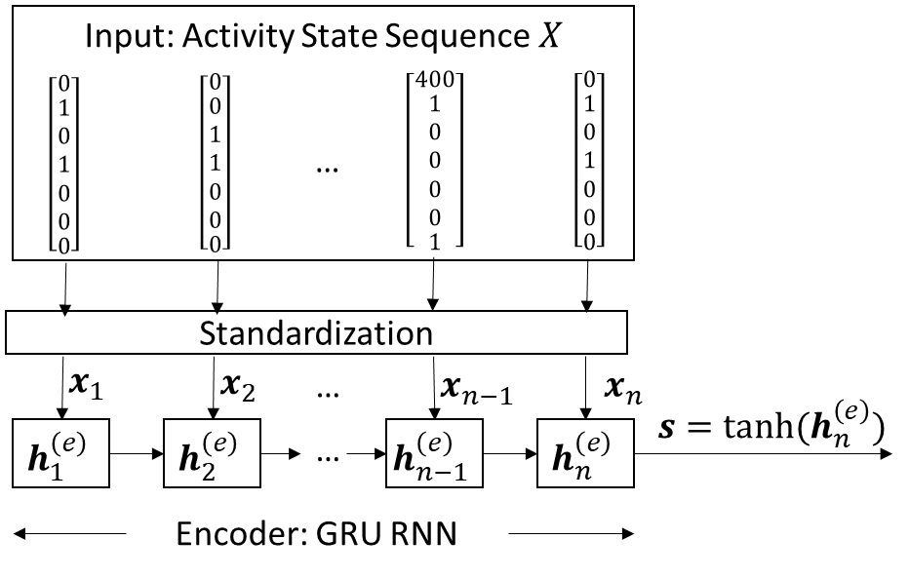
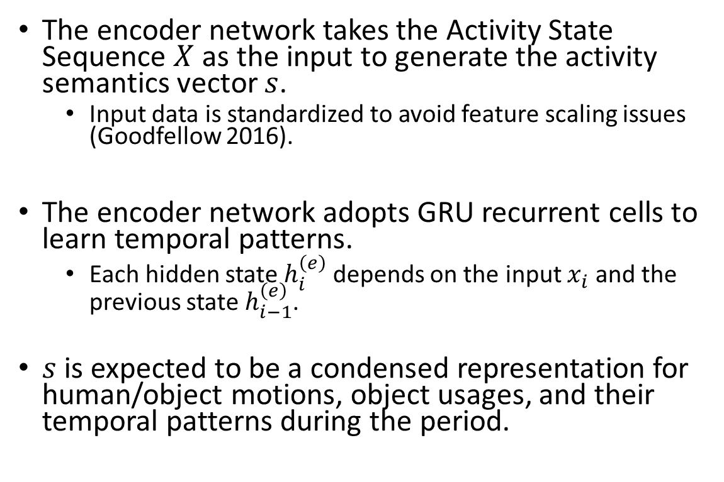
RNN Applications: Seq2Seq – Encoder
The encoder network takes the Activity State Sequence $X$ as the input to generate the activity semantics vector $s$.
Input data is standardized to avoid feature scaling issues (Goodfellow 2016).
The encoder network adopts GRU recurrent cells to learn temporal patterns.
Each hidden state $h_{i}^{\left(e\right)}$ depends on the input $x_{i}$ and the previous state $h_{i−1}^{\left(e\right)}$.
$s$ is expected to be a condensed representation for human/object motions, object usages, and their temporal patterns during the period.

Slide 32
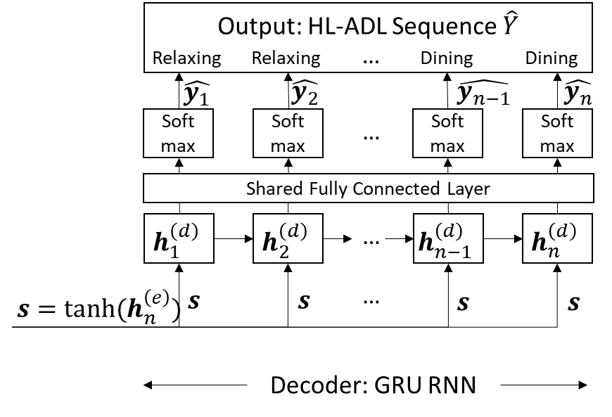
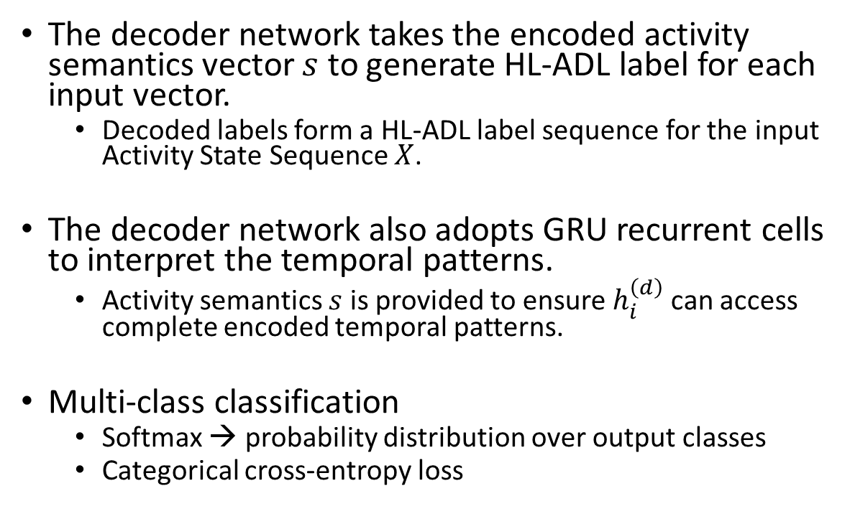

RNN Applications: Seq2Seq – Decoder
The decoder network takes the encoded activity semantics vector $s$ to generate HL-ADL label for each input vector.
Decoded labels form a HL-ADL label sequence for the input Activity State Sequence $X$.
The decoder network also adopts GRU recurrent cells to interpret the temporal patterns.
Activity semantics $s$ is provided to ensure $h_{i}^{\left(d\right)}$ can access complete encoded temporal patterns.
Multi-class classification
Softmax → probability distribution over output classes
Categorical cross-entropy loss
$$s$$

Slide 33
RNN Applications: Activities of Daily Living (ADL) Recognition
Our proposed model is evaluated on two different datasets.
The result suggests that our framework is more flexible in adjusting to different real-life HL-ADL recognition applications.
Recall of S2S_GRU against benchmarks on a wearable/environment motion sensor dataset
Recall (%) | Relaxing | Coffee time | Early morning | Cleanup | Sandwich time
S2S_GRU | 61.7 | 66.5 | 72.1 | 82.6 | 79.1
HMM | 48.8 | 19.5*** | 6.4*** | 17.4*** | 40.9***
S2S_LSTM | 60.0 | 54.9** | 75.9 | 83.2 | 59.9***
Recall of S2S_GRU against benchmarks on a environment sensor dataset
Recall (%) | Filling pillbox | Watch DVD | Water plants | Answer the phone | Prepare gift card | Prepare soup | Cleaning | Choose outfit
S2S_GRU | 88.6 | 79.0 | 58.5 | 80.8 | 92.1 | 71.1 | 85.0 | 58.0
HMM | 33.2*** | 31.6*** | 16.8*** | 22.0*** | 29.9*** | 26.4*** | 20.4*** | 22.5***
S2S_LSTM | 86.1* | 77.8 | 64.3 | 74.9* | 90.8* | 69.6 | 82.5 | 49.5**
*: p-value<0.05, **: p-value<0.01, ***: p-value<0.001

Slide 34
Summary
RNNs reuse the same parameters for different time steps.
Vanilla RNNs face vanishing and exploding gradient problems.
LSTM and GRU are recurrent units that retain past information and update with a gated design.
The “additive” structure avoids vanishing gradient problem.
RNNs allow flexible architecture designs to adapt to different sequence learning requirements.
Sequential input, output, or both
One or more RNN layers
RNNs have broad real-life applications.
Text processing, machine translation, signal extraction/recognition, image captioning, …

Slide 35
Important References
Bengio, Y., Simard, P., & Frasconi, P. (1994). Learning long-term dependencies with gradient descent is difficult. IEEE transactions on neural networks, 5(2), 157-166.
Goodfellow, I., Bengio, Y., Courville, A., & Bengio, Y. (2016). Deep learning (Vol. 1). Cambridge: MIT press.
Graves, A. (2012). Supervised sequence labelling with recurrent neural networks. https://www.cs.toronto.edu/~graves/preprint.pdf
Jozefowicz, R., Zaremba, W., & Sutskever, I. (2015, June). An empirical exploration of recurrent network architectures. In International Conference on Machine Learning (pp. 2342-2350).
Lipton, Z. C., Berkowitz, J., & Elkan, C. (2015). A critical review of recurrent neural networks for sequence learning. arXiv preprint arXiv:1506.00019.
Salehinejad, H., Baarbe, J., Sankar, S., Barfett, J., Colak, E., & Valaee, S. (2017). Recent Advances in Recurrent Neural Networks. arXiv preprint arXiv:1801.01078.

