Slide 1
Cybercriminal Jargon Identification and Analysis using Unsupervised Learning
Kangzhi Zhao
April 2016

Slide 2
Agenda
Introduction
Literature Review
Research Questions
System and Research Design
Research Testbed
Research Experiment
Findings and Discussions
Conclusions and Future Directions
References

Slide 3
Introduction
Cybercrime costs global economy up to $500B a year
  Online underground economy facilitates exchanging products and services.
  Great concern has been drawn in the public and academic field.
In 2015, cybercrime cause $12.5B loss in China
  Cybercrime costs nearly $20 per Chinses netizen, 32% netizen in China have suffered loss.
  More than 90 thousands people work for cybercrime in 2011.
  QQ group and Baidu Forum are the main market place for underground economy.
Notes:
According to a newly-released report sponsored by McAfee, global cyber activity is costing up to $500 billion each year, which is almost as much as the estimated cost of drug trafficking.(http://www.foxbusiness.com/features/2013/07/22/report-cyber-crime-costs-global-economy-up-to-1-trillion-year.html)
Franklin and Perrig 2007
http://www.12321.cn/pdf/2015zgwmqybhdcbg.pdf
Jianwei, Zhuge, Gu Liang, and Duan Haixin. "Investigating China’s online underground economy." In Conference on the Political Economy of Information Security in China. 2012.

Slide 4
Introduction
Underground market has gradually been in a hot research with various research topics
Research on underground economy would greatly benefit cyber defenses but face many challenges
  Untraditional dataset in exclusive cyber market, making it hard to get the research testbed
  Researchers may encounter unfamiliar technical concepts and terms
  Unfamiliar with the underground market rule and the role of participants

Slide 5
Introduction
We are motivated to study jargon of underground market using unsupervised learning.
  Understanding jargon is a critical problem for mining domain-specific data especially in underground market.
  Current research on cybercriminal jargon mainly depends on criminal case exposed.
  We need to use unsupervised learning to follow the enormous and changing text post we get from underground market.

Slide 6
Introduction
Recent progress of unsupervised learning on lexical semantics provides us better understanding on words and expressions.
  Word2Vec using recurrent neural network language models (RNNLMs) provides good features to represent terms.
  Latent Dirichlet Allocation (LDA) can be seen as a conceptual clustering method which automatically groups semantically related terms together to form high-level cybercrime related features (concepts).
  Help to understand the jargon in cybercrime markets.
  Help to identify the jargon.
  Better understand the meaning of jargon in underground markets.
Notes:
Social Media Analytics for Cyber Attack Forensic Raymond Y.K. Lau, Yunqing Xia, and Chunping Li

Slide 7
Literature Review
Underground markets
Researchers are getting interesting in studying underground market in recent years.(Benjamin et al. 2015)
Underground market participants depend heavily on advertisement.
  Sellers utilize advertisements to promote products and services. (Fossi et al. 2009; Franklin and Perrig 2007; Peretti 2008)
  Advertisement posts is fairly good for text mining because it contains various jargon to describe the products and services.

Slide 8
Literature Review
Chinese underground markets has its own features
  Participants depend heavily on QQ group and Baidu forums to post advertisements and exchange information and tools.(Zhuge et al, 2012)
  QQ Tencent Messenger is the second largest instant-message app in China. QQ group is a service by QQ supporting multi-person conversion.
  Baidu forum are the largest Chinese forum in China.
  Chinese underground markets include money stealing, virtual assets stealing, Internet service abuse and cybercrime training.(Zhuge et al, 2012)
  Data collection and jargon extraction can refer to these topics.

Slide 9
Literature Review
Data collection
Searching for the underground communities.
  Keyword searches (Fallman et al. 2010)
  Snowball collection(Holt & Lampke, 2010)
Data is collected through various means
  Most forum data can be collected through web crewlers.
  Some exclusive data such as QQ group data has to be collected manually. (Zhuge, 2012)

Slide 10
Literature Review
Past work
Recent researches focus on some major topics
  General analyze of underground market. (Motoyama, Marti, et al. 2011; Yip et al., 2013; Odabas et al., 2015)
  Key participants and their social network. (Zhang and Li , 2013; Benjamin & Chen, 2014; Abbasi et al., 2014; Zhang et al., 2015)
  Understanding of hacker Language and concepts. (Lau, Xia, et al., 2012; Benjamin & Chen, 2015)
  Cybercrime in other language. (Holt and Strumsky, 2012)

Slide 11
Literature Review
Few research focus on Chinese underground markets.
  A vast and rapidly growing underground market but hard to understand.
  Previous studies are mainly general analysis of Chinese underground market.
Few research on analyzing jargon of underground market.
  Cybercriminal jargon of current research mainly comes from criminal cases exposed. (Fallman et al. 2010)
  Need a methodology to automatically extract and understand jargon from large-scale text post.

Slide 12
Literature Review
Pre-understanding of Chinese jargon
Semantic feature of Chinese cyber language
  Terms of cyber language have some features different from life expressions and written words
  Includes symbolic network language, new created network language, numeral network language and abbreviative network language. (Dong, 2008)
  Lots of abbreviative network terms come from English and Pinyin which utilize homonym.
  Help us manually pick out some jargon as prior knowledge.

Slide 13
Literature Review
Jargon and Information retrieval problem
Jargon must have measurable features (Kageura, 1996)
  Unithood to represent an independent and complete meaning with stable structure.
  Termhood to be highly relevant to a specific domain.
Jargon extraction can be treated as an information retrieval(IR) problem.
  Automatic term extraction (ATE), or automatic term recognition (ATR)

Slide 14
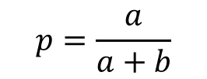
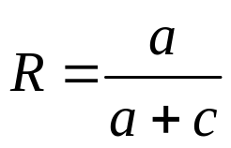
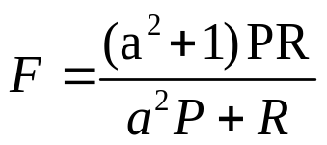
Literature Review
There is no uniform standard to evaluate the result of IR (Vivaldi et al, 2007)
Some typical evaluations of IR
  Precision, Recall, F-score(a weighs the P and R)
 | Term | Non-term
Extracted | a | b
Non-extracted | c

Slide 15
Literature Review
Methods for ATE or ATR (Yuan, 2015)
  Based on linguistics (Castellvi etl. 2001)
  Base on statistical distribution of terms
    Frequency, TF-IDF, Domain Relevance, Domain Consensus
  Combining linguistic and statistic rules
    C-value
  Combining with machine learning method
    HMM, CRFs
We are using unsupervised machine learning to automatically extract term and understand jargon.

Slide 16
Literature Review
Lexical semantics
We are motivated to utilize unsupervised machine learning
  Suitable for scalable and automated large-scale text mining
Two methodology for understanding jargon.
  Neural network language model(NNML) for word embedding.
  Topic model

Slide 17
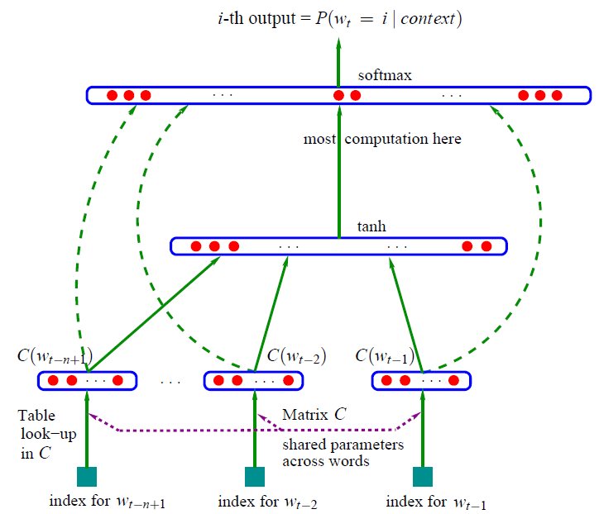
Literature Review
NNLM aim to develop the probability distribution over sequences of words
  Develop the training through a few layers of artificial neuron
  Represent word vectors for every word in the corpus
  Many NNLM can develop state-of-the-art word embedding

Slide 18
Literature Review
Word2vec is a group of related unsupervised learning models with shallow, two-layer neural networks.
  Develop word vectors in k Dimensional space based on their semantic in the context.
  Word embedding can be used in NLP such as clustering, word analysis.
  The similarity of the word vector represent the similarity of their semantics used to understand the jargon.
  Word embedding has the ability of Additive Compositionality
  vector(‘Paris’) – vector(‘France’ )+vector(‘italy’) ≈ vector(‘Rome’) vector(‘king’) – vector(‘man’) +vector(‘woman’) ≈ vector(‘queen’)

Slide 19
Literature Review
Word2vec has two model architectures: CBOW and Skip-gram
  Continuous Bag-of-Words Model(CBOW) maximize probability of a central word given its context.
  Skip-gram maximize the probability of the context given its central word.

Slide 20
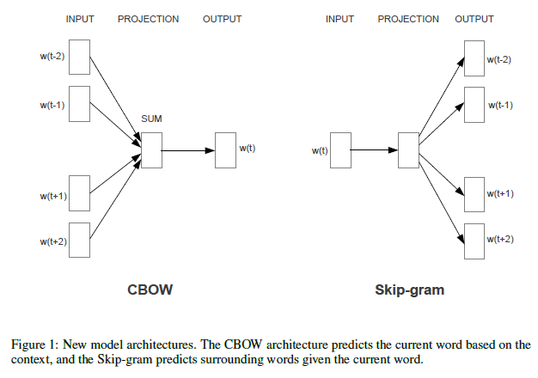
Literature Review
Two architectures preform differently on the same corpus.
  Skip-gram: works well with small amount of the training data, represents well even rare words or phrases.
  CBOW: several times faster to train than the skip-gram, slightly better accuracy for the frequent words.

Slide 21
Literature Review
Word2vec has two training algorithm for both architecture: hierarchical softmax and negative sampling.
  Need to be further proved when applied on our corpus.
Word2vec provides us with a state-of-the-art word-embedding method to represent words in the corpus with high performance.
  Hence can help understand the jargon in the underground markets.

Slide 22
Literature Review
Latent Dirichlet Allocation (LDA) is a classic topic model that generate a mixture over an underlying set of topics from our corpus.
  Each topic is modeled as an infinite mixture over an underlying set of topic probabilities, which enhance group terms with similar meaning.
  This will help us find the meaning of jargon in underground markets.

Slide 23
Research Questions
Research Gap
  Few research has done on jargon analysis of underground markets.
  Chinese cybercrime is still an infant research field, and current research mainly focus on general analysis.
  No such research focusing on the thoroughly analysis and comparison of underground market on the IR problem with unsupervised learning.
Research Question
  How does current state-of–the-art unsupervised learning perform on understanding cybercriminal jargon?
  Which schema and algorithm do better to extract jargon?
  Can we get further insight into the jargon beyond our pre-existing knowledge?

Slide 24
System and Research Design
Data
collecting
Data
pre-procession
Lexical Semantics
Evaluation
Keywords
Pre-Collection
Extract valid
text data
Word2vec Model
Result
evaluation
Word Segment
Topic Model
Data Extraction
Result
Discussing
Data Scrubbing
Model Refreshing

Slide 25
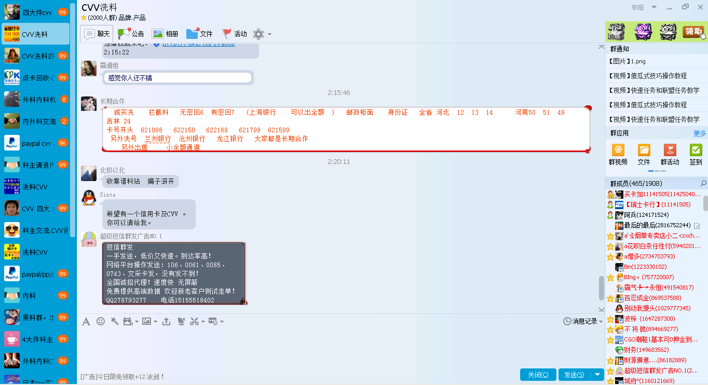
Research Testbed
We use chat log from QQ group.
  QQ group is more exclusive than Baidu forum because QQ group host (creator) can control who can join the group and can also expel the group members.
  Thus the chat log brings more effective information including numerous and various jargon to advertise products and services.
Data
collecting
Keywords
Pre-Collection
Data Extraction

Slide 26
Research Testbed
Because of the limitation of Tencent, we manually join in 29 QQ groups with 23000+ members in total.
Data
collecting
Keywords
Pre-Collection
Group id | Group name | Total member | Member capacity
518270961 | 四大行 | 1885 | 2000
140976389 | 日本cvv实力接货刷货 | 660 | 2000
372779882 | 外料内料CVV等交流 | 609 | 1000
472812351 | 洗料CVV | 1885 | 2000
518471495 | 洗料CVV | 1885 | 2000
76649054 | CVV洗料四大 | 1926 | 2000
426176059 | 国内CVV | 2000 | 2000
196653656 | CVV 四大 拦截料 | 1902 | 2000
517530328 | CVV洗料 | 1908 | 2000
197313973 | 点卡回收-CVV交流 | 984 | 1000
四大件cvv | 四大件cvv | 1486 | 2000
Data Extraction

Slide 27
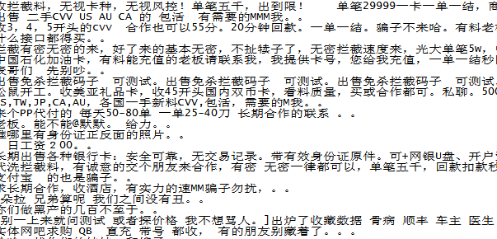
Research Testbed
We finally collected 90000+ text posts
  Because of the limitation to record the group chat log only when getting online, we collect most of the group post from 20160318 to 20160404.
  After wiping off the redundant or meaningless posts, we get about 18800 text post in total, most of which are advertisement of the cybercriminal participants.
Data
collecting
Keywords
Pre-Collection
Data Extraction

Slide 28
Research Experiment
Extract valid text data
  Wipe off log metadata, system message, picture information
Word segment
  ICTCLAS toolbox from Chinese Academy of Sciences
  Manually picked user dictionary with about 500 Chinese term including some jargon of underground market.
Data Scrubbing
  Strip punctuation and stop words
Data
pre-procession
Extract valid
text data
Word Segment
Data Scrubbing

Slide 29
Research Experiment
Code for word2vec and topic model
  Different model architecture for word2vec
  Different training algorithm for both architechure
  Train 10 models for evaluation
Choose the hyper-parameter
Lexical Semantics
Word2vec Model
Topic Model
Model Refreshing

Slide 30
Research Experiment
It is a challenge to evaluate unsupervised learning in research.
  Compared with the benchmark.
  Using traditional data sets.
We face the following difficulties.
  We are using the untraditional data.
  Unsupervised learning has different performance when applied on different dataset.
  There is no benchmark because Chinese cybercriminal text mining is a new topic.
Evaluation
Result
evaluation
Result
Discussing

Slide 31
Research Experiment
We focus on the research questions
  How does state-of–the-art unsupervised learning perform on understanding cybercriminal jargon?
  Which schema and algorithm do better to extract jargon?
  Can we get further insight into the jargon beyond our pre-existing knowledge?
We get the embedding words and the topic distribution on words
  Can be evaluated by its precision@k, a common technique for unsupervised learning (Agichtein et al., 2006)
Evaluation
Result
evaluation
Result
Discussing

Slide 32
Research Experiment
We first get four word embedding models.
  CBOW + negative sampling
  CBOW + hierarchical softmax
  Skip gram + negative sampling
  Skip gram + hierarchical softmax
  We choose 70 jargon and get the 10 most similar words of each jargon under 4 models separately.
  We evaluate the performance of each model by calculating the P@10 in order to answer the first research questions.
  We do the pairwise comparison judgment to answer the second research question.
Evaluation
Result
evaluation
Result
Discussing

Slide 33
Research Experiment
We then get the posts topics distributed on a series of words.
  Words with similar meaning should be separated in the same topic.
  We find a specific jargon with most distribution probability in a topic, and treat the bag of words in that topic as its most similar words.
  We calculate the P@10 as well and evaluate it on 70 jargon.
Evaluation
Result
evaluation
Result
Discussing

Slide 34
Findings and Discussions
Two example of test word.
 | 洗料 |  | 四大件
1 | 出料 | 0.916172 | 广发 | 0.892864
2 | 机子 | 0.877228 | 四大 | 0.868508
3 | 试单 | 0.869973 | 4大 | 0.865067
4 | 有意者 | 0.869257 | 大额 | 0.857389
5 | 基站 | 0.866542 | 二十万 | 0.855467
6 | 航空机票 | 0.858605 | 广发四大 | 0.854781
7 | 者 | 0.850602 | 交通 | 0.849424
8 | 拦截料 | 0.849222 | 民生 | 0.838702
9 | 寻找 | 0.844255 | 招商 | 0.833639
10 | 三五万 | 0.839619 | 附近 | 0.833082
P@10 | 40% |  | 70%

Slide 35
Findings and Discussions
Performance of different approaches
  CBOW+NS > CBOW+HS > SG+HS > SG+NS > Topic model
Approach |  |  | P@10 | P-value
Word2vec | HS | CBOW | 57.91%*** | 0.000172694
 |  | SG | 55.56%
 | NS | CBOW | 60.56%*** | 3.79585E-11
 |  | SG | 50.59%
Topic Model |  |  | 0.338 | -----
HS: hierarchical softmax NG: negative sampling CBOW: continuous-bag-of-words SG: skip-gram
*p<0.05 **p<0.01 ***p<0.001

Slide 36
Findings and Discussions
Findings
  In terms of understanding the jargon of underground market, word2vec can perform more than 50% of accuracy with p@10 as the evaluation methodology.
  With our methodology to evaluation p@10, topic model can perform around 34% of accuracy.
  In our experiment, the architecture of CBOW perform better. CBOW with negative sampling performs best.

Slide 37
Findings and Discussions
Discussion
  CBOW performs significantly better than SG.
  According to T Mikolov, CBOW is several times faster to train than the skip-gram, slightly better accuracy for the frequent words.
  We can see that the jargon in our corpus is just high frequent words, which may be the cause of significantly higher accuracy of the performance.
  Word2vec has an over all higher performance than topic model when understanding jargon of underground market, which may be caused by our evaluation methodology of topic model.

Slide 38
Conclusions and Future Directions
State-of–the-art unsupervised learning can well understand the Chinese cybercriminal jargon, which provide us with an automatic and scalable methodology to deal with text posts in Chinese underground market.
In the future, we will further improve the performance of our unsupervised learning methodology, such as extending to an online automatic detection of emerging threat, which may be helpful to secure China's e-commerce environment.

Slide 39
Reference
Benjamin, V. and Chen, H., 2015, May. Developing understanding of hacker language through the use of lexical semantics. In Intelligence and Security Informatics (ISI), 2015 IEEE International Conference on (pp. 79-84). IEEE.
Jianwei, Z., Liang, G. and Haixin, D., 2012, July. Investigating China’s online underground economy. In Conference on the Political Economy of Information Security in China.
Mikolov, T., Sutskever, I., Chen, K., Corrado, G.S. and Dean, J., 2013. Distributed representations of words and phrases and their compositionality. In Advances in neural information processing systems (pp. 3111-3119).
Blei, D.M. and Lafferty, J.D., 2006, June. Dynamic topic models. InProceedings of the 23rd international conference on Machine learning (pp. 113-120). ACM.
Franklin, J., Perrig, A., Paxson, V. and Savage, S., 2007, October. An inquiry into the nature and causes of the wealth of internet miscreants. InACM conference on Computer and communications security (pp. 375-388).
Lau, R.Y., Xia, Y. and Li, C., 2012. Social Media Analytics for Cyber Attack Forensic. International Journal of Research in Engineering and Technology (IJRET), 1(4), pp.217-220.
Fallmann, H., Wondracek, G. and Platzer, C., 2010. Covertly probing underground economy marketplaces (pp. 101-110). Springer Berlin Heidelberg.
Hasan, K.S. and Ng, V., 2014, June. Automatic Keyphrase Extraction: A Survey of the State of the Art. In ACL (1) (pp. 1262-1273).
Fossi, M., Johnson, E., Turner, D., Mack, T., Blackbird, J., McKinney, D., Low, M.K., Adams, T., Laucht, M.P. and Gough, J., 2008. Symantec report on the underground economy. Symantec Corporation.
Kageura, K. and Umino, B., 1996. Methods of automatic term recognition: A review. Terminology, 3(2), pp.259-289.
Vivaldi, J. and Rodríguez, H., 2007. Evaluation of terms and term extraction systems: A practical approach. Terminology, 13(2), pp.225-248.
Benjamin, V., Li, W., Holt, T. and Chen, H., 2015, May. Exploring threats and vulnerabilities in hacker web: Forums, IRC and carding shops. In Intelligence and Security Informatics (ISI), 2015 IEEE International Conference on (pp. 85-90). IEEE.

