Slide 1


Exploring Topics and Key Hackers in Chinese Hacker Communities
Zhen Fang and Xinyi Zhao
Apr.8, 2016

Slide 2
Outline
Introduction
Literature Review
Research Objectives
Research Testbed
Research Design
Results and Discussions
Conclusions
Implications and Future Work
References

Slide 3
Introduction
China has a large population of hackers as well as servers hosting malware. (Carr, 2012)
Cybersecurity issues are becoming more and more serious which needs deeper investigation, but few studies talk about hacker communities in China.
A research is conducted to exploring the hottest topics and their evolution in the community, and analyze the characteristics of key hackers as well.
Advanced topic modeling techniques including LDA, Dynamic Topic Model and Author Topic Model are developed in the study.

Slide 4
Literature Review
Underground Economy
Relevant news and reports about emerging cyber-security issues of Chinese E-Commerce
  In China, 20,086 frauds was reported from Jan. to Sep. in 2015, which created 89 millions RMB lost. Approximately, the 1.6 millions people work for cybercrime¹.
  On 5th February 2016, hackers attempted to access more than 20 million active accounts on Chinese e-commerce website, Taobao².
  Baidu Forums and QQ Groups are the main market places for underground economy³.
Source:
[1]. http://www.trendmicro.com/vinfo/us/security/news/cyber-attacks/hack-attempt-on-taobao-accessed-20m-accounts
[2]. http://media.china.com.cn/cmgl/2015-11-06/541989.html
[3]. http://i9.hexunimg.cn/2012-07-24/143928693.pdf

Slide 5
Literature Review
Underground Economy
Industrial chains of underground economy in China (Zhuge et al, 2012)
  Information stealing
    Techniques: Phishing, Bank Stealing Trojan Horse, ATM skimmers, PoS skimmers, Pocket skimmers
    Information: Account password (e-commerce, online games, entertainment, etc.), ID card information, credit & debit cards password
  Money laundering
    Credit & Debit card fraud, duplication and impersonation
    Obtaining cash from illegal means and dividing the spoils
Source: http://i9.hexunimg.cn/2012-07-24/143928693.pdf

Slide 6
Literature Review
Underground Economy
Related research
  The amount of virtual assets traded on Chinese underground market is huge. Significant amount of Chinese websites contain some kind of malicious content. (Zhuge et al., 2009)
  Hackers in the online underground marketplace actively participant to acquire tools or services for cyber crimes. (Franklin and Perrig, 2007)
  Hackers are highly sepcialized in underground economy. (Herley and Florêncio, 2010) The supply chain is mature enough to have two stages – information stealing and money laundering. (Zhuge et al., 2012)

Slide 7
Literature Review
Hacker Community
Topics
  Hackers contribute to the community by teaching less skilled hackers, selling stealing information and spreading vulnerabilities. (Benjamin and Chen, 2012)
Social Network
  Hacker community is a decentralized network with several influential leaders. (Lu et al., 2010)
  Skilled hackers are usually centrally located in the friendship network of the community. (Holt et al., 2012)
  Betweenness centrality, Closeness centrality, Degree centrality, and Eigenvector centrality are common indexes of social network analysis to identify key hackers in the community. (Lu et al., 2010; Holt and Lampke, 2010)

Slide 8
Literature Review
Hacker Community
Key Hackers
  There are four types of hackers in the community. (Zhang., 2015)
    Guru hackers are respectable and usually share ideas and knowledge with others.
    Casual hackers often act as observers.
    Learning hackers use the forums for knowledge learning.
    Novice hackers are beginners of hacking and join the community for a short period.
  Hackers who contribute most to the community are generally the most reputable experts. (Benjamin and Chen, 2012)

Slide 9
Literature Review
Topic Modeling
LDA (Latent Dirichlet Allocation)
  LDA Model is used to explore latent topics of words in documents and to cluster documents. (Blei et al., 2003)
  LDA topic model is effective in extracting latent semantic information from text corpora and allows a document to belong to multiple topics. (Y Song et al., 2009)
  Many improvements of LDA Model can be used for mining text streams and detecting specific topics and trends. (L Alsumait et al., 2008; Zhao et al., 2011)

Slide 10
Literature Review
Topic Modeling
Dynamic Topic Modeling
  Dynamic Topic Modeling is used to detect time evolution topics in large document collections. (Blei et al., 2006)
  DTM can be applied to explore the changing topics of new posts collected from Tianya Community, an influential Chinese BBS. They summarize patterns of the topics fluctuation with visualization. (Cao et al., 2014)
  DTM can be used to analyze the strengths of topics over time and changes of content in software systems to help developers better understand their projects. (Hu et al., 2015)

Slide 11
Literature Review
Topic Modeling
Author Topic Modeling
  Author-Topic Modeling is used to set up relationships between author and their output topics. (Rosen-Zvi et al., 2004)
  Author-Topic Model can be modified to discover the linguistic affinity between committee members and further investigate their voting behaviors. (Broniatowski et al., 2010)
  Author-Topic Model can be modifited to discover user interest on twitter, which outperforms the basic LDA model and traditional Author-Topic Model. (Xu et al., 2011)

Slide 12
Research Objectives
Research Gap
  No researches have integrated LDA, DTMand ATM to discover the basic knowledge including hottest topics, topic evolution and key hacker characteristics.
  Few researches have explored the characteristics of Chinese hacker communities.
Research Questions
  What are the hottest topics and the trends of topics in Chinese hacker communities?
  How many types of hackers are there in the community?
  What are the characteristics of key hackers in the community?

Slide 13
Research Testbed
Baidu Tieba
  One of the basic underground market places.
  Information about underground trades, members, dates, etc.
  Threads and author-pages from 19 forums
    cvvvvv吧，cvvvvvvvvp吧，jp刷货吧采集吧，拦截吧，四大吧，黑产吧，外币外卡吧，银行唯一的秘密吧，外卡吧，料主吧，拦截料吧，洗拦截吧，大胆吧，外机吧，路子非常野吧，储蓄吧，原轨原密吧，取钱吧
  Data Volume
    9,794 threads and authors
  Time range
    From Oct. 2004 to Feb. 2016

Slide 14
Research Testbed
Baidu Tieba
Table 1. Data Source Information
Forum | Threads | Hackers | Time | Forum | Threads | Hackers | Time
01 | 1,131 | 1,280 | 2004.10 – 2016.2 | 11 | 83 | 788 | 2014.4– 2016.2
02 | 1,920 | 1,010 | 2004.12 – 2016.2 | 12 | 57 | 52 | 2015.1 – 2016.2
03 | 706 | 2,996 | 2007.1 – 2016.2 | 13 | 353 | 310 | 2015.4 – 2016.2
04 | 1,286 | 1,285 | 2008.7 – 2016.2 | 14 | 47 | 67 | 2015.7 – 2016.2
05 | 93 | 107 | 2012.9 – 2016.2 | 15 | 717 | 2,066 | 2015.12 – 2016.2
06 | 225 | 338 | 2013.1 – 2016.2 | 16 | 407 | 822 | 2015.10 – 2016.2
07 | 380 | 488 | 2013.4 – 2016.2 | 17 | 165 | 343 | 2015.11 – 2016.2
08 | 730 | 747 | 2013.4 – 2016.2 | 18 | 469 | 1,125 | 2015.11 – 2016.2
09 | 875 | 357 | 2013.5 – 2016.2 | 19 | 66 | 159 | 2015.12 – 2016.2
10 | 84 | 79 | 2013.7 – 2016.2 | Total | 9,794 | 9,589 | 2014.10 – 2016.2

Slide 15
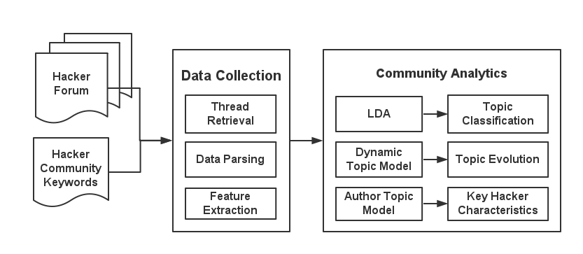
Research Design
Framework

Slide 16
Research Design
Data Collection
Thread Retrieval and Data Parsing
  Crawl and parse Baidu Tieba using Java programming
  Obtain all the threads, posts and authors in 19 specific forums
  Build up the database and store the data in MySQL
Feature Extraction
  Forum involvement features are collected including:
    # Posts
    # Starting Posts
    # Replies

Slide 17





Research Design
Topic Classification
LDA Model is used to analyze the text structure in a set of documents. It explores the topics used to generate every document and explain the distribution of words in documents by using topic distribution.
LDA assumes the following generative process for each document d:
Step 1. For each document d, draw topic distribution .
Step 2. For each topic k in the vocabulary, draw word distribution
.
Step 3. For each word in each document:
(a) Draw topic .
(b) Draw word .

Slide 18






Research Design
Topic Evolution
Dynamic topic model incorporate time into topic model, and it can describe the trend of the development of the topics.
The generative process for documents in different time period is:
( matches natural parameters to mean parameters)
Step 1. Draw hyper-parameters for topics .
Step 2. Draw natural parameters for words of each topics
.
Step 3. For each document in time period t:
(a) Draw natural parameters for topics .
(b) For each word :
(1) Draw .
(2) Draw .

Slide 19


Research Design
Key Hacker Characteristics
Author topic model emphasizes that it is authors, not documents, that use topics to generate words. It can tell us what topic distribution authors choose when they create documents.
The generative process for documents by different authors is:
Step 1. For each author a, draw topic distribution .
Step 2. For each topic k in the vocabulary, draw word distribution
.
Step 3. For each word in each document (when a is its author):
(a) Draw topic .
(b) Draw word .

Slide 20
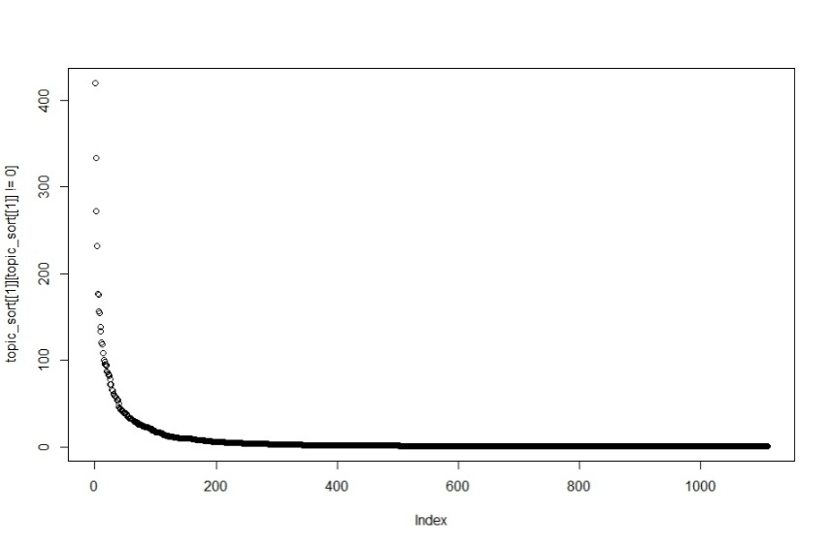
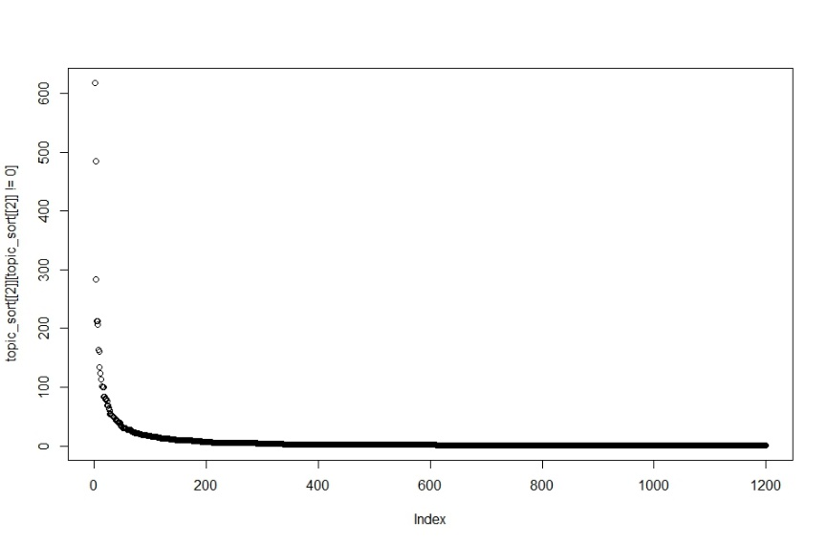
Results and Discussions
Topic Classification
Sorting the probability of keywords under each topic.
Selecting the most frequency keywords and predict the topics.
Figure 1. Keywords probability distribution of Topic 1
Figure 2. Keywords probability distribution of Topic 2

Slide 21
Results and Discussions
Topic Classification
Table 2. Topic classification details
ID | Related Topic | Percent | Keywords
01 | Trading | 13.80% | QQ, 料, 出售, 101, 收, 做, 无, 人, 朋友, 外料, 懂, 款, 201, etc.
02 | Fraud Prevention & Identification | 17.05% | 加, 骗子, qq, 骗, 联系方式, 留, 卖, 件, 死, 货, 支付宝, 妈, 发, etc.
03 | Recruiting people to make money together | 11.25% | 钱, 做, 只, 想, 说, 需要, 真, 现在, 找, 玩, 少, 赚, 游戏, 再, 不错, etc.
04 | Trading, recruitment | 5.43% | 交易, 中, 一个, 平台, 人, 本吧, 最, 问题, 进行, 新, 项目, 一定, etc.
05 | Contact for corporation | 15.18% | 联系, 顶, 卡, 靠谱, 机器, 电话, 微信, 原轨, 线, 外, 储, 要求, etc.
06 | Calling for corporation & devices | 9.71% | 合作, 求, 机, 企鹅, 采集, 长期, 留下, 技术, 楼, 设备, POS, etc.
07 | Casual chat | 7.30% | 人, 点, 主, 时, 说, 小, 事, 里, 知道, 一起, 太, 子, 女, 开, 哈哈哈, etc.
08 | Interception, laundering | 9.26% | 料, 拦截, 实力, 通道, 料主, 无密, 回, 老板, 洗拦截, 回款, 速度, etc.
09 | Contact for corporation | 6.52% | 好, 一个, 楼主, QQ, 支持, 手机, 请, 需要, 买, 找, 一下, 下, etc.
10 | Casual chat | 4.50% | 地板, 好, 梦, 爱, 粉, 后, 签到, 经验, 水, 贴, 殇, 干, 下, 再, 回复, etc.

Slide 22
Results and Discussions
Topic Evolution
To keep the accuracy of dynamic topic model, posts before Jul. 2012 which are so few that they are merged in this experiment.
The total time range are divided into 9 periods of time:
Table 3. # Posts of different time periods
Time ID | Time Periods | # Posts
1 | 2004.10.1 – 2012.6.30 | 478
2 | 2012.7.1 – 2012.12.31 | 29
3 | 2013.1.1 – 2013.6.30 | 218
4 | 2013.7.1 – 2013.12.31 | 1,082
5 | 2014.1.1 – 2014.6.30 | 182
6 | 2014.7.1 – 2014.12.31 | 151
7 | 2015.1.1 – 2015.6.30 | 516
8 | 2015.6.30 – 2015.12.31 | 4,027
9 | 2016.1.1 – 2016.2.31 | 3,111

Slide 23
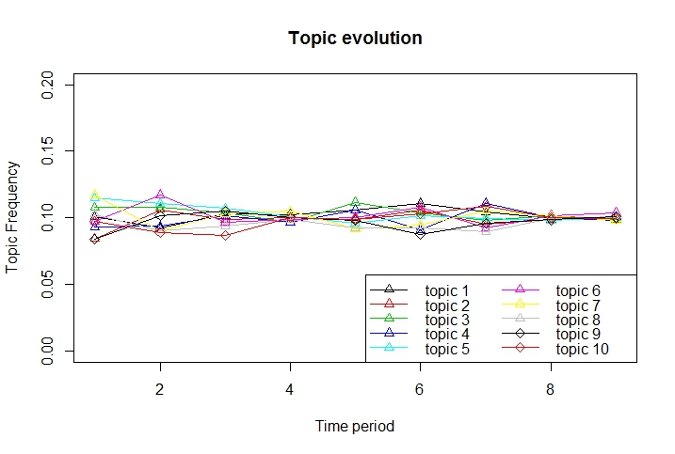
Results and Discussions
Topic Evolution
Figure 3 shows the trend of topic evolution. Topics tend to keep a constant percentage in the community and fluctuate with time.
Figure 3. Topic evolution

Slide 24
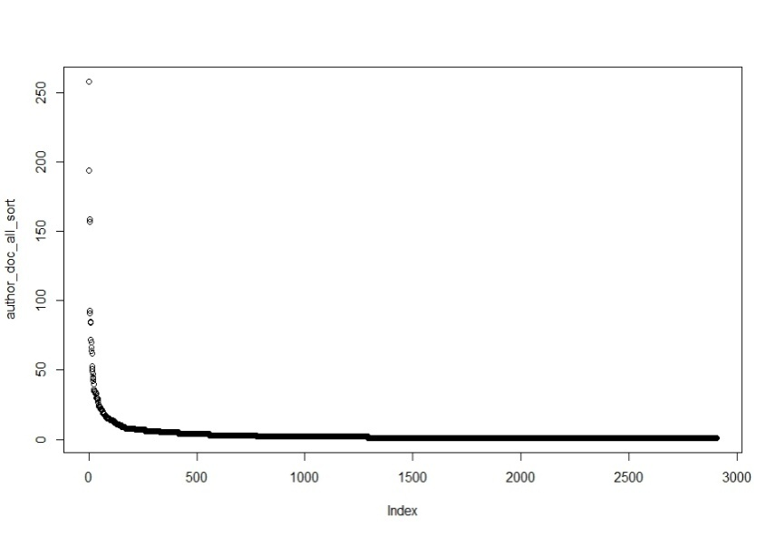
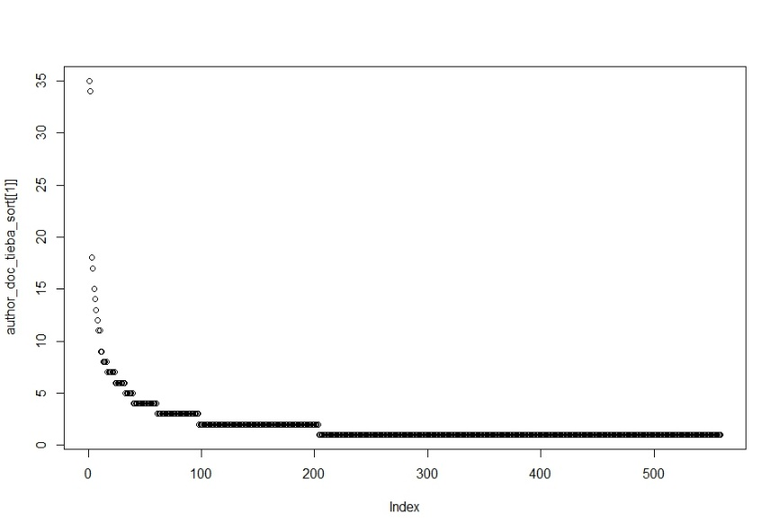
Results and Discussions
Key Hacker Characteristics
Posts number:
  Few hackers in the communities are extremely active, while most of members seldom posts and just observes.
Figure 4. Post number distribution in all the forums
Figure 5. Post number distribution in Forum 1

Slide 25
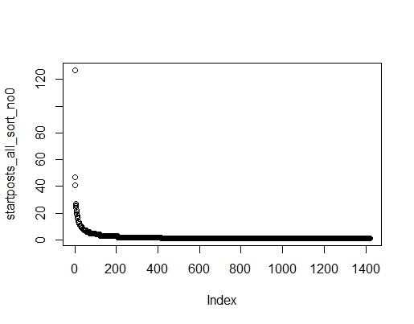
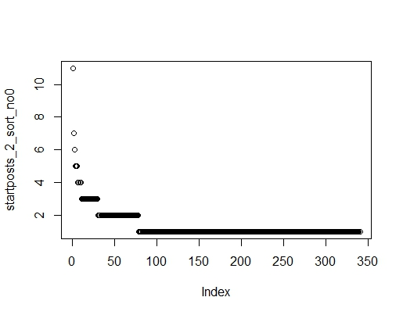
Results and Discussions
Key Hacker Characteristics
Starting posts number:
  Few hackers in the communities are extremely active, while most of members seldom posts and just observes.
Figure 6. Starting post number distribution in all the forums
Figure 7. Starting post number distribution in Forum 2

Slide 26
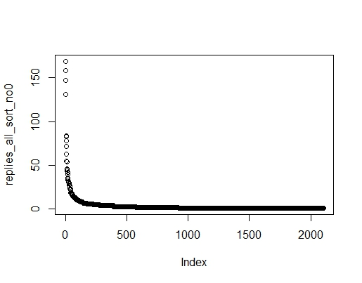
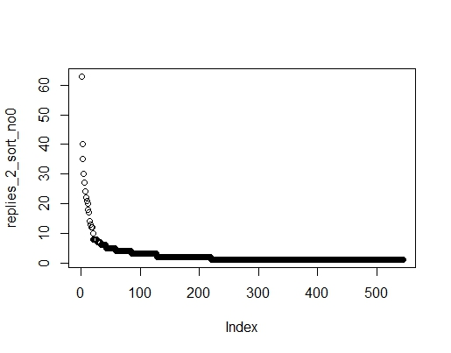
Results and Discussions
Key Hacker Characteristics
Replies number:
  Few hackers in the communities are extremely active, while most of members seldom posts and just observes.
Figure 8. Replies number distribution in all the forums
Figure 9. Replies number distribution in Forum 2

Slide 27
Results and Discussions
Key Hacker Characteristics
No large discrepancies are found among the key hackers by different definitions of # Posts, # Starting Posts and # Replies.
Table 4. Key hackers under different definitions
Definition | Top 20 key hackers in all the forums
# Posts | cv**vp, 外**家, 武**钱, **墓, me**ng, **max, **塞, 千**散, 老**伤, 财**66, 富**号, 快**66, sk**喵, 爱**活, 海**绿, 会**64, **X2, 勤**密, 酱**le, bb**63
# Starting Posts | cv**vp, 勤**密, 财**66, lo**gf, 富**号, 外**家, 新**心, 上**的, me**ng, 会**64, 玉**宝, 爱**活, 怖**首, bb**63, **盤, su**47, pr**哼1, 拦**78, sk**en, 0f**m
# Replies | 外**家, 武**钱, 闲墓, cv**vp, 千**散, **塞, 老**伤, me**ng, **max, 快**66, sk**喵, **X2, 海**绿, 富**号, 爱**活, 酱**le, 贝**商, Ca**墨, 话**长, 我**累

Slide 28
Results and Discussions
Key Hacker Characteristics
In terms of the total number of posts, we can detect the key members of a forum.
By observing the content posted by those key hackers, we can divide them into several types:
  Expert Trader: those who are active and expert in trading posts
  Forum Leader: those in the highest executive level of the forums
  Casual Talker: those who are active to post irrelevant spams
  Information Communicator: those who often reply with relevant information
Those who seldom talk in the community are defined as:
  Uninvolved Observer

Slide 29
Results and Discussions
Key Hacker Characteristics
Key Hacker examples:
  Expert Trader (135, 65.43%)
    me**ng, 老**伤, 财**66, 富**号, 快**66, 爱**活, 会**64, 勤**密, bb**63
  Forum Leader (51, 1.47%)
    **max, 0f**m, 仓*, cv**vp, 贴**会, sk**en,外**家, yy**08
  Casual Talker (34, 20.45%)
    武**钱, 闲*, 连*, 老**伤, s**喵, 海**绿, 羽**2, 酱*le
  Information Communicator (4, 12.64%)
    闲*, 连*, 千**散

Slide 30
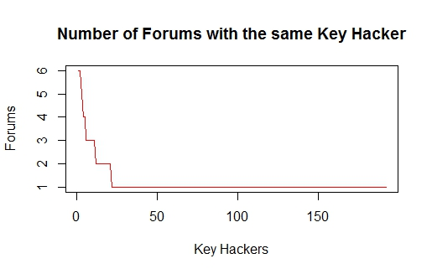
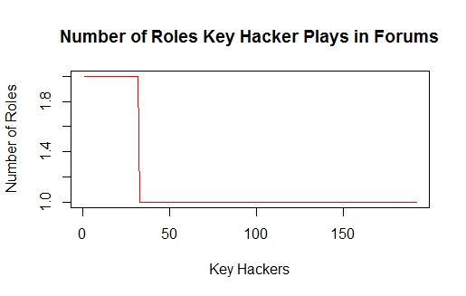
Results and Discussions
Key Hacker Characteristics
Most key hackers play an important role in only 1 forums, while few are active in several forums.
Almost all the key hackers are involved in 1 or 2 types.
Figure 10. Number of forums with the same key hacker
Figure 11. Number of forums with the same key hacker

Slide 31
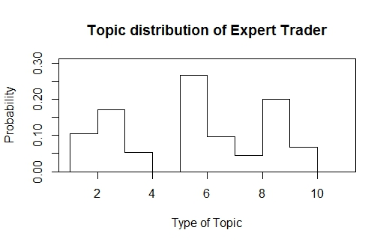
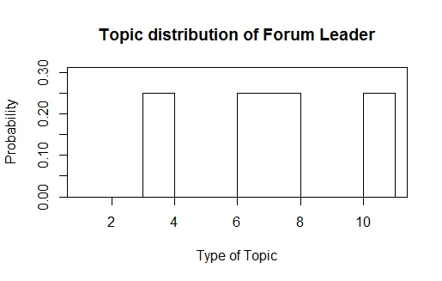
Results and Discussions
Key Hacker Characteristics
Which topics are key hackers interested in?
  Expert Trader:
    Topic # 05 Contact for corporation
    Topic # 08 Interception, laundering
    Topic # 01 Trading
  Forum Leader:
    Topic # 03 Recruiting people to make money together
    Topic # 06 Calling for corporation & devices
    Topic # 07 Casual chat
    Topic # 10 Casual chat
Figure 12. Topic distribution of Expert Trader
Figure 13. Topic distribution of Forum Leader

Slide 32
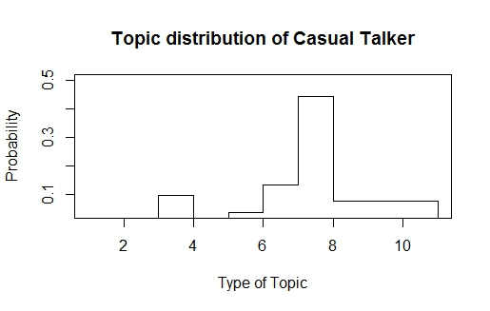
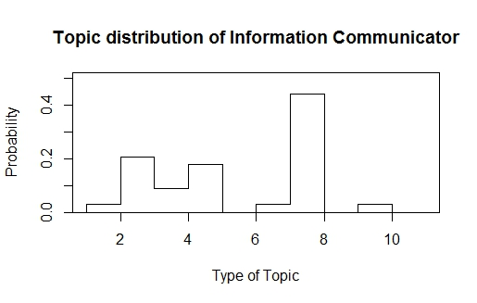
Results and Discussions
Key Hacker Characteristics
Which topics are key hackers interested in?
  Casual Talker:
    Topic # 07 Casual chat
    Topic # 06 Calling for corporation
    & devices
  Forum Leader:
    Topic # 07 Causal chat
    Topic # 02 Fraud Prevention & Identification
    Topic # 04 Trading, recruitment
Figure 14. Topic distribution of Casual Talker
Figure 15. Topic distribution of Information Communicator

Slide 33
Results and Discussions
Key Hacker Characteristics
Which topics are hottest in each forums?
Table 5. Hottest topics in each forums
Forum | Hottest Topics | Forum | Hottest Topics
01 | #4 (0.30), #7 (0.25), #3 (0.20) | 11 | #4 (1.00)
02 | #6 (0.35), #2 (0.20), #8 (0.20) | 12 | #8 (0.50), #3 (0.25), #9 (0.25)
03 | #8 (0.40), #2 (0.30), #3 (0.15) | 13 | #5 (0.77)
04 | #1 (0.35), #3 (0.15), #5 (0.15) | 14 | #2 (0.50), #3 (0.50)
05 | #2 (0.33), #7 (0.33), #8 (0.33) | 15 | #2 (0.30), #5 (0.30), #8 (0.20)
06 | #5 (0.78) | 16 | #2 (0.37), #1 (0.21)
07 | #6 (0.41) | 17 | #5 (0.57), #2 (0.29)
08 | #7 (0.40), #10 (0.20) | 18 | #5 (0.65),
09 | #7 (0.80) | 19 | #2 (0.50), #5 (0.50)
10 | #8 (0.75)

Slide 34
Conclusions
Topic Classification
  Topics in Chinese hacker communities basically include trading, calling for corporation and recruitments, interception and laundering, and casual chat.
Topic Evolution
  Topics tend to keep a constant percentage in the community and fluctuate with time.
Key Hackers Characteristics
  There are basically 4 types of key hackers who actively post in the community - Expert Trader, Forum Leader, Casual Talker, and Information Communicator.
  Each forum is like an information island, lacking communication with other forums. Different forums concern different topics and have different key hackers.
  Key hackers only focus on topics related to their types, rather than widely participant in different topics.

Slide 35
Implications and Future Work
Key Hackers Detection
  Based on the detected key hackers with topic modeling, we can have better control towards the Chinese hacker community.
Algorithm Improvement
  We make contributions to the applications of LDA Model in the background of Chinese Hacker issues.
  Other algorithms, costumed to Chinese online text, can be discussed in topic classification to improve the accuracy.
Better Data Source
  Baidu Tieba and QQ group are two major communities for Chinese hackers. The data from QQ group in the future may provide some other evidences on hacker topics.
Social Network Involved
  The social structure and network pattern of different hackers is still important and needs to be studied in the future.

Slide 36
References
Alsumait, L., Barbara, D., & Domeniconi, C. (2008). On-line LDA: Adaptive Topic Models for Mining Text Streams with Applications to Topic Detection and Tracking. IEEE International Conference on Data Mining (pp.3-12). IEEE.
Benjamin, V., & Chen, H. (2012). Securing cyberspace: Identifying key actors in hacker communities. IEEE International Conference on Intelligence and Security Informatics (pp.24-29).
Blei, D. M., Ng, A. Y., & Jordan, M. I. (2003). Latent dirichlet allocation. Journal of Machine Learning Research, 3, 993-1022.
Blei, D. M., & Lafferty, J. D. (2006). Dynamic topic models. ICML (pp.113--120).
Broniatowski, D. A., & Magee, C. L. (2010). Analysis of Social Dynamics on FDA Panels Using Social Networks Extracted from Meeting Transcripts. In Social Computing (SocialCom), 2010 IEEE Second International Conference on (pp. 329-334). IEEE.
Cao, L. & Tang, X. (2014) Topics and trends of the on-line public concerns based on Tianya forum. Journal of System Science and Systems Engineering. 23, 2, 212-230.
Carr, J. (2012). Inside cyber warfare - mapping the cyber underworld..Computers & Security, 31(6), 801.
Franklin, J., Perrig, A., Paxson, V., & Savage, S. (2007). An inquiry into the nature and causes of the wealth of internet miscreants. Ccs 07 Acm Conference on Computer & Communications Security (Vol.45, pp.375-388).
Herley, C., & Florêncio, D. (2010). Nobody Sells Gold for the Price of Silver: Dishonesty, Uncertainty and the Underground Economy. Springer US.
Hu, J., Sun, X., Lo, D. & Li, B. (2015) Modeling the Evolution of Development Topics using Dynamic Topic Models. Software Analysis, Evolution and Reengineering (SANER), 2015 IEEE 22nd International Conference on, Montreal, QC, 2015, 3-12.
Holt, T. J., & Lampke, E. (2010). Exploring stolen data markets online: products and market forces. Criminal Justice Studies, 23(23), 33-50.

Slide 37
References
Holt, T. J., Strumsky, D., Smirnova, O., & Kilger, M. (2012). Examining the social networks of malware writers and hackers. International Journal of Cyber Criminology, 6(1).
Lu, Y. (2009). The social organization of a criminal hacker network: a case study. International Journal of Information Security & Privacy,3(2), 90-104.
Lu Y (Lu, Yong), Polgar M (Polgar, Michael), Luo X (Luo, & Xin), et al. (2010). Social network analysis of a criminal hacker community. Journal of Computer Information Systems, 51(2), 31-41.
Rosen-Zvi, M., Griffiths, T., Steyvers, M., & Smyth, P. (2004). The author-topic model for authors and documents. Conference on Uncertainty in Artificial Intelligence (pp.487-494). AUAI Press.
Song, Y., Pan, S., Liu, S., Zhou, M. X., & Qian, W. (2009). Topic and keyword re-ranking for LDA-based topic modeling.. ACM Conference on Information and Knowledge Management, CIKM 2009, Hong Kong, China, November (pp.1757-1760).
Xu, Z., Ru, L., Xiang, L. & Yang, Q. (2011). Discovering User Interest on Twitter with a Modified Author-Topic Model. In Proceedings of the 2011 IEEE/WIC/ACM International Conferences on Web Intelligence and Intelligent Agent Technology. IEEE Computer Society, Washington DC, USA, Vol. 1. 422-429.
Zhang, X., Tsang, A., Yue, W. T., & Chau, M. (2015). The classification of hackers by knowledge exchange behaviors. Information Systems Frontiers, 17(6), 1239-1251.
Zhao, Q., Qin, Z., & Wan, T. (2011). Topic Modeling of Chinese Language Using Character-Word Relations.. Neural Information Processing - 18th International Conference, ICONIP 2011, Shanghai, China, November 13-17, 2011, Proceedings, Part III (Vol.7064, pp.139-147).
Zhuge, J., Holz, T., Song, C., Guo, J., Han, X., & Zou, W. (2009). Studying malicious websites and the underground economy on the chinese web. Managing Information Risk & the Economics of Security, 225-244.
Zhuge, J., Duan, H., & Gu, L. (2012). Studying Malicious Websites and the Underground Economy on the Chinese Web. China Information Security, 9, 54-71.

