Slide 1
An SIR Model for Violent Topic Diffusion in Social Media
J. Woo, J. Son, and H. Chen
AI Lab, University of Arizona
Acknowledgements: DOD, DTRA, CTFP, NPS; NSF CRI; NSF EXP-LA; (ARFL WMD, CIA, FBI)

Slide 2
Research Background
1. Introduction
Opinion formation through web 2.0
Web has evolved to become a global platform through which anyone can conveniently disseminate, share, and communicate ideas (Chen, 2008)
People share various news/information on technological innovation, political and social issues through blogs, web forums, social networking sites, etc.
They form new political, economic, social opinion by sharing their views and discussing with others
The prevalence of social media makes information/opinion more contagious and speeds up its diffusion
Positive aspects of political use of social media
Politicians are using the web 2.0 platform to deliver their messages to citizens
Blogs are used to advertise candidates/policies/campaigns
Web forums are used to investigate public opinion and reflect it into policy

Slide 3
Research Background
1. Introduction
Negative aspects of political use of social media
Terrorists use the web to deliver the extreme ideology to people and encourage them to get involved in fanatic behaviors
Insurgents in Iraq have posted Web messages asking for munitions, financial support, and volunteers (Blakemore, 2004)
Technology Studies identified five categories of terrorist use of the Web (Technical Analysis Group, 2004): propaganda (to disseminate radical messages); recruitment and training, fundraising; communications, and targeting (to conduct online surveillance and identify vulnerabilities of potential targets such as airports)
Extreme ideology that was restricted to small group spreads easily though social media such as web forum, blog, video sharing site, social network sites, etc.

Slide 4
Research Background
1. Introduction
Thought contagion and spread of opinion
Lynch (1996) suggested that people’s opinions and thoughts are contagious
A rumor, a political message, or a link to a web page are all examples of information that can spread from person to person, contagiously, in the style of an epidemic (Kleinberg, 2008)
Due to similarities in the patterns of the spread of epidemics and opinion contagion processes, it is natural to address opinion contagion using the same theoretical principles of the epidemic
Importance of research on the on-line information diffusion
As the influence of social media becomes more powerful, it is necessary to understand the mechanisms and properties of information diffusion, especially extreme opinion, through these new publication methods for politics perspectives

Slide 5
Previous Research
2. Literature Review
Some research studied information diffusion in the society in political perspective
Some researchers studied the mechanism of anti-government opinion, extreme ideology, fanatic behaviors and explored diffusion models in their applications
They mainly adopted the epidemic model based on the contagion of ideology
There is limited research on the on-line information diffusion in political perspective
Most studies that deal with information diffusion on blog, email network, and discussion forum have been performed for marketing perspective, especially for viral marketing
Few studies investigate political blogs to find influential blogger based on link-based analysis
According to the previous studies, the personal blog has failed to recast its messages to other bloggers (Chen 2009)
Web forums, where people with common interests share/discuss opinion, are probable for the diffusion study

Slide 6
Epidemiology in Extreme Ideology
2. Literature Review
Epidemic model in extreme ideology diffusion
Crenshaw (2000) noted that research in psychological motivations for terrorism should be based upon models that acknowledge the interaction between individual, group, and society
Epidemic models assist in modeling the spread of ideas and explaining following questions (Valenty, 2005)
What facilitates the spread of ideology/idea?
What is the transmission mechanism for ideology/idea?
Epidemic process of ideology contagion
Once individuals have received the message(s), some proportion will proceed to move sequentially through the ideological stages of vulnerability and semi-fanaticism, ending with full fanaticism (Valenty, 2005)

Slide 7
Models in Political Information Diffusion
2. Literature Review
Classifications of epidemic models
Population Level
Population-level models trace the diffusion process where the individuals have contact randomly, i.e. anyone can have a contact with anyone
SIR and its variant models divide the population into classes and derive the interaction rules between the classes
Network Level
Network-level models consider the social network in the population
The properties of social networks determine the rate and success of the spread of disease/ideology
Threshold models (Granovetter, 1987) assume that individuals get infected after the certain proportion of the population are infected
Independent cascade model (Goldenberg, 2000, 2001) assume that individuals get infected with connected neighbor with a certain probability
Individual Level
Agent-based models define rules at the individual level, which allows the capture of local interactions and individuals’ adaptive behaviors
7

Slide 8
Review of Recent Research
2. Literature Review
Epidemic modeling in the society
Fan (2003) applied the ideodynamics model to predict the time trend of public opinion about the economy
Santonja et al. (2008) built the epidemic model to express how extreme behavior spreads to the population and validated the model using voting data
Romero et al. (2009) built an epidemic model that incorporates three classes of susceptibles, third party voters, and third party members and validate the model using real data
Stauffer and Sahimi (2006) studied the mechanisms of spread of extreme opinions using epidemic model that has the exposed period and simulated the diffusion process in scale-free network
Carley et al. (2006) simulated Bio-terror events using agent-based model
8

Slide 9
Review of Recent Research
2. Literature Review
Epidemic modeling in on-line media
Blog
From the early experience of powerful blogger to politics, there have been studies that analyze political blog connection (Adamic, 2005)
They were trying to find out influential political bloggers to examine how much they affect to others and from where to where influence flows
Yano (2009) modeled discussions in online political blogs from posts, the authorship, and comments
Video sharing site (Youtube)
Boynton (2009) studied the dynamics of attention by examining videos of the campaign and using proposed equation-based models
9

Slide 10
Research Gaps and Study Aim
3. Research Design
There is limited research on modeling of extreme idea diffusion
Especially, in the cyberspace, even though extremists use the web to diffuse their idea, few studies attempt to explain the mechanism behind of idea diffusion
Among other social media, the web forum where is open to web users and anyone express their ideas and interact with others is a good example to find out the mechanism of idea diffusion
We aim to study how topical discussion diffuses between authors in a political forum
We will model the diffusion process of violent topics in the dark web forum and political topics in the general political forum using the baseline model (SIR model)

Slide 11
SIR Model for Web Forum
3. Research Design
SIR model (Kermack,1927) in the web forum context
S:Possible
authors
Transfer with rate of α
I:Current
authors
Transfer with rate of β
R:Past
authors
Elements | Topic diffusion in web forums
What flows | Topics (key words)
S: Susceptible | Authors (including commenter) who might read posts (comment or thread) on the topic
I: Infective | Authors who write posts on the topic
R: Rcovered | Authors who no longer write posts on a topic
Infection rate : α | The probability of writing a comment or thread after reading posts on the topic
Recovery rate : β | The probability that authors lose infectivity to other authors

Slide 12
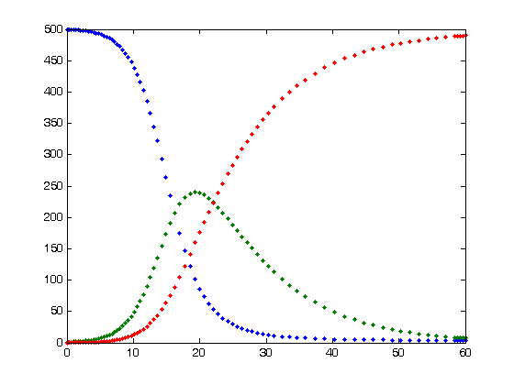
SIR Model for Web Forum
3. Research Design
Interaction Rule
Possible authors/commenters are initially susceptible (S)
They become infected (I) ,i.e. write thread or leave comments on other threads ,with probability α if they read posts about a topic
Then some of authors and commenters will recover with probability β when their posts lose infectivity to others
Mathematical Formulation of SIR model (Kermack,1927)
S(t) : the number of possible authors at time t
R(t) : the number of recovered authors a time t
I(t) ; the number of infective authors at time t

Slide 13
Research Framework
3. Research Design
Data Collection
Time-series Pattern Derivation
Model Fitting
Web forum
Parser
Topic-based Time Series Extraction
Parameter Initialization
-Initial susceptibles, Equation parameters
Spider
Web forum
Spiky Topics Identification
Calculation
- Estimation of infectives
-Objective function
Topic Extraction
Model Setting
Parameter Adjustment
- based on objective function and algorithm
Mutual Information :
Key phrase Extractor
Status-change Rules Definition
Topics
Objective Function & Optimization Algorithm setting
Optimal
Parameter set

Slide 14
Parameter Estimation
3. Research Design
Fitting procedures
There is no closed-form solution to a non-linear problem
Instead, numerical algorithms are used to find the value of the parameters that minimize the objective
χ2 goodness-of-fit, which is based on minimizing the statistic, sum of square error, is adopted
Genetic algorithm is adopted for estimation tool

Slide 15
Validation Metrics
3. Research Design
The goodness of fit of the model (Bass, 1969)
It is estimated from whole data; in particular, the fit of the epidemic diffusion curve to the time series data,

Slide 16
Experiment Design
3. Research Design
Research Testbed
Dark Web forum
Ummah (Period : 2002-04-01 ~ 2010-04-01 , Posts :1,263,724, Threads: 76,242, Members:15,345)
Evaluation Metrics
Data fitting : MSE and R-square
Parameter Optimization
Genetic algorithm is used for SIR model with a objective function

Slide 17
Experiment Design
4. Experiment Results
Topic Extraction
The Mutual Information (MI) phrase extractor is used to extract the major topics (phrases) from the online discussions
Mutual information is commonly used to measure how consistently two patterns occur together
The identified phrases are the series of words that contain the information representing the documents
The important topics are selected according to their frequency of appearance

Slide 18
Topic Extraction
4. Experiment Results
Key Topics
Recent key topics are extracted during 2009-01~2009-12 based on the frequency and one controversial topic is added

Slide 19
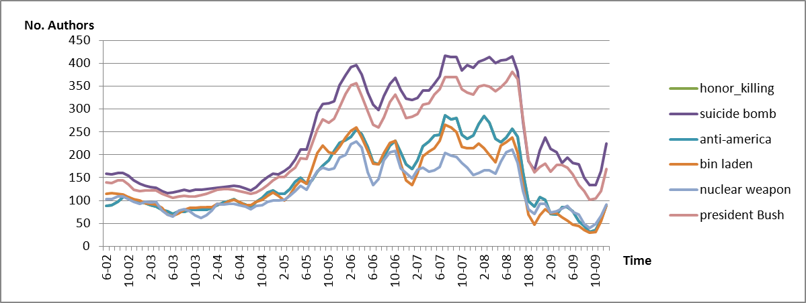
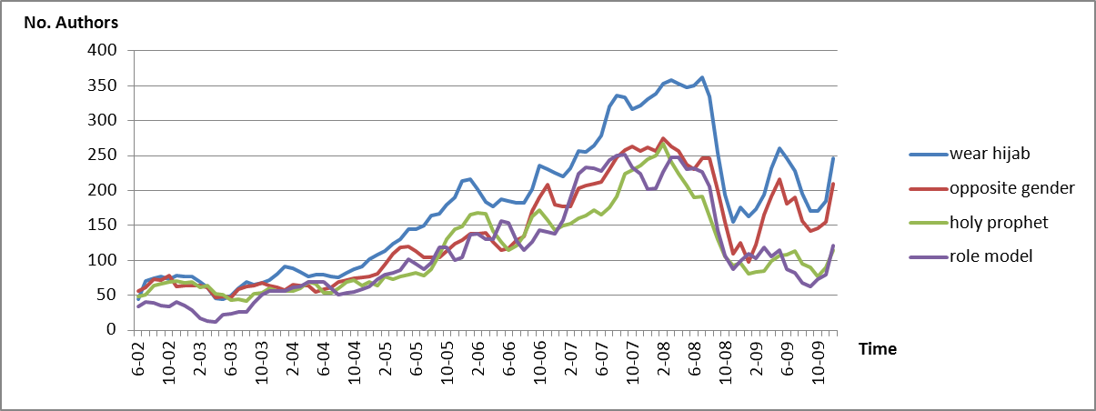
Topic Extraction
4. Experiment Results
Topic Classification
Time-series trends of the controversial topics with high frequencies are displayed in two categories of violent topics and general topics
Violent Topics
General Topics

Slide 20
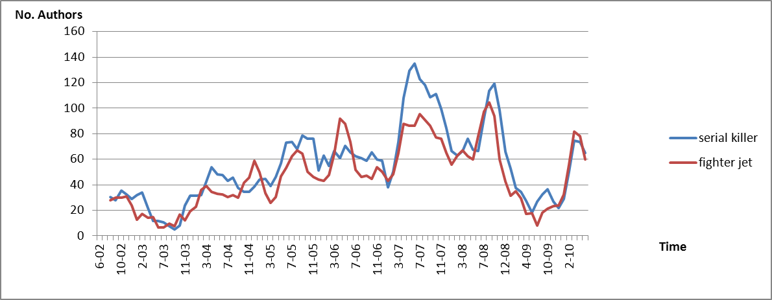
Topic Extraction
4. Experiment Results
Topic Classificaton
The symmetric curve indicates the existence of strong infection in the diffusion process
Strong Infection Topics
Weak
Infection Topics

Slide 21
Key Topic Examination
4. Experiment Results
Key Topic : Anti-Americanism
Keyword : (Hate, kill, hit, anti) & America
Background
Among especially Muslims in the middle east countries, America’s political participation in their countries resulted in widespread anger against America
In the forum, many author express their hates on western countries, especially America
Example
Americans on this forum(Replies: 149, Views: 2,150)
Arent you irritated/turned off by all the foreigners who think they know our culture or try to bash our country? Seriously getting tired of this. They act like their country is perfect. It is funny though because a lot of people bash America and at the same time when they need our help they come running to us.
Maybe because of our foreign policy bro. I live in America and also the way we always support israel disregarding the killed Palestinians. So Excuse me, are you troubled by the fact that OUR tax dollars are being spent in killing innocent people in Gaza?

Slide 22
Key Topic Examination
4. Experiment Results
Key Topic : Suicide Bomb
Keyword: suicide & (attack, bomb, terror)
Background
The number of attacks in forms of suicide bombings has grown, and become a common feature in Iraq and Afghanistan as young people get infected by extreme ideology
This topic is the one of the most controversial issues in the forum
People who have extreme opinion express their support for suicide bombing
Example
Suicide bombing and terrorism declared as unislamic (Replies: 42, Views: 395)
The news comes as the Islamic group Minhaj-ul-Quran releases in Britain a 600-page document condemning terrorism.… It is one of the most comprehensive documents of its kind to be published in Britain
Most people here have a negative view of him. What exactly constitutes terrorism in his eyes?

Slide 23
SIR Model Fitting: Infectious Violent Ideas
4. Experiment Results
Parameter Estimation
The fitness function values and estimation values for parameters of the SIR model are shown in the table
SIR modeling for extremist forums has consistently high R-square for model fitting
About 1,500 initial susceptible authors (out of 15,000 total forum members); about 4-7 authors out of 10,000 get infected; about 3-5 authors out of 100 recover.
Some topics are more infectious than others and have more staying power

Slide 24
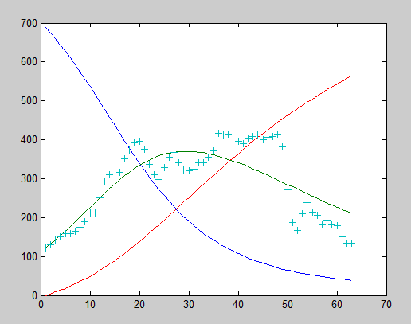
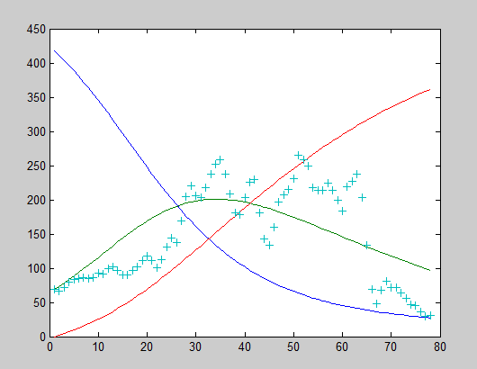
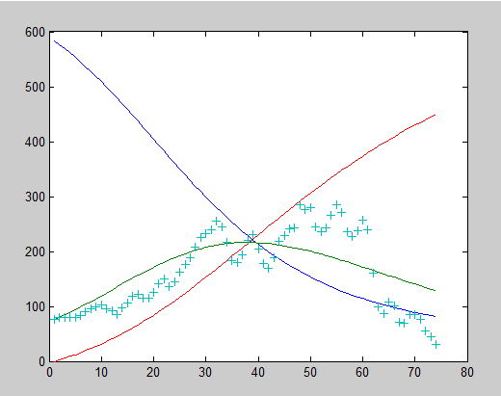
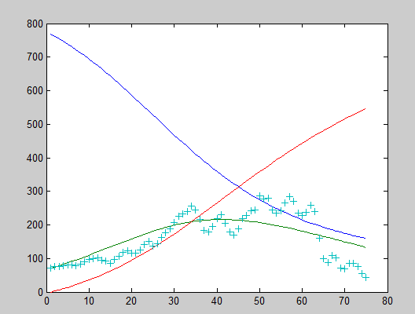
Estimation Curves
4. Experiment Results
Suicide bomb
Bin Laden
Anti-Americanism
Honor killing

Slide 25
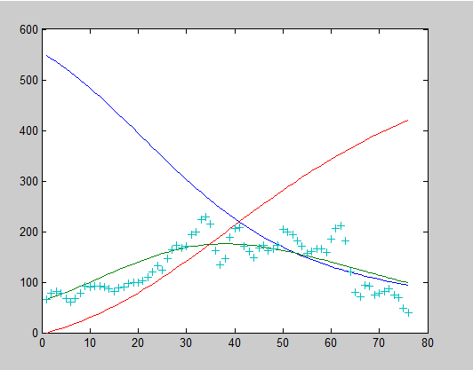
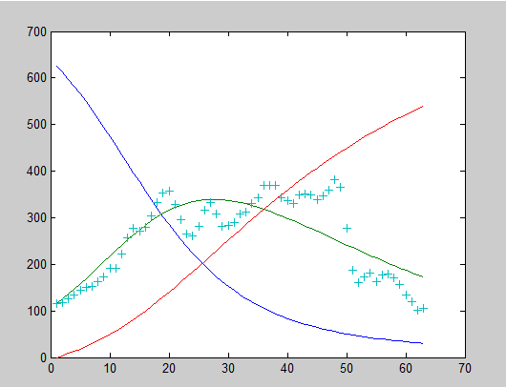
Estimation Curves
4. Experiment Results
Nuclear Weapon
George Bush
From the estimation curve, the future pattern can be approximately by extrapolation
“Suicide bomb”, “Bin laden”, and “President Bush” topics have few susceptibles at end of the estimation period, so the diffusion process will end soon after infected authors recover
“Anti-America”, “Honor killing”, and “Nuclear weapon” topics will last longer than the previous three topics since they have more susceptibles

Slide 26
Discussion
4. Experiment Results
Among top frequent topics, violent topics embed strong infection pattern than general topics
The SIR model performed well in modeling of the number of involving authors on a topic
The fitting result using genetic algorithm provided good results with R-square values that range from 0.5 to 0.7
For top 5 violent topics, the infection rates are estimated at the same value; the recovery rates differ on topics
The high overlap of authors for 6 topics results in similar diffusion process

Slide 27
Conclusion
5. Conclusion
Conclusions
Topic diffusion process in the web forum can be described as the disease diffusion process, which is based on the contagion between susceptible and infective
The probability that forum users get involved in a topic can be aggregated and be described as a specific value
Contributions
We extended the information diffusion research to a new domain: web forums
We also examined the possibility of applying the epidemic model to topic diffusion in web forums
Future research
Incorporating external events into social media SIR: Event-based SIR for Dark Web
Incorporating sentiment into social media SIR: Sentiment-based SIR for Dark Web
Social media SIR modeling for geopolitial events: SIR for GeoPolitical Web

Slide 28
Comments Welcome!
Hsinchun Chen, Ph.D.
hchen@eller.arizona.edu
http://ai.arizona.edu

