Slide 1
Logistic Regression & Elastic Net
Weifeng Li and Hsinchun Chen
Credits: Hui Zou, University of Minnesota Trevor Hastie, Stanford University Robert Tibshirani, Stanford University

Slide 2
Outline
Logistic Regression
Why Logistic Regression?
Logistic Regression Model
Fitting Logistic Regression
Application: Making Predictions
Regularization
Motivation
Ridge regression
LASSO
Elastic Net
Elastic Net Application
Elastic Net v.s. LASSO
Elastic Net Extensions: Sparse PCA & Kernel Elastic Net
Conclusion

Slide 3
Outline
Logistic Regression
Why Logistic Regression?
Logistic Regression Model
Fitting Logistic Regression
Application: Making Predictions
Regularization
Motivation
Ridge regression
LASSO
Elastic Net
Elastic Net Application
Elastic Net v.s. LASSO
Elastic Net Extensions: Sparse PCA & Kernel Elastic Net
Conclusion

Slide 4
Why use Logistic Regression?
The dependent variables in many research problems are “limited” to a couple of categories.
Examples:
Whether a user in the hacker community is a key criminal
Whether a piece of text in the hacker social media implies a potential threat
Whether a patient is diabetic given her symptoms
Whether the mention of a drug along with some complications suggests Adverse Drug Effect

Slide 5
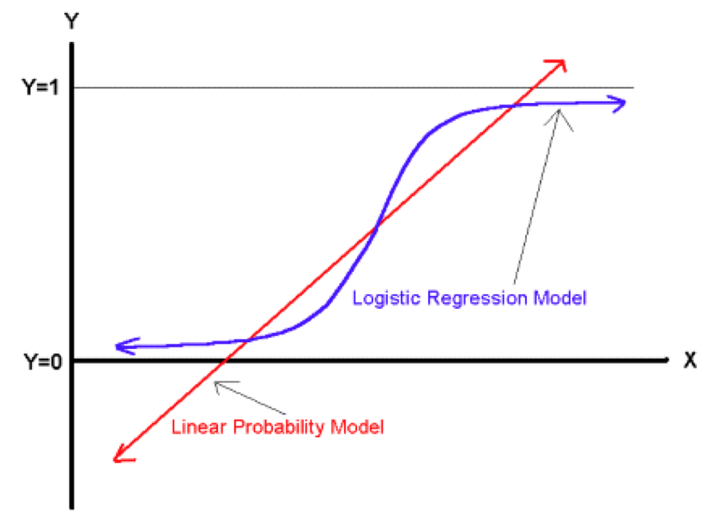

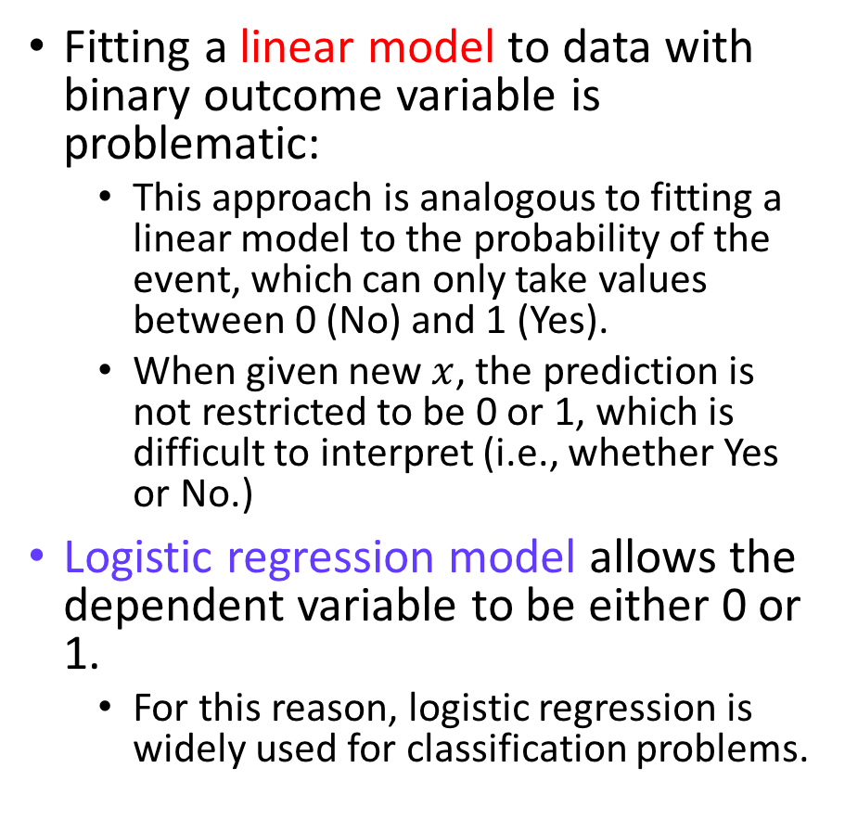
Limitations with Linear Regression
Fitting a linear model to data with binary outcome variable is problematic:
This approach is analogous to fitting a linear model to the probability of the event, which can only take values between 0 (No) and 1 (Yes).
When given new $x$, the prediction is not restricted to be 0 or 1, which is difficult to interpret (i.e., whether Yes or No.)
Logistic regression model allows the dependent variable to be either 0 or 1.
For this reason, logistic regression is widely used for classification problems.
y
Linear Model
Yes
Binary Outcome
Prediction: Yes? No?
$$x^{new}$$
x
No

Slide 6
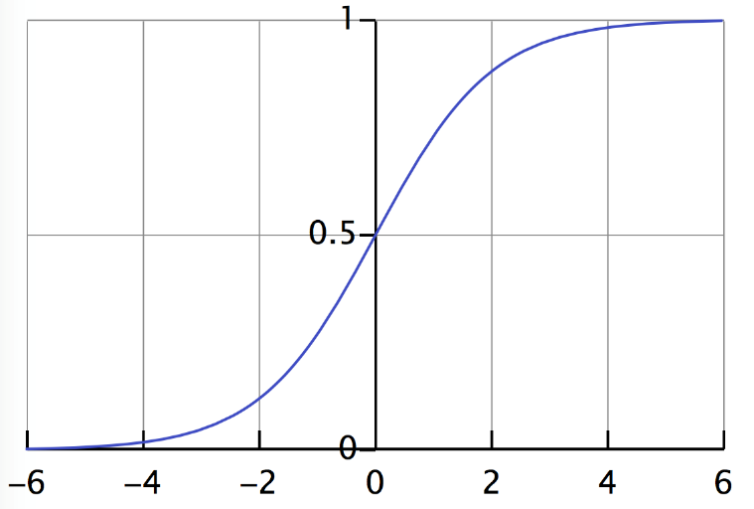
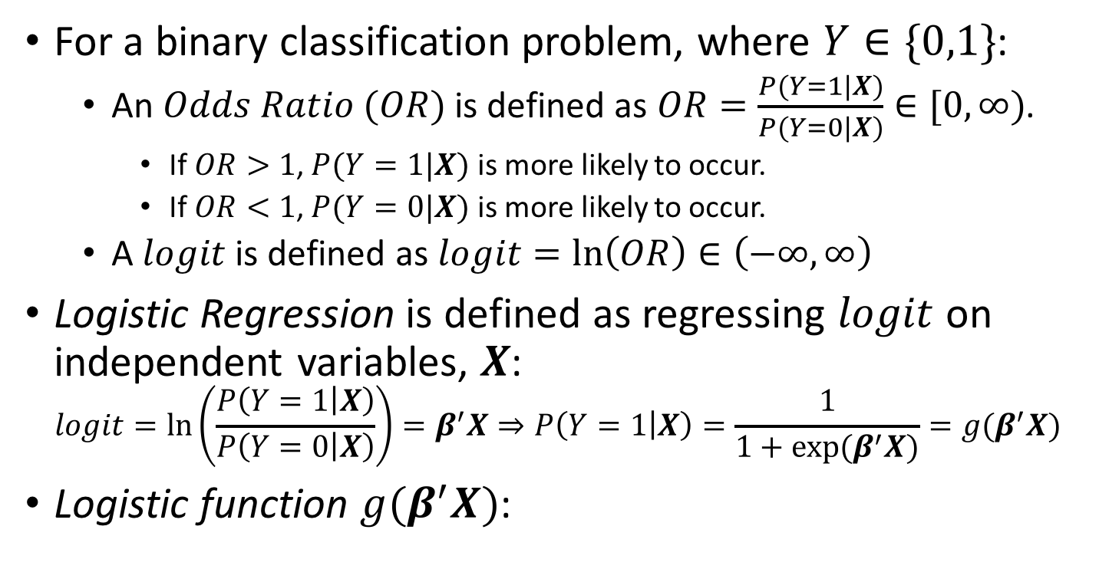
Logistic Regression
For a binary classification problem, where $Y∈\{0,1\}$:
An $Odds Ratio (OR)$ is defined as $OR=\frac{P(Y=1|X)}{P(Y=0|X)}∈[0,∞)$.
If $OR>1$, $P(Y=1|X)$ is more likely to occur.
If $OR<1$, $P(Y=0|X)$ is more likely to occur.
A $logit$ is defined as $logit=\ln\left(OR\right)∈\left(−∞,∞\right)$
Logistic Regression is defined as regressing $logit$ on independent variables, $X$: $logit=\ln\left(\frac{P\left(Y=1 | X\right)}{P\left(Y=0 | X\right)}\right)=β^{′}X⇒P\left(Y=1 | X\right)=\frac{1}{1+exp⁡(β^{′}X)}=g(β^{′}X)$
Logistic function $g(β^{′}X)$:
Notes:
wiki

Slide 7
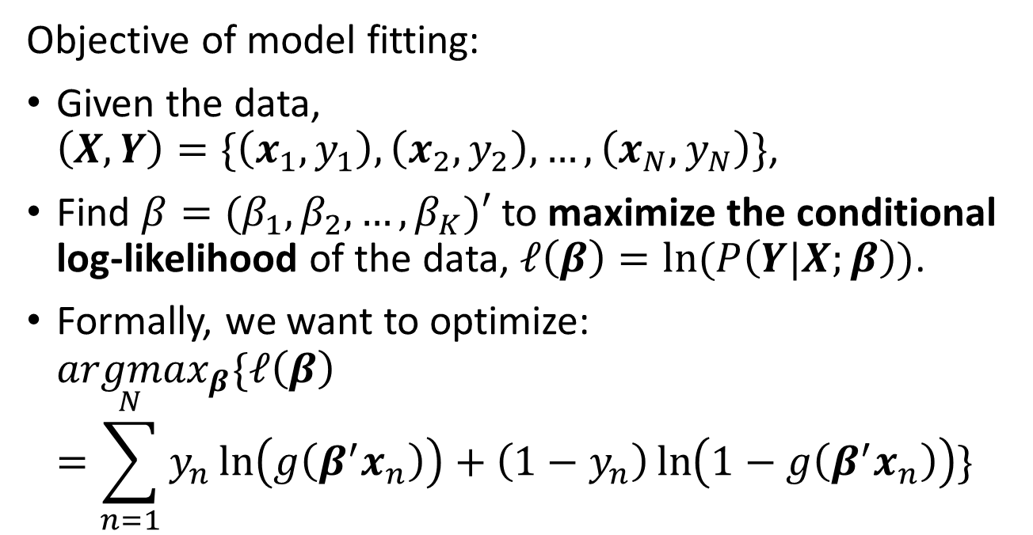
Fitting Logistic Regression Models
Objective of model fitting:
Given the data, $\left(X,Y\right)=\{\left(x_{1},y_{1}\right),\left(x_{2},y_{2}\right),…,\left(x_{N},y_{N}\right)\}$,
Find $β=(β_{1},β_{2},…,β_{K})′$ to maximize the conditional log-likelihood of the data, $ℓ\left(β\right)=ln⁡(P\left(Y|X;β\right))$.
Formally, we want to optimize: ${argmax}_{β}\{ℓ\left(β\right)=\sum_{n=1}^{N}{y_{n}\ln\left(g\left(β^{′}x_{n}\right)\right)+\left(1−y_{n}\right)\ln\left(1−g\left(β^{′}x_{n}\right)\right)}\}$
Notes:
cs229

Slide 8
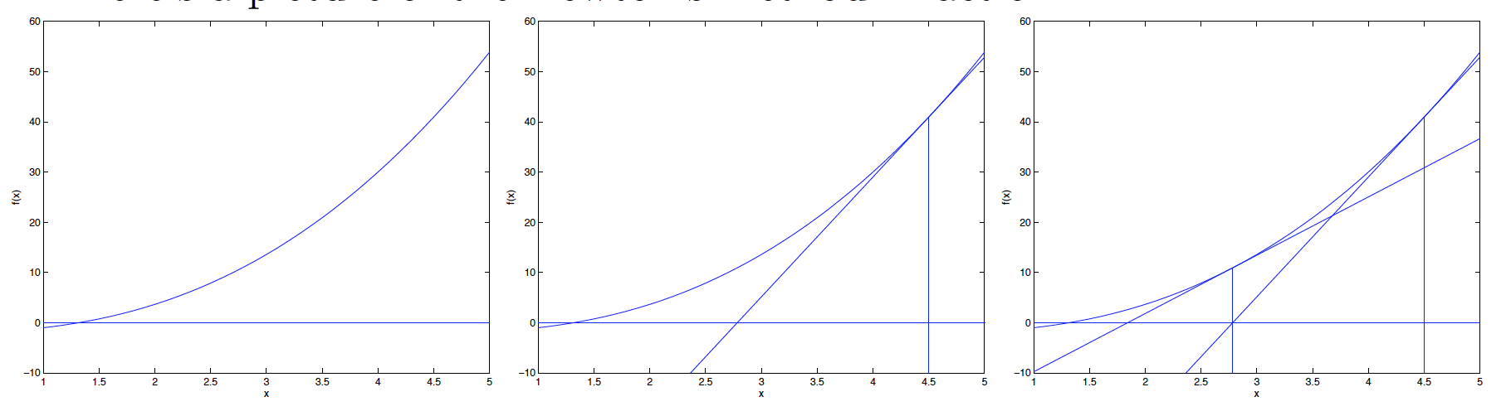



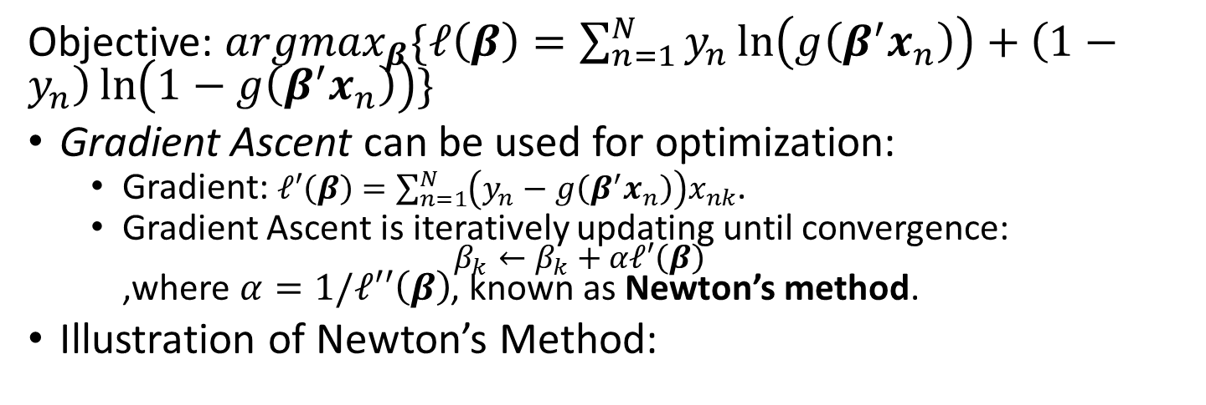
Fitting Logistic Regression Models
Objective: ${argmax}_{β}\{ℓ\left(β\right)=\sum_{n=1}^{N}{y_{n}\ln\left(g\left(β^{′}x_{n}\right)\right)+\left(1−y_{n}\right)\ln\left(1−g\left(β^{′}x_{n}\right)\right)}\}$
Gradient Ascent can be used for optimization:
Gradient: $ℓ′\left(β\right)=\sum_{n=1}^{N}{\left(y_{n}−g\left(β^{′}x_{n}\right)\right)x_{nk}}$.
Gradient Ascent is iteratively updating until convergence: $β_{k}←β_{k}+αℓ′\left(β\right)$ ,where $α=1/ℓ′′\left(β\right)$, known as Newton’s method.
Illustration of Newton’s Method:
$$β^{1}$$
$$β^{initial}$$
$$β^{3}$$
Notes:
cs229

Slide 9
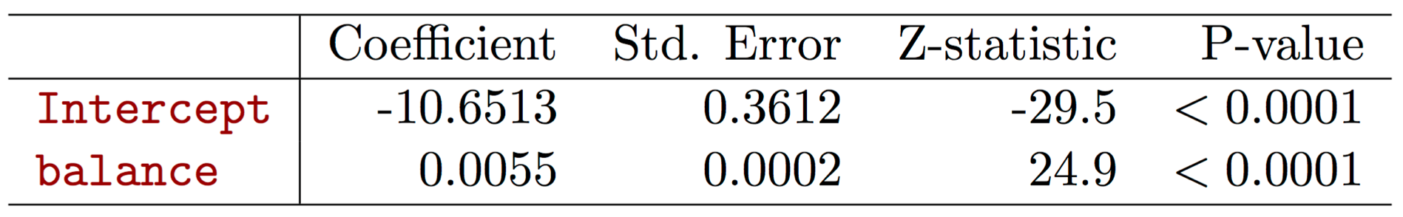
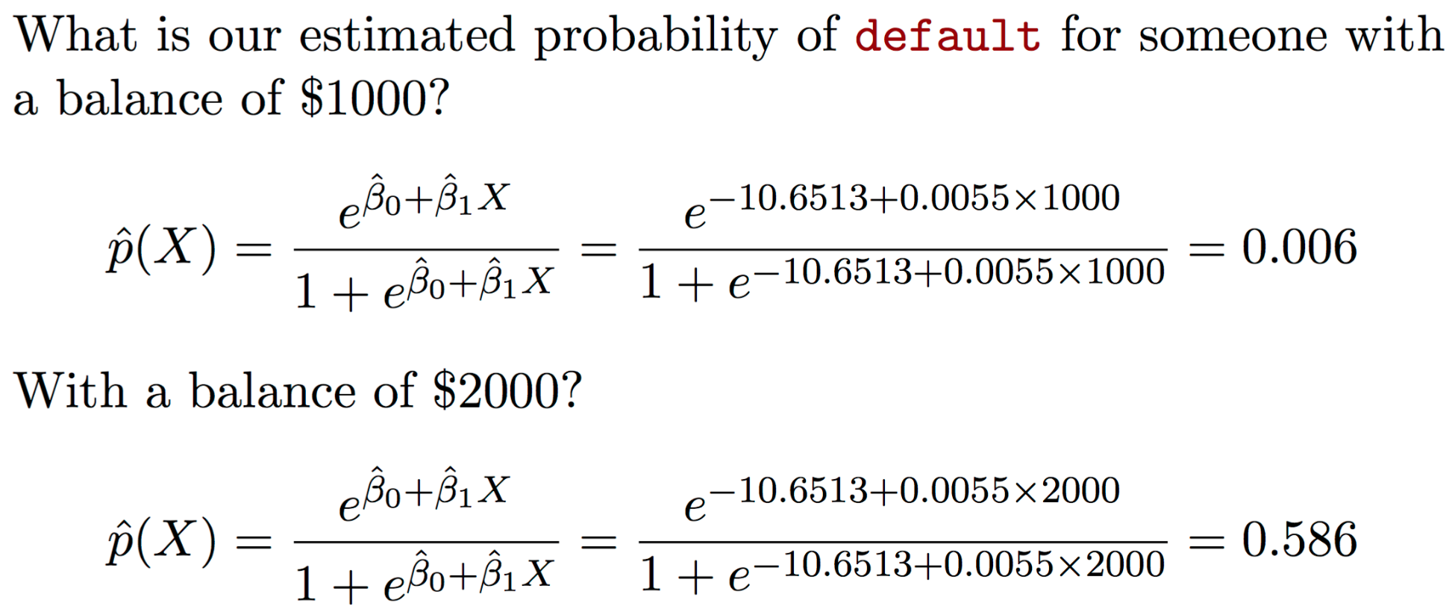
Application: Making Predictions

Slide 10
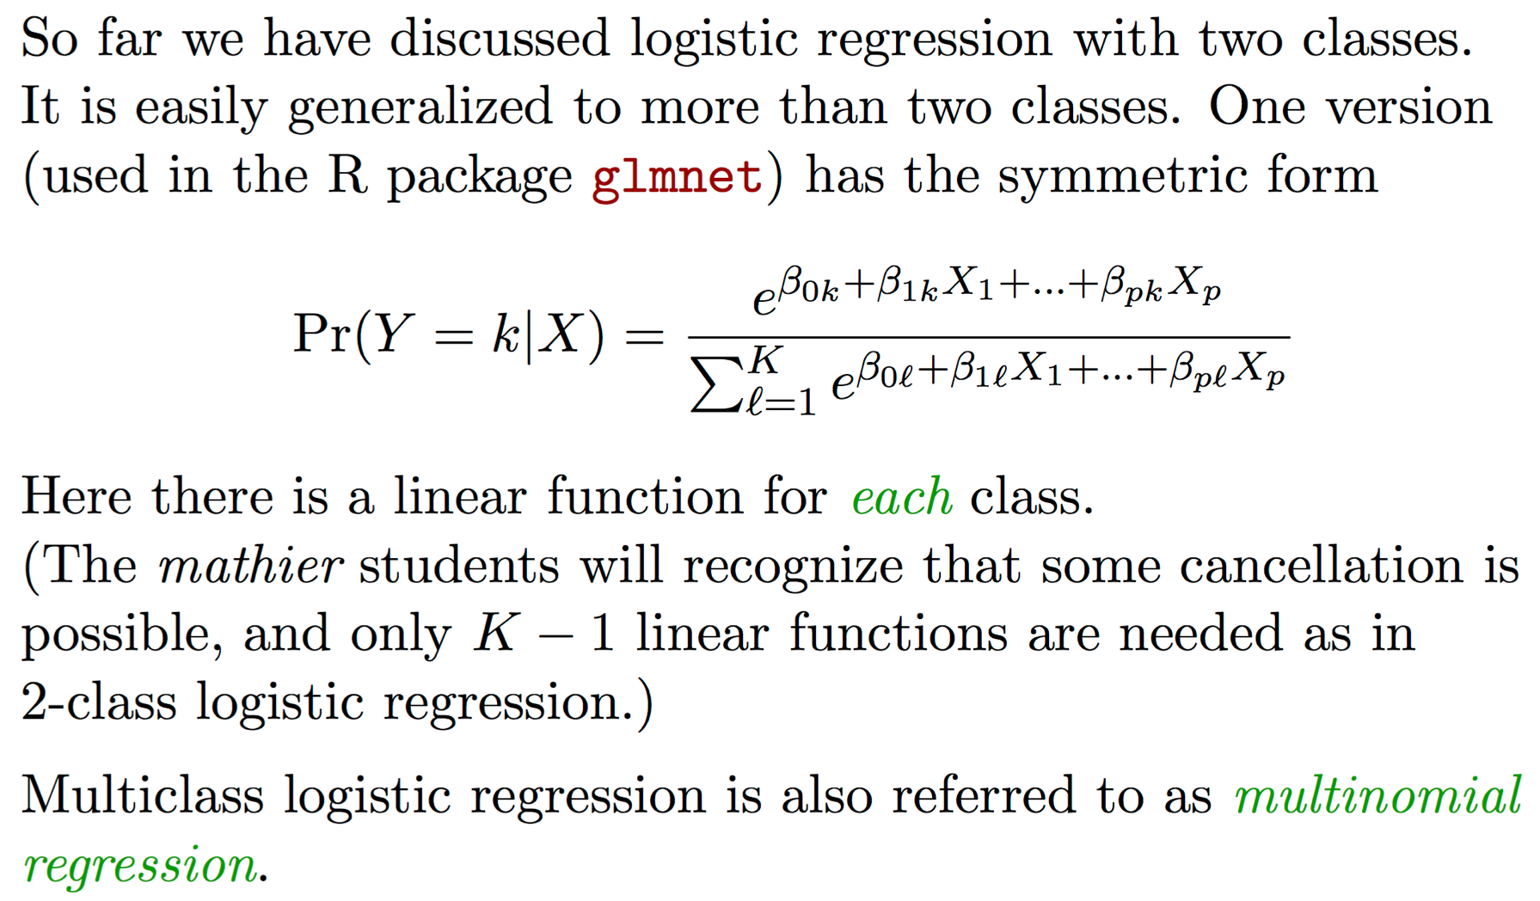
Logistic Regression with More than Two Classes

Slide 11
Outline
Logistic Regression
Why Logistic Regression?
Logistic Regression Model
Fitting Logistic Regression
Application: Making Predictions
Regularization
Motivation
Ridge regression
LASSO
Elastic Net
Elastic Net Application
Elastic Net v.s. LASSO
Elastic Net Extensions: Sparse PCA & Kernel Elastic Net
Conclusion

Slide 12
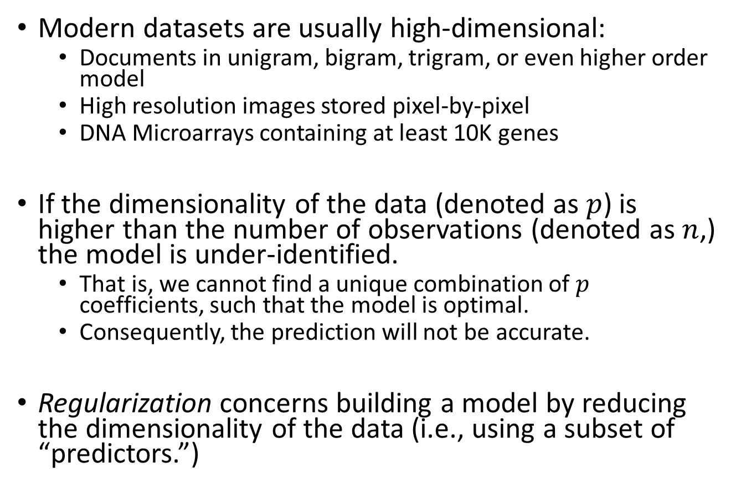
Regularization: Motivation
Modern datasets are usually high-dimensional:
Documents in unigram, bigram, trigram, or even higher order model
High resolution images stored pixel-by-pixel
DNA Microarrays containing at least 10K genes
If the dimensionality of the data (denoted as $p$) is higher than the number of observations (denoted as $n$,) the model is under-identified.
That is, we cannot find a unique combination of $p$ coefficients, such that the model is optimal.
Consequently, the prediction will not be accurate.
Regularization concerns building a model by reducing the dimensionality of the data (i.e., using a subset of “predictors.”)

Slide 13
Regularization Methods
Subset Selection: identify a subset of the p predictors that we believe to be related to the response variable.
Best Subset Selection: selects the subset with the best performance
Forward Stepwise Selection: adds predictors one-at-a-time
Backward Stepwise Selection: iteratively removes the least useful predictor
Dimension Reduction: project the p predictors into a M-dimensional subspace, where M<p.
This is achieved by computing M different linear combinations of the variables.
For example, Principle Component Analysis: finds a low-dimensional representation of a dataset that contains as much as possible of the variation
Shrinkage: fit a model involving all p predictors, but the estimated coefficients are shrunken towards to zero relative to the least square estimates.
Ridge Regression, LASSO, Elastic Net, which we will discuss in the following slides.

Slide 14
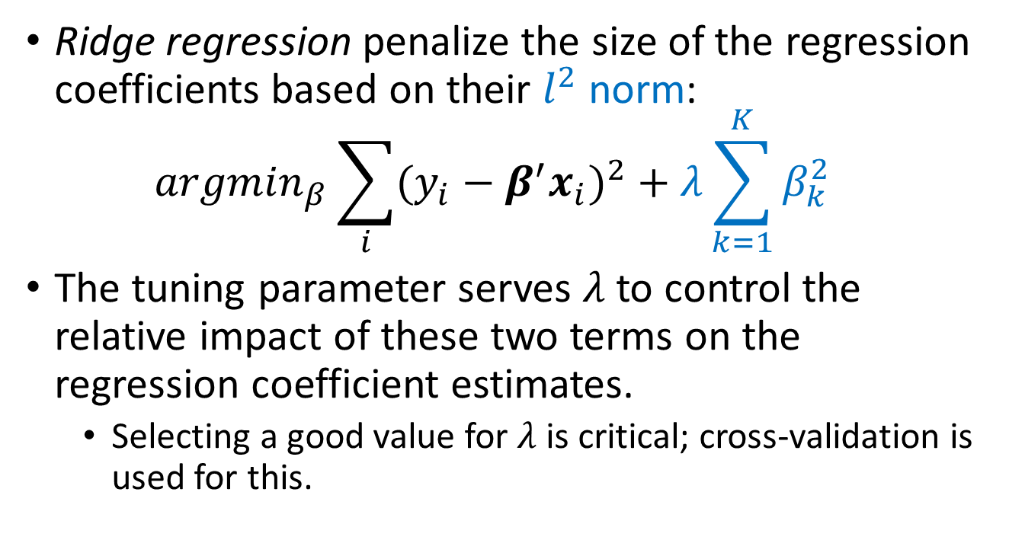
Ridge Regression
Ridge regression penalize the size of the regression coefficients based on their $l^{2}$ norm: ${argmin}_{β}\sum_{i}{{(y_{i}−β^{′}x_{i})}^{2}}+λ\sum_{k=1}^{K}{β_{k}^{2}}$
The tuning parameter serves $λ$ to control the relative impact of these two terms on the regression coefficient estimates.
Selecting a good value for $λ$ is critical; cross-validation is used for this.

Slide 15
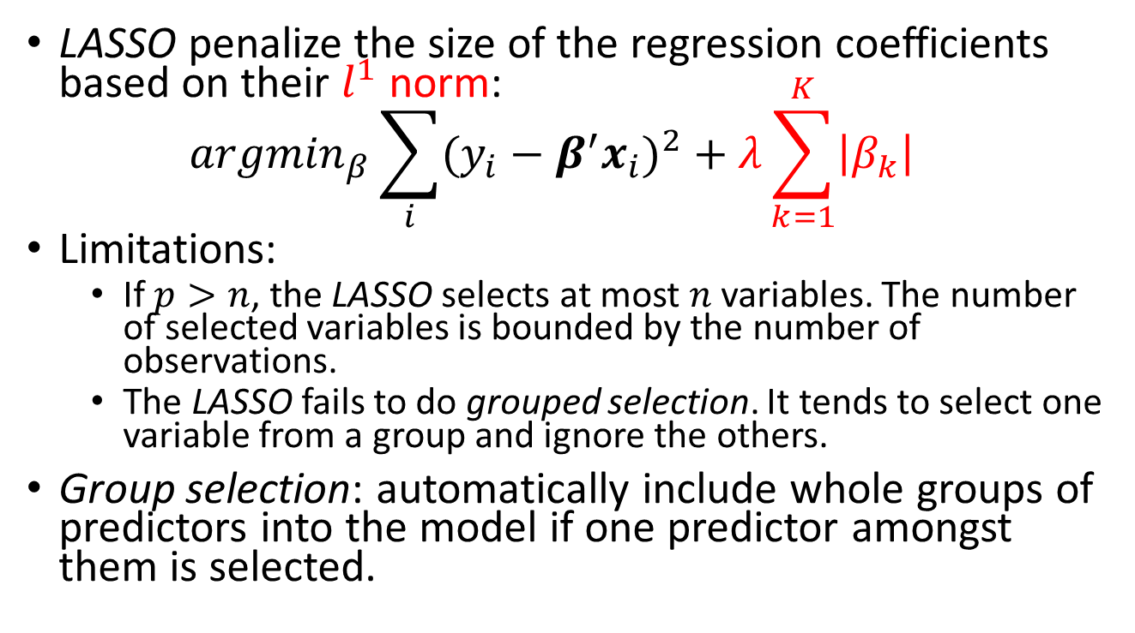
Least Absolute Shrinkage and Selection Operator (LASSO)
LASSO penalize the size of the regression coefficients based on their $l^{1}$ norm: ${argmin}_{β}\sum_{i}{{(y_{i}−β^{′}x_{i})}^{2}}+λ\sum_{k=1}^{K}{\left|β_{k}\right|}$
Limitations:
If $p>n$, the LASSO selects at most $n$ variables. The number of selected variables is bounded by the number of observations.
The LASSO fails to do grouped selection. It tends to select one variable from a group and ignore the others.
Group selection: automatically include whole groups of predictors into the model if one predictor amongst them is selected.

Slide 16
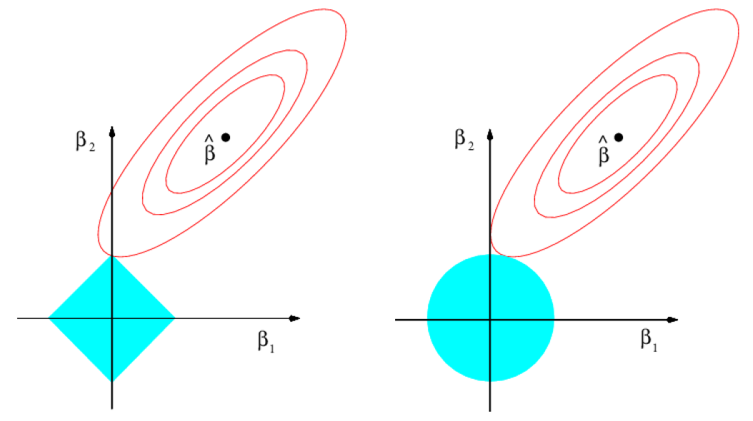
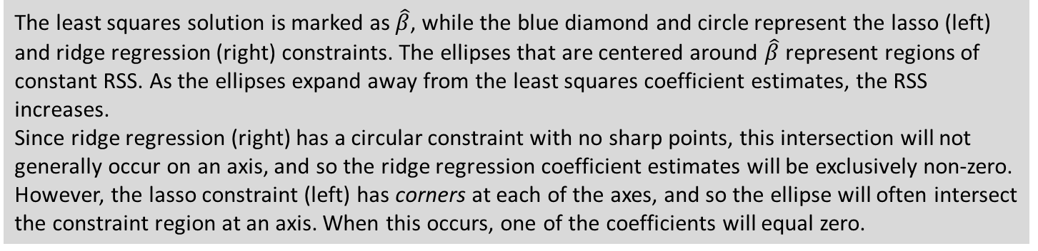
Comparing Ridge and LASSO
The least squares solution is marked as $\hat{β}$, while the blue diamond and circle represent the lasso (left) and ridge regression (right) constraints. The ellipses that are centered around $\hat{β}$ represent regions of constant RSS. As the ellipses expand away from the least squares coefficient estimates, the RSS increases.
Since ridge regression (right) has a circular constraint with no sharp points, this intersection will not generally occur on an axis, and so the ridge regression coefficient estimates will be exclusively non-zero. However, the lasso constraint (left) has corners at each of the axes, and so the ellipse will often intersect the constraint region at an axis. When this occurs, one of the coefficients will equal zero.

Slide 17
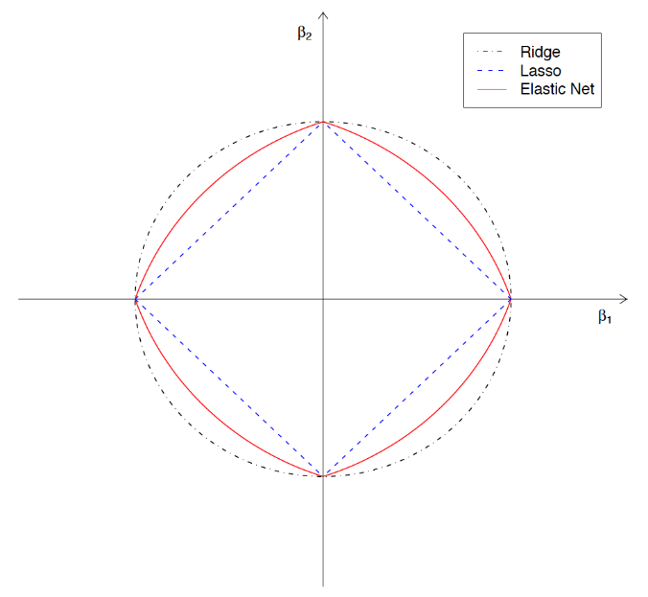
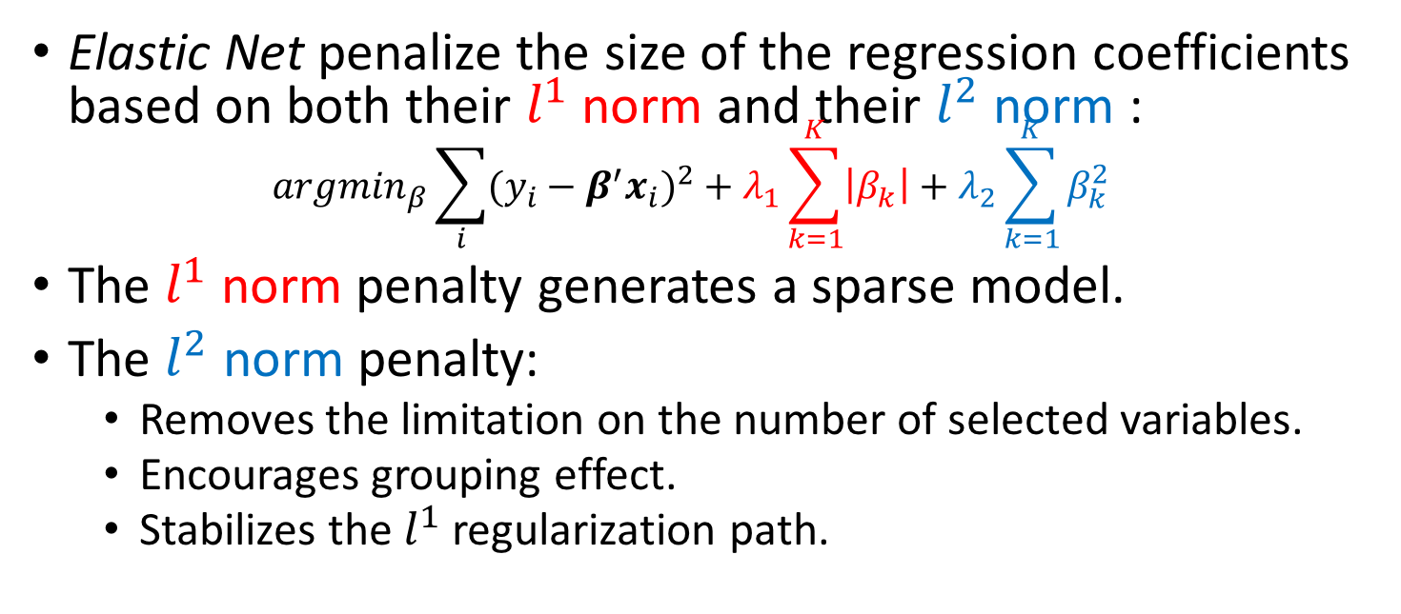
Elastic Net
Elastic Net penalize the size of the regression coefficients based on both their $l^{1}$ norm and their $l^{2}$ norm : ${argmin}_{β}\sum_{i}{{(y_{i}−β^{′}x_{i})}^{2}}+λ_{1}\sum_{k=1}^{K}{\left|β_{k}\right|}+λ_{2}\sum_{k=1}^{K}{β_{k}^{2}}$
The $l^{1}$ norm penalty generates a sparse model.
The $l^{2}$ norm penalty:
Removes the limitation on the number of selected variables.
Encourages grouping effect.
Stabilizes the $l^{1}$ regularization path.
Geometric Illustration of Elastic Net, Ridge regression, and LASSO
Ridge
Lasso
Singularities at the vertexes (necessary for sparsity)
Strict convex edges (necessary for grouping)
Elastic Net

Slide 18
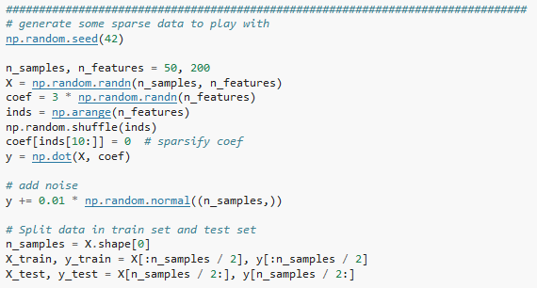


Elastic Net Application
We show how to use Elastic Net by conducting a simple linear regression with simulated data.
Construct an ill-posed problem:
Number of features >> Number of data points
Generate $X$ randomly
Total: 200 coefficients
Build a sparse model by setting only 10 non-zero coefficients
Generate $Y=β^{′}X+0.01z$, where $z$ is standard normal noise
Source code can be found here: http://scikit-learn.org/stable/_downloads/plot_lasso_and_elasticnet.py
Notes:
http://scikit-learn.org/stable/_downloads/plot_lasso_and_elasticnet.py

Slide 19
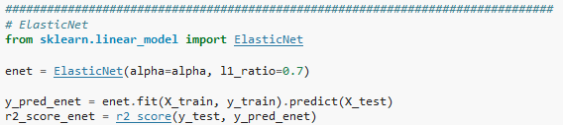
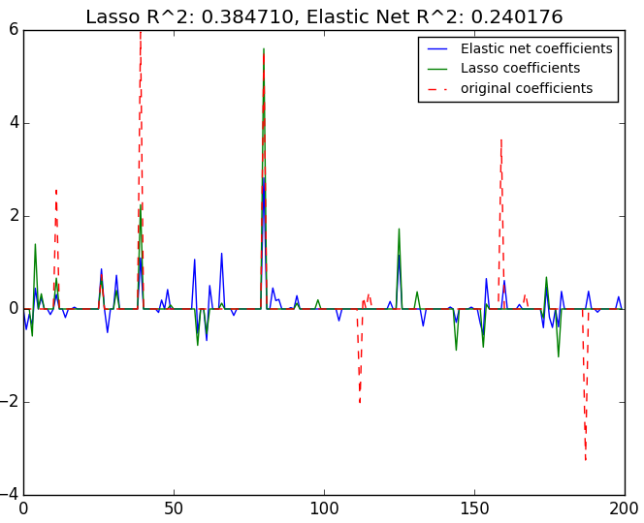
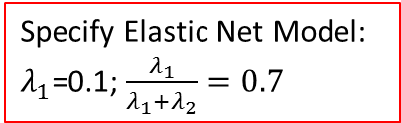



Elastic Net Application
Specify Elastic Net Model:
$λ_{1}$=0.1; $\frac{λ_{1}}{λ_{1}+λ_{2}}=0.7$
$$λ_{1}$$
$$λ_{1}/(λ_{1}+λ_{2})$$
Run model
Make predictions
Evaluate the predictions using $R^{2}$
Output
Given the ill-posed problem (# features >> # samples,) Elastic Net is able to capture most of the non-zero coefficients.
Elastic Net generates sparse estimates of the coefficients: most of the estimates are 0.
In general LASSO gives larger coefficient estimates than Elastic Net
Estimates
Coefficient

Slide 20
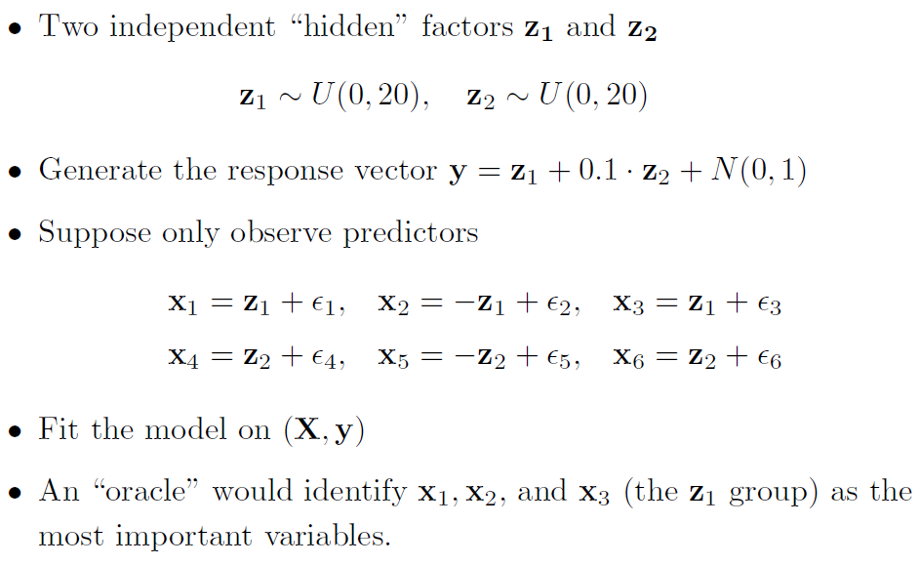
Elastic Net v.s. LASSO: A Simple Illustration

Slide 21
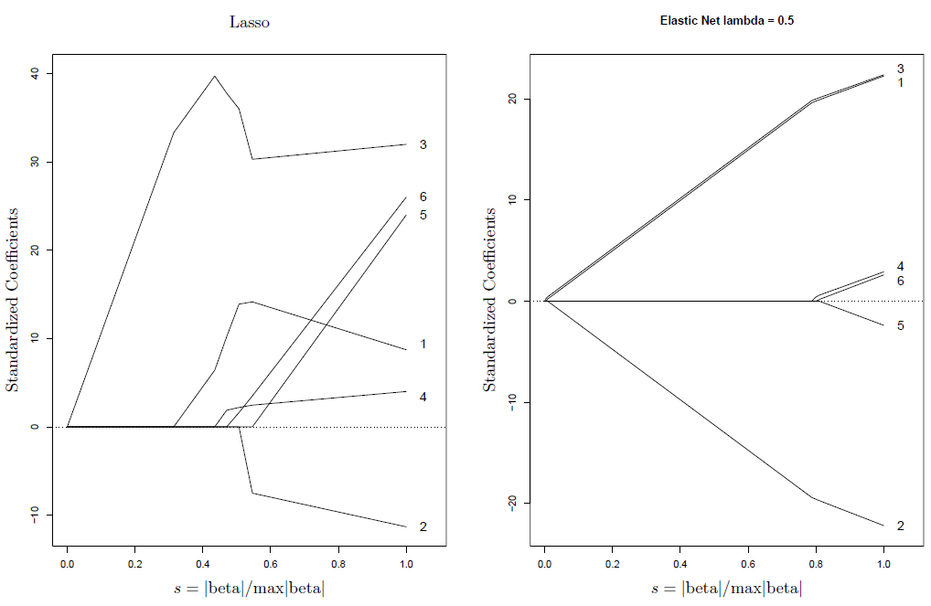
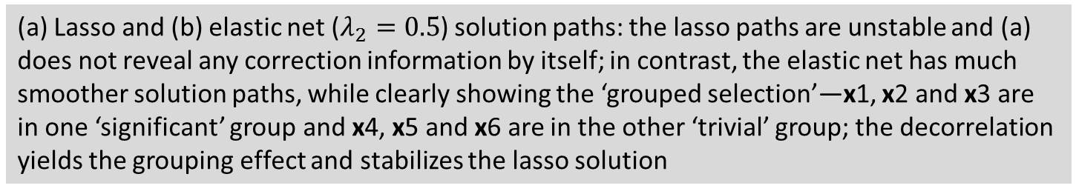
Elastic Net v.s. LASSO: Solution Paths
(a) Lasso and (b) elastic net ($λ_{2}=0.5$) solution paths: the lasso paths are unstable and (a) does not reveal any correction information by itself; in contrast, the elastic net has much smoother solution paths, while clearly showing the ‘grouped selection’—x1, x2 and x3 are in one ‘significant’ group and x4, x5 and x6 are in the other ‘trivial’ group; the decorrelation yields the grouping effect and stabilizes the lasso solution

Slide 22
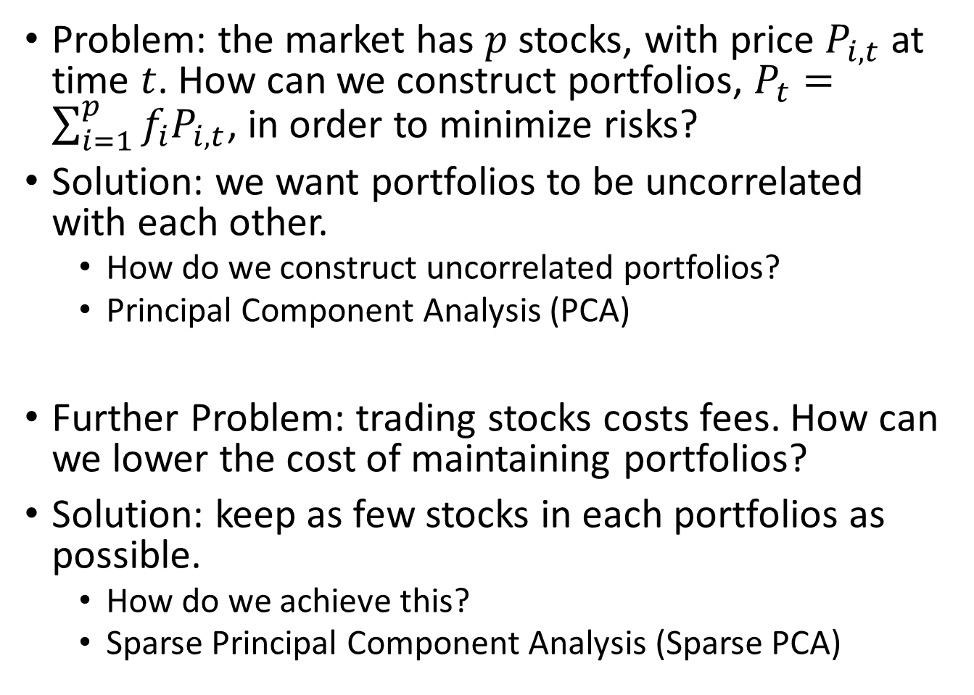
Elastic Net Extensions: Constructing Portfolios
Problem: the market has $p$ stocks, with price $P_{i,t}$ at time $t$. How can we construct portfolios, $P_{t}=\sum_{i=1}^{p}{f_{i}P_{i,t}}$, in order to minimize risks?
Solution: we want portfolios to be uncorrelated with each other.
How do we construct uncorrelated portfolios?
Principal Component Analysis (PCA)
Further Problem: trading stocks costs fees. How can we lower the cost of maintaining portfolios?
Solution: keep as few stocks in each portfolios as possible.
How do we achieve this?
Sparse Principal Component Analysis (Sparse PCA)

Slide 23
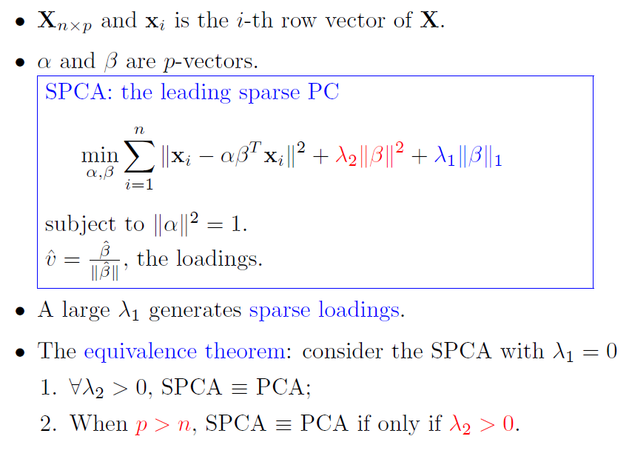
Elastic Net Extensions: Sparse PCA
Obtain principal components (PC) with sparse loadings.
That is, we want PCs to be sparse linear combinations of input variables.
Data
PCA

Slide 24


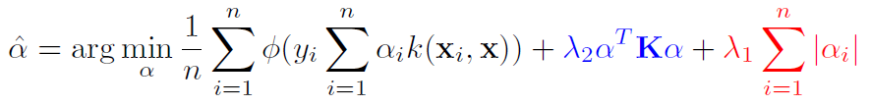

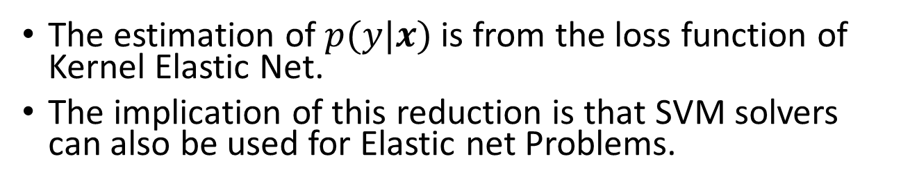
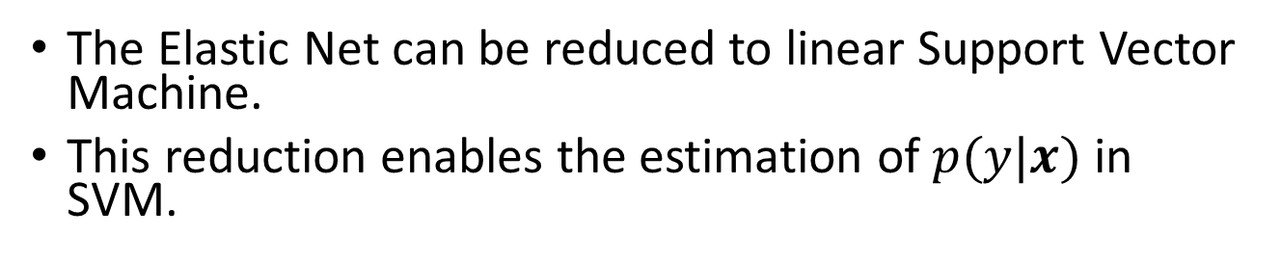
Elastic Net Extensions: Kernel Elastic Net
The Elastic Net can be reduced to linear Support Vector Machine.
This reduction enables the estimation of $p(y|x)$ in SVM.
Linear SVM:
Loss function
Kernel Elastic Net
Loss function
The estimation of $p(y|x)$ is from the loss function of Kernel Elastic Net.
The implication of this reduction is that SVM solvers can also be used for Elastic net Problems.

Slide 25
Outline
Logistic Regression
Why Logistic Regression?
Logistic Regression Model
Fitting Logistic Regression
Application: Making Predictions
Regularization
Motivation
Ridge regression
LASSO
Elastic Net
Elastic Net Application
Elastic Net v.s. LASSO
Elastic Net Extensions: Sparse PCA & Kernel Elastic Net
Conclusion

Slide 26
Conclusion
Logistic regression performs regression on discrete dependent variables.
It performs better than linear in predicting probabilities.
It builds on the idea of Odds Ratio.
It is solved by optimization (rather than OLS)
It can be used for making predictions on the probability or category.
The Elastic Net performs Ridge regression and LASSO simultaneously:
It is able to perform grouped selection
It is appropriate for under-identified problems
Elastic Net works better than Ridge regression and LASSO.
It has interesting applications in sparse PCA and support vector machine.

Slide 27
Resources
Logistic Regression (implemented in most statistical software)
SAS, R (glm; GLMNET; lmer), MATLAB (mnrfit)
JAVA (mallet), Python (scikit-learn), etc.
Elastic Net
R packages
“elasticnet”
”Glmnet: Lasso and elastic-net regularized generalized linear models”
“pensim: Simulation of high-dimensional data and parallelized repeated penalized regression”
JMP Pro 11
Python: scikit-learn
MATLAB: SVEN (Support Vector Elastic Net)

