Slide 1

CyberGate: A Design Framework and System for Text Analysis of CMC
Ahmed Abbasi and Hsinchun Chen
MISQ, 32(4), 2008

Slide 2
Outline
Introduction
Background
Design Framework for CMC Text Analysis
System Design: CyberGate
CMC Text Analysis Example using CyberGate
Evaluation
Conclusions

Slide 3
Introduction
Computer mediated communication (CMC) has seen tremendous growth due to the fast propagation of the Internet.
Text-based modes of CMC include email, listservs, forums, chat, and the world wide web (Herring, 2002).
  These modes of CMC have a profound impact on organizations.
    Electronic communication - Culture and Interaction
    Online Communities - Business Operations
Business online communities provide invaluable mechanisms for various forms of interaction (Cothrel, 2000).
  Knowledge dissemination (communities/networks of practice)
    (Wenger, 1998; Wenger & Snyder, 2000; Wasko & Faraj, 2005)
  Transfer of goods/services (internet marketplaces)
  Product/service reviews (consumer rating forums)
    (Turney & Littman, 2003; Pang et al., 2002)

Slide 4
Introduction
Large volumes of information inherent in online communities has proven to be problematic
  Very large scale conversations (VLSC) involving thousands of people and messages (Sack, 2000; Herring, 2002)
  Enormous information quantities make such places noisy and difficult to navigate (Viegas & Smith, 2004).
Many believe solution is to develop systems for navigation and knowledge discovery (Wellman, 2001).
  Such CMC systems can improve informational transparency
    (Smith, 1999; Erickson & Kellogg, 2000; Sack, 2000; Kelly, 2002).
  Intended for online community participants and researchers/analysts studying these communities (Smith, 1999).
Consequently, numerous CMC information systems have been developed
  (Xiong & Donath, 1999; Fiore & Smith, 2002; Viegas et al., 2004; Viegas & Smith, 2004).

Slide 5
Introduction
These techniques generally visualize information provided in the message headers.
  Interaction (send/reply structure) and activity (posting patterns) based information
Little support provided for analysis of textual information contained in messages.
  When provided, text analysis is based on simple feature representations used in IR systems (Sack, 2000; Whitelaw & Patrick, 2004).
    E.g., bag-of-words (Mladenic & Stefan, 1999)

Slide 6
Introduction
Online discourse rich in social cues including emotion, opinion, style, and genre (Yates & Orlikowski, 1992; Henri, 1992; Hara et al., 2000).
Need for improved CMC system content analysis capabilities based on richer textual representation.
  Requires complex set of features, techniques, and visual representations that are not well defined.
There is a need for a design framework to support CMC text analysis systems (Sack, 2000).

Slide 7
Introduction
In this study we propose:
A Design Framework for the creation of CMC systems that provide improved text analysis capabilities.
  By incorporating richer set of information types.
Our framework addresses several important issues from the text mining literature.
  E.g., tasks, information types, features, selection methods, and visualization techniques.
We then develop the CyberGate system based on our design framework.
  Includes the Writeprint and Ink Blot techniques that can be used for analysis and categorization of CMC text.

Slide 8
Background: CMC Systems
CMC Content Analysis
  Several dimensions have been proposed for CMC content analysis (Henri, 1992; Hara et al., 2000).
  The information utilized for CMC content analysis can be categorized as either structural or textual.
    Structural features – based on communication topology
    Textual features – based on communication content

Slide 9
Background: CMC Systems
Structural Features
  Features extracted from message headers
  Posting activity (Fiore et al., 2002)
    E.g., # posts, # initial messages, # replies, # responses to author post etc.
    Represent social accounting metrics (Smith, 2002).
    Can provide insight into different roles such as debaters, experts, etc. (Zhu & Chen, 2001; Viegas & Smith, 2004)
  Interaction/Social networks (Sack, 2000; Smith & Fiore, 2001)
    Can help identify key members and relationships (e.g., centrality, link densities)

Slide 10
Background: CMC Systems
Structural Features
  Plethora of CMC systems developed to support structural features.
    Several tools visualize posting patterns: Loom (Donath et al., 1999), Authorlines (Viegas & Smith, 2004).
    Conversation Map visualizes social networks based on send/reply patterns (Sack, 2000).
    Netscan visualizes interaction threads and networks (Smith & Fiore, 2001; Smith, 2002)
    PeopleGarden and Communication Garden both use flower metaphors to display author and thread activity (Xiong & Donath, 1999; Zhu & Chen, 2001).
    Babble (Erickson & Kellog, 2000) and Coterie (Donath, 2002) are geared towards showing structural and activity patterns in persistent conversation.

Slide 11
Background: CMC Systems
Textual Features
  Features derived from message body
  The informational richness of CMC text was previously questioned (Daft & Lengel, 1986)
  Numerous studies have since demonstrated the richness of CMC content (Contractor & Eisenberg, 1990; Fulk et al., 1990; Yates & Orlikowski, 1992; Lee, 1994; Panteli, 2002).
  In additional to topical information and events (e.g., Allan et al., 1998), textual online discourse contains:
    Social cues (Spears & Lea, 1992; 1994; Henri, 1992)
      Emotions (Picard, 1997; Subasic & Huettner, 2001)
      Opinions (Hearst, 1992)
      Power cues (Panteli, 2002)
      Style (Abbasi & Chen, 2006; Zheng et al., 2006)
      Genres, e.g., questions, statements, comments (Yates & Orlikowski, 1992)

Slide 12
Background: CMC Systems
Textual Features
  Limited support for text features in CMC systems
    Loom (Donnath et al., 1999) shows some content patterns based on message moods.
    Chat Circles (Donnath et al., 1999) displays messages based on message length.
    Conversation Map (Sack, 2000) uses computational linguistics to build semantic networks for discussion topics.
    Communication Garden (Zhu & Chen, 2001) performs topic categorization based on noun phrases.
  Features used in CMC systems are insufficient to effectively capture textual content in online discourse (Sack, 2000; Whitelaw & Patrick, 2004).
    Most use text information retrieval system features.
    IR systems more concerned with information access than analysis (Hearst, 1999)
    Mladenic & Stefan (1999) presented a review of 29 IR systems, all of which used bag-of-words.

Slide 13
Background: CMC Systems
Previous CMC Systems
System Name | Reference | Feature Types |  | Feature Descriptions
 |  | Structural | Textual
Chat Circles | Donnath et al., 1999 | √ | √ | Headers, Message length
Loom | Donnath et al., 1999 | √ | √ | Terms, Punctuation, Headers
People Garden | Xiong & Donnath, 1999 | √ |  | Headers
Babble | Erickson & Kellogg, 2000 | √ |  | Headers
Conversation Map | Sack, 2000 | √ | √ | Semantic, Headers
Communication Garden | Zhu & Chen, 2001 | √ | √ | Noun phrases, Headers
Coterie | Donath, 2002 | √ |  | Headers
Newsgroup Treemaps | Fiore & Smith, 2002 | √ |  | Headers
PostHistory | Viegas et al., 2004 | √ |  | Headers
Social Network Fragments | Viegas et al., 2004 | √ |  | Headers
Authorlines | Viegas & Smith, 2004 | √ |  | Headers
Newsgroup Crowds | Viegas & Smith, 2004 | √ |  | Headers

Slide 14
Background: Need for Enhanced Systems
Numerous CMC researchers and analysts have stated the need for tools to support CMC text analysis.
  Textual features are important yet often overlooked in email analysis (Panteli, 2002).
    Features such as use of greetings and signatures, which can be important power cues, can easily be captured using stylistic feature extractors (Zheng et al., 2006).
  Hara et al. (2000) noted that there has been limited CMC content analysis since manual methods are time consuming.
  Paccagnella (1997) suggested that computer programs to support CMC text analysis would be helpful, yet do not exist.
  Cothrel (2000) stated that discussion content is an essential dimension of online community success measurement, yet proper definition and measurement remains elusive.

Slide 15
Background: Need for Enhanced Systems
Why do most CMC systems support structural information but not textual content?
Structural features well defined, easy to extract, and easy to visualize.
  Activity based features (Fiore et al., 2002) and interaction features (network metrics)
  Posting activity and interaction easily extracted from message headers.
  Visualization: bar chart variants for activity frequency, networks for interaction (Xiong & Donath, 1999; Zhu & Chen, 2001; Viegas & Smith, 2004).

Slide 16
Background: Need for Enhanced Systems
Why do most CMC systems support structural information but not textual content?
Rich textual features not well defined, difficult to extract, and harder to present to end users.
  Text classification requires complex set of subjective features (Donath et al., 1999).
    E.g., over 1000 features used for analyzing style, with no consensus (Rudman, 1997).
  Extraction can be challenging due to high levels of noise in online discourse text (Knight, 1999; Nasukawa & Nagano, 2001).
  Many techniques developed to support different facets of text visualization (Wise, 1999; Miller et al., 1998, Rohrer et al., 1998, Huang et al., 2005) with no single solution.
    Text presentation requires the use of multiple views (Losiewicz et al., 2000)

Slide 17
Background: Need for Enhanced Systems
Sack (2000) argues for a new CMC system design philosophy that incorporates automatic text analysis techniques.
  He states “…it is necessary to formulate a complementary design philosophy for CMC systems in which the point is to help participants and observers spot emerging groups and changing patterns of communication…” (p. 86).
Design guidelines needed because of:
  Lack of previous tools for CMC textual analysis
  Complexity of text analysis tasks
  Appropriate features and presentation styles not well defined
    Abundance of potential features and visual representations
    Numerous feature selection/reduction techniques used for text (Huang et al., 2005)
    Standard visualization techniques may not apply to text (Keim, 2002).

Slide 18
Design Framework for CMC Text Analysis
Design is a product and a process (Walls et al., 1992; Hevner et al., 2004).
  Product is the set of requirements and necessary design guidelines for IT artifacts.
  Process is the steps taken to develop IT artifacts.
IS development typically follows an iterative process of building and evaluating (March & Smith, 1995; Simon, 1996).
  Important in design situations involving a complex or poorly defined set of user requirements (Markus et al., 2002).
  The ambiguities associated with CMC text analysis component alternatives also warrant the use of such a design process.
Thus, we focus on the design product elements of Walls et al.’s (1992) model, which are presented in the table below.
Design Product
1. Kernel theories | Theories from natural of social sciences governing design requirements
2. Meta-requirements | Describes a class of goals to which theory applies
3. Meta-design | Describes a class of artifacts hypothesized to meet meta-requirements
4. Testable hypotheses | Used to test whether meta-design satisfies meta-requirements
(Walls et al., 1992)

Slide 19
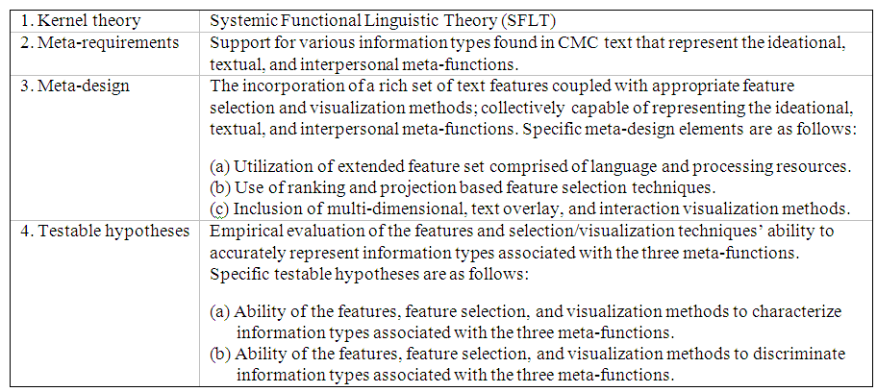
Design Framework for CMC Text Analysis
Components of the Proposed Design Framework for CMC Text Analysis Systems

Slide 20
Design Framework: Kernel Theory
Effective analysis of CMC text entails the utilization of a language theory that can provide representational guidelines.
Systemic Functional Linguistic Theory (SFLT) provides an appropriate mechanism for representing CMC text information (Halliday, 2004).
SFLT states that language has three meta-functions:
  Ideational – language consists of ideas
  Textual – language has organization, structure, and flow
  Interpersonal – language is a medium of exchange between people
The three meta-functions are intended to provide a comprehensive functional representation of language meaning by encompassing the physical, mental, and social elements of language (Fairclough, 2003).

Slide 21
Design Framework: Meta-Requirements
Information Types
  Text-based information systems should incorporate a wide range of information types capable of representing the ideational, textual, and interpersonal meta-functions.
  “Any summary of a very large scale conversation is incomplete if it does not incorporate all three of these meta-functions (ideational, interpersonal, and textual),” (Sack, 2000; p. 75).

Slide 22
Design Framework: Meta-Requirements
Information Types
  Examples of ideational information types found in text include:
  Topics (e.g., Chen et al., 2003)
    Supported by all information retrieval systems (Mladenic & Stefan, 1999).
    Example of a topic would be “hurricane”
  Events (e.g., Allan et al., 1998)
    Events are specific incidents with a temporal dimension
    Example of an event would be “Hurricane Katrina”
  Opinions
    Sentiments about a topic, such as agonistic, neutral, or antagonistic (Hearst, 1992)
    Popular applications include movie/product review sites (Turney & Littman, 2003)
  Emotions (Picard, 1997)
    Various affects such as happiness, horror, anger, etc. (Subasic & Huettner, 2001)

Slide 23
Design Framework: Meta-Requirements
Information Types
  Examples of textual information types include:
  Style
    Numerous stylistic attributes, including vocabulary richness, word choices, and punctuation usage (Argamon et al., 2003; Abbasi & Chen, 2006).
    Example styles include formal (use of greetings, structured sentences, paragraphs), informal (no sentences, no greetings, erratic punctuation usage), etc.
  Genres
    Genres are classes of writing
    Genres found in an organizational communication settings include inquiries, informational messages, news articles, memos, resumes, reports, interviews, etc. (Yates & Orlikowski, 1992; Santini, 2004).

Slide 24
Design Framework: Meta-Requirements
Information Types
  The table below shows example for each information type and their corresponding analysis applications.
Information Type | Examples | Analysis Types | References
Ideational | Topics | Topical Analysis | Mladenic & Stefan, 1999; Chen et al., 2003
 | Events | Event Detection | Allan et al., 1998
 | Opinions | Sentiment Analysis | Hearst, 1992; Turney & Littman, 2003
 | Emotions | Affect Analysis | Picard, 1997; Subasic & Huettner, 2001
Textual | Style | Authorship Analysis Deception Detection Power Cues | Argamon et al.,2003; Abbasi & Chen, 2006; Zhou et al., 2004; Panteli, 2002
 | Genres | Genre Analysis | Yates & Orlikowski, 1992; Santini, 2004
 | Metaphors/ Vernaculars | Semantic Networks | Sack, 2000
Interpersonal | Interaction | Social Networks | Sack, 2000; Viegas et al., 2004
 |  | Conversation Streams | Smith & Fiore, 2001

Slide 25
Design Framework: Meta-Design
Features
  Linguistic features can be classified into two broad categories (Cunningham, 2002)
  Both categories are often used in conjunction to complement each other.
  Language Resources
    Data-only resources such as lexicons, thesauruses, word lists (e.g., pronouns), etc.
    Such self-standing features exist independent of the context and provide powerful discriminatory potential.
    However, language resource construction is typically manual, and features may be less generalizable across information types (Pang et al., 2002).
  Processing Resources
    Require programs/algorithms for computation
    E.g., parts-of-speech, n-grams, statistical features (e.g., vocabulary richness), bag-of-words
    Majority of these features are context-dependent (change according to text corpus)
    However, extraction procedures/definitions remain constant, making processing resources highly generalizable across information types.
    Consequently, features such as bag-of-words, POS, and n-grams used to represent information types across various applications (Argamon et al., 2003, Santini, 2004).

Slide 26
Design Framework: Meta-Design
Feature Selection
  Three types of feature selection techniques have been identified in previous research (Guyon & Elisseeff, 2003)
  All three have also been used in text mining
  Ranking
    Techniques that rank/sort attributes based on some heuristic (Duch et al., 1997; Hearst, 1999)
  Projection
    Transformation techniques that utilize dimensionality reduction (Huber, 1985; Huang et al., 2005).
  Subset Selection
    Techniques that select a subset of attributes
    Typically use search strategies to consider different feature combinations (Dash & Liu, 1997)
  Each technique has its pros and cons

Slide 27
Design Framework: Meta-Design
Feature Selection
  Ranking and projection methods have seen greater use due to their simplicity/efficiency and propensity to handle noise, respectively.
  Therefore we limit our discussion to these two categories.
  Ranking Methods, e.g., information gain, chi-squared, Pearson’s correlation, etc. (Forman, 2003)
    Pros
      Greater explanatory potential (Seo & Shneiderman, 2002)
      Simplicity and scalability
    Cons
      Typically only consider individual features’ predictive power (Guyon & Elisseeff, 2003; Li et al., 2006)
  Projection Methods, e.g., PCA, MDS, SOM (Huang et al., 2005)
    Pros
      Robust against noise
        Consequently used a lot in text mining (Abbasi & Chen, 2006)
    Cons
      Transformation results in reduced explanatory potential (Seo & Shneiderman, 2002)

Slide 28
Design Framework: Meta-Design
Feature Selection
  The table below shows example selection methods that have been applied to text mining and the type of analysis performed.
Selection Method | Examples | Analysis Types | Reference
Ranking | Information Gain | Topical | Efron et al., 2004
 | Decision Tree Model | Authorship | Abbasi & Chen, 2005
 | Minimum Frequency | Sentiment | Pang et al., 2002
Projection | Principal Component Analysis | Authorship | Abbasi & Chen, 2006
 | Multi-Dimensional Scaling | Topical | Allan & Leuski, 2000
 | Self-Organizing Map | Topical | Chen et al., 2003

Slide 29
Design Framework: Meta-Design
Visualization
  Text visualization is challenging since text cannot easily be described by numbers (Keim, 2002).
  Requires the use of multiple views, representing different data types (Losiewicz et al., 2000), with varying dimensionalities
    Text itself is one-dimensional
    Textual features are multi-dimensional (Huang et al., 2005)
      Feature statistics (e.g., frequency, variance, similarity) provide important insight yet abstract away from underlying content they are intended to represent.
    Relation between features and text (structural, semantic, etc.) often established using 2D-3D text overlay (e.g., Cunningham, 2002).
    This is also important in order to allow users to assess quality of feature extraction and representation (Losiewicz et al., 2000) due to the high levels of noise in text (Knight, 1999; Nasukawa & Nagano, 2001).

Slide 30
Design Framework: Meta-Design
Visualization
  Multi-dimensional text visualization
    Several multi-dimensional techniques have been used for text visualization
      Used to display feature occurrence statistics and patterns
    Graphs/Plots
      E.g., Radar Charts (Subasic & Huettner, 2001; Abbasi & Chen, 2005), Parallel Coordinates (Huang et al., 2005), and Scatter Plot Matrices (Huang et al., 2005)
    Reduced Dimensionality
      Visualizations based on reduced feature spaces
      E.g., Writeprints (Abbasi & Chen, 2006), ThemeRiver© (Havre et al., 2002), Text Blobs (Rohrer et al., 1998)
  Text Overlay
    Combine text with feature occurrence patterns to provide greater insight.
    E.g., Themescapes (Wise, 1999), Stereoscopic Document View (Miller et al., 1998), and Text Annotation (Cunningham, 2002)

Slide 31
Design Framework: Hypotheses
Testable hypotheses are intended to assess whether the meta-design satisfies meta-requirements (Walls et al., 1992).
  Entails evaluating the meta-design’s ability to accurately represent information types associated with the three meta-functions.
In text mining, “representation” can imply data characterization or data discrimination (Han and Kamber, 2001).
Testing characterization
  Using case studies to illustrate system’s ability to detect important patterns and trends.
Testing data discrimination
  Empirically evaluating system’s ability to categorize text information.

Slide 32
System Design: CyberGate
Description
  Using our design framework as a guideline, we developed a text-based information system for CMC analysis called CyberGate.
    Developed in several iterations of adding and testing information types.
    Supports many tasks, information types, features, and selection and visualization techniques.
  Two core components are the Writeprint and Ink Blot techniques.
  We present an overview of the entire system, then focus on these two techniques.

Slide 33
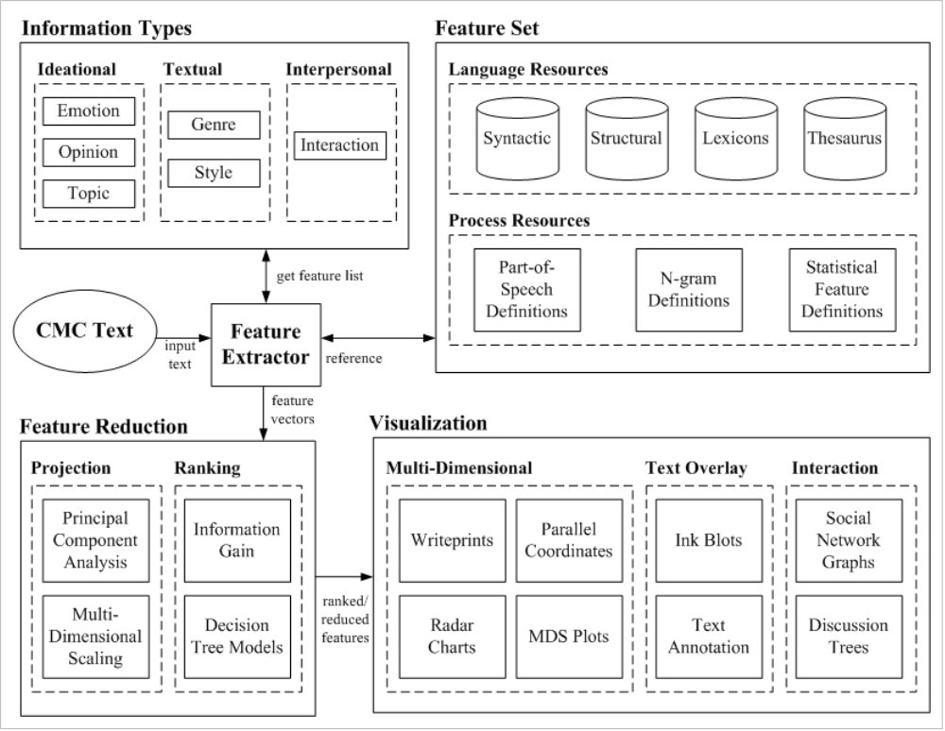
System Design: CyberGate

Slide 34
System Design: CyberGate
Information Types and Features
  CyberGate supports several information types, including topics, sentiments, affects, style, and genres.
  In order to enable the capturing of such a breadth of information, several language and processing resources were included.
    These include language resources such as sentiment and affect lexicons, word lists, and the Wordnet thesaurus (Fellbaum, 1998).
    Processing resources such as an n-grams, statistical features (Abbasi & Chen, 2005; Zheng et al., 2006), parts-of-speech, noun phrases, and named entities (McDonald et al., 2004)

Slide 35
System Design: CyberGate
Feature Set
Resource | Category | Feature Groups | Quantity | Examples
Language | Lexical | Word Length | 20 | word frequency distribution
 |  | Letters | 26 | A,B,C
 |  | Special Characters | 21 | $,@,#,*,&
 |  | Digits | 10 | 0,1,2
 | Syntactic | Function Words | 250 | of, for, the, on, if
 |  | Pronouns | 20 | I, he, we, us, them
 |  | Conjunctions | 30 | and, or, although
 |  | Prepositions | 30 | at, from, onto, with
 |  | Punctuation | 8 | !,?,:,”
 | Structural | Document Structure | 14 | has greeting, has url, requoted content
 |  | Technical Structure | 50 | file extensions, fonts, images
 | Lexicons | Sentiment Lexicons | 3000 | positive, negative terms
 |  | Affect Lexicons | 5000 | happiness, anger, hate, excitement
Process | Lexical | Word-Level Lexical | 8 | % char per word
 |  | Char-Level Lexical | 7 | % numeric char per message
 |  | Vocabulary Richness | 8 | hapax legomana, Yules K,
 | Syntactic | POS Tags | 2200 | NP_VB
 | Content-Based | Noun Phrases | Varies | account, bonds, stocks
 |  | Named Entities | Varies | Enron, Cisco, El Paso, California
 |  | Bag-of-words | Varies | all words except function words
 | N-Grams | Character-Level | Varies | aa, ab, aaa, aab
 |  | Word-Level | Varies | went to, to the, went to the
 |  | POS-Level | Varies | NNP_VB VB,VB ADJ
 |  | Digit Level | 1100 | 12, 94, 192

Slide 36
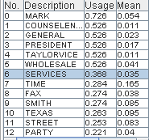
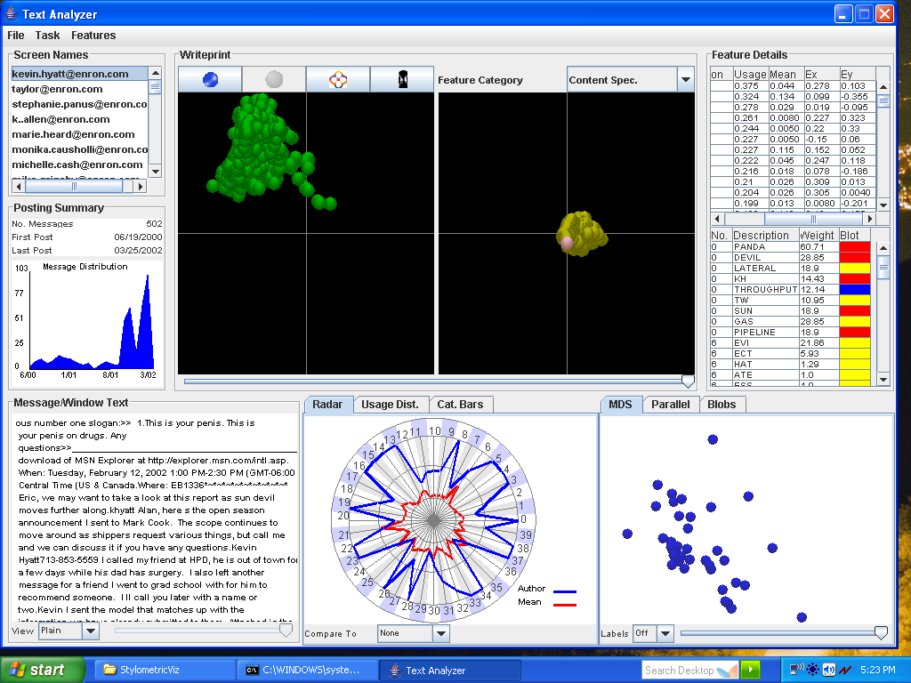
System Design: CyberGate
All Features
Feature Reduction
  CyberGate uses both ranking and projection based feature reduction methods.
  Feature Ranking
    Uses Information Gain (IG) and Decision Tree Models (DTM) for ranking features
    Both shown to be effective for textual feature selection (Forman, 2003; Efron et al., 2004; Abbasi & Chen, 2005)
  Projection
    Uses PCA and MDS for lower dimension feature projection.
    PCA and MDS have both been previously used for textual feature reduction (Abbasi & Chen, 2006; Huang et al., 2005).
DTM Ranking
PCA Projections

Slide 37
System Design: CyberGate
Visualization
  CyberGate includes basic, multi-dimensional, and text overlay based visual representations.
    Basic
      Tables and graphs for point values and usage comparisons.
    Multi-dimensional
      Writeprints to show usage variation across messages, windows, and time (Abbasi & Chen, 2006).
      Parallel coordinates to show feature similarities across messages, windows, and time.
      Radar Charts to compare feature usage across authors.
      MDS plots to show feature usage correlations.
    Text Overlay
      Ink Blots that superimpose colored circles (blots) onto text for usage frequency analysis
        Size of blot indicates feature rank/weight (based on feature ranking techniques)
        Color indicates usage (red = high, blue = low, yellow = medium).
      Text annotation simply highlights key features in text (Cunningham, 2002).

Slide 38
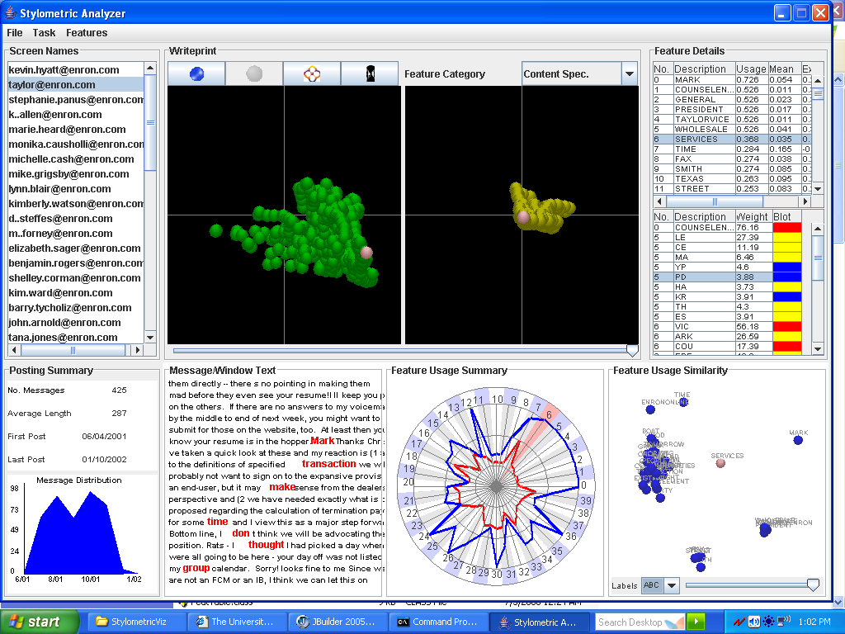
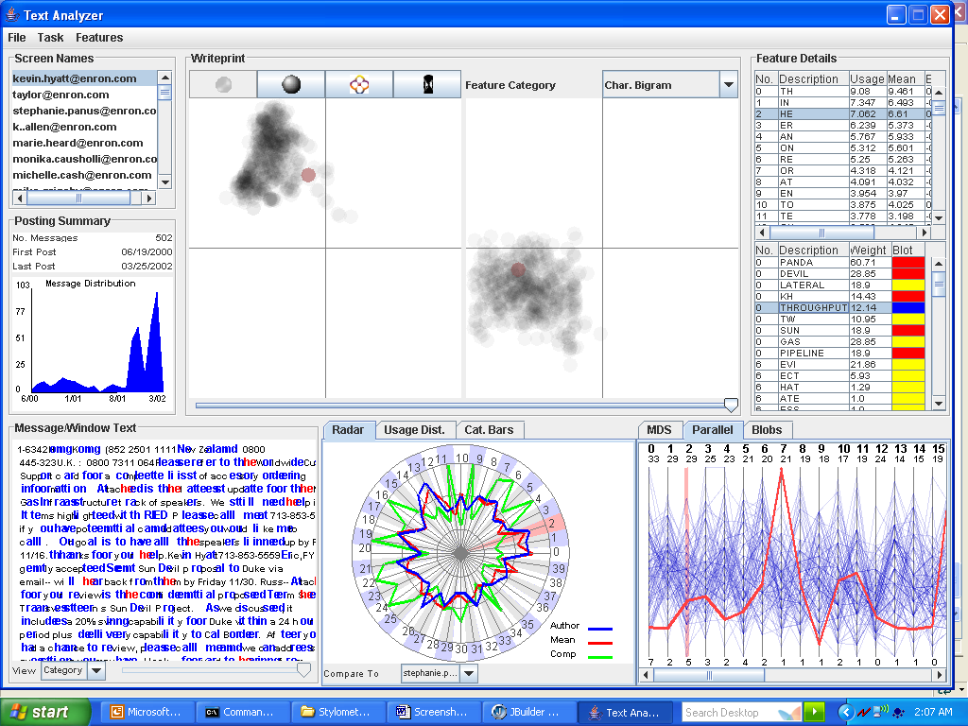
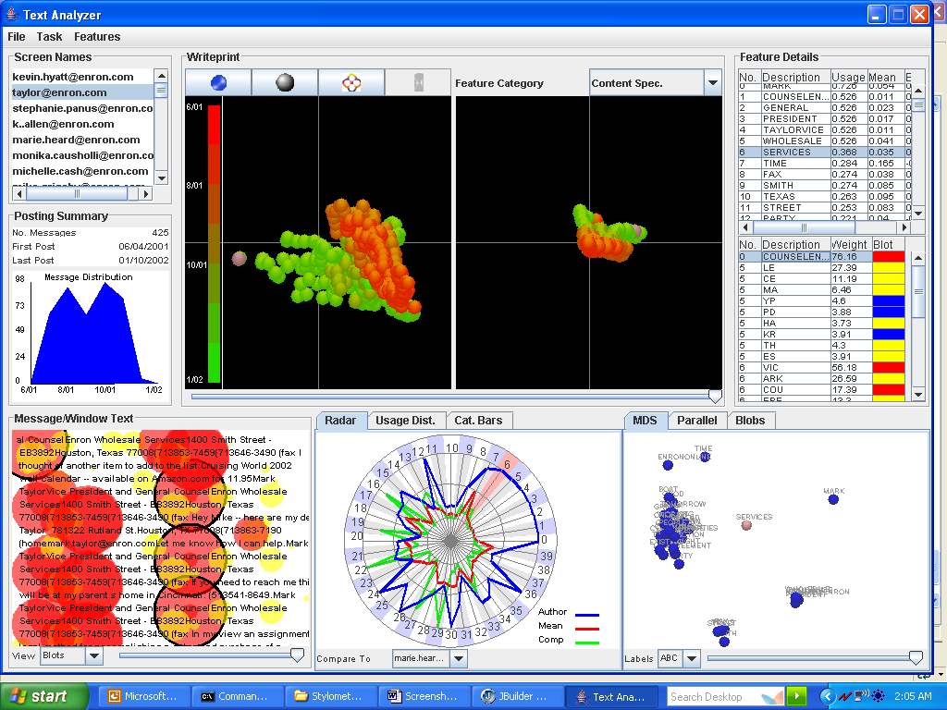
CyberGate: Multi-Dimensional Views
Two dimensional PCA projections based on feature occurrences. Each circle denotes a single message. Selected message is highlighted in pink. Writeprints show feature usage/occurrence variation patterns. Greater variation results in more sporadic patterns.
Parallel vertical lines represent features. Bolded numbers are feature numbers (0-15). Smaller numbers above and below feature lines denote feature range. Blue polygonal lines represent messages. Selected message is highlighted in red. Selected feature is highlighted in pink (#2).
Writeprints
Parallel Coordinates
Chart shows normalized feature usage frequencies. Blue line represents author’s average usage, red line indicates mean usage across all authors, and green line is another author (being compared against). The numbers represent feature numbers. Selected feature is highlighted (#6).
MDS algorithm used to project features into two-dimensional space based on occurrence similarity. Each circle denotes a feature. Closer features have higher co-occurrence. Labels represent feature descriptions. Selected feature is highlighted in pink (the term “services”).
Radar Charts
MDS Plots

Slide 39
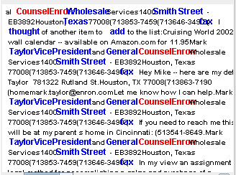
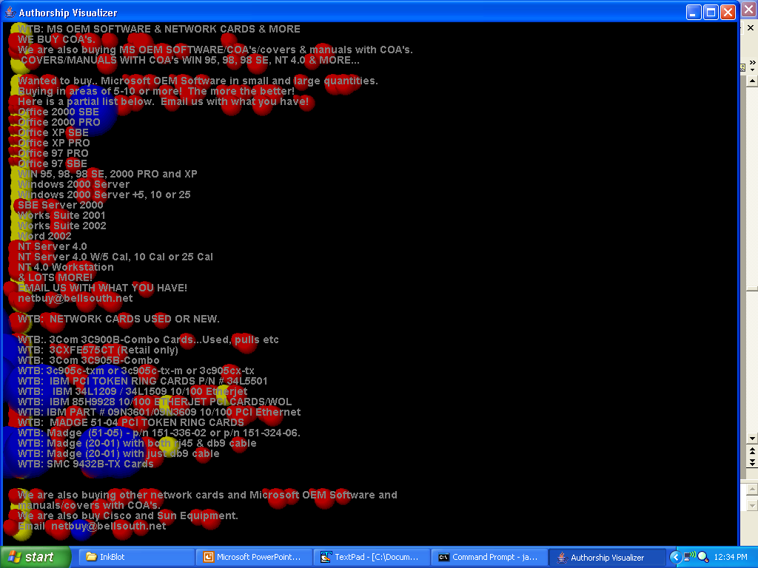
CyberGate: Text Views
Feature occurrences are highlighted in blue. The selected bag-of-words feature is highlighted in red (“CounselEnron”).
Colored circles (blots) superimposed onto feature occurrence locations in text. Blot size and color indicates feature importance and usage. Selected feature’s blots are highlighted with black circles.
Text Annotation
Ink Blots

Slide 40
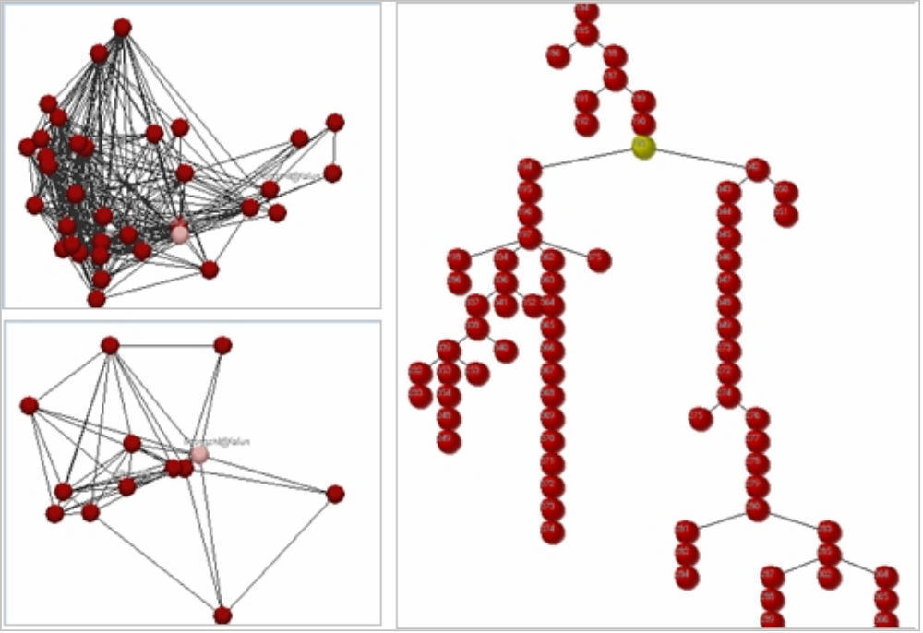
CyberGate: Interaction Views
CyberGate includes graph and tree visualizations
A-B: Author and thread level social networks
C: Thread discussion trees
A)
C)
B)

Slide 41
System Design: Writeprints and Ink Blots
CyberGate includes the Writeprint and Ink Blot techniques
Core components driving the system’s analysis and categorization functions.
These techniques epitomize the essence of the proposed design framework:
Representational Richness
  Writeprints and Ink Blots can incorporate a wide range of features representing various information types.
  Both techniques also utilize feature selection and visualization.

Slide 42
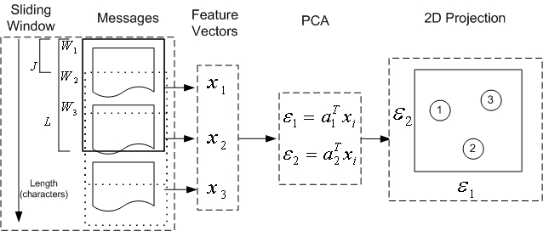
System Design: Writeprints
Writeprints uses principal component analysis (PCA) with a sliding window algorithm to create lower dimensional plots that accentuate feature usage variation.
Writeprint Technique Steps
Derive two primary eigenvectors (ones with the largest eigenvalues) from feature usage matrix.
Extract feature vectors for sliding window instance.
Compute window instance coordinates by multiplying window feature vectors with two eigenvectors.
Plot window instance points in two dimensional space.
Repeat steps 2-4 for each window.

Slide 43
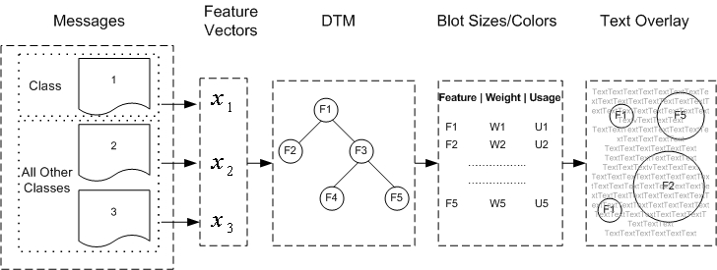
System Design: Ink Blots
Ink Blots uses decision tree models (DTM) to select features which are superimposed onto text to show usage frequencies as they occur within their textual structure.
Ink Blot Technique Steps
Separate input text into two classes (one for class of interest, one class
containing all remaining texts).
Extract feature vectors for messages.
Input vectors into DTM as binary class problem.
For each feature in computed decision tree, determine blot size and color
based on DTM weight and feature usage.
Overlay feature blots onto their respective occurrences in text.
Repeat steps 1-5 for each class.

Slide 44
Application Example: The Enron Case
We use Writeprints and Ink Blots to illustrate how CyberGate supports text analysis of CMC.
  Additional CyberGate views such as parallel coordinates and MDS plots are also incorporated.
  Used to illustrate CyberGate’s ability to support data characterization.
The example application on the Enron email corpus reflects the ability of these techniques to collectively support the analysis of ideational and textual information.
Example relates to two authors from Enron, neither of which was directly involved in the scandal.
  Author A worked in the sales division while Author B was in the company’s legal department.

Slide 45
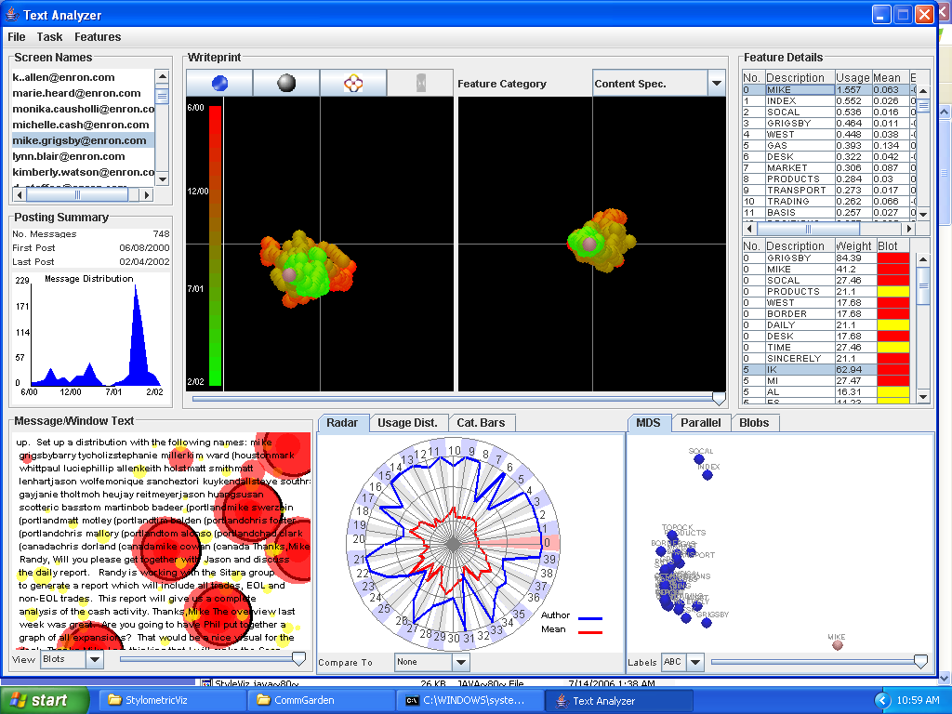
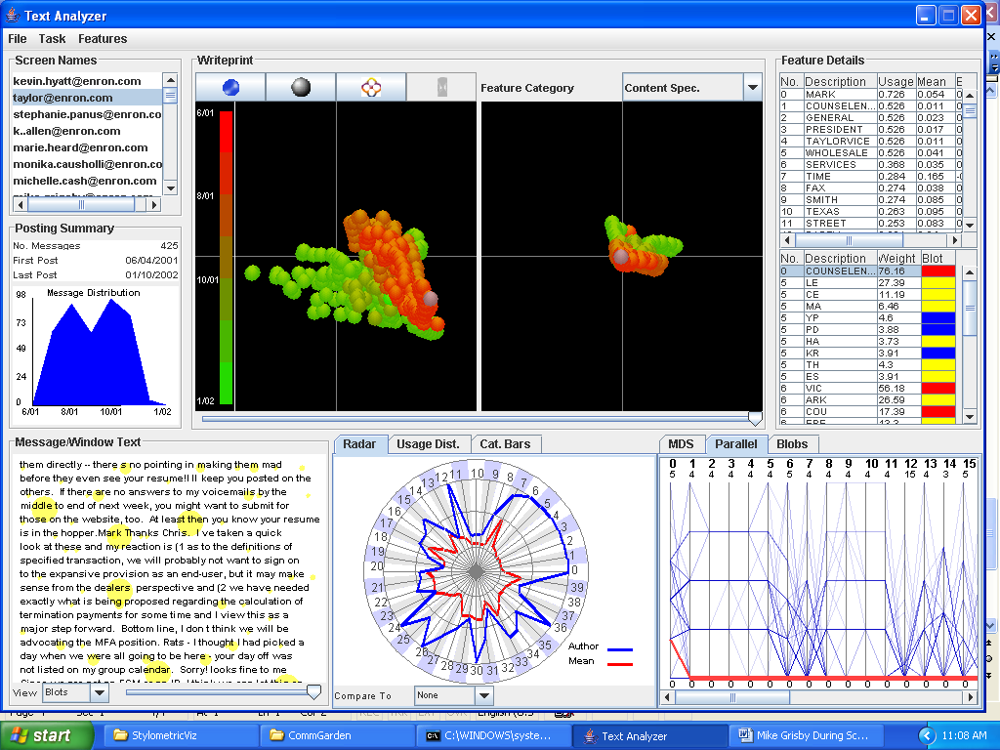
Application Example: The Enron Case
Temporal Writeprint views of the two authors across all features (lexical, syntactic, structural, content-specific, n-grams, etc.).
Each circle denotes a text window that is colored according to the point in time at which it occurred.
The bright green points represent text windows from emails written after the scandal had broken out while the red points represent text windows from before.
Author B has greater overall feature variation, attributable to a distinct difference in the spatial location of points prior to the scandal as opposed to afterwards.
In contrast, Author A has no such difference, with his newer (green) text points placed directly on top of his older (redder) ones.
Consequently, Author B has had a profound change with respect to the text in his emails while there doesn’t appear to be any major changes for Author A.
Author A
Author B

Slide 46
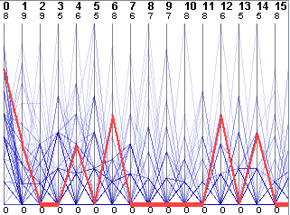
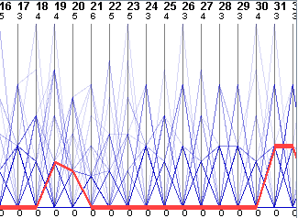
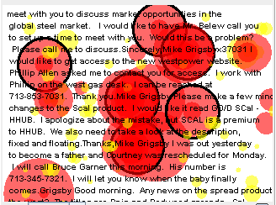
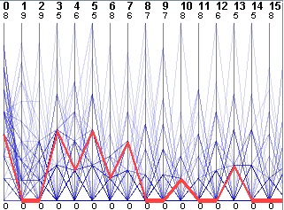
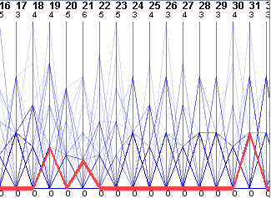
Application Example: The Enron Case
Ink Blots and parallel coordinates for sample points taken from Author A for text windows before and after the scandal.
The Ink Blot views show the author’s key features superimposed onto the text.
There doesn’t appear to be a major difference in the usage of these features in text before and after the scandal.
Parallel coordinates shows the author’s 32 most important bag-of-words, including sales and business deal related terms (the major topical content of the author’s text).
Again, the before and after coordinate patterns seem similar, suggesting little topical deviation attributable to the scandal.
Before Scandal Text
After Scandal Text

Slide 47
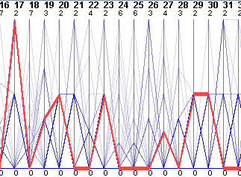
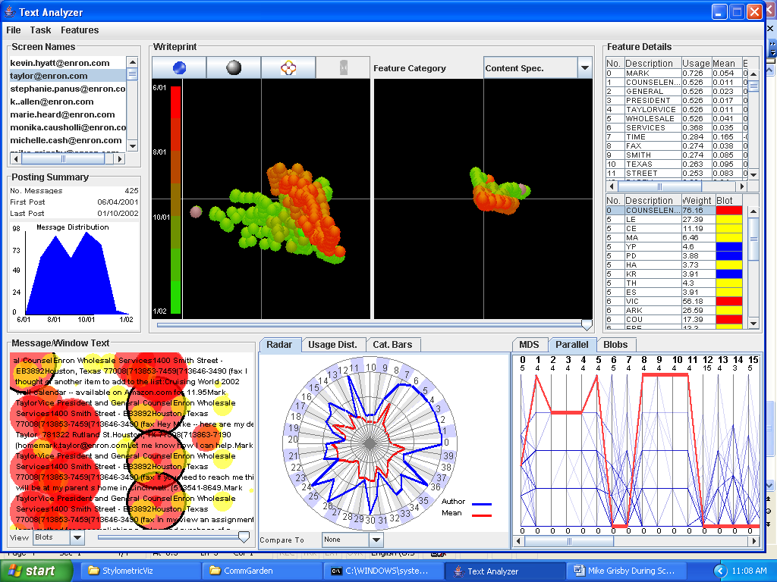

Application Example: The Enron Case
Author B’s after scandal text has greater occurrence of key ink blot features. While emails before the scandal focus on legal aspects of business deals with terms such as “counterparties” and “negotiations,” after scandal discourse revolves around Author B providing advice and legal counsel to fellow employees.
The post-scandal emails are more formal, containing greater usage of email signatures (e.g., job title, contact information).
Bag-of-word parallel coordinates for these signature terms (e.g., title, address, phone number) correspond to the first 12 features while terms relating to business legalities correspond to the latter features (e.g., 15-30).
Before Scandal Text
After Scandal Text

Slide 48
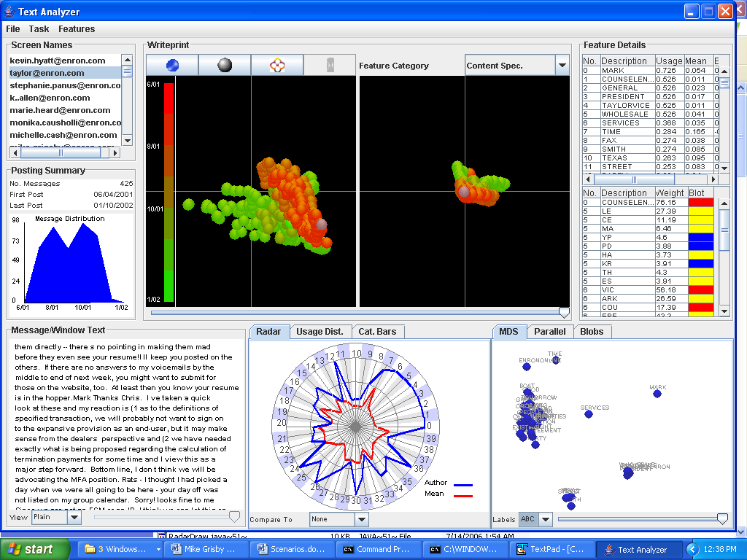
Application Example: The Enron Case
Yates and Orlikowski (1999) stated that “the purpose of a genre is not an individual’s private motive for communicating, but purpose socially constructed and recognized by the relevant organizational community…” (p. 15).
Important characteristics of a genre form include structural and linguistic features including elements of style such as the level of formality and text formatting.
For Author B, the post scandal emails signify a shift in genres.
MDS Plots of Bag-of-Words
Before Scandal:
Business/legal terms
After Scandal:
Job title and contact information

Slide 49
Evaluation
Text Categorization using Writeprints and Ink Blots
  Writeprints and Ink Blots represent the two core components of CyberGate.
  In addition to analysis, the two techniques can also support text categorization.
    Writeprints is effective at capturing occurrence variation which can be useful for categorizing style.
    Ink Blots is geared towards occurrence frequency which can be beneficial for topical and sentiment categorization.
Conducted 5 experiments to evaluate techniques:
  Categorization of Ideational Information
    Topics -> Topic Categorization
    Opinions -> Sentiment Classification
  Categorization of Textual Information
    Style -> Authorship Classification
    Genres -> Genre Classification
  Categorization of Interpersonal Information
    Interaction -> Interactional Coherence Analysis

Slide 50
Evaluation
Compared Writeprints and Ink Blots with SVM.
  SVM – SVM run using same features as CyberGate
  Baseline – SVM run using bag-of-words
  Support Vector Machine (SVM) has been a powerful machine learning algorithm for text categorization.
    Topic Classification (Dumais et al., 1998)
    Sentiment Classification (Pang et al., 2002)
    Authorship Classification (Abbasi & Chen, 2005; Zheng et al., 2006)
    Genre Classification (Santini, 2004)
  Run using linear kernel with sequential minimal optimization (SMO) algorithm (Platt, 1999)

Slide 51
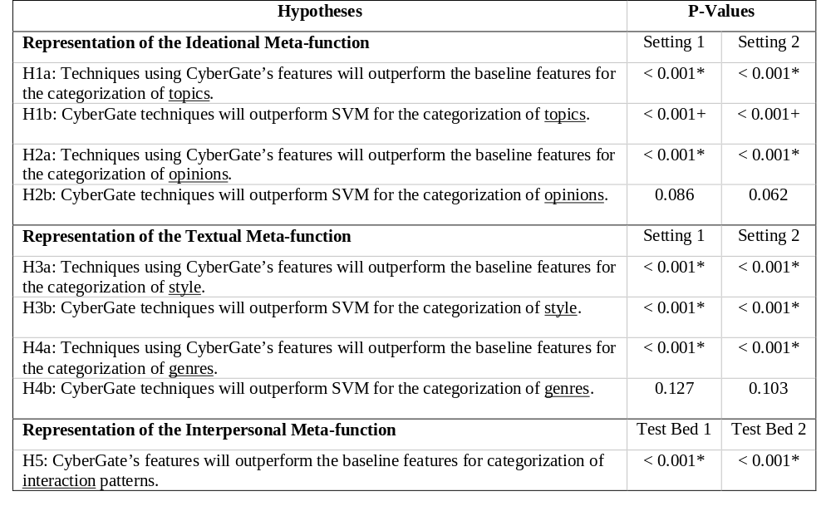
Evaluation
Summary of hypotheses testing results for ensuing experiments
* P-values significant at alpha=0.05 + Results contradict hypotheses

Slide 52
Evaluation: Experiment 1
Topic Categorization
  Objective to test effectiveness of features and techniques for capturing topical information.
  Test bed = 10 topics taken from Enron email corpus (100 emails per topic).
  Compared SVM against Ink Blot technique.
  Feature set = bag-of-words and noun phrases
    Both effective in prior research (Dumais et al., 1998; Chen et al., 2003).
  Two experiment settings were run, one using 5 topics and the other one using all 10 topics.
  Both techniques were run using 10-fold cross validation.
  For Ink Blots, the class with the highest ratio of red to blue blot area was assigned the anonymous message.

Slide 53
Evaluation: Experiment 1
Topic Categorization Results
  Both techniques achieved accuracy over 90% in all instances.
  SVM significantly outperformed the Ink Blot technique for the 5 and 10 topic experiment settings.
  The higher performance of SVM was attributable to its ability to better classify the small percentage of messages that were in the gray area between topics.
 | Techniques
# Topics | SVM | Ink Blots | Baseline
5 topics | 95.70 | 92.25 | 88.75
10 Topics | 93.25 | 90.10 | 86.55

Slide 54
Evaluation: Experiment 2
Sentiment Classification
  Objective to test effectiveness of features and techniques for capturing opinions.
  Test bed of 2000 digital camera product reviews taken from www.epinions.com.
    1000 positive (4-5 star) and 1000 negative (1-2 star) reviews
    500 for each star level (i.e., 1,2,4,5)
  Two experimental settings were tested
    Classifying 1 star versus 5 star (extreme polarity)
    Classifying 1+2 star versus 4+5 star (milder polarity)
  Feature set encompassed a lexicon of 3000 positive or negatively oriented adjectives and word n-grams (Pang et al., 2002; Turney & Littman, 2003).
  Compared Ink Blots against SVM.
    Both run using 10-fold cross validation.

Slide 55
Evaluation: Experiment 2
Sentiment Classification Results
  SVM marginally outperformed Ink Blots however the enhanced performance was not statistically significant (p-values on pair wise t-tests > 0.05).
  The overall accuracies for both techniques were consistent with previous work which has been in the 85%-90% range (e.g., Pang et al., 2002).
  Once again the improved performance of SVM was attributable to its ability to better detect messages containing sentiments with less polarity.
  Many of the milder (2 and 4 star) reviews contained positive and negative comments about different aspects of the product.
    It was more difficult for the Ink Blot technique to detect the overall orientation of many of these messages.
 | Techniques
Sentiments | SVM | Ink Blots | Baseline
Extreme Polarity | 93.00 | 92.20 | 83.00
Mild Polarity | 89.40 | 86.80 | 77.10

Slide 56
Evaluation: Experiment 3
Style Classification
  Used to test effectiveness of features and techniques for capturing style.
  Test bed = Enron email corpus (used 25 or 50 authors)
  Entity resolution classification task in which half of messages used for training (known entity) and half for testing (anonymous identity).
    Objective is to match anonymous identity to the correct known entities (in training data) based on stylistic/authorship tendencies.
  Feature set consisted of lexical, syntactic, structural, content-specific, and n-grams.
    The effectiveness of these features as style markers has previously been demonstrated (Abbasi & Chen, 2005; Zheng et al., 2006).
  Compared Writeprints against SVM.

Slide 57
Evaluation: Experiment 3
Style Classification Results
  Writeprints outperformed SVM by 8%-10% for both experimental settings.
  The improved performance was statistically significant for 25 and 50 authors.
  Furthermore, the Writeprint accuracies for such a large number of authors are higher than previous studies (Zheng et al., 2006).
 | Techniques
# Authors | SVM | Writeprints | Baseline
25 Authors | 84.00 | 92.00 | 62.00
50 Authors | 80.00 | 90.00 | 51.00

Slide 58
Evaluation: Experiment 4
Genre Classification
  Objective to test effectiveness of features and techniques for capturing genres.
  Test bed of 3000 forum postings from the Sun Technology Forum (forum.java.sun.com)
  Genres included questions, informative messages, and general messages (no information, just comments).
    1000 messages used for each genre.
  Two experimental settings were run:
    Questions (1000 messages) versus non-questions (500 informative, 500 comments)
    All three genres (1000 messages each)
  The feature set consisted of lexical, syntactic, structural, content-specific, and n-gram features.
  Compared Ink Blots with SVM (again, 10-fold CV).

Slide 59
Evaluation: Experiment 4
Genre Classification Results
  Ink Blots marginally outperformed SVM however the enhanced performance was not statistically significant based on pair wise t-tests (p-values > 0.05).
  The overall accuracies for both techniques were consistent with previous results dealing with 2-3 genres (e.g., Santini, 2004).
  This provides evidence for the effectiveness of the underlying features and techniques for categorizing genres.
 | Techniques
Genres | SVM | Ink Blots | Baseline
Questions vs. Non-questions | 98.10 | 98.55 | 90.10
All Three Genres | 96.40 | 96.50 | 86.00

Slide 60
Evaluation: Experiment 5
Interactional Coherence Analysis
  We used two test beds:
    Four conversation threads taken from the Sun Java Technology forum (1200 messages posted by 120 users).
    Three threads taken from the LNSG social discussion forum (400 messages posted by 100 users).
  The CyberGate feature set consisted of structural features (taken from the message headers) as well as function words, bag-of-words, noun phrases, and named entities derived from body text.
    Intended to represent various interaction cues, including direct address and lexical relations.
  The baseline feature set consisted of only structural features, as used in prior systems (Donath et al., 1999; Smith and Fiore, 2001).
  Used the F-measure to evaluate performance

Slide 61
Evaluation: Experiment 5
Interactional Coherence Analysis Results
  CyberGate’s extended feature set significantly outperformed the baseline (p-values < 0.001).
  The performance difference was more pronounced on the LNSG forum.
  Users in this forum make less use of structural features when interacting with one another, instead preferring to rely on text-based interaction cues.
  The results illustrate the importance of using richer features for representing CMC interactions.
 | Features
Test Bed | CyberGate | Baseline
Sun Java Forum | 86.00 | 77.40
LNSG Forum | 77.11 | 55.55

Slide 62
Evaluation
Results Discussion
The Writeprint and Ink Blot techniques performed well, typically with categorization accuracy over 90%.
SVM performed better on ideational information types while Writeprints and Ink Blots outperformed SVM on textual information.
  SVM had higher accuracy for topic and sentiment classification (significantly higher for topics).
  Writeprints and Ink Blots had higher accuracy for style and genre classification (significantly higher for authorship style classification).
In all instances, the Writeprint and Ink Blot performance was at least on par with the state-of-the art categorization accuracies reported in previous studies.
  In the case of Writeprints for style classification, the performance was considerably better than results obtained in previous research.
The results support the viability of CyberGate’s core techniques for textual categorization of ideational and textual information.

Slide 63
Conclusion
In this paper our major research contributions are two-fold:
Firstly, we developed a framework for the categorization and analysis of computer mediated communication text.
  Based on representational richness, taken from Systemic Functional Linguistic Theory, and methodological triangulation.
Secondly, we developed the CyberGate system to evaluate the efficacy of our design framework.
  Features the Writeprint and Ink Blot techniques
  Presented an application example to illustrate text analysis capabilities
  Experiments were conducted to evaluate the ability of the CyberGate components for categorization of CMC text.
The results indicated that Writeprints and Ink Blots were effective for analysis and categorization of web discourse.

Slide 64
Appendix: CyberGate Interface

Slide 65
Appendix: CyberGate Interface

