Slide 1
Predictive Analytics: Regression & Classification
Weifeng Li, Sagar Samtani and Hsinchun Chen
Spring 2016
Acknowledgements: Cynthia Rudin, Hastie & Tibshirani
Michael Crawford – San Jose State University
Pier Luca Lanzi – Politecnico di Milano

Slide 2
Outline
Introduction and Motivation
Terminology
Regression
Linear regression, hypothesis testing
Multiple linear regression
Classification
Decision Tree
Random Forest
Naïve Bayes
K Nearest Neighbor
Support Vector Machine
Evaluation metrics
Conclusion and Resources

Slide 3
Introduction and Motivation
In recent years, there has been a growing emphasis for researchers and practitioners alike to be able to “predict” the future based on past data.
These slides present two standard “predictive analytics” approaches:
Regression – given a set of attributes, predict the value for a record
Classification – given a set of attributes, predict the label (i.e., class) for the record

Slide 4
Introduction and Motivation
Consider the following:
The NFL trying to predict the number of Super Bowl viewers
An insurance company determining how many policy holders will have an accident
Or:
A bank trying to determine if a customer will default on their loan
A marketing manager needs to determine whether a customer will purchase or not
Regression
Classification
Notes:
Classification is has a variety of applications, such as:
Determining whether a website is phishing or legit
Categorizing news stories as finance, weather, sports, etc.
Classifying unknown source code into their programming language
Determining whether a tumor cell is benign or malicious

Slide 5
Background – Terminology
Let’s review some common data mining terms.
Data mining data is usually represented with a feature matrix.
Features
Attributes used for analysis
Represented by columns in feature matrix
Instances
Entity with certain attribute values
Represented by rows in feature matrix
An example instance is highlighted in red (also called a feature vector).
Class Labels
Indicate category for each instance.
This example has two classes (C1 and C2).
Only used for supervised learning.
The Feature Matrix
Features
Attributes used to classify instances
 | F1 | F2 | F3 | F4 | F5
C1 | 41 | 1.2 | 2 | 1 | 3.6
C2 | 63 | 1.5 | 4 | 0 | 3.5
C1 | 109 | 0.4 | 6 | 1 | 2.4
C1 | 34 | 0.2 | 1 | 0 | 3.0
C1 | 33 | 0.9 | 6 | 1 | 5.3
C2 | 565 | 4.3 | 10 | 0 | 3.2
C1 | 21 | 4.3 | 1 | 0 | 1.2
C2 | 35 | 5.6 | 2 | 0 | 9.1
Each instance has a class label
Instances

Slide 6
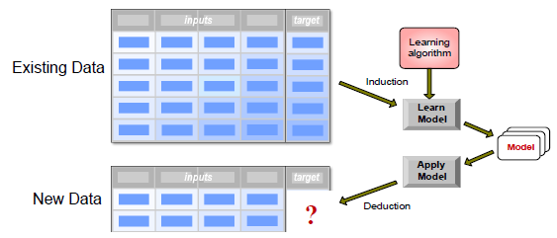
Background – Terminology
In predictive tasks, a set of input instances are mapped into a continuous (using regression) or discrete (using classification) outputs.
Given a collection of records, where each records contains a set of attributes, one of the attributes is the target we are trying to predict.

Slide 7
Outline
Introduction and Motivation
Terminology
Regression
Linear regression, hypothesis testing
Multiple linear regression
Classification
Decision Tree
Random Forest
Naïve Bayes
K Nearest Neighbor
Support Vector Machine
Evaluation metrics
Conclusion and Resources

Slide 8
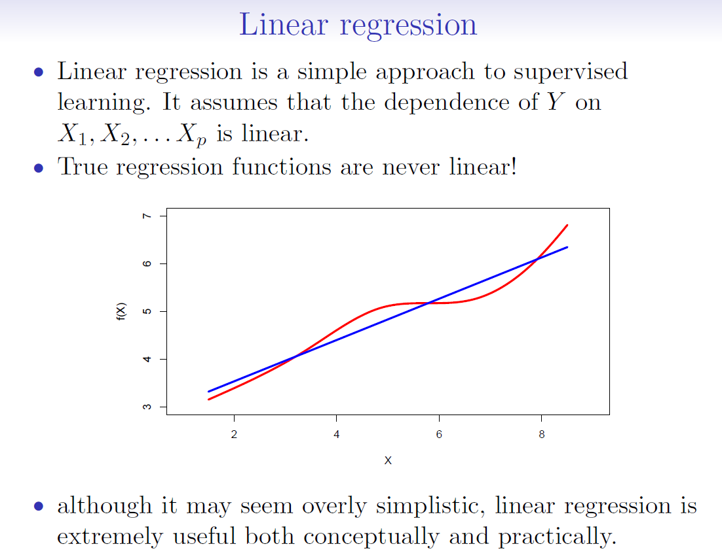

Slide 9
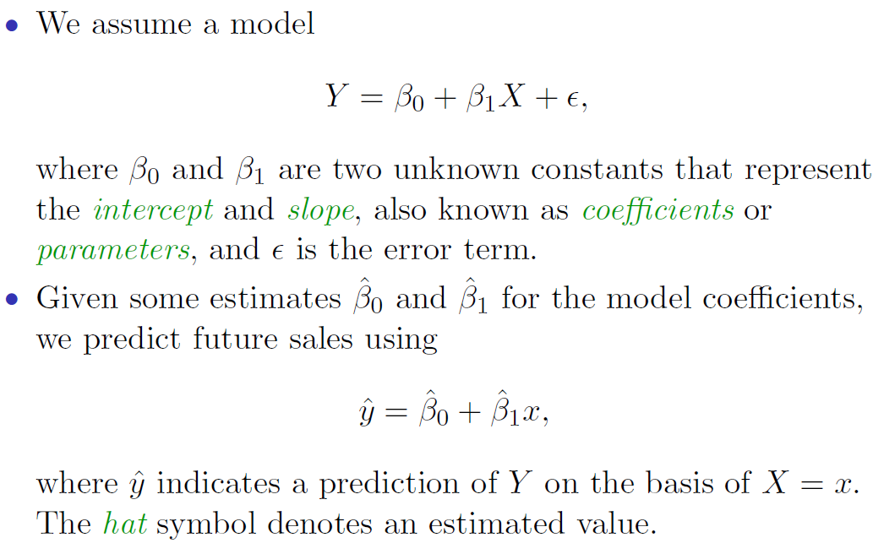
Simple Linear Regression

Slide 10
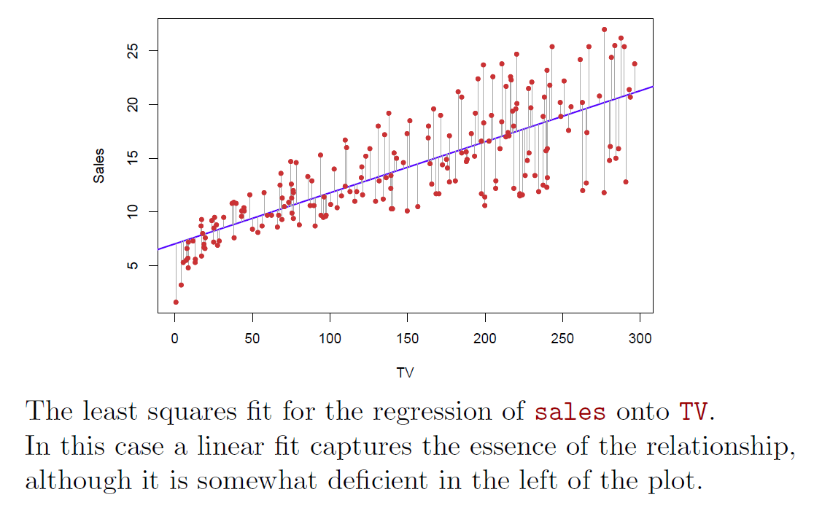
Simple Linear Regression: Example

Slide 11
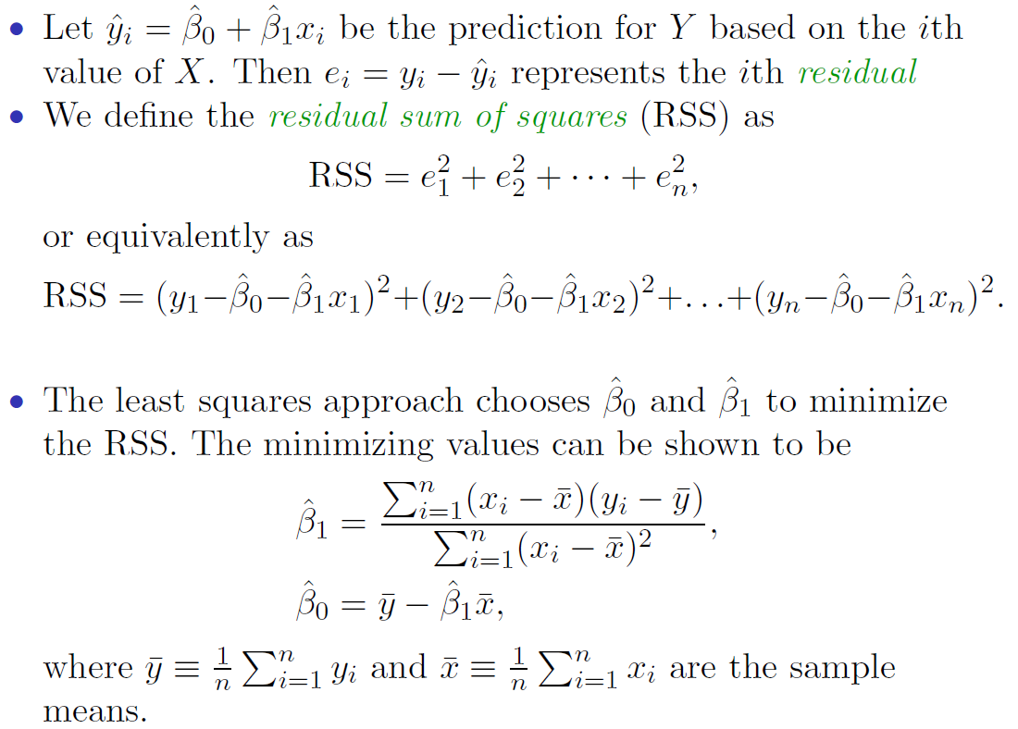
Estimation of the Parameters by Least Squares

Slide 12
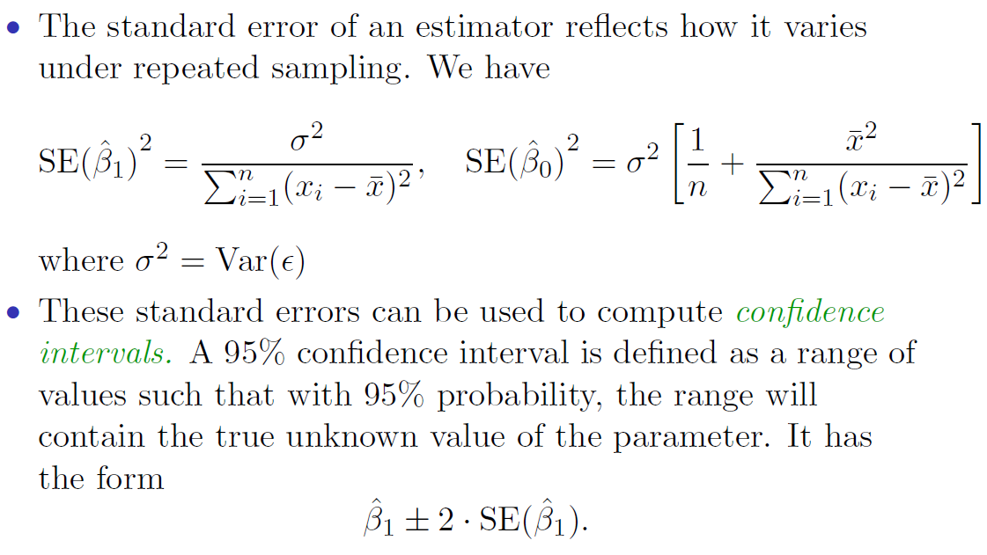
Assessing the Accuracy of the Coefficient Estimates

Slide 13
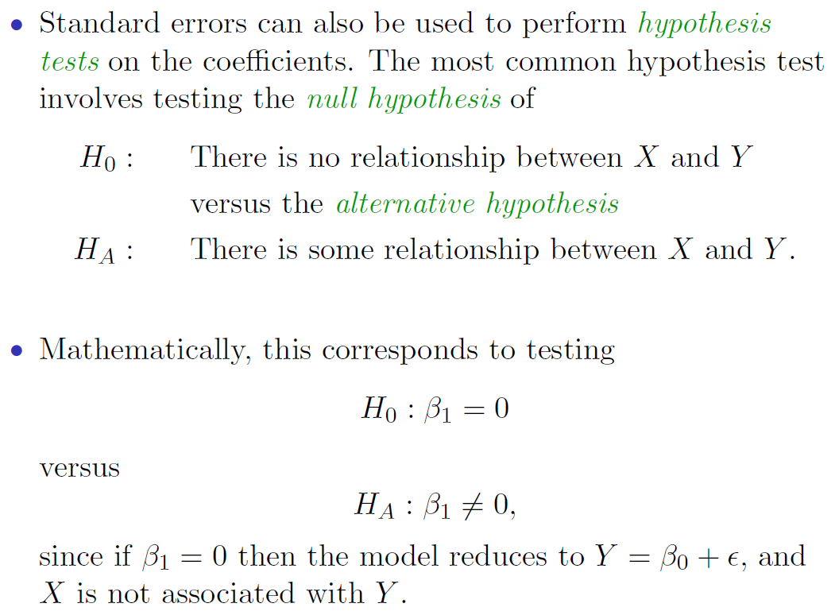
Hypothesis Testing

Slide 14
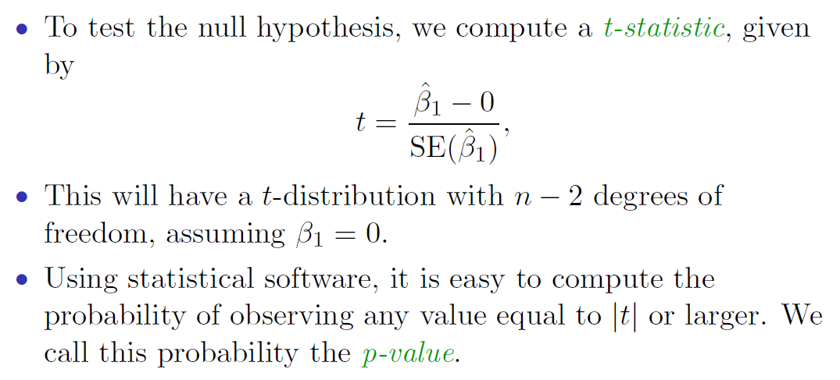
Hypothesis Testing (continued)

Slide 15
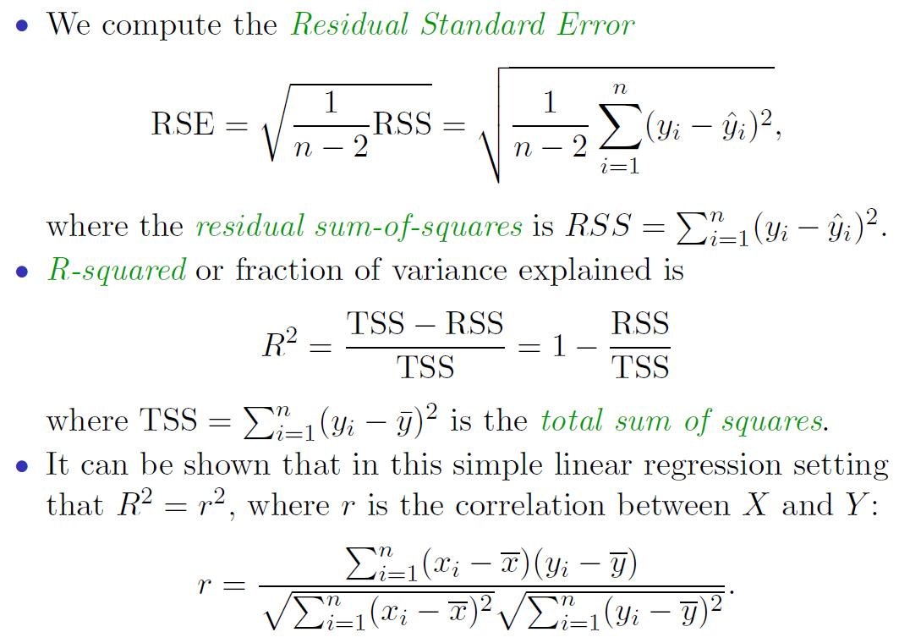
Model Evaluation: Assessing the Overall Accuracy of the Model

Slide 16

Multiple Linear Regression
Multiple linear regression models the relationship between two or more explanatory variables (i.e., predictors or independent variables) and a response variable (i.e., dependent variable.)
Multiple linear regression models can be used for predicting response variable that has range from $−∞$ to $∞$.

Slide 17
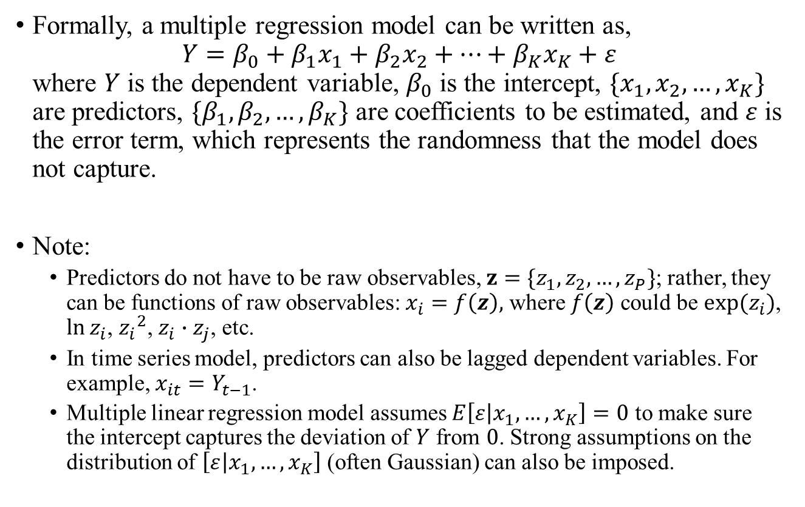
Multiple Linear Regression Model
Formally, a multiple regression model can be written as, $Y=β_{0}+β_{1}x_{1}+β_{2}x_{2}+…+β_{K}x_{K}+ε$ where $Y$ is the dependent variable, $β_{0}$ is the intercept, $\{x_{1},x_{2},…,x_{K}\}$ are predictors, $\{β_{1},β_{2},…,β_{K}\}$ are coefficients to be estimated, and $ε$ is the error term, which represents the randomness that the model does not capture.
Note:
Predictors do not have to be raw observables, $z=\{z_{1},z_{2},…,z_{P}\}$; rather, they can be functions of raw observables: $x_{i}=f\left(z\right),$ where $f\left(z\right)$ could be $exp⁡(z_{i})$, $\ln{z_{i}}$, ${z_{i}}^{2}$, $z_{i}∙z_{j}$, etc.
In time series model, predictors can also be lagged dependent variables. For example, $x_{it}=Y_{t−1}$.
Multiple linear regression model assumes $E\left[ε | x_{1},…,x_{K}\right]=0$ to make sure the intercept captures the deviation of $Y$ from $0$. Strong assumptions on the distribution of $\left[ε | x_{1},…,x_{K}\right]$ (often Gaussian) can also be imposed.

Slide 18
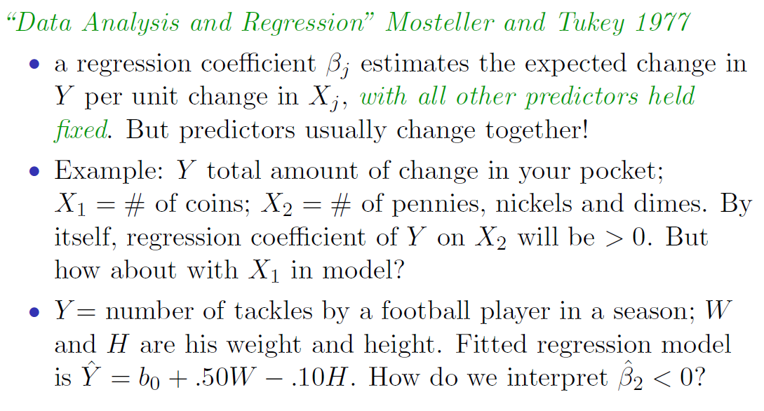
Application: Interpreting Regression Coefficients

Slide 19
Outline
Introduction and Motivation
Terminology
Regression
Linear regression, hypothesis testing
Multiple linear regression
Classification
Decision Tree
Random Forest
Naïve Bayes
K Nearest Neighbor
Support Vector Machine
Evaluation metrics
Conclusion and Resources

Slide 20
Classification Background
Classification is a two-step process: a model construction (learning) phase, and a model usage (applying) phase.
In model construction, we describe a set of pre-determined classes:
Each record is assumed to belong to a predefined class based on its features
The set of records is used for model construction is a training set
The trained model is then applied to unseen data to classify those records into the predefined classes.
Model should fit well to training data and have strong predictive power.
Do NOT want to overfit a model, as that results in low predictive power.

Slide 21
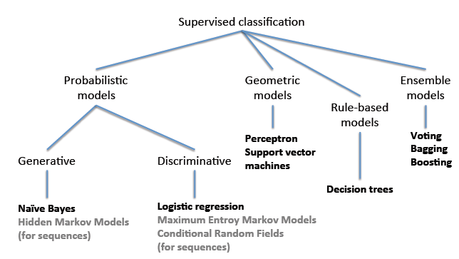
Classification Methods

Slide 22
Classification Methods
There is no “best” method. Methods can be selected based on metrics (accuracy, precision, recall, F-measure), speed, robustness, scalability, and robustness.
We will cover some of the more classic and state-of-the-art techniques in the following slides, including:
Decision Tree
Random Forest
Naïve Bayes
K-Nearest Neighbor
Support Vector Machine (SVM)

Slide 23
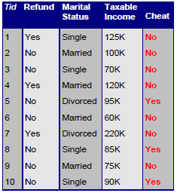
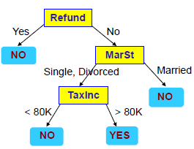

Decision Tree
A decision tree is a tree-structured plan of a set of attributes to test in order to predict the output.

Slide 24
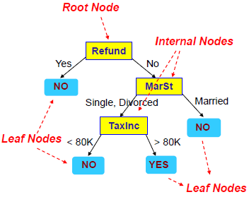
Decision Tree – Example
The top most node in a tree is the root node.
An internal node is a test on an attribute.
A leaf node represents a class label.
A branch represents the outcome of the test.

Slide 25
Building a Decision Tree
There are many algorithms to build a Decision Tree (ID3, C4.5, CART, SLIQ, SPRINT, etc).
Basic algorithm (greedy)
Tree is constructed in a top-down recursive divide-and-conquer manner
At start all the training records are at the root
Splitting attributes (and their split conditions, if needed) are selected on the basis of a heuristic or statistical measure (Attribute Selection Measure)
Records are partitioned recursively based on splitting attribute and its condition
When to stop partitioning?
All records for a given node belong to the same class
There are no remaining attributes for further partitioning
There are no records left

Slide 26
ID3 Algorithm
1) Establish Classification Attribute (in Table R)
2) Compute Classification Entropy.
3) For each attribute in R, calculate Information Gain using classification attribute.
4) Select Attribute with the highest gain to be the next Node in the tree (starting from the Root node).
5) Remove Node Attribute, creating reduced table R_{S}.
6) Repeat steps 3-5 until all attributes have been used, or the same classification value remains for all rows in the reduced table.

Slide 27
Building a Decision Tree – Splitting Attributes
Selecting the best splitting attribute depends on the attribute type (categorical vs continuous) and number of ways to split (2-way split, multi-way split).
We want to use a purity function (summarized below) that will help us to choose the best splitting attribute.
WEKA will allow you to choose your desired measure.
Measure | Description | Pros | Cons
Information Gain (ID3/C4.5) | Chooses the attribute with the lowest amount of entropy (i.e., uncertainty) to classify a record | Fast, works well with few multivalued attributes | Biased towards multivalued attributes
Gain Ratio | Modification to Info gain that reduces its bias on high-branch attributes. Takes into account branch sizes. | More robust than Information Gain | Prefers unbalanced splits in which one partition is much smaller than the others
Gini Index | Used in CART, SLIQ | Golden standard in economics Incorporates all data | Biased towards multivalued attributes, has difficulty when # of classes is large

Slide 28

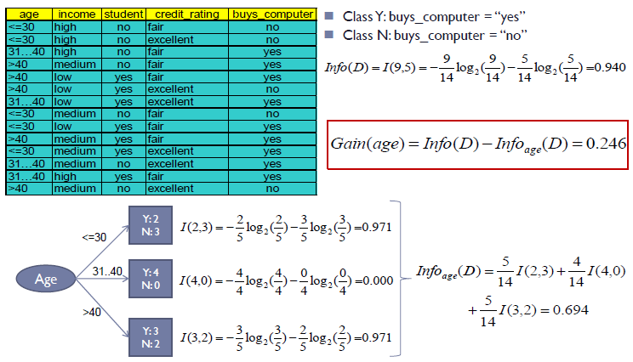
Information Gain Example

Slide 29
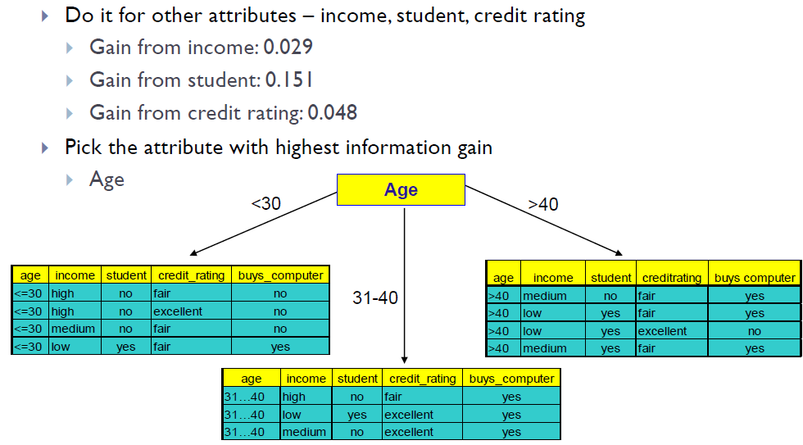
Information Gain Example (continued)

Slide 30
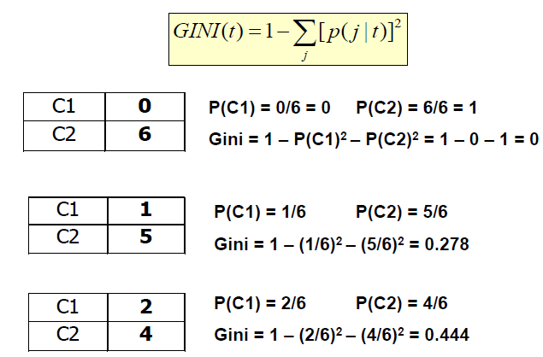
GINI Index Example

Slide 31
Building a Decision Tree - Pruning
A common issue with Decision Tree is overfitting. To address such an issue, we can apply pre and post-pruning rules.
WEKA will give you these options.
Pre-pruning – stop the algorithm before it becomes a full tree. Typical stopping conditions for a node include:
Stop if all records for a given node belong to the same class
Stop if there are no remaining attributes for further partitioning
Stop if there are no records left
Post-pruning – grow the tree to its entirety.
Trim the nodes of the tree in a bottom-up fashion
If error improves after trimming, replace sub-tree by a leaf node
Class label of leaf is determined from majority class of records in sub-tree

Slide 32
Random Forest – Bagging
Before Random Forest, we must first understand “bagging.”
Bagging is the idea wherein a classifier is made up of many individual classifiers from the same family.
They are combined through majority rule (unweighted)
Each classifier is trained on a bootstrapped sample with replacement from the training data.
Each of classifiers in the bag is a “weak” classifier

Slide 33
Random Forest
Random Forest is based off of decision tree and bagging.
The weak classifier in Random Forest is a decision tree.
Each decision tree in the bag is using only a subset of features.
Only two hyper-parameters to tune:
How many trees to build
What percentage of features to use in each tree
Performs very well and can be implemented in WEKA!

Slide 34
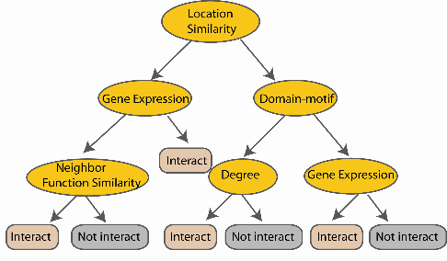
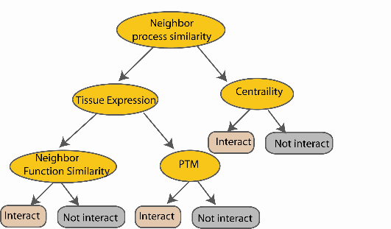
Random Forest
Create decision tree
from each
bootstrap sample
Create bootstrap samples
from the training data
M features
Take the majority vote
N examples
....…
....…

Slide 35
Naïve Bayes
Naïve Bayes is a probabilistic classifier applying Bayes’ theorem.
Assumes that the value of features are independent of other features and that features have equal importance.
Hence “Naive”
Scales and performs well in text categorization tasks.
E.g., spam or legitimate email, sports or politics, etc.
Also has extensions such as Gaussian Naïve Bayes, Multinomial Naïve Bayes, and Bernoulli Naïve Bayes.
Naïve Bayes and Multinomial Naïve Bayes are part of WEKA

Slide 36



Naïve Bayes – Bayes Theorem
Naïve Bayes is based off of Bayes theorem, where a posterior is calculated based on prior events, likelihood, and evidence.
Example – If a patient has stiff neck, what is the probability he/she has meningitis given that:
A doctor knows that meningitis causes stiff neck 50% of the time
Prior probability of any patient having meningitis is 1/50,000
Prior probability of any patient having stiff neck is 1/20
In English

Slide 37




Naïve Bayes – Approach to Classification
Approach to Naïve Bayes classification:
Compute the posterior probability P(C | A₁ , A₂ , … , A_{n}) for all values of C (i.e., class) using Bayes’ theorem.
After computing the posteriors for all values, choose the value of C that maximizes:
This is equivalent to choosing value of C that maximizes:
The following equation equates to the first equation. It also illustrates the “naive” assumption that all attributes (A_{i}) are independent from each other.

Slide 38
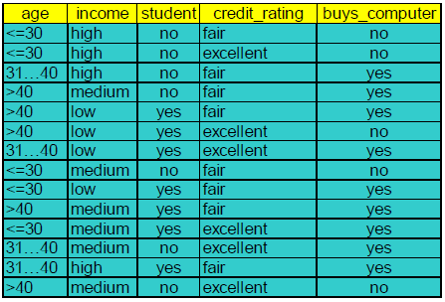



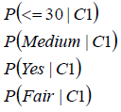
Naïve Bayes – Example

Slide 39
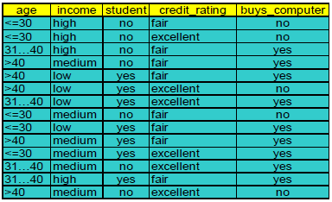
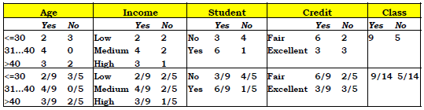
Naïve Bayes – Example

Slide 40
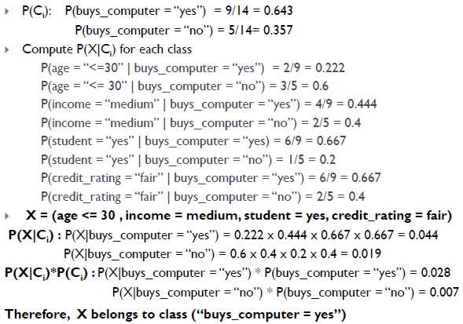
Naïve Bayes – Example

Slide 41
K-Nearest Neighbor
All instances correspond to points in an n-dimensional Euclidean space
Classification is delayed till a new instance arrives
Classification done by comparing feature vectors of the different points
Target function may be discrete or real-valued

Slide 42
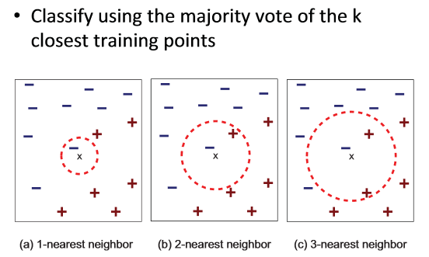
K-Nearest Neighbor

Slide 43
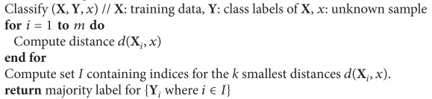
K-Nearest Neighbor Pseudocode

Slide 44
Support Vector Machine
SVM is a geometric model that views the input data as two sets of vectors in an n-dimensional space. It is very useful for textual data.
It constructs a separating hyperplane in that space, one which maximizes the margin between the two data sets.
To calculate the margin, two parallel hyperplanes are constructed, one on each side of the separating hyperplane.
A good separation is achieved by the hyperplane that has the largest distance to the neighboring data points of both classes.
The vectors (points) that constrain the width of the margin are the support vectors.

Slide 45
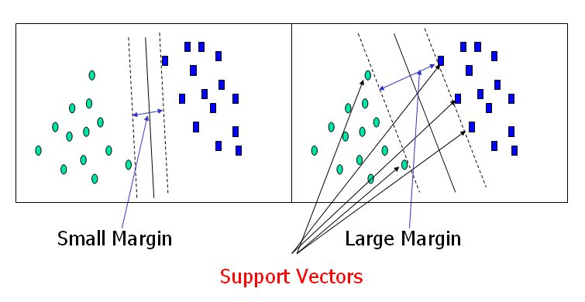
Support Vector Machine
Solution 1
Solution 2
An SVM analysis finds the line (or, in general, hyperplane) that is oriented so that the margin between the support vectors is maximized. In the figure above, Solution 2 is superior to Solution 1 because it has a larger margin.

Slide 46
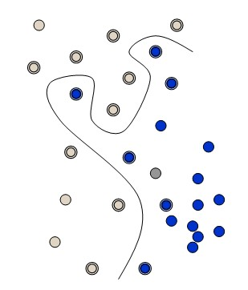
Support Vector Machine – Kernel Functions
What if a straight line or a flat plane does not fit?
The simplest way to divide two groups is with a straight line, flat plane or an N-dimensional hyperplane. But what if the points are separated by a nonlinear region?
Rather than fitting nonlinear curves to the data, SVM handles this by using a kernel function to map the data into a different space where a hyperplane can be used to do the separation.
Nonlinear, not flat

Slide 47
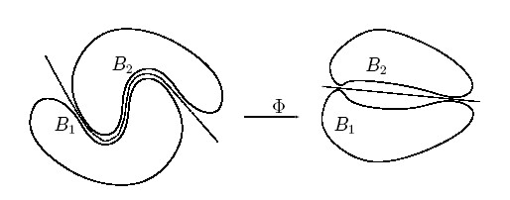
Support Vector Machine – Kernel Functions
Kernel function Φ: map data into a different space to enable linear separation.
Kernel functions are very powerful. They allow SVM models to perform separations even with very complex boundaries.
Some popular kernel functions are linear, polynomial, and radial basis.
For data in a structured representation, convolution kernels (e.g., string, tree, etc.) are frequently used.
While you can construct your own kernel functions according to the data structure, WEKA provides a variety of in-built kernels.

Slide 48
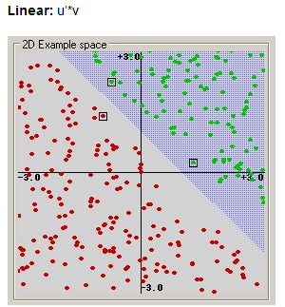
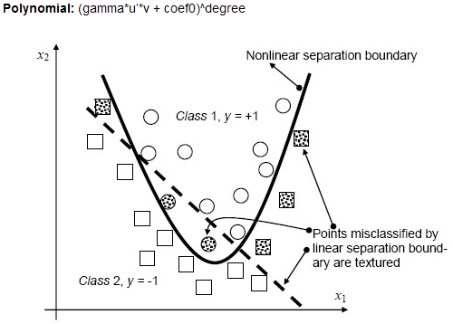
Support Vector Machine – Kernel Examples

Slide 49
Summary of Classification Methods
Classifier | Pros | Cons | WEKA Support?
Naïve Bayes | -Easy to implement -Less model complexity | -No variable dependency -Over simplification | Yes
Decision Tree | -Fast -Easily interpretable -Generally performs well | -Tend to overfit -Little training data for lower nodes | Yes
Random Forest | -Strong performance -Simple to implement | -Few hyper-parameters to tune -A little harder to interpret than decision trees | Yes
K-Nearest Neighbor | -Simple and powerful -No training involved | -Slow and expensive | Yes
Support Vector Machine | -Tend to have better performance than other methods -Works well on text classification -Works well with large feature set | -Can be computationally intensive -Choice of kernel may not be obvious | Yes

Slide 50
Outline
Introduction and Motivation
Terminology
Regression
Linear regression, hypothesis testing
Multiple linear regression
Classification
Decision Tree
Random Forest
Naïve Bayes
K Nearest Neighbor
Support Vector Machine
Evaluation metrics
Conclusion and Resources

Slide 51
Evaluation – Model Training
While the parameters of each model may differ, there are several methods to train a model.
We want to avoid overfitting a model and maximize its predictive power.
There are two standard methods for training a model:
Hold-out – reserve 2/3 of data for training and 1/3 for testing
Cross-Validation – partition data into k disjoint subsets, train on k-1 partitions, test on remaining
Many software (e.g., WEKA, RapidMiner) will do these methods automatically for you.

Slide 52
Evaluation
There are several questions we should ask after model training:
How predictive is the model we learned?
How reliable and accurate are the predicted results?
Which model performs better?
We want our model to perform well on our training set but also have strong predictive power.
Fortunately, various metrics applied on the testing set can help us choose the “best” model for our application.

Slide 53
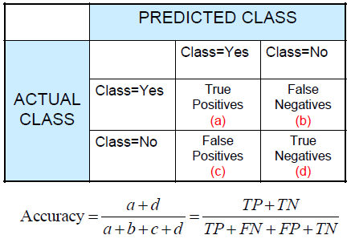
Metrics for Performance Evaluation
A Confusion Matrix provides measures to compute a models’ accuracy:
True Positives (TP) – # of positive examples correctly predicted by the model
False Negative (FN) – # of positive examples wrongly predicted as negative by the model
False Positive (FP) - # of negative examples wrongly predicted as positive by the model
True Negative (TN) - # of negative examples correctly predicted by the model

Slide 54
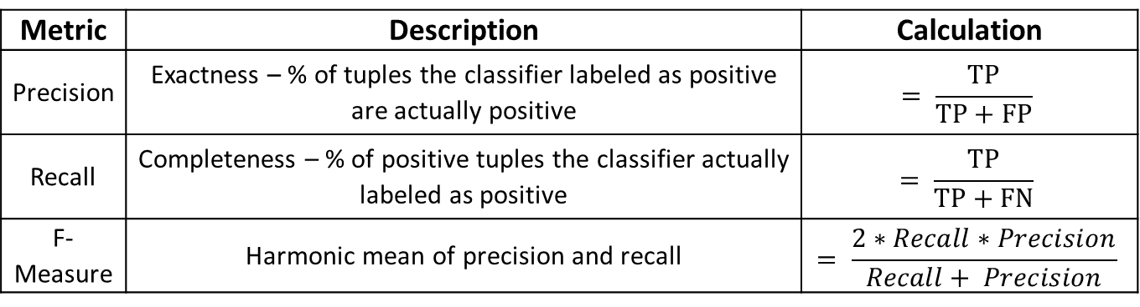
Metrics for Performance Evaluation
However, accuracy can be skewed due to a class imbalance.
Other measures are better indicators for model performance.
Metric | Description | Calculation
Precision | Exactness – % of tuples the classifier labeled as positive are actually positive | $$= \frac{TP}{TP+FP}$$
Recall | Completeness – % of positive tuples the classifier actually labeled as positive | $$= \frac{TP}{TP+FN}$$
F-Measure | Harmonic mean of precision and recall | $$= \frac{2∗Recall∗Precision}{Recall+ Precision}$$

Slide 55
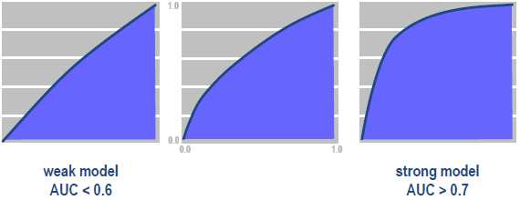
Metrics for Performance Evaluation
Models can also be compared visually using a Receiver Operating Characteristic (ROC) curve.
An ROC curve characterizes the trade-off between TP and FP rates.
TP rate is plotted on the y-axis against FP rate on the x-axis
Stronger models will generally have more Area Under the ROC curve (AUC).
TP
FP

Slide 56
Outline
Introduction and Motivation
Terminology
Regression
Linear regression, hypothesis testing
Multiple linear regression
Classification
Decision Tree
Random Forest
Naïve Bayes
K Nearest Neighbor
Support Vector Machine
Evaluation metrics
Conclusion and Resources

Slide 57
Conclusion
Regression and classification techniques can provide powerful predictive analytics techniques.
Linear and multiple regression provide mechanisms to predict specific data values.
Classification allows for predicting specific classes of output.
Many existing tools today can implement these techniques directly.
WEKA, Rapidminer, SAS, SPSS, etc.

Slide 58
References
Data Mining: Concepts and Techniques, 3rd Edition. JiaweiHan, Micheline Kamberand Jian Pei. Morgan Kaufmann
Introduction to Data Mining. Pang-Ning Tan, Michael Steinbach and Vipin Kumar. Addison-Wesley
Tay, B., Hyun, J. K., & Oh, S. (2014). A machine learning approach for specification of spinal cord injuries using fractional anisotropy values obtained from diffusion tensor images. Computational and mathematical methods in medicine, 2014.

Slide 59
Appendix: Technical Details

Slide 60
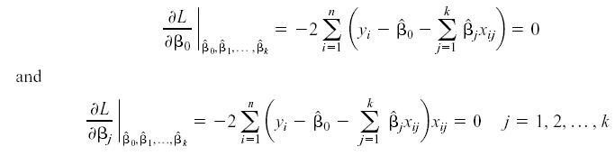
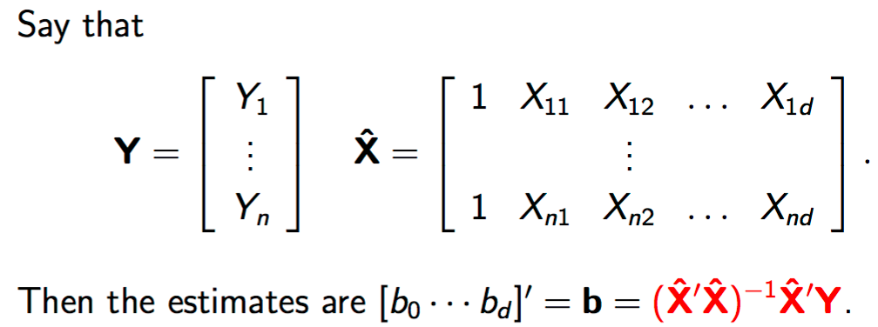
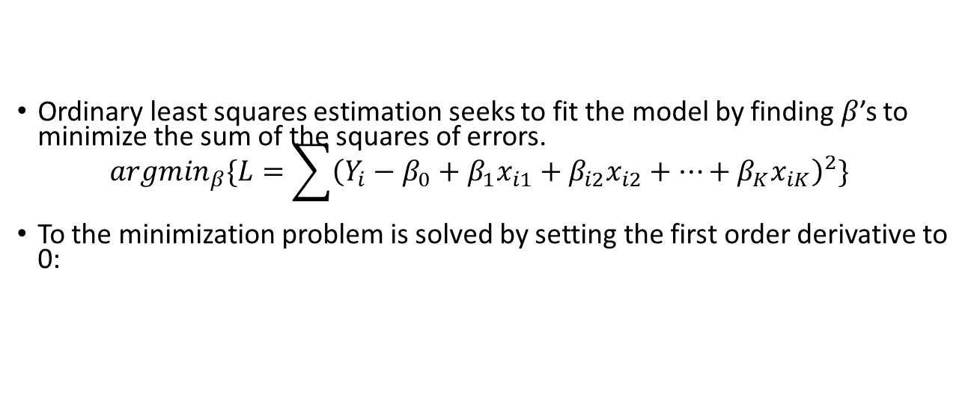
Fitting Multiple Linear Regression Model: Ordinary Least Squares Estimation
Ordinary least squares estimation seeks to fit the model by finding $β$’s to minimize the sum of the squares of errors. ${argmin}_{β}\{L=\sum{{\left(Y_{i}−β_{0}+β_{1}x_{i1}+β_{i2}x_{i2}+…+β_{K}x_{iK}\right)}^{2}}\}$
To the minimization problem is solved by setting the first order derivative to 0:

