Slide 1
Tableau Overview
Sagar Samtani and Hsinchun Chen
MIS 496A
Spring 2016

Slide 2
Tableau Background
Tableau is a powerful data visualization software.
Capable of creating various interactive visualizations from a multitude of data sources.
Tableau is a commercial software, but is available to students for free.
Download from (http://www.tableau.com/academic/students)
Tableau is primarily a drag-and-drop software.

Slide 3
Data Sources and Types of Visualizations
Tableau can connect to variety of data sources, including:
Local files – Excel, text, Access
Traditional databases – SQL Server, MySQL, Oracle, PostgreSQL, DB2
Cloud technologies – Amazon Aurora, EMR, Redshift, BigQuery
Big Data Technologies – Hadoop, Hive, Spark SQL
Tableau can create a variety of visualizations including:
Basic bar and line charts (e.g., temporal, box plots, etc.)
Geospatial analysis
Word clouds
Treemaps
Network analysis, although there are better tools for this (e.g., Gephi)!
These visualizations can be combined into interactive dashboards.
Can later be published online or shared easily.

Slide 4
Walkthrough Example
The following example will teach you how to load data into Tableau, make three basic visualizations, and put them into a dashboard.
Bar chart, Word Cloud, and Geospatial visualization.
The data used in this example is an Excel spreadsheet about NFL Offensive players from 1999-2013. It contains:
~40,000 rows of data
Player information (physically measurable traits, birthplace, college attended)
Positions played
Wins achieved in career

Slide 5
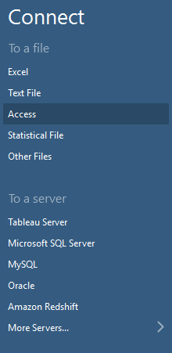
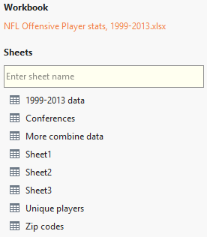
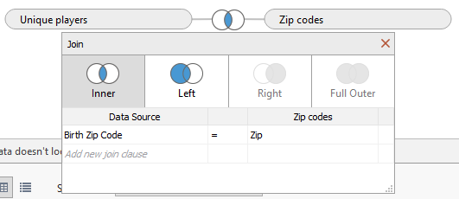
Connecting to a Data Source
1
2
3
2
We will have to connect to a data source to start making visualizations.
Since our data is in an Excel workbook, we will select that.
Second, we will join two of the sheets in the workbook such that we can get access to a larger set of data. Drag the “Unique players” and “Zip codes” sheets to the right. Select the “Inner” join option.
We will join the sheets based on zip code.

Slide 6
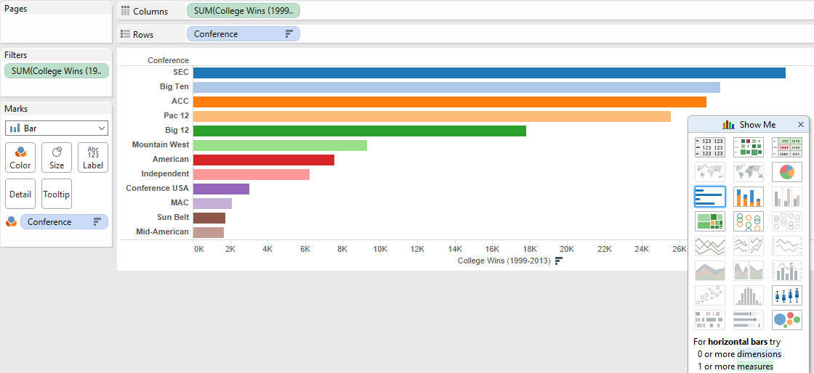
Creating a Bar Chart
1
3
2
Suppose we want to know which major college conferences have most combined wins since 1999.
First, drag the “Conference” dimension into the “Rows” bar, and the “College Wins” into the columns. Hit the drop down on the “College Wins” and select “Sum.”
Second, select bar chart on the right hand side.
To add a little bit of color, drag the “Conference” into the “Color” mark.

Slide 7
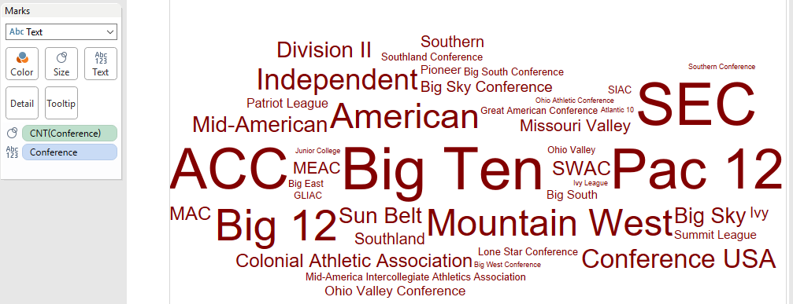
Creating a Word Cloud
1
2
Suppose now we want to get a general sense of the most popular conferences in terms of player enrollment is concerned. A word cloud is a great way to visually represent this.
First, switch the “Marks” option to “Text”.
Second, drag the “Conference” dimension into the “Text” marks box.
Then drag the “Conference” dimension into the “Size” marks box.
Adjust the measurement on this by hitting the drop down and selecting “Measure (Count)”

Slide 8
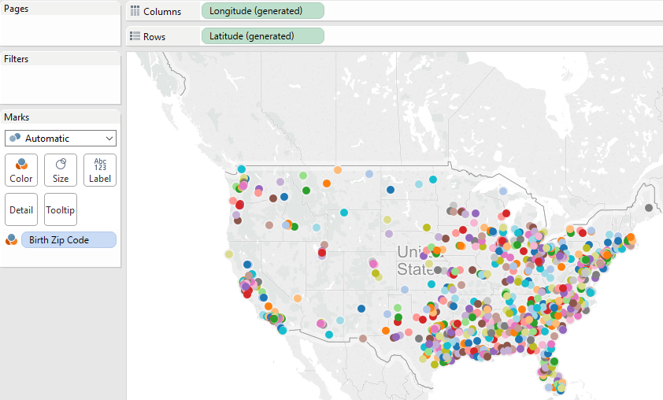
Creating a Geospatial Visualization
Consider now that we are interested in the birthplaces of all of the NFL players.
We can easily create a map representation.
Drag the “Longitude” dimension to columns, and “Latitude” dimension to the rows. Select the map visualization.
Add in some color by dragging the “Birth Zip Code” into the “Color” Marks.
1
2

Slide 9
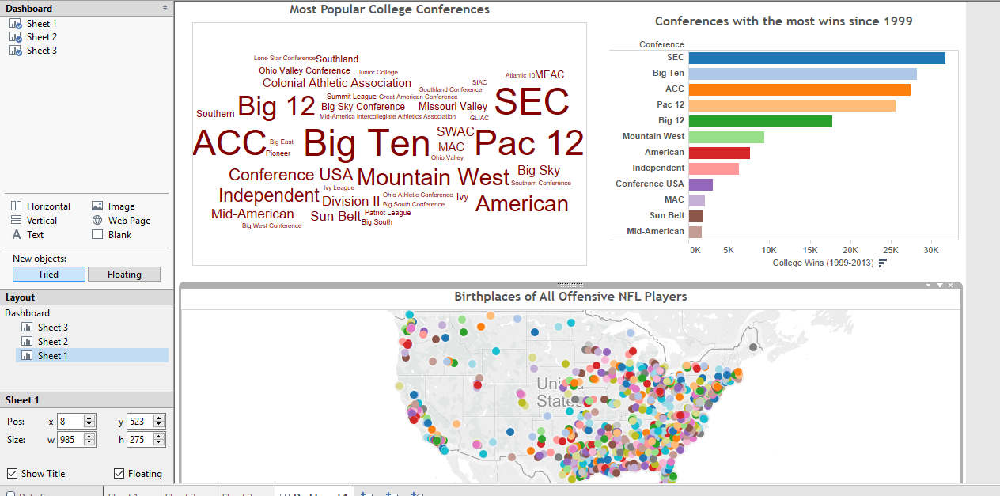
Combining Visualizations into a Dashboard
To tell a more comprehensive story, we can create a dashboard combining all of the visualizations.
Simply open a dashboard view and start dragging sheets into the dashboard.
You can format and add filters into the dashboard as you wish.

Slide 10
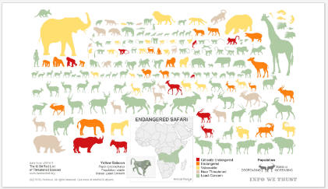
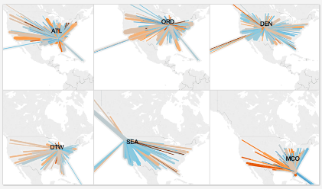
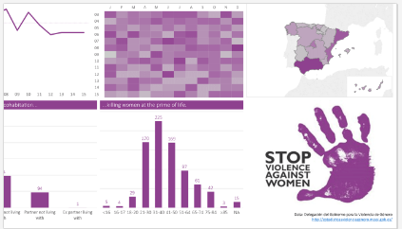
Further Examples
It is useful to explore other Tableau visualizations to get ideas.
https://public.tableau.com/s/gallery contains many great visualizations.
Endangered Safari –
https://public.tableau.com/s/gallery/endangered-safari
US Flights Delayed by Precipitation –
https://public.tableau.com/s/gallery/blame-weather-us-flight-delayed-precipitation
Domestic Violence in Spain –
https://public.tableau.com/s/gallery/domestic-violence-spain

Slide 11
Resources
Gallery of Tableau visualizations:
https://public.tableau.com/s/gallery
Tableau training videos:
http://www.tableau.com/learn/training
Sample Tableau data sources:
https://public.tableau.com/s/resources

