Slide 1

Weka Overview
Sagar Samtani and Hsinchun Chen
Spring 2016, MIS 496A
Acknowledgements: Mark Grimes, Gavin Zhang – University of Arizona
Ian H. Witten – University of Waikato
Gary Weiss – Fordham University

Slide 2
Outline
WEKA introduction
WEKA capabilities and functionalities
Data pre-processing in WEKA
WEKA Classification Example
WEKA Clustering Example
WEKA integration with Java
Conclusion and Resources

Slide 3
WEKA Introduction
Waikato Environment for Knowledge Analysis (WEKA), is a Java based open-source data mining tool developed by the University of Waikato.
WEKA is widely used in research, education, and industry.
WEKA can be run on Windows, Linux, and Mac.
Download from http://www.cs.waikato.ac.nz/ml/weka/downloading.html
In recent years, WEKA has also been implemented in Big Data technologies such as Hadoop.

Slide 4
WEKA’s Role in the Big Picture
Input
Raw data
Data Mining by WEKA
Pre-processing
Classification
Regression
Clustering
Association Rules
Visualization
Output
Result

Slide 5
WEKA Capabilities and Functionalities
WEKA has tools for various data mining tasks, summarized in Table 1.
A complete list of WEKA features is provided in Appendix A.
Data Mining Task | Description | Examples
Data Pre-Processing | Preparing a dataset for analysis | Discretizing, Nominal to Binary
Classification | Given a labeled set of observations, learn to predict labels for new observations | BayesNet, KNN, Decision Tree, Neural Networks, Perceptron, SVM
Regression | Learn to predict numeric values for observations | Linear Regression, Isotonic Regression
Clustering | Identify groups (i.e., clusters) of similar observations | K-Means
Association rule mining | Discovering relationships between variables | Apriori Algorithm, Predictive Accuracy
Feature Selection | Find attributes of observations important for prediction | Cfs Subset Evaluation, InfoGain
Visualization | Visually represent data mining results | Cluster assignments, ROC curves
Table 1. WEKA tools for various data mining tasks

Slide 6
WEKA Capabilities and Functionalities
WEKA can be operated in four modes:
Explorer – GUI, very popular interface for batch data processing; tab based interface to algorithms.
Knowledge flow – GUI where users lay out and connect widgets representing WEKA components. Allows incremental processing of data.
Experimenter – GUI allowing large scale comparison of predictive performances of learning algorithms
Command Line Interface (CLI) – allowing users to access WEKA functionality through an OS shell. Allows incremental processing of data.
WEKA can also be called externally by programming languages (e.g., Matlab, R, Python, Java), or other programs (e.g., RapidMiner, SAS).

Slide 7
Data Pre-Processing in WEKA – Data Format
The most popular data input format for Weka is an “arff” file, with “arff” being the extension name of your input data file. Figure 1 illustrates an arff file.
Weka can also read from CSV files and databases.
@relation heart-disease-simplified
@attribute age numeric
@attribute sex { female, male}
@attribute chest_pain_type { typ_angina, asympt, non_anginal, atyp_angina}
@attribute cholesterol numeric
@attribute exercise_induced_angina { no, yes}
@attribute class { present, not_present}
@data
63,male,typ_angina,233,no,not_present
67,male,asympt,286,yes,present
Name of relation
Data types for each
attribute
Each row of data, comma separated

Slide 8
Data Pre-Processing in WEKA
We will walk through sample classification and clustering using both the Explorer and Knowledge Flow WEKA configurations.
We will use the Iris “toy” data set. This data set has four attributes (Petal Width, Petal Length, Sepal Width, and Sepal Length), and contains 150 data points.
The Iris data set can be downloaded from: http://storm.cis.fordham.edu/~gweiss/data-mining/datasets.html

Slide 9
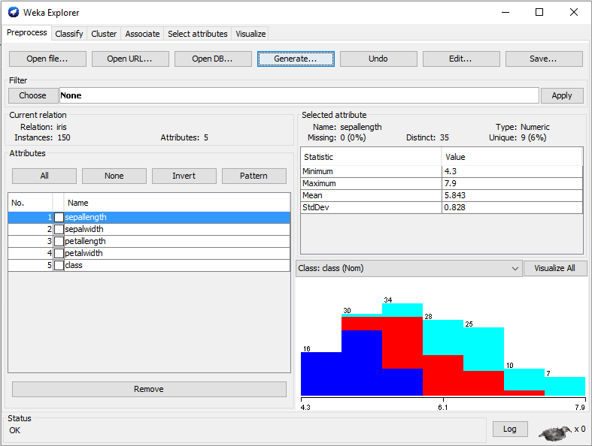
Data Pre-Processing in WEKA - Explorer
To load the Iris data into WEKA Explorer view, click on “Open File” and select the Iris.arff file.
After loading the file, you can see basic statistics about various attributes.
You can also perform other data pre-processing such as data type conversion or discretization by using the “Choose” tab.
Leave everything as default for now.
1
3
2

Slide 10
CLASSIFICATION – RANDOM FOREST EXAMPLE

Slide 11
WEKA Classification – Random Forest Example
Let’s use the loaded data to perform a classification task.
In the Iris dataset, we can classify each record into one of three classes - setosa, versicolor, and virginica.
The following slides will walk you through how to classify these records using the Random Forest classifier.

Slide 12
WEKA Classification – Random Forest Example
Random Forest is based off of bagging decision trees.
Each decision tree in the bag is only using a subset of features.
As such, there are only a few hyper-parameters we need to tune in WEKA:
How many trees to build (we will build 10)
How deep to build the trees (we will select 3)
Number of features which should be used for each tree (we will choose 2)

Slide 13
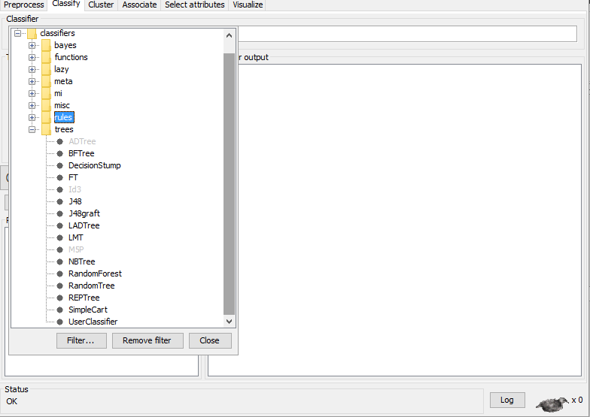
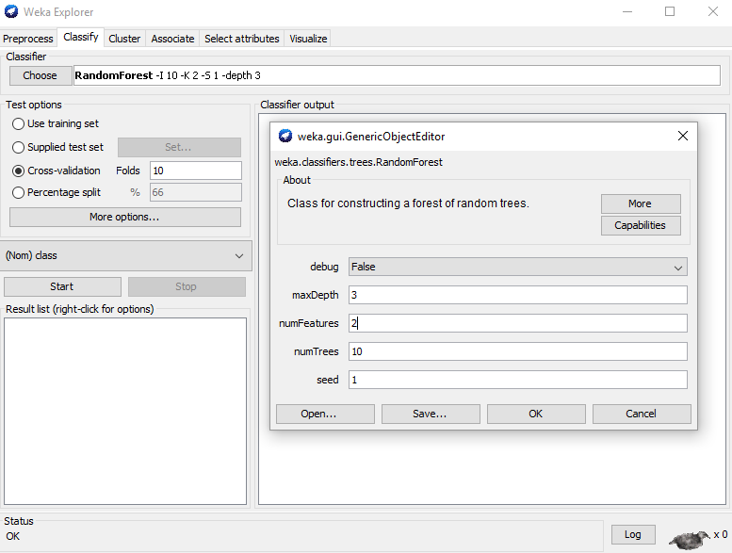
WEKA Classification – Explorer Configurations
1
1
2
1
List of all
classifiers
3
2
Let’s configure the classifier to have 10 trees, a max depth of 3, each tree to use 2 features.
WEKA also allows you to select testing/training options. 10 fold cross-validation is a standard, select that.
After configuring the classifier settings, press “Start.”
After loading data, select the “Classify” tab. All classification tasks will be completed in this area.
Click on the “Choose” button. WEKA has a variety of in-built classifiers. For our purposes, select “Random Forest.”

Slide 14
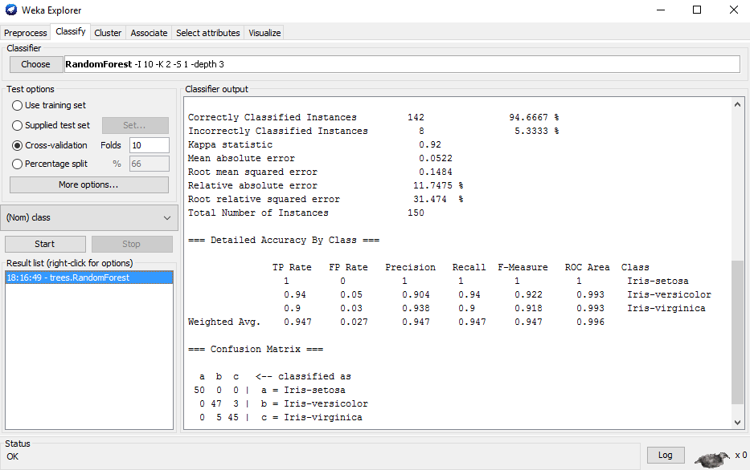
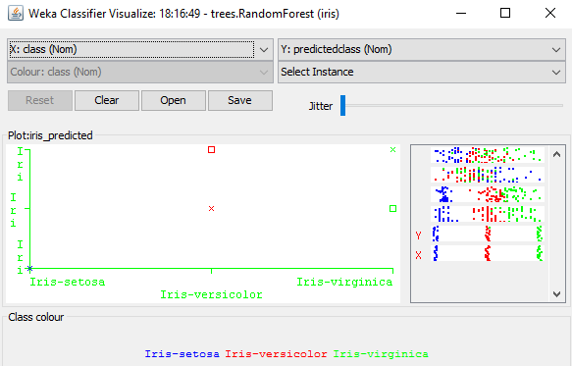
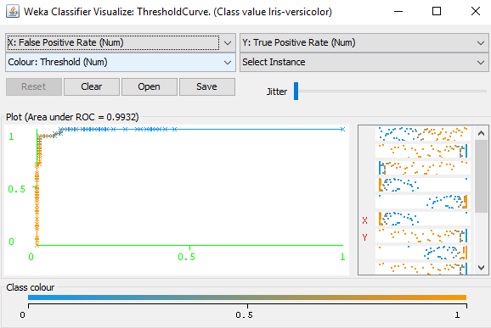
WEKA Classification – Explorer Results
3
1
2
3
After running the algorithm, you will get your results! All of the previously run models will appear in the bottom left.
The results of your classifier (e.g., confusion matrix, accuracies, etc.) will appear in the “Classifier output” section.
You can also generate visualizations for your results by right-clicking on the model in the bottom left and selecting a visualization.
Classifier errors and ROC curve visualizations are provided on the right.

Slide 15
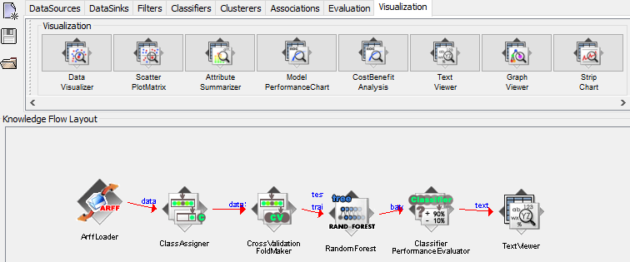
WEKA Classification – Knowledge Flow
We can also run the same classification task using WEKA’s Knowledge Flow GUI.
Select the “ArffLoader” from the “Data Sources” tab. Right click on it and load in the Iris arff file.
Then choose the “ClassAssigner” from “Evaluation” tab. This icon will allow us to select which class is to be predicted.
Then select the “Cross Validation Fold Maker” from the “Evaluation” tab. This will make the 10 fold cross- validation for us.
We can then choose a “Random Forest” classifier from the “Classifiers” tab.
To evaluate the performance of the classifier, select the “Classifier Performance Evaluator” from the “Evaluation” tab.
Finally, to output the results, select the “Text Viewer” from the “Visualization” tab. You can then right click on the Text Viewer and run the classifier.
1
2
3
4
5
6
7

Slide 16
CLUSTERING EXAMPLE – K-MEANS

Slide 17
WEKA Clustering
Clustering is an unsupervised algorithm allowing users to partition data into meaningful subclasses (clusters).
We will walk through an example using the Iris dataset and the popular k-Means algorithm.
We will create 3 clusters of data and look at their visual representations.

Slide 18
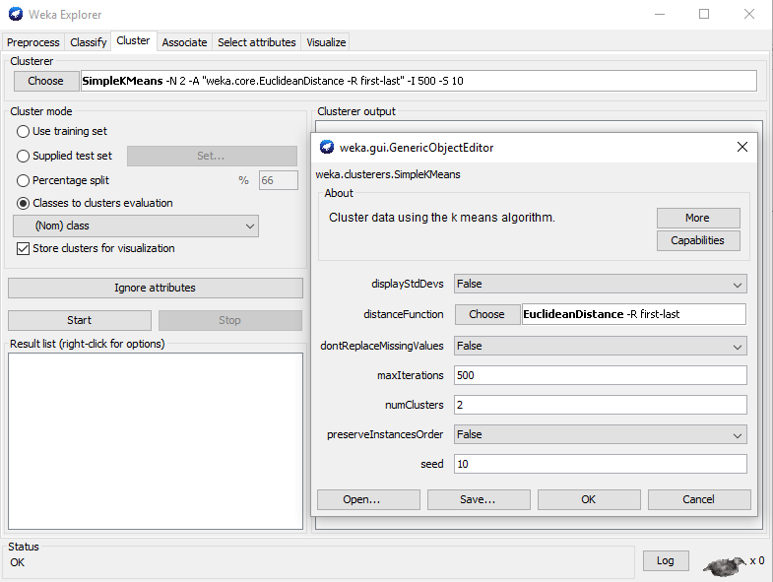
WEKA Clustering – Explorer Configurations
Performing a clustering task is a similar process in WEKA’s Explorer. After loading the data, select the “Cluster” tab and “Choose” a clustering algorithm. We will select the popular k-means.
Second, configure the algorithm by clicking on the text next to the “Choose” button. A pop up will appear allowing us to choose select the number of clusters we want. We will choose 2, as that will create 3 clusters. Leave others default.
Finally, we can choose a cluster mode. For the time being, we will select “Classes to clusters evaluation.”
After configuration, press “Start”
1
3
2

Slide 19
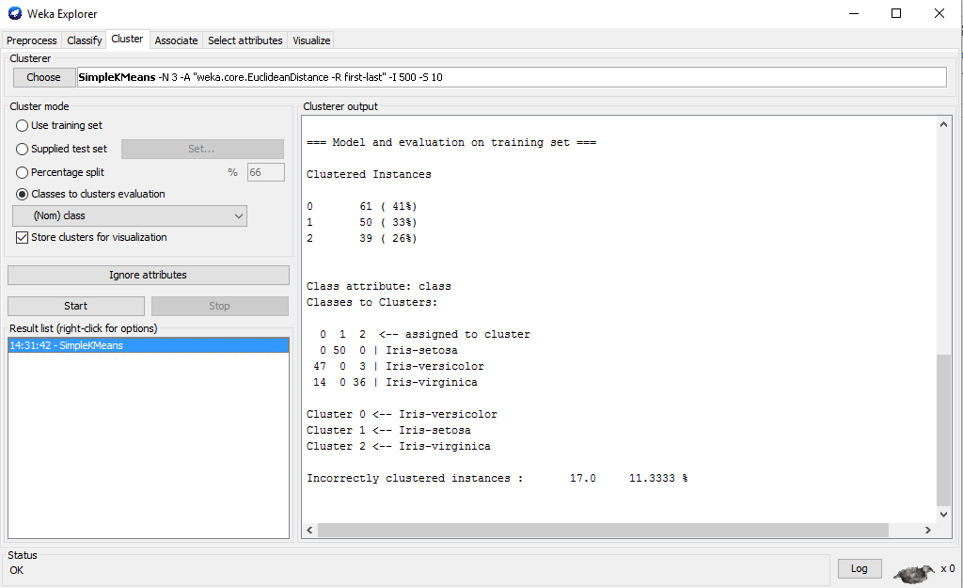
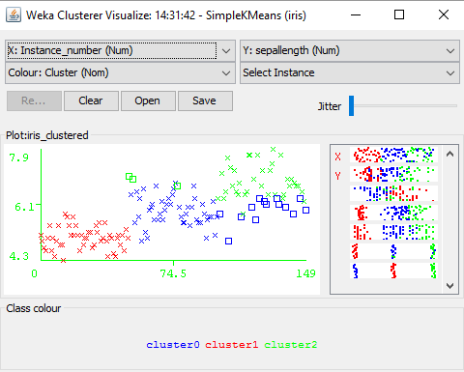
WEKA Clustering – Explorer Results
1
After running the algorithm, we can see the results in the “Clusterer output.”
We can also visualize the clusters by right clicking on the model in the left corner and selecting visualize.

Slide 20
WEKA INTEGRATION WITH JAVA

Slide 21
WEKA Integration with Java
WEKA can be imported using a Java library to your own Java application.
There are three sets of classes you may need to use when developing your own application.
Classes for Loading Data
Classes for Classifiers
Classes for Evaluation

Slide 22
WEKA Integration with Java – Loading Data
Related WEKA classes
weka.core.Instances
weka.core.Instance
weka.core.Attribute
How to load input data file into instances?
Every DataRow -> Instance, Every Attribute -> Attribute, Whole -> Instances
# Load a file as Instances
FileReader reader;
reader = new FileReader(path);
Instances instances = new Instances(reader);

Slide 23
WEKA Integration with Java – Loading Data
Instances contain Attribute and Instance
How to get every Instance within the Instances?
How to get an Attribute?
# Get Instance
Instance instance = instances.instance(index);
# Get Instance Count
int count = instances.numInstances();
# Get Attribute Name
Attribute attribute = instances.attribute(index);
# Get Attribute Count
int count = instances.numAttributes();

Slide 24
WEKA Integration with Java – Loading Data
How to get the Attribute value of each Instance?
Class Index (Very Important!)
# Get value
instance.value(index); or
instance.value(attrName);
# Get Class Index
instances.classIndex(); or
instances.classAttribute().index();
# Set Class Index
instances.setClass(attribute); or
instances.setClassIndex(index);

Slide 25
WEKA Integration with Java - Classifiers
WEKA classes for C4.5, Naïve Bayes, and SVM
Classifier: all classes which extend weka.classifiers.Classifier
C4.5: weka.classifier.trees.J48
NaiveBayes: weka.classifiers.bayes.NaiveBayes
SVM: weka.classifiers.functions.SMO
How to build a classifier?
# Build a C4.5 Classifier
Classifier c = new weka.classifier.trees.J48();
c.buildClassifier(trainingInstances);
# Build a SVM Classifier
Classifier e = weka.classifiers.functions.SMO();
e.buildClassifier(trainingInstances);

Slide 26
WEKA Integration with Java - Evaluation
Related WEKA classes for evaluation:
weka.classifiers.CostMatrix
weka.classifiers.Evaluation
How to use the evaluation classes?
# Use Classifier To Do Classification
CostMatrix costMatrix = null;
Evaluation eval = new Evaluation(testingInstances, costMatrix);
for (int i = 0; i < testingInstances.numInstances(); i++){
eval.evaluateModelOnceAndRecordPrediction(c,testingInstances.instance(i));
System.out.println(eval.toSummaryString(false));
System.out.println(eval.toClassDetailsString()) ;
System.out.println(eval.toMatrixString());
}

Slide 27
WEKA Integration with Java – Evaluation
How to obtain the training dataset and the testing dataset?
Random random = new Random(seed);
instances.randomize(random);
instances.stratify(N);
for (int i = 0; i < N; i++)
{
Instances train = instances.trainCV(N, i , random);
Instances test = instances.testCV(N, i , random);
}

Slide 28
Conclusion and Resources
The overall goal of WEKA is to provide tools for developing Machine Learning techniques and allow people to apply them to real-world data mining problems.
Detailed documentation about different functions provided by WEKA can be found on the WEKA website and MOOC course.
WEKA Download – http://www.cs.waikato.ac.nz/ml/weka/
MOOC Course – https://weka.waikato.ac.nz/explorer

Slide 29
Appendix A – WEKA Pre-Processing Features
Learning type | Attribute/ Instance? | Function/Feature
Supervised | Attribute | Add classification, Attribute selection, Class order, discretize, Nominal to Binary
 | Instance | Resample, SMOTE, Spread Subsample, Stratified Remove Folds
Unsupervised | Attribute | Add, Add Cluster, Add Expression, Add ID, Add Noise, Add Values, Center, Change Date Format, Class Assigner, Copy, Discretize, First Order, Interquartile Range, Kernel Filter, Make Indicator, Math Expression, Merge two values, Nominal to binary, Nominal to string, Normalize, Numeric Cleaner, Numeric to binary, Numeric to nominal, Numeric transform, Obfuscate, Partitioned Multi Filter, PKI Discretize, Principal Components, Propositional to multi instance, Random projection, Random subset, RELAGGS, Remove, Remove Type, Remove useless, Reorder, Replace missing values, Standardize, String to nominal, String to word vector, Swap values, Time series delta, Time series translate, Wavelet
 | Instance | Non Sparse to sparse, Normalize, Randomize, Remove folds, Remove frequent values, Remove misclassified, Remove percentage, Remove range, Remove with values, Resample, Reservoir sample, Sparse to non sparse, Subset by expression

Slide 30
Appendix A – WEKA Classification Features
Classifier Type | Classifiers
Bayes | BayesNet, Complement Naïve Bayes, DMNBtext, Naïve Bayes, Naïve Bayes Multinomial, Naïve Bayes Multinomial Updatable, Naïve Bayes Simple, Naïve Bayes Updateable
Functions | LibLINEAR, LibSVM, Logistic, Multilayer Perceptron, RBF Network, Simple Logistic, SMO
Lazy | IB1, Ibk, Kstar, LWL
Meta | AdaBoostM1, Attribute Selected Classifier, Bagging, Classification via clustering, Classification via Regression, Cost Sensitive Classifier, CVParameter Selection, Dagging, Decorate, END, Filtered Classifier, Grading, Grid Search, LogitBoost, MetaCost, MultiBoost AB, MultiClass Classifier, Multi Scheme, Ordinal Class Classifier, Raced Incremental Logit Boost, Random Committee, Random Subspace
Mi | Citation KNN, MISMO, MIWrapper, SimpleMI
Rules | Conjuntive Rule, Decision Table, DTNB, Jrip, Nnge, OneR, PART, Ridor, ZeroR
Trees | BFTree, Decision Stump, FT, J48, J48graft, LAD Tree, LMT, NB Tree, Random Forest, Random Tree, REP Tree, Simple Cart, User Classifier

Slide 31
Appendix A – WEKA Clustering Features
Cobweb, DBSCAN, EM, Farthest First, Filtered Clusterer, Hierarchical Clusterer, Make Density Based Clusterer, OPTICS, SimpleKMeans

