Slide 1
Python Review for Data Analytics
Mohammadreza Ebrahimi
Artificial Intelligence Lab, University of Arizona
MIS464
Spring 2020

Slide 2
Outline
Python Review for Data Analytics
Development Environment Setup (Required for this tutorial)
Programming Essentials
Data Types
Data Structures
Control Flow Statements
Functions
Classes and Objects
Inheritance
Putting All Together
Exhaustive Enumeration Example (Finding Cube Roots)
Bisection Search Example (Finding Square Roots)
Obtain and Process Data from Kaggle with Python
Data Visualization with Python

Slide 3

About the TA (Reza)
I am a 4th year PhD student at the AI Lab, and your TA for MIS464.
My research interest is in AI-enabled cybersecurity using machine learning (adversarial learning, transfer learning, semi-supervised learning, deep learning), and text/web mining.
If you have questions, the best way to reach me is to send me an email.
However, you are always welcome to stop by my cubicle at MCCL 4th floor (cubicle # 35).
Good luck! I am looking forward to a fruitful semester!
Mohammadreza Ebrahimi
Artificial Intelligence Lab
University of Arizona
ebrahimi@email.Arizona.edu

Slide 4
About this Tutorial
This Python Review Session is focused on the fundamentals of programing and language syntax.
Specifically we follow four learning objectives:
Understanding the language syntax.
Understanding the language features useful for data analytics.
Understanding loading and preprocessing the data with python.
Understanding visualization of the data with Python.
Advanced topics such as dynamic programming and implementation of search algorithms are beyond the scope of this tutorial.
The difficulty level of the materials is designed to increase gradually.

Slide 5
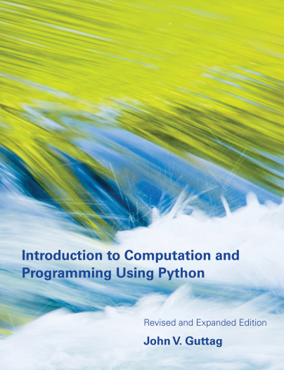
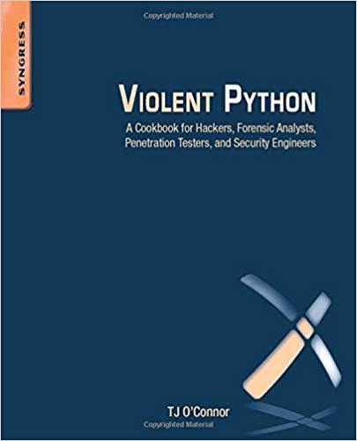
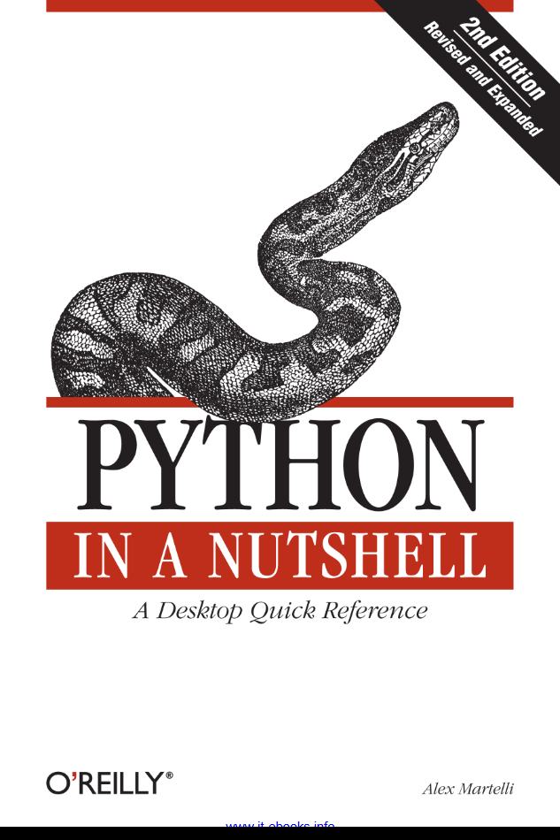
Credit
This tutorial is based upon the following books and websites:
https://towardsdatascience.com https://machinelearningmastery.com
https://www.tutorialspoint.com https://Kaggle.com
https://www.w3schools.com https://runawayhorse001.github.io

Slide 6
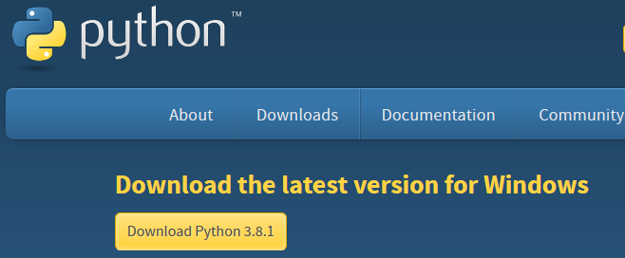
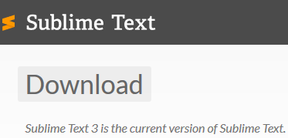

Development Environment Setup (Required)
Python development environment requires two main installations:
The Python download site (http://www.python.org/download/):
Installers for Windows, Mac OS X, and Linux
Selected most powerful IDEs for Python Programming
Sublime Text 3: download site (https://www.sublimetext.com/3) [Recommended for this tutorial]
PyCharm: download site (https://www.jetbrains.com/pycharm/)
Eclipse with Pydev: download site (https://www.pydev.org/) → Requires Eclipse and Java to be installed.

Slide 7
Programming Essentials
We review the essential python programming structures (not meant to be comprehensive):
Data Types
Variables
Strings
Data Structures
Lists
Dictionaries
Control Flow Statements
If, For, and While
Break and Continue
Functions
Classes and Objects
Inheritance

Slide 8
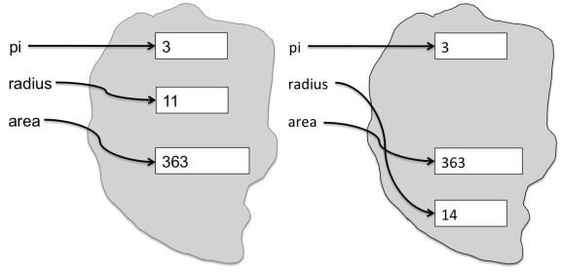

Data Types: Variables and Assignments
A variable points to data stored in a memory location. This memory location can store different values.
E.g., integers, real numbers, Booleans, strings, etc.
Binding: Assigning an object in memory to a variable .

Slide 9
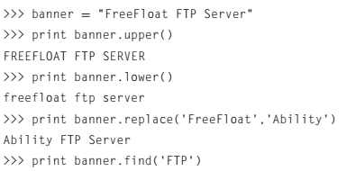

Data Types: Strings
Python string module provides a variety of methods for strings:
upper()/Lower(): Converts a string to its uppercase/lowercase variant.
replace(old,new): Replaces the old occurrence of the substring old with the substring new.
find(): Yields the offset where the first occurrence of the substring occurs.
Strings need to be surrounded by “ ”.
Should find(FTP)return 10, or 8?

Slide 10
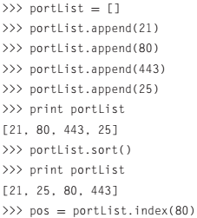
Data Structures: Lists
The list data structure provides a way to store arrays of objects.
We can construct lists of any data type.
There are built-in methods for performing actions on lists:
append(): Adds an item to the end of the list.
sort(): Orders the list (default is from lower to higher).
index(): Returns the index of the given list item.
What would be returned by index(80)?
Hint: Indexing in Python is “zero-based.”
Output list

Slide 11
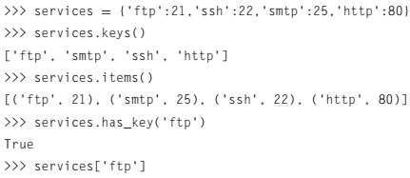
Data Structures: Dictionaries
The dictionary consists of pairs of items, each containing a key and value pair.
When constructing a dictionary, each key is separated from its value by a colon (i.e., ‘key : value’).
Items are separated by commas.
What would be returned by services[‘ftp’]?
What is the key-value pair in this case?
Can you print the list of values?
Hint: If your guess does not work, try to searching on ‘Stack Overflow.’

Slide 12

Control Flow Statements: ‘if’ and ‘for’
We may need to execute a statement only if a condition holds.
if (x <0):
Print “x is negative”
elif (x==0):
print “x is zero”
We may need to repeat execution of a statement for a number of times.
Count = 0
for char in “MIS464”:
if (char == ‘4’):
count = count +1
Condition
Pay attention to the indentation!
Pay attention to ‘==‘ as opposed to ‘=‘
What happens if you assign x = 2 and execute the above code?
What would be the value of ‘count’ after executing?

Slide 13
Control Flow Statements: ‘While’
While is used for repeating statements until a certain condition holds.
Count = 0
while (x >0):
x = x // 2
count = count +1
print count
The loop body should contain code that eventually makes the loop condition false (loop needs to terminate).
Condition
‘//’ denotes truncating division (e.g., 9 // 2 = 4)
Loop
Body
Which math operation does the code approximate?

Slide 14
Control Flow Statements: ‘Break,’ and ‘Continue’
There are two mechanisms to explicitly terminate (make the loop condition false):
Break: Terminates the loop immediately.
Continue: Terminates the current iteration of the loop body, and execution continues with the next iteration of the loop.
For char in ‘MIS464’:
if (char == ‘4’):
break
print char
For char in ‘MIS464’:
if (char == ‘4’):
continue
print char
What would be the output?
What would be the output?

Slide 15
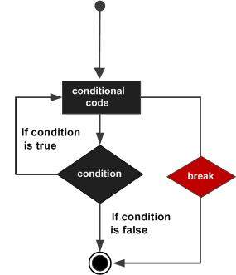
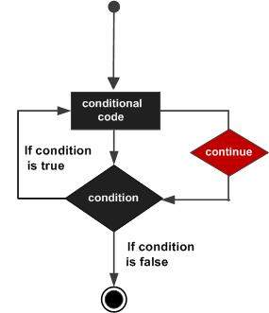
Control Flow Statements: ‘Break,’ and ‘Continue’ (cont’d)
The following figure compares the control flow for break (left) and continue (right).
https://www.tutorialspoint.com

Slide 16


Functions
Functions allow us to reuse our statements. Two main benefits of using functions:
Reusability: Helps avoiding redundant statements.
Readability: The code will be more concise and easier to understand.
Using functions entails 1) defining and 2) calling them.
1. Defining a function named max
2. Function Call
x and y are function parameters.
print (max(4,0))
4 and 0 are called arguments of this function call.

Slide 17
Functions: Keyword Arguments
Consider the following print function:
def printName(firstName, lastName, reverse):
if reverse:
print lastName + ', ' + firstName
else:
print firstName, lastName
The following ways of calling printName are equivalent:
printName(‘John’, ‘Doe’, False)
printName(‘John’, ‘Doe’, False)
printName(‘John’, ‘Doe’, reverse = False)
printName(‘John’, lastName = ‘Doe’, reverse = False)
printName(lastName=‘Done’, firstName=‘John’, reverse=False)
Using Keyword Arguments in Calling Functions
Keyword Arguments should always appear after regular arguments.

Slide 18
Functions: Default Values
Default values allow calling a function with fewer than the specified number of arguments.
We change the previous print function as follows:
def printName(firstName, lastName, reverse = False):
if reverse:
print lastName + ', ' + firstName
else:
print firstName, lastName
The following function calls are all allowed:
printName(‘Olga’, ‘Puchmajerova’)
printName(‘Olga’, ‘Puchmajerova’, True)
printName('Olga', ‘Puchmajerova’, reverse = True)
Default Value
The last two function calls are semantically equal (i.e., yield the same output)
Which one of the above function calls exploits default value?

Slide 19
Classes and Objects
Python is a procedural, object oriented language. Such languages support user-defined types.
Classes: user-defined type definition (e.g., Course).
Objects: the instantiation of these types (e.g., MIS464).
We define a class named ‘Course’ with two attributes (title and level) and one method (prnt_name).
class Course:
def __init__(self, title, level):
self.title = title
self.level = level
def prnt_name(self):
print(“The course title is: ” + self.title)
Every class has an initializer function that assigns values to attributes. (Used when we instantiate the class).
Attribute
Class method

Slide 20
Classes and Objects (cont’d)
Now, we can instantiate the course class to get an MIS464 object.
MIS464 = Course(‘Data Analytics’,’UnderGraduate)
MIS464.prnt_name()
print (MIS464.level)
Object
Class
Attribute #1: title
Attribute #2: level
Call an object function
In what line the __init__()is called?
Refer to an object attribute or function

Slide 21
Inheritance
Often classes have properties in common with other classes.
E.g., built-in types list and str have len function with same meaning.
Inheritance allows creating a class hierarchy in which each class ‘inherits’ from the upper class in the hierarchy.
The upper class in the hierarchy is called ‘superclass.’
The down-stream class is called ‘subclass.’
Subclass can inherit attributes and methods from the superclass. This facilitates abstraction.
Consider the following abstraction:
[page 99 of Guttag’s book]
Person
MITPerson

Slide 22
Inheritance (cont’d)
The class MITPerson inherits attributes and methods from its parent class, Person.
Superclass: Person
Subclass: MITPerson
class Person(object):
def __init__(self, name, lastName, birthDay):
self.name = name
self.lastName = lastName
self.birthDay = birthDay
def getName(self):
return self.name
def getLastName(self):
return self.lastName
def setBirthday(self, birthdate):
self.birthday = birthdate
class MITPerson(Person):
nextIdNum = 0 #employee number
def __init__(self, name):
Person.__init__(self, name, lastName, birthDay)
self.idNum = MITPerson.nextIdNum MITPerson.nextIdNum += 1
def getIdNum(self):
return self.idNum
What methods or attributes are inherited?
Wat is the employee number for the second instantiation of MITPerson?

Slide 23
Putting All Together: Exhaustive Enumeration Example (Finding Cube Roots) [page 21 in Guttag’s book]
#Find the cube root of a perfect cube
x = int(raw_input('Enter an integer: '))
ans = 0
while ans**3 < abs(x):
ans = ans + 1
if ans**3 != abs(x):
print x, 'is not a perfect cube'
else:
if x < 0:
ans = -ans
print 'Cube root of', x,'is', ans
The following snippet returns y such that x=y³.
This means it calculates the cube root of any given integer which is a perfect cube.
Raw_input function takes user input.
Let us trace the code for x=27, x=25, and x=-9 together!
Why is this approach called ‘exhaustive search’?

Slide 24
Putting All Together : Exhaustive Enumeration Example (Finding Cube Roots) (cont’d) [page 21 in Guttag’s book]
Let’s rewrite the exhaustive enumeration seen in the previous example in a different way.
We replace the while loop with a ‘for loop’ and ‘break.’
#Find the cube root of a perfect cube
x = int(raw_input('Enter an integer: '))
for ans in range(0, abs(x)+1):
if ans**3 >= abs(x):
break
if ans**3 != abs(x):
print x, 'is not a perfect cube'
else:
if x < 0:
ans = -ans
print 'Cube root of', x,'is', ans
Can you guess what is the functionality of range in this code snippet?

Slide 25
Putting All Together: Bisection Search Example (Finding Square Roots) [page 28 in Guttag’s book]
Class Approximation:
def findRoot(x, epsilon):
if x < 0:
return None
numGuesses = 0
low = 0.0
high = max(1.0, x)
ans = (high + low)/2.0
while abs(ans**2 - x) >= epsilon:
numGuesses +=1
if ans**2 < x:
low = ans
else:
high = ans
ans = (high + low)/2.0
return ans
app = Approximation()
print (app.findRoot(24, 0.01))
Approximation class encapsulates the functionality of approximating square roots via binary search.
Returns float y such that y² is within epsilon of x.
In this example, we encapsulate the functionality in a class.
Definitions
Let us trace the code line by line together!
Calls

Slide 26
Python Quick Reference [complete version on page 287 of Guttag’s book]
Common operations on numerical types
i+j, i-j are the sum and subtraction.
i*j is the product of i and j.
i//j is integer division.
i/j is i divided by j. In Python 2.7, when i and j are both of type int, the result is also an int, otherwise the result is a float.
i%j is the remainder when the int i is divided by the int j.
i**j is i raised to the power j.
Comparison and Boolean operators
x == y returns True if x and y are equal.
x != y returns True if x and y are not equal.
<, >, <=, >= are greater, lower, greater or equal, lower or equal
a and b is True if both a and b are True, and False otherwise.
a or b is True if at least one of a or b is True, and False otherwise.
not a is True if a is False, and False if a is True.

Slide 27
Python Quick Reference (cont’d) [complete version on page 287 of Guttag’s book]
Common operations on sequence types
seq[i] returns the i^{th} element in the sequence.
len(seq) returns the length of the sequence.
seq1 + seq2 concatenates the two sequences.
seq[start:end] returns a slice of the sequence.
for e in seq iterates over the elements of the sequence.
Common string methods
s.count(s1) counts how many times the string s1 occurs in s.
s.find(s1) returns the index of the first occurrence of the substring s1 in s.
s.lower(),s.upper() converts uppercase letters to lowercase and vice versa.
s.replace(old, new) replaces all occurrences of string old with string new.
s.rstrip() removes trailing white space.
s.split(d) Splits s using d as a delimiter. Returns a list of substrings of s

Slide 28
Python Quick Reference (cont’d) [complete version on page 287 of Guttag’s book]
Common list methods
L.append(e) adds the object e to the end of L.
L.insert(i, e) inserts the object e into L at index i.
L.extend(L1) appends the items in list L1 to the end of L.
L.remove(e) deletes the first occurrence of e from L.
L.index(e) returns the index of the first occurrence of e in L.
L.pop(i) removes and returns the item at index i. Defaults to -1.
L.sort() has the side effect of sorting the elements of L.
Common operations on dictionaries
len(d) returns the number of items in d.
d.keys() returns a list containing the keys in d.
d.values() returns a list containing the values in d.
d[k] returns the item in d with key k. Raises KeyError if k is not in d.
d.get(k, v) returns d[k] if k in d, and v otherwise.
d[k] = v associates the value v with the key k.
del d[k] removes element with key k from d. Raises KeyError if k is not in d.
for k in d iterates over the keys in d.

Slide 29
Data Analytics Components
After introducing the essentials of Python programing, we are ready to move on to data analytics with python.
Data analytics often encompasses at least the following three phases:
1) Preprocessing: Unifying (merging) different sources, changing the level of granularity (e.g., daily to monthly), etc.
2) Visualization: Visualizing the data (or results of analysis) to provide insights.
3) Model building: Using machine learning algorithms to build a model that provides a business value.
While Phase 1 is often a prerequisite, the order of Phases 2 and 3 is interchangeable and iterative.
Next, we describe Phase 1 (preprocessing) with a real-world example .
iterative

Slide 30
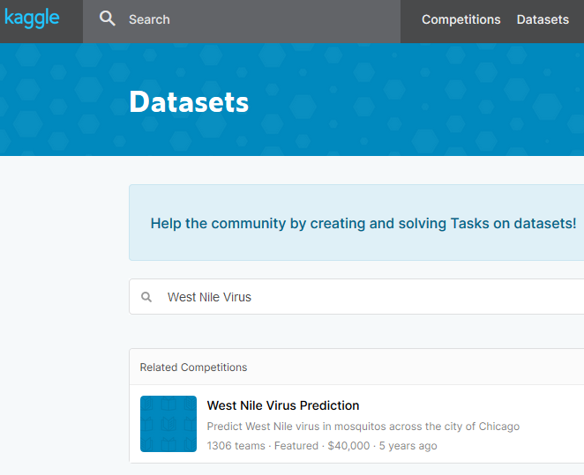
Obtain and Process Data from Kaggle with Python
Kaggle is a subsidiary of Google, which allows data scientists and regular users to share datasets for data analytics.
Serves a community of data scientists and machine learning engineers.
Hosts competitions to solve data science challenges.
Visit https://www.kaggle.com/datasets
Search for West Nile Virus.
Search Datasets here

Slide 31
Obtain and Process Data from Kaggle with Python (cont’d)
West Nile Virus (WNV) was released in a Kaggle competition in 2015.
Competition’s task: Predict WNV in mosquitoes across Chicago.
WNV often spreads to humans through infected mosquitos.
Prize: $40,000
Number of participants: 1,306
The figure shows the competition’s scoreboard:
Prediction Accuracy
# of tries
Winner
Method: Deep Learning
.
.
.
Me!
Method: Ensemble of Random Forests
.
.
.

Slide 32
Obtain and Process Data from Kaggle with Python (cont’d)
As noted, data analytics very often starts with data preprocessing.
After data preprocessing, deep learning or any other machine learning methods can be applied to build a model.
For data pre-processing most Kaggle participants use Python along with two libraries called Pandas and NumPy.
Pandas: Offers data structures and operations for manipulating numerical tables.
NumPy: A package for scientific computing that support N-dimensional arrays.
import pandas as pd
import numpy as np
External Package
alias
After importing any package the alias can be treated in the same way as an object.
E.g., pd.read_csv() is a function call to read a comma separated file.

Slide 33

Obtain and Process Data from Kaggle with Python (cont’d)
After importing Pandas library, we can use its built-in functions and data structures. We present three useful examples from WNV dataset:
Load the weather comma separated file from WNV dataset:
weather = pd.read_csv(‘path\to\weather.csv’)
Replace missing values with a scalar:
weather = weather.replace(‘-’,100)
Join Datasets on a specific criterion
weather_stn1 = weather[weather[‘Station’]==1]
weather_stn2 = weather[weather[‘Station’]==2]
weather = weather_stn1.merge(weather_stn2, on='Date')
You can obtain the full pre-processing code from my GitHub repository at: https://github.com/mohammadrezaebrahimi/Kaggle-s-WNV-competition
Join Criterion
I recommend each of you create your own repository on GitHub.

Slide 34
Read From and Write Into Files
Sometimes we simply want to interact with a text or CSV file without using Pandas.
Python has built-in read and write functions (less verbose than Java or C++).
To read or write to a file, first we need to create a file handler.
f = open(‘test.txt', ‘w’)
When the handler is created we can use it to interact with the file as follows:
f.read() returns a string containing contents of the file.
f.readlines() returns a list containing lines of the file.
f.write(s) write the string s to the end of the file.
f.writelines(L) Writes each element of L to the file.
f.close() closes the file.
‘W’ creates a file for writing.
'r’ opens an existing file for reading.
‘a’ opens an existing file for appending.
File name /path
mode
How can we open a file both for reading and writing?

Slide 35
Visualizing Data with Python
Three main recent packages are most commonly used for data visualization in Python:
Matplotlib: The most common library (low level: most flexible)
Pandas Visualization: An abstraction on Matplotlib (high level: less flexible)
(Part of Pandas data processing library introduced in Review I)
Seaborn: Provides more professional and aesthetic look than the other two.
Due to the high usage and flexibility, we focus on Matplotlib in this tutorial.
The fundamentals of visualization that are covered are common for all three packages.

Slide 36
Visualizing Data with Python: Data Types
Before we can visualize data, we need to understand which type of data we are trying to visualize.
In the simplest form, a dataset includes attributes and their values.
Commonly encountered attribute types in data analytics are as follows:
Categorical attributes: Relates to quality and includes two main types:
Nominal: No order (e.g., course title: ‘data analytics’ and ‘data science’).
Ordinal: Represent order (e.g., course level: ‘under grad’, ‘grad’, or ‘PhD seminar’).
Numerical attributes:
Discrete: Can only take certain values (e.g., # of students enrolled in a course).
Continuous: Can be described by a number on real line (e.g., duration of a class).

Slide 37
Visualizing Data with Python: Common Visualization Types
We cover the most common types of visuals seen in data science reports or papers.
These visuals assist gaining a better insight from the data and include:
Scatter Plots: Useful for visualizing categorical data points (samples)
Line Charts: Useful for continuous or categorical data
E.g., changes of one variable as a function of another variable
Histograms: useful for showing the distribution of all types of data
Bar Charts: Useful for categorical data with not many different categories

Slide 38
Visualizing Data with Python: Package Installation and Datasets
Matplotlib can be installed by running either of the following commands:
pip install matplotlib
conda install matplotlib
We use two data sets for the visualization purposes:
Wine Reviews: Available from Kaggle at https://www.kaggle.com/zynicide/wine-reviews
Iris: One of the oldest data analytics data sets available from UCI repository at: https://archive.ics.uci.edu/ml/datasets/iris. Data points are flowers.
To import the above data sets, we can use Pandas as seen in Review I:
import pandas as pd
iris = pd.read_csv('iris.csv', names=['sepal_length', 'sepal_width', 'petal_length', 'petal_width', 'class']
pip comes with standard python installation.
Conda requires to be installed as well.
Attribute Name

Slide 39

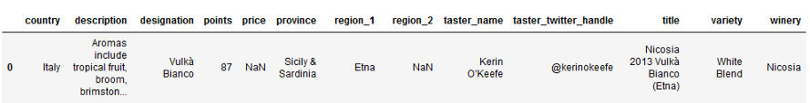
Visualizing Data with Python: Package Installation and Datasets (cont’d)
After loading the data with Pandas, we can see the attributes and values by executing the following statement:
print(iris.head())
Attributes
Values
Class: Flower type
wine_reviews = pd.read_csv('winemag-data-130k-v2.csv', index_col=0)
wine_reviews.head()
Attributes
Values

Slide 40
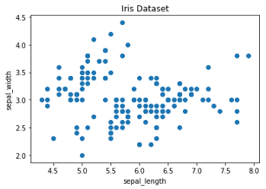

Visualizing Data with Python: Scatter Plots
To visualize Iris data in a scatter plot, first we need to import pyplot from matplotlib package.
import matplotlib.pyplot as plt
Now, we can use plt object to create the scatter plot from the data:
# create a figure and axis
fig, ax = plt.subplots()
# scatter the sepal_length against the sepal_width
ax.scatter(iris['sepal_length'], iris['sepal_width'])
# set a title and labels
ax.set_title('Iris Dataset')
ax.set_xlabel('sepal_length')
ax.set_ylabel('sepal_width')
Title
Data Points
https://towardsdatascience.com
Y Axis
Lines beginning with ‘#’ are comments (will not be executed by Python interpreter).
X Axis

Slide 41
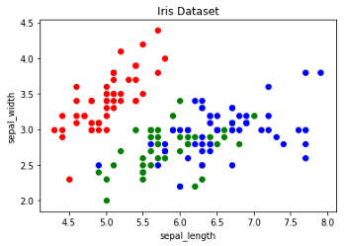
Visualizing Data with Python: Scatter Plots (cont’d)
To add to the readability of the visualization, we color each data points by its class (flower type).
# create color dictionary
colors = {'Iris-setosa':'r', 'Iris-versicolor':'g', 'Iris-virginica':'b'}
# create a figure and axis
fig, ax = plt.subplots()
# plot each data-point
for i in range(len(iris['sepal_length'])):
ax.scatter(iris['sepal_length'][i], iris['sepal_width'][i],color=colors[iris['class'][i]])
# set a title and labels
ax.set_title('Iris Dataset')
ax.set_xlabel('sepal_length')
ax.set_ylabel('sepal_width')
https://towardsdatascience.com
How many classes exist in the dataset?

Slide 42
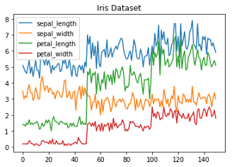
Visualizing Data with Python: Line Charts (cont’d)
The following snippet plots a line chart for Iris dataset.
# get columns to plot
columns = iris.columns.drop(['class'])
# create x data
x_data = range(0, iris.shape[0])
# create figure and axis
fig, ax = plt.subplots()
# plot each column
for column in columns:
ax.plot(x_data, iris[column], label=column)
# set title and legend
ax.set_title('Iris Dataset')
ax.legend()
Legend
https://towardsdatascience.com
Value of sepal_length for each Data Point (in blue)
What are x and y axes in this example?

Slide 43
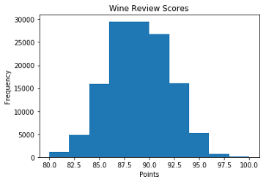
Visualizing Data with Python: Histograms
The following snippet plots a Histogram for Wine Review dataset.
# create figure and axis
fig, ax = plt.subplots()
# plot histogram ax.hist(wine_reviews['points’])
# set title and labels
ax.set_title('Wine Review Scores’)
ax.set_xlabel('Points’)
ax.set_ylabel('Frequency')
https://towardsdatascience.com
Based on the histogram, how rare is it to have wine with 97.5 point rate?
Does the histogram remind you of any particular data distribution?

Slide 44
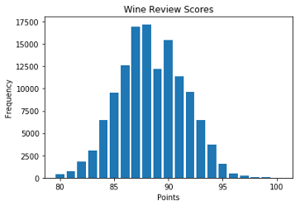

Visualizing Data with Python: Bar Charts
The following snippet plots a bar chart for Wine Review dataset.
# create a figure and axis
fig, ax = plt.subplots()
# count the occurrence of each class
data = wine_reviews['points'].value_counts()
# get x and y data
points = data.index
frequency = data.values
# create bar chart ax.bar(points, frequency)
# set title and labels
ax.set_title('Wine Review Scores’)
ax.set_xlabel('Points') ax.set_ylabel('Frequency')
https://towardsdatascience.com
Based on the bar chart, what is the most frequent rate for wine in this data set?
Does the bar chart remind you of any particular data distribution?

