Slide 1
An Introduction to Graph Neural Networks: Overview, Implementation, and Application
Steven Ullman and Hsinchun Chen
Artificial Intelligence Lab, University of Arizona
Updated Fall 2022

Slide 2
Acknowledgements
Selected pictures and content from: Jure Leskovec, Stanford University, William L. Hamilton, McGill University, Petar Veličković, University of Cambridge, Benjamin Sanchez-Lengeling, Google Research, Thomas N. Kipf, Max Welling, University of Amsterdam.
W.L. Hamilton, “Graph Representation Learning,” 2020.

Slide 3
Outline
Introduction
Graph Data Representations
Problems/Tasks for Graph Structured Data
Graph Neural Networks (GNN)
Node Embedding
Vanilla GNN
Graph Convolutional Network (GCN)
Graph Attention Network (GAT)
Implementation Example
Research Examples

Slide 4
Introduction
Graph Data Representations
Problems/Tasks for Graph Structured Data
Graph Neural Networks (GNN)
Node Embedding
Vanilla GNN
Graph Convolutional Network (GCN)
Graph Attention Network (GAT)
Implementation Example
Research Examples

Slide 5
Introduction
Graphs and networks are data structures that capture rich relational information between a set of objects and their connections to each other.
Social networks capture relationships between people.
Molecular networks capture atomic structures and atom bonds.
To capture this information, many researchers have developed machine and deep learning-based approaches that can operate on and interpret graph data structures.
Key practical applications of these methods include antibacterial discovery, physics simulations, fake news detection, traffic prediction, and recommendation systems.
These fruitful efforts and interest among many have culminated in a large community of Graph Representation Learning (GRL) and Machine/Deep Learning on Graphs.

Slide 6
Introduction
Past Approaches:
Recurrent Neural Networks (RNN): Used in directed acyclic graphs (i.e., ‘trees’) → captures sequential relationship between objects.
Convolutional Neural Networks (CNN): Represent graph connections as a grid (i.e., adjacency matrix) → perform convolutions and pooling operations.
Limitations:
RNNs are constrained in their extendibility and representation ability due to state transition operations.
CNNs operate on images where spatial relationships between pixels are meaningful.

Slide 7
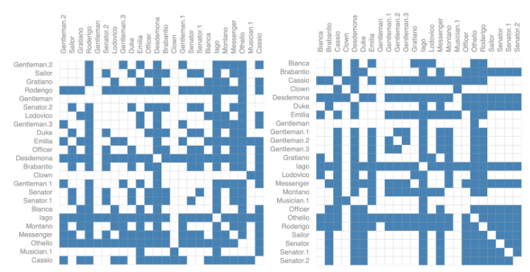
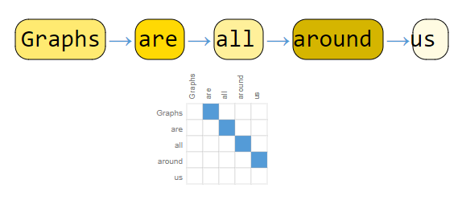
Introduction
Figure 1. Graph of words (left); Permuted adjacency matrices of the same graph (right).
Key problems with operating on graphs are illustrated in Figure 1.
Sequential graph of words for RNN creates a simple line (limited representation).
Grid-based adjacency matrix of the same graph can be permuted.

Slide 8
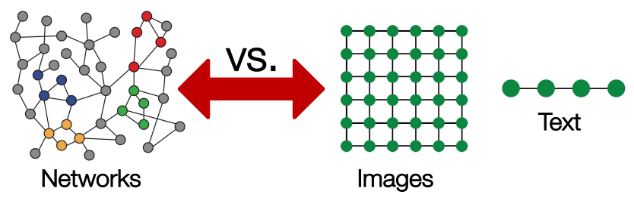
Introduction
Figure 2. Comparison between network/graph representation and images and text.
Images and text are sequentially-dependent structures; Networks are often much more complex.
Objective: Define an architecture that can operate on and capture attributes from a network that preserves the graph symmetries.

Slide 9
Introduction
Graph Data Representations
Problems/Tasks for Graph Structured Data
Graph Neural Networks (GNN)
Node Embedding
Vanilla GNN
Graph Convolutional Network (GCN)
Graph Attention Network (GAT)
Implementation Example
Research Examples

Slide 10
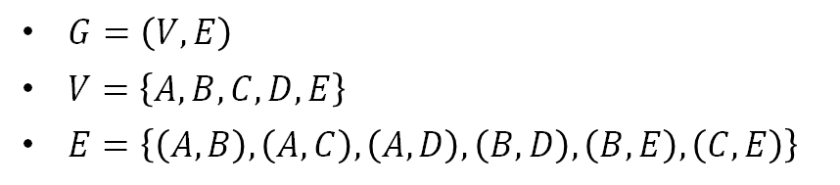
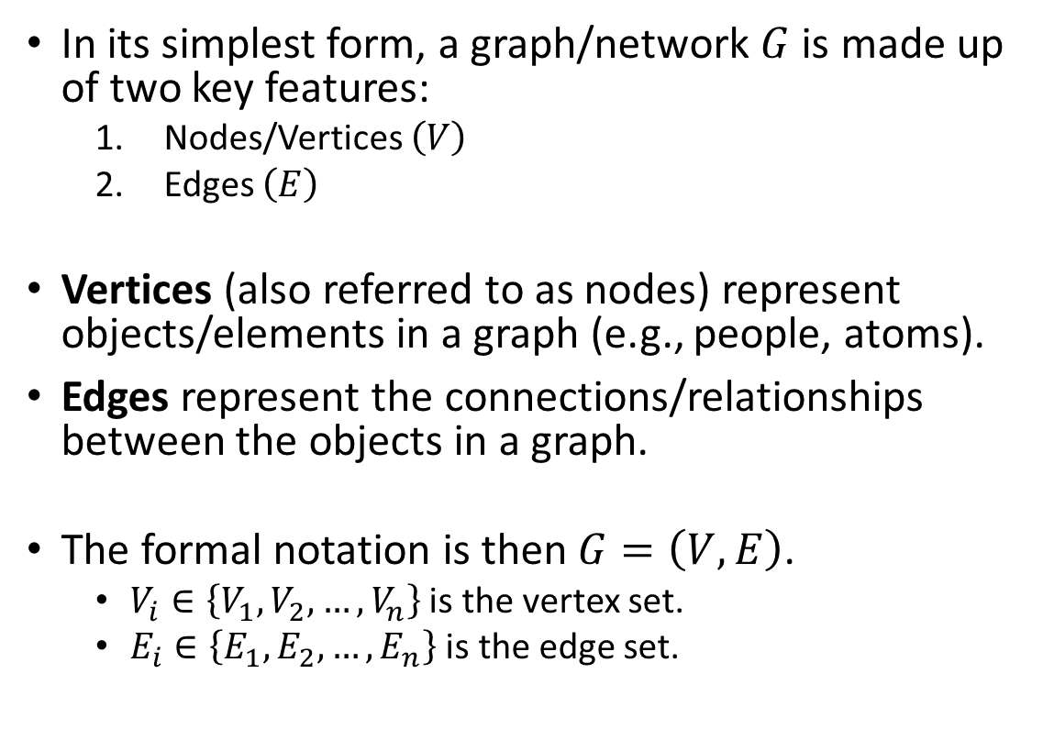
Graph Data Representations
Graph/Network
Nodes/Vertices
A
In its simplest form, a graph/network $G$ is made up of two key features:
Nodes/Vertices $\left(V\right)$
Edges $\left(E\right)$
Vertices (also referred to as nodes) represent objects/elements in a graph (e.g., people, atoms).
Edges represent the connections/relationships between the objects in a graph.
The formal notation is then $G=\left(V,E\right)$.
$V_{i}∈\left\{V_{1},V_{2},…,V_{n}\right\}$ is the vertex set.
$E_{i}∈\left\{E_{1},E_{2},…,E_{n}\right\}$ is the edge set.
B
C
D
E
Edges
$G=\left(V,E\right)$
$V=\left\{A,B,C,D,E\right\}$
$E=\left\{\left(A,B\right),\left(A,C\right),\left(A,D\right),\left(B,D\right),\left(B,E\right),\left(C,E\right)\right\}$
Figure 3. Example graph with defined node (vertex) and edge list.

Slide 11
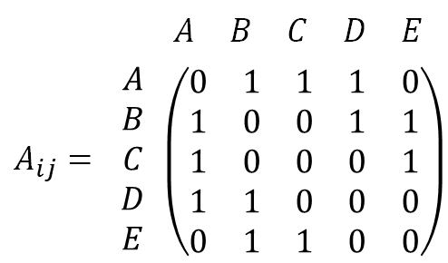
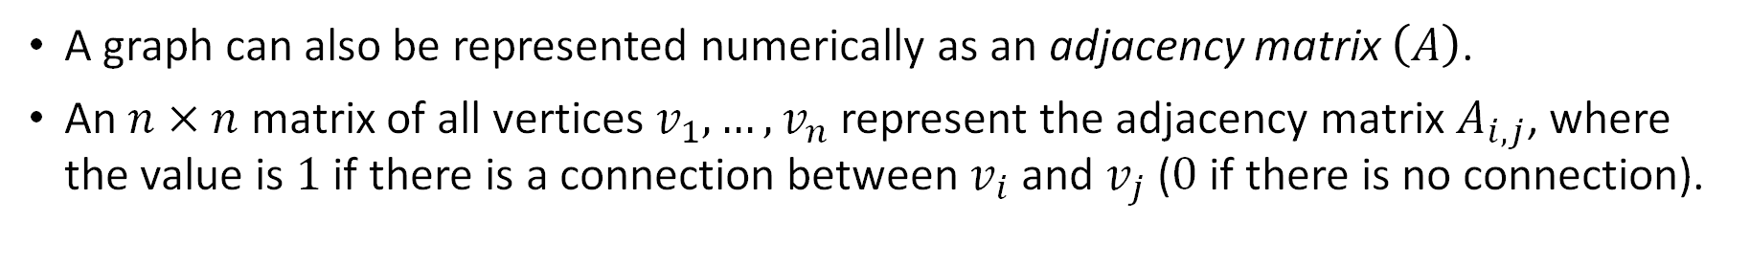
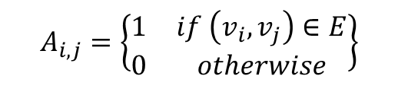
Graph Data Representations
$$A_{i,j}=\left\{\begin{matrix}1 & if \left(v_{i},v_{j}\right)∈E \\ 0 & otherwise\end{matrix}\right\}$$
A
B
C
 |  | $$\begin{matrix}A & B & C & D & E\end{matrix}$$
$$A_{ij}=$$ | $$\begin{matrix}A \\ B \\ C \\ D \\ E\end{matrix}$$ | $$\left(\begin{matrix}0 & 1 & 1 & 1 & 0 \\ 1 & 0 & 0 & 1 & 1 \\ 1 & 0 & 0 & 0 & 1 \\ 1 & 1 & 0 & 0 & 0 \\ 0 & 1 & 1 & 0 & 0\end{matrix}\right)$$
D
E
Figure 4. Graph represented as an adjacency matrix
A graph can also be represented numerically as an adjacency matrix $\left(A\right)$.
An $n×n$ matrix of all vertices $v_{1},…,v_{n}$ represent the adjacency matrix $A_{i,j}$, where the value is $1$ if there is a connection between $v_{i}$ and $v_{j}$ ($0$ if there is no connection).

Slide 12
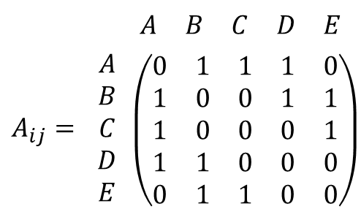
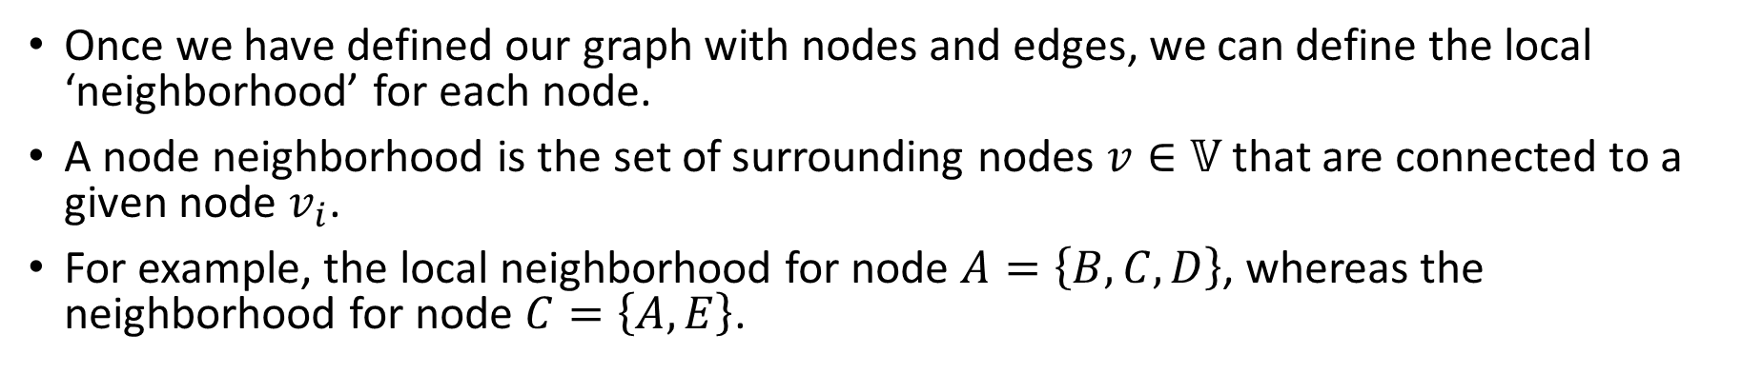
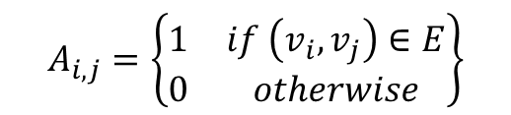
Graph Data Representations
$$A_{i,j}=\left\{\begin{matrix}1 & if \left(v_{i},v_{j}\right)∈E \\ 0 & otherwise\end{matrix}\right\}$$
A
B
C
 |  | $$\begin{matrix}A & B & C & D & E\end{matrix}$$
$$A_{ij}=$$ | $$\begin{matrix}A \\ B \\ C \\ D \\ E\end{matrix}$$ | $$\left(\begin{matrix}0 & 1 & 1 & 1 & 0 \\ 1 & 0 & 0 & 1 & 1 \\ 1 & 0 & 0 & 0 & 1 \\ 1 & 1 & 0 & 0 & 0 \\ 0 & 1 & 1 & 0 & 0\end{matrix}\right)$$
D
E
Figure 5. Node Neighborhoods
Once we have defined our graph with nodes and edges, we can define the local ‘neighborhood’ for each node.
A node neighborhood is the set of surrounding nodes $v∈𝕍$ that are connected to a given node $v_{i}$.
For example, the local neighborhood for node $A=\left\{B,C,D\right\}$, whereas the neighborhood for node $C=\left\{A,E\right\}$.

Slide 13
Graph Data Representations
A
A
B
B
C
C
D
D
E
E
Figure 6. Undirected Graph
Figure 7. Directed Graph
There are two primary types of graphs: an undirected (Figure 6) or directed graph (Figure 7).
Undirected Graph: Connection between vertices are bidirectional.
Directed Graph: Connection between vertices are directional, resulting in an ordered pair.

Slide 14
Introduction
Graph Data Representations
Problems/Tasks for Graph Structured Data
Graph Neural Networks (GNN)
Node Embedding
Vanilla GNN
Graph Convolutional Network (GCN)
Graph Attention Network (GAT)
Implementation Example
Research Examples

Slide 15
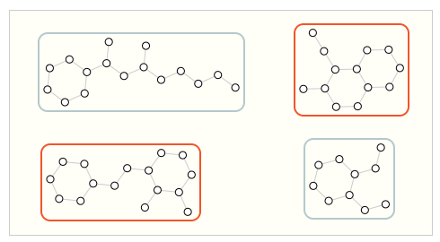
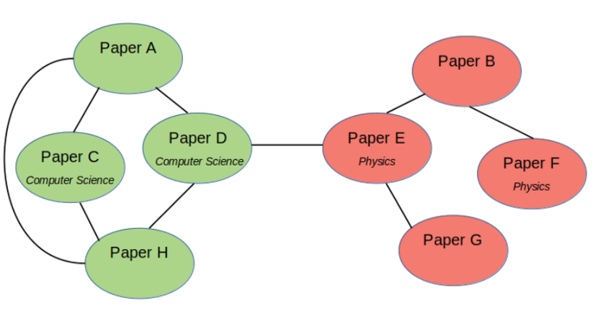
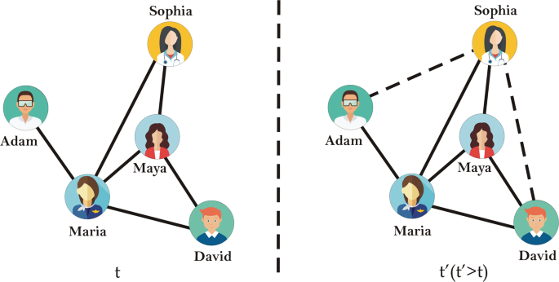
Problems/Tasks For Graph Structured Data
Three prevailing types of tasks exist based on the graph properties.
Graph-Level:
Whole-graph classification → Classify proteins based on molecular structure.
Node/Vertex-Level:
Node classification → Predict topic of paper based on citations.
Edge-Level:
Edge/link prediction → Predict if two friends are likely to have a connection/friendship.
Graph-Level
Node/Vertex-Level
Edge-Level
Figure 8. Selected graph tasks

Slide 16
Problems/Tasks for Graph Structured Data
Graphs are ubiquitous data structures that can be found everywhere; but how can we make predictions based on graph data?
In order to make inferences based on graphs, we must first transform the graph, node, or edge into a suitable representation that is machine-readable.
Machine and deep learning methods operate on vector representations of data.
All properties of graphs can be transformed into vector representations; for this module we will focus on transforming nodes.

Slide 17
Introduction
Graph Data Representations
Problems/Tasks for Graph Structured Data
Graph Neural Networks (GNN)
Node Embedding
Vanilla GNN
Graph Convolutional Network (GCN)
Graph Attention Network (GAT)
Implementation Example
Research Examples

Slide 18






Graph Neural Networks – Node Embedding
$$Enc\left(B\right)$$
$$z_{B}$$
$$z_{B}$$
A
B
C
$$z_{E}$$
$$z_{E}$$
$$Enc\left(E\right)$$
D
E
Embedding Space
Node Embeddings
Figure 9. Creating node embeddings
This process is commonly referred to as creating ‘node embeddings’; encoding nodes as low-dimensional vectors.
The goal of embedding nodes is to learn a representation that a) summarizes the node position and b) preserves the structure of the node’s neighborhood.

Slide 19
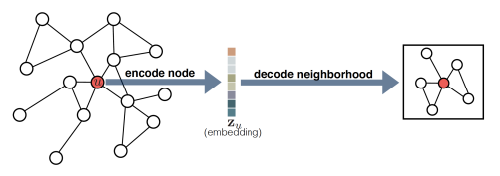
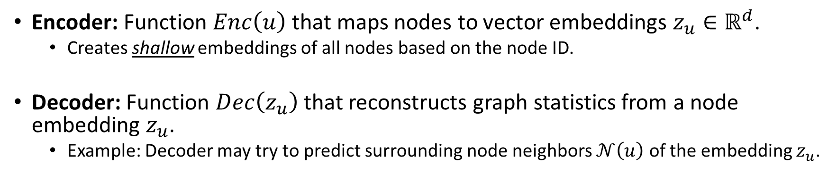
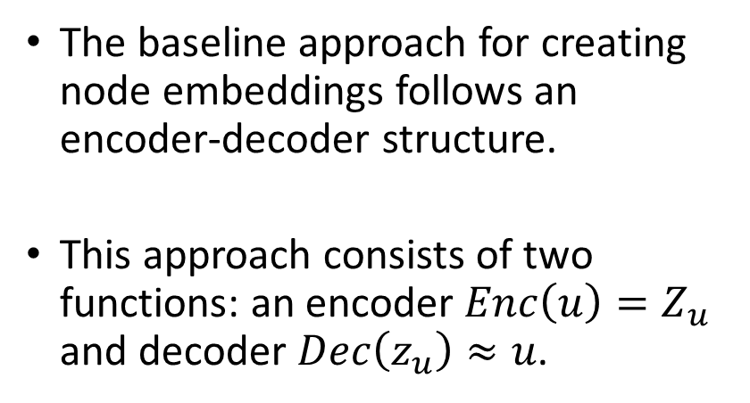
Graph Neural Networks – Node Embedding
The baseline approach for creating node embeddings follows an encoder-decoder structure.
This approach consists of two functions: an encoder $Enc\left(u\right)=Z_{u}$ and decoder $Dec\left(z_{u}\right)≈u$.
Figure 10. Encoder-Decoder Embedding Model
Encoder: Function $Enc\left(u\right)$ that maps nodes to vector embeddings $z_{u}∈ℝ^{d}$.
Creates shallow embeddings of all nodes based on the node ID.
Decoder: Function $Dec\left(z_{u}\right)$ that reconstructs graph statistics from a node embedding $z_{u}$.
Example: Decoder may try to predict surrounding node neighbors $𝒩\left(u\right)$ of the embedding $z_{u}$.

Slide 20
Introduction
Graph Data Representations
Problems/Tasks for Graph Structured Data
Graph Neural Networks (GNN)
Node Embedding
Vanilla GNN
Graph Convolutional Network (GCN)
Graph Attention Network (GAT)
Implementation Example
Research Examples

Slide 21
Graph Neural Networks – Vanilla GNN
Baseline node embedding methods only create shallow representations of nodes as vectors based on node ID; shallow approaches omit valuable features.
An encoder can be generalized such that it captures additional graph properties such as first- and second-order node neighborhoods, edge weights, and more.
Capturing more graph features requires a function that can learn and produce low-dimensional representations based on surrounding node features.
This objective inspired a learning model called a Graph Neural Network (GNN).

Slide 22
Graph Neural Networks – Vanilla GNN
GNNs extend node embeddings where the goal is to learn vector representations of nodes that also depend on the structure of the graph and its features.
The objective for GNNs is to define a function that is permutation invariant or permutation equivariant.
Permutation Invariance: Function does not depend on ordering of rows/columns in adjacency matrix.
Permutation Equivariance: Function output is permuted in a consistent way when the adjacency matrix is permuted.
GNNs primarily operate through a neural message passing framework, where messages between nodes are exchanged and updated using neural networks.

Slide 23
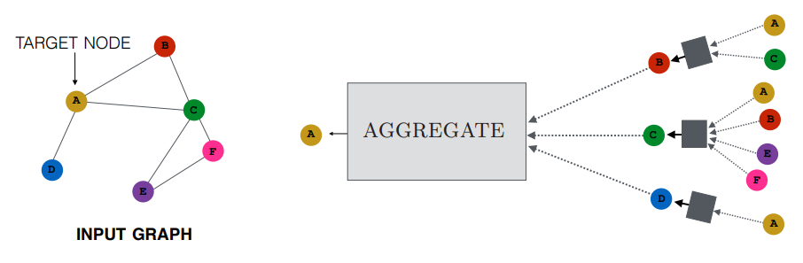




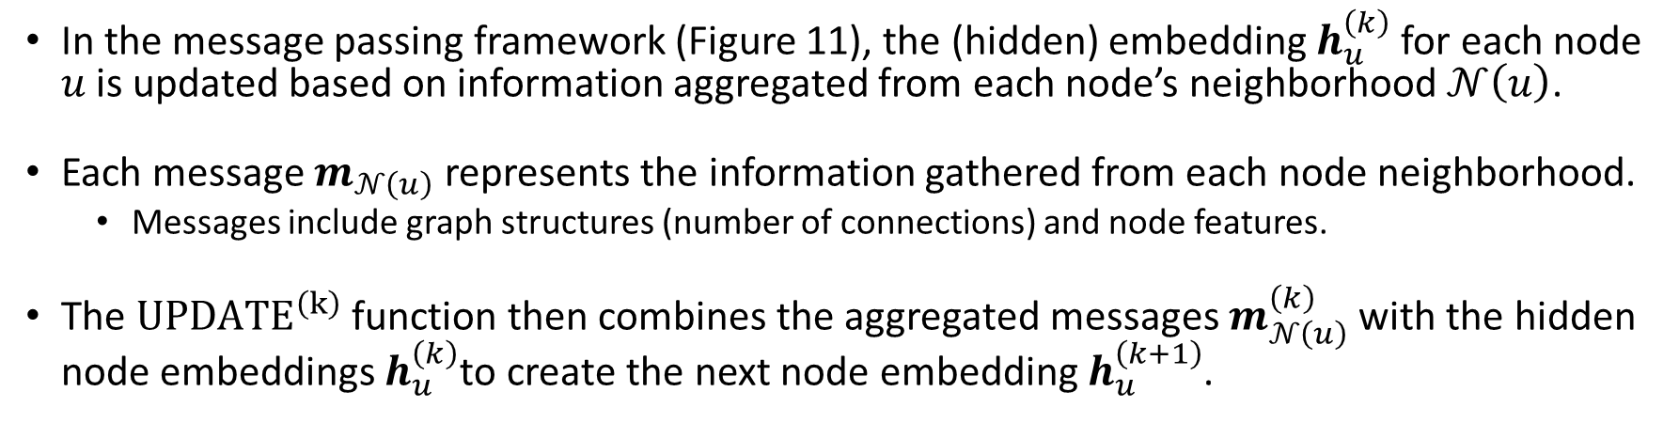






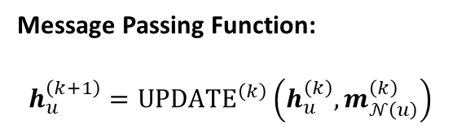


Graph Neural Networks – Vanilla GNN
$$h_{B}^{\left(k\right)}$$
$$m_{𝒩\left(B\right)}$$
$$𝒩\left(B\right)$$
Message Passing Function:
$$h_{u}^{\left(k+1\right)}={UPDATE}^{\left(k\right)}\left(h_{u}^{\left(k\right)},m_{𝒩\left(u\right)}^{\left(k\right)}\right)$$
$$m_{𝒩\left(A\right)}$$
$$𝒩\left(A\right)$$
$$h_{A}^{\left(k+1\right)}$$
$$h_{C}^{\left(k\right)}$$
$$m_{𝒩\left(C\right)}$$
$$𝒩\left(C\right)$$
$$h_{D}^{\left(k\right)}$$
$$m_{𝒩\left(D\right)}$$
$$𝒩\left(D\right)$$
Figure 11. Message Passing Framework
In the message passing framework (Figure 11), the (hidden) embedding $h_{u}^{\left(k\right)}$ for each node $u$ is updated based on information aggregated from each node’s neighborhood $𝒩\left(u\right)$.
Each message $m_{𝒩\left(u\right)}$ represents the information gathered from each node neighborhood.
Messages include graph structures (number of connections) and node features.
The ${UPDATE}^{\left(k\right)}$ function then combines the aggregated messages $m_{𝒩\left(u\right)}^{\left(k\right)}$ with the hidden node embeddings $h_{u}^{\left(k\right)}$to create the next node embedding $h_{u}^{\left(k+1\right)}$.

Slide 24
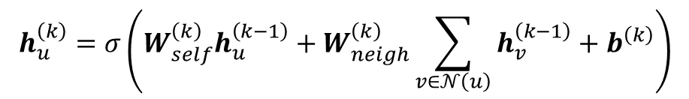
Graph Neural Networks – Vanilla GNN
$$h_{u}^{\left(k\right)}=σ\left(W_{self}^{\left(k\right)}h_{u}^{\left(k−1\right)}+W_{neigh}^{\left(k\right)}\sum_{v∈𝒩\left(u\right)}{h_{v}^{\left(k−1\right)}+b^{\left(k\right)}}\right)$$
Node Embedding
Bias Term
Non-linear Function
(tanh, ReLU)
Trainable Weights for Node
and Node Neighborhood
Previous Node
Embedding
Message Aggregation from
Node Neighborhood
Figure 12. Formal GNN Function
Following the neural message passing framework, the formal GNN function is defined in Figure 12.
The basic intuition is:
Sum the messages incoming from the neighbors.
Combine the neighborhood information with the node’s previous embedding using a linear combination.
Apply an elementwise non-linearity.

Slide 25
Introduction
Graph Data Representations
Problems/Tasks for Graph Structured Data
Graph Neural Networks (GNN)
Node Embedding
Vanilla GNN
Graph Convolutional Network (GCN)
Graph Attention Network (GAT)
Implementation Example
Research Examples

Slide 26
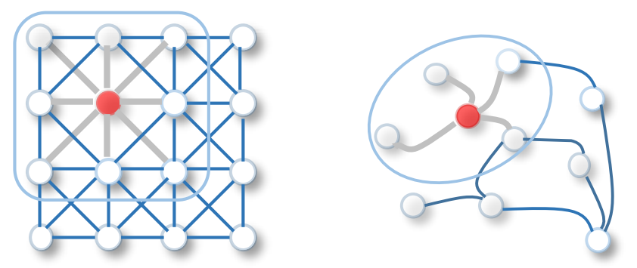
Graph Neural Networks – Graph Convolutional Network
Inspired by the success of CNNs in computer vision, researchers adapted convolution operations into GNNs.
This extension of the GNN is referred to as a Graph Convolutional Network (GCN).
Figure 13. Convolution for Image (left) and Graph (right)
Recall: Conventional CNN architectures do not perform well with graph data.
The relationship of pixels (rows and columns) is meaningful, where a permutation of the image grid changes the image all together; adjacency matrix permutation does not change the graph.
GCNs extend the GNN aggregation operation to account for a) neighborhood normalization, and b) self-loops (connection between the node and itself).

Slide 27
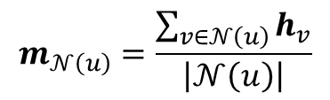
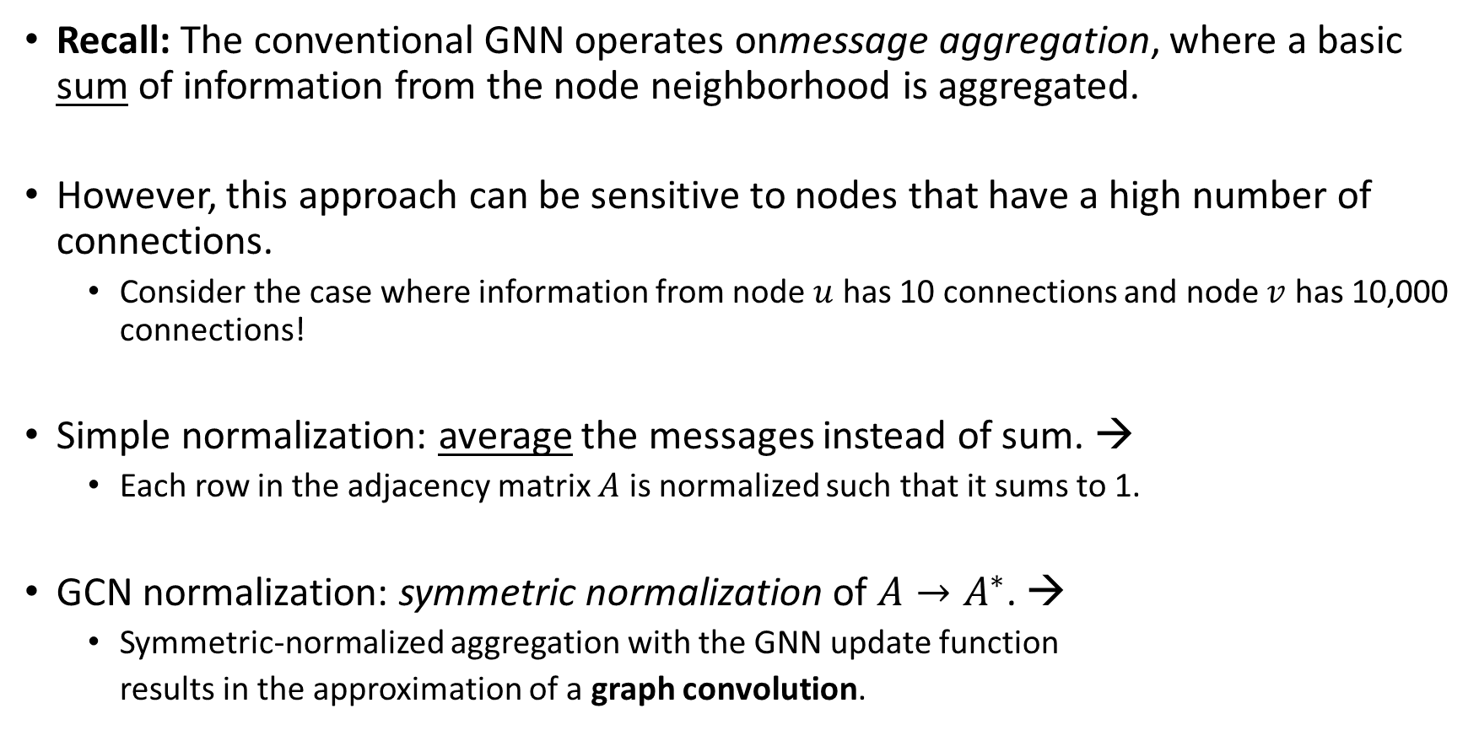
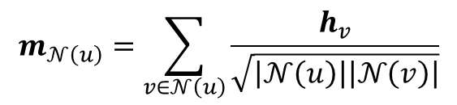
Graph Neural Networks – Graph Convolutional Network
Recall: The conventional GNN operates onmessage aggregation, where a basic sum of information from the node neighborhood is aggregated.
However, this approach can be sensitive to nodes that have a high number of connections.
Consider the case where information from node $u$ has 10 connections and node $v$ has 10,000 connections!
Simple normalization: average the messages instead of sum. →
Each row in the adjacency matrix $A$ is normalized such that it sums to 1.
GCN normalization: symmetric normalization of $A→A^{∗}$. →
Symmetric-normalized aggregation with the GNN update function
results in the approximation of a graph convolution.
$$m_{𝒩\left(u\right)}=\frac{\sum_{v∈𝒩\left(u\right)}{h_{v}}}{\left|𝒩\left(u\right)\right|}$$
$$m_{𝒩\left(u\right)}=\sum_{v∈𝒩\left(u\right)}{\frac{h_{v}}{\sqrt{\left|𝒩\left(u\right)\right|\left|𝒩\left(v\right)\right|}}}$$

Slide 28

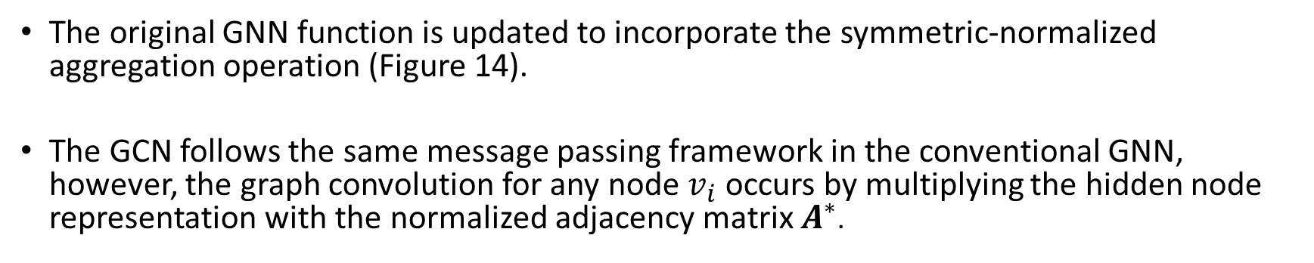
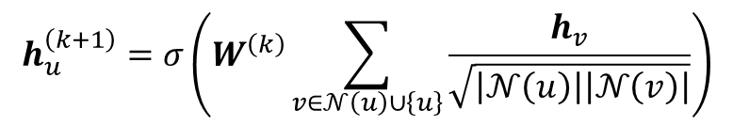

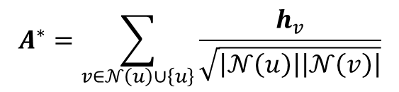
Graph Neural Networks – Graph Convolutional Network
$$h_{u}^{\left(k+1\right)}=σ\left(W^{\left(k\right)}\sum_{v∈𝒩\left(u\right)∪\left\{u\right\}}{\frac{h_{v}}{\sqrt{\left|𝒩\left(u\right)\right|\left|𝒩\left(v\right)\right|}}}\right)$$
Normalized Expression:
Symmetric-Normalized
Aggregation
Node Embedding
Nonlinear Activation
Learnable Weights
$$h_{u}^{\left(k+1\right)}=σ\left(W^{\left(k\right)}h^{\left(k\right)}A^{∗}\right)$$
$$A^{∗}=\sum_{v∈𝒩\left(u\right)∪\left\{u\right\}}{\frac{h_{v}}{\sqrt{\left|𝒩\left(u\right)\right|\left|𝒩\left(v\right)\right|}}}$$
Simplified Expression for $A^{∗}$:
Figure 14. GCN Formulation
The original GNN function is updated to incorporate the symmetric-normalized aggregation operation (Figure 14).
The GCN follows the same message passing framework in the conventional GNN, however, the graph convolution for any node $v_{i}$ occurs by multiplying the hidden node representation with the normalized adjacency matrix $A^{∗}$.

Slide 29
Introduction
Graph Data Representations
Problems/Tasks for Graph Structured Data
Graph Neural Networks (GNN)
Node Embedding
Vanilla GNN
Graph Convolutional Network (GCN)
Graph Attention Network (GAT)
Implementation Example
Research Examples

Slide 30
Graph Neural Networks – Graph Attention Network
Additional methods were created to adapt and extend the message aggregation function in GNNs to learn valuable node representations.
Inspired by the success of the attention mechanism (Bahdanau et al. 2015), researchers started to incorporate attention mechanisms into GNNs.
Intuition: Essence of using attention mechanisms in GNNs is to assign attention weights or calculate the “importance” of each node neighbor during aggregation.
This model design resulted in the Graph Attention Network (GAT).

Slide 31
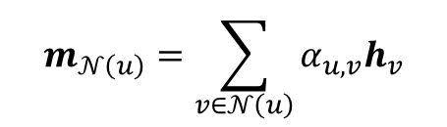

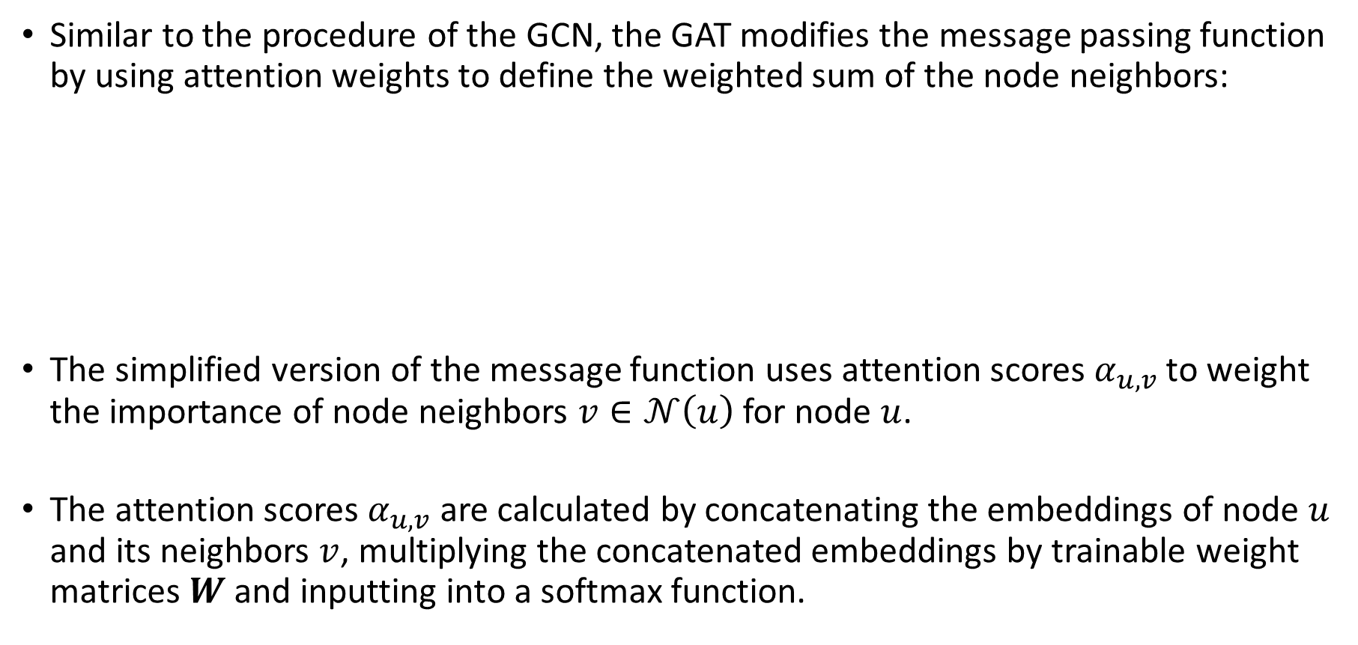
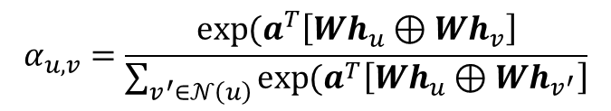
Graph Neural Networks – Graph Attention Network
Similar to the procedure of the GCN, the GAT modifies the message passing function by using attention weights to define the weighted sum of the node neighbors:
The simplified version of the message function uses attention scores $α_{u,v}$ to weight the importance of node neighbors $v∈𝒩\left(u\right)$ for node $u$.
The attention scores $α_{u,v}$ are calculated by concatenating the embeddings of node $u$ and its neighbors $v$, multiplying the concatenated embeddings by trainable weight matrices $W$ and inputting into a softmax function.
$$m_{𝒩\left(u\right)}=\sum_{v∈𝒩\left(u\right)}{α_{u,v}h_{v}}$$
$$α_{u,v}=\frac{\exp{(a^{T}\left[Wh_{u}⊕Wh_{v}\right]}}{\sum_{v^{′}∈𝒩\left(u\right)}{\exp{(a^{T}\left[Wh_{u}⊕Wh_{v^{′}}\right]}}}$$
Node Neighbor Embedding
Aggregated Message
Attention Scores
Sum of Attention Scores $×$ Node Embeddings
For All Node Neighbors
Figure 15. GAT Formulation (left); Attention Calculation (right).

Slide 32
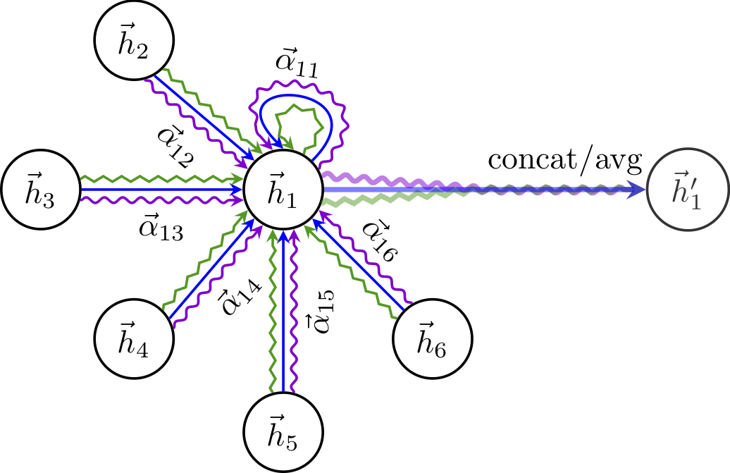
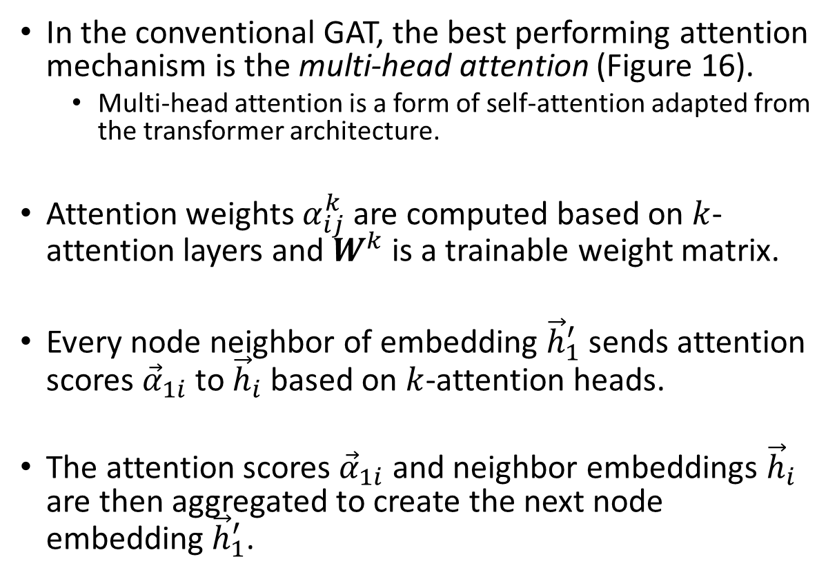

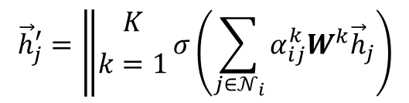
Graph Neural Networks – Graph Attention Network
In the conventional GAT, the best performing attention mechanism is the multi-head attention (Figure 16).
Multi-head attention is a form of self-attention adapted from the transformer architecture.
Attention weights $α_{ij}^{k}$ are computed based on $k$-attention layers and $W^{k}$ is a trainable weight matrix.
Every node neighbor of embedding ${\vec{h}}_{1}^{′}$ sends attention scores ${\vec{α}}_{1i}$ to ${\vec{h}}_{i}$ based on $k$-attention heads.
The attention scores ${\vec{α}}_{1i}$ and neighbor embeddings ${\vec{h}}_{i}$ are then aggregated to create the next node embedding${\vec{h}}_{1}^{′}$.
$${\vec{h}}_{j}^{′}=\left\|{K \atop k=1}σ\left(\sum_{j∈𝒩_{i}}{α_{ij}^{k}W^{k}{\vec{h}}_{j}}\right)\right.$$
Attention Aggregation
for $k$ Layers:
Figure 16. Illustration of GAT with Multi-Head Attention

Slide 33
Introduction
Graph Data Representations
Problems/Tasks for Graph Structured Data
Graph Neural Networks (GNN)
Node Embedding
Vanilla GNN
Graph Convolutional Network (GCN)
Graph Attention Network (GAT)
Implementation Example
Research Examples

Slide 34
Implementation Example
Below are two guides for Python implementations of GNNs:
GCN Node Classification: https://keras.io/examples/graph/gnn_citations/
GAT Node Classification: https://keras.io/examples/graph/gat_node_classification/
Python Requirements (‘pip install’):
Keras
Tensorflow
NetworkX
Pandas
Numpy
Matplotlib

Slide 35
Introduction
Graph Data Representations
Problems/Tasks for Graph Structured Data
Graph Neural Networks (GNN)
Node Embedding
Vanilla GNN
Graph Convolutional Network (GCN)
Graph Attention Network (GAT)
Implementation Example
Research Examples

Slide 36
Research Examples
Automated PII Extraction from Social Media for Privacy Risk Awareness: A Muti-Context Attention Approach
Detecting and Grouping Vulnerable Virtual Machines

Slide 37
Research Example: Privacy and PII Extraction (PIIE)
In recent years, social media users are increasingly getting used to posting their daily lives on social media.
This trend is accompanied by increasing exposure of personally identifiable information (PII) on social media leading to significant privacy risks.
Many challenges exist in automating the extraction of PII in social media, such as gathering labeled data due to privacy concerns and capturing valuable contextual information in social media profiles/posts.
In this study, we aim to leverage a Deep Learning (DL) approach to extract users’ exposed PII in social media automatically.
It can facilitate various applications, such as victim prediction and privacy risk assessment, to raise users’ privacy awareness.
To achieve this goal, we propose the Multi-Context Attention for PII Extraction (MCA-PIIE) framework.

Slide 38
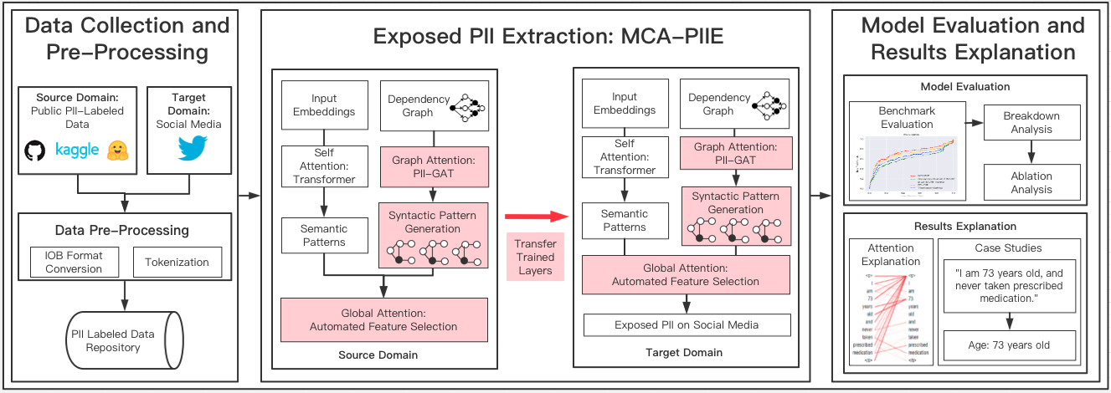
Research Example: Privacy and PII Extraction (PIIE) Research Framework
Proposed social media PIIE framework. Note: key novelty has been highlighted in red.
Intuition: Capture meaningful syntactic word dependencies using GAT to incorporate contextual information into embedding.

Slide 39
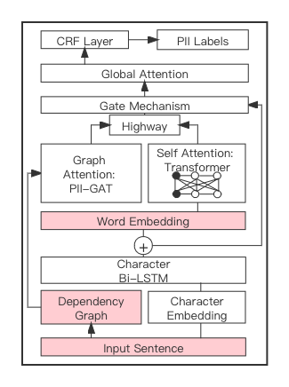
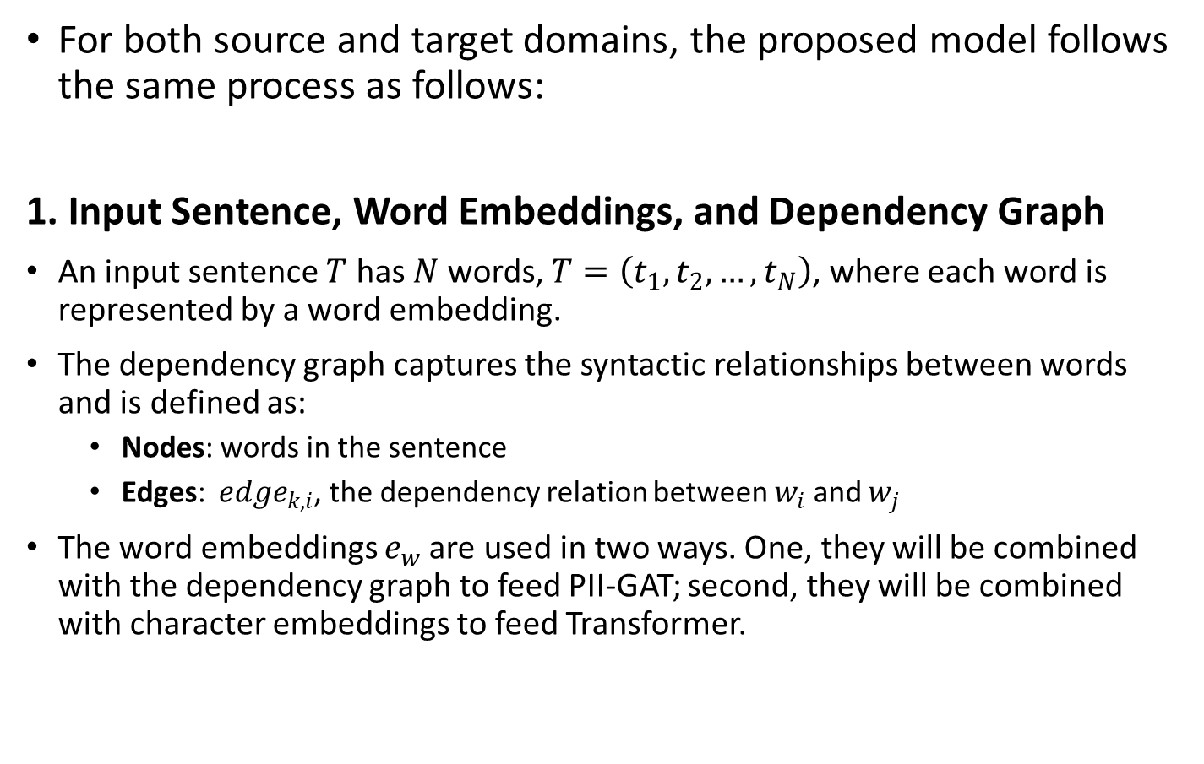
Research Example: MCA-PIIE
For both source and target domains, the proposed model follows the same process as follows:
1. Input Sentence, Word Embeddings, and Dependency Graph
An input sentence $T$ has $N$ words, $T=\left(t_{1},t_{2},…, t_{N}\right)$, where each word is represented by a word embedding.
The dependency graph captures the syntactic relationships between words and is defined as:
Nodes: words in the sentence
Edges: ${ edge}_{k,i}$, the dependency relation between $w_{i}$ and $w_{j}$
The word embeddings $e_{w}$are used in two ways. One, they will be combined with the dependency graph to feed PII-GAT; second, they will be combined with character embeddings to feed Transformer.
Proposed MCA-PIIE model. Note: components described in this slide are highlighted in red.
Notes:
We summarize our experiment results next.

Slide 40
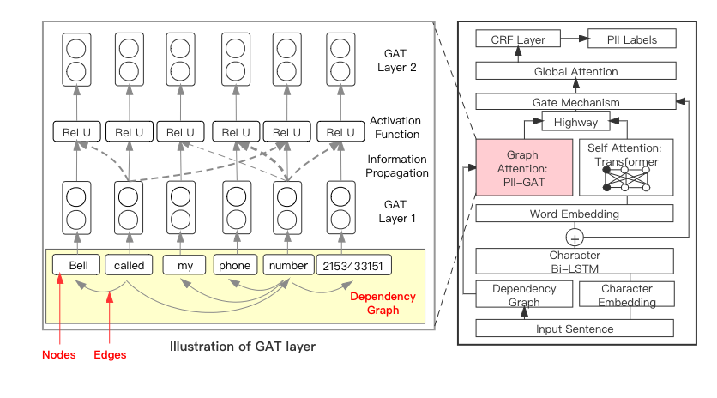
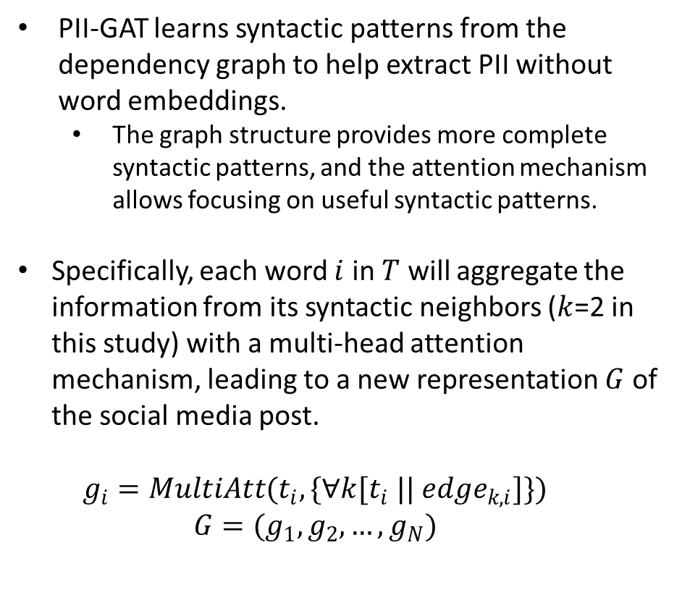
Research Example: MCA-PIIE Model – PII-GAT
2. Graph Attention: PII-GAT
PII-GAT learns syntactic patterns from the dependency graph to help extract PII without word embeddings.
The graph structure provides more complete syntactic patterns, and the attention mechanism allows focusing on useful syntactic patterns.
Specifically, each word $i$ in $T$ will aggregate the information from its syntactic neighbors ($k$=2 in this study) with a multi-head attention mechanism, leading to a new representation $G$ of the social media post.
$$g_{i}=MultiAtt(t_{i},\{∀k[t_{i} ||{ edge}_{k,i}]\})$$
$$G=(g_{1},g_{2},…,g_{N})$$
Proposed MCA-PIIE model with illustration of PII-GAT. Note: yellow box is the dependency graph, and the width of a line indicates its attention score.
Notes:
The graph guides PII-GCN to propagate the word representations based on syntactic-related words. These words are considered “neighbors” of a word, and their information will be incorporated to form the new representation of this word.
PII-GCN generates nodal representations of each word by propagating the information from the neighboring nodes, where the neighbors are syntax-related words in the dependency graph. It can integrate word representations (nodal features) and dependency graphs (structural features) into a single embedding to incorporate syntactic patterns.

Slide 41
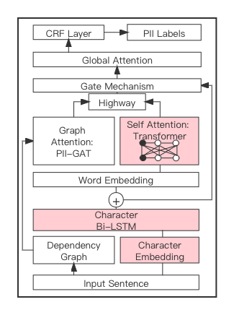
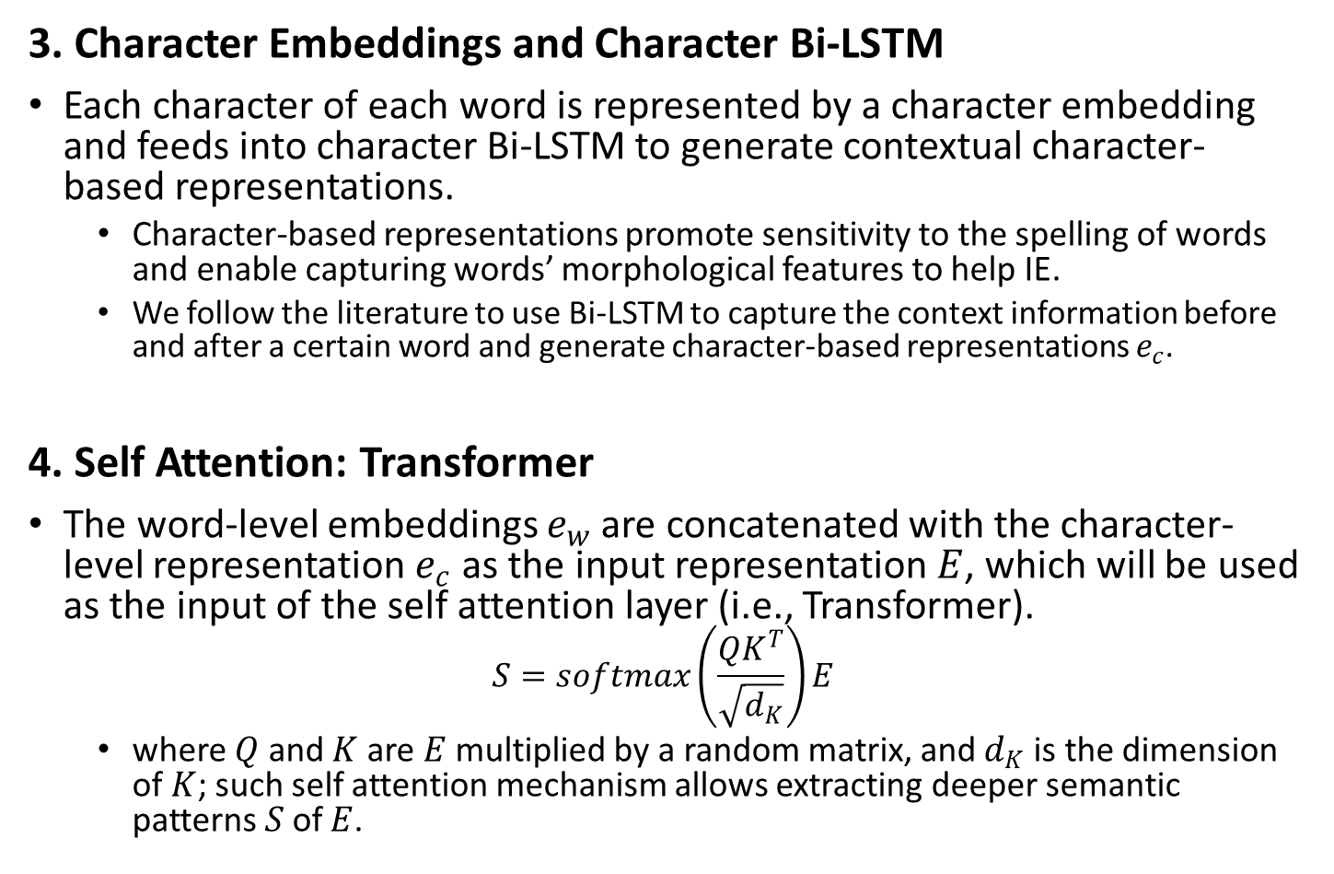
Research Example: MCA-PIIE
3. Character Embeddings and Character Bi-LSTM
Each character of each word is represented by a character embedding and feeds into character Bi-LSTM to generate contextual character-based representations.
Character-based representations promote sensitivity to the spelling of words and enable capturing words’ morphological features to help IE.
We follow the literature to use Bi-LSTM to capture the context information before and after a certain word and generate character-based representations $e_{c}$.
4. Self Attention: Transformer
The word-level embeddings $e_{w}$are concatenated with the character-level representation $e_{c}$ as the input representation $E$, which will be used as the input of the self attention layer (i.e., Transformer).
$$S=softmax\left(\frac{QK^{T}}{\sqrt{d_{K}}}\right)E$$
where $Q$ and $K$ are $E$ multiplied by a random matrix, and $d_{K}$ is the dimension of $K$; such self attention mechanism allows extracting deeper semantic patterns $S$of $E$.
Proposed MCA-PIIE model. Note: components described in this slide are highlighted in red.
Notes:
We summarize our experiment results next.

Slide 42
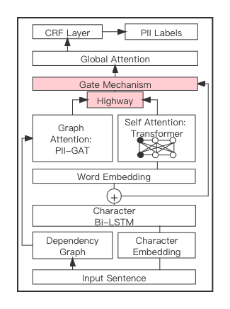
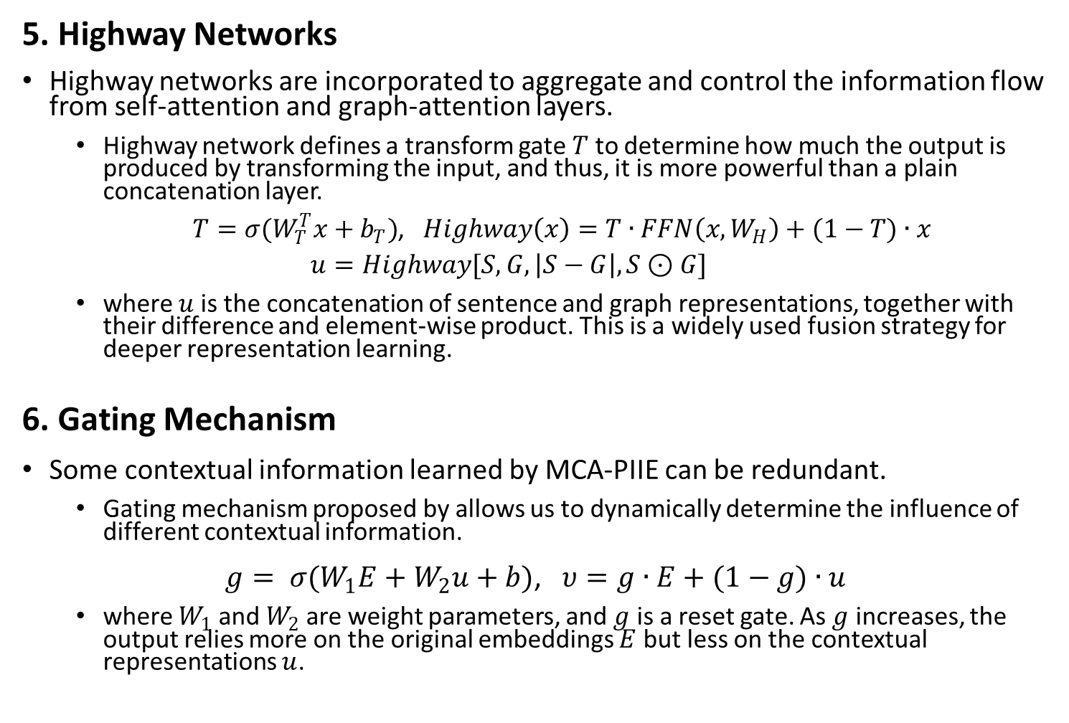
Research Example: MCA-PIIE
5. Highway Networks
Highway networks are incorporated to aggregate and control the information flow from self-attention and graph-attention layers.
Highway network defines a transform gate $T$to determine how much the output is produced by transforming the input, and thus, it is more powerful than a plain concatenation layer.
$T=σ(W_{T}^{T}x+b_{T})$, $Highway\left(x\right)=T∙FFN\left(x,W_{H}\right)+(1−T)∙x$
$$u=Highway[S, G, \left|S−G\right|,S⊙G]$$
where $u$is the concatenation of sentence and graph representations, together with their difference and element-wise product. This is a widely used fusion strategy for deeper representation learning.
6. Gating Mechanism
Some contextual information learned by MCA-PIIE can be redundant.
Gating mechanism proposed by allows us to dynamically determine the influence of different contextual information.
$g= σ(W_{1}E+W_{2}u+b)$, $υ=g∙E+(1−g)∙u$
where $W_{1}$and $W_{2}$ are weight parameters, and $g$ is a reset gate. As $g$ increases, the output relies more on the original embeddings $E$ but less on the contextual representations $u$.
Proposed MCA-PIIE model. Note: components described in this slide are highlighted in red.
Notes:
We summarize our experiment results next.

Slide 43
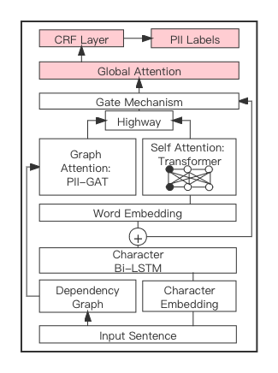
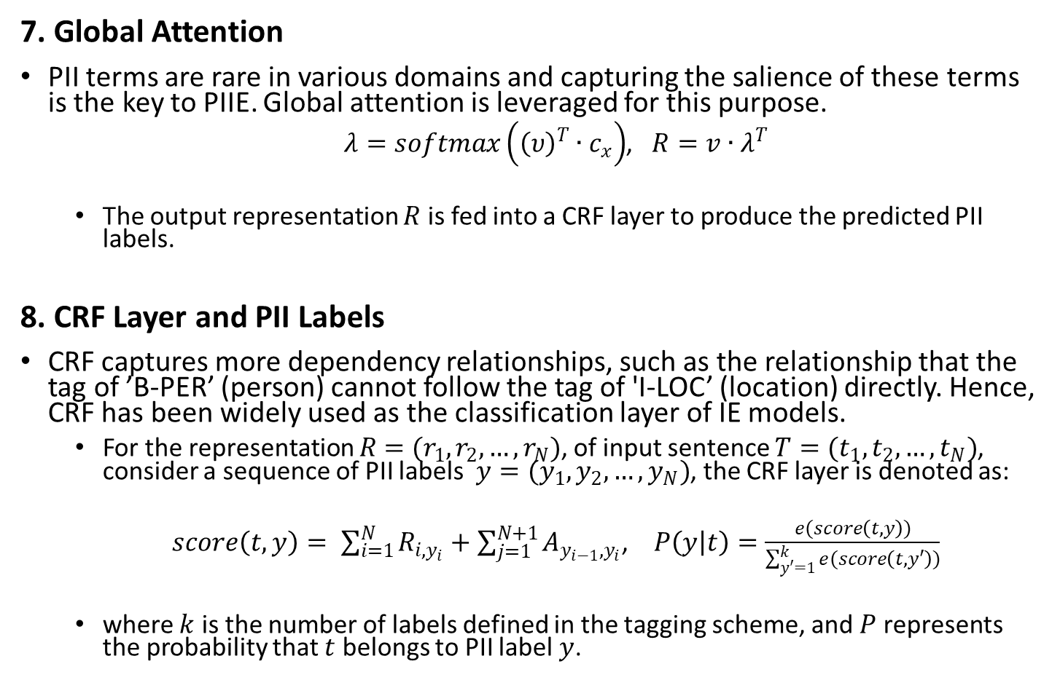
Research Example: MCA-PIIE
7. Global Attention
PII terms are rare in various domains and capturing the salience of these terms is the key to PIIE. Global attention is leveraged for this purpose.
$λ=softmax\left({\left(υ\right)}^{T}∙c_{x}\right)$, $R=v∙λ^{T}$
The output representation $R$ is fed into a CRF layer to produce the predicted PII labels.
8. CRF Layer and PII Labels
CRF captures more dependency relationships, such as the relationship that the tag of ’B-PER’ (person) cannot follow the tag of 'I-LOC’ (location) directly. Hence, CRF has been widely used as the classification layer of IE models.
For the representation $R$ $=(r_{1},r_{2},…, r_{N})$, of input sentence $T=(t_{1},t_{2},…, t_{N})$, consider a sequence of PII labels $y=(y_{1},y_{2},…, y_{N})$, the CRF layer is denoted as:
$score\left(t,y\right)= \sum_{i=1}^{N}{R_{i,y_{i}}}+\sum_{j=1}^{N+1}{A_{y_{i−1},y_{i}}}$, $P\left(y | t\right)=\frac{e(score\left(t,y\right))}{\sum_{y′=1}^{k}{e(score\left(t,y′\right))}}$
where $k$ is the number of labels defined in the tagging scheme, and $P$ represents the probability that $t$ belongs to PII label $y$.
Proposed MCA-PIIE model. Note: components described in this slide are highlighted in red.
Notes:
We summarize our experiment results next.

Slide 44
Research Example: Experiment Results – MCA-PIIE
Domain | Method | Accuracy | Precision | Recall | F1 Score
Source | Bi-LSTM + CRF + Transfer | 95.3%*** | 92.6%*** | 89.0%*** | 91.6%***
 | Transformer | 94.1%*** | 93.0%*** | 90.2%*** | 92.5%***
 | Dependency-Guided LSTM-CRF | 97.8%*** | 94.5%*** | 93.3%*** | 94.0%***
 | Source Domain DTL-PIIE | 98.1%** | 95.9% | 94.1%** | 94.6%**
 | Source Domain MCA-PIIE | 99.0% | 96.1% | 95.2% | 95.5%
Target (Twitter) | Dependency-Guided LSTM-CRF | 59.3%*** | 61.0%*** | 54.6%*** | 57.2%***
 | Transformer | 64.9%*** | 67.2%*** | 60.4%*** | 65.1%***
 | Bi-LSTM + CRF + Transfer | 68.7%*** | 68.3%*** | 62.5%*** | 67.4%***
 | DTL-PIIE (Ours) | 73.2%*** | 72.5% | 65.2%** | 71.1%**
 | MCA-PIIE (Ours) | 75.3% | 72.9% | 66.5% | 72.3%
Results of MCA-PIIE vs prevailing DL-based IE models. Note: * p<0.1; ** p<0.05; *** p<0.01
Our proposed model MCA-PIIE is evaluated using social media data collected from Twitter.
The outstanding performance of MCA-PIIE is because DTL helps understand more PII that is not labeled in social media data. Also, MCA-PIIE leverages three attention mechanisms to learn rich contextual information.
Notes:
The superior performance of our model can be mainly attributed to three main components: a Transformer-based context encoder, a PII-GCN for learning syntactic patterns, and DTL for knowledge transfer.
Transformer leveraged global context to emphasize words that helped identify PII in social media posts. For example, a user can mention “phone number” at the beginning while leaving the number at the end of a post. In this case, “phone number” is not in the local contexts of the PII (i.e., the number) due to the long distance between them, but Transformer can capture the global contexts and extract the PII.
Compared with Dependency-guided LSTM-CRF that only used sequential dependencies of syntactic patterns, our model leveraged PII-GCN to incorporate the graph structure of syntactic patterns. The sequential dependencies of syntactic patterns only consider directly related words in the syntax, whereas in social media, words directly related to PII can often be written in irregular forms (e.g., bd stands for birthdate). These words also cannot be represented by pre-trained word embeddings, and their syntax-related words are further needed to guide PIIE. Our model with PII-GCN considers all words related to PII in the dependency graph and outperforms prior models in PIIE.
Last but not least, our results suggest that DTL can effectively generalize the global contexts and syntactic patterns learned from publicly available PII data to the social media domain to improve PIIE performance.

Slide 45
Research Examples
Automated PII Extraction from Social Media for Privacy Risk Awareness: A Muti-Context Attention Approach
Detecting and Grouping Vulnerable Virtual Machines

Slide 46
Research Example: Detecting and Grouping Vulnerable Virtual Machines
Public cloud providers (e.g., Amazon Web Services) and the National Science Foundation (NSF) have invested millions of dollars into developing high-performance computing (HPC) resources to support high-impact computational workflows.
Users access HPC resources through configurable virtual machine (VM) images, where users install open-source software (i.e., packages) from third parties (e.g., GitHub) and manipulate file systems (e.g., permissions) to support their desired analytics.
However, open-source software can contain significant code-based vulnerabilities (e.g., shell injection) and misconfigured file systems can lead to crashes and permission bypass.
Cloud providers often lack dedicated support staff to prioritize and remediate vulnerabilities; therefore, vulnerabilities can remain undetected for years.
In this research we develop a novel research framework that aims to:
Automatically scan user VMs to detect code-based vulnerabilities in open-source packages on VMs.
Group VMs with similar vulnerabilities to facilitate vulnerability remediation and prioritization.

Slide 47
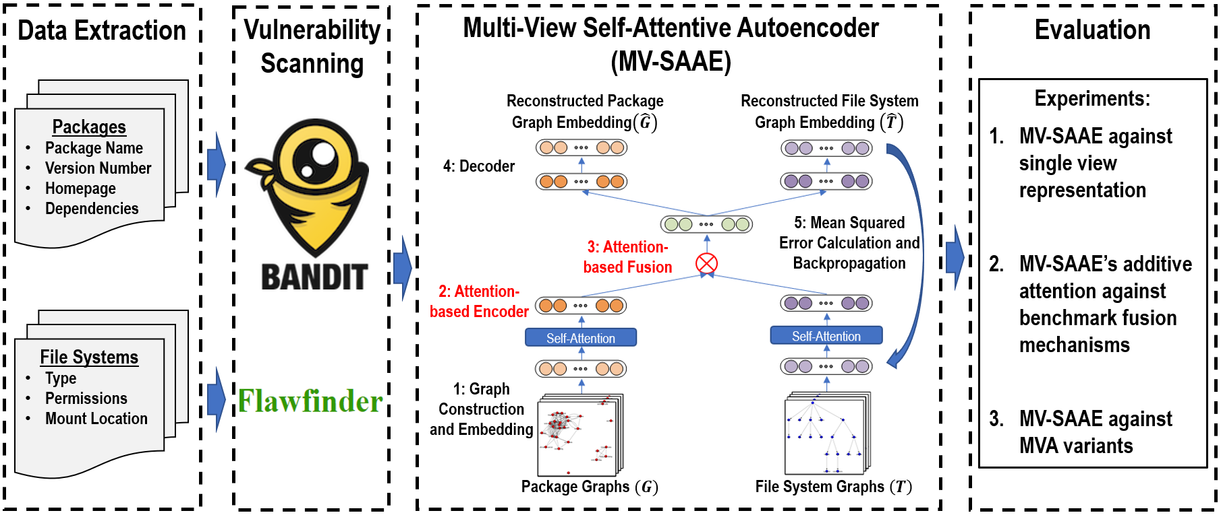
Research Example: Detecting and Grouping Vulnerable Virtual Machines
Our proposed research design to generate graph-level embeddings for downstream VM image clustering (prioritization) is illustrated below.

Slide 48
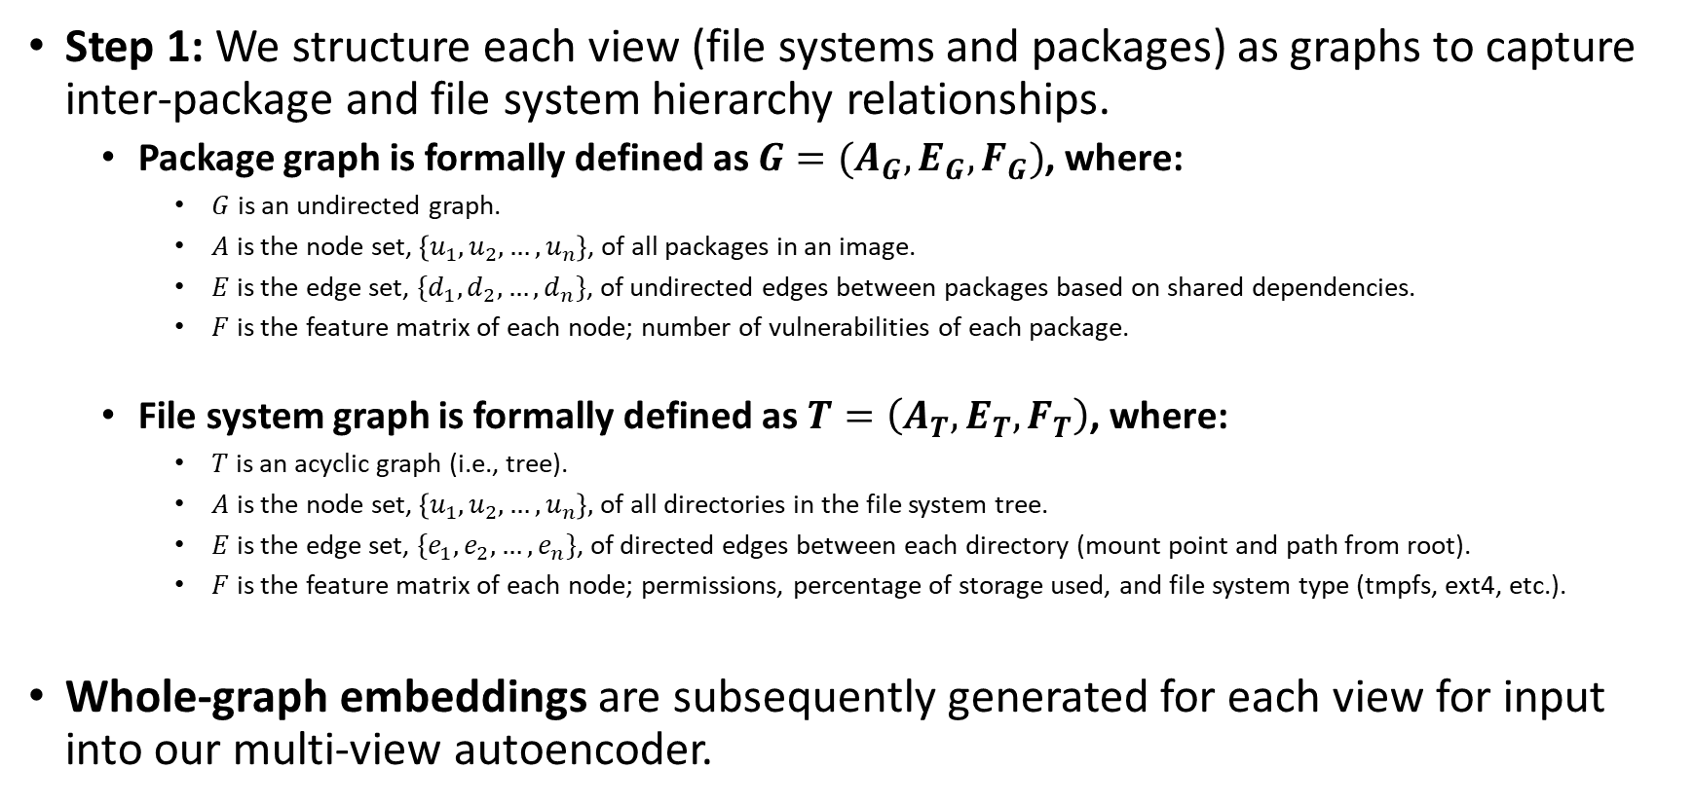
Research Example: Graph Construction and Embedding
Step 1: We structure each view (file systems and packages) as graphs to capture inter-package and file system hierarchy relationships.
Package graph is formally defined as $G=(A_{G},E_{G},F_{G})$, where:
$G$ is an undirected graph.
$A$ is the node set, $\left\{u_{1}, u_{2},…,u_{n}\right\}$, of all packages in an image.
$E$ is the edge set, $\{d_{1}, d_{2},…,d_{n}\}$, of undirected edges between packages based on shared dependencies.
$F$ is the feature matrix of each node; number of vulnerabilities of each package.
File system graph is formally defined as $T=\left(A_{T},E_{T},F_{T}\right)$, where:
$T$ is an acyclic graph (i.e., tree).
$A$ is the node set, $\left\{u_{1}, u_{2},…,u_{n}\right\},$ of all directories in the file system tree.
$E$ is the edge set, $\{e_{1}, e_{2},…,e_{n}\}$, of directed edges between each directory (mount point and path from root).
$F$ is the feature matrix of each node; permissions, percentage of storage used, and file system type (tmpfs, ext4, etc.).
Whole-graph embeddings are subsequently generated for each view for input into our multi-view autoencoder.
Notes:
Given the multiple views of VM images within Atmosphere, an Alignment-based approach shows promise as a learning strategy for comparing multiple views.
We follow an Alignment-based approach since we generate the embeddings separately.
Alignment methods seek to perform alignment (similarity, distance) between the representations learned from multiple different views.
The nature of the extracted image can be represented as both directed and undirected graphs, promoting the use of graph embedding techniques.
Two data views were selected based on attribute properties:
Applications: Relationships between applications based on dependencies
Let A represent the application and D represent the dependencies
{A_{n}: D₁, D₂, D₃,…,D_{n}}
File Systems: Hierarchical ‘tree’-like structure
(A→ B), (A → C), (B → D), (C → E) (C → F),…
Based on the structure of the data, we represent the views as the following graphs:
Applications: Undirected Graph
Captures application-to-application relationships based on similar dependencies
Data structure → graph (undirected, node-attributed)
Node (application) attributes: version number, home page, description, priority, vulnerabilities
File Systems: Directed Acyclic Graph (Tree)
Captures hierarchical relationship between parent and child directories
Data structure → tree (directed/acyclic; node-attributed)
Nodes (type of file system (e.g., sysfs, cgroup, etc.)); attributes: user permissions, % of storage used, name
Combined view (representation alignment view)

Slide 49
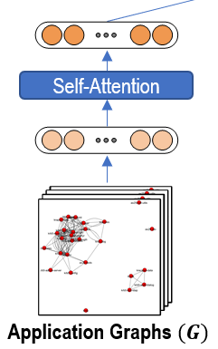

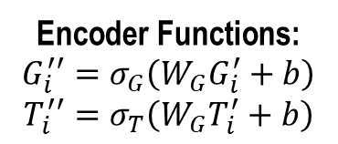


Research Example: MV-SAAE – Attention-based Encoder
Step 2: We input the graph embeddings into a multi-view autoencoder, where the embeddings are attended using self-attention.
The first attention operation is a self-attention which helps the MV-SAAE attend to the most correlated dimensions of each package and file system embedding.
Scaled dot-product attention weighs the inputs, wherein query $\left(Q\right)$, key $\left(K\right)$, and value ($V$) are equal values of each embedding input.
The self-attended embedding is the weighted sum of $G_{i}$ and $T_{i}$, which is derived from the score of $softmax\left(\frac{G_{i}^{T}G_{i}}{\sqrt{n_{G}}}\right)$ and $softmax\left(\frac{T_{i}^{T}T_{i}}{\sqrt{n_{T}}}\right)$.
$G_{i}^{′′}$and $T_{i}^{′′}$denote the encoded, self-attended embeddings, and are computed through non-linear activation functions $σ_{G}\left(W_{G}G_{i}^{′}+b\right)$ and $σ_{T}(W_{T}T_{i}^{′}+b)$.
Encoder Functions:
$$G_{i}^{′′}=σ_{G}\left(W_{G}G_{i}^{′}+b\right)$$
$$T_{i}^{′′}=σ_{T}\left(W_{G}T_{i}^{′}+b\right)$$
Scaled Dot-Product Attention Operations:
$$G_{i}^{′}=softmax\left(\frac{G_{i}^{T}G_{i}}{\sqrt{n_{G}}}\right)G_{i}$$
$$T_{i}^{′}=softmax\left(\frac{T_{i}^{T}T_{i}}{\sqrt{n_{T}}}\right)T_{i}$$
Package Graphs $(G)$
MV-SAAE Attention-Based Encoding
49
Notes:
Scaled dot-product attention is only capturing the correlated feature dimensions → inner product is computed with other feature dimensions to get a correlation matrix, softmax normalizes the correlation matrix into weights

Slide 50







Research Example: MV-SAAE – Fusion Operation
Fusion Operation:
$$φ=avg\{αG_{i}^{′′},α^{c}T_{i}^{′′}\}$$
Step 3: The self-attended embeddings are input into an attention gate to determine which embedding should be prioritized during fusion.
We adapt an additive attention mechanism to weigh the package and file system embeddings.
$G_{i}^{′′}$ and $T_{i}^{′′}$ are concatenated and inputted into a fully connected layer to derive a scalar weight value $α$ and its compliment $α^{c}$, where $W_{a}$ denotes a learned weight matrix.
The joint representation $φ$ is created by averaging $αG_{i}^{′′}$ and $α^{c}T_{i}^{′′}$ and creates an image-specific representation for each VM.
Attention Gate:
$$α=σ\left(W_{a}\left[G_{i}^{′′};T_{i}^{′′}\right]\right)$$
$$α^{c}=\left(1−α\right)$$
$$G_{i}^{′′}$$
$$T_{i}^{′′}$$
MV-SAAE Attention-Based Gating Mechanism

Slide 51






Research Example: MV-SAAE – Decoder and MSE Calculation
Reconstructed Package Graph Embedding$\left(\hat{G}\right)$
Reconstructed File System Graph Embedding $\left(\hat{T}\right)$
Step 4: Two decoders reconstruct the inputs ${\hat{G}}_{i}$ and ${\hat{T}}_{i}$from the shared representation $φ\left(∙\right)$.
Step 5: Two $MSE$ functions calculate the loss between the original and reconstructed package and file system inputs.
The MV-SAAE weights are iteratively updated via backpropagation. Encoding, decoding, and backpropagation repeat until both $MSE$ functions are minimized.
MSE Calculation:
$$MSE_{G_{i}}=\frac{1}{n}\sum_{i=1}^{n}{{\left(G_{i}−\hat{G_{i}}\right)}^{2}}$$
$$MSE_{T_{i}}=\frac{1}{n}\sum_{i=1}^{n}{{\left(T_{i}−{\hat{T}}_{i}\right)}^{2}}$$
Decoder Functions:
$$\hat{G_{i}}=σ\left(W_{j}φ\left(∙\right)+b_{j}\right)$$
$${\hat{T}}_{i}=σ\left(W_{j}φ\left(∙\right)+b_{j}\right)$$
MV-SAAE Decoder and MSE Calculation

Slide 52






Research Example: Case Study – Clustering Similar Images
To demonstrate the practical utility of the MV-SAAE, we conduct a case study by clustering all the VM images in our dataset (126 VM images, 233K+ vulnerable packages, 4,014 file systems).
The case study uses embeddings generated by the MV-SAAE to group similar VM images for targeted vulnerability assessment and prioritized remediation.
VM Data Extraction
Vulnerability Scanning
MV-SAAE
Vulnerability Cluster Analysis

Slide 53

Research Example: Case Study
Cluster | Vulnerability | Severity | Package | Count
Cluster C | Insecure Function | High | Libblockdev2 | 41
 |  |  | Yadm | 29
 |  |  | Youker-assistant | 28
 |  |  | Pymca | 27
 | Insecure Input | High | Zabbix-cli | 103
 |  |  | Cupp | 29
 |  |  | Elastalert | 13
 | XSS Vulnerability | High | Libqt5webkit5 | 4
 |  |  | Python3-spyder | 3
 |  |  | Python3-azure | 2
Cluster E | Insecure Input | Low | node-gyp | 34
 |  |  | bup | 31
 |  |  | python-google-compute-engine | 31
 | Insecure Module | Low | bup | 20
 |  |  | python-google-compute-engine | 17
 |  |  | python-sympy | 15
 | Insecure Function | Medium | python-sympy | 60
 |  |  | python-html5lib | 4
 |  |  | cura-engine | 4
A (n=10)
B (n=22)
C (n=19)
D (n=4)
F (n=18)
E (n=47)
Clustered Vulnerable VM Images
Cluster C (n=19):
Images in this cluster contain an average of 2,990 vulnerable packages.
Each image contains approximately 740 high-severity, 1,320 medium-severity, and 3,050 low-severity vulnerabilities.
Cluster E (n=47):
Images in this cluster contain an average of 620 vulnerable packages.
Each image contains approximately 240 high-severity, 120 medium-severity, and 690 low-severity vulnerabilities.
Selected Vulnerable Packages Within Clusters

Slide 54
Summary
Graph structured data can be found everywhere; GNNs can allow us to capture information and make predictions using graph data.
GNNs and node embeddings follow a message passing framework where data is captured from surrounding node neighborhoods to produce vector representations (embeddings).
GCNs extend conventional GNNs to incorporate normalized adjacency matrices and perform graph convolutions; GATs incorporate attention to measure the importance of node neighbors while producing embeddings.
GNNs are valuable methods used in real-world applications.
Graph analytics, node classification, link prediction, graph classification/clustering, information propagation.
Biology, drug classification, social network analysis, privacy and cybersecurity.

Slide 55
References
Kipf, T. N., and Welling, M. 2016. “Semi-Supervised Classification with Graph Convolutional Networks,” International Conference on Representation Learning (ICLR), September 9. (http://arxiv.org/abs/1609.02907).
Veličković, P., Cucurull, G., Casanova, A., Romero, A., Liò, P., and Bengio, Y. 2017. “Graph Attention Networks,” International Conference on Representation Learning (ICLR), October 30. (http://arxiv.org/abs/1710.10903).
Zhou, J., Cui, G., Hu, S., Zhang, Z., Yang, C., Liu, Z., Wang, L., Li, C., and Sun, M. 2018. “Graph Neural Networks: A Review of Methods and Applications,” arXiv [cs.LG], , December 20. (http://arxiv.org/abs/1812.08434).

