Slide 1
Inside Internet Search Engines:
Fundamentals
Jan Pedersen
and
William Chang

Slide 2
Outline
Basic Architectures
  Search
  Directory
Term definitions:
  Spidering, indexing etc.
  Business model

Slide 3
Basic Architectures: Search
Log
20M queries/day
Spider
Web
SE
Spam
Index
SE
Browser
Freshness
SE
24x7
Quality results
800M pages?

Slide 4
Basic Architectures: Directory
Surfing
Url submission
Ontology
Web
SE
SE
Browser
SE
Reviewed Urls

Slide 5
Spidering
Web HTML data
  Hyperlinked
  Directed, disconnected graph
  Dynamic and static data
  Estimated 800M indexible pages
Freshness
  How often are pages revisited?

Slide 6
Indexing
Size
  from 50 to 150M urls
  50 to 100% indexing overhead
    200 to 400GB indices
Representation
  Fields, meta-tags and content
  NLP: stemming?

Slide 7
Search
Augmented Vector-space
  Ranked results with Boolean filtering
Quality-based reranking
  Based on hyperlink data
  or user behavior
Spam
  Manipulation of content to improve placement

Slide 8
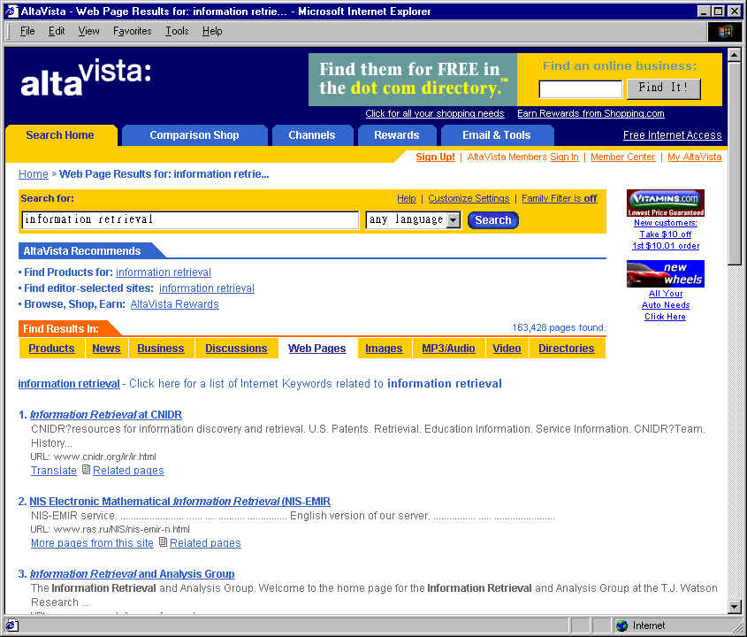

Slide 9
Queries
Short expressions of information need
  2.3 words on average
  Relevance overload is a key issue
    Users typically only view top results
Search is a high volume business
  Yahoo! 50M queries/day
  Excite 30M queries/day
  Infoseek 15M queries/day

Slide 10
Directory
Manual categorization and rating
  Labor intensive
    20 to 50 editors
  High quality, but low coverage
    200-500K urls
Browsable ontology
Open Directory is a distributed solution

Slide 11
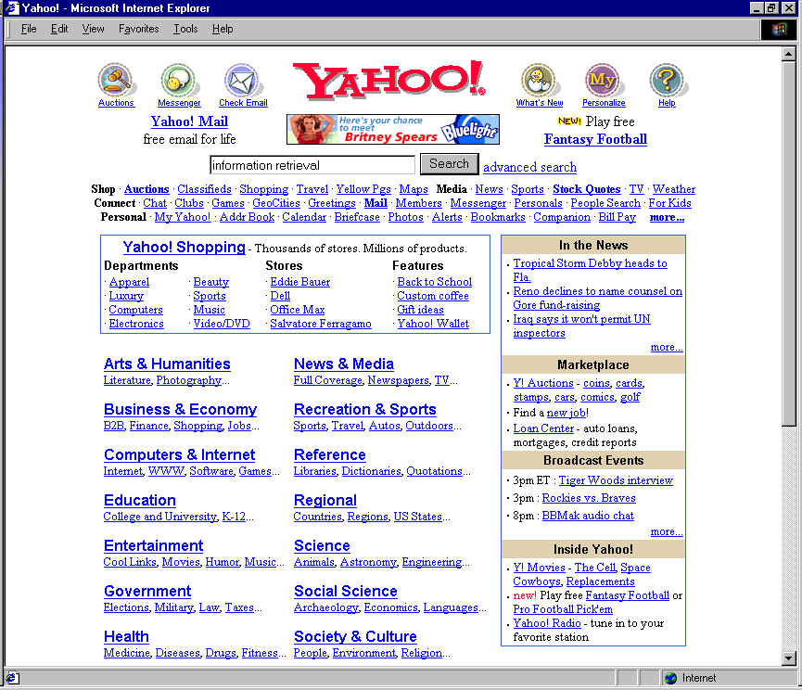

Slide 12
Hybrid Services
Query is used for navigation
  Directory placement
  Recommended
Point of integration
  Multiple data sources
    Web, News, Shopping, Community, etc.

Slide 13
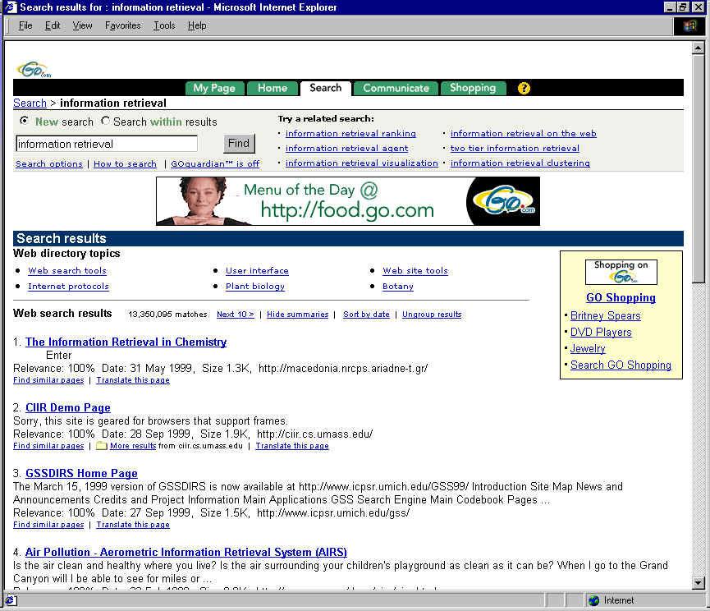

Slide 14
Business Model
Advertising
  Highly targeted, based on query
  Keyword selling; Between $3 to $25 CPM
Cost per query is critical
  Between $.5 and $1.0 per thousand
Distribution
  Many portals outsource search

Slide 15
Basic Problem
Provide the highest quality search at the lowest possible cost
  More traffic is better
    More ad impressions
  Targetable queries are better
    Not all keywords are sold

Slide 16
Web Resources
Search Engine Watch
  www.searchenginewatch.com
“Analysis of a Very Large Alta Vista
Query Log”; Silverstein et al.
  SRC Tech note 1998-014
  www.research.digital.com/SRC

Slide 17
Web Resources
“The Anatomy of a Large-Scale
Hypertextual Web Search Engine”; Brin
and Page
  google.stanford.edu/long321.htm
WWW conferences
  www8.org

