Slide 1
Inside Internet Search Engines:
Search
Jan Pedersen
and
William Chang

Slide 2
Basic Architectures: Search
Log
Spider
20M queries/day
Web
SE
Spam
Index
SE
Browser
Freshness
SE
24x7
Quality results
800M pages?

Slide 3
Query Language
Augmented Vector space
  Relevance scored results
  Tf, idf weighting
  Boolean constraints: +, -
  Phrases: “”
  Fields:
    e.g. title:

Slide 4
Does Word Order Matter?
Try “information retrieval” versus
“retrieval information”
  Do you get the same results?
The query parser
  Interprets query syntax: +,-, “”
    Rarely used
  General query from free text
    Critical for precision

Slide 5
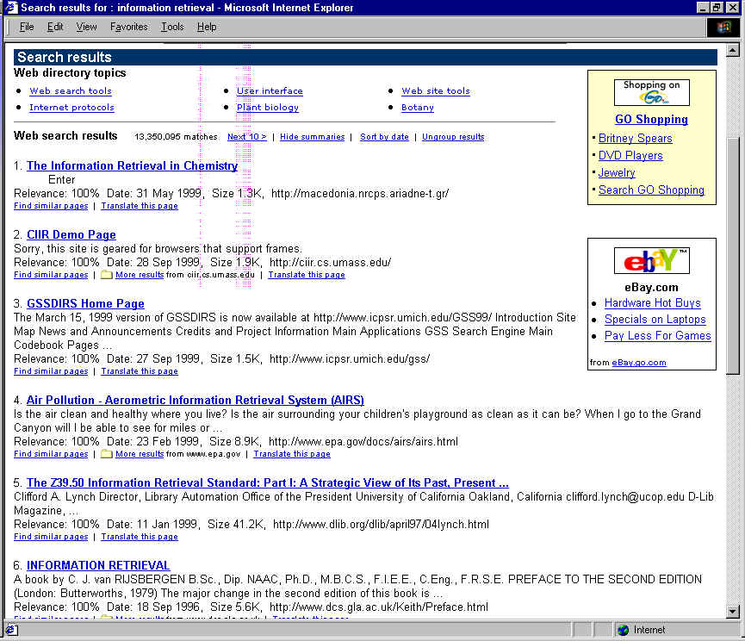

Slide 6
Precision Enhancement
Phrase induction
  All terms, the closer the better
Url and Title matching
Site clustering
  Group urls from same site
Quality-based reranking

Slide 7
Link Analysis
Authors vote via links
  Pages with higher inlink are higher quality
Not all links are equal
  Links from higher quality sites are better
  Links in context are better
Resistant to Spam
  Only cross-site links considered

Slide 8
Page Rank (Page’98)
Limiting distribution of a random walk
  Jump to a random page with Prob. ε
  Follow a link with Prob. 1- ε
Probability of landing at a page D:
  ε/T + Σ P(C)/L(C)
  Sum over pages leading to D
  L(C) = number of links on page D

Slide 9
HITS (Kleinbery’98)
Hubs: pages that point to many good pages
Authorities: pages pointed to by many good pages
Operates over a vincity graph
  pages relevant to a query
Refined by the IBM Clever group
  further contextualization

Slide 10
Hyperlink Vector Voting (Li’97)
Index documents by in-link anchor texts
  Follow links backward
  Can be both precision and recall enhancing
    The “evil empire”
How to combine with standard ranking?
  Relative weight is a tuning issue

Slide 11
Evaluation
No industry standard benchmark
  Evaluations are qualitative
  Excessive claims abound
  Press is not be discerning
Shifting target
  Indices change daily
  Cross engine comparison elusive

Slide 12
Complexity Analysis
Search is both CPU and I/O intensive
  I/O to access postings
    Random access
  CPU to compute scores
  Caching strategies are very effective
    Term cache has 40% hit rate
Expensive queries are long and loaded with rare terms

Slide 13
Performance versus Size
Time
Index Size

Slide 14
Complexity Analysis
CPU costs asymptotically constant
  Due to term truncation
I/O cost can be kept to one I/O per term
  Again due to truncation
Implies the bigger the better
  No advantage to distributed search

Slide 15
The Economics of Big Indices
Very large indices require distributed search
  Easy scalability; maintenance
  Practical hardware limitations
Implies Cost = Size * Throughput
  Since each half of a big index requires the same hardware to sustain the same throughput
  Worse: queries needing a big index are hard to monetize

Slide 16
How to Have your Cake...
Layered Search
  Small, high quality engine for common queries
    Low cost per query; high revenue per query
  Large, low throughput engine for rare queries
    High cost per query, low revenue per query
  Average query costs can be kept low
    While still offering comprehensiveness

Slide 17
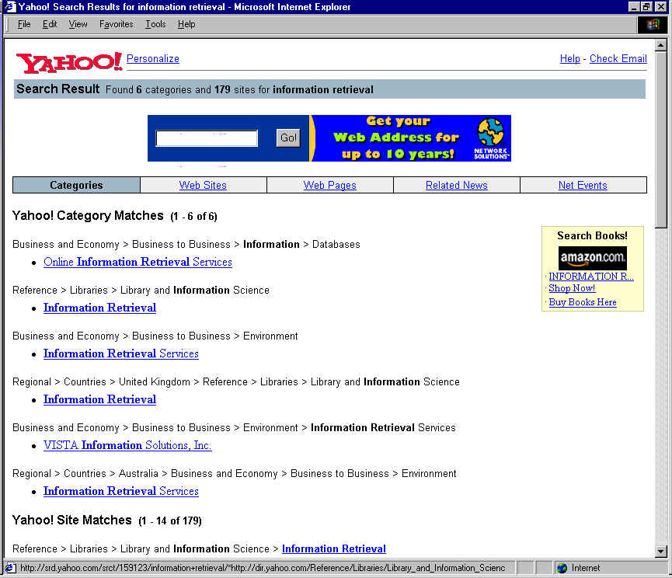

Slide 18
Novel Search Engines
Ask Jeeves
  Question Answering
  Directory for the Hidden Web
Direct Hit
  Direct popularity
  Click stream mining

Slide 19
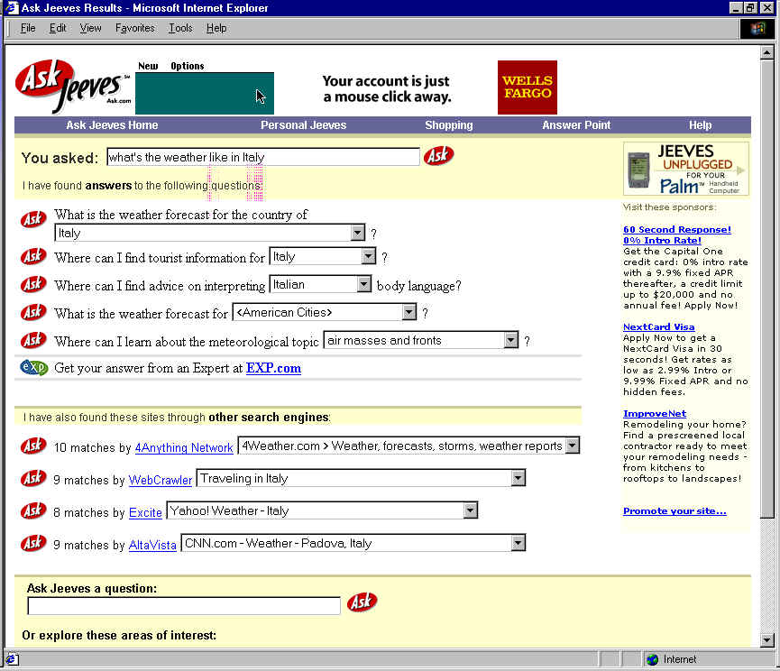

Slide 20
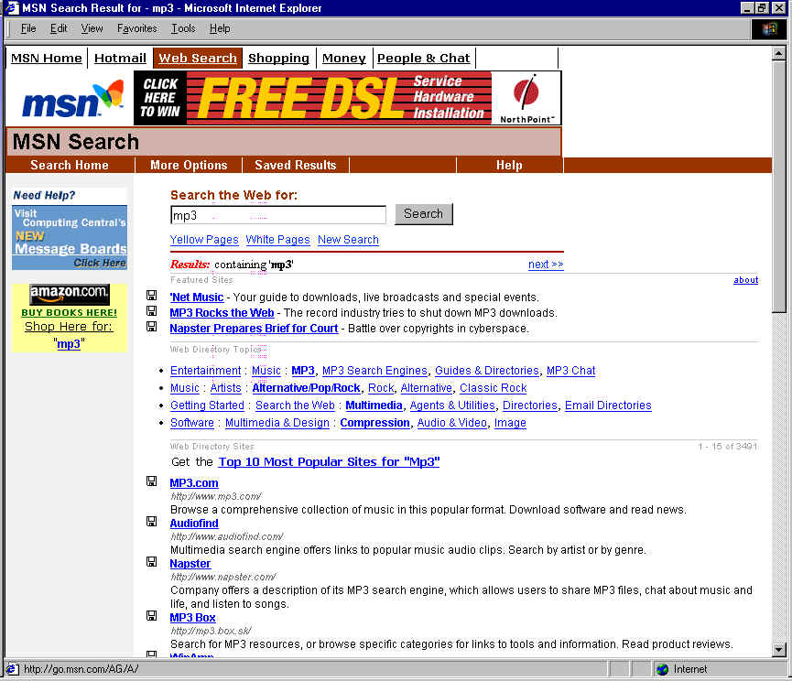

Slide 21
Summary
Search Engines are surprisingly effective
  Given short queries
  Precision enhancing techniques are critical
Centralized search is maximally efficient
  but one can achieve a big index through layering

