Slide 1




UA/Eller/MIS Program Overview
Hsinchun Chen, 2019
MIS

Slide 2
Management Information Systems
MIS Definition: (1) management oriented (organization, context); (2) information centric (data, knowledge); (3) systems driven (interconnected, design)
Selected past successes in MIS, Arizona examples:
  J. Nunamaker, GroupSystems, GDSS, 1984-: EBS, idea divergence/convergence; $67M funding (IBM/Intel/VC), $84M sales; 41 dissertations, 220 pubs; 5000+ worldwide installations ➔ Avatar, DHS Broder Center
  H. Chen, COPLINK, security informatics, 1997-: information sharing and crime data mining; $7M funding (DOJ/NSF/VC), $30M sales; 55 pubs, 70 students; 5,000+ public safety/security agencies, i2/COPLINK acquired by IBM in September 2011 ➔ Dark Web, AZSecure

Slide 3
MIS Disciplines
Organizational behavior, management, sociology, strategy (Minnesota, MIT)
Economic modeling, management science, OR, supply chain (UT Austin, CMU)
Design science, computer science, system, database, algorithm, interface (Arizona, NYU)

Slide 4

Top Five UA MIS Programs
MIS
MIT: economics, IT consulting
CMU: economics, MS/OR, social
UT Austin: economics, MS/OR
Arizona: system, technical
Minnesota: economic, social

Slide 5
CS vs. MIS
CS: science-based, computer driven, core foundations (compiler, networking, OS), theories, algorithms, databases
MIS Computational Design Science: (emerging, relevant, high-impact) applications, problem-driven, information-centric, multi-disciplinary, organization relevant

Slide 6
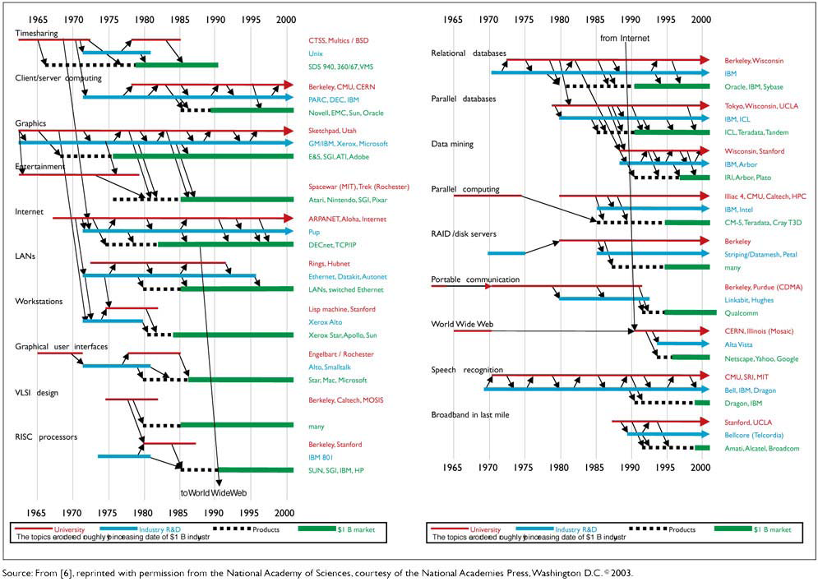
CS Ecosystem and Impacts
University research ➔ Industry R&D ➔ Products ➔ $1B Market (job and wealth creation)

Slide 7
Web, Data, and Text, and Mining
Web Mining: Web 1.0 Surface Web, digital library, search engines; Yahoo, Google ➔ Web 2.0 Social Web ➔ Web 3.0 Mobile Web ➔ Web 4.0 AI-enabled Web
Data Mining: ID3, neural networks, genetic algorithms, SVM ➔ Weka, SPSS, IBM Intelligent Miner, IBM Cognos, Tableau ➔ Bid Data, Hadoop, SPARK ➔ Statistical machine learning, deep learning, AI
Text Mining: search engine, information extraction ➔ sentiment analysis, multilingual systems ➔ deep learning, Q/A systems (Watson), machine translation (Google Translate)

Slide 8
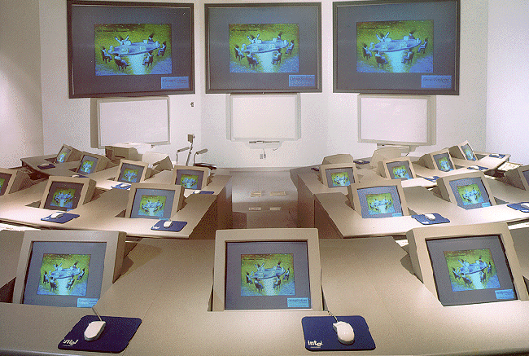
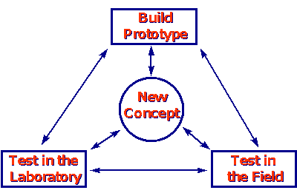


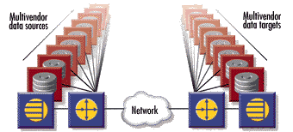
Vision for UA-MIS
To establish leadership in information technology education, research and outreach that accentuate innovation, hands-on experience and strategic values of information management, intelligence and technology.
MIS

Slide 9
Historical Overview
BS, MS and Ph.D. programs were first offered in 1974.
The department was established in 1977, second oldest in MIS.
20 faculty members, 25 Ph.D., 200 MS, 300 BS students
Ranked in top-5 by News & World Report for 30 consecutive years!
Unique values of our program
  Successful innovations and high-impact research
  Hands-on learning in system development, application and management
  Applied and highly relevant
MIS

Slide 10
Faculty
20 faculty members
Total Research Funding: $200+ million (largest among all MIS and b-schools)
Pioneers and leaders in
  Collaboration technology and science
  Knowledge management and artificial intelligence
  Security and health analytics research
  Economics and technology management issues
Featured in Fortune, Business Week, Forbes, Sciences and New York Times articles
MIS

Slide 11
UA-MIS Board of Advisors
Provide guidance and support
Established in summer 1998
Inkind, scholarship, infrastructure and fund donations exceeding $10 million
Members include:
  AOL, Ameristar Casinos, Andersen Consulting, Arthur Andersen, Cap Gemini, Cargill, Commerce One, Compaq, EMC², Farmers Insurance, HP, Harvard Group, Honeywell, IBM, IFS, Intel, Oracle, PWC, Raytheon, RCM Technologies, SoftQuad, Ultralife Batteries
MIS

Slide 12
Major UA/MIS Research Centers
MIS
Center for the Management of Information (CMI): Collaborative computing and group systems research, border security, deception detection
Artificial Intelligence Lab: Web computing, business intelligence, security and health informatics research
INSITE, Advanced Database Research Group: Data modeling and management research, business intelligence

Slide 13
UA/MIS Faculty Research Coverage:
MIS
Technical/design: artificial intelligence, web computing, GDSS, databases, deception detection, business intelligence, health and security informatics
Economics/management sciences/OR: workflow, supply-chain, project management; applied econometrics, auctioning, modeling
Social/behavioral/cognitive: social impacts, computer-mediated communication, human-computer interactions (HCI)

Slide 14
AI Lab Background
Founded in 1989 by Dr. Hsinchun Chen (300+ journal papers; h-index 95, highest in MIS)
Excellence in Digital Library, Web Computing, Health Informatics, and Security and Intelligence Informatics
Funding, $40M, 100+ grants: federal (50+ grants from NSF; NIH, NIJ, DARPA, etc.) and industries (SAP, HP, IBM, etc.)
20+ researchers: 5 researchers/staff, 6 Ph.D. students, 10 MS/BS students (and 10+ affiliated faculty)
Research infrastructure: Linux/Windows/AWS servers; Python/Java, DBMS (Oracle/MS SQL)
MIS

Slide 15
AI Lab Projects: (1) Web Intelligence and Mining
MIS
Meta searching, multi-lingual support, post-retrieval analysis, knowledge map visualization, e-commerce
Scientific portals: NanoPort (for Nano Technology), DGPort (for digital government)
Intelligence portals: (English/Chinese) business intelligence and medical intelligence, Spanish/Arabic/Chinese
CMC visualization by Glyphs, MDS/SOM visualization for financial management and Internet survey, financial data/text mining, GetSmart e-learning concept map, CyberGate

Slide 16
AI Lab Projects: (2) Security Informatics/Analytics
MIS
Digital government application, information sharing and analysis, social network analysis, data/text mining, cybersecurity research
COPLINK, Dark Web, and AZSecure
Criminal and terrorism social network analysis (SNA): centrality, block-modeling, clustering
Criminal and terrorism data/text mining: criminal element association mining and clustering (time, place, objects)
Cyber threat intelligence: hacker community analytics, emerging threats, large-scale vulnerability assessment, AI for Cybersecurity

Slide 17
AI Lab Projects: (3) Health Informatics/Analytics
MIS
Medical data and text mining, gene pathway analysis, medical ontologies, eletcronic health records (EHR) analysis, mobile health
Medical portals: HelpfulMed, medical knowledge map (MED and Cancer)
Gene pathway data and text mining & infectious disease information sharing, BioPortal
EHR temporal data mining and disease progression; patient social media analytics
Mobile health analytics, Parkinson Disease, senior care, fall detection, Activity of Daily Living, deep learning for mobile health

Slide 18
Research Opportunities
MIS
Ph.D. Program: excellent GPA (top 5 in class), strong GRE/GMAT (top 5%), strong research record, strong faculty personal recommendation ($24,000 annual financial support, 5 years) ➔ become professor ($180,000+)
MS Program: good GPA and GRE/GMAT (top 10%), good recommendation (good chance for financial support after first semester, $18,000 per year, 2 years) ➔ become IT professional ($80,000+)
Need good to excellent English communication skills (speaking and writing)
Joint faculty research, sabbatical exchange, visitor program

Slide 19
For more information
MIS
Eller College: http://eller.arizona.edu
AI Lab: http://ai.arizona.edu
Hsinchun Chen: hchen@eller.arizona.edu

